Slide 1

CSCI 132: Basic Data Structures and Algorithms
Queues (Linked List implementation)
Reese Pearsall
Fall 2023
https://www.cs.montana.edu/pearsall/classes/fall2023/132/main.html
*All images are stolen from the internet

Slide 2

Announcements
Program 3 posted, due 11/1
No class on Friday October 27th and Monday October 30th

Slide 3
Announcements
Program 3

Slide 4
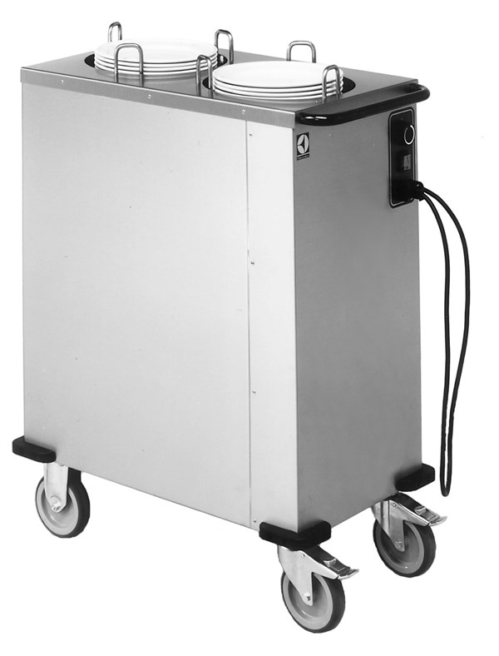
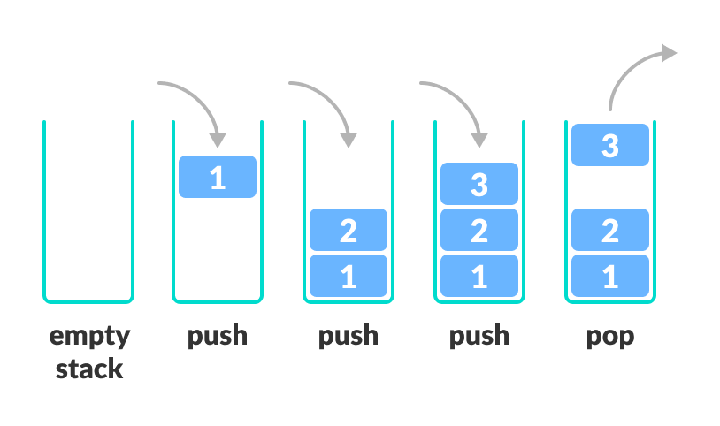
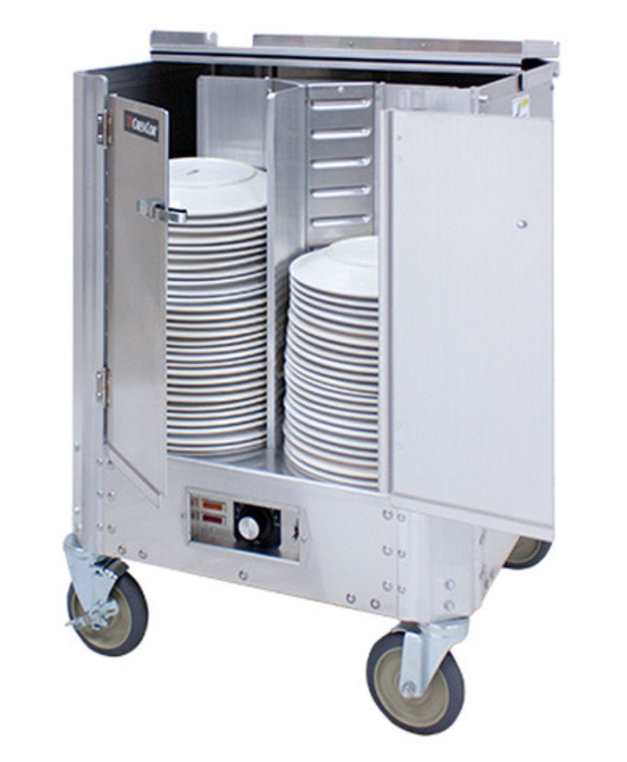
A stack is a data structure that can hold data, and follows the last in first out (LIFO) principle
We can:
Add an element to the top of the stack (push)
Remove the top element (pop)

Slide 5
Stack Runtime Analysis
Algorithm | w/ Array | w/ Linked List
Creation | O(n) | O(1)
Push() | O(1) | O(1)
Pop() | O(1) | O(1)
peek() | O(1) | O(1)
Print() | O(n) | O(n)

Slide 6
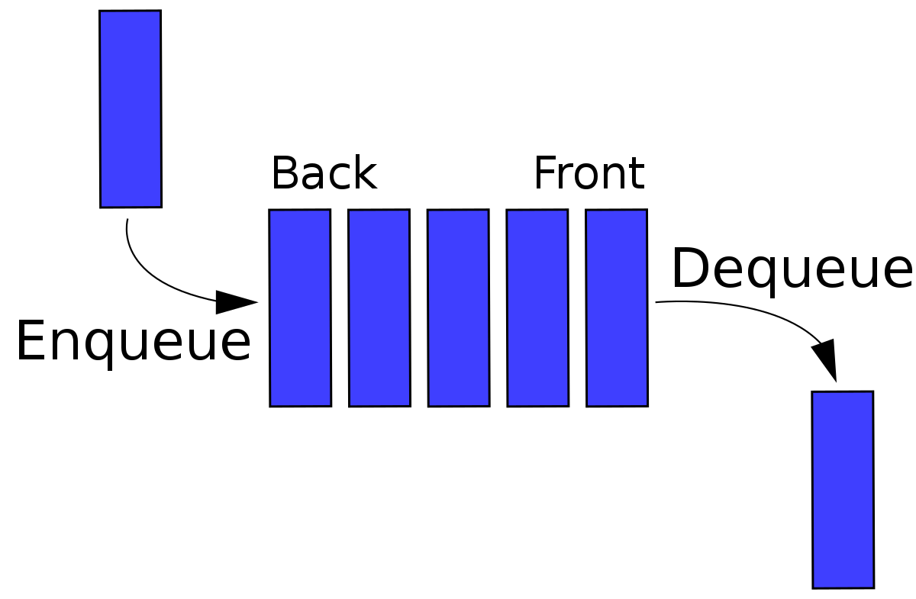
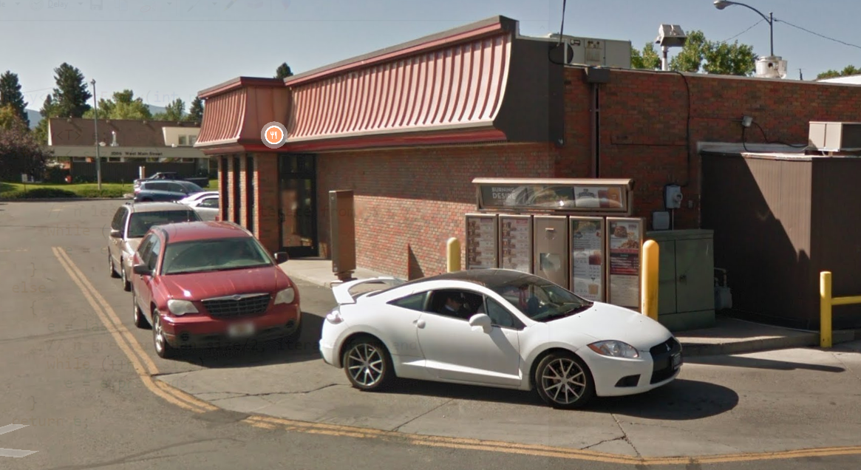
A Queue is a data structure that holds data, but operates in a First-in First-out (FIFO) fashion

Slide 7

A Queue is a data structure that holds data, but operates in a First-in First-out (FIFO) fashion
Elements get added to the Back of the Queue.
Elements get removed from the Front of the queue
Once again, we need a data structure to hold the data of the queue
Linked List (today)
Array (tomorrow)

Slide 8
A Queue is a data structure that holds data, but operates in a First-in First-out (FIFO) fashion
The Queue ADT has the following methods:
Enqueue- Add new element to the queue
Dequeue- Remove element from the queue
** Always remove the front-most element
Peek()- Return the element that is at the front of the queue
IsEmpty() – Returns true if queue is empty, returns false is queue is not empty

Slide 9
A Queue is a data structure that holds data, but operates in a First-in First-out (FIFO) fashion
Back
Queue
Front
Reese
queue.enqueue(“Reese”);

Slide 10
A Queue is a data structure that holds data, but operates in a First-in First-out (FIFO) fashion
Back
Queue
Front
Susan
Reese
queue.enqueue(“Reese”);
queue.enqueue(“Susan”);

Slide 11
A Queue is a data structure that holds data, but operates in a First-in First-out (FIFO) fashion
Back
Queue
Front
Cosmo
Susan
Reese
queue.enqueue(“Reese”);
queue.enqueue(“Susan”);
queue.enqueue(“Cosmo”);

Slide 12
A Queue is a data structure that holds data, but operates in a First-in First-out (FIFO) fashion
Back
Queue
Front
Spencer
Cosmo
Susan
Reese
queue.enqueue(“Reese”);
queue.enqueue(“Susan”);
queue.enqueue(“Cosmo”);
queue.enqueue(“Spencer”);

Slide 13
A Queue is a data structure that holds data, but operates in a First-in First-out (FIFO) fashion
Back
Queue
Front
Spencer
Cosmo
Susan
Reese
queue.enqueue(“Reese”);
queue.enqueue(“Susan”);
queue.enqueue(“Cosmo”);
queue.enqueue(“Spencer”);
queue.deque()

Slide 14
A Queue is a data structure that holds data, but operates in a First-in First-out (FIFO) fashion
Back
Queue
Front
Spencer
Cosmo
Susan
queue.enqueue(“Reese”);
queue.enqueue(“Susan”);
queue.enqueue(“Cosmo”);
queue.enqueue(“Spencer”);
queue.deque()

Slide 15
A Queue is a data structure that holds data, but operates in a First-in First-out (FIFO) fashion
Back
Queue
Front
Spencer
Cosmo
Susan
queue.enqueue(“Reese”);
queue.enqueue(“Susan”);
queue.enqueue(“Cosmo”);
queue.enqueue(“Spencer”);
queue.deque()
queue.deque()

Slide 16
A Queue is a data structure that holds data, but operates in a First-in First-out (FIFO) fashion
Back
Queue
Front
Matt
Spencer
Cosmo
queue.enqueue(“Reese”);
queue.enqueue(“Susan”);
queue.enqueue(“Cosmo”);
queue.enqueue(“Spencer”);
queue.deque()
queue.deque()
queue.enqueue(“Matt”);

Slide 17
A Queue is a data structure that holds data, but operates in a First-in First-out (FIFO) fashion
Back
Queue
Front
Matt
Spencer
Cosmo
queue.enqueue(“Reese”);
queue.enqueue(“Susan”);
queue.enqueue(“Cosmo”);
queue.enqueue(“Spencer”);
queue.deque()
queue.deque()
queue.enqueue(“Matt”);
queue.peek()
→ “Cosmo”

Slide 18
A Queue is a data structure that holds data, but operates in a First-in First-out (FIFO) fashion
Back
Queue
Front
Matt
Spencer
Cosmo
Tail
Head
Linked List Implementation
When we enqueue, we add the element to ???
When we dequeue, we remove the element from ???

Slide 19
A Queue is a data structure that holds data, but operates in a First-in First-out (FIFO) fashion
Back
Queue
Front
Matt
Spencer
Cosmo
Tail
Head
Linked List Implementation
When we enqueue, we add the element to the end of the linked list
When we dequeue, we remove the element from the beginning of the linked list

Slide 20
A Queue is a data structure that holds data, but operates in a First-in First-out (FIFO) fashion
Back
Queue
Front
Matt
Spencer
Cosmo
As we use our queue, we need to keep track of a few things
The size of the queue
The front of the queue (not when we use LLs)
The back of the queue (not when we use LLs)

