Slide 1

CSCI 132: Basic Data Structures and Algorithms
Searching (Binary Search)
Reese Pearsall
Fall 2023
https://www.cs.montana.edu/pearsall/classes/fall2023/132/main.html
*All images are stolen from the internet

Slide 2

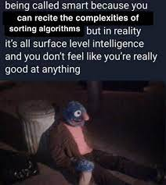
Announcements
Lab 12 due tomorrow @11:59 PM
Program 5 due Sunday December 10th
^{Gradebook}

Slide 3
char[][] maze
[ [ #, #, #, # ,#],
[ #, . , . , . , #],
[ . , . ,# , . , #],
[ #, #, #, . , #],
[ #, . , . , . , . ],
]

Slide 4
char[][] maze
[ [ #, #, #, # ,#],
[ #, . , . , . , #],
[ . , . ,# , . , #],
[ #, #, #, . , #],
[ #, . , . , . , . ],
]
maze[0]

Slide 5
char[][] maze
[ [ #, #, #, # ,#],
[ #, . , . , . , #],
[ . , . ,# , . , #],
[ #, #, #, . , #],
[ #, . , . , . , . ],
]
maze[1]

Slide 6
char[][] maze
[ [ #, #, #, # ,#],
[ #, . , . , . , #],
[ . , . ,# , . , #],
[ #, #, #, . , #],
[ #, . , . , . , . ],
]
maze[1][0]

Slide 7
char[][] maze
[ [ #, #, #, # ,#],
[ #, . , . , . , #],
[ . , . ,# , . , #],
[ #, #, #, . , #],
[ #, . , . , . , . ],
]
maze[1][2]

Slide 8
char[][] maze
[ [ #, #, #, # ,#],
[ #, . , . , . , #],
[ . , . ,# , . , #],
[ #, #, #, . , #],
[ #, . , . , . , . ],
]
maze[y][x]

Slide 9
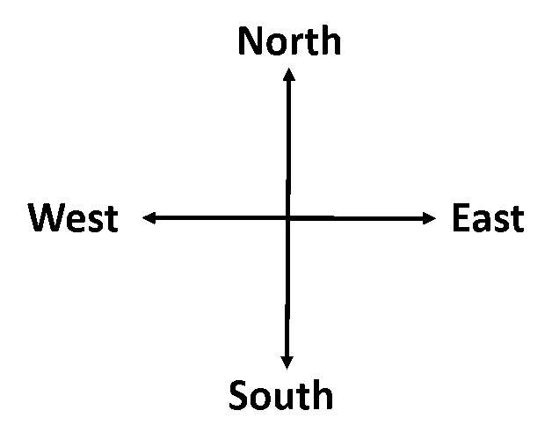




char[][] maze
[ [ #, #, #, # ,#],
[ #, . , . , . , #],
[ . , . ,# , . , #],
[ #, #, #, . , #],
[ #, . , . , . , . ],
]
(2, 1)
(2, 2)
Goal: Move forward one spot
We need to know which direction we are facing first!
maze[y][x]
How do we know direction we are facing?

Slide 10


char[][] maze
[ [ #, #, #, # ,#],
[ #, . , . , . , #],
[ . , . ,# , . , #],
[ #, #, #, . , #],
[ #, . , . , . , . ],
]
(2, 1)
(2, 2)
Goal: Move forward one spot
We need to know which direction we are facing first!
maze[y][x]
Our character Y value and our hand’s Y value is the same,
And our character’s X value is less than our hands’ X value

Slide 11
char[][] maze
[ [ #, #, #, # ,#],
[ #, . , . , . , #],
[ . , . ,# , . , #],
[ #, #, #, . , #],
[ #, . , . , . , . ],
]
(2, 1)
(2, 2)
if(y == hand_y && hand_x > x)
direction = "North";
}
maze[y][x]

Slide 12
char[][] maze
[ [ #, #, #, # ,#],
[ #, . , . , . , #],
[ . , . ,# , . , #],
[ #, #, #, . , #],
[ #, . , . , . , . ],
]
if(y == hand_y && hand_x > x)
direction = "North";
}
…
(2, 1)
(2, 2)
How do we detect if we can move forward?
maze[y][x]

Slide 13
char[][] maze
[ [ #, #, #, # ,#],
[ #, . , . , . , #],
[ . , . ,# , . , #],
[ #, #, #, . , #],
[ #, . , . , . , . ],
]
if(y == hand_y && hand_x > x)
direction = "North";
}
…
(2, 1)
(2, 2)
if(maze[hand_y][hand_x] == '#' && maze[y-1][x] == ‘.’){
}
maze[y][x]

Slide 14
char[][] maze
[ [ #, #, #, # ,#],
[ #, . , . , . , #],
[ . , . ,# , . , #],
[ #, #, #, . , #],
[ #, . , . , . , . ],
]
if(y == hand_y && hand_x > x)
direction = "North";
}
…
(2, 1)
(2, 2)
if(maze[hand_y][hand_x] == '#' && maze[y-1][x] == ‘.’){
}
Make one move by recursively calling the method with the new values
maze[y][x]
makeMove(x, y, hand_x, hand_y)

Slide 15
char[][] maze
[ [ #, #, #, # ,#],
[ #, . , . , . , #],
[ . , . ,# , . , #],
[ #, #, #, . , #],
[ #, . , . , . , . ],
]
if(y == hand_y && hand_x > x)
direction = "North";
}
…
(2, 1)
(2, 2)
if(maze[hand_y][hand_x] == '#' && maze[y-1][x] == ‘.’){
}
Make one move by recursively calling the method with the new values
maze[y][x]
makeMove(x, y, hand_x, hand_y)

Slide 16
char[][] maze
[ [ #, #, #, # ,#],
[ #, . , . , . , #],
[ . , . ,# , . , #],
[ #, #, #, . , #],
[ #, . , . , . , . ],
]
if(y == hand_y && hand_x > x)
direction = "North";
}
…
(1, 1)
(1, 2)
(2, 1)
(2, 2)
if(maze[hand_y][hand_x] == '#' && maze[y-1][x] == ‘.’){
}
makeMove(x, y-1, hand_x, hand_y-1);
maze[y][x]
makeMove(x, y, hand_x, hand_y)

Slide 17
char[][] maze
[ [ #, #, #, # ,#],
[ #, . , . , . , #],
[ . , . ,# , . , #],
[ #, #, #, . , #],
[ #, . , . , . , . ],
]
if(y == hand_y && hand_x > x)
direction = "North";
}
…
if(direction.equals("North")) {
(1, 1)
(1, 2)
(2, 1)
(2, 2)
if(maze[hand_y][hand_x] == '#' && maze[y-1][x] == ‘.’){
}
makeMove(x, y-1, hand_x, hand_y-1);
maze[y][x]
makeMove(x, y, hand_x, hand_y)

Slide 18
char[][] maze
[ [ #, #, #, # ,#],
[ #, . , . , . , #],
[ . , . ,# , . , #],
[ #, #, #, . , #],
[ #, . , . , . , . ],
]
if(y == hand_y && hand_x > x)
direction = "North";
}
…
if(direction.equals("North")) {
(1, 1)
(1, 2)
(2, 1)
(2, 2)
if(maze[hand_y][hand_x] == '#' && maze[y-1][x] == ‘.’){
}
makeMove(x, y-1, hand_x, hand_y-1);
maze[y][x]
Turn right and move forward one spot?
makeMove(x, y, hand_x, hand_y)

Slide 19
char[][] maze
[ [ #, #, #, # ,#],
[ #, . , . , . , #],
[ . , . ,# , . , #],
[ #, #, #, . , #],
[ #, . , . , . , . ],
]
if(y == hand_y && hand_x > x)
direction = "North";
}
…
if(direction.equals("North")) {
(1, 1)
(1, 2)
(2, 1)
(2, 2)
if(maze[hand_y][hand_x] == '#' && maze[y-1][x] == ‘.’){
}
if(maze[hand_y][hand_x] == ‘.’ && maze[y-1][x]=='#’){
}
makeMove(x, y-1, hand_x, hand_y-1);
maze[y][x]
makeMove(x, y, hand_x, hand_y)

Slide 20


char[][] maze
[ [ #, #, #, # ,#],
[ #, . , . , . , #],
[ . , . ,# , . , #],
[ #, #, #, . , #],
[ #, . , . , . , . ],
]
if(y == hand_y && hand_x > x)
direction = "North";
}
…
if(direction.equals("North")) {
(1, 1)
(1, 2)
(2, 1)
(2, 2)
if(maze[hand_y][hand_x] == '#' && maze[y-1][x] == ‘.’){
}
if(maze[hand_y][hand_x] == ‘.’ && maze[y-1][x]=='#’){
}
makeMove(x, y-1, hand_x, hand_y-1);
maze[y][x]
makeMove(??, ??, ??, ??);
makeMove(x, y, hand_x, hand_y)

Slide 21


char[][] maze
[ [ #, #, #, # ,#],
[ #, . , . , . , #],
[ . , . ,# , . , #],
[ #, #, #, . , #],
[ #, . , . , . , . ],
]
if(y == hand_y && hand_x > x)
direction = "North";
}
…
if(direction.equals("North")) {
(1, 1)
(1, 2)
(2, 1)
(2, 2)
if(maze[hand_y][hand_x] == '#' && maze[y-1][x] == ‘.’){
}
if(maze[hand_y][hand_x] == ‘.’ && maze[y-1][x]=='#’){
}
makeMove(x, y-1, hand_x, hand_y-1);
maze[y][x]
makeMove(x+1, y, hand_x, hand_y+1);
makeMove(x, y, hand_x, hand_y)

Slide 22


char[][] maze
[ [ #, #, #, # ,#],
[ #, . , . , . , #],
[ . , . ,# , . , #],
[ #, #, #, . , #],
[ #, . , . , . , . ],
]
if(y == hand_y && hand_x > x)
direction = "North";
}
…
if(direction.equals("North")) {
(1, 1)
(1, 2)
(2, 1)
(2, 2)
if(maze[hand_y][hand_x] == '#' && maze[y-1][x] == ‘.’){
}
if(maze[hand_y][hand_x] == ‘.’ && maze[y-1][x]=='#’){
}
makeMove(x, y-1, hand_x, hand_y-1);
maze[y][x]
makeMove(x+1, y, hand_x, hand_y+1);
makeMove(x, y, hand_x, hand_y)

Slide 23
char[][] maze
[ [ #, #, #, # ,#],
[ #, . , . , . , #],
[ . , . ,# , . , #],
[ #, #, #, . , #],
[ #, . , . , . , . ],
]
if(y == hand_y && hand_x > x)
direction = "North";
}
…
if(direction.equals("North")) {
(1, 1)
(1, 2)
(2, 1)
(2, 2)
if(maze[hand_y][hand_x] == '#' && maze[y-1][x] == ‘.’){
}
if(maze[hand_y][hand_x] == ‘.’ && maze[y-1][x]=='#’){
}
makeMove(x, y-1, hand_x, hand_y-1);
maze[y][x]
makeMove(x+1, y, hand_x, hand_y+1);
makeMove(x, y, hand_x, hand_y)

Slide 24
char[][] maze
maze[y][x]
[ [ #, #, #, # ,#],
[ #, . , . , . , #],
[ . , . ,# , . , #],
[ #, #, #, . , #],
[ #, . , . , . , . ],
]
if(y == hand_y && hand_x > x)
direction = "North";
}
…
if(direction.equals("North")) {
(1, 1)
(1, 2)
(2, 1)
(2, 2)
if(maze[hand_y][hand_x] == '#' && maze[y-1][x] == ‘.’){
}
if(maze[hand_y][hand_x] == ‘.’ && maze[y-1][x]=='#’){
}
makeMove(x, y-1, hand_x, hand_y-1);
makeMove(x+1, y, hand_x, hand_y+1);
Turn right
Go forward
Turn left
makeMove(x, y, hand_x, hand_y)

Slide 25
char[][] maze
maze[y][x]
[ [ #, #, #, # ,#],
[ #, . , . , . , #],
[ . , . ,# , . , #],
[ #, #, #, . , #],
[ #, . , . , . , . ],
]
if(y == hand_y && hand_x > x)
direction = "North";
}
…
if(direction.equals("North")) {
(1, 1)
(1, 2)
(2, 1)
(2, 2)
if(maze[hand_y][hand_x] == ‘.’ && maze[y-1][x]=='#’){
}
if(maze[hand_y][hand_x] == '#' && maze[y-1][x] == ‘.’){
}
Right
makeMove(x+1, y, hand_x, hand_y+1);
Forward
Turn right
Go forward
Turn left
makeMove(x, y-1, hand_x, hand_y-1);
Left
// Turn left

Slide 26
char[][] maze
maze[y][x]
[ [ #, #, #, # ,#],
[ #, . , . , . , #],
[ . , . ,# , . , #],
[ #, #, #, . , #],
[ #, . , . , . , . ],
]
if(y == hand_y && hand_x > x)
direction = "North";
}
…
if(direction.equals("North")) {
(1, 1)
(1, 2)
(2, 1)
(2, 2)
if(maze[hand_y][hand_x] == ‘.’ && maze[y-1][x]=='#’){
}
if(maze[hand_y][hand_x] == '#' && maze[y-1][x] == ‘.’){
}
Right
makeMove(x+1, y, hand_x, hand_y+1);
Forward
makeMove(x, y-1, hand_x, hand_y-1);
You will have need if statements for North, East, South, and West
Lots of if statements ☺
Left
// Turn left

Slide 27
char[][] maze
maze[y][x]
[ [ #, #, #, # ,#],
[ #, . , . , . , #],
[ . , . ,# , . , #],
[ #, #, #, . , #],
[ #, . , . , . , . ],
]
if(y == hand_y && hand_x > x)
direction = "North";
}
…
if(direction.equals("North")) {
(1, 1)
(1, 2)
(2, 1)
(2, 2)
if(maze[hand_y][hand_x] == ‘.’ && maze[y-1][x]=='#’){
}
if(maze[hand_y][hand_x] == '#' && maze[y-1][x] == ‘.’){
}
This code is technically not complete, you will need to ass some more code here (backtracking)
Right
makeMove(x+1, y, hand_x, hand_y+1);
Forward
makeMove(x, y-1, hand_x, hand_y-1);
You will have need if statements for North, East, South, and West
Lots of if statements ☺
Left
// Turn left

Slide 28
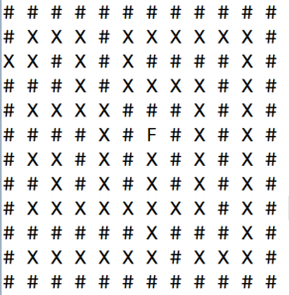
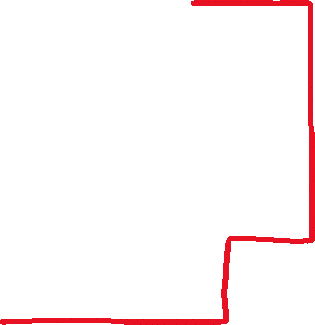


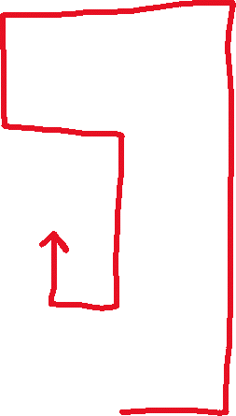




= Backtracking path

Slide 29
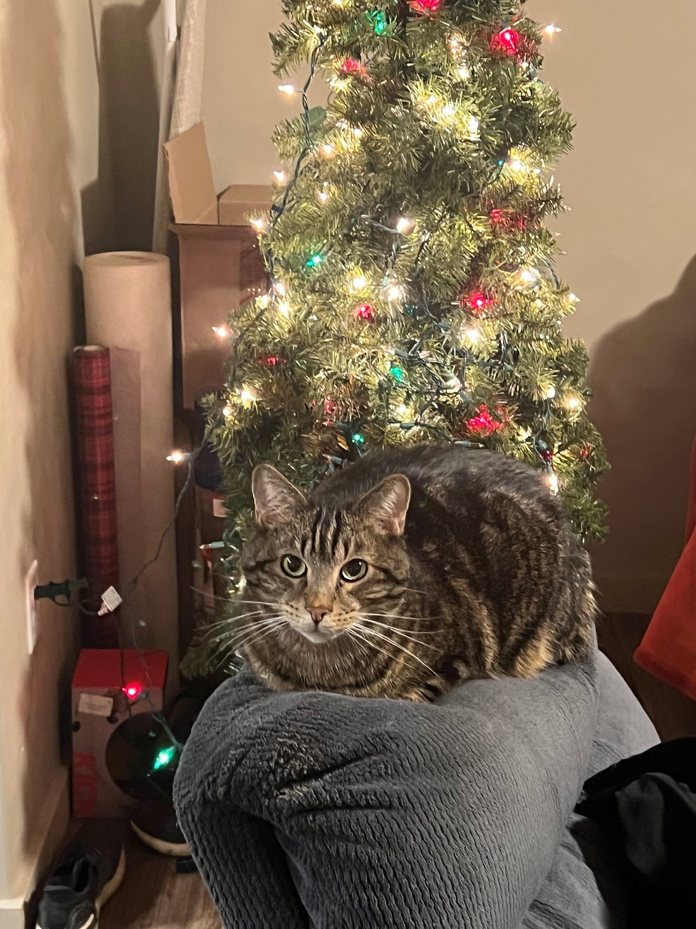

Slide 30

Searching
We store values in data structures, but we also need to retrieve/search for values!
Today, we will discuss techniques for how to search for a value in a data structure
(We will be using arrays, but these techniques could also be used on Linked Lists, queues, stacks, etc)

Slide 31
Searching
Option 1: Linear Search
Check every spot until one by one until we find what we are looking for
public int linear_search(int[] array, int s) {
for(int i = 0; i < array.length; i++) {
if(array[i] == s) {
return i;
}
}
return -1;
}

Slide 32
Searching
Option 1: Linear Search
Check every spot until one by one until we find what we are looking for
Not efficient for large data structures. O(n) running time
public int linear_search(int[] array, int s) {
for(int i = 0; i < array.length; i++) {
if(array[i] == s) {
return i;
}
}
return -1;
}

Slide 33
Can we do better?
Searching
Option 1: Linear Search
Check every spot until one by one until we find what we are looking for
Not efficient for large data structures. O(n) running time
public int linear_search(int[] array, int s) {
for(int i = 0; i < array.length; i++) {
if(array[i] == s) {
return i;
}
}
return -1;
}

Slide 34
0
12
1 | 2 | 9 | 10 | 11 | 15 | 18 | 21 | 27 | 31 | 41 | 43 | 50
What if our array is sorted?

Slide 35
Target Value: 27
0
12
1 | 2 | 9 | 10 | 11 | 15 | 18 | 21 | 27 | 31 | 41 | 43 | 50
We can leverage the fact that this array is sorted to make searching more efficient

Slide 36
Target Value: 27
0
12
1 | 2 | 9 | 10 | 11 | 15 | 18 | 21 | 27 | 31 | 41 | 43 | 50
Start at the middle of the array

Slide 37
Target Value: 27
0
12
1 | 2 | 9 | 10 | 11 | 15 | 18 | 21 | 27 | 31 | 41 | 43 | 50
Start at the middle of the array
Compare to target value:
→ If the value is the target value, return
→ If the target value is greater than the middle, discard the “left section” of the array
→ If the target value is less than the middle, discard the “right section” of the array

Slide 38
Target Value: 27
0
12
1 | 2 | 9 | 10 | 11 | 15 | 18 | 21 | 27 | 31 | 41 | 43 | 50
low
high
Start at the middle of the array
Compare to target value:
→ If the value is the target value, return
→ If the target value is greater than the middle, discard the “left section” of the array
→ If the target value is less than the middle, discard the “right section” of the array
We will define two pointers, low and high that point to the possible bounds of the target value

Slide 39
Target Value: 27
0
12
1 | 2 | 9 | 10 | 11 | 15 | 18 | 21 | 27 | 31 | 41 | 43 | 50
low
high
Start at the middle of the array
Compare to target value:
→ If the value is the target value, return
→ If the target value is greater than the middle, discard the “left section” of the array
→ If the target value is less than the middle, discard the “right section” of the array
We will define two pointers, low and high that point to the possible bounds of the target value

Slide 40
Target Value: 27
0
12
1 | 2 | 9 | 10 | 11 | 15 | 18 | 21 | 27 | 31 | 41 | 43 | 50
low
high
Start at the middle of the array
Compare to target value:
→ If the value is the target value, return
→ If the target value is greater than the middle, discard the “left section” of the array (move the low pointer)
→ If the target value is less than the middle, discard the “right section” of the array (move the high pointer)
Because we know the array is sorted, and the target value is greater than our mid point, then we know the target value must be located somewhere to the right.
We can eliminate half of the array!!!

Slide 41
Target Value: 27
0
7
12
1 | 2 | 9 | 10 | 11 | 15 | 18 | 21 | 27 | 31 | 41 | 43 | 50
low
high
Start at the middle of the array
Compare to target value:
→ If the value is the target value, return
→ If the target value is greater than the middle, discard the “left section” of the array (move the low pointer)
→ If the target value is less than the middle, discard the “right section” of the array (move the high pointer)
3. Recalculate the mid point, and repeat loop back to step 2 until target value is found

Slide 42
Target Value: 27
0
7
12
1 | 2 | 9 | 10 | 11 | 15 | 18 | 21 | 27 | 31 | 41 | 43 | 50
low
high
Start at the middle of the array
Compare to target value:
→ If the value is the target value, return
→ If the target value is greater than the middle, discard the “left section” of the array (move the low pointer)
→ If the target value is less than the middle, discard the “right section” of the array (move the high pointer)
3. Recalculate the mid point, and repeat loop back to step 2 until target value is found

Slide 43
Target Value: 27
0
7
12
1 | 2 | 9 | 10 | 11 | 15 | 18 | 21 | 27 | 31 | 41 | 43 | 50
low
high
Start at the middle of the array
Compare to target value:
→ If the value is the target value, return
→ If the target value is greater than the middle, discard the “left section” of the array (move the low pointer)
→ If the target value is less than the middle, discard the “right section” of the array (move the high pointer)
3. Recalculate the mid point, and repeat loop back to step 2 until target value is found

Slide 44
Target Value: 27
0
7
8
12
1 | 2 | 9 | 10 | 11 | 15 | 18 | 21 | 27 | 31 | 41 | 43 | 50
low
high
Start at the middle of the array
Compare to target value:
→ If the value is the target value, return
→ If the target value is greater than the middle, discard the “left section” of the array (move the low pointer)
→ If the target value is less than the middle, discard the “right section” of the array (move the high pointer)
3. Recalculate the mid point, and repeat loop back to step 2 until target value is found

Slide 45
Target Value: 27
0
7
8
12
1 | 2 | 9 | 10 | 11 | 15 | 18 | 21 | 27 | 31 | 41 | 43 | 50
low
high
Start at the middle of the array
Compare to target value:
→ If the value is the target value, return
→ If the target value is greater than the middle, discard the “left section” of the array (move the low pointer)
→ If the target value is less than the middle, discard the “right section” of the array (move the high pointer)
3. Recalculate the mid point, and repeat loop back to step 2 until target value is found

Slide 46
Target Value: 27
0
7
8
12
1 | 2 | 9 | 10 | 11 | 15 | 18 | 21 | 27 | 31 | 41 | 43 | 50
low
high
Start at the middle of the array
Compare to target value:
→ If the value is the target value, return
→ If the target value is greater than the middle, discard the “left section” of the array (move the low pointer)
→ If the target value is less than the middle, discard the “right section” of the array (move the high pointer)
3. Recalculate the mid point, and repeat loop back to step 2 until target value is found

Slide 47
Target Value: 27
0
7
8
12
1 | 2 | 9 | 10 | 11 | 15 | 18 | 21 | 27 | 31 | 41 | 43 | 50
low
high
Start at the middle of the array
Compare to target value:
→ If the value is the target value, return
→ If the target value is greater than the middle, discard the “left section” of the array (move the low pointer)
→ If the target value is less than the middle, discard the “right section” of the array (move the high pointer)
3. Recalculate the mid point, and repeat loop back to step 2 until target value is found

Slide 48
Target Value: 27
0
7
8
12
1 | 2 | 9 | 10 | 11 | 15 | 18 | 21 | 27 | 31 | 41 | 43 | 50
low
high
Start at the middle of the array
Compare to target value:
→ If the value is the target value, return
→ If the target value is greater than the middle, discard the “left section” of the array (move the low pointer)
→ If the target value is less than the middle, discard the “right section” of the array (move the high pointer)
3. Recalculate the mid point, and repeat loop back to step 2 until target value is found

Slide 49
Target Value: 27
0
7
8
12
1 | 2 | 9 | 10 | 11 | 15 | 18 | 21 | 27 | 31 | 41 | 43 | 50
low
high
Start at the middle of the array
Compare to target value:
→ If the value is the target value, return
→ If the target value is greater than the middle, discard the “left section” of the array (move the low pointer)
→ If the target value is less than the middle, discard the “right section” of the array (move the high pointer)
3. Recalculate the mid point, and repeat loop back to step 2 until target value is found

Slide 50
Target Value: 27
0
7
8
12
1 | 2 | 9 | 10 | 11 | 15 | 18 | 21 | 27 | 31 | 41 | 43 | 50
low
high
Start at the middle of the array
Compare to target value:
→ If the value is the target value, return
→ If the target value is greater than the middle, discard the “left section” of the array (move the low pointer)
→ If the target value is less than the middle, discard the “right section” of the array (move the high pointer)
3. Recalculate the mid point, and repeat loop back to step 2 until target value is found

Slide 51
Target Value: 27
0
7
8
12
1 | 2 | 9 | 10 | 11 | 15 | 18 | 21 | 27 | 31 | 41 | 43 | 50
low
high
Start at the middle of the array
Compare to target value:
→ If the value is the target value, return
→ If the target value is greater than the middle, discard the “left section” of the array (move the low pointer)
→ If the target value is less than the middle, discard the “right section” of the array (move the high pointer)
3. Recalculate the mid point, and repeat loop back to step 2 until target value is found
This algorithm is known as Binary Search

Slide 52

Target Value: 27
0
7
8
12
1 | 2 | 9 | 10 | 11 | 15 | 18 | 21 | 27 | 31 | 41 | 43 | 50
low
high
Start at the middle of the array
Compare to target value:
→ If the value is the target value, return
→ If the target value is greater than the middle, discard the “left section” of the array (move the low pointer)
→ If the target value is less than the middle, discard the “right section” of the array (move the high pointer)
3. Recalculate the mid point, and repeat loop back to step 2 until target value is found
How to calculate the mid point?

Slide 53

Target Value: 27
0
7
8
12
1 | 2 | 9 | 10 | 11 | 15 | 18 | 21 | 27 | 31 | 41 | 43 | 50
low
high
Start at the middle of the array
Compare to target value:
→ If the value is the target value, return
→ If the target value is greater than the middle, discard the “left section” of the array (move the low pointer)
→ If the target value is less than the middle, discard the “right section” of the array (move the high pointer)
3. Recalculate the mid point, and repeat loop back to step 2 until target value is found
How to calculate the mid point? (low + high) / 2

Slide 54
Target Value: 27
0
7
8
12
1 | 2 | 9 | 10 | 11 | 15 | 18 | 21 | 27 | 31 | 41 | 43 | 50
low
high
Start at the middle of the array
Compare to target value:
→ If the value is the target value, return
→ If the target value is greater than the middle, discard the “left section” of the array (move the low pointer)
→ If the target value is less than the middle, discard the “right section” of the array (move the high pointer)
3. Recalculate the mid point, and repeat loop back to step 2 until target value is found
How do we know when to stop looping?

Slide 55
Target Value: 27
0
7
8
12
1 | 2 | 9 | 10 | 11 | 15 | 18 | 21 | 27 | 31 | 41 | 43 | 50
low
high
Start at the middle of the array
Compare to target value:
→ If the value is the target value, return
→ If the target value is greater than the middle, discard the “left section” of the array (move the low pointer)
→ If the target value is less than the middle, discard the “right section” of the array (move the high pointer)
3. Recalculate the mid point, and repeat loop back to step 2 until target value is found
If we find the target value, or if low and high cross each other (low > high)
How do we know when to stop looping?

Slide 56
Target Value: 27
0
7
8
12
LET’S CODE THIS
1 | 2 | 9 | 10 | 11 | 15 | 18 | 21 | 27 | 31 | 41 | 43 | 50
low
high
Start at the middle of the array
Compare to target value:
→ If the value is the target value, return
→ If the target value is greater than the middle, discard the “left section” of the array (move the low pointer)
→ If the target value is less than the middle, discard the “right section” of the array (move the high pointer)
3. Recalculate the mid point, and repeat loop back to step 2 until target value is found
If we find the target value, or if low and high cross each other (low > high)
How do we know when to stop looping?

Slide 57
private static int binary_search(int[] array, int n) {
int low = 0;
int high = array.length - 1;
while(low <= high) {
int mid = (low + high) / 2;
if(n == array[mid]) {
return mid;
}
else if(n > array[mid]) {
low = mid + 1;
}
else {
high = mid - 1;
}
}
return -1;
}

Slide 58
private static int binary_search(int[] array, int n) {
int low = 0;
int high = array.length - 1;
while(low <= high) {
int mid = (low + high) / 2;
if(n == array[mid]) {
return mid;
}
else if(n > array[mid]) {
low = mid + 1;
}
else {
high = mid - 1;
}
}
return -1;
}
Running time?

Slide 59
private static int binary_search(int[] array, int n) {
int low = 0;
int high = array.length - 1;
while(low <= high) {
int mid = (low + high) / 2;
if(n == array[mid]) {
return mid;
}
else if(n > array[mid]) {
low = mid + 1;
}
else {
high = mid - 1;
}
}
return -1;
}
Running time?
Each time we loop, we eliminate half the array

Slide 60
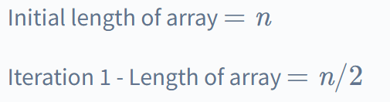
Running time?

Slide 61
Running time?

Slide 62

Running time?

Slide 63


Running time?
After k iterations, eventually our array has been reduced to one element
“Two to what power makes n??”

Slide 64

Running time?
After k iterations, eventually our array has been reduced to one element
“Two to what power makes n??”

Slide 65

Running time?
After k iterations, eventually our array has been reduced to one element
“Two to what power makes n??”

Slide 66


Running time?
After k iterations, eventually our array has been reduced to one element
“Two to what power makes n??”
After K iterations, we will have done log(n) divisions

Slide 67
private static int binary_search(int[] array, int n) {
int low = 0;
int high = array.length - 1;
while(low <= high) {
int mid = (low + high) / 2;
if(n == array[mid]) {
return mid;
}
else if(n > array[mid]) {
low = mid + 1;
}
else {
high = mid - 1;
}
}
return -1;
}
Running time?
Generally speaking, whenever we eliminate half of the problem each iteration, that will give us O(logn) running time

Slide 68
private static int binary_search(int[] array, int n) {
int low = 0;
int high = array.length - 1;
while(low <= high) {
int mid = (low + high) / 2;
if(n == array[mid]) {
return mid;
}
else if(n > array[mid]) {
low = mid + 1;
}
else {
high = mid - 1;
}
}
return -1;
}
O(1)
O(1)
O(log n)
O(1)
O(1)
O(1)
O(1)
O(1)
O(1)
O(1)
Running time?
Generally speaking, whenever we eliminate half of the problem each iteration, that will give us O(logn) running time

Slide 69
private static int binary_search(int[] array, int n) {
int low = 0;
int high = array.length - 1;
while(low <= high) {
int mid = (low + high) / 2;
if(n == array[mid]) {
return mid;
}
else if(n > array[mid]) {
low = mid + 1;
}
else {
high = mid - 1;
}
}
return -1;
}
O(1)
O(1)
O(log n)
O(1)
O(1)
O(1)
O(1)
O(1)
O(1)
O(1)
Running time?
O(log n)

Slide 70
private static int binary_search(int[] array, int n) {
int low = 0;
int high = array.length - 1;
while(low <= high) {
int mid = (low + high) / 2;
int result = x.compareTo(array[mid])
if(result = 0) {
return mid;
}
else if(result > 0){
low = mid + 1;
}
else {
high = mid - 1;
}
}
return -1;
}
We can do binary search on an array of Strings using the compareTo() method

Slide 71
private static int binary_search(????????????) {
if(low <= high) {
int mid = (low + high) / 2;
if(n == array[mid]) {
return mid;
}
else if(n > array[mid]) {
return binary_search(?????????);
}
else {
return binary_search(?????????);
}
}
else {
return -1;
}
}
Binary Search can also be implemented using recursion

