Slide 1

CSCI 132: Basic Data Structures and Algorithms
Sorting (Part 4)
Reese Pearsall
Fall 2023
https://www.cs.montana.edu/pearsall/classes/fall2023/132/main.html
*All images are stolen from the internet

Slide 2
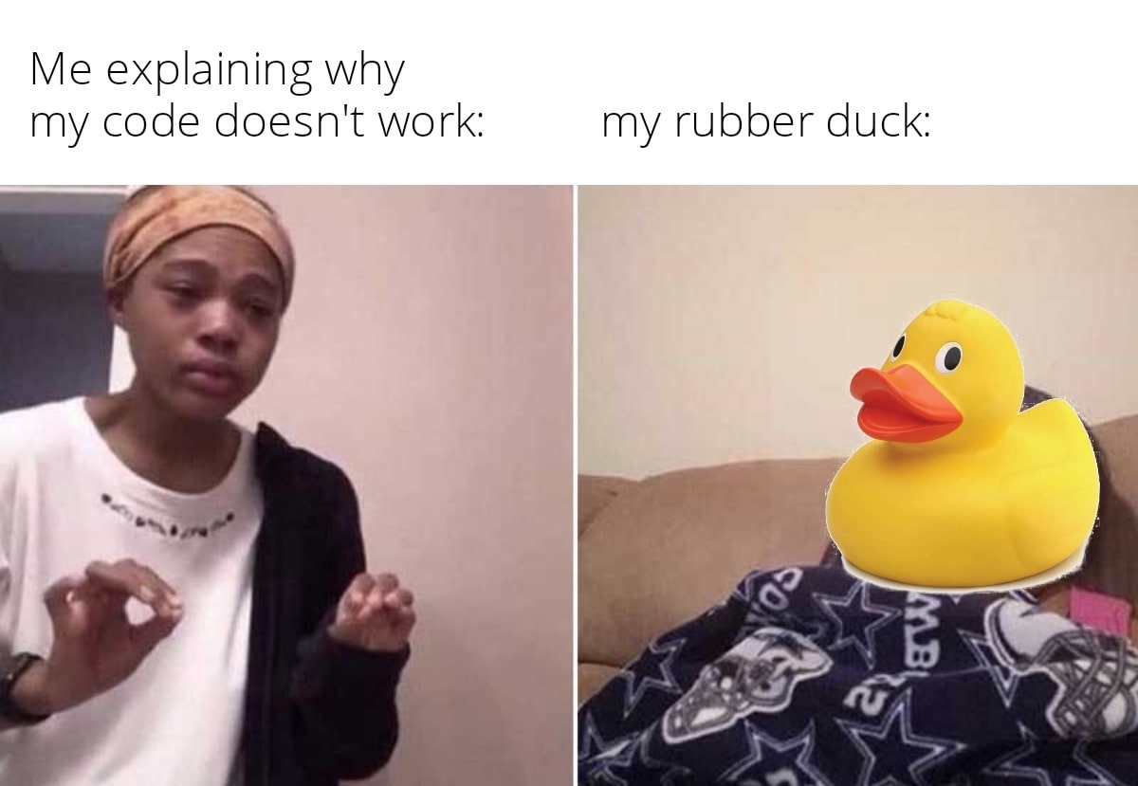
Announcements
Program 5 due Sunday December 10th
Lab 12 posted → Fill out the course evaluation
Rubber Duck Extra Credit Posted
Next Wednesday (12/6) is an optional help session for program 5 (no lecture)

Slide 3
private static int binary_search(int[] array, int n) {
int low = 0;
int high = array.length - 1;
while(low <= high) {
int mid = (low + high) / 2;
if(n == array[mid]) {
return mid;
}
else if(n > array[mid]) {
low = mid + 1;
}
else {
high = mid - 1;
}
}
return -1;
}
O(1)
O(1)
O(log n)
O(1)
O(1)
O(1)
O(1)
O(1)
O(1)
O(1)
Running time?
O(log n)

Slide 4
Why O(log n) ?
1 | 2 | 9 | 10 | 11 | 15 | 18 | 21 | 27 | 31 | 41 | 43 | 50
low
high
1 | 2 | 9 | 10 | 11 | 15 | 18 | 21 | 27 | 31 | 41 | 43 | 50
low
high
1 | 2 | 9 | 10 | 11 | 15 | 18 | 21 | 27 | 31 | 41 | 43 | 50
low
high
1 | 2 | 9 | 10 | 11 | 15 | 18 | 21 | 27 | 31 | 41 | 43 | 50
low
high

Slide 5
Every time that we loop, we eliminate half the array. We will never check all n elements of the array; therefore, it can’t be O(n).
Whenever we reduce the amount of work done by half, that generally gives us O(logn) running time
Why O(log n) ?
1 | 2 | 9 | 10 | 11 | 15 | 18 | 21 | 27 | 31 | 41 | 43 | 50
low
high
1 | 2 | 9 | 10 | 11 | 15 | 18 | 21 | 27 | 31 | 41 | 43 | 50
low
high
1 | 2 | 9 | 10 | 11 | 15 | 18 | 21 | 27 | 31 | 41 | 43 | 50
low
high
1 | 2 | 9 | 10 | 11 | 15 | 18 | 21 | 27 | 31 | 41 | 43 | 50
low
high

Slide 6
private static int binary_search(????????????) {
if(low <= high) {
int mid = (low + high) / 2;
if(n == array[mid]) {
return mid;
}
else if(n > array[mid]) {
return binary_search(?????????);
}
else {
return binary_search(?????????);
}
}
else {
return -1;
}
}
Binary Search can also be implemented using recursion

Slide 7
private static int binary_search_recursive(int[] array, int n, int high, int low) {
if(low <= high) {
int mid = (low + high) / 2;
if(n == array[mid]) {
return mid;
}
else if(n > array[mid]) {
return binary_search_recursive(array, n, high, mid+1);
}
else {
return binary_search_recursive(array, n, mid-1, low);
}
}
else {
return -1;
}
}
Binary Search can also be implemented using recursion

Slide 8
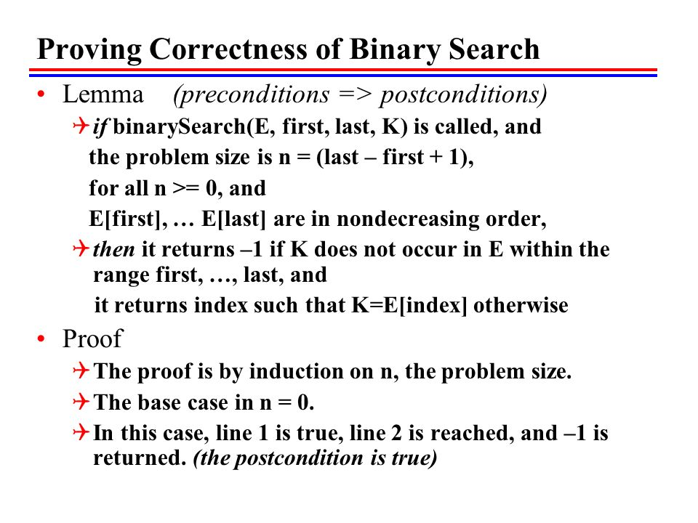
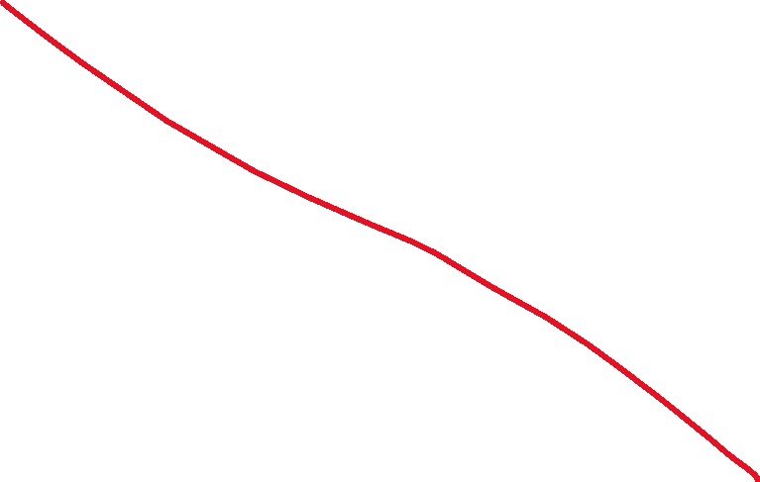
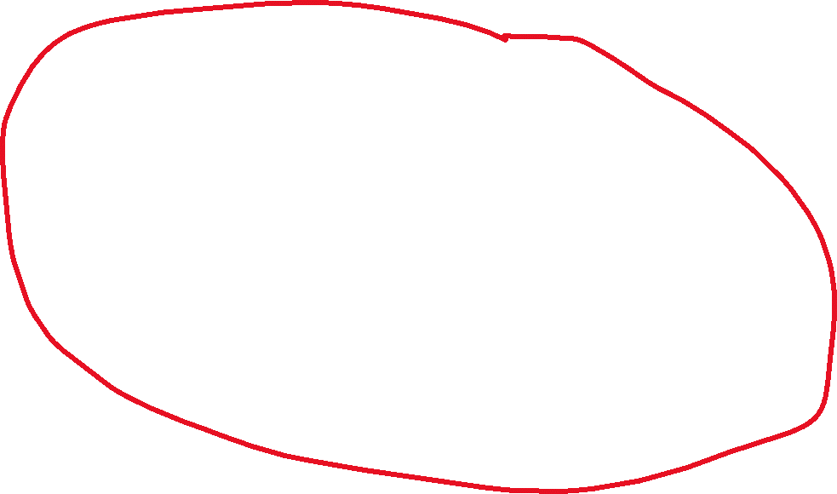

Slide 9
Quicksort Error?
Program 5 error?

Slide 10
if(y == hand_y && hand_x > x)
direction = "North";
}
…
if(direction.equals("North")) {
if(maze[hand_y][hand_x] == '#' && maze[y-1][x] == ‘.’){
}
if(maze[hand_y][hand_x] == ‘.’ && maze[y-1][x]=='#’){
}

Slide 11

if(y == hand_y && hand_x > x)
direction = "North";
}
…
if(direction.equals("North")) {
if(maze[hand_y][hand_x] == '#' && maze[y-1][x] == ‘.’){
}
if(maze[hand_y][hand_x] == ‘.’ && maze[y-1][x]=='#’){
}
//move forward
//turn right

Slide 12
Running Time of Sorting Algorithms
Bubble Sort | ??? | ???
Selection Sort | ??? | ???
Merge Sort | ??? | ???
Quick Sort | ??? | ???

Slide 13
You will not be tested about today’s sorting algorithms.

Slide 14
public int[] selectionSort(int[] array) {
int n = array.length;
for(int i = 0; i < n -1; i++) {
int min_index_so_far = i;
for (int j = i + 1; j < n; j++) {
if(array[j] < array[min_index_so_far]) {
min_index_so_far = j;
}
}
int temp = array[i];
array[i] = array[min_index_so_far];
array[min_index_so_far] = temp;
}
return array;
}

Slide 15
Insertion Sort
We divide our array into two sections. A sorted section, and an unsorted section. We iterate through the array, and for each iteration, we move one element from the unsorted section to the sorted section
38 | 27 | 43 | 3 | 9 | 82 | 10 | 14

Slide 16
Insertion Sort
We divide our array into two sections. A sorted section, and an unsorted section. We iterate through the array, and for each iteration, we move one element from the unsorted section to the sorted section
38 | 27 | 43 | 3 | 9 | 82 | 10 | 14
38 | 27 | 43 | 3 | 9 | 82 | 10 | 14

Slide 17

Insertion Sort
We divide our array into two sections. A sorted section, and an unsorted section. We iterate through the array, and for each iteration, we move one element from the unsorted section to the sorted section
38 | 27 | 43 | 3 | 9 | 82 | 10 | 14
38 | 27 | 43 | 3 | 9 | 82 | 10 | 14
38 | 27 | 43 | 3 | 9 | 82 | 10 | 14
27 | 38 | 43 | 3 | 9 | 82 | 10 | 14

Slide 18

Insertion Sort
We divide our array into two sections. A sorted section, and an unsorted section. We iterate through the array, and for each iteration, we move one element from the unsorted section to the sorted section
38 | 27 | 43 | 3 | 9 | 82 | 10 | 14
38 | 27 | 43 | 3 | 9 | 82 | 10 | 14
38 | 27 | 43 | 3 | 9 | 82 | 10 | 14
27 | 38 | 43 | 3 | 9 | 82 | 10 | 14
27 | 38 | 43 | 3 | 9 | 82 | 10 | 14

Slide 19

Insertion Sort
We divide our array into two sections. A sorted section, and an unsorted section. We iterate through the array, and for each iteration, we move one element from the unsorted section to the sorted section
38 | 27 | 43 | 3 | 9 | 82 | 10 | 14
38 | 27 | 43 | 3 | 9 | 82 | 10 | 14
38 | 27 | 43 | 3 | 9 | 82 | 10 | 14
27 | 38 | 43 | 3 | 9 | 82 | 10 | 14
27 | 38 | 43 | 3 | 9 | 82 | 10 | 14

Slide 20
Insertion Sort
We divide our array into two sections. A sorted section, and an unsorted section. We iterate through the array, and for each iteration, we move one element from the unsorted section to the sorted section
38 | 27 | 43 | 3 | 9 | 82 | 10 | 14
38 | 27 | 43 | 3 | 9 | 82 | 10 | 14
38 | 27 | 43 | 3 | 9 | 82 | 10 | 14
27 | 38 | 43 | 3 | 9 | 82 | 10 | 14
3 | 27 | 38 | 43 | 9 | 82 | 10 | 14

Slide 21
Insertion Sort
We divide our array into two sections. A sorted section, and an unsorted section. We iterate through the array, and for each iteration, we move one element from the unsorted section to the sorted section
38 | 27 | 43 | 3 | 9 | 82 | 10 | 14
38 | 27 | 43 | 3 | 9 | 82 | 10 | 14
38 | 27 | 43 | 3 | 9 | 82 | 10 | 14
27 | 38 | 43 | 3 | 9 | 82 | 10 | 14
3 | 27 | 38 | 43 | 9 | 82 | 10 | 14
3 | 9 | 27 | 38 | 43 | 82 | 10 | 14

Slide 22
Insertion Sort
We divide our array into two sections. A sorted section, and an unsorted section. We iterate through the array, and for each iteration, we move one element from the unsorted section to the sorted section
3 | 9 | 27 | 38 | 43 | 82 | 10 | 14

Slide 23
Insertion Sort
We divide our array into two sections. A sorted section, and an unsorted section. We iterate through the array, and for each iteration, we move one element from the unsorted section to the sorted section
3 | 9 | 27 | 38 | 43 | 82 | 10 | 14

Slide 24

Insertion Sort
We divide our array into two sections. A sorted section, and an unsorted section. We iterate through the array, and for each iteration, we move one element from the unsorted section to the sorted section
3 | 9 | 27 | 38 | 43 | 82 | 10 | 14
3 | 9 | 10 | 27 | 38 | 43 | 82 | 14

Slide 25


Insertion Sort
We divide our array into two sections. A sorted section, and an unsorted section. We iterate through the array, and for each iteration, we move one element from the unsorted section to the sorted section
3 | 9 | 27 | 38 | 43 | 82 | 10 | 14
3 | 9 | 10 | 27 | 38 | 43 | 82 | 14

Slide 26

Insertion Sort
We divide our array into two sections. A sorted section, and an unsorted section. We iterate through the array, and for each iteration, we move one element from the unsorted section to the sorted section
3 | 9 | 27 | 38 | 43 | 82 | 10 | 14
3 | 9 | 10 | 27 | 38 | 43 | 82 | 14
3 | 9 | 10 | 14 | 27 | 38 | 43 | 82

Slide 27

Insertion Sort
We divide our array into two sections. A sorted section, and an unsorted section. We iterate through the array, and for each iteration, we move one element from the unsorted section to the sorted section
3 | 9 | 27 | 38 | 43 | 82 | 10 | 14
3 | 9 | 10 | 27 | 38 | 43 | 82 | 14
3 | 9 | 10 | 14 | 27 | 38 | 43 | 82
Running time: O(n²)

Slide 28
Insertion Sort
void insertionSort(int array[]) {
int size = array.length;
for (int step = 1; step < size; step++) {
int key = array[step];
int j = step - 1;
// Compare key with each element on the left of it until an element smaller than
// it is found.
// For descending order, change key<array[j] to key>array[j].
while (j >= 0 && key < array[j]) {
array[j + 1] = array[j];
--j;
}
// Place key at after the element just smaller than it.
array[j + 1] = key;
}
}

Slide 29
Shell Sort
Compare items that are distant from each other. After each iteration, decrease the gap size.
N = 8
Gap = 4
38 | 27 | 43 | 3 | 9 | 82 | 10 | 14

Slide 30
Shell Sort
Compare items that are distant from each other. After each iteration, decrease the gap size.
N = 8
Gap = 4
38 | 27 | 43 | 3 | 9 | 82 | 10 | 14
4

Slide 31
Shell Sort
Compare items that are distant from each other. After each iteration, decrease the gap size.
N = 8
Gap = 4
9 | 27 | 43 | 3 | 38 | 82 | 10 | 14
4

Slide 32
Shell Sort
Compare items that are distant from each other. After each iteration, decrease the gap size.
N = 8
Gap = 4
9 | 27 | 43 | 3 | 38 | 82 | 10 | 14
4

Slide 33
Shell Sort
Compare items that are distant from each other. After each iteration, decrease the gap size.
N = 8
Gap = 4
9 | 27 | 43 | 3 | 38 | 82 | 10 | 14
4

Slide 34
Shell Sort
Compare items that are distant from each other. After each iteration, decrease the gap size.
N = 8
Gap = 4
9 | 27 | 10 | 3 | 38 | 82 | 43 | 14
4

Slide 35
Shell Sort
Compare items that are distant from each other. After each iteration, decrease the gap size.
N = 8
Gap = 4
9 | 27 | 10 | 3 | 38 | 82 | 43 | 14
4

Slide 36
Shell Sort
Compare items that are distant from each other. After each iteration, decrease the gap size.
N = 8
Gap = 4
Gap = 2
9 | 27 | 10 | 3 | 38 | 82 | 43 | 14
2

Slide 37
Shell Sort
Compare items that are distant from each other. After each iteration, decrease the gap size.
N = 8
Gap = 4
Gap = 2
9 | 27 | 10 | 3 | 38 | 82 | 43 | 14
2

Slide 38
Shell Sort
Compare items that are distant from each other. After each iteration, decrease the gap size.
N = 8
Gap = 4
Gap = 2
9 | 3 | 10 | 27 | 38 | 82 | 43 | 14
2

Slide 39
Shell Sort
Compare items that are distant from each other. After each iteration, decrease the gap size.
N = 8
Gap = 4
Gap = 2
9 | 3 | 10 | 27 | 38 | 82 | 43 | 14
2

Slide 40
Shell Sort
Compare items that are distant from each other. After each iteration, decrease the gap size.
N = 8
Gap = 4
Gap = 2
9 | 3 | 10 | 27 | 38 | 82 | 43 | 14
2

Slide 41
Shell Sort
Compare items that are distant from each other. After each iteration, decrease the gap size.
N = 8
Gap = 4
Gap = 2
9 | 3 | 10 | 27 | 38 | 82 | 43 | 14
2

Slide 42
Shell Sort
Compare items that are distant from each other. After each iteration, decrease the gap size.
N = 8
Gap = 4
Gap = 2
9 | 3 | 10 | 27 | 38 | 82 | 43 | 14
2

Slide 43
Shell Sort
Compare items that are distant from each other. After each iteration, decrease the gap size.
N = 8
Gap = 4
Gap = 2
9 | 3 | 10 | 27 | 38 | 14 | 43 | 82
2

Slide 44
Shell Sort
Compare items that are distant from each other. After each iteration, decrease the gap size.
N = 8
Gap = 4
Gap = 2
9 | 3 | 10 | 27 | 38 | 14 | 43 | 82
2

Slide 45
Shell Sort
Compare items that are distant from each other. After each iteration, decrease the gap size.
N = 8
Gap = 4
Gap = 2
Gap = 1
9 | 3 | 10 | 27 | 38 | 14 | 43 | 82
1

Slide 46
Shell Sort
Compare items that are distant from each other. After each iteration, decrease the gap size.
N = 8
Gap = 4
Gap = 2
Gap = 1
3 | 9 | 10 | 27 | 38 | 14 | 43 | 82
1

Slide 47
Shell Sort
Compare items that are distant from each other. After each iteration, decrease the gap size.
N = 8
Gap = 4
Gap = 2
Gap = 1
3 | 9 | 10 | 27 | 38 | 14 | 43 | 82
1

Slide 48
Shell Sort
Compare items that are distant from each other. After each iteration, decrease the gap size.
N = 8
Gap = 4
Gap = 2
Gap = 1
3 | 9 | 10 | 27 | 38 | 14 | 43 | 82
1

Slide 49
Shell Sort
Compare items that are distant from each other. After each iteration, decrease the gap size.
N = 8
Gap = 4
Gap = 2
Gap = 1
3 | 9 | 10 | 27 | 38 | 14 | 43 | 82
1

Slide 50
Shell Sort
Compare items that are distant from each other. After each iteration, decrease the gap size.
N = 8
Gap = 4
Gap = 2
Gap = 1
3 | 9 | 10 | 27 | 38 | 14 | 43 | 82
1

Slide 51
Shell Sort
Compare items that are distant from each other. After each iteration, decrease the gap size.
N = 8
Gap = 4
Gap = 2
Gap = 1
3 | 9 | 10 | 27 | 14 | 38 | 43 | 82
1

Slide 52
Shell Sort
Compare items that are distant from each other. After each iteration, decrease the gap size.
N = 8
Gap = 4
Gap = 2
Gap = 1
3 | 9 | 10 | 27 | 14 | 38 | 43 | 82
1

Slide 53
Shell Sort
Compare items that are distant from each other. After each iteration, decrease the gap size.
N = 8
Gap = 4
Gap = 2
Gap = 1
3 | 9 | 10 | 27 | 14 | 38 | 43 | 82
1

Slide 54
Shell Sort
Compare items that are distant from each other. After each iteration, decrease the gap size.
N = 8
Gap = 4
Gap = 2
Gap = 1
3 | 9 | 10 | 27 | 14 | 38 | 43 | 82
(do it again ??)

Slide 55
Shell Sort
Compare items that are distant from each other. After each iteration, decrease the gap size.
N = 8
Gap = 4
Gap = 2
Gap = 1
3 | 9 | 10 | 27 | 14 | 38 | 43 | 82
1

Slide 56
Shell Sort
Compare items that are distant from each other. After each iteration, decrease the gap size.
N = 8
Gap = 4
Gap = 2
Gap = 1
3 | 9 | 10 | 27 | 14 | 38 | 43 | 82
1

Slide 57
Shell Sort
Compare items that are distant from each other. After each iteration, decrease the gap size.
N = 8
Gap = 4
Gap = 2
Gap = 1
3 | 9 | 10 | 27 | 14 | 38 | 43 | 82
1

Slide 58
Shell Sort
Compare items that are distant from each other. After each iteration, decrease the gap size.
N = 8
Gap = 4
Gap = 2
Gap = 1
3 | 9 | 10 | 27 | 14 | 38 | 43 | 82
1

Slide 59
Shell Sort
Compare items that are distant from each other. After each iteration, decrease the gap size.
N = 8
Gap = 4
Gap = 2
Gap = 1
3 | 9 | 10 | 14 | 27 | 38 | 43 | 82
1

Slide 60

Shell Sort
Compare items that are distant from each other. After each iteration, decrease the gap size.
N = 8
Gap = 4
Gap = 2
Gap = 1
3 | 9 | 10 | 14 | 27 | 38 | 43 | 82
Running time: O(n²)

Slide 61
Cocktail Shaker Sort
Double Sided Bubble Sort
https://en.wikipedia.org/wiki/Cocktail_shaker_sort
Running time: O(n²)

Slide 62
Does anyone have any ideas for a very bad sorting algorithm, but still works?

Slide 63
Does anyone have any ideas for a very bad sorting algorithm, but still works?
If we are really lucky, our algorithm is insanely fast
If we are really unlucky, our algorithm will never finish

Slide 64
Bogo Sort (stupid sort) randomly shuffles the array until its sorted
while not sorted(array):
shuffle(array)
Running time: O(pain) if we don’t keep track of permutations checked
O(n!) if we keep track of permuations

Slide 65

Bogo Sort (stupid sort) randomly shuffles the array until its sorted
while not sorted(array):
shuffle(array)
Best case scenario, this is the most efficient sorting algorithm!
Running time: O(pain) if we don’t keep track of permutations checked
O(n!) if we keep track of permutations
This sorting algorithm is a joke, please don’t take this one seriously…

Slide 66
Sorting Algorithms Visualized
https://youtu.be/kPRA0W1kECg

