Slide 1

CSCI 466: Networks
Lecture 3: OSI Model, Packet Forwarding
Reese Pearsall
Fall 2023
https://www.cs.montana.edu/pearsall/classes/fall2023/466/main.html

Slide 2
Announcements
TA: Shahnaj Mou
Office Hours: Mondays 3:10 – 4:10 and 5:10 – 6:00 PM in Barnard Hall 259
Email: shahnajmou@gmail.com
Groups + Partners

Slide 3
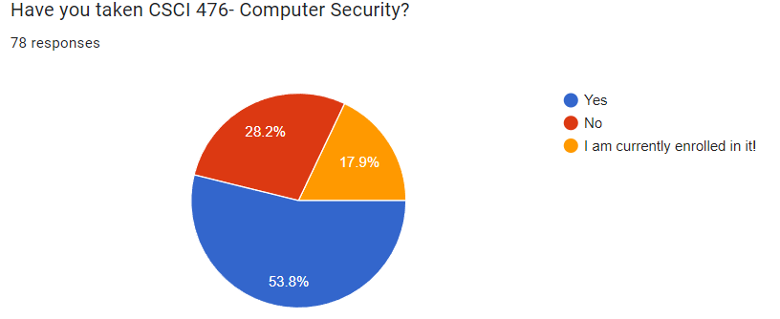
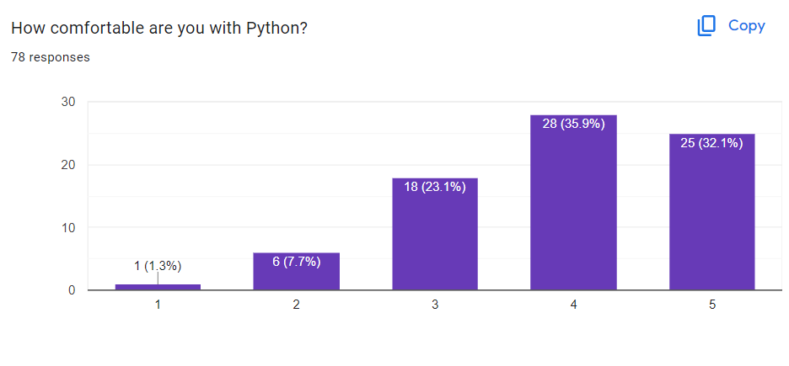
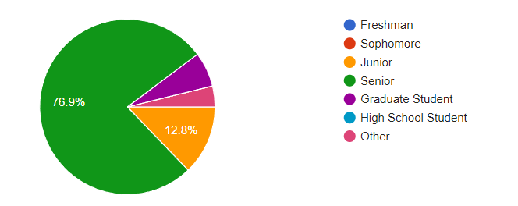
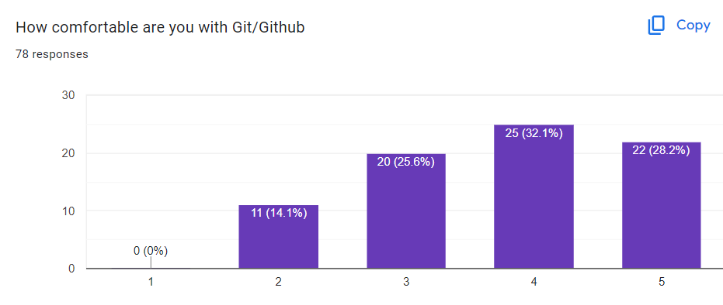
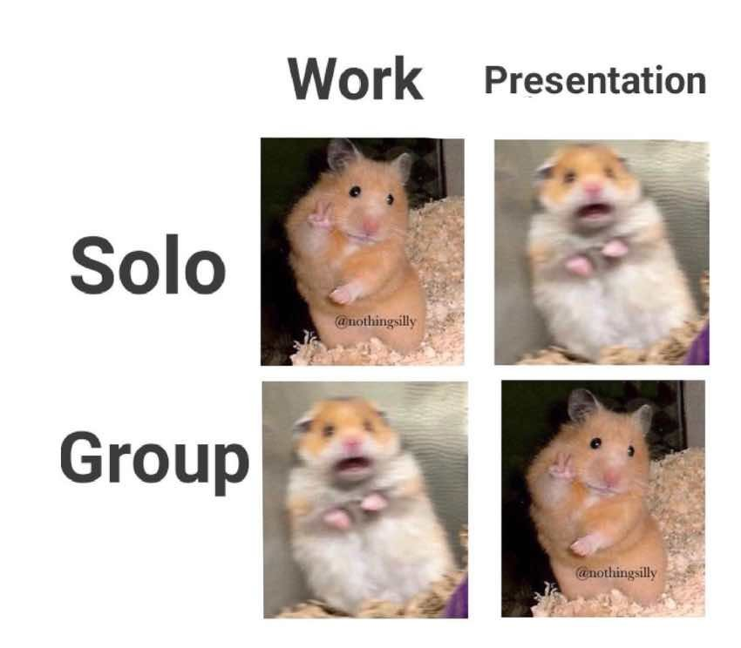
Questionnaire Stuff
“This seems relevant for my career” “I hate group projects”,
“I am a hardcore procrastinator”
It makes my life much less stressful knowing people have used Git ☺

Slide 4
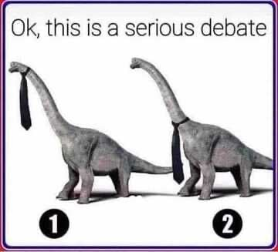
Questionnaire Stuff

Slide 5
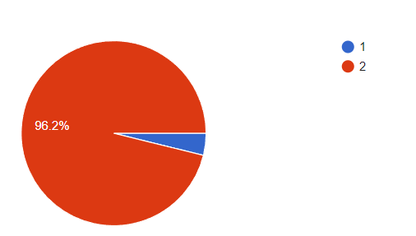
Questionnaire Stuff

Slide 6

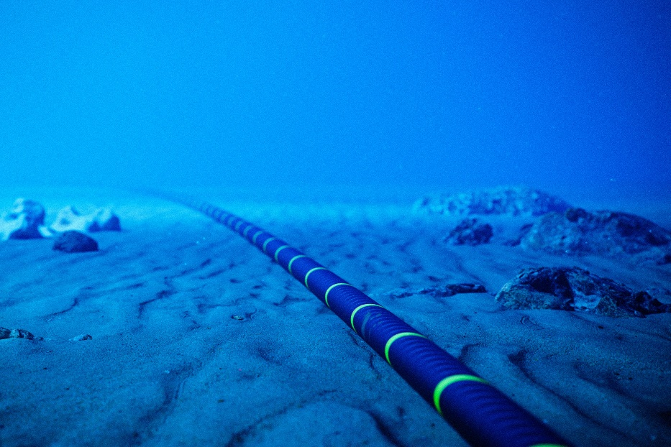
Submarine Cables
Submarine cables are set on the floors of the ocean
https://www.youtube.com/watch?v=d0gs497KApU

Slide 7
Application Layer
OSI Model
Presentation Layer
*
Application Layer
Session Layer
*
Messages from Network Applications
Transport Layer
Network Layer
Physical Layer
Data Link Layer
Bits being transmitted over a copper wire
Physical Layer
*In the textbook, they condense it to a 5-layer model, but 7 layers is what is most used

Slide 8
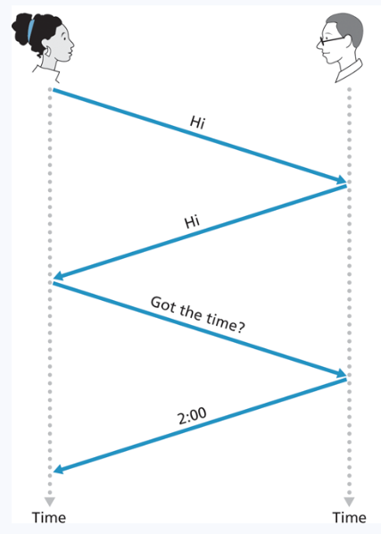
What is a protocol?

Slide 9
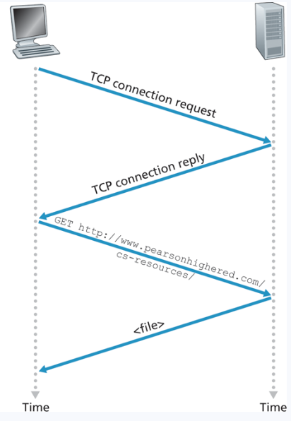
What is a protocol?

Slide 10
What is a protocol?
A protocol defines the format and the order of messages exchanges between two or more communicating entities, as well as the actions taken on the transmission and/or receipt of the message or event

Slide 11
Application Layer
OSI Model
The layer which interacts directly with applications and provides necessary protocols and services for web applications
Humans interact with this layer
Data from user → Application Layer → Sent to next layer down

Slide 12
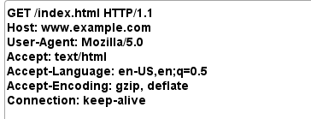
Application Layer
OSI Model
The layer which interacts directly with applications and provides necessary protocols and services for web applications
Humans interact with this layer
Data from user → Application Layer → Sent to next layer down
Search query on website →
→ Sent to presentation layer

Slide 13
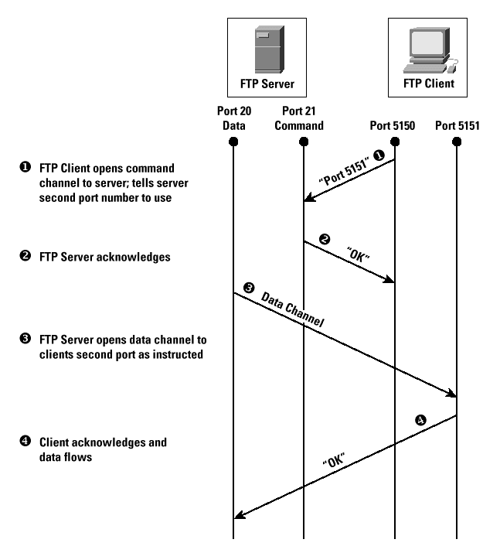
Application Layer
OSI Model
The layer which interacts directly with applications and provides necessary protocols and services for web applications
Protocol defines the steps of getting data from application to application
Humans interact with this layer
Data from user → Application Layer → Sent to next layer down
Search query on website →
→ Sent to presentation layer

Slide 14




Application Layer
OSI Model
The layer which interacts directly with applications and provides necessary protocols and services for web applications
Protocol defines the steps of getting data from application to application
Humans interact with this layer
Data from user → Application Layer → Sent to next layer down
Search query on website →
→ Sent to presentation layer

Slide 15
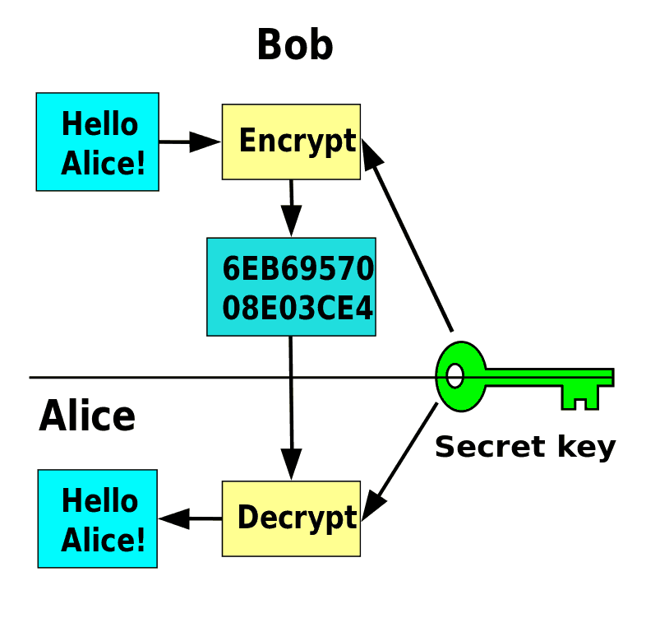
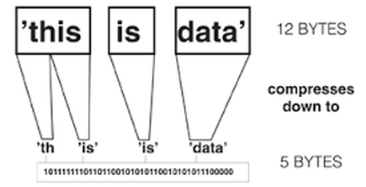
Presentation Layer
OSI Model
The layer which allows applications to interpret meaning of data
Translation
Encryption
Compression
Text encoding → Encoding, Ascii
Bit/Byte order
File Syntax

Slide 16



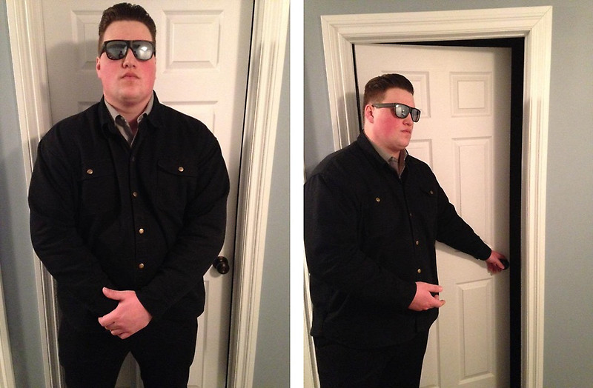


Session Layer
OSI Model
Manages, monitors, and synchronizing “sessions” between endpoints
Implements checkpoints while data is flowing
Authentication
Authorization

Slide 17
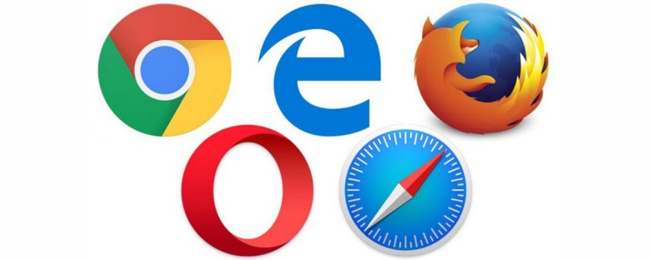

OSI Model
Application Layer
Presentation Layer
Session Layer
Most of this functionality is handled by our web browsers

Slide 18
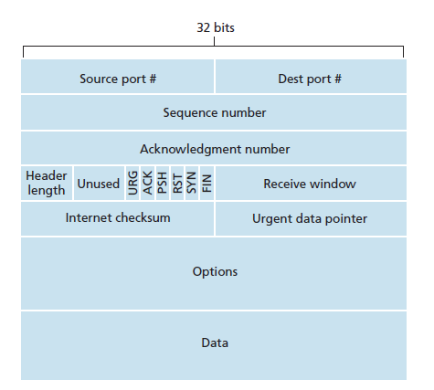

Transport Layer
OSI Model
Manges end to end communication and method of how data will be transferred
Ensures that the data received at host will be in the same order in which it was transmitted
Splits up packets into smaller segments
What should the transmission rate be?

Slide 19
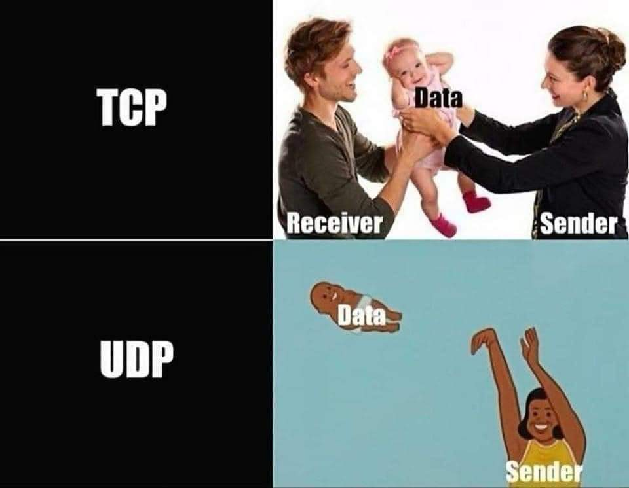
Transport Layer
OSI Model
Transmission Control Protocol (TCP)
User Datagram Protocol (UDP)
Requires an established connection to transmit data.
Guarantees delivery of data in order
Extensive error checking and acknowledgement of data
Connectionless protocol
Faster, Simpler
Not reliable
No acknowledgement of data, basic error checking

Slide 20
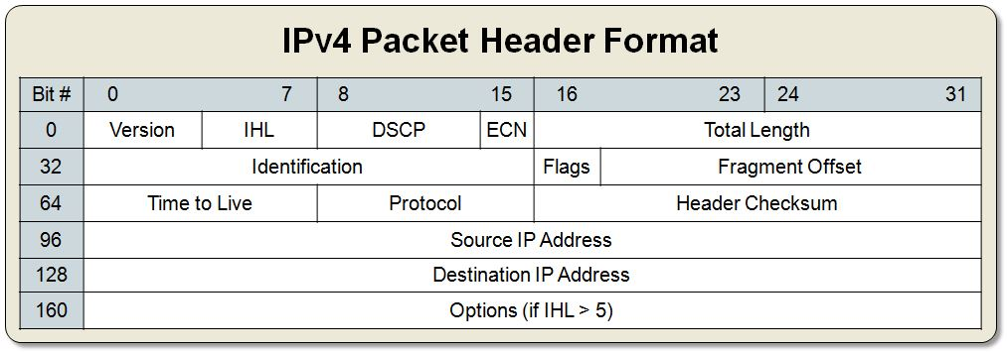










Transport Layer
OSI Model
Network Layer
Primary purpose is to move datagrams from one host to another, and to determine physical path to destination
What route to take?
We also assign IP addresses to our packet

Slide 21
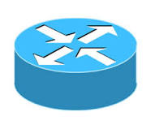


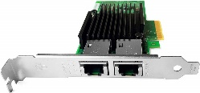

Transport Layer
OSI Model
Network Layer
Data Link Layer
Handles the formatting and physical addressing of the “packet” before reaching the destination
Source MAC
Destination MAC
To From
Good morning, I hope you are having a good day!
Frame
Link layer needs to pack bits into frames
011010110111010101110111010110110101010101011101100011110101011010110101010010011110010111010101110101011011011011010101011101101110101011011101011010111011010110110110101100010101
011010110111010101110111010110110101010101011101100011110101011010110101010010011110010111010101110101011011011011010101011101101110101011011101011010111011010110110110101100010101
110101101110101011101110101101110101101110101011101110101101110101101110101011101110101101010101110101011001010111010101100101011101010110010101110101011001010111010101100101011101
011010110111010101110111010110110101010101011101100011110101011010110101010010011110010111010101110101011011011011010101011101101110101011011101011010111011010110110110101100010101

Slide 22
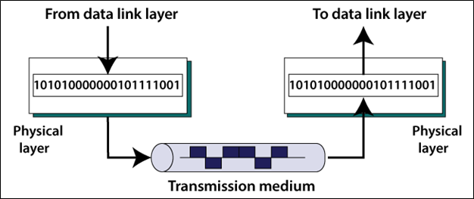

Physical Layer
OSI Model
Transport Layer
Network Layer
Data Link Layer
Transmits bits into physical signals over some medium

Slide 23
OSI Model
Encapsulation
Application Layer
Data
Presentation Layer
Data
Session Layer
Data

Slide 24
OSI Model
Encapsulation
Application Layer
Data
Presentation Layer
Data
Session Layer
Data
Transport Layer
Data
TCP Header
“Segment”

Slide 25
OSI Model
Encapsulation
Application Layer
Data
Presentation Layer
Data
Session Layer
Data
Transport Layer
Data
TCP Header
“Segment”
Network Layer
Data
TCP Header
IP Header
“Datagram”

Slide 26
OSI Model
Encapsulation
Application Layer
Data
Presentation Layer
Data
Session Layer
Data
Transport Layer
Data
TCP Header
“Segment”
Network Layer
Data
TCP Header
IP Header
“Datagram”
Data Link Layer
Data
TCP Header
IP Header
MAC Header
“Frame”

Slide 27
OSI Model
Encapsulation
Application Layer
Data
Presentation Layer
Data
Session Layer
Data
Transport Layer
Data
TCP Header
Network Layer
Data
TCP Header
IP Header
Data Link Layer
Data
TCP Header
IP Header
MAC Header
Physical Layer
0101010101111010100110101010101010

Slide 28
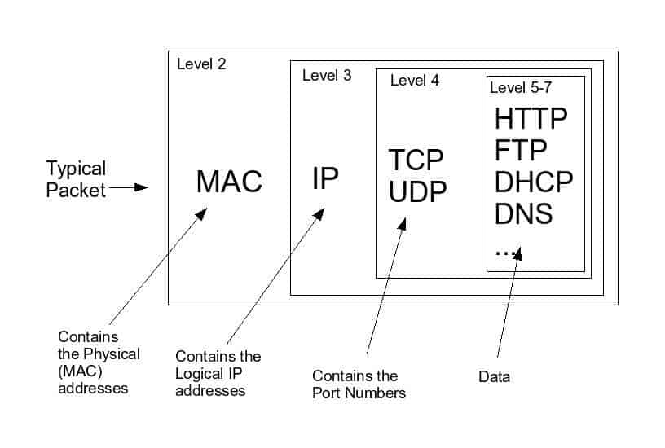
OSI Model
Encapsulation

Slide 29
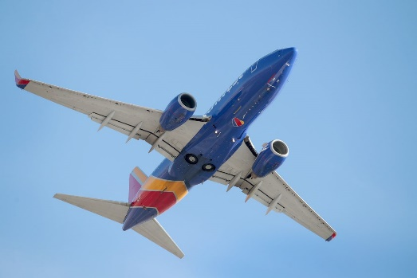
OSI Model
Ticket (purchase)

Slide 30
OSI Model
Ticket (purchase)
Baggage (Check)

Slide 31
OSI Model
Ticket (purchase)
Baggage (Check)
Gates (load)

Slide 32
OSI Model
Ticket (purchase)
Baggage (Check)
Gates (load)
Runway Takeoff

Slide 33
OSI Model
Ticket (purchase)
Baggage (Check)
Gates (load)
Runway Takeoff
Airplane Routing

Slide 34
OSI Model
Ticket (purchase)
Baggage (Check)
Gates (load)
Runway Takeoff
Airplane Routing
Airplane Routing

Slide 35
OSI Model
Ticket (purchase)
Baggage (Check)
Gates (load)
Runway Takeoff
Runway landing
Airplane Routing
Airplane Routing

Slide 36
OSI Model
Ticket (purchase)
Baggage (Check)
Gates (load)
Gates (unload)
Runway Takeoff
Runway landing
Airplane Routing
Airplane Routing

Slide 37
OSI Model
Ticket (purchase)
Baggage (Check)
Baggage (claim)
Gates (load)
Gates (unload)
Runway Takeoff
Runway landing
Airplane Routing
Airplane Routing

Slide 38




OSI Model
Ticket (purchase)
Tickets (complain)
Baggage (Check)
Baggage (claim)
Gates (load)
Gates (unload)
Runway Takeoff
Runway landing
Airplane Routing
Airplane Routing

Slide 39
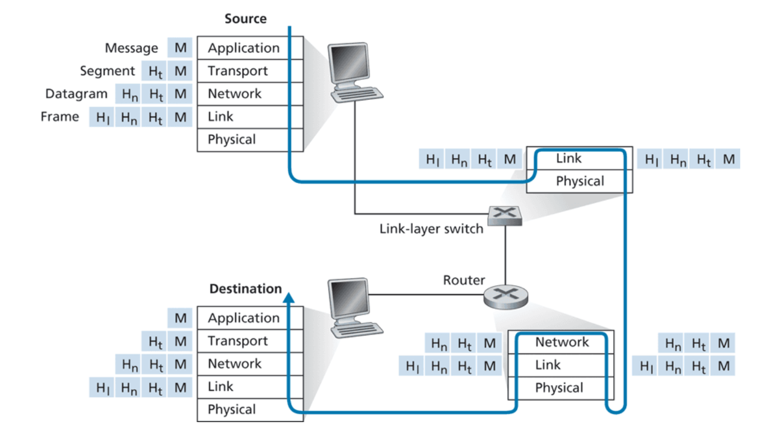
OSI Model

Slide 40
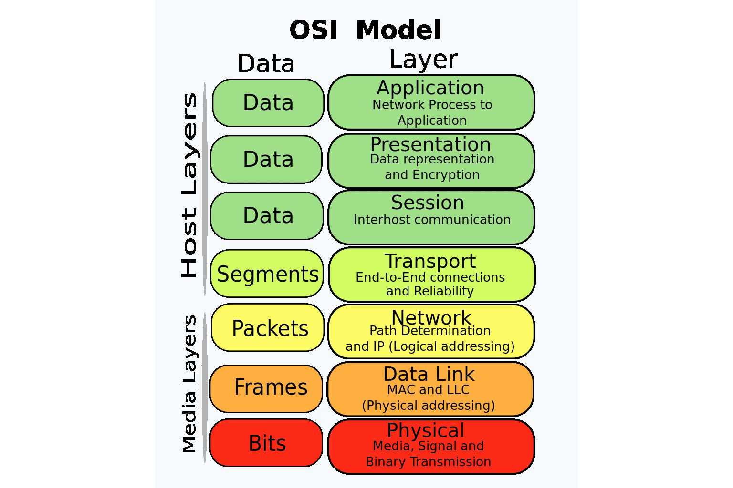
OSI Model

Slide 41
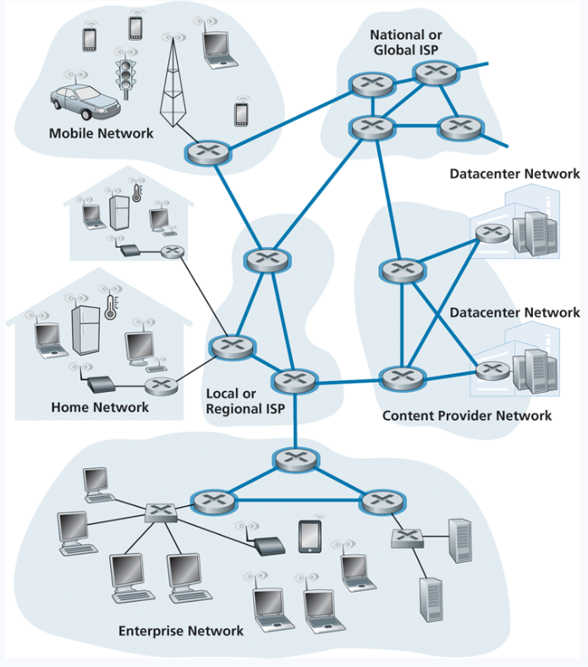
The internet is a network of networks, connected by packet switches and communication links
Messages going from A to B are split into packets
“Good morning, I hope you are having a good day!”
To: Host A
John Paxton
192.42.98.11
From: Host B
Reese Pearsall
192.5.223.42
Generated Packet
Good morning, I hope you are having a good day!
Communication links have different transmission rates
10 Mbps
500 kbps
100 kbps

Slide 42
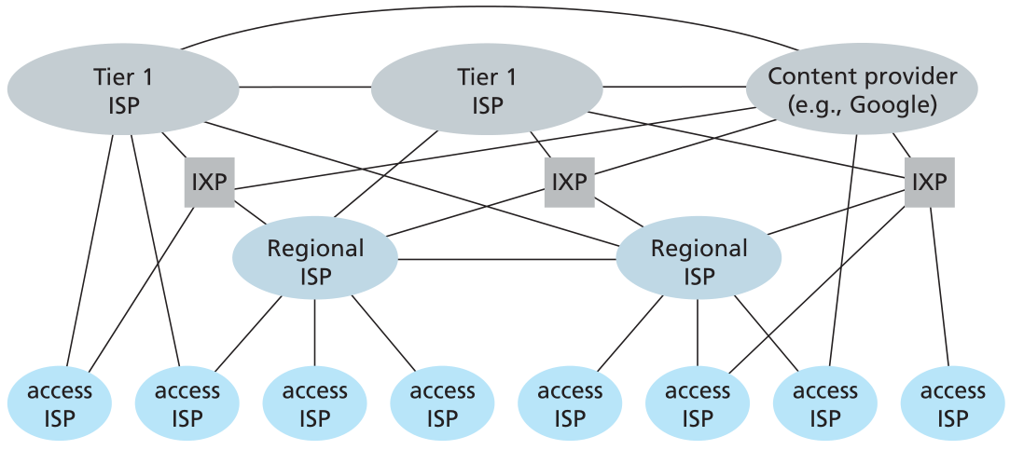
The internet is a network of networks, connected by packet switches and communication links
Messages going from A to B are split into packets
“Good morning, I hope you are having a good day!”
To: Host A
John Paxton
192.42.98.11
From: Host B
Reese Pearsall
192.5.223.42
Generated Packet
Good morning, I hope you are having a good day!
Communication links have different transmission rates
10 Mbps
500 kbps
100 kbps

Slide 43
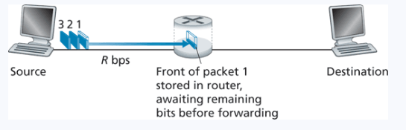
Data Forwarding
Packet Switching
Uses store-and-forward transmission
Store and forward- wait for the entire packet to arrive, check value(s) of packet, and then forward to next location

Slide 44
Data Forwarding
Routing Table
Network 192.47.0.1
Network 192.27.3.11
1
2
3
4
Network 192.4.02.11
3
2
Network 101.0.1
1
Network 103.44.7

Slide 45


Data Forwarding
Routing Table
Network 192.47.0.1
Network 192.27.3.11
Destination
Interface
Network 192.4.02.11
3
Network 192.47.0.1
1
1
Network 192.27.3.11
2
2
Network 101.0.1
4
4
3
4
Network 103.44.7
Network 192.4.02.11
3
2
Network 101.0.1
1
Network 103.44.7

Slide 46


Data Forwarding
Routing Table
Network 192.47.0.1
Network 192.27.3.11
Destination
Interface
Network 192.4.02.11
3
Network 192.47.0.1
1
1
We will discuss how these tables are populated in several weeks
Network 192.27.3.11
2
2
Network 101.0.1
4
4
3
4
Network 103.44.7
Network 192.4.02.11
3
2
Network 101.0.1
1
Network 103.44.7

Slide 47
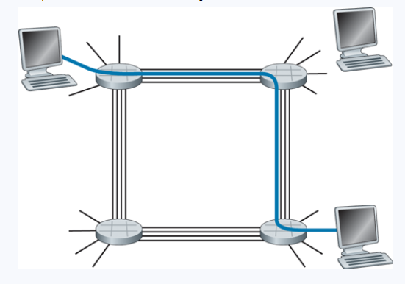
Data Forwarding
In circuit switching, the path and resources for transmitting from A to B is reserved
Communication links are divided into circuits, which allow for concurrent usage of the link

Slide 48
Data Forwarding
In circuit switching, the path and resources for transmitting from A to B is reserved
Communication links are divided into circuits, which allow for concurrent usage of the link
Reserved spaces that are not in use result in silent periods

Slide 49
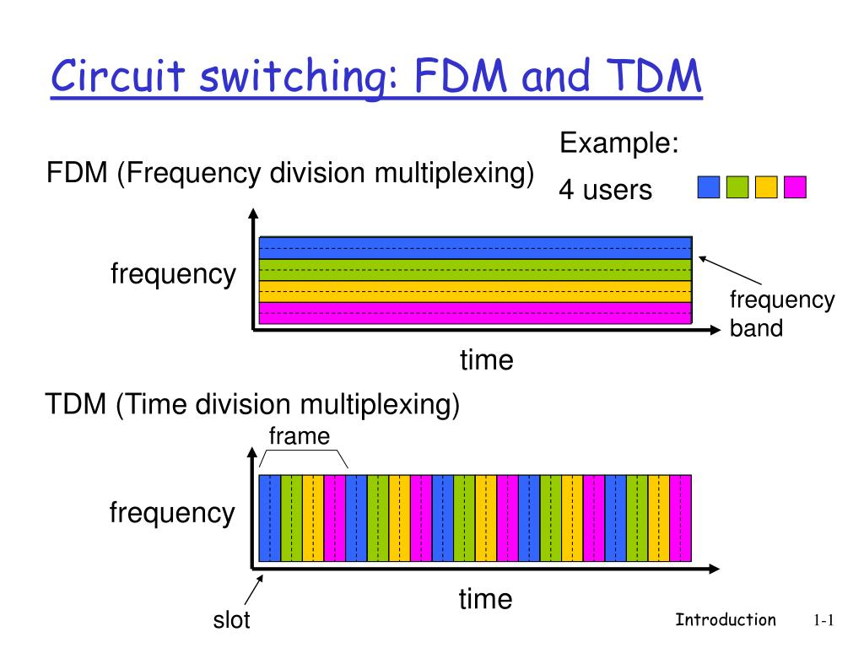
How are links “reserved” ?

Slide 50
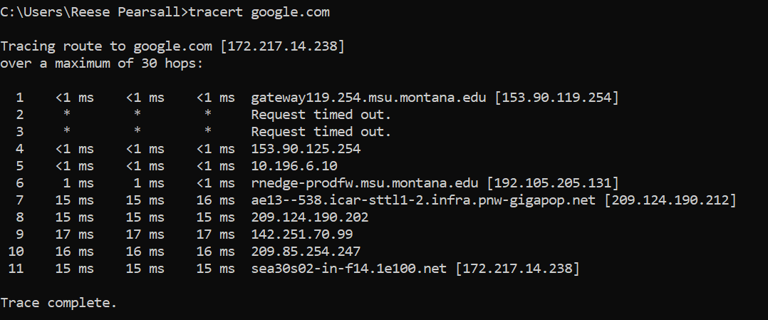
Traceroute
Network diagnostic tool that displays route taken to destination and RTT for each hop

Slide 51
Traceroute
Network diagnostic tool that displays route taken to destination and RTT for each hop
Hop #
RTT time for each packet
Destination

Slide 52
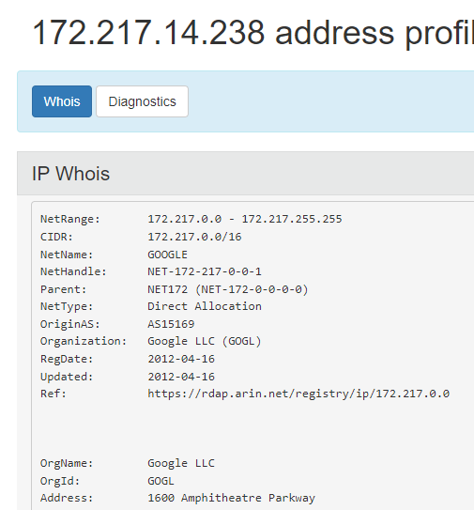
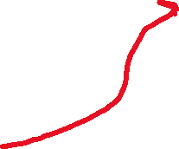
Traceroute
Network diagnostic tool that displays route taken to destination and RTT for each hop
Hop #
RTT time for each packet
Destination
whois- provides registration data of a domain or IP address

Slide 53

Traceroute
Network diagnostic tool that displays route taken to destination and RTT for each hop
Hop #
RTT time for each packet
Destination
whois- provides registration data of a domain or IP address

Slide 54
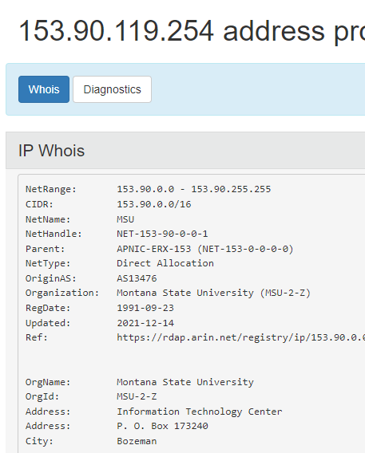

Traceroute
Network diagnostic tool that displays route taken to destination and RTT for each hop
Hop #
RTT time for each packet
Destination
whois- provides registration data of a domain or IP address

