Slide 1

CSCI 466: Networks
Lecture 4: Network Performance
Reese Pearsall
Fall 2023
https://www.cs.montana.edu/pearsall/classes/fall2023/466/main.html

Slide 2
Announcements
Quiz on Friday (no lecture)
Network Edge
Network Core
Access Networks
OSI Model
Data Forwarding
Network Performance
No class on Monday (Holiday)

Slide 3
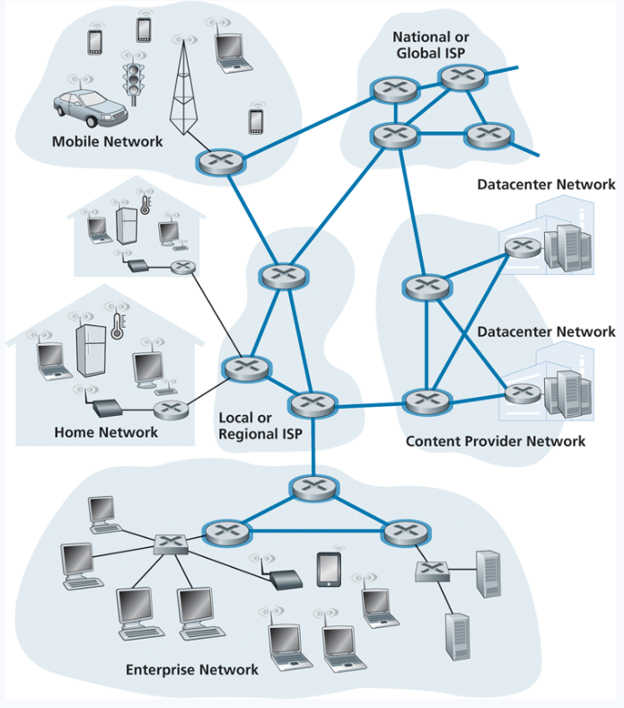
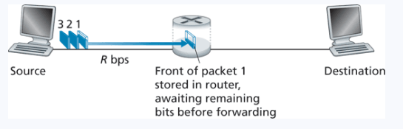
Data Forwarding
Packet Switching
Uses store-and-forward transmission
Time to transmit L bits over a link with transmission rate of R:
L / R

Slide 4
Data Forwarding
Packet Switching
Uses store-and-forward transmission
Time to transmit L bits over a link with transmission rate of R:
L / R
We have many forms of delay though…

Slide 5
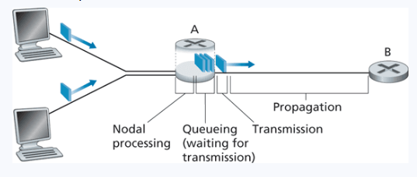
Network Delay
Propagation Delay- time needed to propagate to destination
Transmission delay- Amount of time required to push all the packet’s bits into the link
(dependent on the medium)
Queueing Delay- Time the packet sits in the queue
Processing delay- time required to examine the packet’s header and determine where to direct the packet
Nodal Delay = Processing delay + Queueing delay + Transmission delay + Propagation delay

Slide 6
Network Delay
https://www2.tkn.tu-berlin.de/teaching/rn/animations/propagation/
Propagation Delay- time needed to propagate to destination
(dependent on the medium)
Transmission delay- Amount of time required to push all the packet’s bits into the link
Queueing Delay- Time the packet sits in the queue
Processing delay- time required to examine the packet’s header and determine where to direct the packet
Nodal Delay = Processing delay + Queueing delay + Transmission delay + Propagation delay

Slide 7
Network Delay
Transmission delay- Amount of time required to push all the packet’s bits into the link
Transmission Delay = L / R
L = length of packet (bits) R = transmission rate of link

Slide 8
Network Delay
Propagation Delay- time needed to propagate to destination
(dependent on the medium)
Propagation = d / s
d = distance between host and router s = propagation speed of medium

Slide 9



Network Delay Example Problem
Transmission Delay = L / R
Propogation Delay = d / s
Link 1
Link 2
Transmission Rate: 1000 Mbps
Link Length: 3 Km
Transmission Rate: 100 Mbps
Link Length: 1 Km
Length of Packet = 12000 bits. Propagation Speed of links = 3 * 10^8 m/s
What is the transmission delay of link 1?

Slide 10
Network Delay Example Problem
Transmission Delay = L / R
Propogation Delay = d / s
Link 1
Link 2
Transmission Rate: 1000 Mbps
Link Length: 3 Km
Transmission Rate: 100 Mbps
Link Length: 1 Km
Length of Packet = 12000 bits. Propagation Speed of links = 3 * 10^8 m/s
What is the transmission delay of link 1?
D_{transmission} = L / R

Slide 11
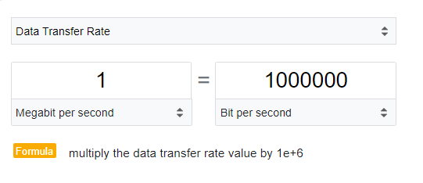
Network Delay Example Problem
Transmission Delay = L / R
Propogation Delay = d / s
Link 1
Link 2
Transmission Rate: 1000 Mbps
Link Length: 3 Km
Transmission Rate: 100 Mbps
Link Length: 1 Km
Length of Packet = 12000 bits. Propagation Speed of links = 3 * 10^8 m/s
What is the transmission delay of link 1?
D_{transmission} = L / R
D_{transmission} = 12000 / (1000 * 100)
Must convert Mbps to bps!

Slide 12
Network Delay Example Problem
Transmission Delay = L / R
Propogation Delay = d / s
Link 1
Link 2
Transmission Rate: 1000 Mbps
Link Length: 3 Km
Transmission Rate: 100 Mbps
Link Length: 1 Km
Length of Packet = 12000 bits. Propagation Speed of links = 3 * 10^8 m/s
What is the transmission delay of link 1?
D_{transmission} = L / R
D_{transmission} = 12000 / (1000 * 1000000)
D_{transmission} = 12000 / 1000000000

Slide 13
Network Delay Example Problem
Transmission Delay = L / R
Propogation Delay = d / s
Link 1
Link 2
Transmission Rate: 1000 Mbps
Link Length: 3 Km
Transmission Rate: 100 Mbps
Link Length: 1 Km
Length of Packet = 12000 bits. Propagation Speed of links = 3 * 10^8 m/s
What is the transmission delay of link 1?
D_{transmission} = L / R
D_{transmission} = 12000 / (1000 * 1000000)
D_{transmission} = 12000 / 1000000000
D_{transmission} = 0.000012 seconds

Slide 14
Network Delay Example Problem
Transmission Delay = L / R
Propogation Delay = d / s
Link 1
Link 2
Transmission Rate: 1000 Mbps
Link Length: 3 Km
Transmission Rate: 100 Mbps
Link Length: 1 Km
Length of Packet = 12000 bits. Propagation Speed of links = 3 * 10^8 m/s
What is the transmission delay of link 1?
What is the Propagation delay of link 1?
D_{transmission} = L / R
D_{transmission} = 12000 / (1000 * 1000000)
D_{transmission} = 12000 / 1000000000
D_{transmission} = 0.000012 seconds

Slide 15
Network Delay Example Problem
Transmission Delay = L / R
Propogation Delay = d / s
Link 1
Link 2
Transmission Rate: 1000 Mbps
Link Length: 3 Km
Transmission Rate: 100 Mbps
Link Length: 1 Km
Length of Packet = 12000 bits. Propagation Speed of links = 3 * 10^8 m/s
What is the transmission delay of link 1?
What is the Propagation delay of link 1?
D_{transmission} = L / R
D_{propagation} = d / s
D_{transmission} = 12000 / (1000 * 1000000)
D_{transmission} = 12000 / 1000000000
D_{transmission} = 0.000012 seconds

Slide 16
Network Delay Example Problem
Transmission Delay = L / R
Propogation Delay = d / s
Link 1
Link 2
Transmission Rate: 1000 Mbps
Link Length: 3 Km
Transmission Rate: 100 Mbps
Link Length: 1 Km
Length of Packet = 12000 bits. Propagation Speed of links = 3 * 10^8 m/s
What is the transmission delay of link 1?
What is the Propagation delay of link 1?
D_{transmission} = L / R
D_{propagation} = d / s
D_{transmission} = 12000 / (1000 * 1000000)
D_{propagation} = (3 * 1000) / 3 * 10^8
D_{transmission} = 12000 / 1000000000
Must convert Km to m!
D_{transmission} = 0.000012 seconds

Slide 17
Network Delay Example Problem
Transmission Delay = L / R
Propogation Delay = d / s
Link 1
Link 2
Transmission Rate: 1000 Mbps
Link Length: 3 Km
Transmission Rate: 100 Mbps
Link Length: 1 Km
Length of Packet = 12000 bits. Propagation Speed of links = 3 * 10^8 m/s
What is the transmission delay of link 1?
What is the Propagation delay of link 1?
D_{transmission} = L / R
D_{propagation} = d / s
D_{transmission} = 12000 / (1000 * 1000000)
D_{propagation} = (3 * 1000) / 3 * 10^8
D_{transmission} = 12000 / 1000000000
D_{propagation} = (3000) / 3 * 10^8
D_{transmission} = 0.000012 seconds

Slide 18
Network Delay Example Problem
Transmission Delay = L / R
Propogation Delay = d / s
Link 1
Link 2
Transmission Rate: 1000 Mbps
Link Length: 3 Km
Transmission Rate: 100 Mbps
Link Length: 1 Km
Length of Packet = 12000 bits. Propagation Speed of links = 3 * 10^8 m/s
What is the transmission delay of link 1?
What is the Propagation delay of link 1?
D_{transmission} = L / R
D_{propagation} = d / s
D_{transmission} = 12000 / (1000 * 1000000)
D_{propagation} = (3 * 1000) / 3 * 10^8
D_{transmission} = 12000 / 1000000000
D_{propagation} = (3000) / 3 * 10^8
D_{transmission} = 0.000012 seconds
D_{propagation} = 0.00001

Slide 19
Network Delay
Propagation Delay- time needed to propagate to destination
Transmission delay- Amount of time required to push all the packet’s bits into the link
(dependent on the medium)
Queueing Delay- Time the packet sits in the queue
Processing delay- time required to examine the packet’s header and determine where to direct the packet
In an uncongested network with N links between source and destination
End-to-end Delay= N(Processing delay + Transmission delay + Propagation delay)

Slide 20
Queueing Delay
Packets arrive to the queue at a rate of a (packets/sec)
Bits are pushed out on the communication link at a rate of R (bits/sec)
L bits per packet

Slide 21
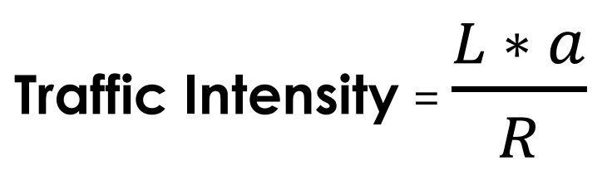
Queueing Delay
Packets arrive to the queue at a rate of a (packets/sec)
Bits are pushed out on the communication link at a rate of R (bits/sec)
L bits per packet
Ratio of average bits that arrive at queue to how quick we can process one bit

Slide 22
Queueing Delay
Packets arrive to the queue at a rate of a (packets/sec)
Bits are pushed out on the communication link at a rate of R (bits/sec)
L bits per packet
Ratio of average bits that arrive at queue to how quick we can process one bit
If traffic intensity > 1 ?

Slide 23
Queueing Delay
Packets arrive to the queue at a rate of a (packets/sec)
Bits are pushed out on the communication link at a rate of R (bits/sec)
L bits per packet
Ratio of average bits that arrive at queue to how quick we can process one bit
Bits arrive to the queue faster than we can process them
Bad!
If traffic intensity > 1 ?

Slide 24
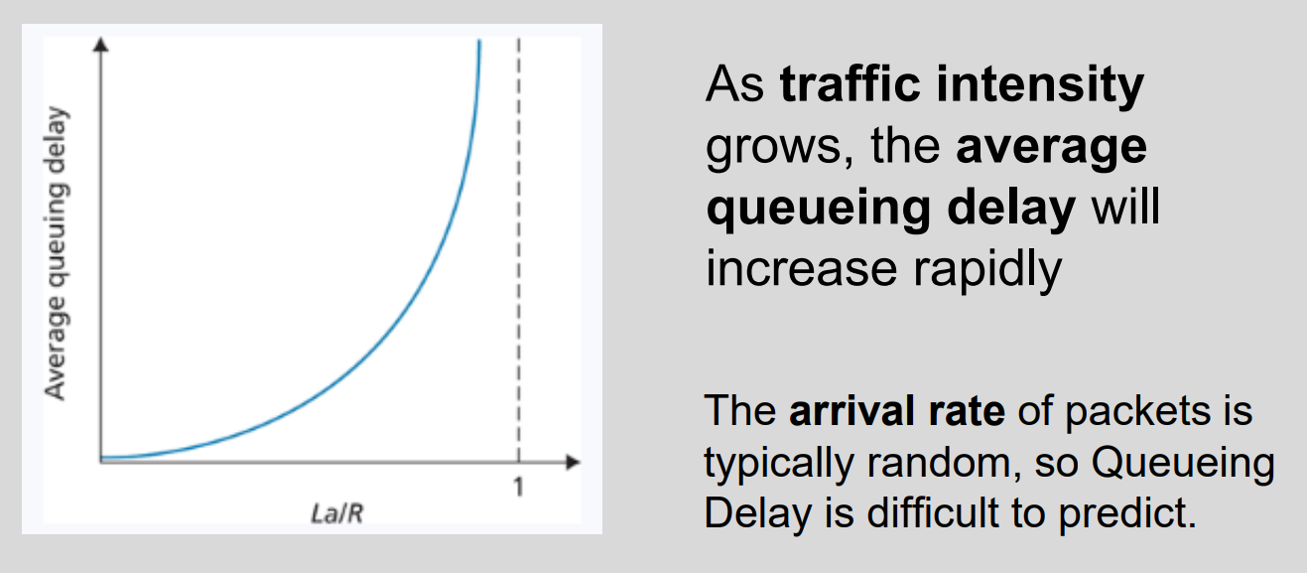
Queueing Delay
Packets arrive to the queue at a rate of a (packets/sec)
Bits are pushed out on the communication link at a rate of R (bits/sec)
L bits per packet
Ratio of average bits that arrive at queue to how quick we can process one bit
We can process bits faster than they arrive
Good!
If traffic intensity <= 1 ?

Slide 25
Packet Loss
Queues have finite space.
If a router has no place to store the packet, the packet will be dropped or lost
The number of lost packets will increase as traffic intensity increases
In addition to delay, the probability of packet loss is helpful to calculate

Slide 26
Packet Loss
Queues have finite space.
If a router has no place to store the packet, the packet will be dropped or lost
The number of lost packets will increase as traffic intensity increases
In addition to delay, the probability of packet loss is helpful to calculate
Ping Test
ping –n 10 8.8.8.8
ping –n 5 131.255.7.26

Slide 27
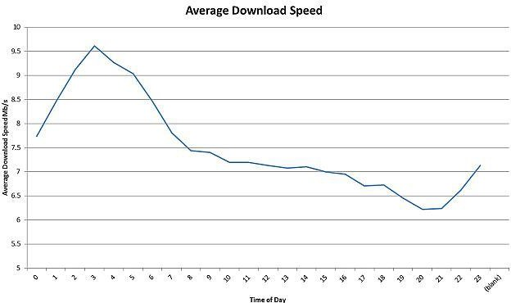
Throughput
Throughput is the amount of data transferred from one place to another within a given time period

Slide 28
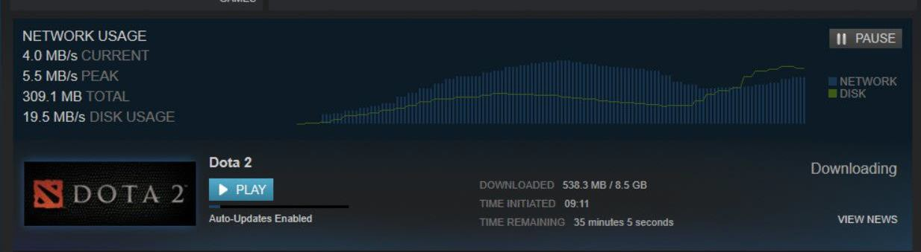
Throughput
Throughput is the amount of data transferred from one place to another within a given time period

Slide 29
Throughput
Throughput is the amount of data transferred from one place to another within a given time period
Instantaneous throughput is the
throughput for a given point in time

Slide 30
Throughput
Throughput is the amount of data transferred from one place to another within a given time period
Instantaneous throughput is the
throughput for a given point in time
The instantaneous throughput at 7:00 PM is roughly 6.5 Mbps

Slide 31
Throughput
Throughput is the amount of data transferred from one place to another within a given time period
Instantaneous throughput is the
throughput for a given point in time
In general, if F bits takes T seconds to transfer from one endpoint to another, the average throughput is:
The instantaneous throughput at 7:00 PM is roughly 6.5 Mbps
𝐹
𝑇

Slide 32
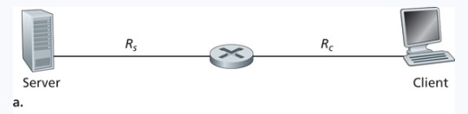
Throughput
R_{s} = transmission rate for server to router
R_{c} = transmission rate for client to router
Throughput for server to client?

Slide 33
Throughput
R_{s}
R_{c}
R_{s} > R_{c}
R_{s} = transmission rate for server to router
R_{c} = transmission rate for client to router
Throughput for server to client?

Slide 34



Throughput
Point in network where flow of data is impaired or stopped
Bottleneck
R_{s}
R_{c}
R_{s} > R_{c}
R_{s} = transmission rate for server to router
R_{c} = transmission rate for client to router
Throughput for server to client?

Slide 35

Throughput
Point in network where flow of data is impaired or stopped
Bottleneck
R_{s}
R_{c}
Buildup
R_{s} > R_{c}
R_{s} = transmission rate for server to router
R_{c} = transmission rate for client to router
Throughput for server to client?

Slide 36
Throughput
Point in network where flow of data is impaired or stopped
Bottleneck
R_{s}
R_{c}
Buildup
R_{s} > R_{c}
R_{s} = transmission rate for server to router
R_{c} = transmission rate for client to router
Throughput for server to client?
Dependent on the bottleneck link!

Slide 37
Throughput
Point in network where flow of data is impaired or stopped
Bottleneck
R_{s}
R_{c}
Buildup
R_{s} > R_{c}
R_{s} = transmission rate for server to router
R_{c} = transmission rate for client to router
𝐹
Throughput for server to client?
Dependent on the bottleneck link!
min{R_{s}, R_{c}}

Slide 38
Throughput
F = 32,000,000 bits
R_{s} = 2 Mbps
R_{c}
= 1 Mbps
R_{s} = transmission rate for server to router
R_{c} = transmission rate for client to router
Time needed to transfer file?

Slide 39
Throughput
F = 32,000,000 bits = 32 Mb
R_{s} = 2 Mbps
R_{c}
= 1 Mbps
R_{s} = transmission rate for server to router
R_{c} = transmission rate for client to router
Time needed to transfer file?

Slide 40
Throughput
F = 32,000,000 bits = 32 Mb
R_{s} = 2 Mbps
R_{c}
= 1 Mbps
Dependent on the bottleneck
R_{c} = transmission rate for client to router
R_{s} = transmission rate for server to router
Time needed to transfer file?
32 seconds

Slide 41
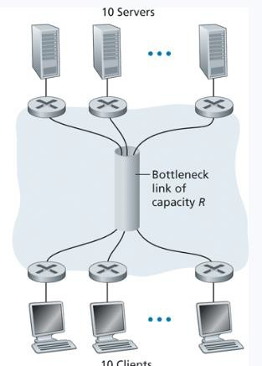
Throughput

Slide 42


Throughput
2
2
2
Link is shared across 10 servers
So each link supports 0.5 Mbps
10
1
1
1

Slide 43
Throughput
2
2
2
Link is shared across 10 servers
So each link supports 0.5 Mbps
10
Sometimes, the bottleneck won’t be the link with the slowest transmission rate
1
1
1

