Slide 1

CSCI 466: Networks
Lecture 6: Wireshark
Reese Pearsall
Fall 2023
https://www.cs.montana.edu/pearsall/classes/fall2023/466/main.html
*All images are stolen from the internet

Slide 2
Announcements
Wireshark Lab 1 is released, due on September 20th
Cookies can be stolen using a variety of different attacks (XSS, Session Hijack, etc). Cookies are generally encrypted
Download Speed vs Upload Speed

Slide 3

Wireshark
Wireshark is a free and open-source network packet analyzer
It captures packets that are leaving and arriving to your machine and provides details about them
You will use Wireshark to analyze real life network traffic for the labs

Slide 4
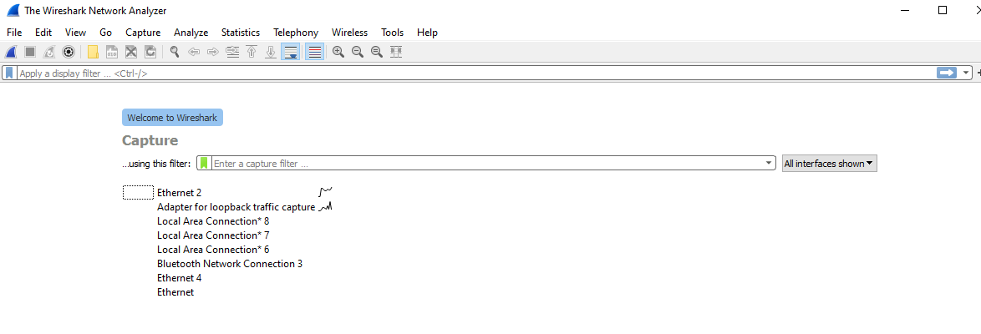

When you boot up Wireshark, you will need to select an interface to capture on
This indicates the interface is generating traffic!
In general, you will select ethernet (wired connections) or Wi-fi (wireless connections)

Slide 5
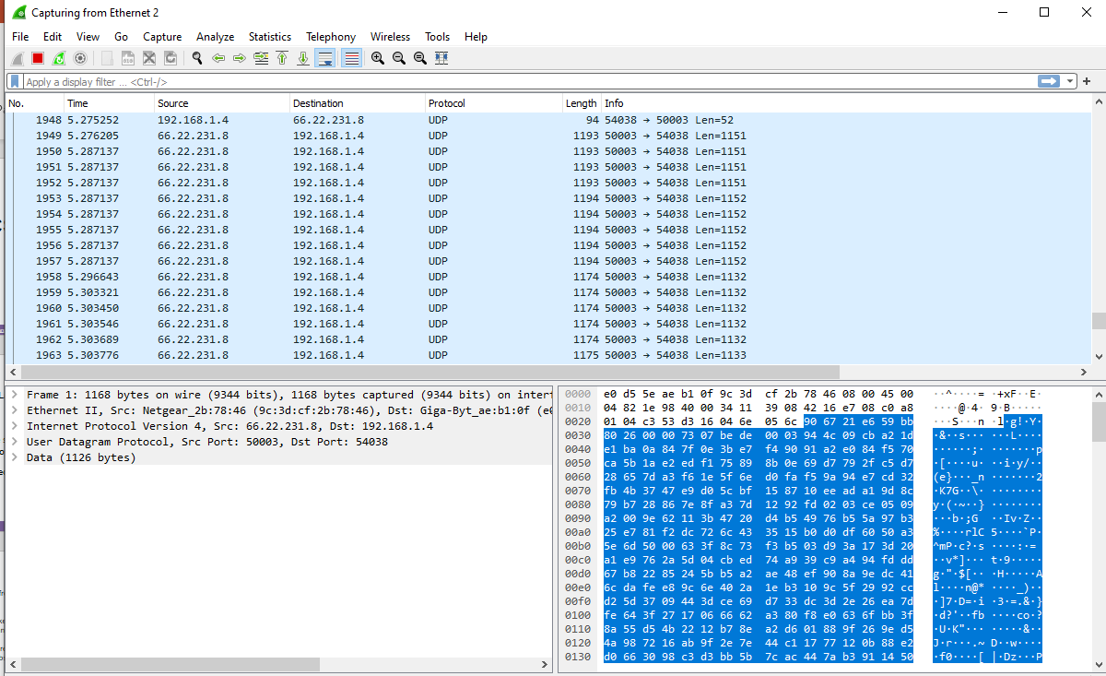
Each row represents a single packet
Once an interface is selected, it will begin capturing packets!

Slide 6
Let’s start generating some HTTP traffic!
We can do this via browsing the web, or through one of our other tools (curl, postman, etc)
If you use a web browser, I recommend using an incognito/private window

Slide 7
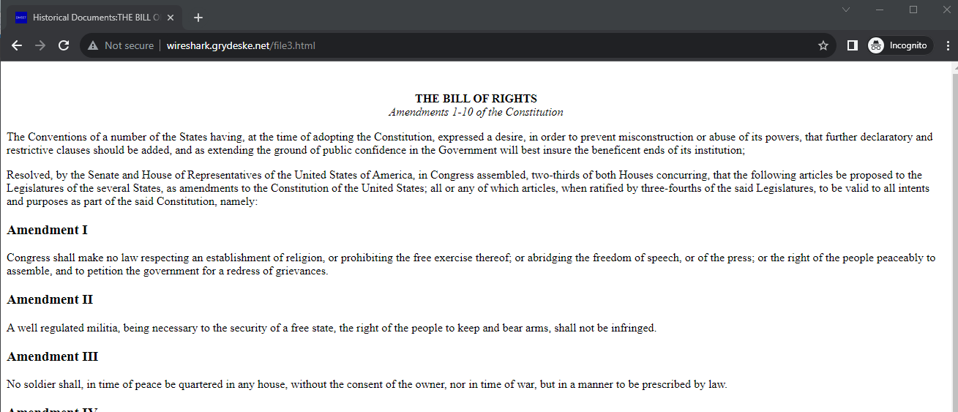
This will issue an HTTP request to download an HTML file
http://wireshark.grydeske.net/file3.html
(must use HTTP, not HTTPS)

Slide 8

Once the page is loaded, press the red square button to stop collecting data

Slide 9
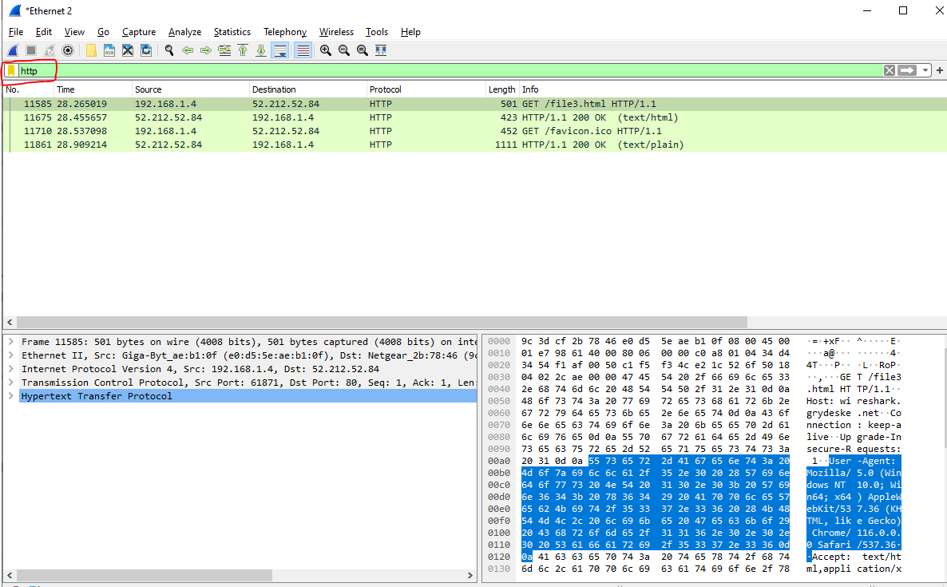
We can add a display filter to filter out any non-http traffic
Add the filter http
This will show only HTTP packets

Slide 10
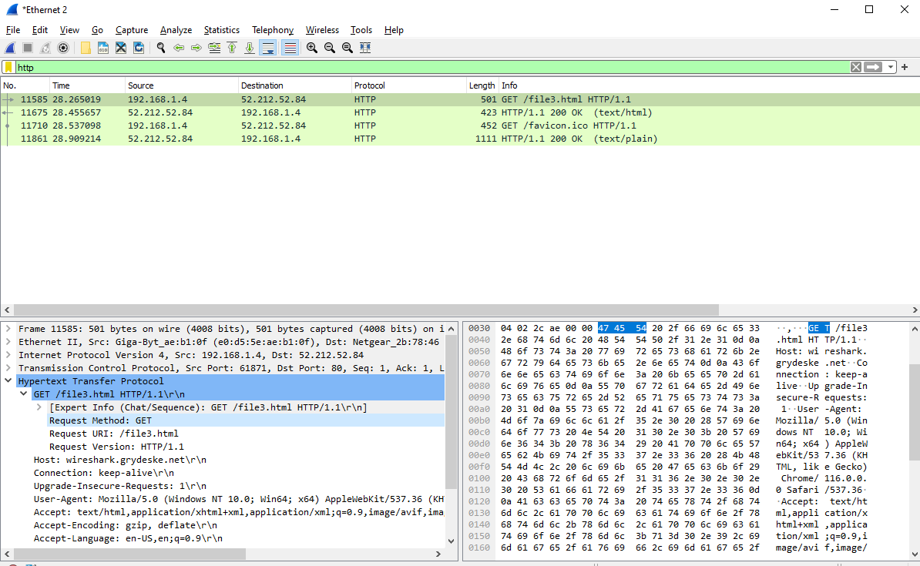
Click on the first packet

Slide 11

Click on the first packet
This pane shows detailed information about the entire packet (at all layers of the OSI)
We can click the “Hypertext Transfer Protocol” dropdown to view contents of the HTTP Request/Response

Slide 12




Click on the first packet
This pane shows detailed information about the entire packet (at all layers of the OSI)
This is the HTTP Request (arrow pointing right)
HTTP Method
HTTP Version
We can click the “Hypertext Transfer Protocol” dropdown to view contents of the HTTP Request/Response

Slide 13
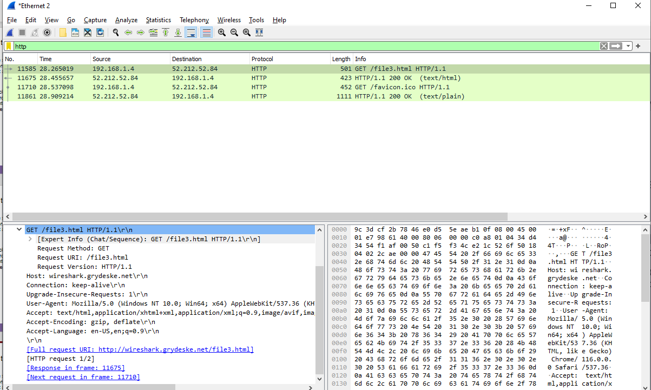



Click on the first packet
This pane shows detailed information about the entire packet (at all layers of the OSI)
Header Fields
URL of request
We can click the “Hypertext Transfer Protocol” dropdown to view contents of the HTTP Request/Response

Slide 14
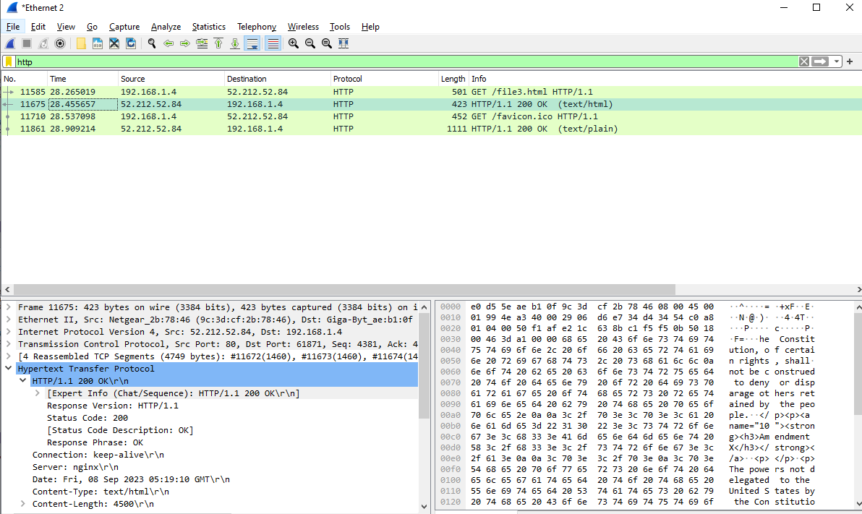


The second packet is the HTTP Response (arrow pointing left)
Request
192.168.1.4
Response
52.212.52.84

Slide 15



Response Status Code
HTTP Version of Response
This pane will try to decode the contents of the HTTP request/HTTP response (HTML)

Slide 16
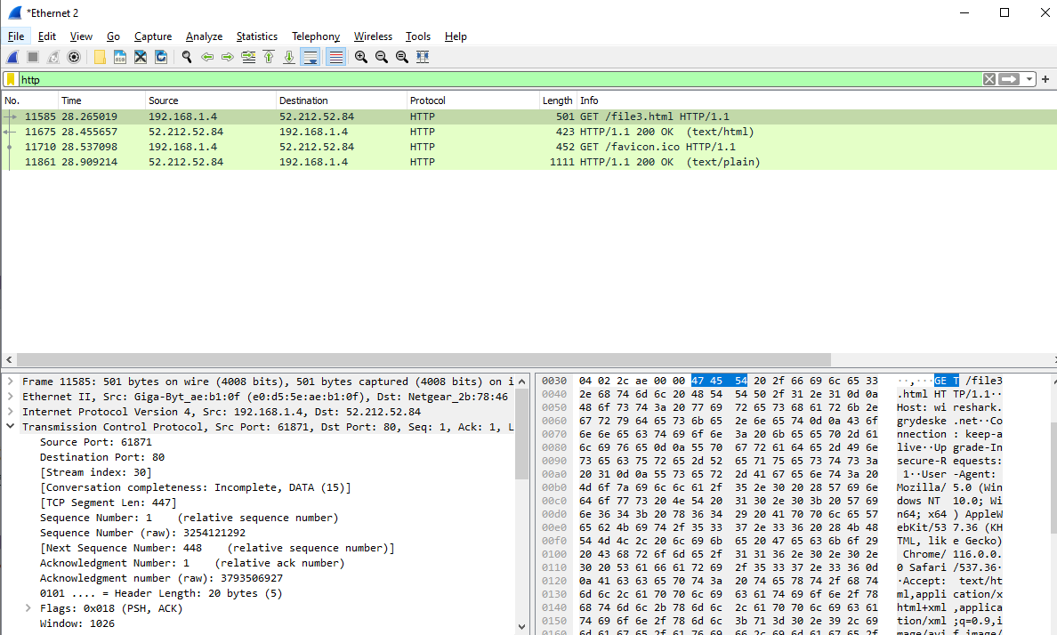
By clicking on “Transmission Control Protocol” we can see information about the transport layer

Slide 17

By clicking on “Transmission Control Protocol” we can see information about the transport layer
This traffic is happening on port 61871 on our local machine

Slide 18
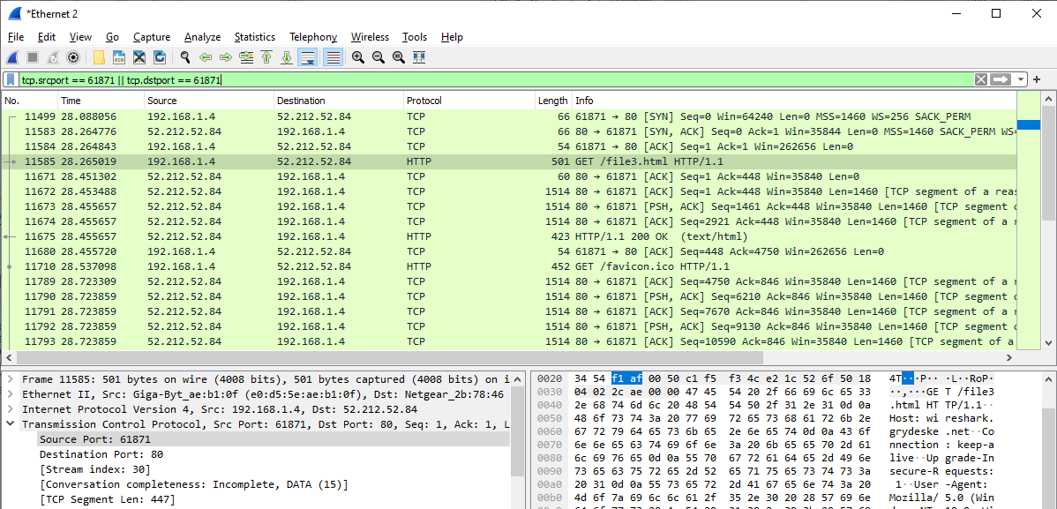
Let’s change our filter to tcp.srcport == 61871 || tcp.dstport == 61871
This will only show traffic where the source port or destination port is 61871

Slide 19

The first three packets is us establishing a TCP connection before we send our fist HTTP request!

