Slide 1

CSCI 466: Networks
Lecture 8: Application Layer
(More DNS, SMTP, FTP)
Reese Pearsall
Fall 2023
https://www.cs.montana.edu/pearsall/classes/fall2023/466/main.html
*All images are stolen from the internet

Slide 2
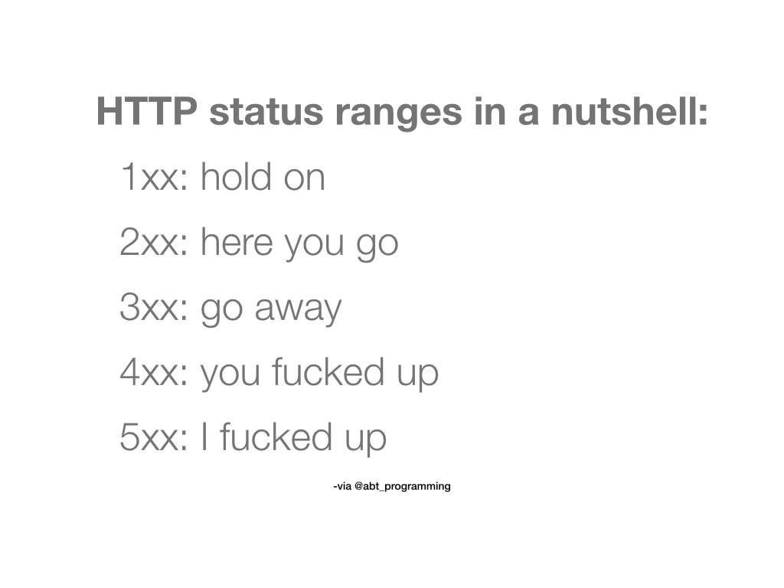
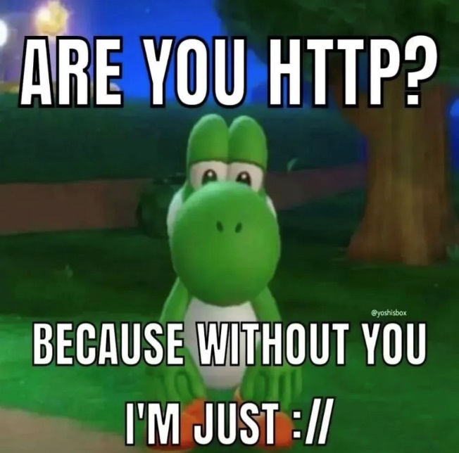
Announcements
Wireshark Lab 1 due on Wednesday @ 11:59 PM
ACM and AWC will be hosting a career fair prep workshop tomorrow at 5:00 PM
Practice Interviews
Career fair opportunities and companies
How to prepare
Casual resume review

Slide 3

Application Layer
OSI Model
Presentation Layer
*
Application Layer
Session Layer
*
Messages from Network Applications
Transport Layer
Network Layer
Physical Layer
Data Link Layer
Bits being transmitted over a copper wire
Physical Layer
*In the textbook, they condense it to a 5-layer model, but 7 layers is what is most used

Slide 4
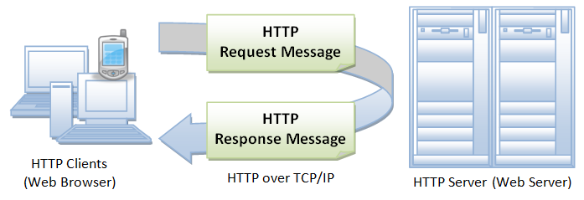
HTTP Requests in Python

Slide 5


DNS
Humans browse the web using hostnames
(They need English)
Computers understand numbers
(They need IP addresses)
DNS
153.90.127.197
Domain Name System (DNS) is a database of mappings between hostnames and IP addresses

Slide 6






DNS Architecture
DNS is a distributed, hierarchical database (no DNS server has all the records!)
Hierarchy consists of different types of DNS servers:
root DNS server
Authoritative DNS servers- Organization’s own DNS with up-to-date records
.com TLD DNS server
.edu TLD DNS server
Top-level domain (TLD) servers- responsible for keeping IP addresses for authoritative DNS servers for each top-level domain (.com, .edu, .jp, etc)
facebook.com DNS
amazon.com DNS
montana.edu DNS
harvard.edu DNS
Root DNS servers- responsible for maintaining IP addresses for TLD servers

Slide 7



DNS Architecture
DNS is a distributed, hierarchical database (no DNS server has all the records!)
root DNS server
Hostname | IP Address
marketplace.facebook.com | 192.23.54.221
gaming.facebook.com | 192.23.54.219
facebook.com | 192.23.54.222
friends.facebook.com | 192.23.54.216
… | …
.com TLD DNS server
.edu TLD DNS server
facebook.com DNS
amazon.com DNS
montana.edu DNS
harvard.edu DNS
Authoritative DNS Server

Slide 8

DNS Architecture
DNS is a distributed, hierarchical database (no DNS server has all the records!)
root DNS server
Hostname | IP Address
google.com Auth. DNS | 77.87.124.3
facebook.com Auth. DNS | 192.23.54.22
amazon.com Auth DNS | 10.172.44.92
ebay.com Auth DNS | 192.7.66.111
… | …
.com TLD DNS server
.edu TLD DNS server
TLD DNS servers hold records for authoritative DNS server for a particular domain
facebook.com DNS
amazon.com DNS
montana.edu DNS
harvard.edu DNS

Slide 9

DNS Architecture
DNS is a distributed, hierarchical database (no DNS server has all the records!)
root DNS server
Hostname | IP Address
.com TLD DNS server | 21.220.198.29
.org TLD DNS server | 68.198.64.235
.edu TLD DNS server | 103.109.123.65
.gov TLD DNS server | 39.61.129.155
… | …
.com TLD DNS server
.edu TLD DNS server
The root DNS server holds records for TLD DNS servers for all top-level domains
facebook.com DNS
amazon.com DNS
montana.edu DNS
harvard.edu DNS

Slide 10
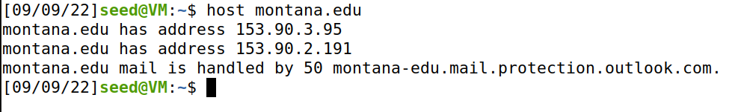
DNS Commands
DNS services
Hostname to IP address translation
host montana.edu
Hostname to IPv6 address translation
host -t AAAA montana.edu
Host aliasing
host -t CNAME img.huffingtonpost.com
Mail server aliasing
host -t MX montana.edu
Load distribution
host huffpost.com | grep "address" | sed -n -e 's/^.*address //p'
Redirection
Look up same host from servers in different regions
host google.com 8.8.8.8
153.90.3.95
(nslookup also works)

Slide 11

DNS Commands
DNS services
Hostname to IP address translation
host montana.edu
Hostname to IPv6 address translation
host -t AAAA montana.edu
Host aliasing
host -t CNAME img.huffingtonpost.com
Mail server aliasing
host -t MX montana.edu
Load distribution
host huffpost.com | grep "address" | sed -n -e 's/^.*address //p'
Redirection
Look up same host from servers in different regions
host google.com 8.8.8.8

Slide 12
DNS Commands
DNS services
Hostname to IP address translation
host montana.edu
Hostname to IPv6 address translation
host -t AAAA montana.edu
Host aliasing
host -t CNAME img.huffingtonpost.com
Mail server aliasing
host -t MX montana.edu
Load distribution
host huffpost.com | grep "address" | sed -n -e 's/^.*address //p'
Redirection
Look up same host from servers in different regions
host google.com 8.8.8.8

Slide 13
DNS Commands
DNS services
Hostname to IP address translation
host montana.edu
Hostname to IPv6 address translation
host -t AAAA montana.edu
Host aliasing
host -t CNAME img.huffingtonpost.com
Mail server aliasing
host -t MX montana.edu
Load distribution
host huffpost.com | grep "address" | sed -n -e 's/^.*address //p'
Redirection
Look up same host from servers in different regions
host google.com 8.8.8.8

Slide 14
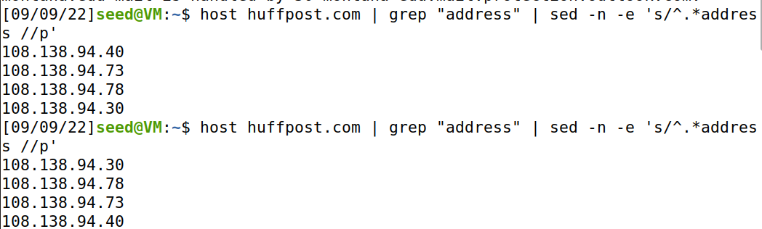
DNS Commands
DNS services
Hostname to IP address translation
host montana.edu
Hostname to IPv6 address translation
host -t AAAA montana.edu
Host aliasing
host -t CNAME img.huffingtonpost.com
Mail server aliasing
host -t MX montana.edu
Load distribution
host huffpost.com | grep "address" | sed -n -e 's/^.*address //p'
Redirection
Look up same host from servers in different regions
host google.com 8.8.8.8
Rotation!

Slide 15
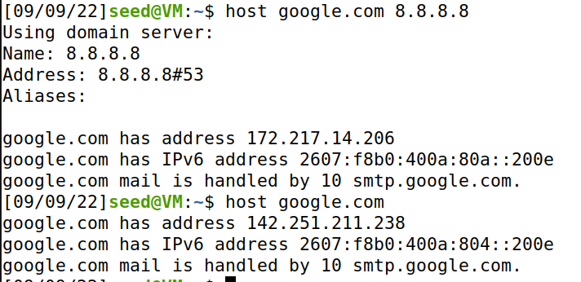

DNS Commands
DNS services
Hostname to IP address translation
host montana.edu
Hostname to IPv6 address translation
host -t AAAA montana.edu
Host aliasing
host -t CNAME img.huffingtonpost.com
Mail server aliasing
host -t MX montana.edu
Load distribution
host huffpost.com | grep "address" | sed -n -e 's/^.*address //p'
Redirection
Look up same host from servers in different regions
host google.com 8.8.8.8

Slide 16
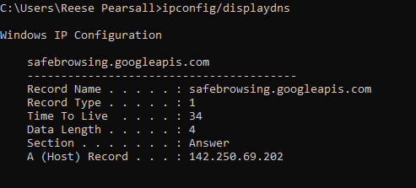
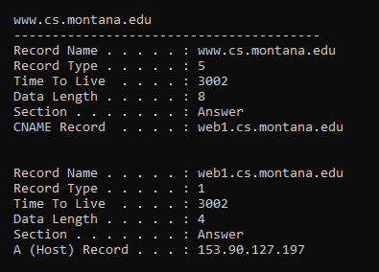
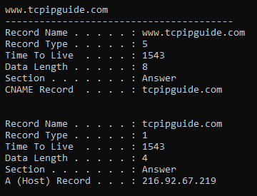
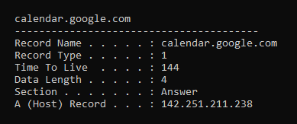
DNS Commands
DNS services
Hostname to IP address translation
host montana.edu
Hostname to IPv6 address translation
host -t AAAA montana.edu
Host aliasing
host -t CNAME img.huffingtonpost.com
Mail server aliasing
host -t MX montana.edu
Load distribution
host huffpost.com | grep "address" | sed -n -e 's/^.*address //p'
Redirection
Look up same host from servers in different regions
host google.com 8.8.8.8
See cached DNS entries on computer
ipconfig/displaydns

Slide 17
DNS Traffic in Wireshark

Slide 18
SMTP
Simple Mail Transfer Protocol (SMTP) is the protocol used for sending e-mails from one server to another

Slide 19

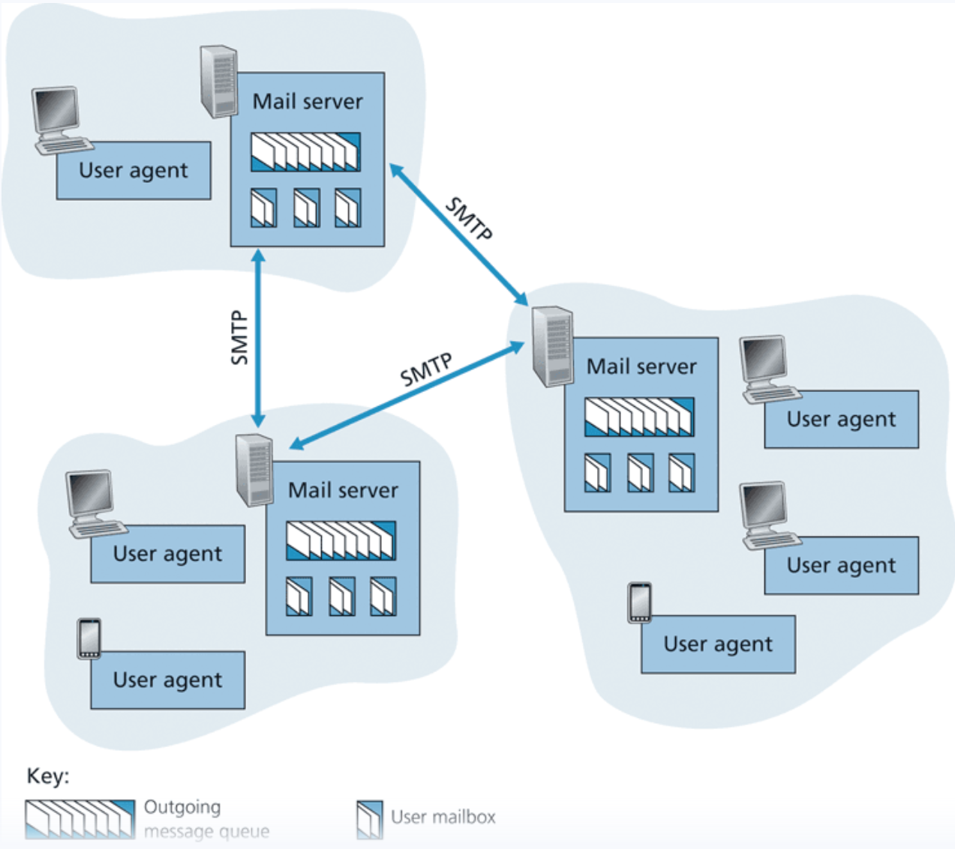


SMTP
Simple Mail Transfer Protocol (SMTP) is the protocol used for sending e-mails from one server to another

Slide 20
SMTP
Simple Mail Transfer Protocol (SMTP) is the protocol used for sending e-mails from one server to another
Each recipient has a mailbox location in one of the mail servers

Slide 21
SMTP
Simple Mail Transfer Protocol (SMTP) is the protocol used for sending e-mails from one server to another
Each recipient has a mailbox location in one of the mail servers
Messages are put in an outgoing message queue when they are sent
SMTP uses TCP to ensure reliable data transfer of emails

Slide 22



SMTP
Simple Mail Transfer Protocol (SMTP) is the protocol used for sending e-mails from one server to another

Slide 23
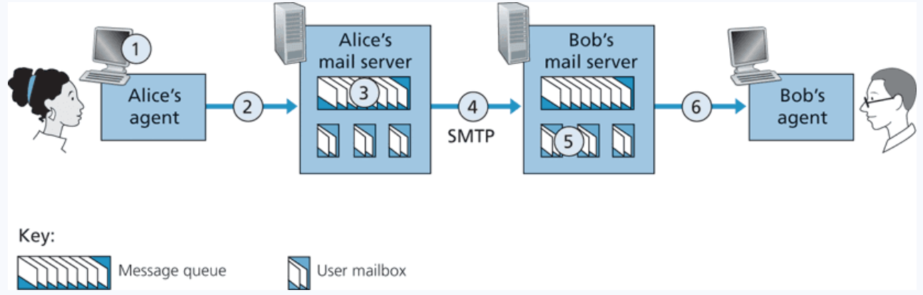
SMTP
1. Alice invokes her user agent for e-mail, provides Bob’s e-mail address (for example, bob@someschool.edu), composes a message, and instructs the user agent to send the message.

Slide 24
SMTP
1. Alice invokes her user agent for e-mail, provides Bob’s e-mail address (for example, bob@someschool.edu), composes a message, and instructs the user agent to send the message.
2. Alice’s user agent sends the message to her mail server, where it is placed in a message queue.

Slide 25
SMTP
1. Alice invokes her user agent for e-mail, provides Bob’s e-mail address (for example, bob@someschool.edu), composes a message, and instructs the user agent to send the message.
2. Alice’s user agent sends the message to her mail server, where it is placed in a message queue.
3. The client side of SMTP, running on Alice’s mail server, sees the message in the message queue. It opens a TCP connection to an SMTP server, running on Bob’s mail server.

Slide 26
SMTP
1. Alice invokes her user agent for e-mail, provides Bob’s e-mail address (for example, bob@someschool.edu), composes a message, and instructs the user agent to send the message.
2. Alice’s user agent sends the message to her mail server, where it is placed in a message queue.
3. The client side of SMTP, running on Alice’s mail server, sees the message in the message queue. It opens a TCP connection to an SMTP server, running on Bob’s mail server.
4. After some initial SMTP handshaking, the SMTP client sends Alice’s message into the TCP connection.

Slide 27
SMTP
1. Alice invokes her user agent for e-mail, provides Bob’s e-mail address (for example, bob@someschool.edu), composes a message, and instructs the user agent to send the message.
2. Alice’s user agent sends the message to her mail server, where it is placed in a message queue.
3. The client side of SMTP, running on Alice’s mail server, sees the message in the message queue. It opens a TCP connection to an SMTP server, running on Bob’s mail server.
4. After some initial SMTP handshaking, the SMTP client sends Alice’s message into the TCP connection.
5. At Bob’s mail server, the server side of SMTP receives the message. Bob’s mail server then places the message in Bob’s mailbox.

Slide 28
SMTP
1. Alice invokes her user agent for e-mail, provides Bob’s e-mail address (for example, bob@someschool.edu), composes a message, and instructs the user agent to send the message.
2. Alice’s user agent sends the message to her mail server, where it is placed in a message queue.
3. The client side of SMTP, running on Alice’s mail server, sees the message in the message queue. It opens a TCP connection to an SMTP server, running on Bob’s mail server.
4. After some initial SMTP handshaking, the SMTP client sends Alice’s message into the TCP connection.
5. At Bob’s mail server, the server side of SMTP receives the message. Bob’s mail server then places the message in Bob’s mailbox.
6. Bob invokes his user agent to read the message at his convenience.

Slide 29
SMTP
Simple Mail Transfer Protocol (SMTP) is the protocol used for sending e-mails from one server to another
This is not a protocol for retrieving emails
STMP uses TCP for the end-to-end delivery (DIRECT)
(PORT 25)

Slide 30
SMTP
POP3 (post office protocol) or IMAP (internet message access protocol) are used to retrieve emails from mail servers.

Slide 31
SMTP
POP3 (post office protocol) or IMAP (internet message access protocol) are used to retrieve emails from mail servers.
POP3 deletes the email of the web server, IMAP maintains a copy to synchronize across multiple devices

Slide 32
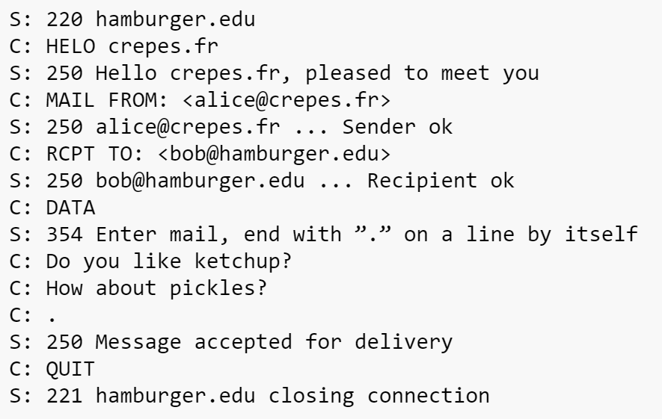






SMTP
SMTP Handshake + Message exchange format
(Very verbose)

Slide 33
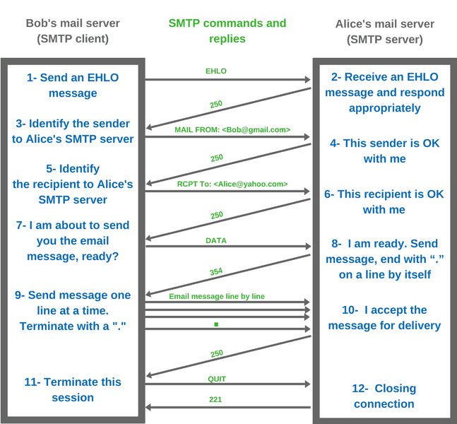

Slide 34
SMTP
Simple Mail Transfer Protocol (SMTP) is the protocol used for sending e-mails from one server to another asynchronously
Ports 25 is reserved for SMTP traffic (and also port 587 & 465)

Slide 35
SMTP Traffic in Wireshark

Slide 36

FTP
File Transfer Protocol (FTP)- protocol used for transferring files from server to client
FTP procedure:
FTP client contacts FTP server at port 21, using TCP
Client authorized over control connection
Client browses remote directory, sends commands over control connection
When server receives file transfer command, server opens 2nd TCP data connection (for file) to client
After transferring one file, server closes data connection
TCP control connection,
server port 21
FTP
client
TCP data connection,
server port 20
FTP
server
FTP communicates over two connections
Port 21 for control information
Port 20 for data
Differences from HTTP
Control communication “out-of-band”
Server maintains per client state: authentication, current directory
Why use a separate control connection?

Slide 37
WINSCP

