Slide 1

CSCI 466: Networks
Pipelining
Reese Pearsall
Fall 2023
https://www.cs.montana.edu/pearsall/classes/fall2023/466/main.html
*All images are stolen from the internet

Slide 2
Announcements
PA 2 Posted. Due Wednesday October 18th

Slide 3

Application Layer
OSI Model
Presentation Layer
*
Application Layer
Session Layer
*
Messages from Network Applications
Transport Layer
Network Layer
Physical Layer
Data Link Layer
Bits being transmitted over some medium
Physical Layer
*In the textbook, they condense it to a 5-layer model, but 7 layers is what is most used

Slide 4
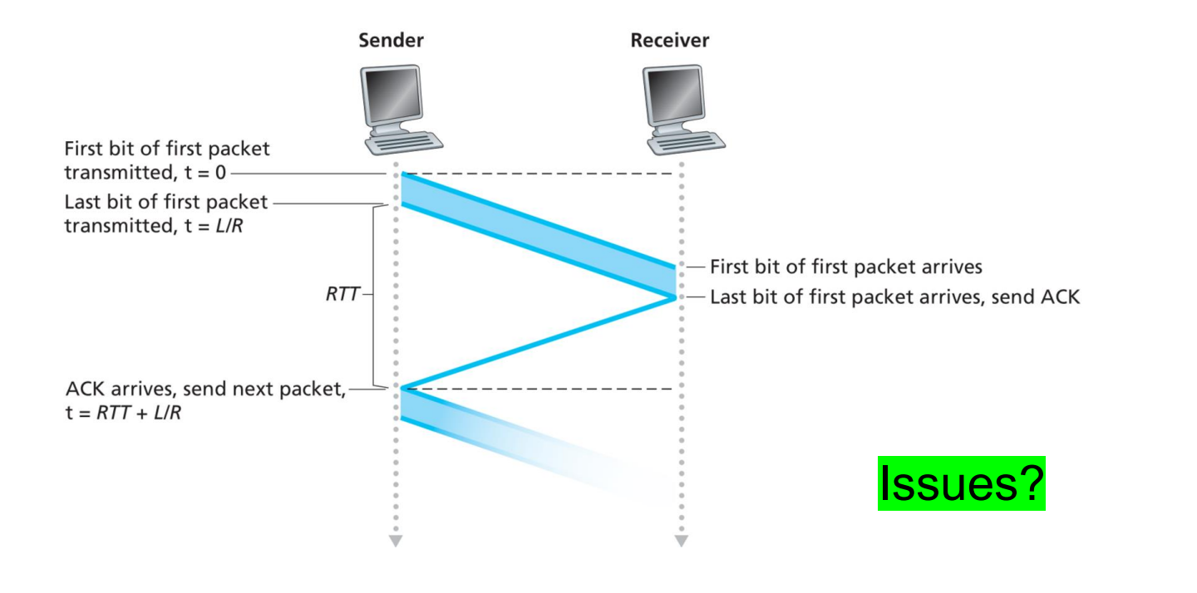
So far, our reliable data transfer protocols have been stop-and-wait

Slide 5
So far, our reliable data transfer protocols have been stop-and-wait
Waiting to receive an ACK is inefficient
We spend a lot of time waiting

Slide 6
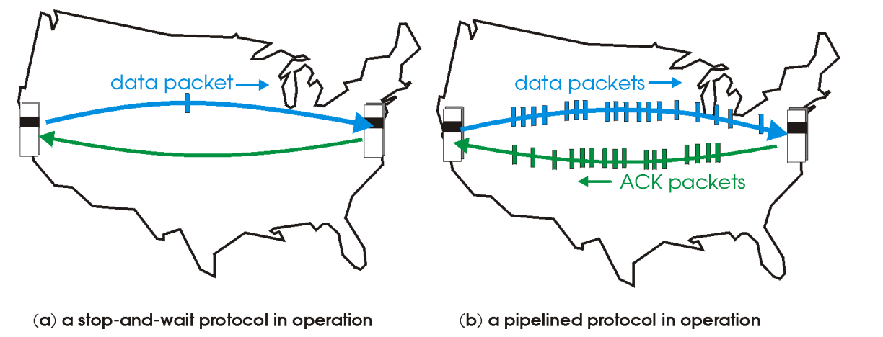
Pipelining: sender allows multiple, “in-flight”, yet-to-be acknowledged packets

Slide 7



Pipelining: sender allows multiple, “in-flight”, yet-to-be acknowledged packets
5
4
8
7
6
3
1
2
1 | 2 | 3 | 4 | 5 | 6 | 7 | 8
1 | 2 | 3 | 4 | 5 | 6 | 7 | 8
Consequences:
Need to use a wider range of sequence numbers

Slide 8

Pipelining: sender allows multiple, “in-flight”, yet-to-be acknowledged packets
5
4
8
7
6
3
1
2
1 | 2 | 3 | 4 | 5 | 6 | 7 | 8
1 | 2 | 3 | 4 | 5 | 6 | 7 | 8
Consequences:
Need to use a wider range of sequence numbers
Sender and receiver may need to buffer more than one packet

Slide 9
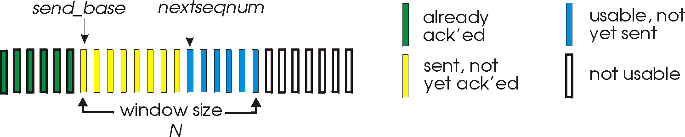
Go-Back-N: sender
sender: “window” of up to N, consecutive transmitted but unACKed pkts
k-bit seq # in pkt header
cumulative ACK: ACK(n): ACKs all packets up to, including seq # n
on receiving ACK(n): move window forward to begin at n+1
timer for oldest in-flight packet
timeout(n): retransmit packet n and all higher seq # packets in window

Slide 10
Go-Back-N: sender
(Why not have an infinite window size?)
sender: “window” of up to N, consecutive transmitted but unACKed pkts
k-bit seq # in pkt header
cumulative ACK: ACK(n): ACKs all packets up to, including seq # n
on receiving ACK(n): move window forward to begin at n+1
timer for oldest in-flight packet
timeout(n): retransmit packet n and all higher seq # packets in window

Slide 11
Go-Back-N: receiver
ACK-only: always send ACK for correctly-received packet so far, with highest in-order seq #
may generate duplicate ACKs
need only remember rcv_base
on receipt of out-of-order packet:
can discard (don’t buffer) or buffer: an implementation decision
re-ACK pkt with highest in-order seq #
Receiver view of sequence number space:
received and ACKed
…
…
Out-of-order: received but not ACKed
rcv_base
Not received

Slide 12

sender window (N=4)
sender
receiver
0 1 2 3 4 5 6 7 8
send pkt0
send pkt1
send pkt2
send pkt3
(wait)
0 1 2 3 4 5 6 7 8
receive pkt0, send ack0
receive pkt1, send ack1
receive pkt3, discard,
(re)send ack1
0 1 2 3 4 5 6 7 8
X
0 1 2 3 4 5 6 7 8
loss
0 1 2 3 4 5 6 7 8
rcv ack0, send pkt4
0 1 2 3 4 5 6 7 8
rcv ack1, send pkt5
receive pkt4, discard,
(re)send ack1
ignore duplicate ACK
receive pkt5, discard,
(re)send ack1
pkt 2 timeout
0 1 2 3 4 5 6 7 8
send pkt2
send pkt3
send pkt4
send pkt5
0 1 2 3 4 5 6 7 8
0 1 2 3 4 5 6 7 8
rcv pkt2, deliver, send ack2
rcv pkt3, deliver, send ack3
rcv pkt4, deliver, send ack4
rcv pkt5, deliver, send ack5
0 1 2 3 4 5 6 7 8

Slide 13
https://www2.tkn.tu-berlin.de/teaching/rn/animations/gbn_sr/

Slide 14
Selective repeat: the approach
pipelining: multiple packets in flight
receiver individually ACKs all correctly received packets
buffers packets, as needed, for in-order delivery to upper layer
sender:
maintains (conceptually) a timer for each unACKed pkt
timeout: retransmits single unACKed packet associated with timeout
maintains (conceptually) “window” over N consecutive seq #s
limits pipelined, “in flight” packets to be within this window

Slide 15
https://www2.tkn.tu-berlin.de/teaching/rn/animations/gbn_sr/

Slide 16
Selective repeat: sender and receiver
sender
receiver
data from above:
if next available seq # in window, send packet
timeout(n):
resend packet n, restart timer
ACK(n) in [sendbase,sendbase+N-1]:
mark packet n as received
if n smallest unACKed packet, advance window base to next unACKed seq #
packet n in [rcvbase, rcvbase+N-1]
send ACK(n)
out-of-order: buffer
in-order: deliver (also deliver buffered, in-order packets), advance window to next not-yet-received packet
packet n in [rcvbase-N,rcvbase-1]
ACK(n)
otherwise:
ignore

Slide 17
Selective Repeat in action
sender window (N=4)
sender
receiver
0 1 2 3 4 5 6 7 8
send pkt0
send pkt1
send pkt2
send pkt3
(wait)
0 1 2 3 4 5 6 7 8
receive pkt0, send ack0
receive pkt1, send ack1
receive pkt3, buffer,
send ack3
0 1 2 3 4 5 6 7 8
X
0 1 2 3 4 5 6 7 8
loss
0 1 2 3 4 5 6 7 8
rcv ack0, send pkt4
0 1 2 3 4 5 6 7 8
rcv ack1, send pkt5
receive pkt4, buffer,
send ack4
record ack3 arrived
receive pkt5, buffer,
send ack5
pkt 2 timeout
0 1 2 3 4 5 6 7 8
send pkt2
(but not 3,4,5)
0 1 2 3 4 5 6 7 8
0 1 2 3 4 5 6 7 8
rcv pkt2; deliver pkt2,
pkt3, pkt4, pkt5; send ack2
0 1 2 3 4 5 6 7 8
Q: what happens when ack2 arrives?

Slide 18
Selective repeat: a dilemma!
sender window
(after receipt)
receiver window
(after receipt)
0 1 2 3 0 1 2
pkt0
0 1 2 3 0 1 2
pkt1
0 1 2 3 0 1 2
0 1 2 3 0 1 2
pkt2
0 1 2 3 0 1 2
example:
seq #s: 0, 1, 2, 3 (base 4 counting)
window size=3
0 1 2 3 0 1 2
0 1 2 3 0 1 2
pkt3
X
0 1 2 3 0 1 2
pkt0
will accept packet
with seq number 0
(a) no problem
0 1 2 3 0 1 2
pkt0
0 1 2 3 0 1 2
pkt1
0 1 2 3 0 1 2
0 1 2 3 0 1 2
pkt2
X
0 1 2 3 0 1 2
X
0 1 2 3 0 1 2
X
timeout
retransmit pkt0
0 1 2 3 0 1 2
pkt0
will accept packet
with seq number 0
(b) oops!

Slide 19
Selective repeat: a dilemma!
sender window
(after receipt)
receiver window
(after receipt)
0 1 2 3 0 1 2
pkt0
0 1 2 3 0 1 2
pkt1
0 1 2 3 0 1 2
0 1 2 3 0 1 2
pkt2
0 1 2 3 0 1 2
example:
seq #s: 0, 1, 2, 3 (base 4 counting)
window size=3
0 1 2 3 0 1 2
0 1 2 3 0 1 2
pkt3
X
0 1 2 3 0 1 2
receiver can’t see sender side
receiver behavior identical in both cases!
something’s (very) wrong!
pkt0
will accept packet
with seq number 0
(a) no problem
Q: what relationship is needed between sequence # size and window size to avoid problem in scenario (b)?
pkt0
0 1 2 3 0 1 2
0 1 2 3 0 1 2
pkt1
0 1 2 3 0 1 2
0 1 2 3 0 1 2
pkt2
X
0 1 2 3 0 1 2
X
0 1 2 3 0 1 2
X
timeout
retransmit pkt0
0 1 2 3 0 1 2
pkt0
will accept packet
with seq number 0

Slide 20
Transport Layer
RDT Principles
Checksum- Used to detect bit errors in transmitted packets

Slide 21
Transport Layer
RDT Principles
Checksum- Used to detect bit errors in transmitted packets
Timer- Used to timeout/retransmit a packet, possibly because the packet (or its ACK) was lost within a channel

Slide 22
Transport Layer
RDT Principles
Checksum- Used to detect bit errors in transmitted packets
Timer- Used to timeout/retransmit a packet, possibly because the packet (or its ACK) was lost within a channel
Sequence Number- Used for sequential numbering of packets of data flowing form sender to receiver. Gaps in sequence number of packets allow the receiver to detect a lost or duplicate packet

Slide 23
Transport Layer
RDT Principles
Checksum- Used to detect bit errors in transmitted packets
Timer- Used to timeout/retransmit a packet, possibly because the packet (or its ACK) was lost within a channel
Sequence Number- Used for sequential numbering of packets of data flowing form sender to receiver. Gaps in sequence number of packets allow the receiver to detect a lost or duplicate packet
Acknowledgement- Used by the receiver to tell the sender that a packet or set of packets has been received correctly. ACKs will typically carry the sequence # of the packet being acknowledged

Slide 24
Transport Layer
RDT Principles
Checksum- Used to detect bit errors in transmitted packets
Timer- Used to timeout/retransmit a packet, possibly because the packet (or its ACK) was lost within a channel
Sequence Number- Used for sequential numbering of packets of data flowing form sender to receiver. Gaps in sequence number of packets allow the receiver to detect a lost or duplicate packet
Acknowledgement- Used by the receiver to tell the sender that a packet or set of packets has been received correctly. ACKs will typically carry the sequence # of the packet being acknowledged
Negative Acknowledgement- Used by the receiver to tell the sender that a packet has not been received correctly. Negative acknowledgements will typically carry the sequence number of the packet that was not received correctly

Slide 25
Transport Layer
RDT Principles
Checksum- Used to detect bit errors in transmitted packets
Timer- Used to timeout/retransmit a packet, possibly because the packet (or its ACK) was lost within a channel
Sequence Number- Used for sequential numbering of packets of data flowing form sender to receiver. Gaps in sequence number of packets allow the receiver to detect a lost or duplicate packet
Acknowledgement- Used by the receiver to tell the sender that a packet or set of packets has been received correctly. ACKs will typically carry the sequence # of the packet being acknowledged
Negative Acknowledgement- Used by the receiver to tell the sender that a packet has not been received correctly. Negative acknowledgements will typically carry the sequence number of the packet that was not received correctly
Window, pipelining- The sender may be restricted to sending only packets with sequence numbers that fall within a given range. By allowing multiple packets to be transmitted but not yet acknowledged, sender utilization can be increased over a stop-and-wait mode of operation

