Slide 1

CSCI 466: Networks
UDP and TCP
Reese Pearsall
Fall 2023
https://www.cs.montana.edu/pearsall/classes/fall2023/466/main.html
*All images are stolen from the internet

Slide 2
Announcements
PA 2 Posted. Due Wednesday October 18th

Slide 3

Application Layer
OSI Model
Presentation Layer
*
Application Layer
Session Layer
*
Messages from Network Applications
Transport Layer
Network Layer
Physical Layer
Data Link Layer
Bits being transmitted over some medium
Physical Layer
*In the textbook, they condense it to a 5-layer model, but 7 layers is what is most used

Slide 4
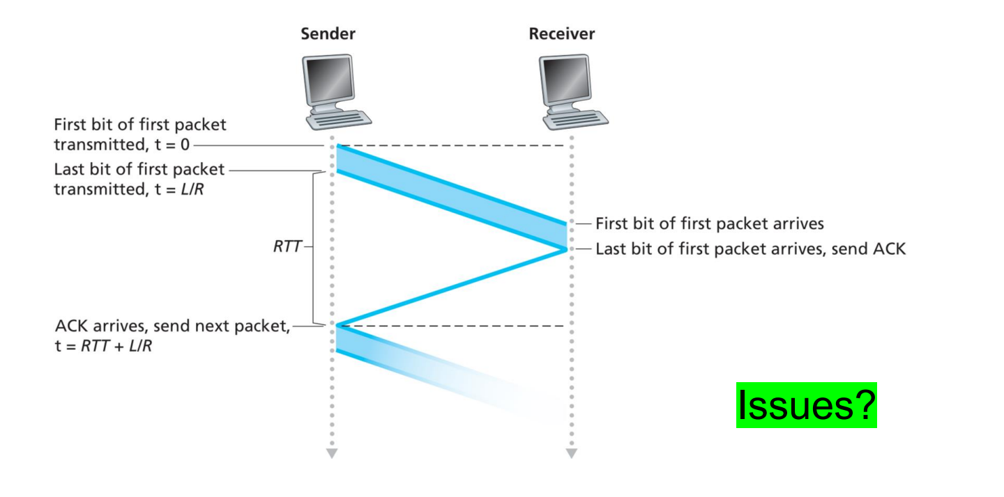
So far, our reliable data transfer protocols have been stop-and-wait

Slide 5
So far, our reliable data transfer protocols have been stop-and-wait
Waiting to receive an ACK is inefficient
We spend a lot of time waiting

Slide 6
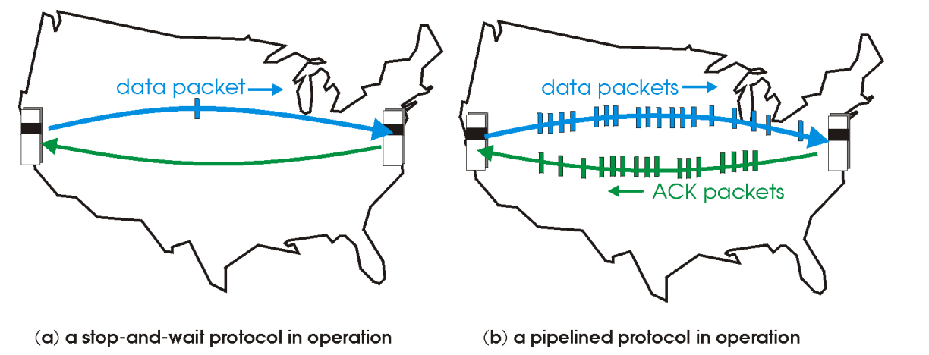
Pipelining: sender allows multiple, “in-flight”, yet-to-be acknowledged packets

Slide 7



Pipelining: sender allows multiple, “in-flight”, yet-to-be acknowledged packets
5
4
8
7
6
3
1
2
1 | 2 | 3 | 4 | 5 | 6 | 7 | 8
1 | 2 | 3 | 4 | 5 | 6 | 7 | 8
Consequences:
Need to use a wider range of sequence numbers

Slide 8

Pipelining: sender allows multiple, “in-flight”, yet-to-be acknowledged packets
5
4
8
7
6
3
1
2
1 | 2 | 3 | 4 | 5 | 6 | 7 | 8
1 | 2 | 3 | 4 | 5 | 6 | 7 | 8
Consequences:
Need to use a wider range of sequence numbers
Sender and receiver may need to buffer more than one packet

Slide 9
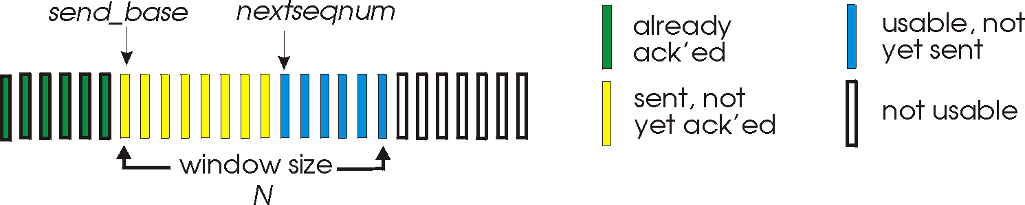
Go-Back-N: sender
sender: “window” of up to N, consecutive transmitted but unACKed pkts
k-bit seq # in pkt header
cumulative ACK: ACK(n): ACKs all packets up to, including seq # n
on receiving ACK(n): move window forward to begin at n+1
timer for oldest in-flight packet
timeout(n): retransmit packet n and all higher seq # packets in window

Slide 10
Go-Back-N: sender
(Why not have an infinite window size?)
sender: “window” of up to N, consecutive transmitted but unACKed pkts
k-bit seq # in pkt header
cumulative ACK: ACK(n): ACKs all packets up to, including seq # n
on receiving ACK(n): move window forward to begin at n+1
timer for oldest in-flight packet
timeout(n): retransmit packet n and all higher seq # packets in window

Slide 11
Go-Back-N: receiver
ACK-only: always send ACK for correctly-received packet so far, with highest in-order seq #
may generate duplicate ACKs
need only remember rcv_base
on receipt of out-of-order packet:
can discard (don’t buffer) or buffer: an implementation decision
re-ACK pkt with highest in-order seq #
Receiver view of sequence number space:
received and ACKed
…
…
Out-of-order: received but not ACKed
rcv_base
Not received

Slide 12

sender window (N=4)
sender
receiver
0 1 2 3 4 5 6 7 8
send pkt0
send pkt1
send pkt2
send pkt3
(wait)
0 1 2 3 4 5 6 7 8
receive pkt0, send ack0
receive pkt1, send ack1
receive pkt3, discard,
(re)send ack1
0 1 2 3 4 5 6 7 8
X
0 1 2 3 4 5 6 7 8
loss
0 1 2 3 4 5 6 7 8
rcv ack0, send pkt4
0 1 2 3 4 5 6 7 8
rcv ack1, send pkt5
receive pkt4, discard,
(re)send ack1
ignore duplicate ACK
receive pkt5, discard,
(re)send ack1
pkt 2 timeout
0 1 2 3 4 5 6 7 8
send pkt2
send pkt3
send pkt4
send pkt5
0 1 2 3 4 5 6 7 8
0 1 2 3 4 5 6 7 8
rcv pkt2, deliver, send ack2
rcv pkt3, deliver, send ack3
rcv pkt4, deliver, send ack4
rcv pkt5, deliver, send ack5
0 1 2 3 4 5 6 7 8

Slide 13
https://www2.tkn.tu-berlin.de/teaching/rn/animations/gbn_sr/

Slide 14
Selective repeat: the approach
pipelining: multiple packets in flight
receiver individually ACKs all correctly received packets
buffers packets, as needed, for in-order delivery to upper layer
sender:
maintains (conceptually) a timer for each unACKed pkt
timeout: retransmits single unACKed packet associated with timeout
maintains (conceptually) “window” over N consecutive seq #s
limits pipelined, “in flight” packets to be within this window

Slide 15
https://www2.tkn.tu-berlin.de/teaching/rn/animations/gbn_sr/

Slide 16
Selective repeat: sender and receiver
sender
receiver
data from above:
if next available seq # in window, send packet
timeout(n):
resend packet n, restart timer
ACK(n) in [sendbase,sendbase+N-1]:
mark packet n as received
if n smallest unACKed packet, advance window base to next unACKed seq #
packet n in [rcvbase, rcvbase+N-1]
send ACK(n)
out-of-order: buffer
in-order: deliver (also deliver buffered, in-order packets), advance window to next not-yet-received packet
packet n in [rcvbase-N,rcvbase-1]
ACK(n)
otherwise:
ignore

Slide 17
Selective Repeat in action
sender window (N=4)
sender
receiver
0 1 2 3 4 5 6 7 8
send pkt0
send pkt1
send pkt2
send pkt3
(wait)
0 1 2 3 4 5 6 7 8
receive pkt0, send ack0
receive pkt1, send ack1
receive pkt3, buffer,
send ack3
0 1 2 3 4 5 6 7 8
X
0 1 2 3 4 5 6 7 8
loss
0 1 2 3 4 5 6 7 8
rcv ack0, send pkt4
0 1 2 3 4 5 6 7 8
rcv ack1, send pkt5
receive pkt4, buffer,
send ack4
record ack3 arrived
receive pkt5, buffer,
send ack5
pkt 2 timeout
0 1 2 3 4 5 6 7 8
send pkt2
(but not 3,4,5)
0 1 2 3 4 5 6 7 8
0 1 2 3 4 5 6 7 8
rcv pkt2; deliver pkt2,
pkt3, pkt4, pkt5; send ack2
0 1 2 3 4 5 6 7 8
Q: what happens when ack2 arrives?

Slide 18
Selective repeat: a dilemma!
sender window
(after receipt)
receiver window
(after receipt)
0 1 2 3 0 1 2
pkt0
0 1 2 3 0 1 2
pkt1
0 1 2 3 0 1 2
0 1 2 3 0 1 2
pkt2
0 1 2 3 0 1 2
example:
seq #s: 0, 1, 2, 3 (base 4 counting)
window size=3
0 1 2 3 0 1 2
0 1 2 3 0 1 2
pkt3
X
0 1 2 3 0 1 2
pkt0
will accept packet
with seq number 0
(a) no problem
0 1 2 3 0 1 2
pkt0
0 1 2 3 0 1 2
pkt1
0 1 2 3 0 1 2
0 1 2 3 0 1 2
pkt2
X
0 1 2 3 0 1 2
X
0 1 2 3 0 1 2
X
timeout
retransmit pkt0
0 1 2 3 0 1 2
pkt0
will accept packet
with seq number 0
(b) oops!

Slide 19
Selective repeat: a dilemma!
sender window
(after receipt)
receiver window
(after receipt)
0 1 2 3 0 1 2
pkt0
0 1 2 3 0 1 2
pkt1
0 1 2 3 0 1 2
0 1 2 3 0 1 2
pkt2
0 1 2 3 0 1 2
example:
seq #s: 0, 1, 2, 3 (base 4 counting)
window size=3
0 1 2 3 0 1 2
0 1 2 3 0 1 2
pkt3
X
0 1 2 3 0 1 2
receiver can’t see sender side
receiver behavior identical in both cases!
something’s (very) wrong!
pkt0
will accept packet
with seq number 0
(a) no problem
Q: what relationship is needed between sequence # size and window size to avoid problem in scenario (b)?
pkt0
0 1 2 3 0 1 2
0 1 2 3 0 1 2
pkt1
0 1 2 3 0 1 2
0 1 2 3 0 1 2
pkt2
X
0 1 2 3 0 1 2
X
0 1 2 3 0 1 2
X
timeout
retransmit pkt0
0 1 2 3 0 1 2
pkt0
will accept packet
with seq number 0

Slide 20
Transport Layer
RDT Principles
Checksum- Used to detect bit errors in transmitted packets

Slide 21
Transport Layer
RDT Principles
Checksum- Used to detect bit errors in transmitted packets
Timer- Used to timeout/retransmit a packet, possibly because the packet (or its ACK) was lost within a channel

Slide 22
Transport Layer
RDT Principles
Checksum- Used to detect bit errors in transmitted packets
Timer- Used to timeout/retransmit a packet, possibly because the packet (or its ACK) was lost within a channel
Sequence Number- Used for sequential numbering of packets of data flowing form sender to receiver. Gaps in sequence number of packets allow the receiver to detect a lost or duplicate packet

Slide 23
Transport Layer
RDT Principles
Checksum- Used to detect bit errors in transmitted packets
Timer- Used to timeout/retransmit a packet, possibly because the packet (or its ACK) was lost within a channel
Sequence Number- Used for sequential numbering of packets of data flowing form sender to receiver. Gaps in sequence number of packets allow the receiver to detect a lost or duplicate packet
Acknowledgement- Used by the receiver to tell the sender that a packet or set of packets has been received correctly. ACKs will typically carry the sequence # of the packet being acknowledged

Slide 24
Transport Layer
RDT Principles
Checksum- Used to detect bit errors in transmitted packets
Timer- Used to timeout/retransmit a packet, possibly because the packet (or its ACK) was lost within a channel
Sequence Number- Used for sequential numbering of packets of data flowing form sender to receiver. Gaps in sequence number of packets allow the receiver to detect a lost or duplicate packet
Acknowledgement- Used by the receiver to tell the sender that a packet or set of packets has been received correctly. ACKs will typically carry the sequence # of the packet being acknowledged
Negative Acknowledgement- Used by the receiver to tell the sender that a packet has not been received correctly. Negative acknowledgements will typically carry the sequence number of the packet that was not received correctly

Slide 25
Transport Layer
RDT Principles
Checksum- Used to detect bit errors in transmitted packets
Timer- Used to timeout/retransmit a packet, possibly because the packet (or its ACK) was lost within a channel
Sequence Number- Used for sequential numbering of packets of data flowing form sender to receiver. Gaps in sequence number of packets allow the receiver to detect a lost or duplicate packet
Acknowledgement- Used by the receiver to tell the sender that a packet or set of packets has been received correctly. ACKs will typically carry the sequence # of the packet being acknowledged
Negative Acknowledgement- Used by the receiver to tell the sender that a packet has not been received correctly. Negative acknowledgements will typically carry the sequence number of the packet that was not received correctly
Window, pipelining- The sender may be restricted to sending only packets with sequence numbers that fall within a given range. By allowing multiple packets to be transmitted but not yet acknowledged, sender utilization can be increased over a stop-and-wait mode of operation

Slide 26
Transport Layer
Transport Layer Protocols:
Transmission Control Protocol (TCP)
User Datagram Protocol (UDP)

Slide 27
Transport Layer
UDP
Why is there a UDP?
“no frills,” “bare bones” Internet transport protocol
“best effort” service, UDP segments may be:
lost
delivered out-of-order to app
no connection establishment (which can add RTT delay)
simple: no connection state at sender, receiver
small header size
no congestion control
UDP can blast away as fast as desired!
can function in the face of congestion
connectionless:
no handshaking between UDP sender, receiver
each UDP segment handled independently of others

Slide 28
Transport Layer
UDP
The UDP header is very small!! (4 bytes, 32 bits)
16 bits
16 bits
Source Port #
Dest. Port #
UDP Header
Length
Checksum
UDP Segment
Data (DNS Query, HTTP 3.0, DHCP)

Slide 29
Transport Layer
TCP
Connection oriented, point-to-point (1 to 1)
→ TCP Handshake must occur before data is being transmitted
Cumulative ACKs
Pipelining
TCP Congestion and flow control set window size
Flow controlled
Sender will not overwhelm receiver
Full-duplex service
A logical connection
Process A
Process B
TCP
TCP
Reliable, in order, data transfer

Slide 30
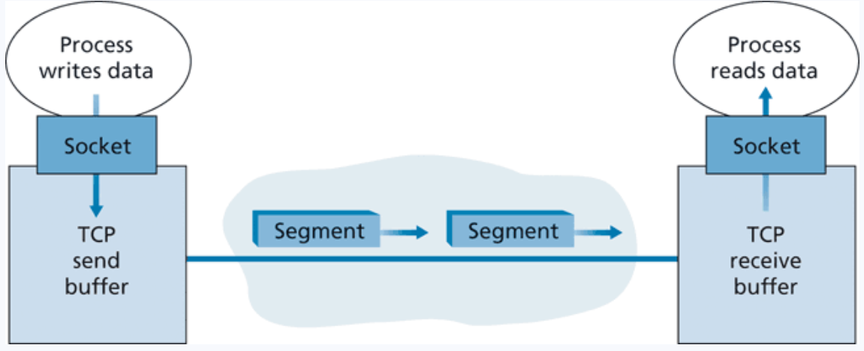

Transport Layer
TCP
The size of the segment is determined by the maximum segment size (MSS)
(Roughly 1500 bytes– size of a link layer frame)

Slide 31
Transport Layer
TCP Sequence Numbers
A TCP connection is transmitting a byte stream
Sequence numbers are based on how much data has been sent
Acknowledgement numbers are based on how much data has been successfully received

Slide 32
Transport Layer
TCP Sequence Numbers
A TCP connection is transmitting a byte stream
SEQ # = 1
Len: 669

Slide 33
Transport Layer
TCP Sequence Numbers
A TCP connection is transmitting a byte stream
SEQ # = 1
Len: 669
ACK # = 670

Slide 34
Transport Layer
TCP Sequence Numbers
A TCP connection is transmitting a byte stream
SEQ # = 1
Len: 669
ACK # = 670
SEQ # = 670
Len: 1460

Slide 35
Transport Layer
TCP Sequence Numbers
A TCP connection is transmitting a byte stream
SEQ # = 1
Len: 669
ACK # = 670
SEQ # = 670
Len: 1460
ACK # = 2130

Slide 36
Transport Layer
TCP Sequence Numbers
A TCP connection is transmitting a byte stream
ACK # = 2130

Slide 37
Transport Layer
TCP Sequence Numbers
A TCP connection is transmitting a byte stream
ACK # = 2130
SEQ # = 2130
Len: 1460

Slide 38
Transport Layer
TCP Sequence Numbers
A TCP connection is transmitting a byte stream
ACK # = 2130
SEQ # = 2130
Len: 1460
ACK # = 3590

Slide 39
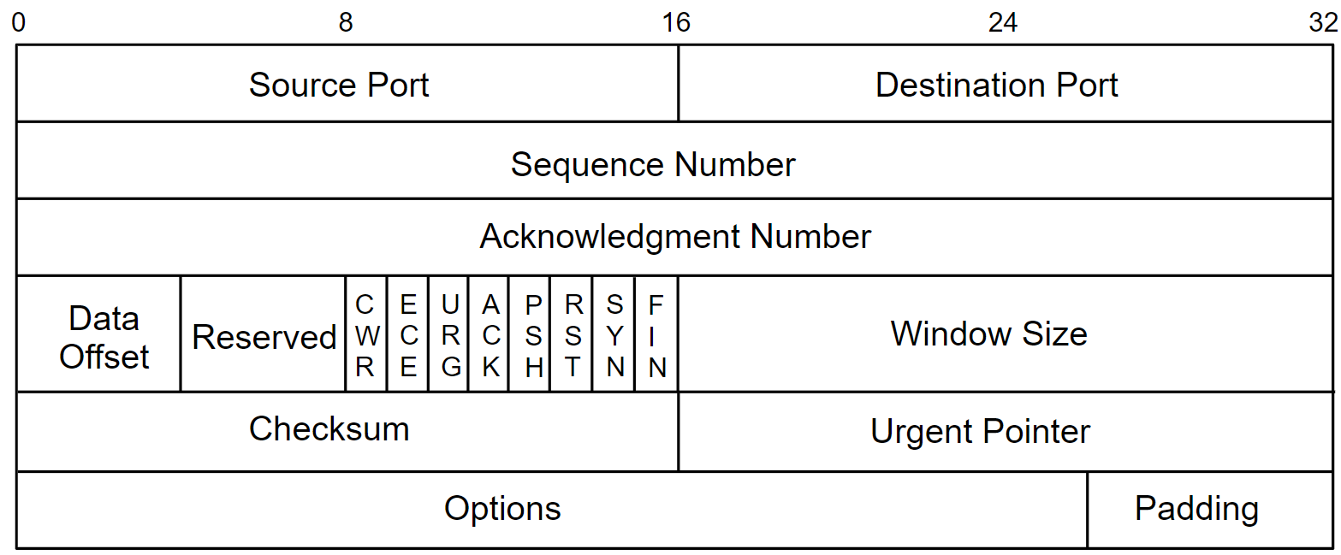
Transport Layer
TCP Sequence Numbers

