Slide 1

CSCI 466: Networks
UDP and TCP
Reese Pearsall
Fall 2023
https://www.cs.montana.edu/pearsall/classes/fall2023/466/main.html
*All images are stolen from the internet

Slide 2
Announcements
PA 2 Posted. Due Wednesday October 18th
Wireshark Lab 2 Posted. Due Friday October 13th

Slide 3
Sending objects through sockets example

Slide 4
PA2 Demo
(time.sleep)

Slide 5

Application Layer
OSI Model
Presentation Layer
*
Application Layer
Session Layer
*
Messages from Network Applications
Transport Layer
Network Layer
Physical Layer
Data Link Layer
Bits being transmitted over some medium
Physical Layer
*In the textbook, they condense it to a 5-layer model, but 7 layers is what is most used

Slide 6
Transport Layer
Transport Layer Protocols:
Transmission Control Protocol (TCP)
User Datagram Protocol (UDP)

Slide 7
Transport Layer
UDP
Why is there a UDP?
“no frills,” “bare bones” Internet transport protocol
“best effort” service, UDP segments may be:
lost
delivered out-of-order to app
no connection establishment (which can add RTT delay)
simple: no connection state at sender, receiver
small header size
no congestion control
UDP can blast away as fast as desired!
can function in the face of congestion
connectionless:
no handshaking between UDP sender, receiver
each UDP segment handled independently of others

Slide 8
Transport Layer
UDP
The UDP header is very small!! (8 bytes, 64 bits)
16 bits
16 bits
Source Port #
Dest. Port #
UDP Header
Length
Checksum
UDP Segment
Data (DNS Query, HTTP 3.0, DHCP)

Slide 9

Transport Layer
TCP
Connection oriented, point-to-point (1 to 1)
→ TCP Handshake must occur before data is being transmitted
Cumulative ACKs
Pipelining
TCP Congestion and flow control set window size
Flow controlled
Sender will not overwhelm receiver
Full-duplex service
A logical connection
Process A
Process B
TCP
TCP
Reliable, in order, data transfer

Slide 10
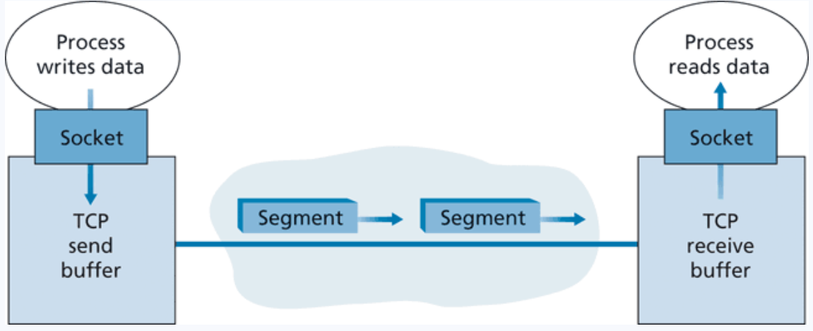

Transport Layer
TCP
The size of the segment is determined by the maximum segment size (MSS)
(Roughly 1500 bytes– size of a link layer frame)

Slide 11

Transport Layer
TCP Sequence Numbers
A TCP connection is transmitting a byte stream
Sequence numbers are based on how much data has been sent
Acknowledgement numbers are based on how much data has been successfully received

Slide 12
Transport Layer
TCP Sequence Numbers
A TCP connection is transmitting a byte stream
SEQ # = 1
Len: 669

Slide 13
Transport Layer
TCP Sequence Numbers
A TCP connection is transmitting a byte stream
SEQ # = 1
Len: 669
ACK # = 670

Slide 14
Transport Layer
TCP Sequence Numbers
A TCP connection is transmitting a byte stream
SEQ # = 1
Len: 669
ACK # = 670
SEQ # = 670
Len: 1460

Slide 15
Transport Layer
TCP Sequence Numbers
A TCP connection is transmitting a byte stream
SEQ # = 1
Len: 669
ACK # = 670
SEQ # = 670
Len: 1460
ACK # = 2130

Slide 16
Transport Layer
TCP Sequence Numbers
A TCP connection is transmitting a byte stream
ACK # = 2130

Slide 17
Transport Layer
TCP Sequence Numbers
A TCP connection is transmitting a byte stream
ACK # = 2130
SEQ # = 2130
Len: 1460

Slide 18
Transport Layer
TCP Sequence Numbers
A TCP connection is transmitting a byte stream
ACK # = 2130
SEQ # = 2130
Len: 1460
ACK # = 3590

Slide 19
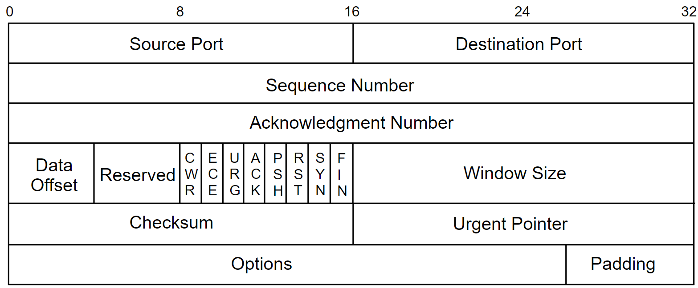
Transport Layer
TCP Header

Slide 20
Transport Layer
TCP Header
(20-60 bytes of data)

Slide 21
Transport Layer
TCP Header
(20-60 bytes of data)
Count by bytes, not segment

Slide 22
Transport Layer
TCP Header
(20-60 bytes of data)
Count by bytes, not segment

Slide 23
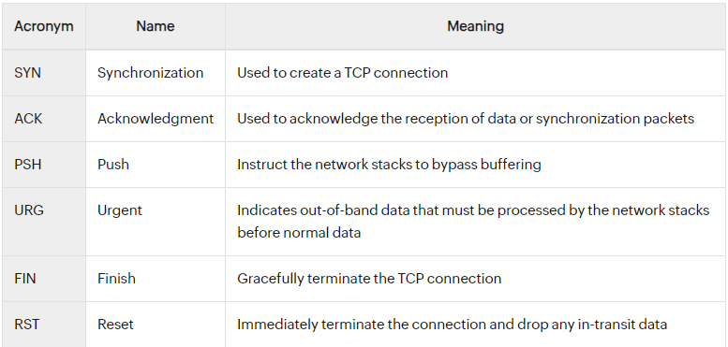
Transport Layer
TCP Header
(20-60 bytes of data)
Count by bytes, not segment
CWR, ECE – Used for congestion control

Slide 24
Transport Layer
TCP Header
(20-60 bytes of data)
Count by bytes, not segment
How many bytes the receiver is willing to accept

Slide 25
Transport Layer
TCP Header
(20-60 bytes of data)
Count by bytes, not segment
Used to detect bit errors

Slide 26
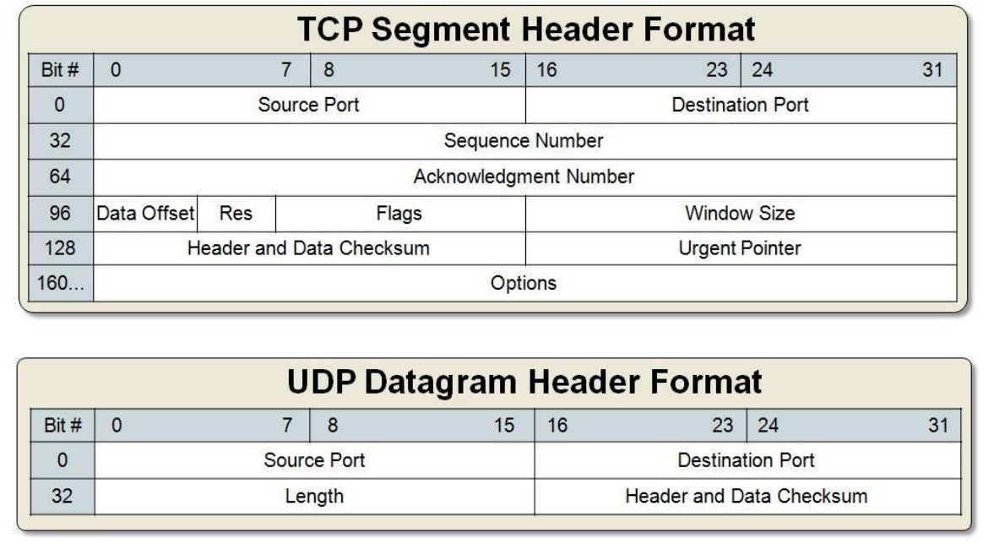
Transport Layer
TCP Header

Slide 27
Transport Layer
TCP Handshake
When a process wants to establish a TCP connection with another host, a TCP handshake must occur

Slide 28
Transport Layer
TCP Handshake
When a process wants to establish a TCP connection with another host, a TCP handshake must occur

Slide 29
Transport Layer
TCP Handshake
When a process wants to establish a TCP connection with another host, a TCP handshake must occur
(SYN, Seq # = x)

Slide 30
Transport Layer
TCP Handshake
When a process wants to establish a TCP connection with another host, a TCP handshake must occur
(SYN, Seq # = x)
1

Slide 31
Transport Layer
TCP Handshake
When a process wants to establish a TCP connection with another host, a TCP handshake must occur
(SYN, Seq # = x)
When establishing the connection, enable the SYN flag (set to 1)
Set an initial sequence number

Slide 32
Transport Layer
TCP Handshake
When a process wants to establish a TCP connection with another host, a TCP handshake must occur
(SYN, Seq # = x)
(SYN, ACK = x + 1, Seq # = y)

Slide 33
Transport Layer
TCP Handshake
When a process wants to establish a TCP connection with another host, a TCP handshake must occur
(SYN, Seq # = x)
(SYN, ACK = x + 1, Seq # = y)
(ACK = y + 1)

Slide 34
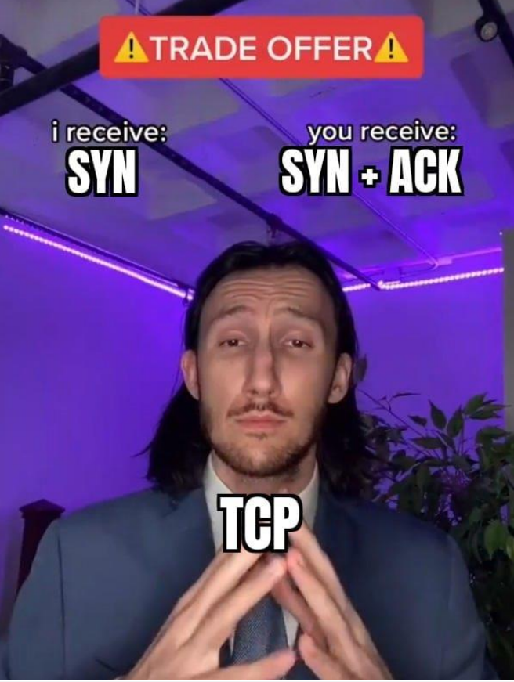
Transport Layer
TCP Handshake
When a process wants to establish a TCP connection with another host, a TCP handshake must occur
(SYN, Seq # = x)
(SYN, ACK = x + 1, Seq # = y)
(ACK = y + 1)

Slide 35
Transport Layer
TCP Goodbye
When a process wants to terminate a TCP connection with another host, it sends a FIN packet
FIN
ACK
FIN
ACK

Slide 36
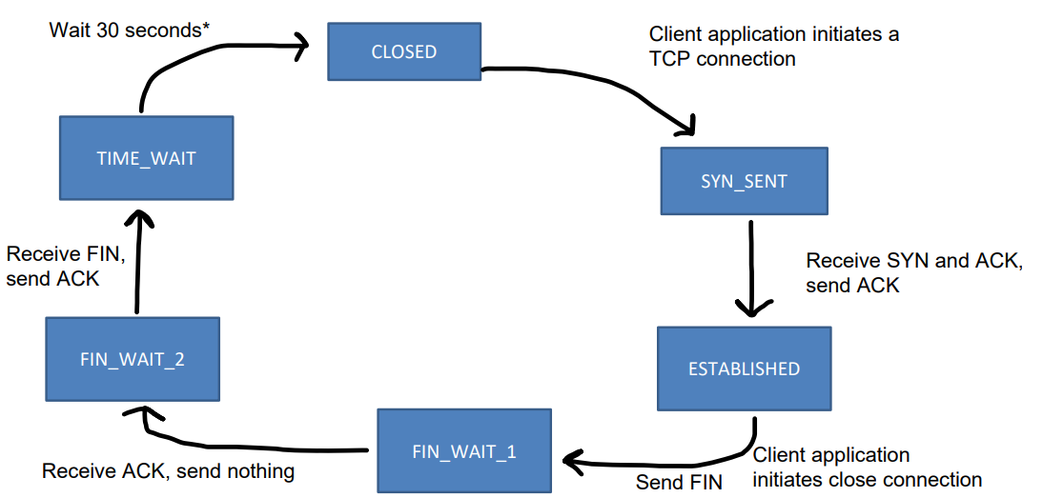
Transport Layer
TCP States

Slide 37
Transport Layer
TCP States
What if we receive a packet that has an invalid port number?
TCP Packet → send a TCP segment back with the RST flag on
UDP Packet → Send an ICMP datagram (network layer thing)

Slide 38
TCP / UDP in Wireshark

Slide 39
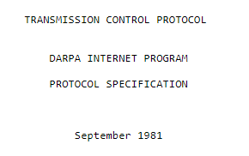
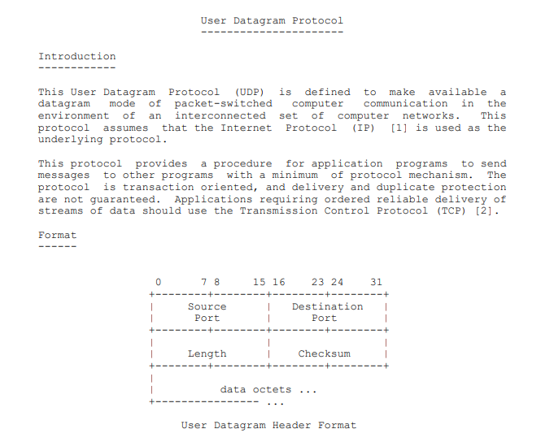
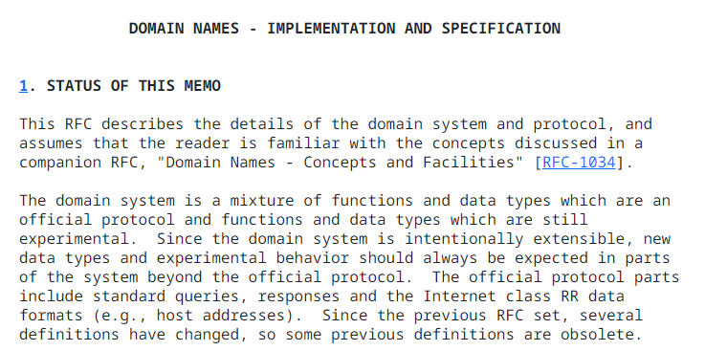
Transport Layer
RFCs
RFCs (Request for Comments) documents and describes the details and standards of how internet protocols (such as HTTP, TCP, UDP) should work
UDP- RFC 768
DNS- RFC 1035
TCP- RFC 793

Slide 40
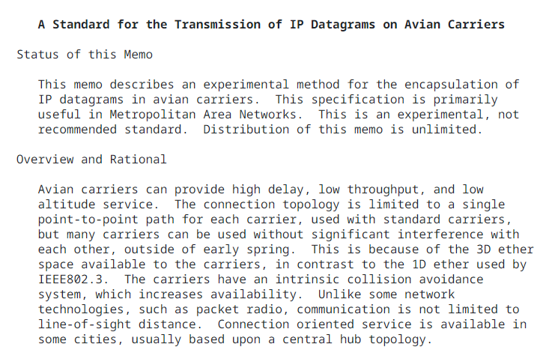

Transport Layer
RFCs

