Slide 1

CSCI 466: Networks
Network Layer – Data Plane
Reese Pearsall Fall 2023
https://www.cs.montana.edu/pearsall/classes/fall2023/466/main.html
*All images are stolen from the internet
1

Slide 2
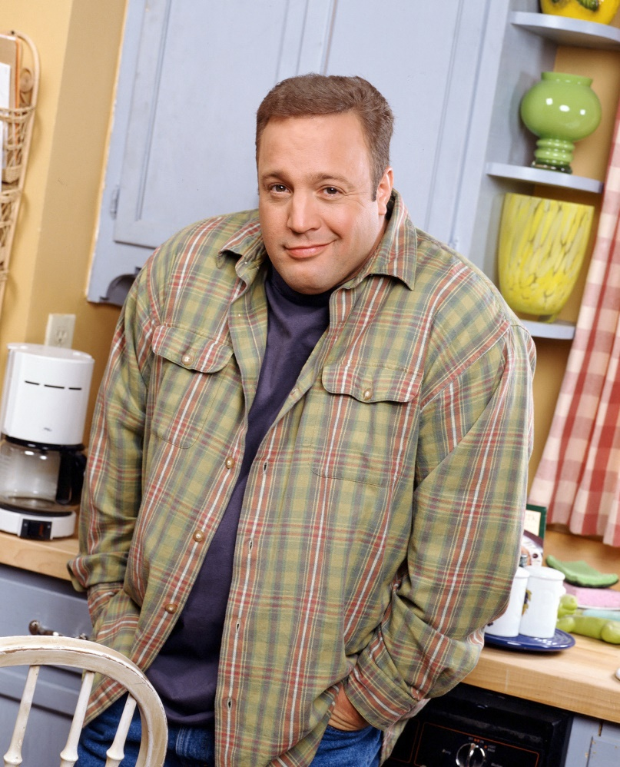
Announcements
“Who is congesting the network???”
UDP:
Wireshark Lab 2 due on Friday
Quiz 4 also on Friday
meme made by reese

Slide 3

Application Layer
Presentation Layer
*
Application Layer
Session Layer
*
Messages from Network Applications
Transport Layer
Network Layer
Physical Layer
Data Link Layer
Bits being transmitted over a medium
Physical Layer
*In the textbook, they condense it to a 5-layer model,
but 7 layers is what is most used

Slide 4

Application Layer
Presentation Layer
*
Application Layer
Session Layer
*
Messages from Network Applications
Transport Layer
Network Layer
Physical Layer
Data Link Layer
Bits being transmitted over a medium
Physical Layer
*In the textbook, they condense it to a 5-layer model,
but 7 layers is what is most used

Slide 5

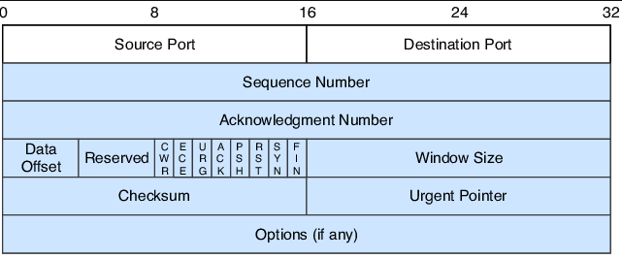
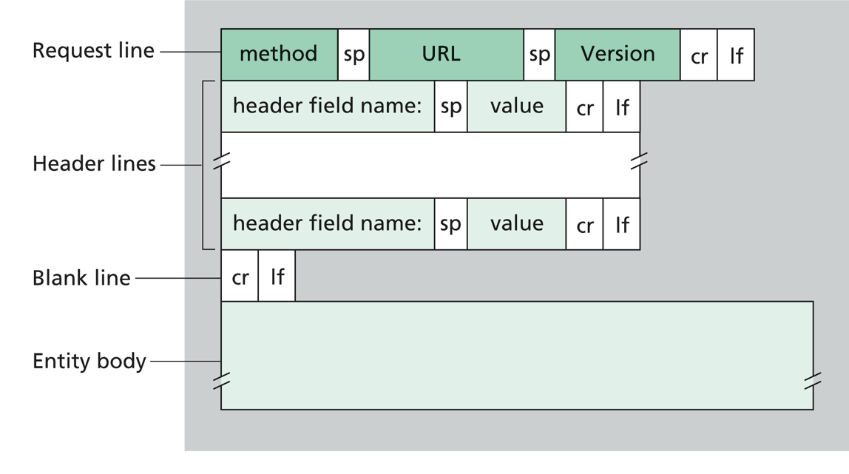
Application Layer
Our packet of information so far…
Transport Layer
“Segment”
Transport Layer Header
Message
Transport Layer Protocol
(ex. TCP)
Application Layer Protocol (ex. HTPP)

Slide 6
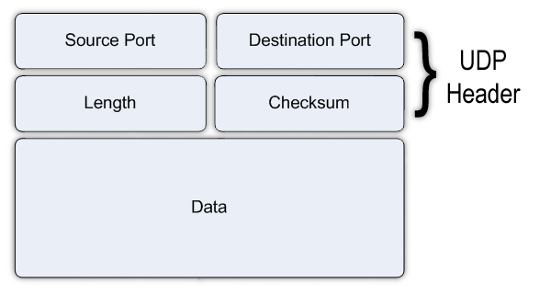
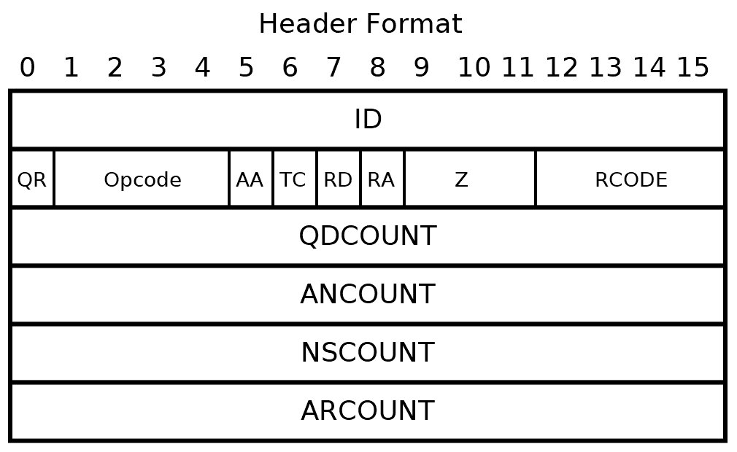
Application Layer
Our packet of information so far…
Transport Layer
“Segment”
Transport Layer Header
Message
Transport Layer Protocol
(ex. UDP)
Application Layer Protocol (ex. DNS)

Slide 7
Application Layer
We’ve only looked at protocols that are running on some host
Transport Layer
Network Layer
???

Slide 8

We will now shift our focus towards routers, or packet switches
In the network layer, we finally get to leave the host and adventure into the network

Slide 9
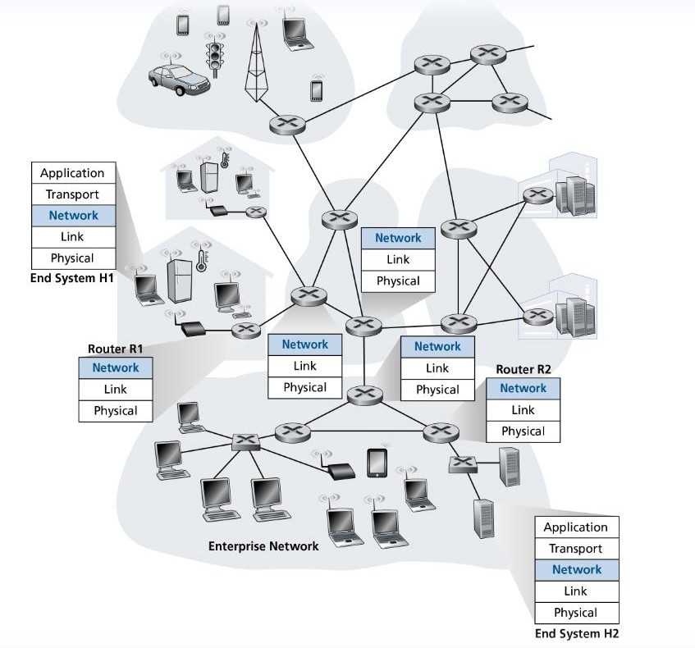
TCP
Routers do not have functionality for application & transport layer protocols
TCP

Slide 10

We will now shift our focus towards routers, or packet switches
Routing: determine route taken by packets from source to destination

Slide 11
We will now shift our focus towards routers, or packet switches
Routing: determine route taken by packets from source to destination
There is likely very many paths from one host to another! Which is the most efficient path?

Slide 12
We will now shift our focus towards routers, or packet switches
?
?
?
Which path should be taken?
Forwarding: move packets from router’s input to appropriate router output

Slide 13

Individual routing algorithm components in each and every router interact in the control plane
Routing
Algorithm
control
plane
data
plane
values in arriving
packet header
0111
1
3
2

Slide 14
Individual routing algorithm components in each and every router interact in the control plane
Routing
Algorithm
control
plane
data
plane
values in arriving
packet header
0111
1
3
2

Slide 15
Software-Defined Networking (SDN) control plane
Remote controller computes, installs forwarding tables in routers
Remote Controller
control
plane
data
plane
CA
CA
CA
CA
CA
values in arriving
packet header
0111
1
3
2

Slide 16






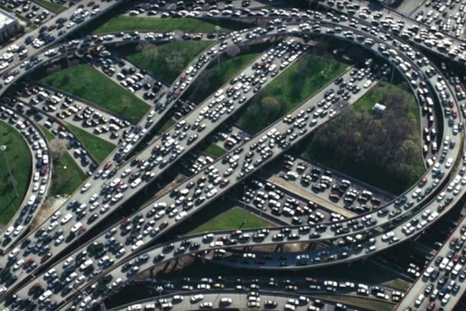
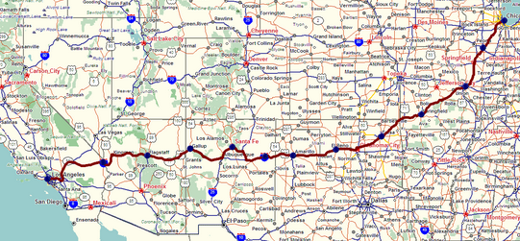
Network Layer
Responsible for the delivery of data through a network
Forwarding
Routing
routing
forwarding

Slide 17
Network Layer
Internet “best effort” service model
No guarantees on:
successful datagram delivery to destination
timing or order of delivery
bandwidth available to end-end flow

Slide 18
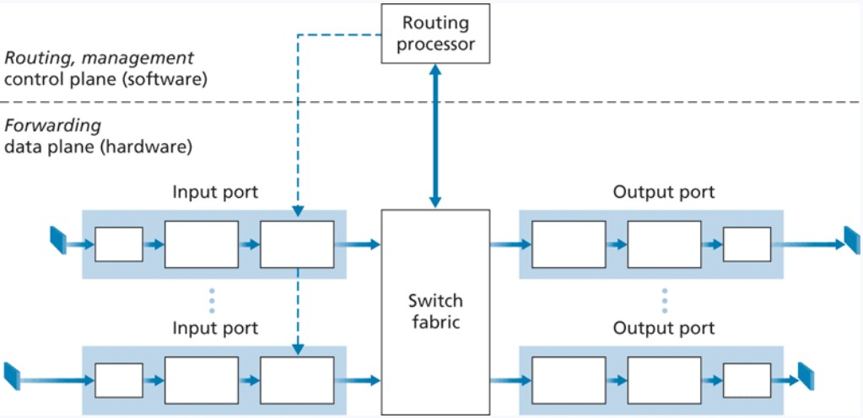
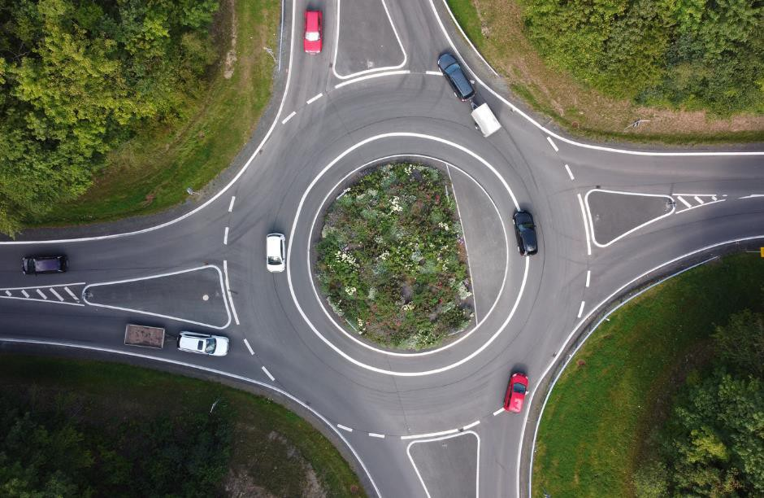
Router Architecture Overview
Destination-based forwarding
Forwarding decisions are based on the destination of the packet
Generalized forwarding
Forwarding decisions based on any set of header field values

Slide 19

Router Architecture Overview
INPUT PORT
Lookup, forwarding, queueing
Bits received
Bit-level reception (physical layer)
Link Layer Protocol
“Switching Fabric”
…
…
Such as over the wire or through the air
Next layer of OSI
model
Ex. Ethernet
Evaluate header field values, lookup output port using forwarding table in memory
Queueing will occur if datagrams arrive faster
than forwarding rate into the switching fabric

Slide 20

Router Architecture Overview
OUTPUT PORT
Storing, ready for send off
“Switching Fabric”
Link Layer Protocol
Send bits
To destination
…
…

Slide 21
Forwarding Techniques
Connection-less
does not require startup,
Has no idea where the final destination is
Routing Table
Address range | Interface (output link)
128.11.52.0 – 128.11.52.255 | 1
153.90.2.0 – 153.90.2.255 | 2
153.90.2.87 – 153.90.2.89 | 3
Lookup, forwarding, queueing
This routing table could get very big…
IP addresses need 32/64 bits of memory each
…
…

Slide 22
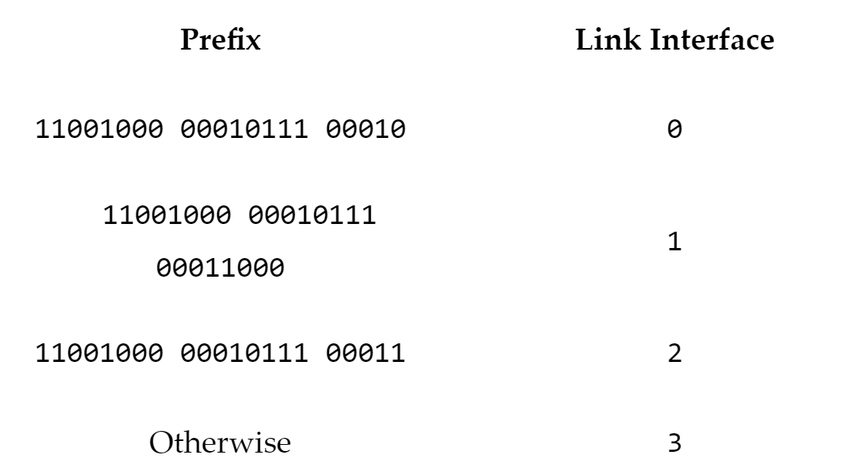
Forwarding Techniques
Connection-less
does not require startup,
Has no idea where the final destination is
Routing Table
Address range | Interface (output link)
128.11.52.0 – 128.11.52.255 | 1
153.90.2.0 – 153.90.2.255 | 2
153.90.2.87 – 153.90.2.89 | 3
Ranges of IP Addresses
Lookup, forwarding, queueing
…
…
Prefix of IP addresses

Slide 23
Forwarding Techniques
Longest prefix matching
Address range | Interface (output link)
11001000 00010111 00010*** ********* | 1
11001000 00010111 00011000 ********* | 2
11001000 00010111 00011*** ******** | 3
otherwise | 4
Lookup, forwarding, queueing
…
…
when looking for forwarding table entry for given destination address, use longest address prefix that matches destination address
examples:
DA: 11001000 00010111 000
10110 10100001
which interface? which interface?
DA: 11001000 00010111 000
11000 10101010

Slide 24
Forwarding Techniques
Longest prefix matching
Address range | Interface (output link)
11001000 00010111 00010*** ********* | 1
11001000 00010111 00011000 ********* | 2
11001000 00010111 00011*** ******** | 3
otherwise | 4
Lookup, forwarding, queueing
…
…
when looking for forwarding table entry for given destination address, use longest address prefix that matches destination address
examples:
DA: 11001000 00010111 000
10110 10100001
which interface? which interface?
DA: 11001000 00010111 000
11000 10101010

Slide 25
Forwarding Techniques
Longest prefix matching
Address range | Interface (output link)
11001000 00010111 00010*** ********* | 1
11001000 00010111 00011000 ********* | 2
11001000 00010111 00011*** ******** | 3
otherwise | 4
Lookup, forwarding, queueing
…
…
when looking for forwarding table entry for given destination address, use longest address prefix that matches destination address
examples:
DA: 11001000 00010111 000
10110 10100001
which interface? which interface?
DA: 11001000 00010111 000
11000 10101010

Slide 26
Forwarding Techniques
Longest prefix matching
Address range | Interface (output link)
11001000 00010111 00010*** ********* | 1
11001000 00010111 00011000 ********* | 2
11001000 00010111 00011*** ******** | 3
otherwise | 4
Lookup, forwarding, queueing
…
…
when looking for forwarding table entry for given destination address, use longest address prefix that matches destination address
examples:
DA: 11001000 00010111 000
10110 10100001
which interface? which interface?
DA: 11001000 00010111 000
11000 10101010

Slide 27

Forwarding Techniques
Longest prefix matching
Address range | Interface (output link)
11001000 00010111 00010*** ********* | 1
11001000 00010111 00011000 ********* | 2
11001000 00010111 00011*** ******** | 3
otherwise | 4
Lookup, forwarding, queueing
…
…
when looking for forwarding table entry for given destination address, use longest address prefix that matches destination address
These lookups need to happen in nanoseconds for our network to function
Ternary content addressable memories (TCAMs) are used in modern routers to do LPM
Cisco routers can carry millions of TCAM entries in their routers

Slide 28
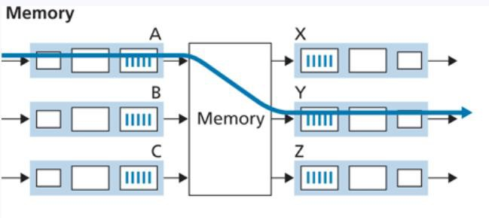
Fabric Switch and Switching
Switching fabric: Mechanism that forwards data from an input port to output port
Switching via memory:
Handled by a CPU (routing processor) Cannot forward data in parallel

Slide 29
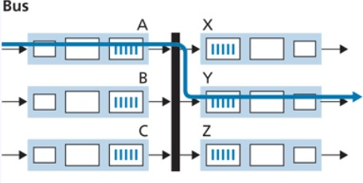
Fabric Switch and Switching
Switching fabric: Mechanism that forwards data from an input port to output port
Switching via memory:
Switching via bus:
Handled by a CPU (routing processor) Cannot forward data in parallel
Datagrams are prepended with a header
A “bus” transports input port datagrams to output ports
“keep going around the roundabout until you find your port”

Slide 30
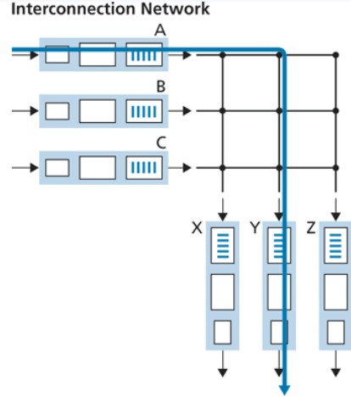
Fabric Switch and Switching
Switching fabric: Mechanism that forwards data from an input port to output port
Switching via memory:
Switching via bus:
Switching via network:
Handled by a CPU (routing processor) Cannot forward data in parallel
Datagrams are prepended with a header
A “bus” transports input port datagrams to output ports
A network of buses
“keep going around the roundabout until you find your port”
One shared bus, but can only fit one datagram

Slide 31
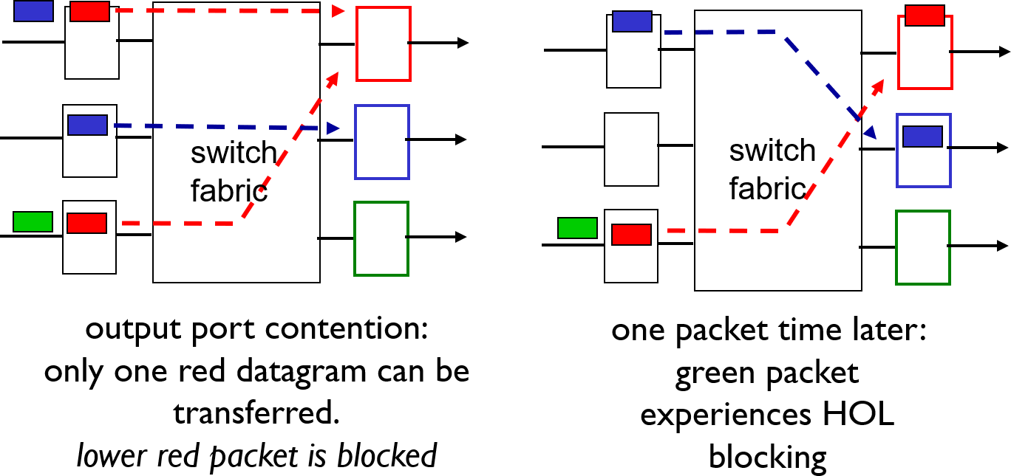
Input Queueing
fabric slower than input ports combined ➔ queueing may occur at input queues
Input ports
Output ports
Input ports
Output ports
Head-of-the-Line (HOL) blocking: queued datagram at front of queue prevents others in queue from moving forward

Slide 32

Output Queueing
OUTPUT PORT
Switching Fabric
Input
port
Storing, ready
for send off
Link Layer Protocol
Send bits
Input port
Incoming packets will have to wait for buffer space to become available
Possible solutions:
Remove a packet
Tail drop: drop arriving packet
Priority: drop/remove on a priority basis
Random: drop/remove randomly
Input port
Input
port

Slide 33
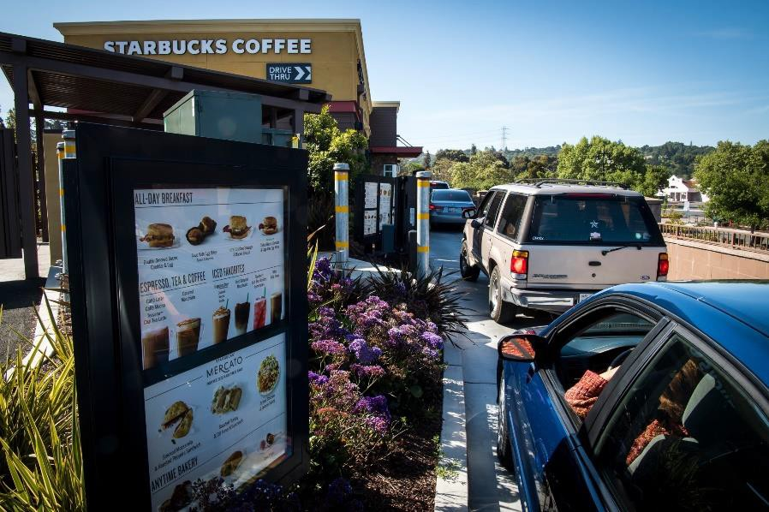
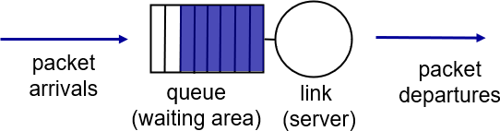
Packet Scheduling
Scheduling is used to determine the next packet to send on the link
FIFO (first in first out): Send in order of arrival to queue

Slide 34
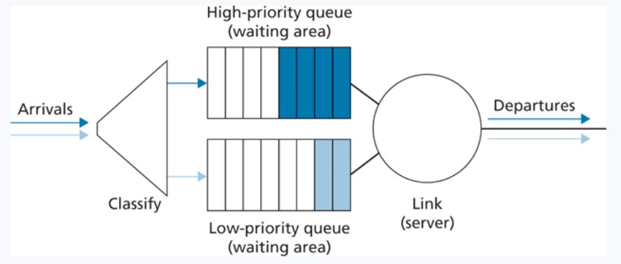

Packet Scheduling
Scheduling is used to determine the next packet to send on the link
Priority: packets are classified into priority classes. High priority = sent over link first

Slide 35
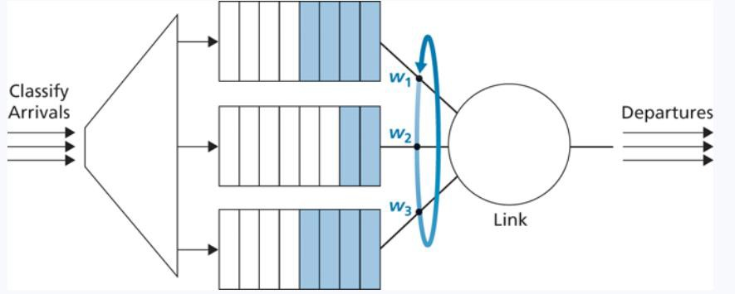
Packet Scheduling
Scheduling is used to determine the next packet to send on the link
Round robin weighted fair queueing: packets are classified into priority classes. Each class gets to send one packet during a “cycle”
Packet from the priority group gets sent
Packet from the middle class gets sent Packet from the plebian class gets sent

