Slide 1

CSCI 466: Networks
Network Layer – Routing (Control Plane)
Reese Pearsall Fall 2023
https://www.cs.montana.edu/pearsall/classes/fall2023/466/main.html
*All images are stolen from the internet
1

Slide 2

Announcements
Wireshark Lab 3 posted. Due a week from today (11/1)
It’s easy
PA3 Posted. Due on November 8th
Quiz 5 on Friday (due at 5 PM)
IP addresses, Subnets, Subnet Masks
Private/Public IP addresses, NAT
IPv4, IPv6, Tunneling
SDN
Routing (Link State vs Distance Vector)
OSPF, BGP, ICMP
NO CLASS ON FRIDAY AND MONDAY
Things to do while reese is gone
Take quiz 5
Work on lab 3/PA3
I’ll be available via email/DMs if you need anything
Watch Monday’s lecture
Party hard

Slide 3
Wireshark Lab 3

Slide 4
PA3

Slide 5
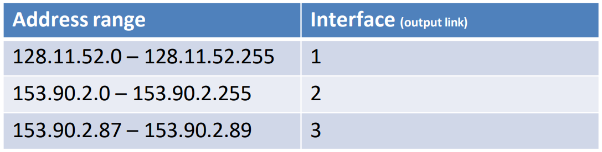
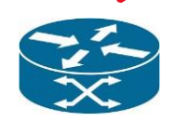
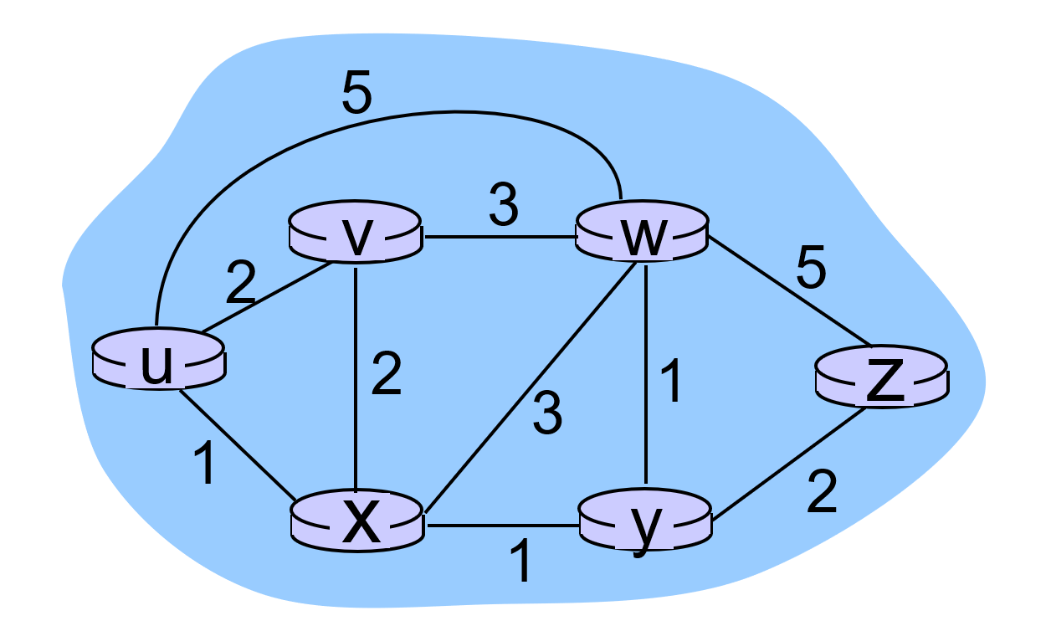
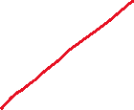
Forwarding refers to moving packets from a router’s input to appropriate router output, and is implemented in the data plane.
Ideally, this output links are the most optimal path to get to the destination
Routing refers to determining the route taken by packets from source to destination, and is implemented in the control plane.
What is the best way to get from u to z?

Slide 6
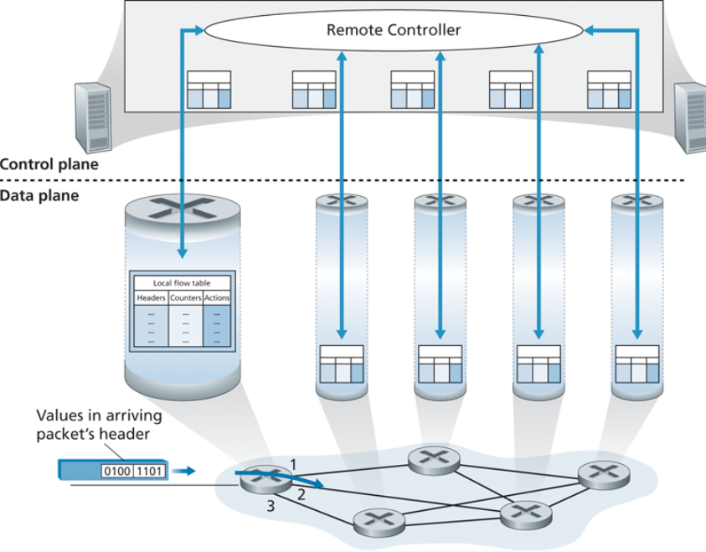
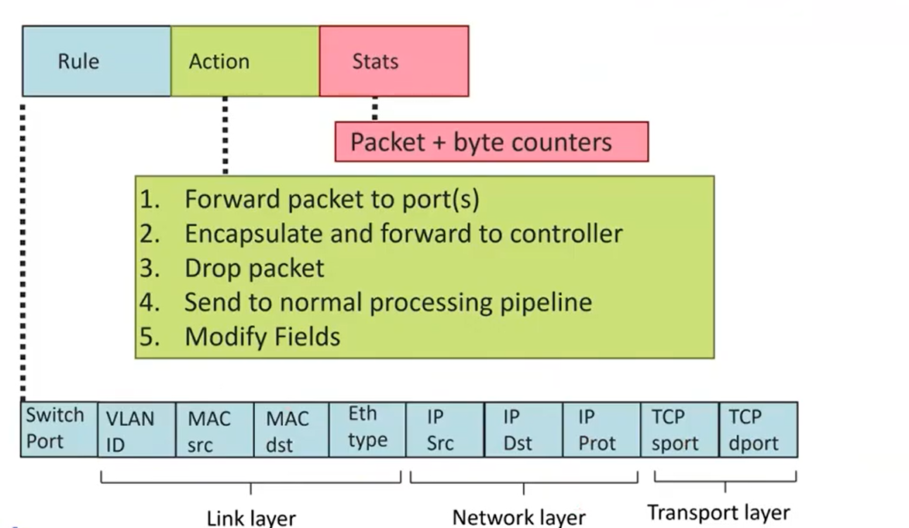
Generalized Forwarding and Software Defines Network (SDN)
Control Plane and Data Plane need to work together in order to create efficient routing tables

Slide 7
Routing tables are filled via routing algorithms
There are two types of routing algorithms

Slide 8
Routing tables are filled via routing algorithms
There are two types of routing algorithms
Centralized/Global- we know the edge costs of the network
We can compute the shortest path from one node, to all other nodes in roughly O(n^2) time.
Once we know the shortest path from A to B, we can update routing tables to reflect that shortest path
Link State algorithms
(Dijkstra’s Algorithm)

Slide 9
Routing tables are filled via routing algorithms
There are two types of routing algorithms
a
b
c
Decentralized- we do not know the edge costs of the entire network.
Only know edge costs to neighbors
8
1
1
1
d
e
f
1
1
Distance Vector algorithms
1
1
1
g
h
i
1
1

Slide 10
Routing tables are filled via routing algorithms
There are two types of routing algorithms
a
b
c
Distance Vector Routing Summary
8
1
1
1
Every so often, neighbors will exchange their local distances
d
e
f
Using these distances, routers will update their local distances if they find a new shortest path
1
1
1
1
1
g
h
i
1
1

Slide 11
Routing tables are filled via routing algorithms
There are two types of routing algorithms
a
b
c
Distance Vector Routing Summary
8
1
All nodes:
receive distance vectors from neighbors
compute their new local distance vector
send their new local distance vector to neighbors
1
1
d
e
f
1
1
1
1
1
g
h
i
1
1
“News spreads slowly”

Slide 12
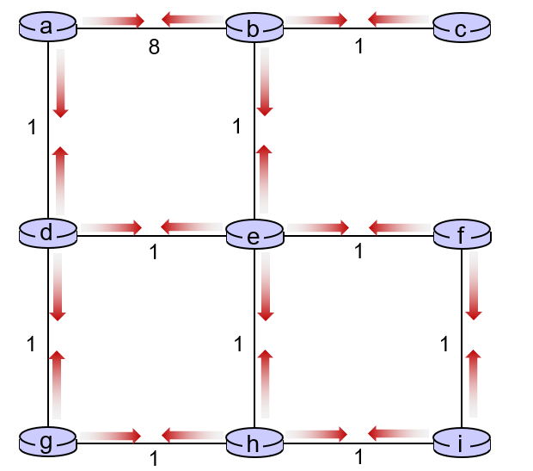
Routing tables are filled via routing algorithms
There are two types of routing algorithms
Centralized/Global- we know the edge costs of the network
Decentralized- we do not know the edge costs of the entire network.
Only know edge costs to neighbors
Link State algorithms
(Dijkstra’s Algorithm)
Distance Vector algorithms

Slide 13
Routing tables are filled via routing algorithms
There are two types of routing algorithms
Centralized/Global- we know the edge costs of the network
Decentralized- we do not know the edge costs of the entire network.
Only know edge costs to neighbors
Link State algorithms
(Dijkstra’s Algorithm)
Distance Vector algorithms
These are not network protocols, these are simply general routing/shortest path algorithms

Slide 14
Routing tables are filled via routing algorithms
There are two types of routing algorithms
Centralized/Global- we know the edge costs of the network
Decentralized- we do not know the edge costs of the entire network.
Only know edge costs to neighbors
Link State algorithms
OSPF
BGP
(Dijkstra’s Algorithm)
Distance Vector algorithms

Slide 15









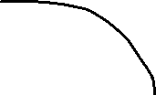
Intra-AS Routing: OSPF
An autonomous system is a group of routers that are under the same administrative control
AS 3
AS 1
AS 2

Slide 16


Intra-AS Routing: OSPF
Open Shortest Path First
OSPF is a link-state protocol that uses flooding of link-state information and Dijkstra’s least-cost algorithm
An autonomous system is a group of routers that are under the same administrative control
AS 1

Slide 17


Intra-AS Routing: OSPF
Open Shortest Path First
OSPF is a link-state protocol that uses flooding of link-state information and Dijkstra’s least-cost algorithm
An autonomous system is a group of routers that are under the same administrative control
1. Each router constructors a topological map of the AS
AS 1

Slide 18


Intra-AS Routing: OSPF
Open Shortest Path First
OSPF is a link-state protocol that uses flooding of link-state information and Dijkstra’s least-cost algorithm
An autonomous system is a group of routers that are under the same administrative control
1. Each router constructors a topological map of the AS
2. Run Dijikstra’s to determine shortest path to each subnet
(Edge costs will be set by a network administrator)
If I wanted to find the path with the shortest amount of hops, what should edge cost be?
AS 1

Slide 19
Intra-AS Routing: OSPF
Open Shortest Path First
OSPF is a link-state protocol that uses flooding of link-state information and Dijkstra’s least-cost algorithm
An autonomous system is a group of routers that are under the same administrative control
1. Each router constructors a topological map of the AS
2. Run Dijikstra’s to determine shortest path to each subnet
(Edge costs will be set by a network administrator)
(could set all edges to be a cost of 1)
A | 1
B | 2
C | 3
… | …
AS 1
3. Fill in routing table

Slide 20


Routing Among the ISPs: BGP
Inter-AS routing protocol involves coordination amongst multiple AS’s, a common protocol needs to be used
?
?
?
?
?
?
?
AS 1
Border Gateway Protocol (BGP) is used for exchanging routing information between AS

Slide 21


Routing Among the ISPs: BGP
Inter-AS routing protocol involves coordination amongst multiple AS’s, a common protocol needs to be used
AS 1
Border Gateway Protocol (BGP) is used for exchanging routing information between AS
BGP allows a router to tell other AS’s that it exists and needs to be connected

Slide 22
Routing Among the ISPs: BGP
AS consists of gateway routers and internal routers
Inter-AS routing protocol involves coordination amongst multiple AS’s, a common protocol needs to be used
AS6
AS3
AS2
AS4
AS5
AS6
AS 1
Border Gateway Protocol (BGP) is used for exchanging routing information between AS
BGP allows a router to tell other AS’s that it exists and needs to be connected

Slide 23
Routing Among the ISPs: BGP
AS consists of gateway routers and internal routers
Inter-AS routing protocol involves coordination amongst multiple AS’s, a common protocol needs to be used
AS6
AS3
AS2
AS4
AS5
AS6
AS 1
Border Gateway Protocol (BGP) is used for exchanging routing information between AS
BGP allows a router to tell other AS’s that it exists and needs to be connected

Slide 24
Routing Among the ISPs: BGP
AS consists of gateway routers and internal routers
Inter-AS routing protocol involves coordination amongst multiple AS’s, a common protocol needs to be used
AS6
“I am AS1 AND I EXIST!”
AS3
AS2
AS4
AS5
AS6
AS 1

Slide 25
Routing Among the ISPs: BGP
AS consists of gateway routers and internal routers
Inter-AS routing protocol involves coordination amongst multiple AS’s, a common protocol needs to be used
AS6
“I am AS1 AND I EXIST!”
AS3
AS2
AS4
AS5
AS6
AS 1
“A1 EXISTS AND FOUND THROUGH AS2”

Slide 26
Internet inter-AS routing: BGP
BGP (Border Gateway Protocol): the de facto inter-domain routing protocol
  “glue that holds the Internet together”
allows subnet to advertise its existence, and the destinations it can reach, to rest of Internet: “I am here, here is who I can reach, and how”
BGP provides each AS a means to:
  obtain destination network reachability info from neighboring ASes (eBGP)
  determine routes to other networks based on reachability information and policy
  propagate reachability information to all AS-internal routers (iBGP)
  advertise (to neighboring networks) destination reachability info

Slide 27
Routing Among the ISPs: BGP
BGP is the routing protocol used for routing amongst different ISPs + AS
Two important functions
Obtain prefix reachability information from neighboring ASs (CIDR)
→ Determine the “best” routes to the prefixes
2b
2a
2c
1b
3b
2d
∂
1a
1c
3a
3c
AS 2
1d
3d
AS 1
eBGP connectivity
AS 3
iBGP connectivity
1c
gateway routers run both eBGP and iBGP protools

Slide 28
Routing Among the ISPs: BGP
BGP is the routing protocol used for routing amongst different ISPs + AS
Two important functions
Obtain prefix reachability information from neighboring ASs
→ Determine the “best” routes to the prefixes
2b
2a
2c
1b
3b
Prefix X connect
2d
1a
1c
3a
3c
External BGP (eBGP)
AS 2
3a → 2c “Hey I have X”
2a → 1c “Hey AS 3 has X and I have AS3”
1d
3d
X
AS 1
eBGP connectivity
AS 3
iBGP connectivity
Internal BGP (iBGP)
2c → 2b
2c → 2d
2c → 2a
1c
gateway routers run both eBGP and iBGP protools

Slide 29
BGP basics
BGP session: two BGP routers (“peers”) exchange BGP messages over semi-permanent TCP connection:
  advertising paths to different destination network prefixes (BGP is a “path vector” protocol)
when AS3 gateway router 3a advertises path AS3,X to AS2 gateway router 2c:
  AS3 promises to AS2 it will forward datagrams towards X
AS 3
3b
AS 1
1b
3a
3c
1a
1c
AS 2
2b
3d
X
1d
2a
2c
BGP advertisement:
AS3, X
2d

Slide 30
BGP protocol messages
BGP messages exchanged between peers over TCP connection
BGP messages [RFC 4371]:
  OPEN: opens TCP connection to remote BGP peer and authenticates sending BGP peer
  UPDATE: advertises new path (or withdraws old)
  KEEPALIVE: keeps connection alive in absence of UPDATES; also ACKs OPEN request
  NOTIFICATION: reports errors in previous msg; also used to close connection

Slide 31
Path attributes and BGP routes
BGP advertised route: prefix + attributes
  prefix: destination being advertised
  two important attributes:
  AS-PATH: list of ASes through which prefix advertisement has passed
  NEXT-HOP: indicates specific internal-AS router to next-hop AS
policy-based routing:
  gateway receiving route advertisement uses import policy to accept/decline path (e.g., never route through AS Y).
  AS policy also determines whether to advertise path to other other neighboring ASes

Slide 32
BGP path advertisement
AS 3
3b
AS 1
1b
3a
3c
1a
1c
AS 2
3d
X
2b
1d
AS3, X
AS2,AS3,X
2a
2c
2d
AS2 router 2c receives path advertisement AS3,X (via eBGP) from AS3 router 3a
based on AS2 policy, AS2 router 2c accepts path AS3,X, propagates (via iBGP) to all AS2 routers
based on AS2 policy, AS2 router 2a advertises (via eBGP) path AS2, AS3, X to AS1 router 1c

Slide 33
ICMP (Internet Control Message Protocol)
used by hosts & routers to communicate network-level information
  error reporting: unreachable host, network, port, protocol
  echo request/reply (used by ping)
network-layer “above” IP:
  ICMP msgs carried in IP datagrams
ICMP message: type, code plus first 8 bytes of IP datagram causing error
Type Code description
0 0 echo reply (ping)
3 0 dest. network unreachable
3 1 dest host unreachable
3 2 dest protocol unreachable
3 3 dest port unreachable
3 6 dest network unknown
3 7 dest host unknown
4 0 source quench (congestion
control - not used)
8 0 echo request (ping)
9 0 route advertisement
10 0 router discovery
11 0 TTL expired
12 0 bad IP header

Slide 34

Control Plane Wrap up
Routing
Algorithm
approaches to network control plane
  - per-router control (traditional)
  - logically centralized control (software defined networking)
traditional routing algorithms
  - routing: link state, distance vectors
  - implementation in Internet: OSPF, BGP
Internet Control Message Protocol
control
plane
data
plane
Next:
Link Layer
Security
Random Topics in session, presentation, and physical layers

