Slide 1

CSCI 466: Networks
Link Layer: Error Detection, Multiple Access Protocols
Reese Pearsall Fall 2023
https://www.cs.montana.edu/pearsall/classes/fall2023/466/main.html
*All images are stolen from the internet
1

Slide 2
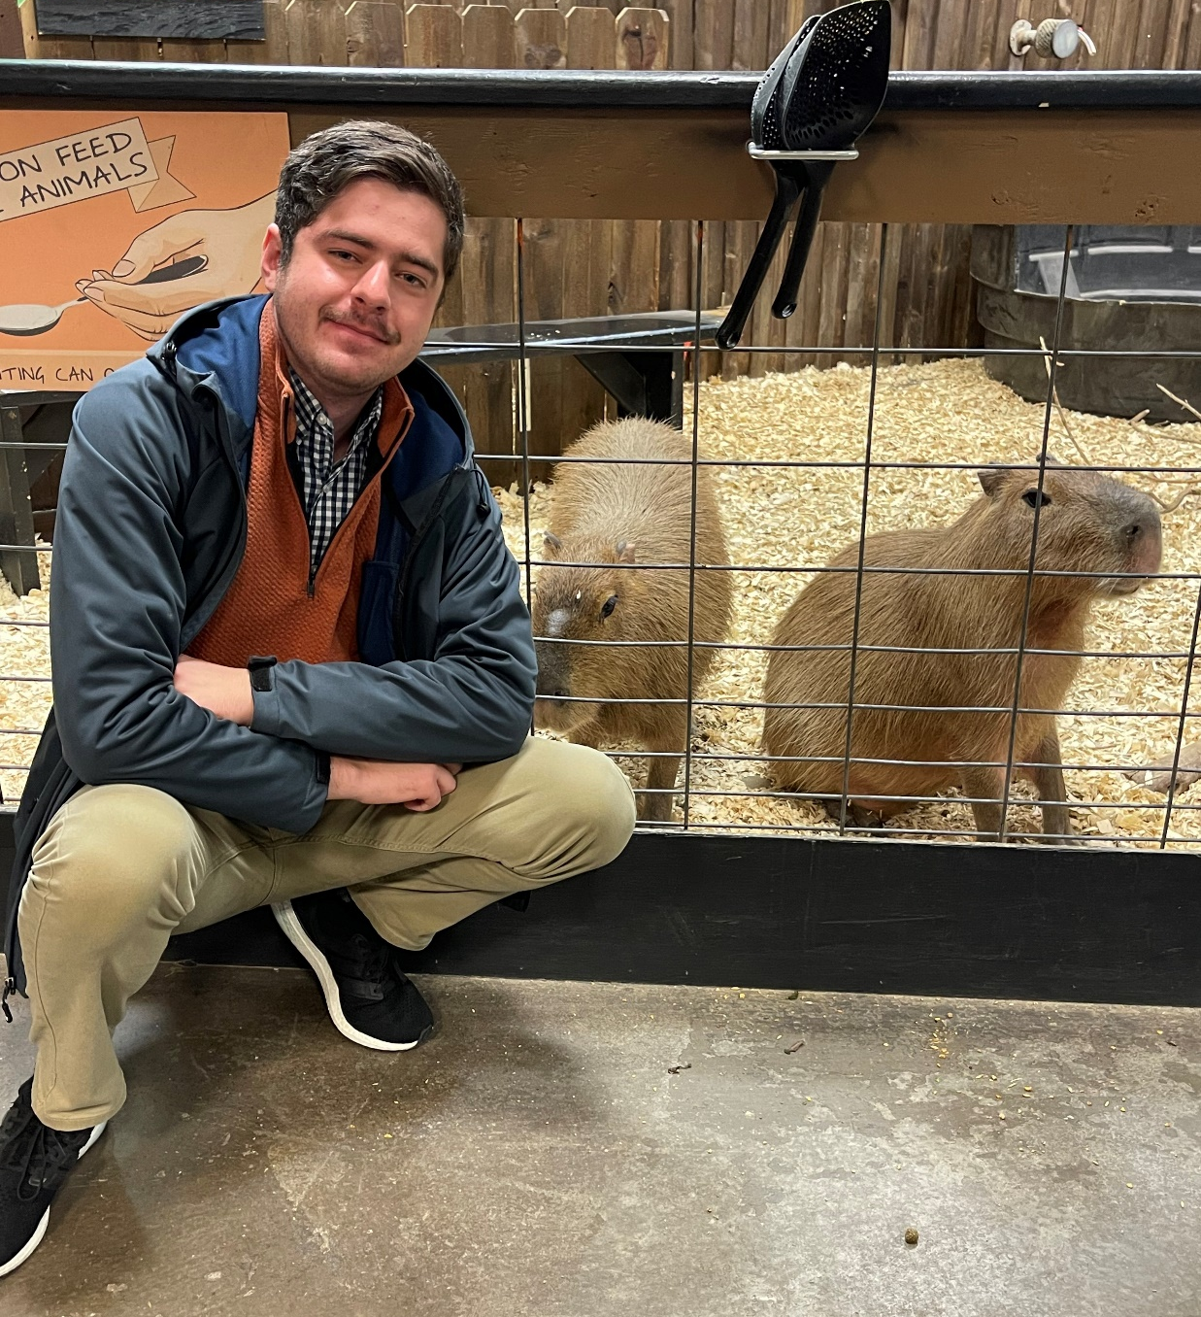
Announcements
Wireshark Lab 3 Due tonight
PA3 due 11/8

Slide 3
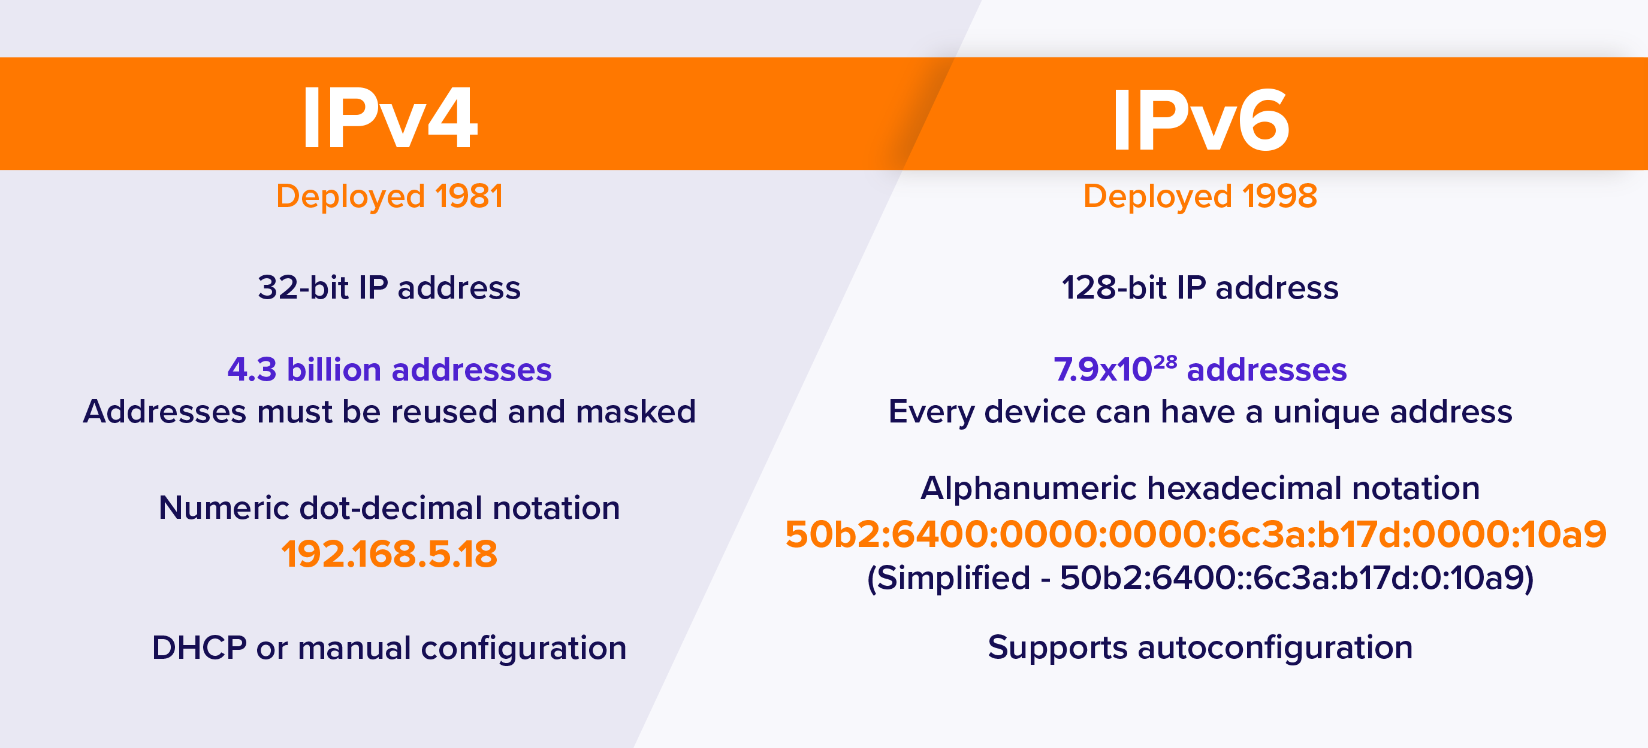
Error Correction
An IPv6 address is 128 bits in length (not 64)
I am going to ask this question on the next Quiz ☺

Slide 4

Application Layer
OSI Model
Presentation Layer
*
Application Layer
Session Layer
*
Messages from Network Applications
Transport Layer
Network Layer
Physical Layer
Data Link Layer
Bits being transmitted over a copper wire
Physical Layer
*In the textbook, they condense it to a 5-layer model, but 7 layers is what is most used

Slide 5


















Data Link Layer
The link layer is responsible for the actual node-to-node delivery of data and ensure error-free transmission of information
We have not addressed how we will overcome various transmission mediums!
terminology:
hosts and routers: nodes
communication channels that connect adjacent nodes along communication path: links
wired links
wireless links
LANs
layer-2 packet: frame, encapsulates datagram
data-link layer has responsibility of
transferring datagram from one node
to physically adjacent node over a link

Slide 6







Data Link Layer
transportation analogy:
trip from Princeton to Lausanne
limo: Princeton to JFK
plane: JFK to Geneva
train: Geneva to Lausanne
Princeton
JFK
Geneva
Lausanne

Slide 7
Data Link Layer
transportation analogy:
trip from Princeton to Lausanne
limo: Princeton to JFK
plane: JFK to Geneva
train: Geneva to Lausanne
tourist = datagram
transport segment = communication link
transportation mode = link-layer protocol
travel agent = routing algorithm
Princeton
JFK
Geneva
Lausanne

Slide 8
Data Link Layer
Services offered by the Link Layer
Framing
→ Encapsulate a network layer Datagram in another header
Link access
→ LL dictate the rules and process of transmitting a frame over a link
Reliable Delivery
→ For unreliable link, some reliable delivery mechanisms may need to be used
Error Detection and Correction
→ Bits can get messed up as the are transmitted through a medium
Why do we need RDT and error detection in the link layer when it is also offered in the transport layer?

Slide 9





Data Link Layer
flow control:
pacing between adjacent sending and receiving nodes
error detection:
errors caused by signal attenuation, noise.
receiver detects errors, signals retransmission, or drops frame
error correction:
receiver identifies and corrects bit error(s) without retransmission
half-duplex and full-duplex:
with half duplex, nodes at both ends of link can transmit, but not at same time
…
…
Cable access
cellular
Ethernet LANs
WiFi

Slide 10
Data Link Layer
Services offered by the Link Layer
Framing
→ Encapsulate a network layer Datagram in another header
Link access
→ LL dictate the rules and process of transmitting a frame over a link
Reliable Delivery
→ For unreliable link, some reliable delivery mechanisms may need to be used
Error Detection and Correction
→ Bits can get messed up as the are transmitted through a medium
Why do we need RDT and error detection in the link layer when it is also offered in the transport layer?
Some packets of data don’t even travel through the transport layer…

Slide 11
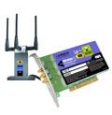
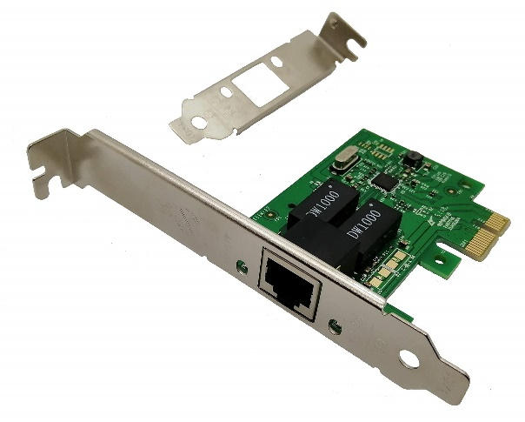

Data Link Layer
Implementation of Link Layer
Implemented within the hardware of your computer
NIC (Network Interface Controller)- Integrated into the motherboard and allows the machine to use LL services such as ethernet (combination of hardware, software, and some firmware)
application
transport
network
link
cpu
memory
link
physical
host
bus
(e.g., PCI)
controller
Wireshark uses your NIC to determine which packets should be sniffed!
physical
transmission
network adapter
card

Slide 12
Data Link Layer
datagram
datagram
controller
controller
sending host
receiving host
datagram
frame
receiving side
looks for errors, rdt, flow control, etc.
extracts datagram, passes to upper layer at receiving side
sending side:
encapsulates datagram in frame
adds error checking bits, rdt, flow control, etc.
Link Layer and LANs
6-12

Slide 13
Data Link Layer
Bits can get messed during the physical layer and link layer
Faulty wires
NIC issues
Unreliable mediums
EDC: error detection and correction bits (e.g., redundancy)
D: data protected by error checking, may include header fields
datagram
datagram
Error detection not 100% reliable!
protocol may miss some errors, but rarely
larger EDC field yields better detection and correction
otherwise
all
bits in D’
OK
?
N
detected
error
d data bits
D
EDC
D’
EDC’
bit-error prone link
Link Layer and LANs
6-13

Slide 14
Data Link Layer
0111000110101011
1
d data bits
parity bit
Even/odd parity: set parity bit so there is an even/odd number of 1’s
At receiver:
compute parity of d received bits
compare with received parity bit – if different than error detected
Link Layer and LANs
6-14

Slide 15


Data Link Layer
Can detect and correct errors (without retransmission!)
two-dimensional parity: detect and correct single bit errors
0111000110101011
1
d data bits
parity bit
row parity
d_{1,1}
. . .
d_{1,j}
d_{1,j+1}
Even/odd parity: set parity bit so there is an even/odd number of 1’s
d_{2,1}
. . .
d_{2,j}
d_{2,j+1}
. . .
. . .
. . .
. . .
At receiver:
compute parity of d received bits
compare with received parity bit – if different than error detected
d_{i,1}
. . .
d_{i,j}
d_{i,j+1}
column
parity
d_{i+1,1}
. . .
d_{i+1,j}
d_{i+1,j+1}
no errors:
1 0 1 0 1
1
detected
and
correctable
single-bit
error:
1 0 1 0 1 1
1 1 1 1 0
0
1 0 1 1 0 0
parity
error
0 1 1 1 0
1
0 1 1 1 0 1
1 0 1 0 1
0
1 0 1 0 1 0
Link Layer and LANs
6-15

Slide 16
Data Link Layer
Checksum
(Sender)
(Receiver)
0110011001100000
0101010101010101
1000111100001100
0100101011000010
0110011001100000
0101010101010101
1000111100001100
Binary sum of words
0100101011000010
(Binary Sum → One’s Complement)
(one’s complement)
1011010100111101
= 1111111111111111
Checksum!
All 1s = No error!

Slide 17
Data Link Layer
more powerful error-detection coding
D: data bits (given, think of these as a binary number)
G: bit pattern (generator), of r+1 bits (given, specified in CRC standard)
r CRC bits
d data bits
D
R
bits to send
<D,R> = D 2^{r} XOR R
formula for these bits
*
sender: compute r CRC bits, R, such that <D,R> exactly divisible by G (mod 2)
receiver knows G, divides <D,R> by G. If non-zero remainder: error detected!
can detect all burst errors less than r+1 bits
widely used in practice (Ethernet, 802.11 WiFi)
Sender/Receiver has D and G. Need to compute R
6-17

Slide 18
Data Link Layer
G
Sender wants to compute R such that:
D . 2^{r} XOR R = nG
1
0
1
0 1 1
1 0 0 1
1 0 1 1 1 0
0 0 0
1 0 0 1
1 0 1
D
2^{r} (here, r=3)
0 0 0
*
... or equivalently (XOR R both sides):
D . 2^{r} = nG XOR R
1 0 1 0
1 0 0 1
1 1 0
... which says:
if we divide D . 2^{r} by G, we want remainder R to satisfy:
0 0 0
1 1 0 0
1 0 0 1
1 0 1 0
1 0 0 1
D.2^{r}
G
algorithm for
computing R
R = remainder [ ]
0 1 1
R
6-18

Slide 19
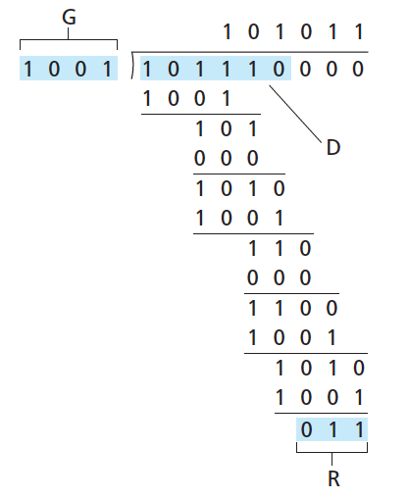
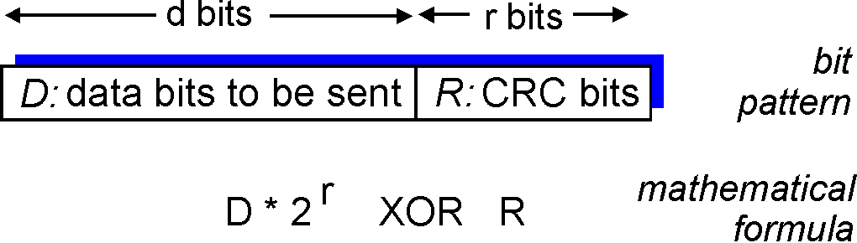

Data Link Layer
(Do some algebra to find R)
D.2^{r}
G
R = remainder[ ]
Sender sends D + R bits.
Receiver divides D + R bits by G. Result should always be Zero if no errors occurred
6-19

Slide 20

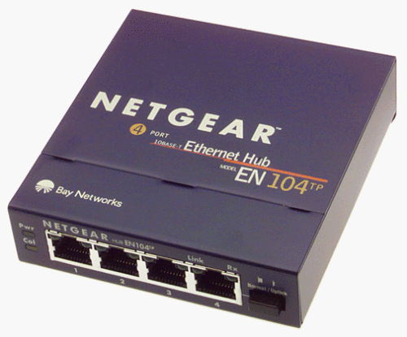




Data Link Layer
Access links
Point to Point – Single sender, Single Receiver at each end of link
Broadcast – shared medium
shared wire (e.g.,
cabled Ethernet)
shared RF
(e.g., 802.11 WiFi)
shared RF
(satellite)
humans at a
cocktail party
(shared air, acoustical)
6-20

Slide 21
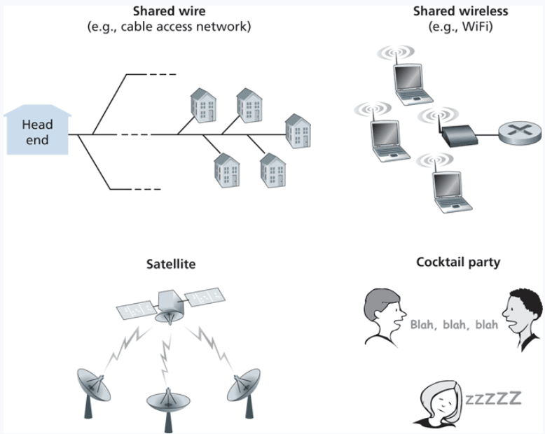
Multiple Access Links
Shared medium = possibility for receivers to get two frame at the same time, AKA a collision
Frame X
Frame y
Frames get tangled together, and neither frame can be read clearly by receiver

Slide 22
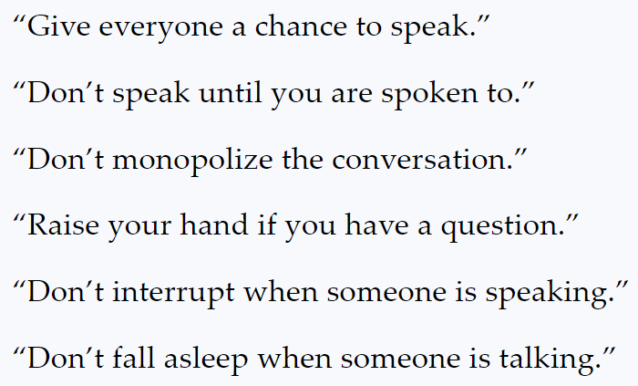
Multiple Access Links
Shared medium = possibility for receivers to get two frame at the same time, AKA a collision
Frame X
Frame y
Frames get tangled together, and neither frame can be read clearly by receiver
In English, we have some rules to prevent collisions from happening
In the link layer, we will discuss 3 multiple access protocols:
Channel Partitioning, Random Access, and Taking Turns

Slide 23
Channel Partitioning
Links total bandwidth = D
Divide channel into N slots
Each node gets (on average) D/N bandwidth
Get to transmit data for a fixed amount of time, and then next node gets to transmit
A
B
C
D
N nodes
A
B
C
D

Slide 24
Channel Partitioning
Links total bandwidth = D
Divide channel into N slots
Each node gets (on average) D/N bandwidth
Get to transmit data for a fixed amount of time, and then next node gets to transmit
A
B
C
D
N nodes
A
B
C
D

Slide 25
Channel Partitioning
Links total bandwidth = D
Divide channel into N slots
Each node gets (on average) D/N bandwidth
Get to transmit data for a fixed amount of time, and then next node gets to transmit
A
B
C
D
N nodes
A
B
C
D

Slide 26
Channel Partitioning
Links total bandwidth = D
Divide channel into N slots
Each node gets (on average) D/N bandwidth
Get to transmit data for a fixed amount of time, and then next node gets to transmit
A
B
C
D
N nodes
A
B
C
D

Slide 27
Channel Partitioning
Links total bandwidth = D
Divide channel into N slots
Each node gets (on average) D/N bandwidth
Get to transmit data for a fixed amount of time, and then next node gets to transmit
A
B
C
D
N nodes
A
B
C
D

Slide 28
Channel Partitioning
Links total bandwidth = D
Divide channel into N slots
Each node gets (on average) D/N bandwidth
Get to transmit data for a fixed amount of time, and then next node gets to transmit
A
B
C
D
N nodes
A
B
C
D

Slide 29
Channel Partitioning
Links total bandwidth = D
Divide channel into N slots
Each node gets (on average) D/N bandwidth
Get to transmit data for a fixed amount of time, and then next node gets to transmit
A
B
C
D
N nodes
A
B
C
D

Slide 30
Channel Partitioning
Links total bandwidth = D
Divide channel into N slots
Each node gets (on average) D/N bandwidth
Get to transmit data for a fixed amount of time, and then next node gets to transmit
A
B
C
D
N nodes
A
B
C
D

Slide 31
Channel Partitioning
Links total bandwidth = D
Divide channel into N slots
Each node gets (on average) D/N bandwidth
Get to transmit data for a fixed amount of time, and then next node gets to transmit
A
B
C
D
N nodes
A
B
C
D

Slide 32
Random Access
Collisions will occur, but we will try to recover from them
Slotted ALOHA: Divide up time into discrete L/R “slots”
L = size of frame
R = Bandwidth
If collisions occur, the colliding nodes will flip a coin to see who should retransmit
L/R = Time needed to transmit one frame
L/R
2 L/R
3 L/R
…
Can only transmit frames at beginning of slots. If collision occurs, the nodes can detect collision before the slot ends

Slide 33
Random Access
Collisions will occur, but we will try to recover from them
Slotted ALOHA: Divide up time into discrete L/R “slots”
L = size of frame
R = Bandwidth
If collisions occur, the colliding nodes will flip a coin to see who should retransmit
L/R = Time needed to transmit one frame
L/R
2 L/R
3 L/R
…
Collision

Slide 34
Random Access
Collisions will occur, but we will try to recover from them
Slotted ALOHA: Divide up time into discrete L/R “slots”
L = size of frame
R = Bandwidth
If collisions occur, the colliding nodes will flip a coin to see who should retransmit
L/R = Time needed to transmit one frame
L/R
2 L/R
3 L/R
…
Collision
Do some probability p and retransmit if needed

Slide 35
Random Access
Collisions will occur, but we will try to recover from them
Slotted ALOHA: Divide up time into discrete L/R “slots”
L = size of frame
R = Bandwidth
If collisions occur, the colliding nodes will flip a coin to see who should retransmit
L/R = Time needed to transmit one frame
L/R
2 L/R
3 L/R
…
Waiting a random delay
Collision
Empty
Collision

Slide 36
Random Access
Collisions will occur, but we will try to recover from them
Slotted ALOHA: Divide up time into discrete L/R “slots”
L = size of frame
R = Bandwidth
If collisions occur, the colliding nodes will flip a coin to see who should retransmit
L/R = Time needed to transmit one frame
L/R
2 L/R
3 L/R
…
Waiting a random delay
Waiting a random delay
Collision
Empty
Collision
Success

Slide 37
Random Access
Collisions will occur, but we will try to recover from them
Slotted ALOHA: Divide up time into discrete L/R “slots”
L = size of frame
R = Bandwidth
If collisions occur, the colliding nodes will flip a coin to see who should retransmit
L/R = Time needed to transmit one frame
L/R
2 L/R
3 L/R
…
Waiting a random delay
Waiting a random delay
Waiting a random delay
Collision
Empty
Collision
Success
Empty
Collision

Slide 38
Random Access
Collisions will occur, but we will try to recover from them
Slotted ALOHA: Divide up time into discrete L/R “slots”
L = size of frame
R = Bandwidth
If collisions occur, the colliding nodes will flip a coin to see who should retransmit
L/R = Time needed to transmit one frame
L/R
2 L/R
3 L/R
…
Waiting a random delay
Waiting a random delay
Waiting a random delay
Collision
Empty
Collision
Success
Empty
Collision
Success

Slide 39
Random Access
Collisions will occur, but we will try to recover from them
Slotted ALOHA: Divide up time into discrete L/R “slots”
L = size of frame
R = Bandwidth
If collisions occur, the colliding nodes will flip a coin to see who should retransmit
L/R = Time needed to transmit one frame
L/R
2 L/R
3 L/R
…
Waiting a random delay
Waiting a random delay
Waiting a random delay
Collision
Empty
Collision
Success
Empty
Collision
Success
Success

Slide 40
polling:
centralized controller “invites” other nodes to transmit in turn
typically used with “dumb” devices
concerns:
polling overhead
latency
single point of failure (master)
Bluetooth uses polling
data
poll
centralized controller
data
client devices

Slide 41

Taking Turns
Token Passing
Nodes are connected in a circular manner, and pass a special frame (token) between each other
Can only transmit messages if you have the token

