Slide 1

CSCI 466: Networks
Link Layer: Addressing, LANs, ARP
Reese Pearsall Fall 2023
https://www.cs.montana.edu/pearsall/classes/fall2023/466/main.html
*All images are stolen from the internet
1

Slide 2
Announcements
Next week’s quiz will be on Wednesday
No class Friday (Veterans Day)
PA2 Grades

Slide 3
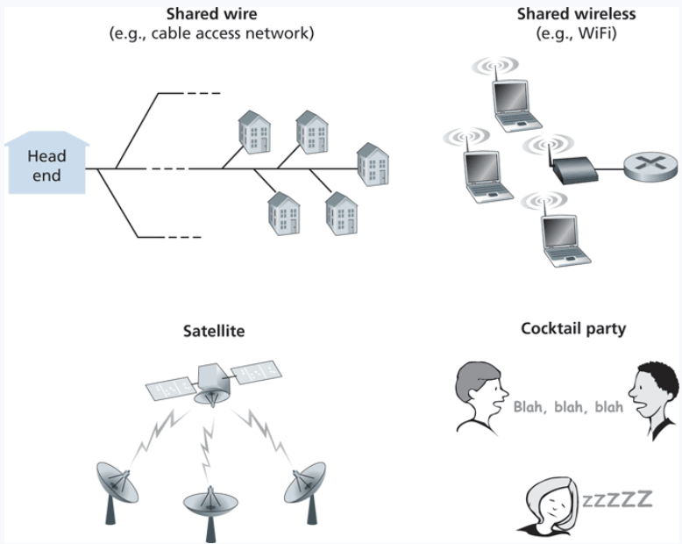

Multiple Access Links
Shared medium = possibility for receivers to get two frame at the same time, AKA a collision
Frame X
Frame y
Frames get tangled together, and neither frame can be read clearly by receiver

Slide 4
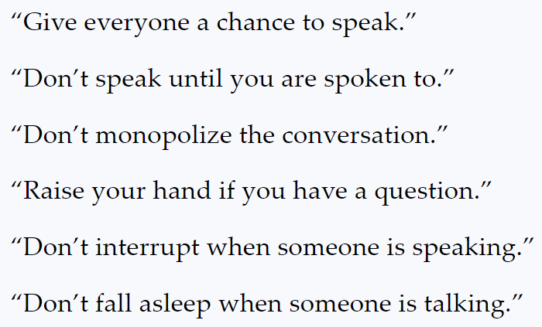
Multiple Access Links
Shared medium = possibility for receivers to get two frame at the same time, AKA a collision
Frame X
Frame y
Frames get tangled together, and neither frame can be read clearly by receiver
In English, we have some rules to prevent collisions from happening
In the link layer, we will discuss 3 multiple access protocols:
Channel Partitioning, Random Access, and Taking Turns

Slide 5
Random Access
Collisions will occur, but we will try to recover from them
Slotted ALOHA: Divide up time into discrete L/R “slots”
L = size of frame
R = Bandwidth
If collisions occur, the colliding nodes will flip a coin to see who should retransmit
L/R = Time needed to transmit one frame
L/R
2 L/R
3 L/R
…
Waiting a random delay
Waiting a random delay
Collision
Empty
Collision
Success
Empty
Collision
Success
Success

Slide 6
“Taking turns” MAC protocols
polling:
centralized controller “invites” other nodes to transmit in turn
typically used with “dumb” devices
concerns:
polling overhead
latency
single point of failure (master)
Bluetooth uses polling
data
poll
centralized controller
data
client devices

Slide 7

Taking Turns
Token Passing
Nodes are connected in a circular manner, and pass a special frame (token) between each other
Can only transmit messages if you have the token

Slide 8
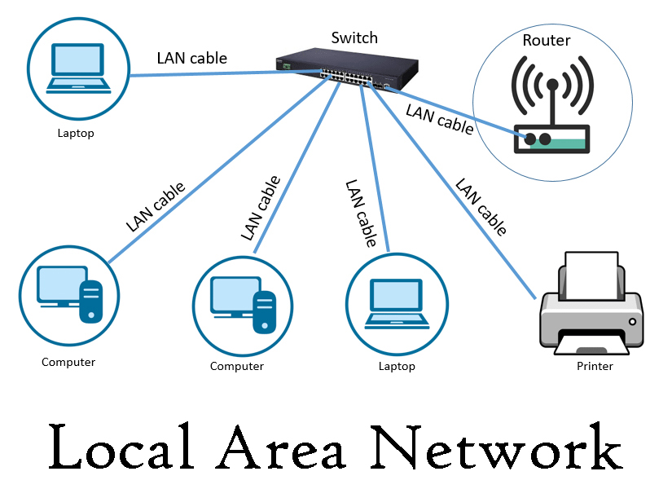
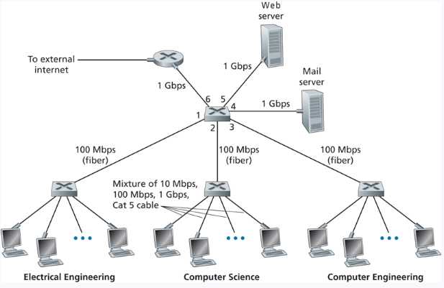
LAN
Local Area Network (LAN)- A collection of devices in one physical location, typically that share a centralized internet connection
Router
Switch
(Within a LAN, we could have several Subnets)

Slide 9
MAC addresses
32-bit IP address:
network-layer address for interface
used for layer 3 (network layer) forwarding
e.g.: 128.119.40.136
MAC (or LAN or physical or Ethernet) address:
function: used “locally” to get frame from one interface to another physically-connected interface (same subnet, in IP-addressing sense)
48-bit MAC address (for most LANs) burned in NIC ROM, also sometimes software settable
e.g.: 1A-2F-BB-76-09-AD
hexadecimal (base 16) notation
(each “numeral” represents 4 bits)

Slide 10
Why do we need MAC addresses?
We need a way to physically identify a device on a network
IP addresses change frequently, but a MAC address will always be the same
An IP address is used to locate a device, a MAC address is used to identify a device
IP Address = Street Address, MAC Address = Name of person living in House
We need both an IP address and a MAC address to transmit a message

Slide 11


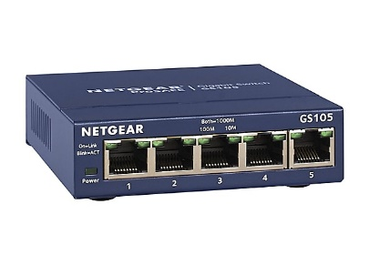




192.168.0.4
01-08-4C-42-1B-52
192.168.0.1
04-06-2C-58-C5-78
192.168.0.2
192.168.0.3
00-04-5A-63-A1-66
02-06-1B-45-A2-12

Slide 12





192.168.0.4
01-08-4C-42-1B-52
192.168.0.1
04-06-2C-58-C5-78
DST IP: 192.168.0.3
192.168.0.2
192.168.0.3
00-04-5A-63-A1-66
02-06-1B-45-A2-12

Slide 13
192.168.0.4
C
01-08-4C-42-1B-52
192.168.0.1
04-06-2C-58-C5-78
DST IP: 192.168.0.3
A
B
192.168.0.2
192.168.0.3
00-04-5A-63-A1-66
02-06-1B-45-A2-12
We need Computer B’s MAC address!

Slide 14
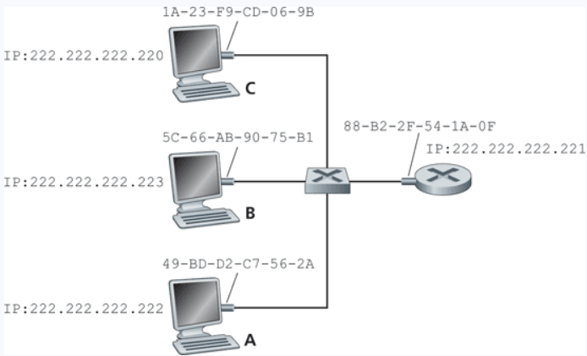
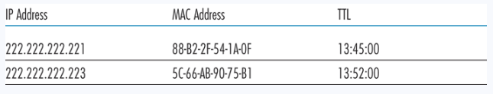
ARP
Protocol for mapping IP Addresses to MAC addresses
Used only for hosts and router interfaces on the same subnet
First the machine checks its ARP table
If the entry does not exist in the table, construct and send an ARP packet
Broadcasts the ARP packet to all interfaces on the LAN (255.255.255.255)
These tables are self-updated, and do not require manual entry*

Slide 15
ARP
A wants to send datagram to B
B’s MAC address not in A’s ARP table.
A broadcasts ARP query packet, containing B's IP address
destination MAC address = FF-FF-FF-FF-FF-FF
all nodes on LAN receive ARP query
B receives ARP packet, replies to A with its (B's) MAC address
frame sent to A’s MAC address (unicast)
A caches (saves) IP-to-MAC address pair in its ARP table until information becomes old (times out)
soft state: information that times out (goes away) unless refreshed
ARP is “plug-and-play”:
nodes create their ARP tables without intervention from net administrator

Slide 16
192.168.0.4
C
01-08-4C-42-1B-52
192.168.0.1
04-06-2C-58-C5-78
DST IP: 192.168.0.3
A
B
192.168.0.2
192.168.0.3
00-04-5A-63-A1-66
Computer A see’s that this IP is in its “group”, so it knows that Computer B must be in the same subnet!
02-06-1B-45-A2-12

Slide 17
192.168.0.4
C
01-08-4C-42-1B-52
192.168.0.1
04-06-2C-58-C5-78
DST IP: 192.168.0.3
A
B
192.168.0.2
192.168.0.3
00-04-5A-63-A1-66
Broadcast an ARP request to the subnet, and hope that we get a response back
02-06-1B-45-A2-12

Slide 18
192.168.0.4
C
01-08-4C-42-1B-52
192.168.0.1
04-06-2C-58-C5-78
Who is 192.168.0.3?
I need your MAC Address
DST IP: 192.168.0.3
A
B
192.168.0.2
192.168.0.3
00-04-5A-63-A1-66
Broadcast an ARP request to the subnet, and hope that we get a response back
02-06-1B-45-A2-12

Slide 19
192.168.0.4
C
01-08-4C-42-1B-52
192.168.0.1
04-06-2C-58-C5-78
Who is 192.168.0.3?
I need your MAC Address
DST IP: 192.168.0.3
!!!
My MAC Address is:
02-06-1B-45-A2-12
A
B
192.168.0.2
192.168.0.3
00-04-5A-63-A1-66
Broadcast an ARP request to the subnet, and hope that we get a response back
02-06-1B-45-A2-12

Slide 20


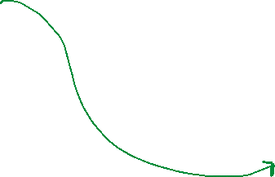
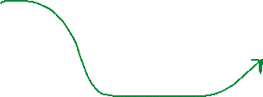
192.168.0.4
C
01-08-4C-42-1B-52
192.168.0.1
04-06-2C-58-C5-78
DST IP: 192.168.0.3
DST MAC: 02-06-1B-45-A2-12
!!!
My MAC Address is:
02-06-1B-45-A2-12
A
B
192.168.0.2
192.168.0.3
00-04-5A-63-A1-66
Broadcast an ARP request to the subnet, and hope that we get a response back
02-06-1B-45-A2-12

Slide 21
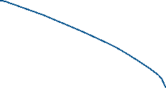

192.168.0.1
04-06-2C-58-C5-78
34.11.16.58
23.44.76.81
DST IP: 12.56.78.34
G
A
12.56.78.34
Google.com
192.168.0.2
00-04-5A-63-A1-66
Home LAN

Slide 22


192.168.0.1
04-06-2C-58-C5-78
34.11.16.58
23.44.76.81
DST IP: 12.56.78.34
G
A
12.56.78.34
Google.com
This IP address is not in its “group”, so it forwards it to the default gateway
192.168.0.2
00-04-5A-63-A1-66
(In most cases, we will need to issue an ARP request to get the MAC address of the default gateway)
Home LAN

Slide 23
192.168.0.1
04-06-2C-58-C5-78
34.11.16.58
23.44.76.81
DST IP: 12.56.78.34
G
A
12.56.78.34
Google.com
The gateway router will look at the IP address of the packet, and determine the best route to get to google.com (network layer)
192.168.0.2
00-04-5A-63-A1-66
Home LAN

Slide 24

192.168.0.1
04-06-2C-58-C5-78
34.11.16.58
23.44.76.81
DST IP: 12.56.78.34
G
A
12.56.78.34
Google.com
It now needs to forward the packet to 34.11.16.58, but it does not know its MAC address
192.168.0.2
00-04-5A-63-A1-66
Home LAN

Slide 25

Who is 34.11.16.58?
I need your MAC Address
192.168.0.1
04-06-2C-58-C5-78
34.11.16.58
23.44.76.81
DST IP: 12.56.78.34
G
A
12.56.78.34
Google.com
It now needs to forward the packet to 34.11.16.58, but it does not know its MAC address
192.168.0.2
00-04-5A-63-A1-66
Issue another ARP request!
Home LAN

Slide 26
Who is 34.11.16.58?
I need your MAC Address
My MAC address is:
05-52-3F-10-C5-57
192.168.0.1
04-06-2C-58-C5-78
34.11.16.58
23.44.76.81
05-52-3F-10-C5-57
DST IP: 12.56.78.34
G
A
12.56.78.34
Google.com
It now needs to forward the packet to 34.11.16.58, but it does not know its MAC address
192.168.0.2
00-04-5A-63-A1-66
Issue another ARP request!
Home LAN

Slide 27
192.168.0.1
04-06-2C-58-C5-78
34.11.16.58
23.44.76.81
05-52-3F-10-C5-57
DST IP: 12.56.78.34
G
A
12.56.78.34
Google.com
192.168.0.2
The next destination is 23.44.76.81, but we need its MAC address!
00-04-5A-63-A1-66
Home LAN

Slide 28






My MAC address is:
09-12-0D-25-D8-74
192.168.0.1
04-06-2C-58-C5-78
34.11.16.58
23.44.76.81
05-52-3F-10-C5-57
DST IP: 12.56.78.34
G
A
12.56.78.34
Google.com
192.168.0.2
The next destination is 23.44.76.81, but we need its MAC address!
Do another ARP!
00-04-5A-63-A1-66
(Remember that ARP gets broadcasted to all direct neighbors)
Home LAN

Slide 29

192.168.0.1
04-06-2C-58-C5-78
34.11.16.58
23.44.76.81
05-52-3F-10-C5-57
09-12-0D-25-D8-74
DST IP: 12.56.78.34
G
A
12.56.78.34
Google.com
192.168.0.2
00-04-5A-63-A1-66
Home LAN

Slide 30
Who is 12.56.78.34?
I need your MAC Address
192.168.0.1
04-06-2C-58-C5-78
34.11.16.58
23.44.76.81
My MAC address is:
01-33-2F-84-B8-55
05-52-3F-10-C5-57
09-12-0D-25-D8-74
DST IP: 12.56.78.34
G
A
12.56.78.34
Google.com
We need to issue one final ARP request, and get the MAC address of our final destination
192.168.0.2
00-04-5A-63-A1-66
Home LAN

Slide 31

192.168.0.1
04-06-2C-58-C5-78
34.11.16.58
23.44.76.81
05-52-3F-10-C5-57
09-12-0D-25-D8-74
DST IP: 12.56.78.34
G
A
12.56.78.34
Google.com
01-33-2F-84-B8-55
We need to issue one final ARP request, and get the MAC address of our final destination
192.168.0.2
00-04-5A-63-A1-66
Home LAN

Slide 32
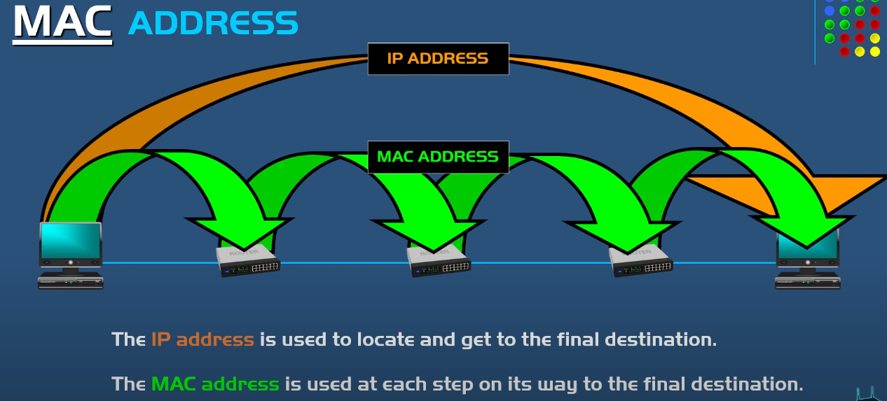

Slide 33
Finding your MAC Address
Ipconfig/all

Slide 34
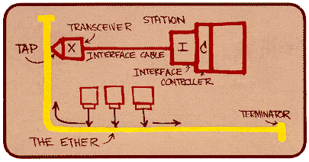
Ethernet
“dominant” wired LAN technology:
single chip, multiple speeds (e.g., Broadcom BCM5761)
first widely used LAN technology
simpler, cheap
kept up with speed race: 10 Mbps – 10 Gbps
Metcalfe’s Ethernet sketch

Slide 35


Ethernet
Ethernet Topology
switch
star
bus: coaxial cable
(outdated)
Link Layer and LANs

Slide 36
Ethernet frame structure
sending adapter encapsulates IP datagram (or other network layer protocol packet) in Ethernet frame
preamble:
7 bytes with pattern 10101010 followed by one byte with pattern 10101011
used to synchronize receiver, sender clock rates
type
preamble
dest.
address
source
address
data (payload)
CRC

Slide 37
Ethernet frame structure (more)
addresses: 6 byte source, destination MAC addresses
if adapter receives frame with matching destination address, or with broadcast address (e.g. ARP packet), it passes data in frame to network layer protocol
otherwise, adapter discards frame
type: indicates higher layer protocol (mostly IP but others possible, e.g., Novell IPX, AppleTalk)
CRC: cyclic redundancy check at receiver
error detected: frame is dropped
type
preamble
dest.
address
source
address
data (payload)
CRC

Slide 38

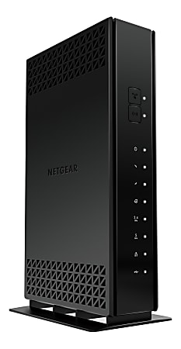







Ethernet switch
Switches will store and forward ethernet frames
Hosts have dedicated, direct connection to switch
Ethernet protocol used on each incoming link, but no collisions between links
Switching: A-A’ and B-B’ can transmit simultaneously, without collisions
Transparent: Hosts are not aware
they are connected to a switch
Plug and play; self-learning
A
C’
B
6
1
2
5
4
3
B’
C
= ethernet cable
A’

Slide 39
Switches vs. routers
application
transport
network
link
physical
both are store-and-forward:
routers: network-layer devices (examine network-layer headers)
switches: link-layer devices (examine link-layer headers)
both have forwarding tables:
routers: compute tables using routing algorithms, IP addresses
switches: learn forwarding table using flooding, learning, MAC addresses
datagram
frame
link
physical
frame
switch
network
link
physical
datagram
frame
application
transport
network
link
physical

Slide 40
https://www.youtube.com/watch?v=1z0ULvg_pW8

