Slide 1

CSCI 466: Networks
Link Layer
Reese Pearsall Fall 2022
https://www.cs.montana.edu/pearsall/classes/fall2022/466/main.html
*All images are stolen from the internet
1

Slide 2
Announcements
NO CLASS Friday 11/10
PA3 due on Wednesday
Quiz 6 on Wednesday
Link Layer (Services, Error Detection, MAC Protocols)
Link Layer (Addressing, Ethernet)
Physical, Presentation, Session Layer

Slide 3



Application Layer
OSI Model
Presentation Layer
*
Application Layer
Session Layer
*
Messages from Network Applications
Transport Layer
Network Layer
Physical Layer
Data Link Layer
Bits being transmitted over a copper wire
Physical Layer
*In the textbook, they condense it to a 5-layer model, but 7 layers is what is most used

Slide 4
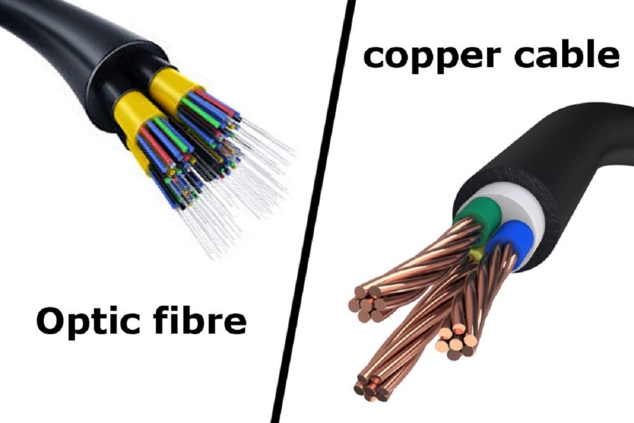
Physical Layer
Bit Pattern
Ethernet Frame
Bit Pattern
0101011101010101010101111101000010101010101010101
Goal: To transmit N bits from a transmitter to a receiver over an analog channel in a timely manner and with low error
What types of medium?
Copper Wire
Optic Fiber
Radio Frequency / Through the air

Slide 5
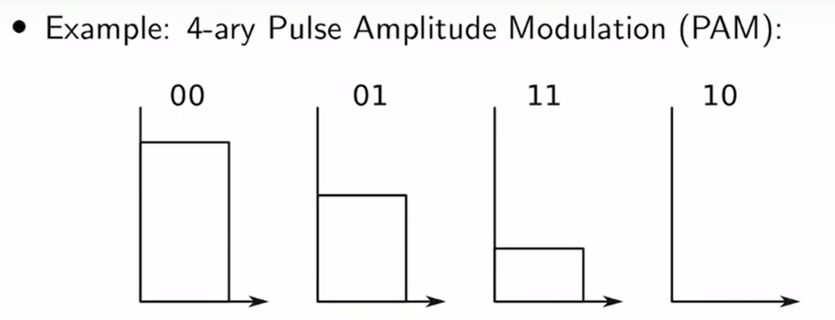
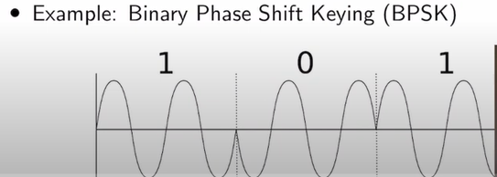

Physical Layer
0101011101010101010101111101000010101010101010101
Ethernet Frame
Representing zeros and ones in the physical layer
0 1 0 1 0 0 1
0 = no electricity
1 = electricity
There are a lot of ways to represent 0/1s

Slide 6
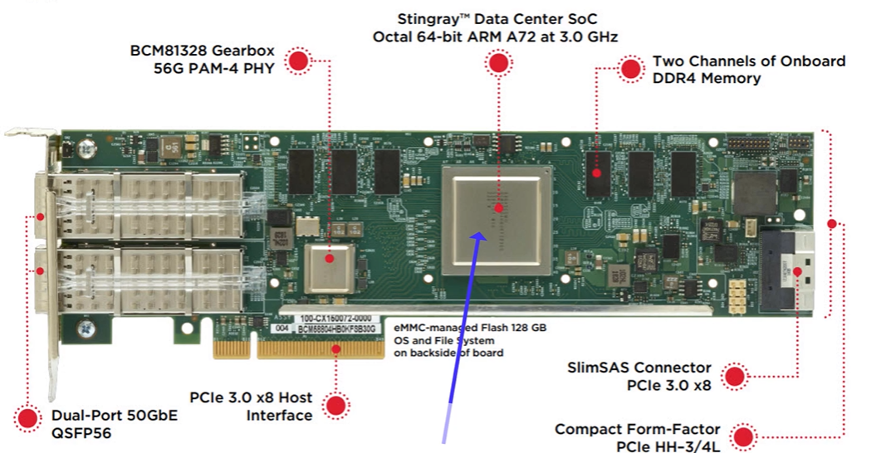

Physical Layer
0101011101010101010101111101000010101010101010101
Ethernet Frame
Representing zeros and ones in the physical layer
0 1 0 1 0 0 1
0 = no electricity
1 = electricity
There are a lot of ways to represent 0/1s

Slide 7
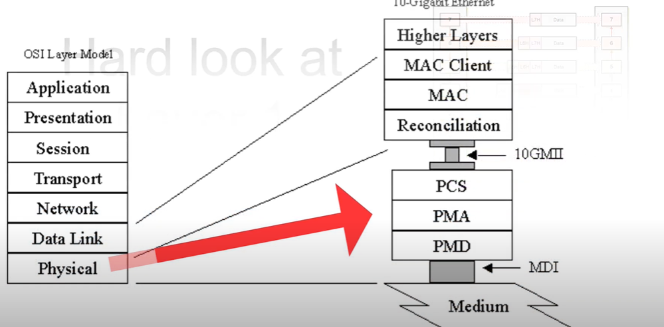
Physical Layer
0101011101010101010101111101000010101010101010101
Ethernet Frame
Physical Layer typically has three sub layers
PCS- Encoding the binary data
PMA- Parallel to serial or serial to parallel
PMD – Voltage amplifiers/LEDs/Lasers

Slide 8
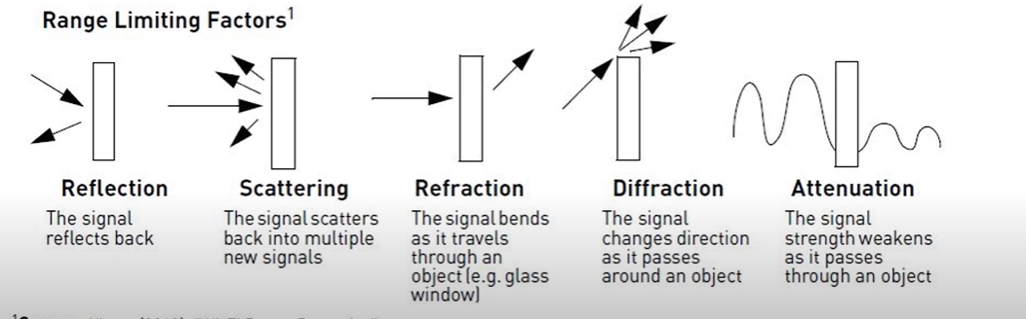
Physical Layer
0101011101010101010101111101000010101010101010101
Ethernet Frame
Noise and interference will corrupt the analog waveforms as they travel through the channel
Each analog channel has a probability p of bit error
Typical Values of p?
A wireless link may have a raw p of 1e-3, with error correction, this can be improved to 1e-6
Fiber optic link may have p of 1e-12
That a very low probability!!!

Slide 9
Physical Layer
0101011101010101010101111101000010101010101010101
Ethernet Frame
Noise and interference will corrupt the analog waveforms as they travel through the channel
Each analog channel has a probability p of bit error
Typical Values of p?
A wireless link may have a raw p of 1e-3, with error correction, this can be improved to 1e-6
Fiber optic link may have p of 1e-12
80 Mbs Wifi Link where p=1e-3 means 4,800 bit errors every minute
10 Gbps fiber optic link where p=1e-12 means 36 bit errors every hour
That a very low probability!!!

Slide 10
Physical Layer
0101011101010101010101111101000010101010101010101
Ethernet Frame
Error Patterns
Frame transmitted: 10110
Error Pattern: 10001
Suppose through error correction in the link layer, we found that a bit error occurred on the first bit and last bit of our pattern
How to get the correct bit pattern of our frame?

Slide 11
Physical Layer
0101011101010101010101111101000010101010101010101
Ethernet Frame
Error Patterns
Frame transmitted: 10110
Error Pattern: 10001
Suppose through error correction in the link layer, we found that a bit error occurred on the first bit and last bit of our pattern
We can run the XOR operator to get the correct pattern back

Slide 12
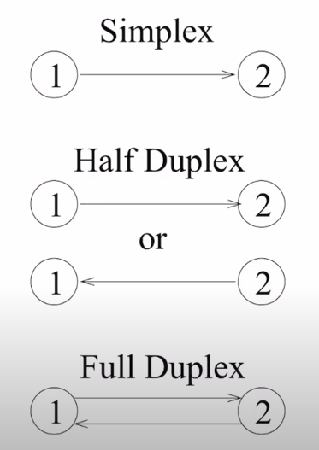
Physical Layer
0101011101010101010101111101000010101010101010101
Ethernet Frame
Physical Layer Transmission

Slide 13
Session Layer
Traffic Control between Computers
Session Layer also makes sure separate files are downloaded correctly
Controls connections and connection information
Establishes, manages, and terminates connections
Authorization, and Authentication between endpoints happens here
Secure Sockets Layer (SSL)- protocol used to establish a safe, encrypted connection between a web application and web server
Establishes a digital certificate to verify a server’s identify
No certificate? Cant do HTTPS
Certificate
Before transmitting Data, your machine may do some SSL communication to verify or check the existence of a certificate
Web Server
Client

Slide 14
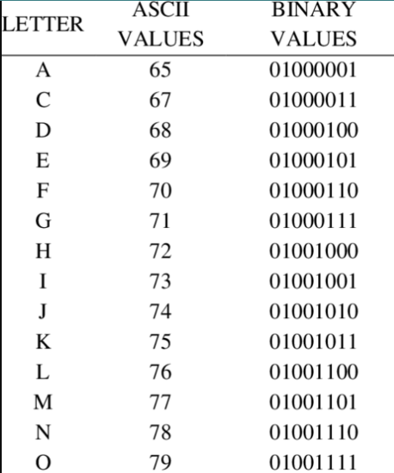
Presentation Layer
The layer that allows applications to interpret meanings of data
Three main jobs:
1. Translation
Formats data for proper compatibility between devices
ASCII
GIF
JPG
Ensures the data is readable by receiving system

Slide 15
Presentation Layer
The layer that allows applications to interpret meanings of data
Three main jobs:
Translation
Compression
“Reduce the size of some data”
Compression Algorithm
Message
Message
Data vs Information??
Type of compression:
1. Lossy- loses some of the original data during compression (is that ok?)
2. Lossless- doesn’t remove data, instead it transforms it to reduce its size

Slide 16
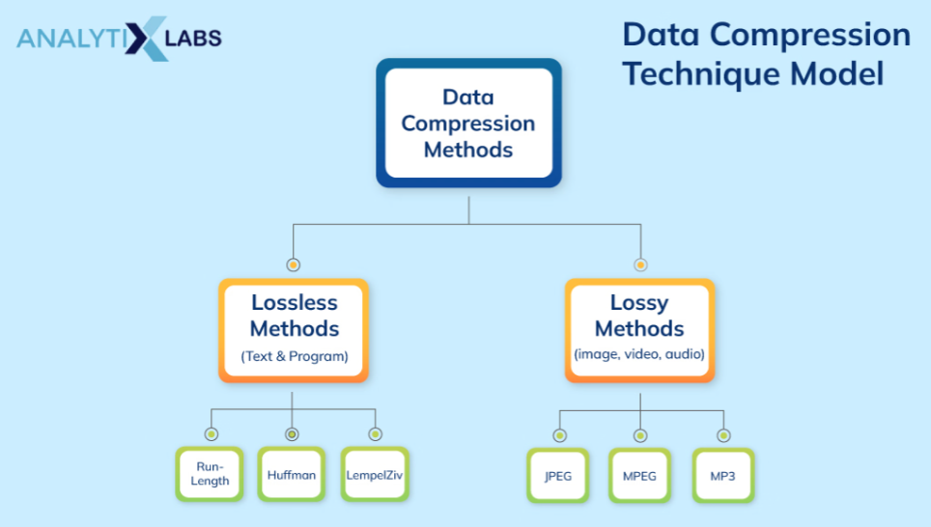
Presentation Layer
The layer that allows applications to interpret meanings of data
Three main jobs:
Translation
Compression

Slide 17
Presentation Layer
The layer that allows applications to interpret meanings of data
Three main jobs:
Translation
Compression

Slide 18



Presentation Layer
The layer that allows applications to interpret meanings of data
Three main jobs:
Translation
Compression
Encryption
Encryption- securing communication between two endpoints (typically in the presence of an adversary)
Hi there!
Shared medium
A threat actor could listen in on these channels

Slide 19

Presentation Layer
The layer that allows applications to interpret meanings of data
Three main jobs:
Translation
Compression
Encryption
Hi there!
Plaintext
Ciphertext
Xb8yDD54zmbm/JFr9phqTjMzKV98m88kMYfvSqBoe+Q=
Encryption- securing communication between two endpoints (typically in the presence of an adversary)
Hi there!
Xb8yDD54zmbm/JFr9phqTjMzKV98m88kMYfvSqBoe+Q=
Bob encrypts his message using a key

Slide 20
Presentation Layer
The layer that allows applications to interpret meanings of data
Three main jobs:
Translation
Compression
Encryption
Hi there!
Plaintext
Ciphertext
Xb8yDD54zmbm/JFr9phqTjMzKV98m88kMYfvSqBoe+Q=
Encryption- securing communication between two endpoints (typically in the presence of an adversary)
Xb8yDD54zmbm/JFr9phqTjMzKV98m88kMYfvSqBoe+Q=
Hi there!
Bob encrypts his message using a key
And sends the ciphertext over the channel

Slide 21
Presentation Layer
The layer that allows applications to interpret meanings of data
Three main jobs:
Translation
Compression
Encryption
Hi there!
Plaintext
Ciphertext
Xb8yDD54zmbm/JFr9phqTjMzKV98m88kMYfvSqBoe+Q=
Encryption- securing communication between two endpoints (typically in the presence of an adversary)
Xb8yDD54zmbm/JFr9phqTjMzKV98m88kMYfvSqBoe+Q=
Hi there!
Alice receives the ciphertext and decrypts it with her key
Hi there!
Bob encrypts his message using a key
And sends the ciphertext over the channel

Slide 22
Presentation Layer
The layer that allows applications to interpret meanings of data
Three main jobs:
Translation
Compression
Encryption
Hi there!
Plaintext
Ciphertext
Xb8yDD54zmbm/JFr9phqTjMzKV98m88kMYfvSqBoe+Q=
Encryption- securing communication between two endpoints (typically in the presence of an adversary)
Symmetric Cryptography (Secret Key Encryption)- Same set of keys are used

Slide 23



Presentation Layer
The layer that allows applications to interpret meanings of data
Three main jobs:
Translation
Compression
Encryption
Hi there!
Plaintext
Ciphertext
Xb8yDD54zmbm/JFr9phqTjMzKV98m88kMYfvSqBoe+Q=
Encryption- securing communication between two endpoints (typically in the presence of an adversary)
Asymmetric Cryptography (Public Key Encryption)- Different set of keys are used

Slide 24
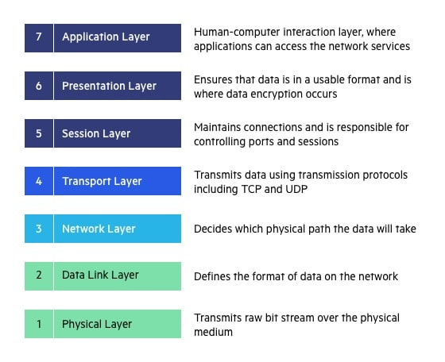

Slide 25



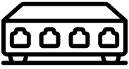












School
Network
Bob
Comcast
Network
DNS Server
Bob joins MSU’s school network for the first time, and wants to visit google.com on his web browser, what happens?
Google
Network
Web Server

Slide 26












School
Network
Bob
Comcast
Network
DNS Server
Bob joins MSU’s school network for the first time, and wants to visit google.com on his web browser, what happens? Bob needs an IP address!
Google
Network
Web Server

Slide 27
School
Network
Bob
Comcast
Network
DNS Server
The operating system on Bob’s laptop creates a DHCP request message and puts this message within a UDP segment with destination port 67 and source port 68. The UDP segment is then placed within an IP datagram with a broadcast IP destination address (255.255.255.255) and a source IP address of 0.0.0.0, since Bob’s laptop doesn’t yet have an IP address.
Google
Network
Web Server

Slide 28
School
Network
Bob
Comcast
Network
DNS Server
00:16:D3:23:68:8A
The IP datagram containing the DHCP request message is then placed within an Ethernet frame. The Ethernet frame has a destination MAC addresses of FF:FF:FF:FF:FF:FF so that the frame will be broadcast to all devices connected to the switch (hopefully including a DHCP server); the frame’s source MAC address is that of Bob’s laptop, 00:16:D3:23:68:8A
Google
Network
Web Server

Slide 29

School
Network
Bob
Comcast
Network
DNS Server
00:16:D3:23:68:8A
Google
Network
The broadcast Ethernet frame containing the DHCP request is the first frame sent by Bob’s laptop to the Ethernet switch. The switch broadcasts the incoming frame on all outgoing ports, including the port connected to the router.
Web Server

Slide 30
School
Network
Bob
Comcast
Network
DNS Server
00:16:D3:23:68:8A
The router receives the broadcast Ethernet frame containing the DHCP request on its interface and the IP datagram is extracted from the Ethernet frame. The datagram’s broadcast IP destination address indicates that this IP datagram should be processed by upper layer protocols at this node, so the datagram’s payload (a UDP segment) is thus demultiplexed up to UDP, and the DHCP request message is extracted from the UDP segment. The DHCP server now has the DHCP request message.
Google
Network
Web Server

Slide 31
School
Network
Bob
Comcast
Network
DNS Server
68.87.71.226
00:16:D3:23:68:8A
68.85.2.1
Let’s suppose the DHCP server allocates address 10.5.5.5 to Bob’s laptop. The DHCP server creates a DHCP ACK message containing this IP address, as well as the IP address of the DNS server (68.87.71.226), the IP address for the default gateway router (68.85.2.1), and the subnet block. The DHCP message is put inside a UDP segment, which is put inside an IP datagram, which is put inside an Ethernet frame. The Ethernet frame has a a destination MAC address of Bob’s laptop (00:16:D3:23:68:8A).
Google
Network
Web Server

Slide 32
School
Network
Bob
Comcast
Network
DNS Server
68.87.71.226
00:16:D3:23:68:8A
10.5.5.5
68.85.2.1
Google
Network
The Ethernet frame containing the DHCP ACK is sent (unicast) by the router to the switch. Because the switch is self-learning and previously received an Ethernet frame (containing the DHCP request) from Bob’s laptop, the switch knows to forward a frame addressed to 00:16:D3:23:68:8A only to the output port leading to Bob’s laptop
The Ethernet frame containing the DHCP ACK is sent (unicast) by the router to the switch. Because the switch is self-learning (Section 6.4.3) and previously received an Ethernet frame (containing the DHCP request) from Bob’s laptop, the switch knows to forward a frame addressed to 00:16:D3:23:68:8A only to the output port leading to Bob’s laptop
Web Server

Slide 33
School
Network
Bob
Comcast
Network
DNS Server
68.87.71.226
00:16:D3:23:68:8A
10.5.5.5
68.85.2.1
Bob’s laptop receives the Ethernet frame containing the DHCP ACK, extracts the IP datagram from the Ethernet frame, extracts the UDP segment from the IP datagram, and extracts the DHCP ACK message from the UDP segment. Bob’s DHCP client then records its IP address and the IP address of its DNS server. It also installs the address of the default gateway into its IP forwarding table. Bob’s laptop will send all datagrams with destination address outside of its subnet to the default gateway.
Google
Network
The Ethernet frame containing the DHCP ACK is sent (unicast) by the router to the switch. Because the switch is self-learning (Section 6.4.3) and previously received an Ethernet frame (containing the DHCP request) from Bob’s laptop, the switch knows to forward a frame addressed to 00:16:D3:23:68:8A only to the output port leading to Bob’s laptop
Web Server

Slide 34
School
Network
Bob
Comcast
Network
DNS Server
68.87.71.226
00:16:D3:23:68:8A
10.5.5.5
68.85.2.1
Google
Network
The Ethernet frame containing the DHCP ACK is sent (unicast) by the router to the switch. Because the switch is self-learning (Section 6.4.3) and previously received an Ethernet frame (containing the DHCP request) from Bob’s laptop, the switch knows to forward a frame addressed to 00:16:D3:23:68:8A only to the output port leading to Bob’s laptop
What’s next?
Web Server

Slide 35
School
Network
Bob
Comcast
Network
DNS Server
68.87.71.226
00:16:D3:23:68:8A
10.5.5.5
68.85.2.1
The operating system on Bob’s laptop thus creates a DNS query message, putting the string “www.google.com” in the question section of the DNS message. This DNS message is then placed within a UDP segment with a destination port of 53 (DNS server). The UDP segment is then placed within an IP datagram with an IP destination address of 68.87.71.226 and a source IP address of 10.5.5.5
Google
Network
Web Server

Slide 36
School
Network
Bob
Comcast
Network
DNS Server
68.87.71.226
00:16:D3:23:68:8A
10.5.5.5
68.85.2.1
Bob’s laptop then places the datagram containing the DNS query message in an Ethernet frame. This frame will be sent (addressed, at the link layer) to the gateway router in Bob’s school’s network. However, even though Bob’s laptop knows the IP address of the school’s gateway router (68.85.2.1) via the DHCP ACK message, it doesn’t know the gateway router’s MAC address. In order to obtain the MAC address of the gateway router, Bob’s laptop will need to use the ARP protocol
Google
Network
Web Server

Slide 37
School
Network
Bob
Comcast
Network
DNS Server
68.87.71.226
00:16:D3:23:68:8A
10.5.5.5
68.85.2.1
Bob’s laptop creates an ARP query message with a target IP address of 68.85.2.1 (the default gateway), places the ARP message within an Ethernet frame with a broadcast destination address (FF:FF:FF:FF:FF:FF) and sends the Ethernet frame to the switch, which delivers the frame to all connected devices, including the gateway router
Google
Network
Web Server

Slide 38
School
Network
Bob
Comcast
Network
DNS Server
68.87.71.226
00:16:D3:23:68:8A
10.5.5.5
68.85.2.1
The gateway router receives the frame containing the ARP query message on the interface to the school network, and finds that the target IP address of 68.85.2.1 in the ARP message matches the IP address of its interface. The gateway router thus prepares an ARP reply, indicating that its MAC address of 00:22:6B:45:1F:1B corresponds to IP address 68.85.2.1. It places the ARP reply message in an Ethernet frame, with a destination address of 00:16:D3:23:68:8A (Bob’s laptop) and sends the frame to the switch, which delivers the frame to Bob’s laptop
Google
Network
Web Server

Slide 39
School
Network
Bob
Comcast
Network
DNS Server
68.87.71.226
00:16:D3:23:68:8A
10.5.5.5
68.85.2.1
00:22:6B:45:1F:1B
Google
Network
Bob’s laptop receives the frame containing the ARP reply message and extracts the MAC address of the gateway router (00:22:6B:45:1F:1B) from the ARP reply message.
Web Server

Slide 40
School
Network
Bob
Comcast
Network
DNS Server
68.87.71.226
00:16:D3:23:68:8A
10.5.5.5
68.85.2.1
00:22:6B:45:1F:1B
Google
Network
Bob’s laptop can now (finally!) address the Ethernet frame containing the DNS query to the gateway router’s MAC address. Note that the IP datagram in this frame has an IP destination address of 68.87.71.226 (the DNS server), while the frame has a destination address of 00:22:6B:45:1F:1B (the gateway router). Bob’s laptop sends this frame to the switch, which delivers the frame to the gateway router.
Web Server

Slide 41
School
Network
Bob
Comcast
Network
DNS Server
68.87.71.226
00:16:D3:23:68:8A
10.5.5.5
NAT
68.85.2.1
00:22:6B:45:1F:1B
(NAT will translate any private IP address to public IP address)
The gateway router receives the frame and extracts the IP datagram containing the DNS query. The router looks up the destination address of this datagram (68.87.71.226) and determines from its forwarding table that the datagram should be sent to the leftmost router in the Comcast network. The IP datagram is placed inside a link-layer frame appropriate for the link connecting the school’s router to the leftmost Comcast router and the frame is sent over this link.
Google
Network
Web Server

Slide 42
School
Network
Bob
Comcast
Network
DNS Server
68.87.71.226
00:16:D3:23:68:8A
10.5.5.5
NAT
68.85.2.1
00:22:6B:45:1F:1B
The leftmost router in the Comcast network receives the frame, extracts the IP datagram, examines the datagram’s destination address (68.87.71.226) and determines the outgoing interface on which to forward the datagram toward the DNS server from its forwarding table, which has been filled in by Comcast’s intra-domain protocol (such as) as well as the Internet’s inter-domain protocol, BGP
Google
Network
Web Server

Slide 43
School
Network
Bob
Comcast
Network
DNS Server
68.87.71.226
00:16:D3:23:68:8A
10.5.5.5
NAT
68.85.2.1
00:22:6B:45:1F:1B
Eventually the IP datagram containing the DNS query arrives at the DNS server. The DNS server extracts the DNS query message, looks up the name www.google.com in its DNS database and finds the DNS resource record that contains the IP address (64.233.169.105) for www.google.com. (assuming that it is currently cached in the DNS server). Recall that this cached data originated in the authoritative DNS server for google.com. The DNS server forms a DNS reply message containing this hostname-to-IP-address mapping, and places the DNS reply message in a UDP segment, and the segment within an IP datagram addressed to Bob’s public IP (68.85.2.1). This datagram will be forwarded back through the Comcast network to the school’s router and from there, via the Ethernet switch to Bob’s laptop
Google
Network
Web Server

Slide 44
School
Network
Bob
Comcast
Network
DNS Server
68.87.71.226
00:16:D3:23:68:8A
10.5.5.5
NAT
68.85.2.1
00:22:6B:45:1F:1B
Google
Network
Bob’s laptop extracts the IP address of the server www.google.com from the DNS message. Finally, after a lot of work, Bob’s laptop is now ready to contact the www.google.com server!
Web Server
64.233.169.105

Slide 45
School
Network
Bob
Comcast
Network
DNS Server
68.87.71.226
00:16:D3:23:68:8A
10.5.5.5
NAT
68.85.2.1
00:22:6B:45:1F:1B
Google
Network
Now what?
Web Server
64.233.169.105

Slide 46
School
Network
Bob
Comcast
Network
DNS Server
68.87.71.226
00:16:D3:23:68:8A
10.5.5.5
NAT
68.85.2.1
00:22:6B:45:1F:1B
Now that Bob’s laptop has the IP address of www.google.com, it can create the TCP socket that will be used to send the HTTP GET message to www.google.com. When Bob creates the TCP socket, the TCP in Bob’s laptop must first perform a three-way handshake with the TCP in www.google.com. Bob’s laptop thus first creates a TCP SYN segment with destination port 80 (for HTTP), places the TCP segment inside an IP datagram with a destination IP address of 64.233.169.105 (www.google.com), places the datagram inside a frame with a destination MAC address of 00:22:6B:45:1F:1B (the gateway router) and sends the frame to the switch
Google
Network
Web Server
64.233.169.105

Slide 47
School
Network
Bob
Comcast
Network
DNS Server
68.87.71.226
00:16:D3:23:68:8A
10.5.5.5
NAT
68.85.2.1
00:22:6B:45:1F:1B
The routers in the school network, Comcast’s network, and Google’s network forward the datagram containing the TCP SYN toward www.google.com, using the forwarding table in each router. Recall that the router forwarding table entries governing forwarding of packets over the inter-domain link between the Comcast and Google networks are determined by the BGP protocol
Google
Network
Web Server
64.233.169.105

Slide 48
School
Network
Bob
Comcast
Network
DNS Server
68.87.71.226
00:16:D3:23:68:8A
10.5.5.5
NAT
68.85.2.1
00:22:6B:45:1F:1B
The routers in the school network, Comcast’s network, and Google’s network forward the datagram containing the TCP SYN toward www.google.com, using the forwarding table in each router. Recall that the router forwarding table entries governing forwarding of packets over the inter-domain link between the Comcast and Google networks are determined by the BGP protocol
Google
Network
Web Server
64.233.169.105

Slide 49
School
Network
Bob
Comcast
Network
DNS Server
68.87.71.226
00:16:D3:23:68:8A
10.5.5.5
NAT
68.85.2.1
00:22:6B:45:1F:1B
Eventually, the datagram containing the TCP SYN arrives at www.google.com. The TCP SYN message is extracted from the datagram and demultiplexed to the welcome socket associated with port 80. A connection socket is created for the TCP connection between the Google HTTP server and Bob’s laptop. A TCP SYNACK segment is generated, placed inside a datagram addressed to Bob’s laptop, and finally placed inside a link-layer frame appropriate for the link connecting www.google.com to its first-hop router.
Google
Network
Web Server
64.233.169.105

Slide 50
School
Network
Bob
Comcast
Network
DNS Server
68.87.71.226
00:16:D3:23:68:8A
10.5.5.5
NAT
68.85.2.1
00:22:6B:45:1F:1B
Google
Network
The datagram containing the TCP SYNACK segment is forwarded through the Google, Comcast, and school networks, eventually arriving at the Ethernet controller in Bob’s laptop. The datagram is demultiplexed within the operating system to the TCP socket
Web Server
64.233.169.105

Slide 51
School
Network
Bob
Comcast
Network
DNS Server
68.87.71.226
00:16:D3:23:68:8A
10.5.5.5
NAT
68.85.2.1
00:22:6B:45:1F:1B
Google
Network
The datagram containing the TCP SYNACK segment is forwarded through the Google, Comcast, and school networks, eventually arriving at the Ethernet controller in Bob’s laptop. The datagram is demultiplexed within the operating system to the TCP socket
Web Server
64.233.169.105

Slide 52
School
Network
Bob
Comcast
Network
DNS Server
68.87.71.226
00:16:D3:23:68:8A
10.5.5.5
NAT
68.85.2.1
00:22:6B:45:1F:1B
Google
Network
The datagram containing the TCP SYNACK segment is forwarded through the Google, Comcast, and school networks, eventually arriving at the Ethernet controller in Bob’s laptop. The datagram is demultiplexed within the operating system to the TCP socket
Web Server
64.233.169.105

Slide 53
School
Network
Bob
Comcast
Network
DNS Server
68.87.71.226
00:16:D3:23:68:8A
10.5.5.5
NAT
68.85.2.1
00:22:6B:45:1F:1B
Google
Network
The datagram containing the TCP SYNACK segment is forwarded through the Google, Comcast, and school networks, eventually arriving at the Ethernet controller in Bob’s laptop. The datagram is demultiplexed within the operating system to the TCP socket
Web Server
64.233.169.105

Slide 54
School
Network
Bob
Comcast
Network
DNS Server
68.87.71.226
00:16:D3:23:68:8A
10.5.5.5
NAT
68.85.2.1
00:22:6B:45:1F:1B
Google
Network
Bob’s laptop then sends an TCP ACK back to google’s web server to complete the TCP handshake
Web Server
64.233.169.105

Slide 55
School
Network
Bob
Comcast
Network
DNS Server
68.87.71.226
00:16:D3:23:68:8A
10.5.5.5
NAT
68.85.2.1
00:22:6B:45:1F:1B
Google
Network
Bob’s laptop then sends an TCP ACK back to google’s web server to complete the TCP handshake
Web Server
64.233.169.105

Slide 56
School
Network
Bob
Comcast
Network
DNS Server
68.87.71.226
00:16:D3:23:68:8A
10.5.5.5
NAT
68.85.2.1
00:22:6B:45:1F:1B
Google
Network
Bob’s laptop then sends an TCP ACK back to google’s web server to complete the TCP handshake
Web Server
64.233.169.105

Slide 57
School
Network
Bob
Comcast
Network
DNS Server
68.87.71.226
00:16:D3:23:68:8A
10.5.5.5
NAT
68.85.2.1
00:22:6B:45:1F:1B
Google
Network
Bob’s laptop then sends an TCP ACK back to google’s web server to complete the TCP handshake
Web Server
64.233.169.105

Slide 58
School
Network
Bob
Comcast
Network
DNS Server
TCP
68.87.71.226
00:16:D3:23:68:8A
10.5.5.5
NAT
68.85.2.1
00:22:6B:45:1F:1B
Google
Network
TCP
Now what?
Web Server
64.233.169.105

Slide 59
School
Network
Bob
Comcast
Network
DNS Server
TCP
68.87.71.226
00:16:D3:23:68:8A
10.5.5.5
NAT
68.85.2.1
00:22:6B:45:1F:1B
With the socket on Bob’s laptop now (finally!) ready to send bytes to www.google.com, Bob’s browser creates the HTTP GET message containing the URL to be fetched. The HTTP GET message is then written into the socket, with the GET message becoming the payload of a TCP segment. The TCP segment is placed in a datagram and sent and delivered to www.google.com.
Google
Network
TCP
Web Server
64.233.169.105

Slide 60
School
Network
Bob
Comcast
Network
DNS Server
TCP
68.87.71.226
00:16:D3:23:68:8A
10.5.5.5
NAT
68.85.2.1
00:22:6B:45:1F:1B
Google
Network
TCP
Web Server
64.233.169.105

Slide 61
School
Network
Bob
Comcast
Network
DNS Server
TCP
68.87.71.226
00:16:D3:23:68:8A
10.5.5.5
NAT
68.85.2.1
00:22:6B:45:1F:1B
Google
Network
TCP
Web Server
64.233.169.105

Slide 62
School
Network
Bob
Comcast
Network
DNS Server
TCP
68.87.71.226
00:16:D3:23:68:8A
10.5.5.5
NAT
68.85.2.1
00:22:6B:45:1F:1B
Google
Network
The HTTP server at www.google.com reads the HTTP GET message from the TCP socket, creates an HTTP response message places the requested Web page content in the body of the HTTP response message, and sends the message into the TCP socket
TCP
Web Server
64.233.169.105
This is only one web object…

Slide 63
School
Network
Bob
Comcast
Network
DNS Server
TCP
68.87.71.226
00:16:D3:23:68:8A
10.5.5.5
NAT
68.85.2.1
00:22:6B:45:1F:1B
The datagram containing the HTTP reply message is forwarded through the Google, Comcast, and school networks, and arrives at Bob’s laptop. Bob’s Web browser program reads the HTTP response from the socket, extracts the html for the Web page from the body of the HTTP response, and finally (finally!) displays the Web page!
Google
Network
TCP
Web Server
64.233.169.105

Slide 64
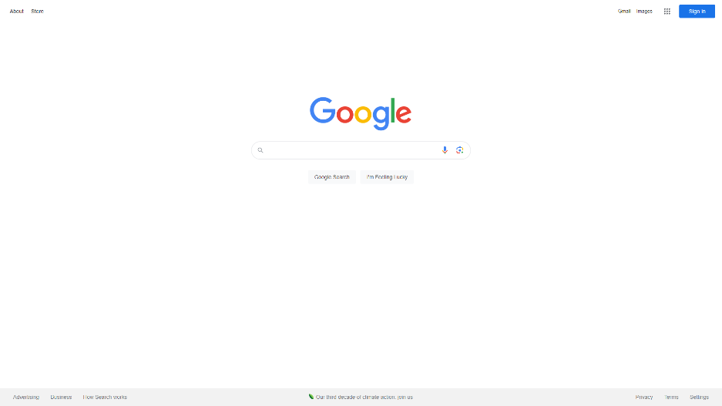

School
Network
Bob
Comcast
Network
DNS Server
TCP
68.87.71.226
00:16:D3:23:68:8A
10.5.5.5
NAT
68.85.2.1
00:22:6B:45:1F:1B
Google
Network
TCP
Web Server
64.233.169.105

