Slide 1

CSCI 466: Networks
Network Security (Network Attacks)
Reese Pearsall Fall 2023
https://www.cs.montana.edu/pearsall/classes/fall2023/466/main.html
*All images are stolen from the internet
1

Slide 2


Slide 3
Network Attacks
Disrupt services, steal data, cause damage over a network
TCP related attacks
TCP Reset
TCP Flooding
TCP Hijack
Malicious Network Routing
BGP Hijack
DNS Poisoning
We talk about some of these in-depth in CSCI 476

Slide 4
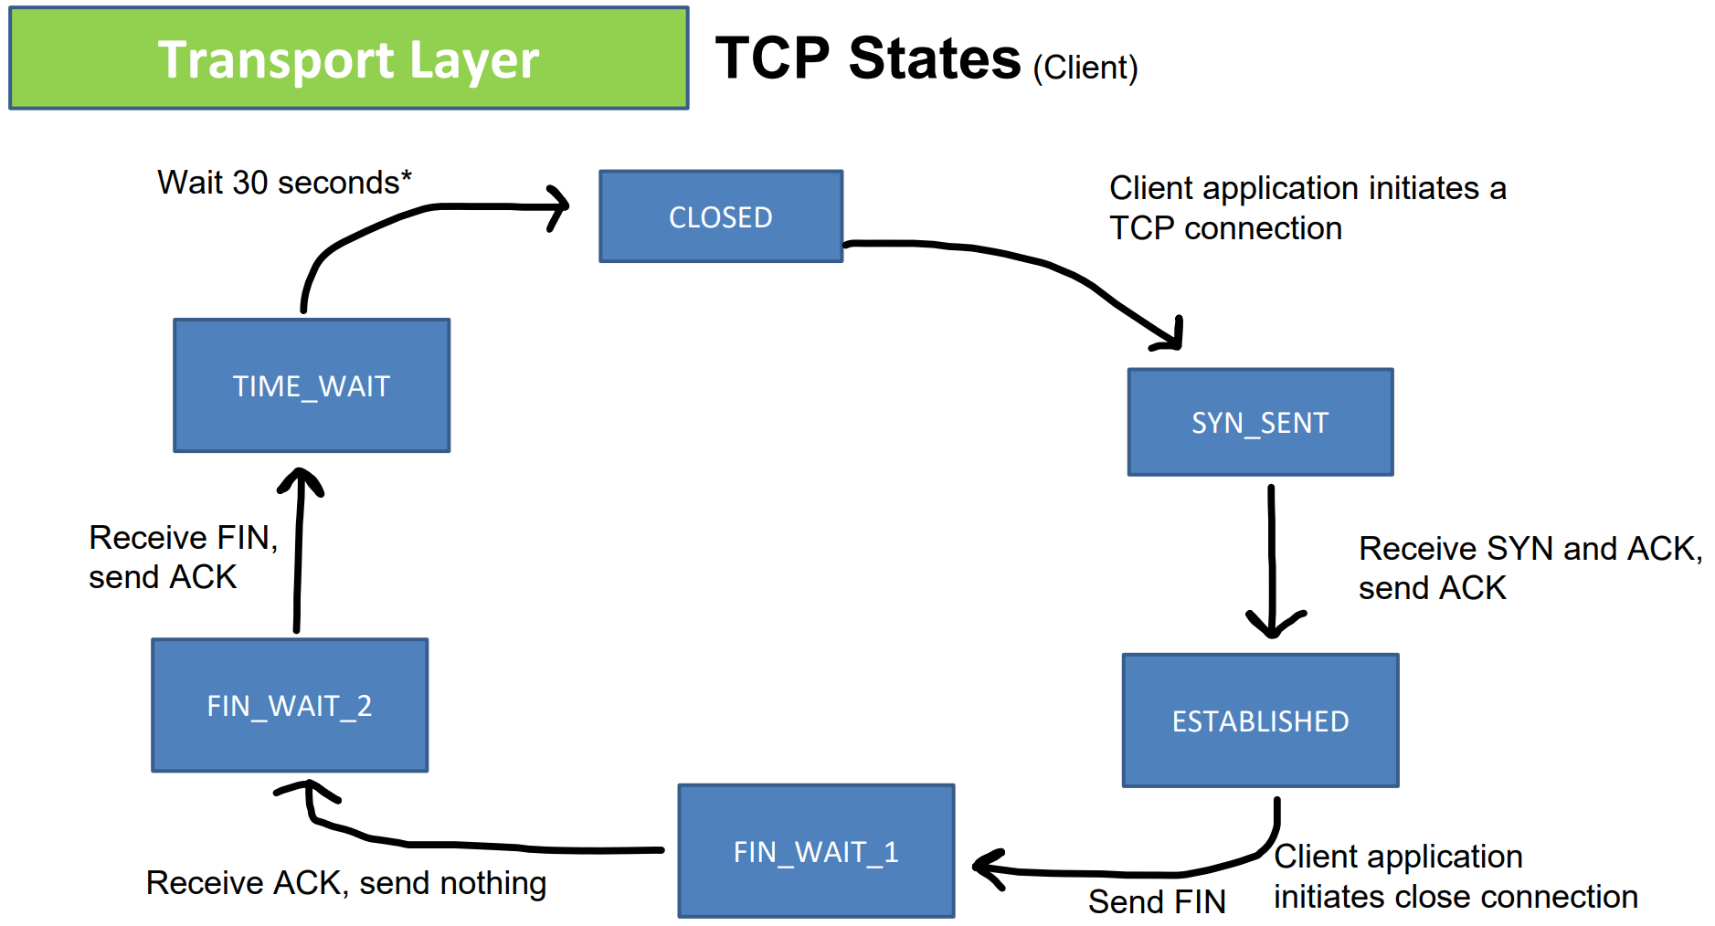
Review of TCP

Slide 5
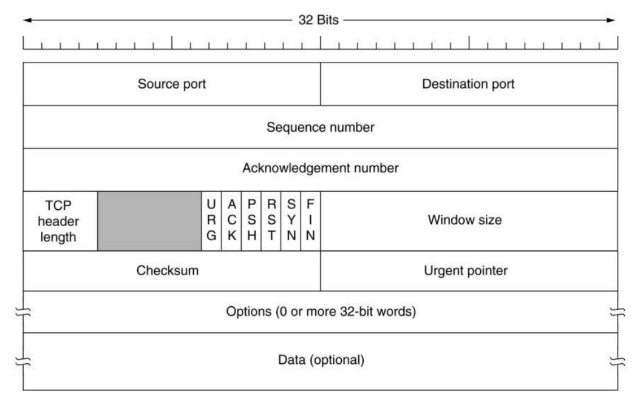
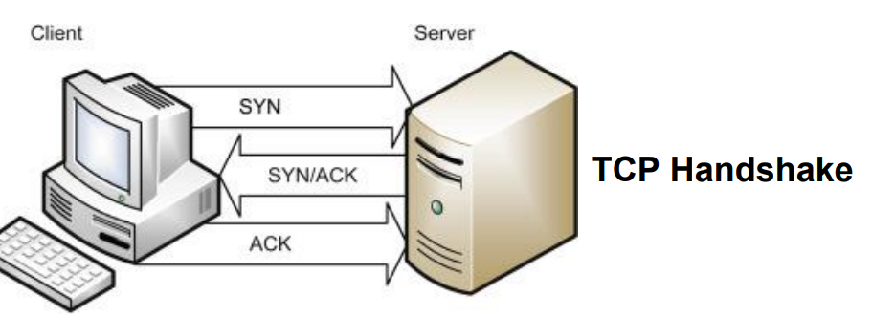


Review of TCP
If the Reset (RST) flag is set (1), then the TCP connection will be reset
If the SYN flag is set(1), then a TCP handshake will be attempted

Slide 6
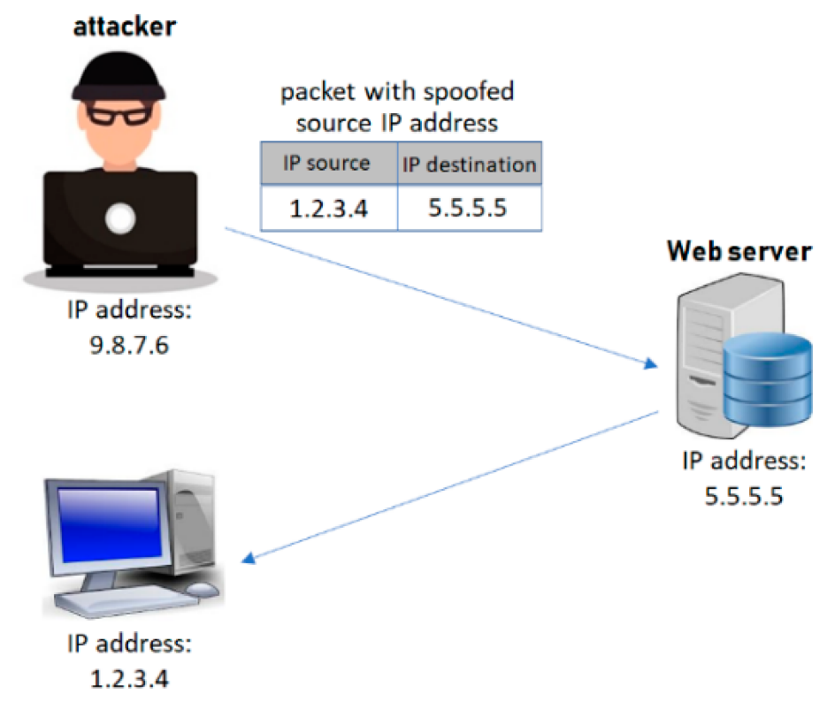
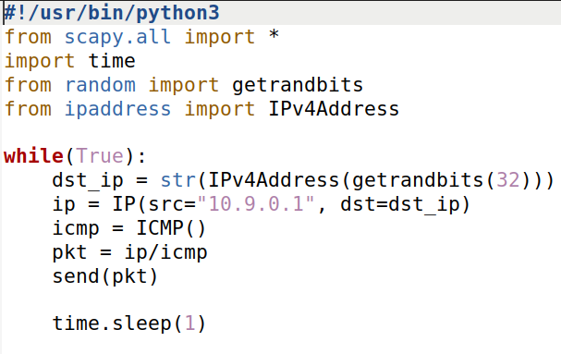
Network Attacks
Packet spoofing is the creation of network packets, typically with the purpose of impersonating another person or system
We can use the scapy module to easily construct spoofed packets
We can use scapy to spoof TCP packets….

Slide 7


SYN Flooding
The Achilles heel:
TCP servers will accept SYN requests, send out SYN+ACK, and wait to receive an ACK
TCP Client
TCP Server
SYN
SYN + ACK
Waiting for an ACK…

Slide 8
SYN Flooding
The Achilles heel:
TCP servers will accept SYN requests, send out SYN+ACK, and wait to receive an ACK
TCP Client
TCP Server
SYN
SYN + ACK
SYN + ACK
Waiting for an ACK…
SYN + ACK
If it does not get an ACK after some amount of time, it will retransmit

Slide 9
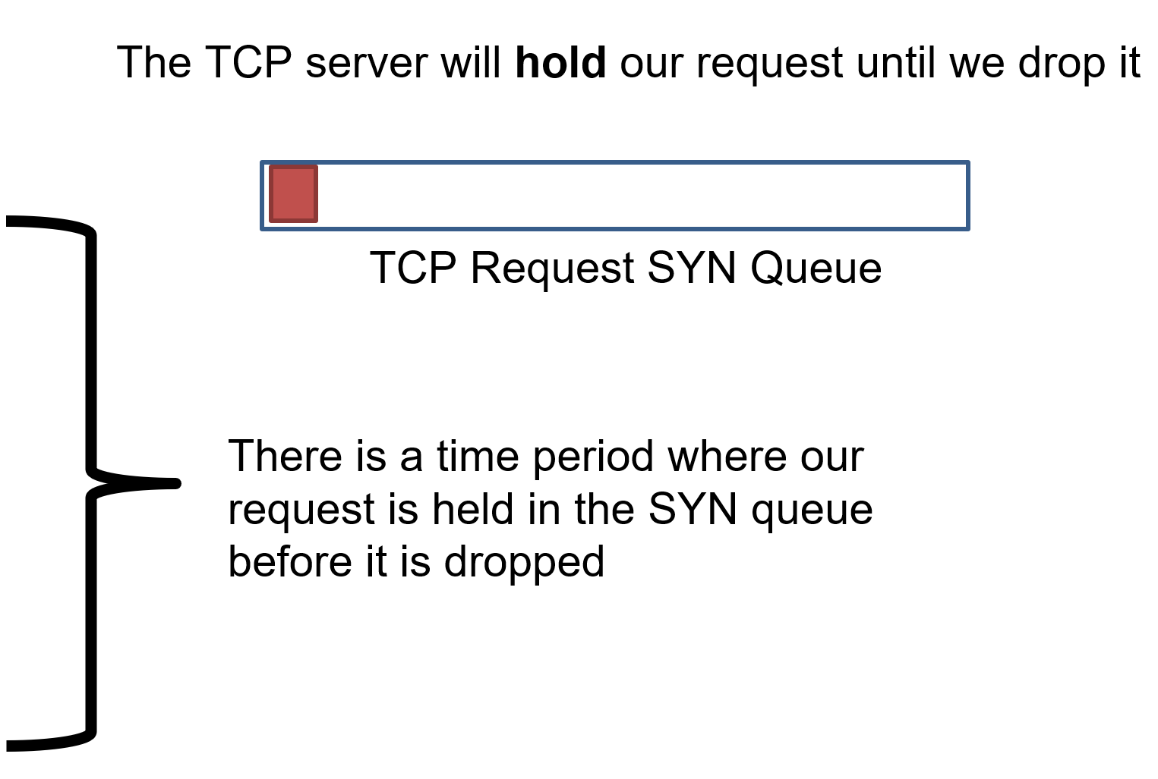
SYN Flooding
The Achilles heel:
TCP servers will accept SYN requests, send out SYN+ACK, and wait to receive an ACK
TCP Client
TCP Server
SYN
SYN + ACK
SYN + ACK
SYN + ACK

Slide 10
SYN Flooding
The Achilles heel:
TCP servers will accept SYN requests, send out SYN+ACK, and wait to receive an ACK
TCP Client
TCP Server
SYN
SYN + ACK
SYN + ACK
SYN + ACK
Goal: Send of a lot of SYN requests form spoofed source IP addresses!

Slide 11
SYN Flooding
The Achilles heel:
TCP servers will accept SYN requests, send out SYN+ACK, and wait to receive an ACK
TCP Client
TCP Server
SYN
The TCP server will hold our request until we drop it
SYN
SYN
SYN
TCP Request SYN Queue
SYN
We can quickly the SYN queue buffer with our spoofed request
SYN
SYN
The TCP server will hold those requests in the queue while it waits
SYN
SYN

Slide 12
SYN Flooding
The Achilles heel:
TCP servers will accept SYN requests, send out SYN+ACK, and wait to receive an ACK
TCP Client
TCP Server
SYN
The TCP server will hold our request until we drop it
SYN
SYN
SYN
TCP Request SYN Queue
SYN
We can quickly the SYN queue buffer with our spoofed request
SYN
SYN
The TCP server will hold those requests in the queue while it waits
SYN
SYN
If the buffer is full…
The TCP server won’t be able to accept new connections!

Slide 13
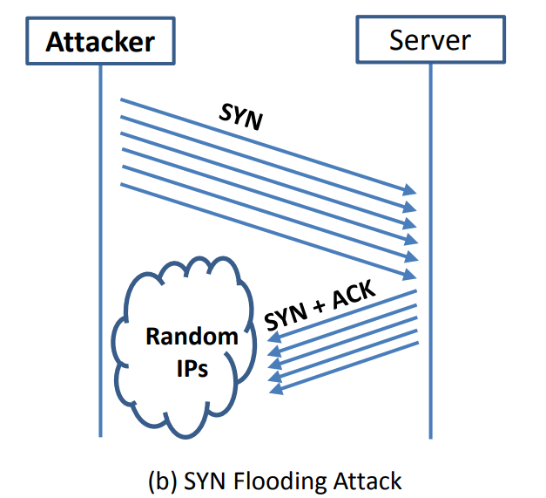
SYN Flooding
The Achilles heel:
TCP servers will accept SYN requests, send out SYN+ACK, and wait to receive an ACK
(The size of this buffer is also set by the operating system)
If a new SYN comes in (from a legitimate user), they will be denied

Slide 14
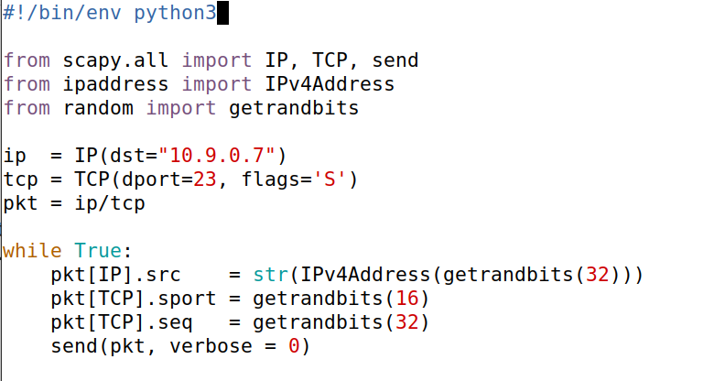
IP address of the victim server
Set the SYN flag
1
Repeatedly send a TCP packet to 10.9.0.7, with a random source IP address
1

Slide 15
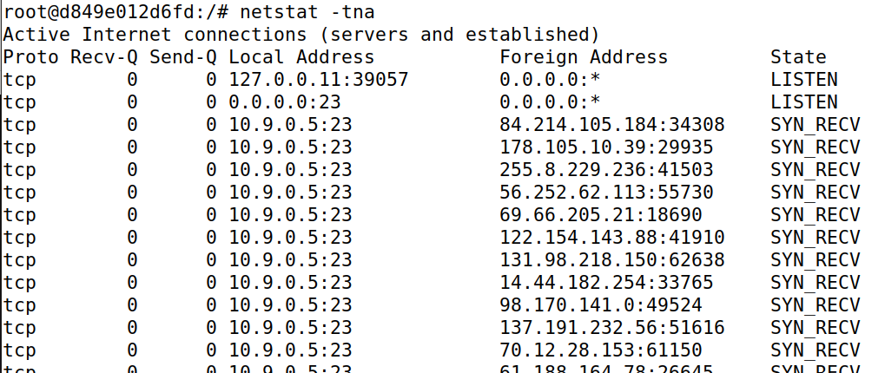
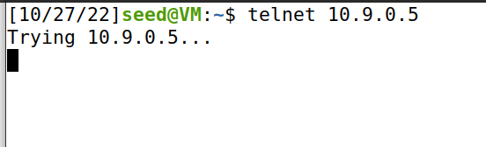




Attacker
New terminal
Server is full!
synflood.py
We’ve filled this server with spoofed SYN requests
Denied
1
Repeatedly send a TCP packet to 10.9.0.7, with a random source IP address
1

Slide 16
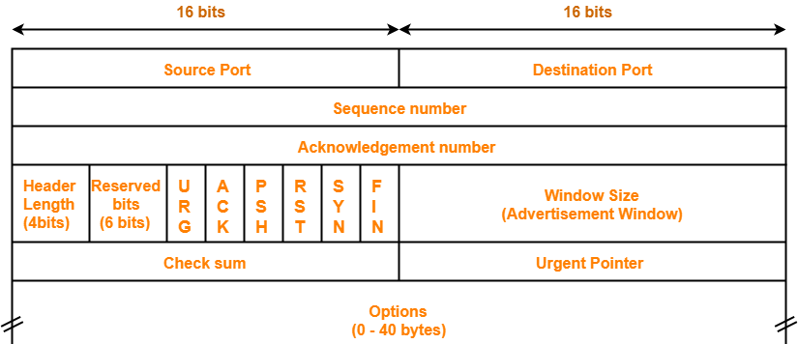

TCP Reset
Goal: Break an established TCP connection by sending a spoofed RESET (RST) packet
Packet

Slide 17
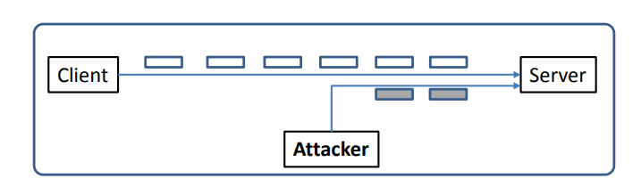
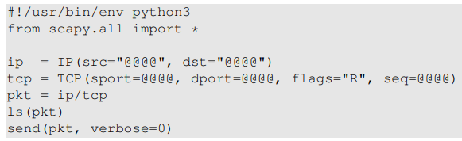

TCP Reset Attack
In order to do our attack, we first need to find an ongoing TCP communication between two users!
A server reads data in some order (typically by sequence number)
To detect an already-existing TCP connection, we will use wireshark!
10.9.0.6
10.9.0.5
SEQ # = 4440
10.9.0.1
If the server gets a SEQ# of something below 4440, it will ignore it
In our spoofed packet, we need to make sure we select a sequence number that matches the sequence number the server is expecting!
(@@@ are placeholders)
We also need to select the same ports!

Slide 18


Slide 19

TCP Hijack Attack
Hijack a current TCP connection and get a TCP server (a telnet connection) to execute commands of our choice
Possible commands we might want to execute:
cat secret_password.txt
rm –rf /
10.9.0.6
10.9.0.5
10.9.0.1
*We need to make sure the spoofed packet as a SEQ # and an ACK # that the TCP server is expecting
Spoofed Packet
Src: 10.9.0.6
Dst: 10.9.0.5
Command: rm-rf /

Slide 20
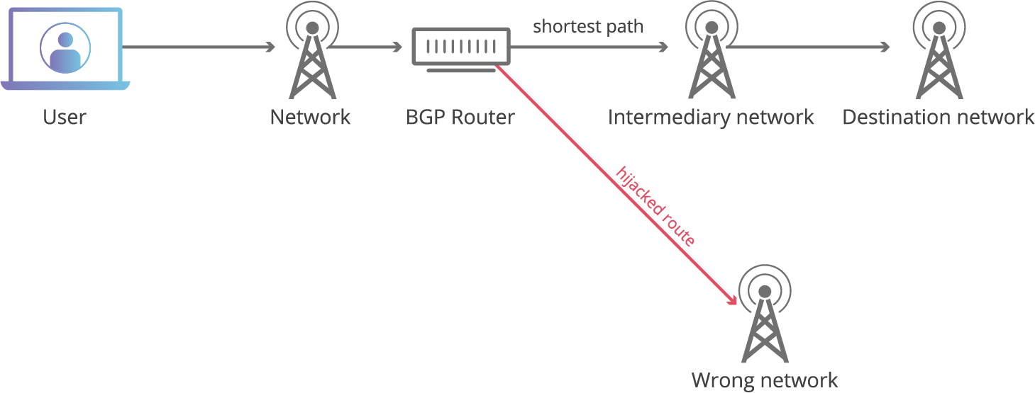
BGP Hijack
BGP is the routing protocol used to connect autonomous systems
Routers send BGP messages to advertise which network prefixes they have access to
If we can trick a BGP router into accepting our bogus routing advertisements, we can redirect traffic
(Do something malicious)

Slide 21
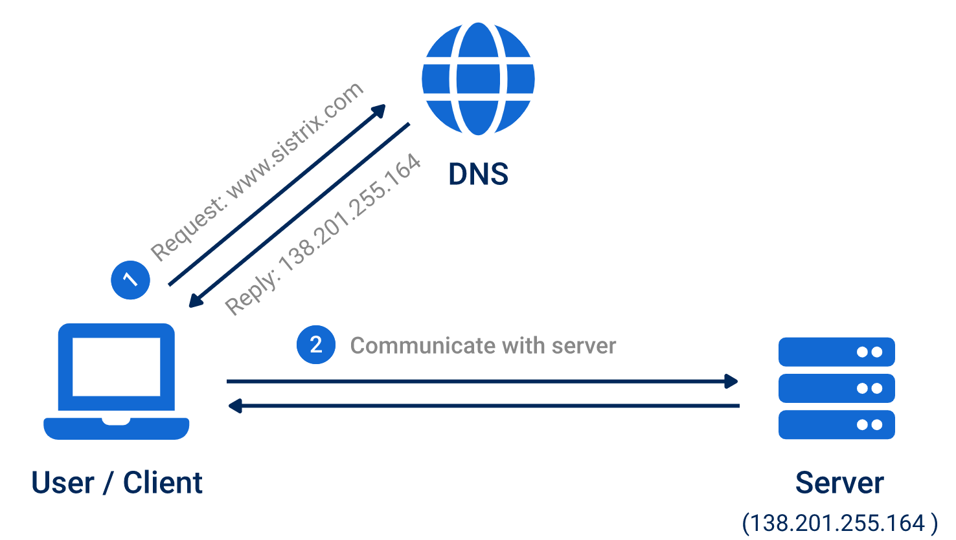
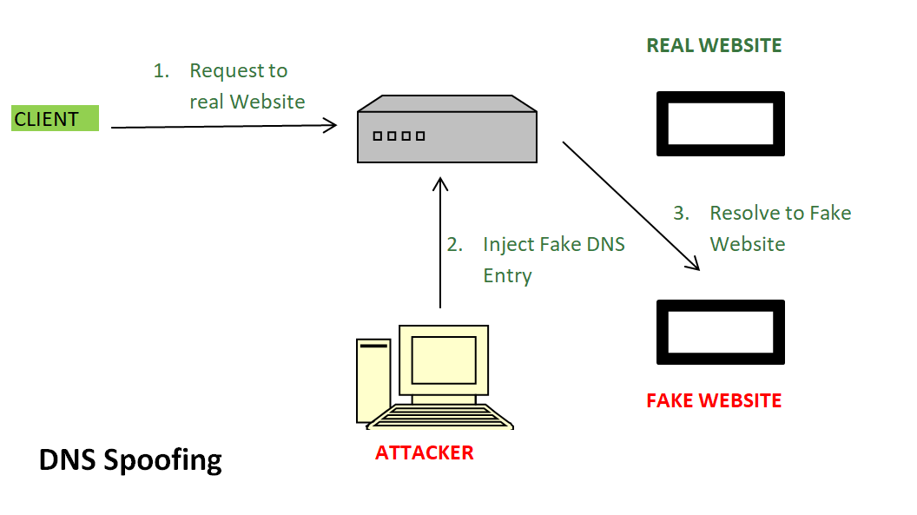
DNS Poisoning
How normal DNS works
Attack is going to inject false DNS entries for legitimate services (montana.edu) and link a malicious IP address for a fake website
If a DNS server is waiting for a DNS query response, we could (very quickly) send a spoofed DNS resolution packet that looks like its coming from a legitimate source

