Slide 1

CSCI 466: Networks
Operational Security (Firewalls, Protocols, Etc)
Reese Pearsall Fall 2023
https://www.cs.montana.edu/pearsall/classes/fall2023/466/main.html
*All images are stolen from the internet
1

Slide 2

Announcements
PA4 due tonight
Wireshark Lab 4 due next Wednesday
Gradebook
Final Exam is next Friday (12/8) (In-person)
Quiz on Friday

Slide 3
Wireshark Lab 4

Slide 4
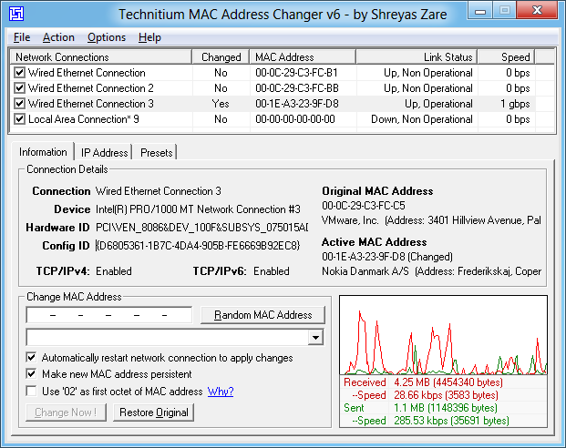
Spoofing MAC Addresses
We used scapy to spoof network layer and transport layer information, but we can also use it to spoof MAC addresses or things like ARP packets
There is a variety of tools out there that allow you to override the MAC addresses of your NIC
Technitium is one program that overrides Windows settings to spoof MAC addresses

Slide 5
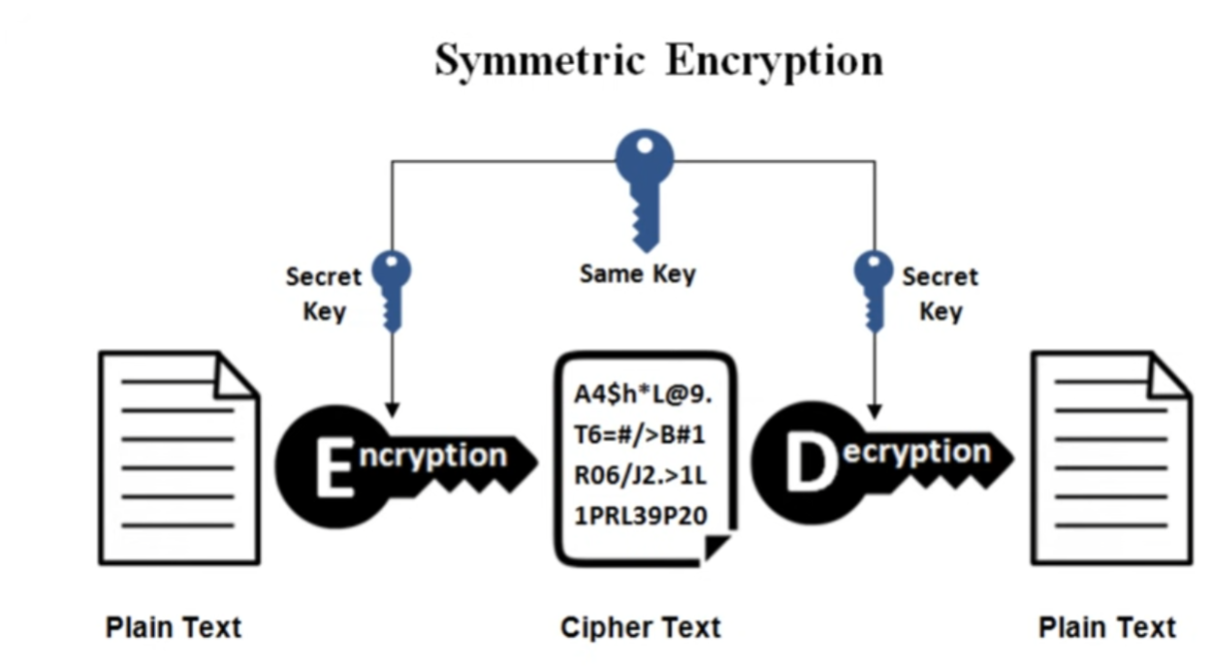
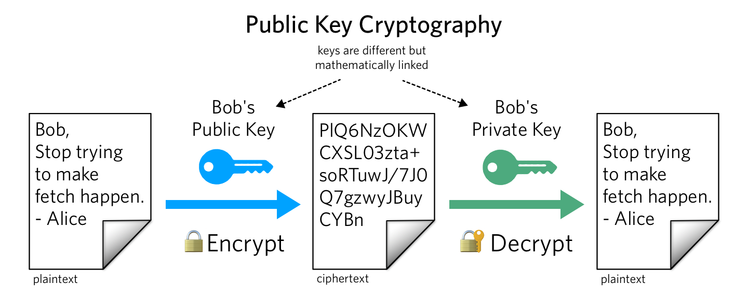
Review
Same key used for encrypting and decrypting
Using block ciphers (AES), we can encrypt an arbitrary size of data
Issue: How to securely share secret keys with each other?
Two keys: Public Key (a lock), and a price key (the key)
Public key is used to encrypt. Private key used to decrypt message
Using math, we can securely send messages over an unsecure channel without sharing any sensitive information
Issue: We can not encrypt stuff bigger than our key (2048 bits)
Symmetric and asymmetric cryptography are used together
(use RSA to send the key for symmetric crypto!)

Slide 6
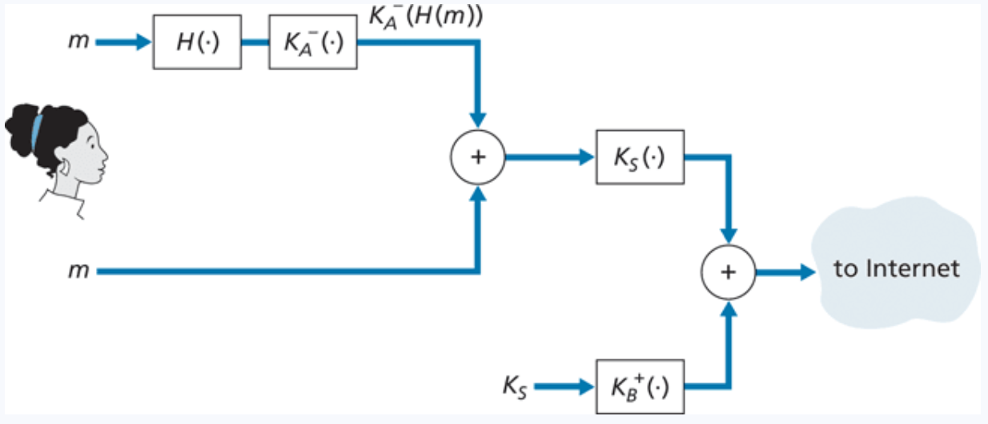






Review
Symmetric Crypto, Asymmetric Crypto, and Hashing all work together to send secure, authentic messages

Slide 7
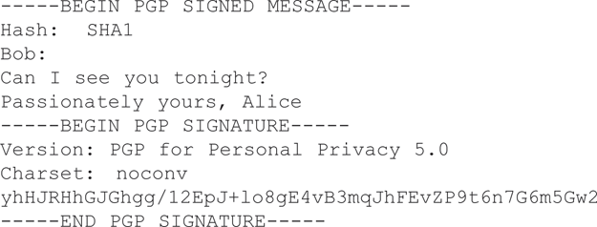
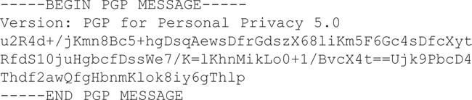
PGP (Pretty Good Privacy)
Email encryption scheme that involves sending a signed hash and encrypted message, and receiver decrypts with public key
PGP software is installed, and public key is generated for user
Private key is generated and protected by a user password
PGP provides a mechanism for public key certification.
Public keys are certified by a web of trust (other users will vouch for other users)

Slide 8

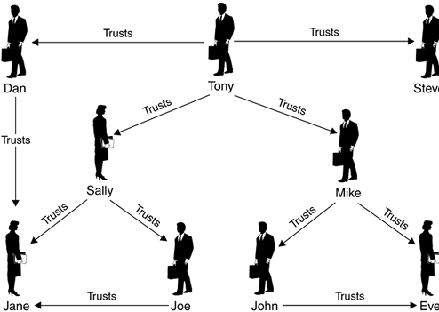
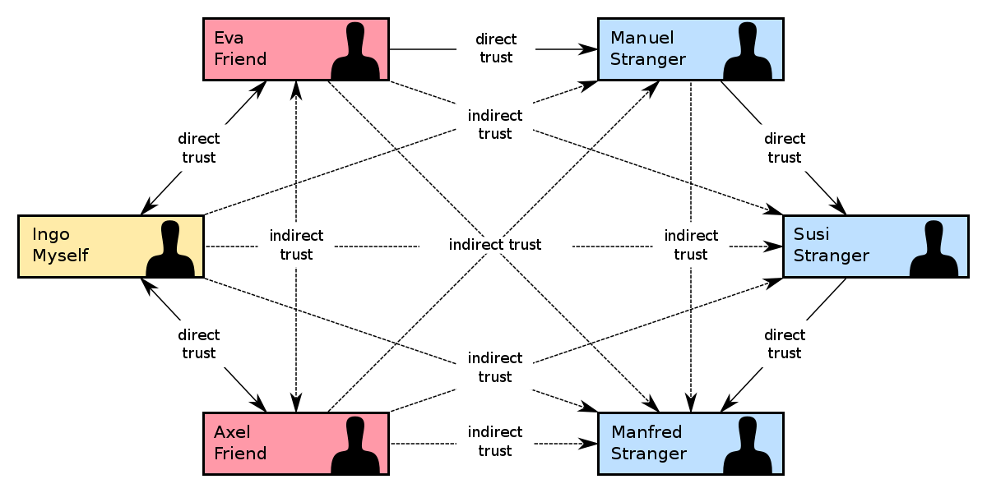
Web of Trust

Slide 9
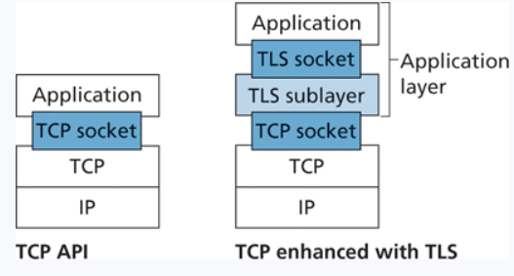
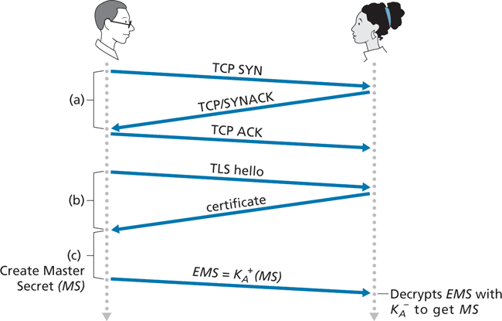
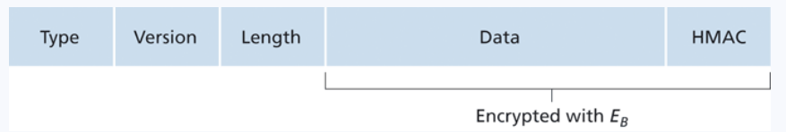
TLS
Transport Layer Security (TLS) is a protocol used to provide communication security over a TCP connection
This exists somewhere between the application layer and transport layer
TLS will always be running if you are doing web communication with https
https = Hypertext Transfer Protocol Secure
Port 443
HTTPS/TLS will handle all the encryption, key generation, certificate checking, authentication for you!
UDP does not use TLS

Slide 10
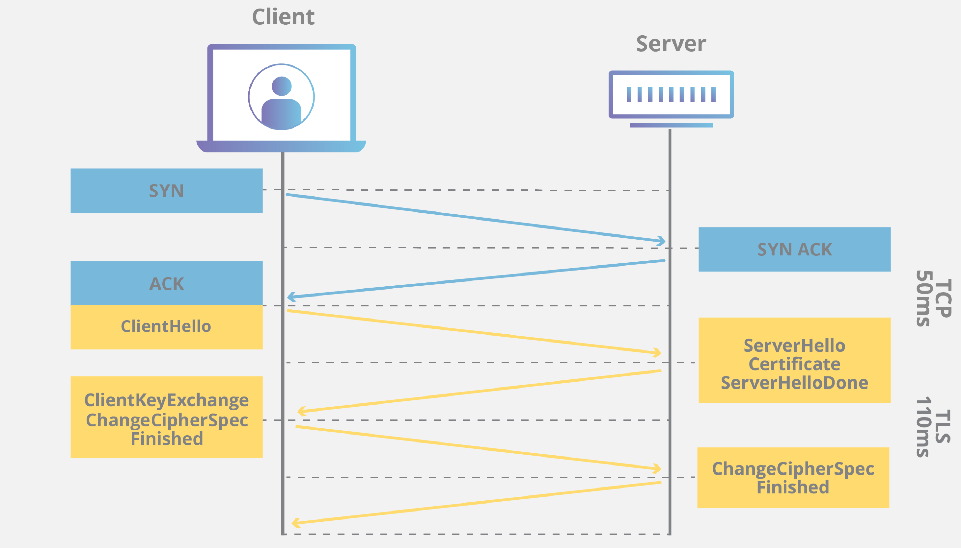
TLS
TLS/SSL does not mandate that two users use a specific symmetric key algorithm
Server will select encryption and hashing algorithm to use
TLS connection can be closed using a TCP FIN

Slide 11
TLS
The client sends a list of cryptographic algorithms it supports, along with a client nonce.
From the list, the server chooses a symmetric algorithm (for example, AES) and a public key algorithm (for example, RSA with a specific key length), and HMAC algorithm (MD5 or SHA-1) along with the HMAC keys. It sends back to the client its choices, as well as a certificate and a server nonce.

Slide 12
TLS
The client sends a list of cryptographic algorithms it supports, along with a client nonce.
From the list, the server chooses a symmetric algorithm (for example, AES) and a public key algorithm (for example, RSA with a specific key length), and HMAC algorithm (MD5 or SHA-1) along with the HMAC keys. It sends back to the client its choices, as well as a certificate and a server nonce.
The client verifies the certificate, extracts the server’s public key, generates a Pre-Master Secret (PMS), encrypts the PMS with the server’s public key, and sends the encrypted PMS to the server.

Slide 13
TLS
The client sends a list of cryptographic algorithms it supports, along with a client nonce.
From the list, the server chooses a symmetric algorithm (for example, AES) and a public key algorithm (for example, RSA with a specific key length), and HMAC algorithm (MD5 or SHA-1) along with the HMAC keys. It sends back to the client its choices, as well as a certificate and a server nonce.
The client verifies the certificate, extracts the server’s public key, generates a Pre-Master Secret (PMS), encrypts the PMS with the server’s public key, and sends the encrypted PMS to the server.
Using the same key derivation function (as specified by the TLS standard), the client and server independently compute the Master Secret (MS) from the PMS and nonces. The MS is then sliced up to generate the two encryption and two HMAC keys. Furthermore, when the chosen symmetric cipher employs CBC (such as 3DES or AES), then two Initialization Vectors (IVs)—one for each side of the connection—are also obtained from the MS. Henceforth, all messages sent between client and server are encrypted and authenticated (with the HMAC).

Slide 14
TLS
The client sends a list of cryptographic algorithms it supports, along with a client nonce.
From the list, the server chooses a symmetric algorithm (for example, AES) and a public key algorithm (for example, RSA with a specific key length), and HMAC algorithm (MD5 or SHA-1) along with the HMAC keys. It sends back to the client its choices, as well as a certificate and a server nonce.
The client verifies the certificate, extracts the server’s public key, generates a Pre-Master Secret (PMS), encrypts the PMS with the server’s public key, and sends the encrypted PMS to the server.
Using the same key derivation function (as specified by the TLS standard), the client and server independently compute the Master Secret (MS) from the PMS and nonces. The MS is then sliced up to generate the two encryption and two HMAC keys. Furthermore, when the chosen symmetric cipher employs CBC (such as 3DES or AES), then two Initialization Vectors (IVs)—one for each side of the connection—are also obtained from the MS. Henceforth, all messages sent between client and server are encrypted and authenticated (with the HMAC).
The client sends the HMAC of all the handshake messages.
The server sends the HMAC of all the handshake messages.

Slide 15
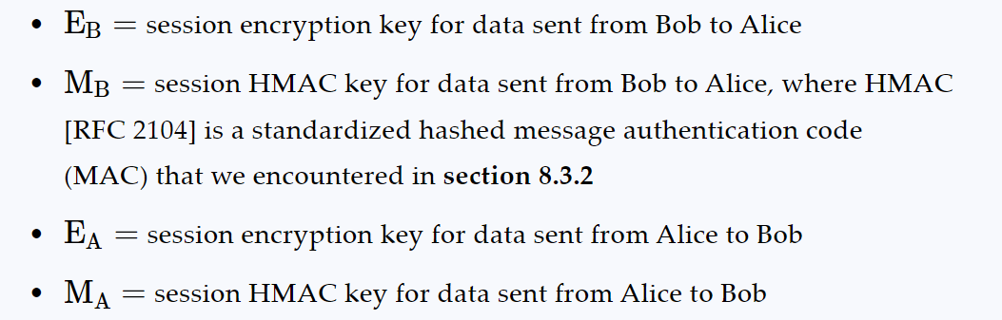
TLS
The TLS Master secret, or “session key” consists of four keys

Slide 16
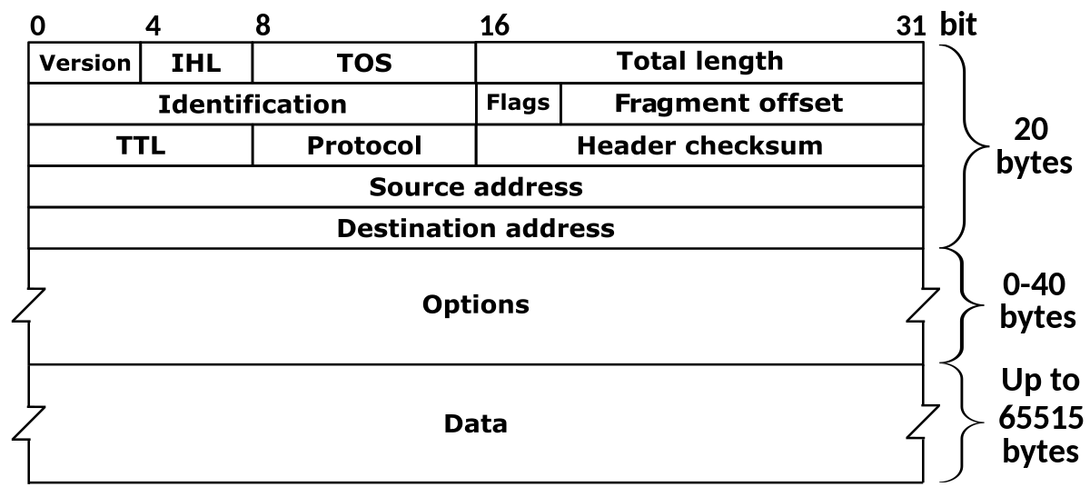
Network-Layer Security
(IPv4 Packet)
We have security at the transport layer, but we might also desire security at a network-layer level
The IP security protocol (IPsec) provides data integrity, origin authentication, attack prevention, and confidentiality at the network-layer
IPsec is most commonly seen when using a Virtual Private Network (VPN)
This could be a TCP segment (unencrypted), TLS segment, UDP segment, ICMP packet etc
Public Network- Anyone can access/communicate with the devices on the network
Private Network- Completely isolated from public internet, typically reserved for a particular institution (this can be costly)

Slide 17
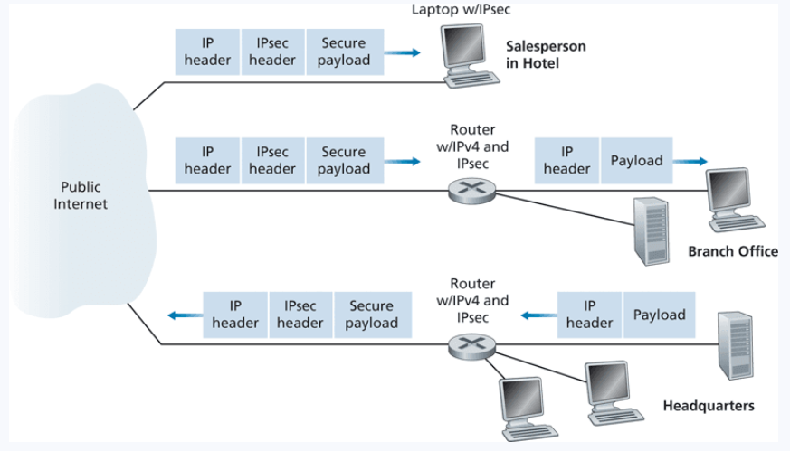



VPNs
IPsec is most commonly seen when using a Virtual Private Network (VPN)
Public Network- Anyone can access/communicate with the devices on the network
Private Network- Completely isolated from public internet, typically reserved for a particular institution (this can be costly)
VPNs extend a private network over a public network
All messages get encrypted prior to entering any public network (using IPsec), and rerouted through a secure network
Converts vanilla IPv4 datagrams to IPsec datagrams
When a source IPsec entity (host or router) sends secure datagrams to a destination entity, it does so with either the Authentication Header (AH) protocol, or the Encapsulation Security Payload (ESP) protocol
(AH = no confidentiality– not used as much as ESP)

Slide 18

IP Sec
provides datagram-level encryption, authentication, integrity
for both user traffic and control traffic (e.g., BGP, DNS messages)
two “modes”:
payload
payload
payload
tunnel mode:
entire datagram is encrypted, authenticated
encrypted datagram encapsulated in new datagram with new IP header, tunneled to destination
transport mode:
only datagram payload is encrypted, authenticated

Slide 19
Security associations (SAs)
before sending data, security association (SA) established from sending to receiving entity (directional, simplex)
Sending, receiving entitles maintain state information about SA
recall: TCP endpoints also maintain state info
IP is connectionless; IPsec is connection-oriented!
200.168.1.100
193.68.2.23
SA
R1 stores for SA:
32-bit identifier: Security Parameter Index (SPI)
origin SA interface (200.168.1.100)
destination SA interface (193.68.2.23)
type of encryption used
encryption key
type of integrity check used
authentication key

Slide 20
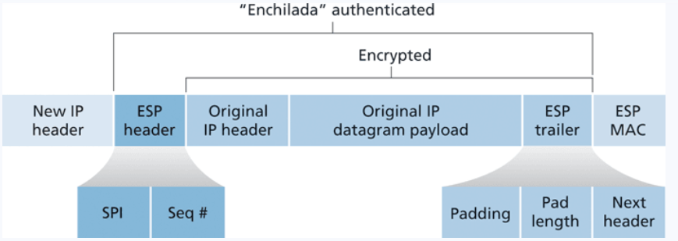
Ipsec Datagram

Slide 21
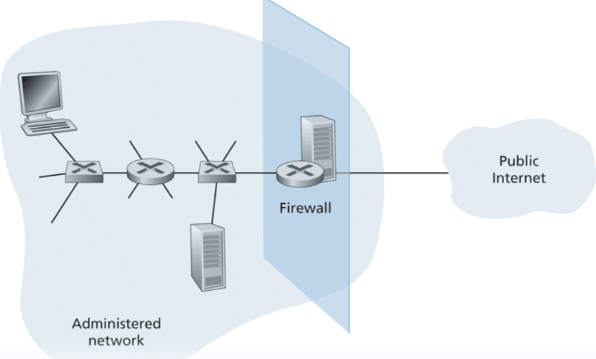
Endpoint Security
A firewall is a combination of hardware and software that isolates an organizations internal network form the internet at large, allowing some packets to pass, and blocking others
Three goals
All traffic from outside to inside, inside to outside, passes through the firewall
Only authorized traffic (defined by firewall’s policy) will be allowed to pass
The firewall itself is immune to penetration

Slide 22
Types of Firewalls
Packet Filter
Analyze packet’s details, and make decision.
Look at IPs, Ports, Protocol, TCP Flags, ICMP Type, and more
Example Polices
Policy | Rules
No outside web access.

Slide 23
Types of Firewalls
Packet Filter
Analyze packet’s details, and make decision.
Look at IPs, Ports, Protocol, TCP Flags, ICMP Type, and more
Example Polices
Policy | Rules
No outside web access. | Drop all outgoing packets to any IP address, port 80 or 443

Slide 24
Types of Firewalls
Packet Filter
Analyze packet’s details, and make decision.
Look at IPs, Ports, Protocol, TCP Flags, ICMP Type, and more
Example Polices
Policy | Rules
No outside web access. | Drop all outgoing packets to any IP address, port 80 or 443
No incoming TCP connections

Slide 25
Types of Firewalls
Packet Filter
Analyze packet’s details, and make decision.
Look at IPs, Ports, Protocol, TCP Flags, ICMP Type, and more
Example Polices
Policy | Rules
No outside web access. | Drop all outgoing packets to any IP address, port 80 or 443
No incoming TCP connections | Drop all incoming TCP SYN packets

Slide 26
Types of Firewalls
Packet Filter
Analyze packet’s details, and make decision.
Look at IPs, Ports, Protocol, TCP Flags, ICMP Type, and more
Example Polices
Policy | Rules
No outside web access. | Drop all outgoing packets to any IP address, port 80 or 443
No incoming TCP connections | Drop all incoming TCP SYN packets
(Would this help with SYN flooding?)

Slide 27
Types of Firewalls
Packet Filter
Analyze packet’s details, and make decision.
Look at IPs, Ports, Protocol, TCP Flags, ICMP Type, and more
Example Polices
Policy | Rules
No outside web access. | Drop all outgoing packets to any IP address, port 80 or 443
No incoming TCP connections | Drop all incoming TCP SYN packets
Prevent your network from being tracerouted

Slide 28
Types of Firewalls
Packet Filter
Analyze packet’s details, and make decision.
Look at IPs, Ports, Protocol, TCP Flags, ICMP Type, and more
Example Polices
Policy | Rules
No outside web access. | Drop all outgoing packets to any IP address, port 80 or 443
No incoming TCP connections | Drop all incoming TCP SYN packets
Prevent your network from being tracerouted | Drop all incoming/outgoing ICMP traffic

Slide 29
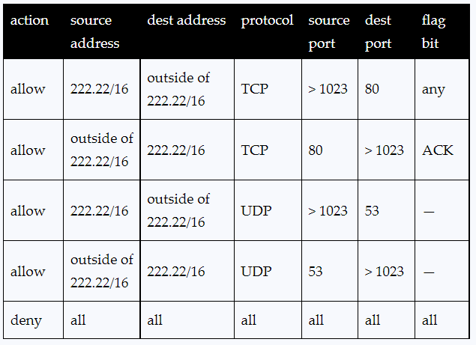
Types of Firewalls
Packet Filter
Analyze packet’s details, and make decision.
Look at IPs, Ports, Protocol, TCP Flags, ICMP Type, and more
Access Control List
Allow/Deny Traffic
In Linux world, these tables are set using the iptables program

Slide 30
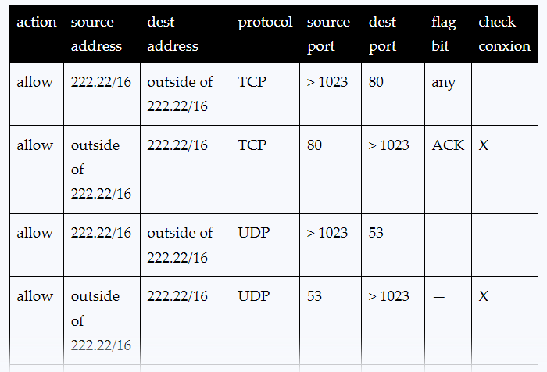
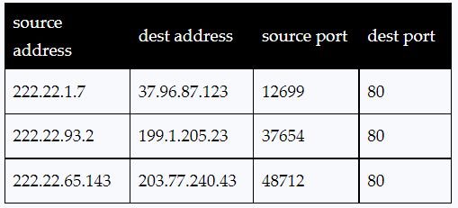

Types of Firewalls
Stateful Filter
→ Make decisions based on connection information
Access Control List for Stateful Filter
Firewall may keep an internal table
Example: Random TCP packet with the ACK bit set, even if no TCP connection established

Slide 31

Types of Firewalls
Application gateways
filter packets on application data as well as on IP/TCP/UDP fields.
example: allow select internal users to telnet outside
host-to-gateway
telnet session
application
gateway
router and filter
gateway-to-remote
host telnet session

Slide 32
Intrusion Detection System
Stateless and Stateful firewalls are examples of Intrusion Prevention Systems (IPS)
There will be times where malicious packets will bypass the firewall, so we need another system within the network to detect potentially malicious traffic
To detect attacks, we need to perform deeper inspection
A series of packets
The context of a packet
Application Data of a Packet
An instruction detection system (IDS) inspects packets will generate an alert when potentially malicious traffic is observed

Slide 33
Intrusion Detection System
Stateless and Stateful firewalls are examples of Intrusion Prevention Systems (IPS)
There will be times where malicious packets will bypass the firewall, so we need another system within the network to detect potentially malicious traffic
To detect attacks, we need to perform deeper inspection
A series of packets
The context of a packet
Application Data of a Packet
An instruction detection system (IDS) inspects packets will generate an alert when potentially malicious traffic is observed
What might suspicious traffic look like?

Slide 34
Intrusion Detection System
Stateless and Stateful firewalls are examples of Intrusion Prevention Systems (IPS)
There will be times where malicious packets will bypass the firewall, so we need another system within the network to detect potentially malicious traffic
To detect attacks, we need to perform deeper inspection
A series of packets
The context of a packet
Application Data of a Packet
An instruction detection system (IDS) inspects packets will generate an alert when potentially malicious traffic is observed
What might suspicious traffic look like?
Communication with foreign, unknown IP address
Unauthorized web traffic
A large spike in traffic

Slide 35
Intrusion Detection System
Two types –
1. Signature-Based Detection Systems
Maintain a large database of known “signatures” for malicious packets
-- Malicious IP addresses or URLs -- Email Addresses
-- Specific String of Bits -- File/Message Hashes
-- Protocol Specific (nmap)
When would signature-based detection not work ?

Slide 36
Intrusion Detection System
Two types –
1. Signature-Based Detection Systems
Maintain a large database of known “signatures” for malicious packets
-- Malicious IP addresses or URLs -- Email Addresses
-- Specific String of Bits -- File/Message Hashes
-- Protocol Specific (nmap)
When would signature-based detection not work ?
Signature-based detection will never work for new threats, so we need a way to dynamically analyze threats
2. Anomaly-based Detection System
If you know what “normal” traffic looks like, you can identify unusual, potentially malicious traffic
You get a large spike in ICMP packets? Someone might be trying to NMAP you

Slide 37
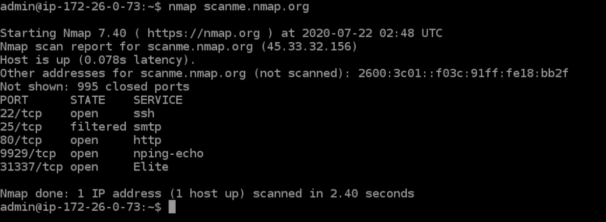
Nmap
Short for network mapper. It is an open-source Linux command-line tools that is used to scan IP addresses or networks to see which hosts are running on their network, discover open ports and services, and detect vulnerabilities
Command issues a bunch of ICMP packets at the target host
Has a lot of great uses to network administrators, and for malicious actors (ie hackers)
Can also return things such as OS versions and application versions

Slide 38
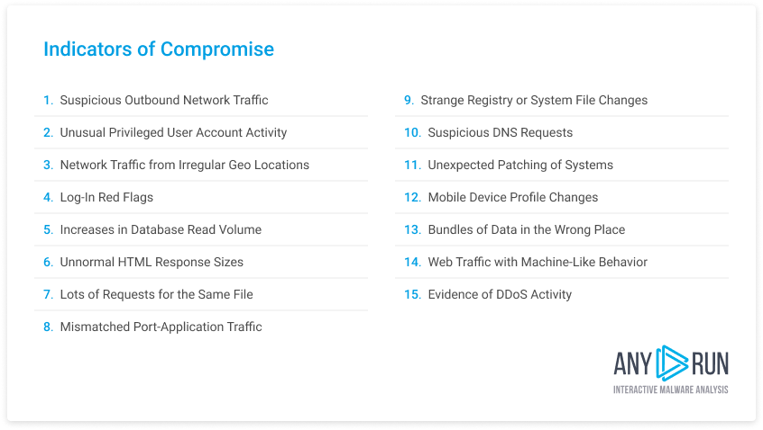
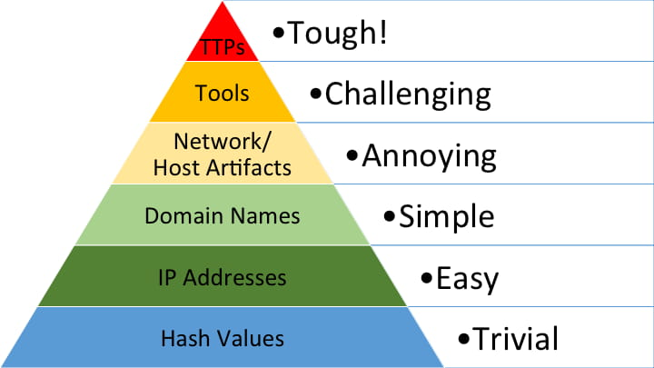
Intrusion Detection System
Security/Network Engineers will look for Indicators of Compromise (IOCs) to determine if a network may have been breached
“Pyramid of Pain”
These are a variety of digital forensics that can be collected

