Slide 1

CSCI 466: Networks
Review
Reese Pearsall Fall 2023
https://www.cs.montana.edu/pearsall/classes/fall2023/466/main.html
*All images are stolen from the internet
1

Slide 2

Announcements
Wireshark Lab 4 due tonight
Final Exam on Friday
Wireshark Lab 5 (course evaluation) and PA5 due next Wednesday (12/13)
Remember to submit a repo link to D2L

Slide 3
Final Exam Structure
No notes allowed
10% of your grade
Please show up
Part I. OSI Model
For each layer
Name the layer (Ex. Network Layer)
Provide a primary responsibility/functionality (Ex. Forwarding and Routing)
Provide the unit of data that is being transmitted (Ex. Datagram)
Part II. Question 2
Won’t tell you the exact question, but it will require your knowledge of how the internet works and how two hosts communicate with each other

Slide 4


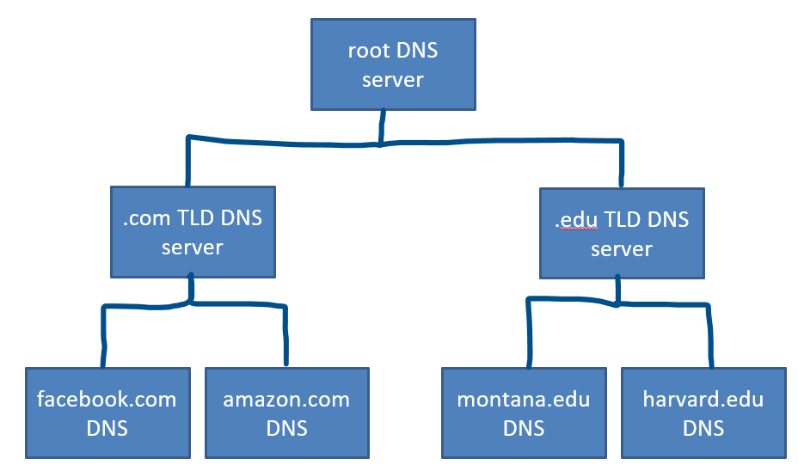
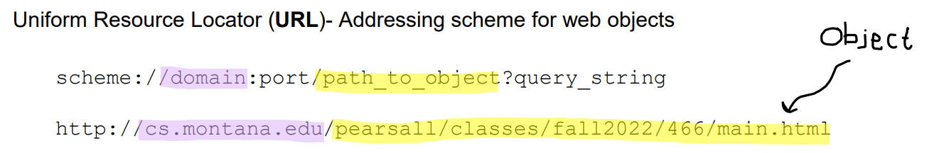
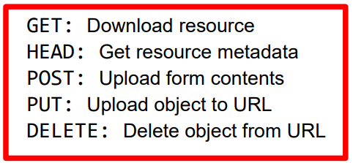
Application Layer
The layer which interacts directly with applications and provide necessary protocols and services for web applications. Specifies the shared commination protocol(s) that will be used by hosts in a communication protocol
Domain Name System (DNS) is a distributed, hierarchical database used for mapping hostnames to IP address
HyperText Transfer Protocol (HTTP)- protocol that dictates the transmitting of hypermedia documents, such as HTML and other webpage objects
Prior to creating a TCP connection and sending an HTTP request, we first need to issue a DNS request!
HTTP Request
(Built on UDP, lookups happen on port 53)
TCP
HTTP Response
TCP
Informational Responses (100s)
Successful Responses (200s)
Redirection messages (300s)
Client error response (400s)
Server error response (500s)

Slide 5
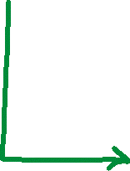
Transport Layer
- Provides host-to-host, reliable data transfer, and dictates the flow of data
Multiplexing is the process of gathering chunks from sockets, encapsulating chunks with header information, and passing the segment into the network layer
Demultiplexing is the receiving segments from the transport layer and delivering the segment to the correct socket.
Socket
Socket
Socket
Segment
Socket
data
data
header
data
header
data
header
data
data
header
data
header
data
header
data

Slide 6
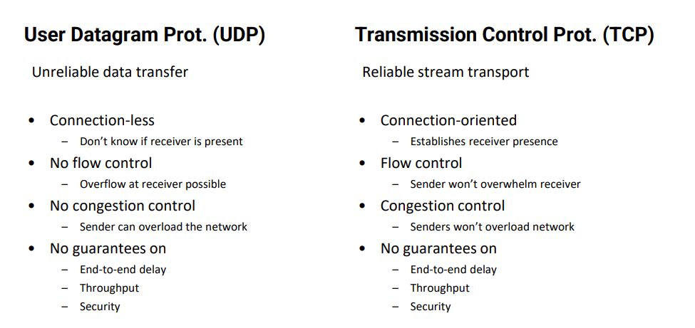
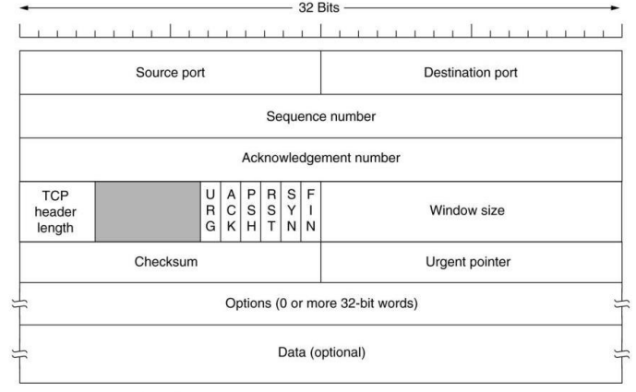
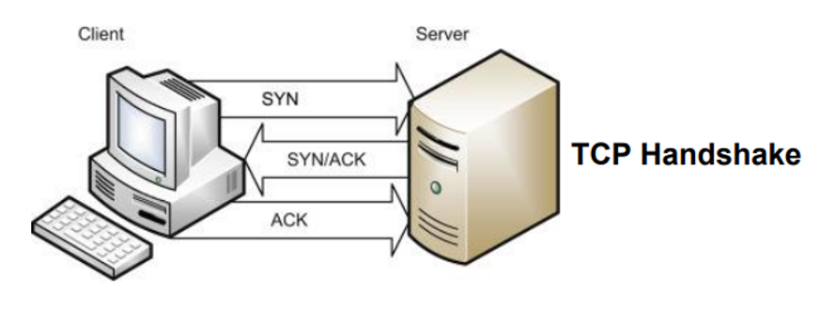









Transport Layer
Provides host-to-host, reliable data transfer, and dictates the flow of data
“Self-Clocking”

Slide 7



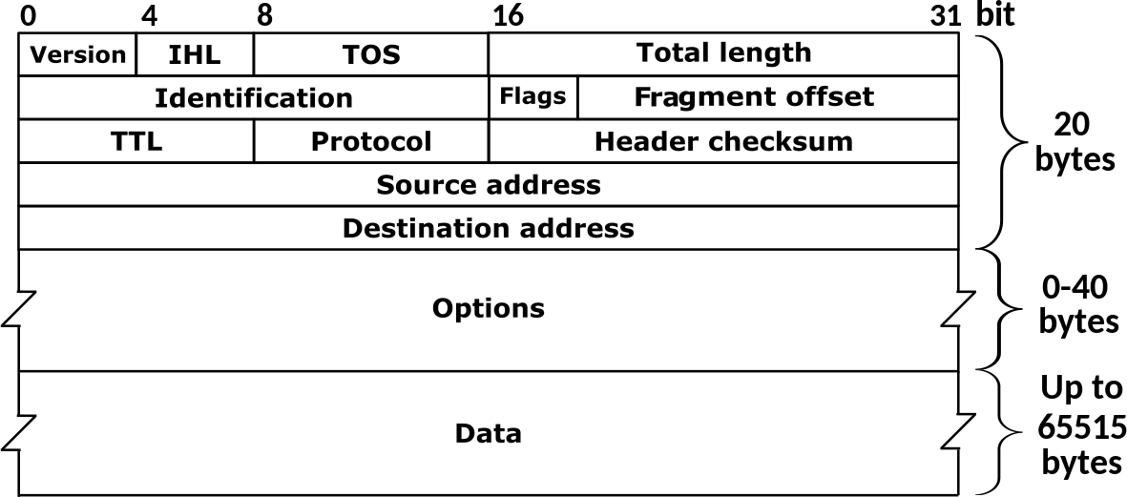
Network Layer
Provides Routing and Forwarding Functionality
Our segments from the transport layer are now encapsulated into network layer datagrams
IP Addresses are assigned here
Forwarding: move packets from router’s input to appropriate router output
IPv4
Address range | Interface (output link)
128.11.52.0 – 128.11.52.255 | 1
153.90.2.0 – 153.90.2.255 | 2
153.90.2.87 – 153.90.2.89 | 3
Address range | Interface (output link)
11001000 00010111 00010*** ********* | 1
11001000 00010111 00011000 ********* | 2
11001000 00010111 00011*** ******** | 3
otherwise | 4
IPv4: 32-bit addresses (decimal)
192.149.252.76

Slide 8














Network Layer
Provides Routing and Forwarding Functionality
Our segments from the transport layer are now encapsulated into network layer datagrams
Routing: determine route taken by packets from source to destination
OSPF is a link-state protocol that uses flooding of link-state information and Dijkstra’s least-cost algorithm
→ Used for routing within an AS
An autonomous system is a group of routers that are under the same administrative control
Border Gateway Protocol (BGP) is used for exchanging routing information between AS
AS 1

Slide 9
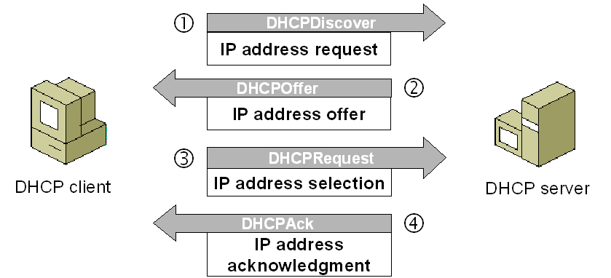
Network Layer
Provides Routing and Forwarding Functionality
Dynamic Host Configuration Protocol (DHCP) is a plug-and-play, client-server protocol that allows a host to obtain an IP address automatically
When a host is automatically assigned an IP address, it might keep that one forever, or the IP addresses can be temporary
(more common)

Slide 10
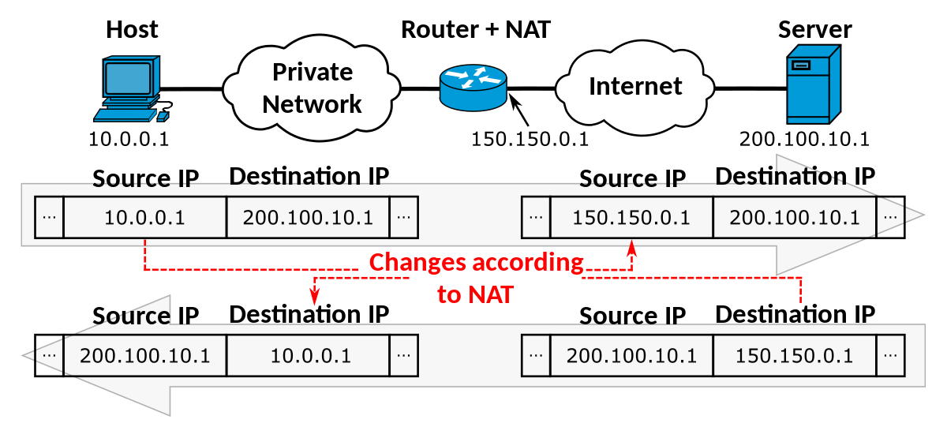
Network Layer
Provides Routing and Forwarding Functionality
NAT is a translation of multiple private IP addresses to one single public IP address
Hides details of inner home network from outside world
All incoming traffic will have same public IP, all outgoing will have same public IP

Slide 11
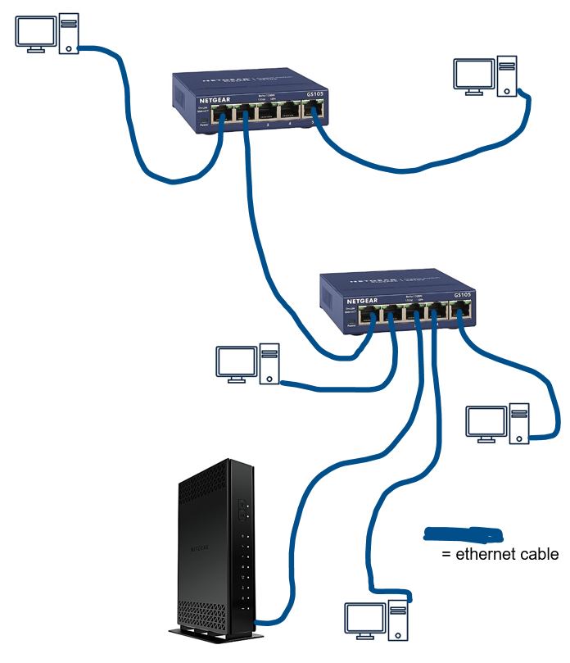
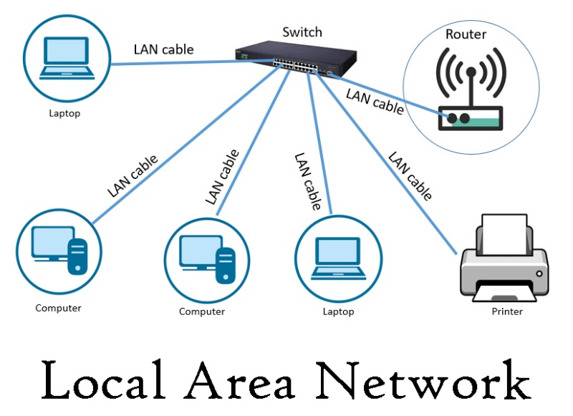
Link Layer
The link layer is responsible for the actual node-to-node delivery of data and ensure error-free transmission of information (handles a variety of mediums)
MAC (Media Access Control) Addresses
Ethernet: Dominant wired LAN technology
function: used ‘locally” to get frame from one interface to another physically-connected interface (same network, in IP-addressing sense)
48 bit MAC address (for most LANs) burned in NIC ROM, also sometimes software settable
Address Resolution Protocol (ARP)
Protocol used to map IP address to MAC addresses
Very commonly used, as we need the MAC address of each host in our path
Broadcast sent on all interfaces
Ethernet switches will store and forward ethernet frames
Routers will forward frames leaving the LAN
(Wi-fi = wifi frame)

Slide 12
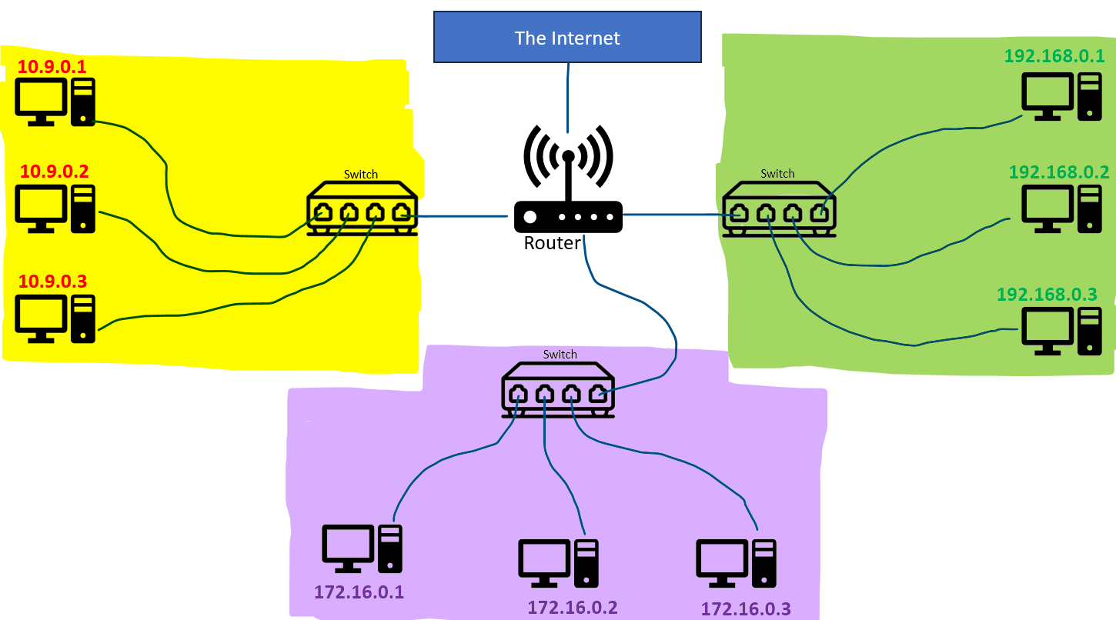

3 subnets
1 LAN

Slide 13









One autonomous system

Slide 14
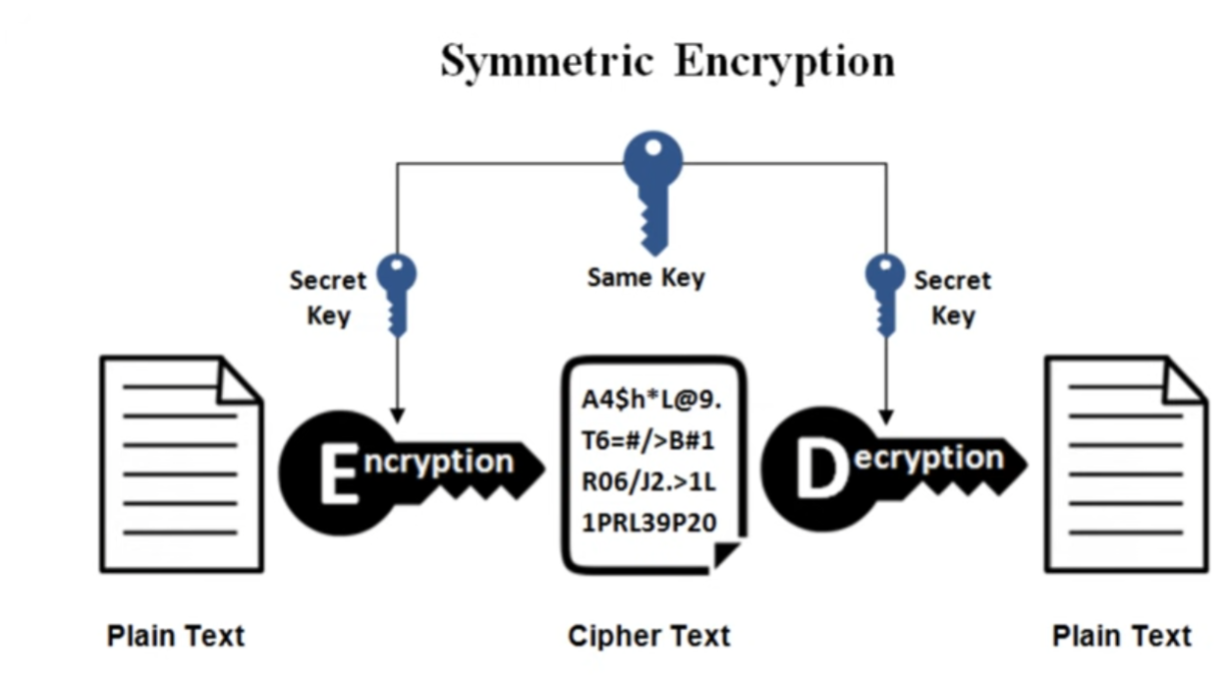
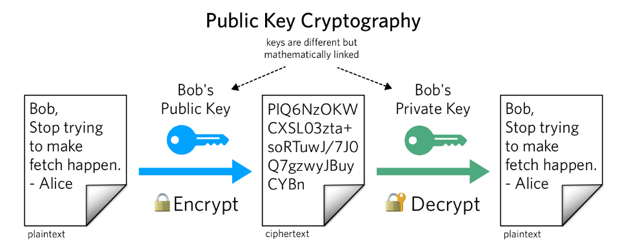
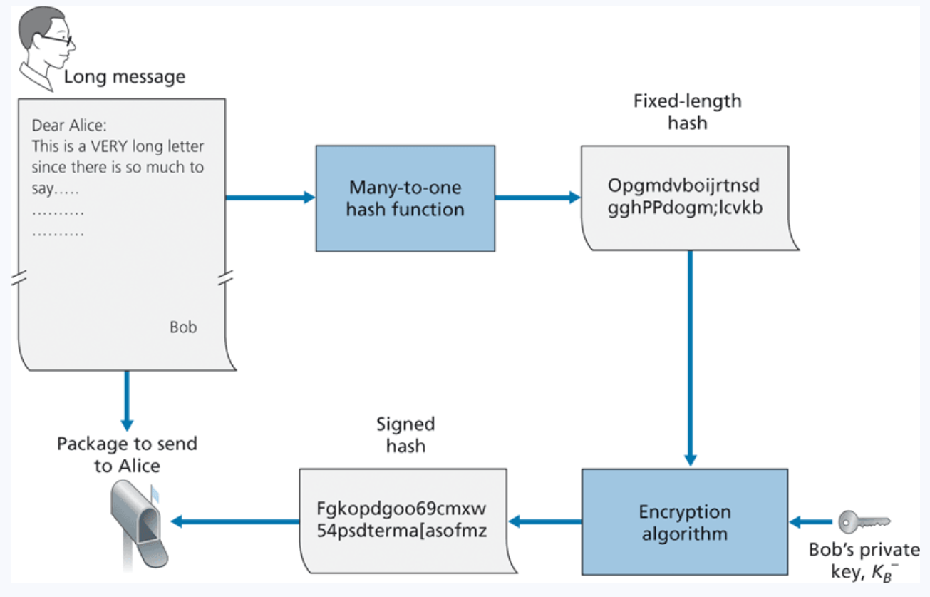
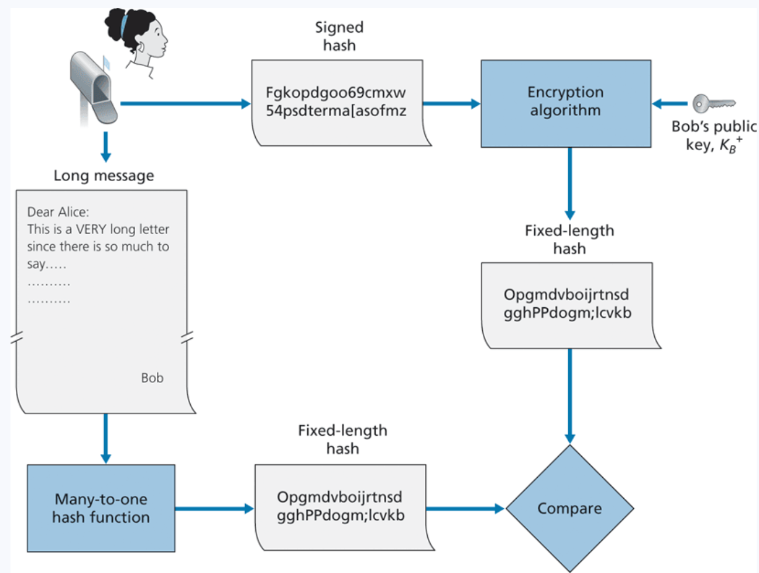
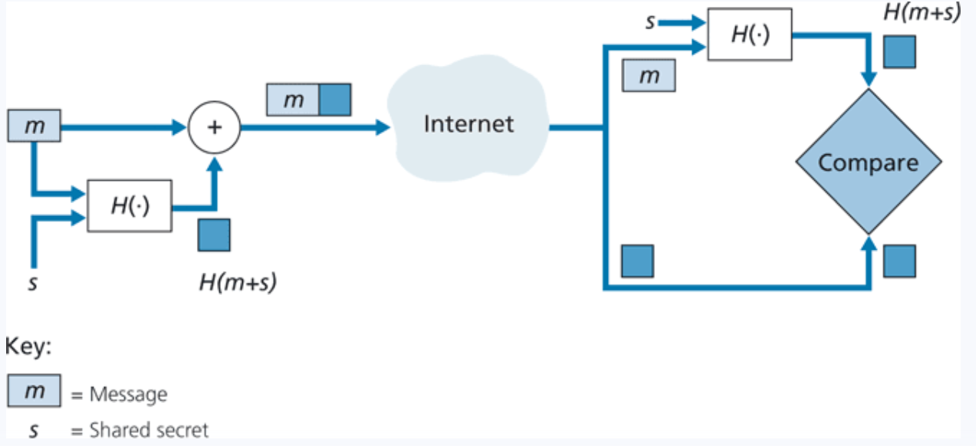

Network Security
All this is implemented in TLS/SSL at the Session + Presentation Layer
Confidentiality- Making sure that only the sender and receiver can read the message (encryption)
Authentication- Making sure that you are communicating with the person you think you are (encryption + hashing)
Integrity- Making sure the message does not get tampered with during transmission (hashing)
Digital Signatures
MAC

Slide 15
OSI MODEL
Application Layer
Provides protocols for sending and receiving data between services and web applications (HTTP)
Messages

Slide 16
OSI MODEL
Application Layer
Provides protocols for sending and receiving data between services and web applications (HTTP)
Messages
Presentation Layer
Encoding, Compressing, and Encrypting Data
Messages

Slide 17
OSI MODEL
Application Layer
Provides protocols for sending and receiving data between services and web applications (HTTP)
Messages
Presentation Layer
Encoding, Compressing, and Encrypting Data
Messages
Session Layer
Authentication. Manages, monitors, “sessions” between endpoints
Messages

Slide 18
OSI MODEL
Application Layer
Provides protocols for sending and receiving data between services and web applications (HTTP)
Messages
Presentation Layer
Encoding, Compressing, and Encrypting Data
Messages
Session Layer
Authentication. Manages, monitors, “sessions” between endpoints
Messages
Transport Layer
Provides host-to-host, reliable data transfer, and dictates the flow of data
Segments

Slide 19
OSI MODEL
Application Layer
Provides protocols for sending and receiving data between services and web applications (HTTP)
Messages
Presentation Layer
Encoding, Compressing, and Encrypting Data
Messages
Session Layer
Authentication. Manages, monitors, “sessions” between endpoints
Messages
Transport Layer
Provides host-to-host, reliable data transfer, and dictates the flow of data
Segments
Network Layer
Forwarding and Routing of Data. Logical Addressing
Datagrams

Slide 20
OSI MODEL
Application Layer
Provides protocols for sending and receiving data between services and web applications (HTTP)
Messages
Presentation Layer
Encoding, Compressing, and Encrypting Data
Messages
Session Layer
Authentication. Manages, monitors, “sessions” between endpoints
Messages
Transport Layer
Provides host-to-host, reliable data transfer, and dictates the flow of data
Segments
Network Layer
Forwarding and Routing of Data. Logical Addressing
Datagrams
Data Link Layer
Handles the formatting and physical addressing of the data before transmitting bits
Frames

Slide 21
OSI MODEL
Application Layer
Provides protocols for sending and receiving data between services and web applications (HTTP)
Messages
Presentation Layer
Encoding, Compressing, and Encrypting Data
Messages
Session Layer
Authentication. Manages, monitors, “sessions” between endpoints
Messages
Transport Layer
Provides host-to-host, reliable data transfer, and dictates the flow of data
Segments
Network Layer
Forwarding and Routing of Data. Logical Addressing
Datagrams
Data Link Layer
Handles the formatting and physical addressing of the data before transmitting bits
Frames
Physical Layer
Transmits bits into physical signals over some medium
Bits

Slide 22
OSI MODEL
Application Layer
Provides protocols for sending and receiving data between services and web applications (HTTP)
Messages
Presentation Layer
Encoding, Compressing, and Encrypting Data
Messages
This is what you need to memorize
Session Layer
Authentication. Manages, monitors, “sessions” between endpoints
Messages
Transport Layer
Provides host-to-host, reliable data transfer, and dictates the flow of data
Segments
Network Layer
Forwarding and Routing of Data. Logical Addressing
Datagrams
Data Link Layer
Handles the formatting and physical addressing of the data before transmitting bits
Frames
Physical Layer
Transmits bits into physical signals over some medium
Bits

Slide 23

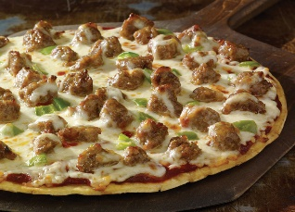


OSI MODEL
Application Layer
A
Away
Presentation Layer
Penguin
Pizza
Session Layer
Said
Sausage
Transport Layer
That
Throw
Network Layer
Nobody
Not
Data Link Layer
Drinks
Do
Physical Layer
Pepsi
Please

Slide 24
OSI MODEL
HTTP, DNS, SMTP, FTP etc
Application Layer
Data
Presentation Layer
Data
(TLS header might also happen here)
Session Layer
Data
Transport Layer
Data
TCP Header
Network Layer
Data
TCP Header
IP Header
Ethernet or Wifi
Data Link Layer
Data
TCP Header
IP Header
MAC Header
Physical Layer
0101010101111010100110101010101010

Slide 25
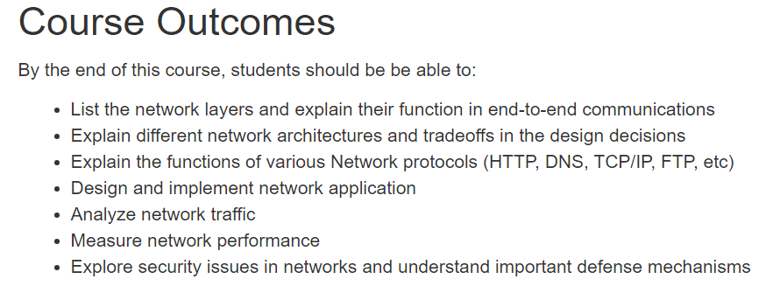








????
HTTP
FTP
OSPF
DNS
SMTP
BGP
TLS/SSL
UDP TCP
“Hourglass” shape of the internet
IP
(NAT, ICMP, DHCP)
ARP Ethernet WiFi
Copper Wire Radio Waves Fiber Optic

Slide 26

Any Questions?

Slide 27
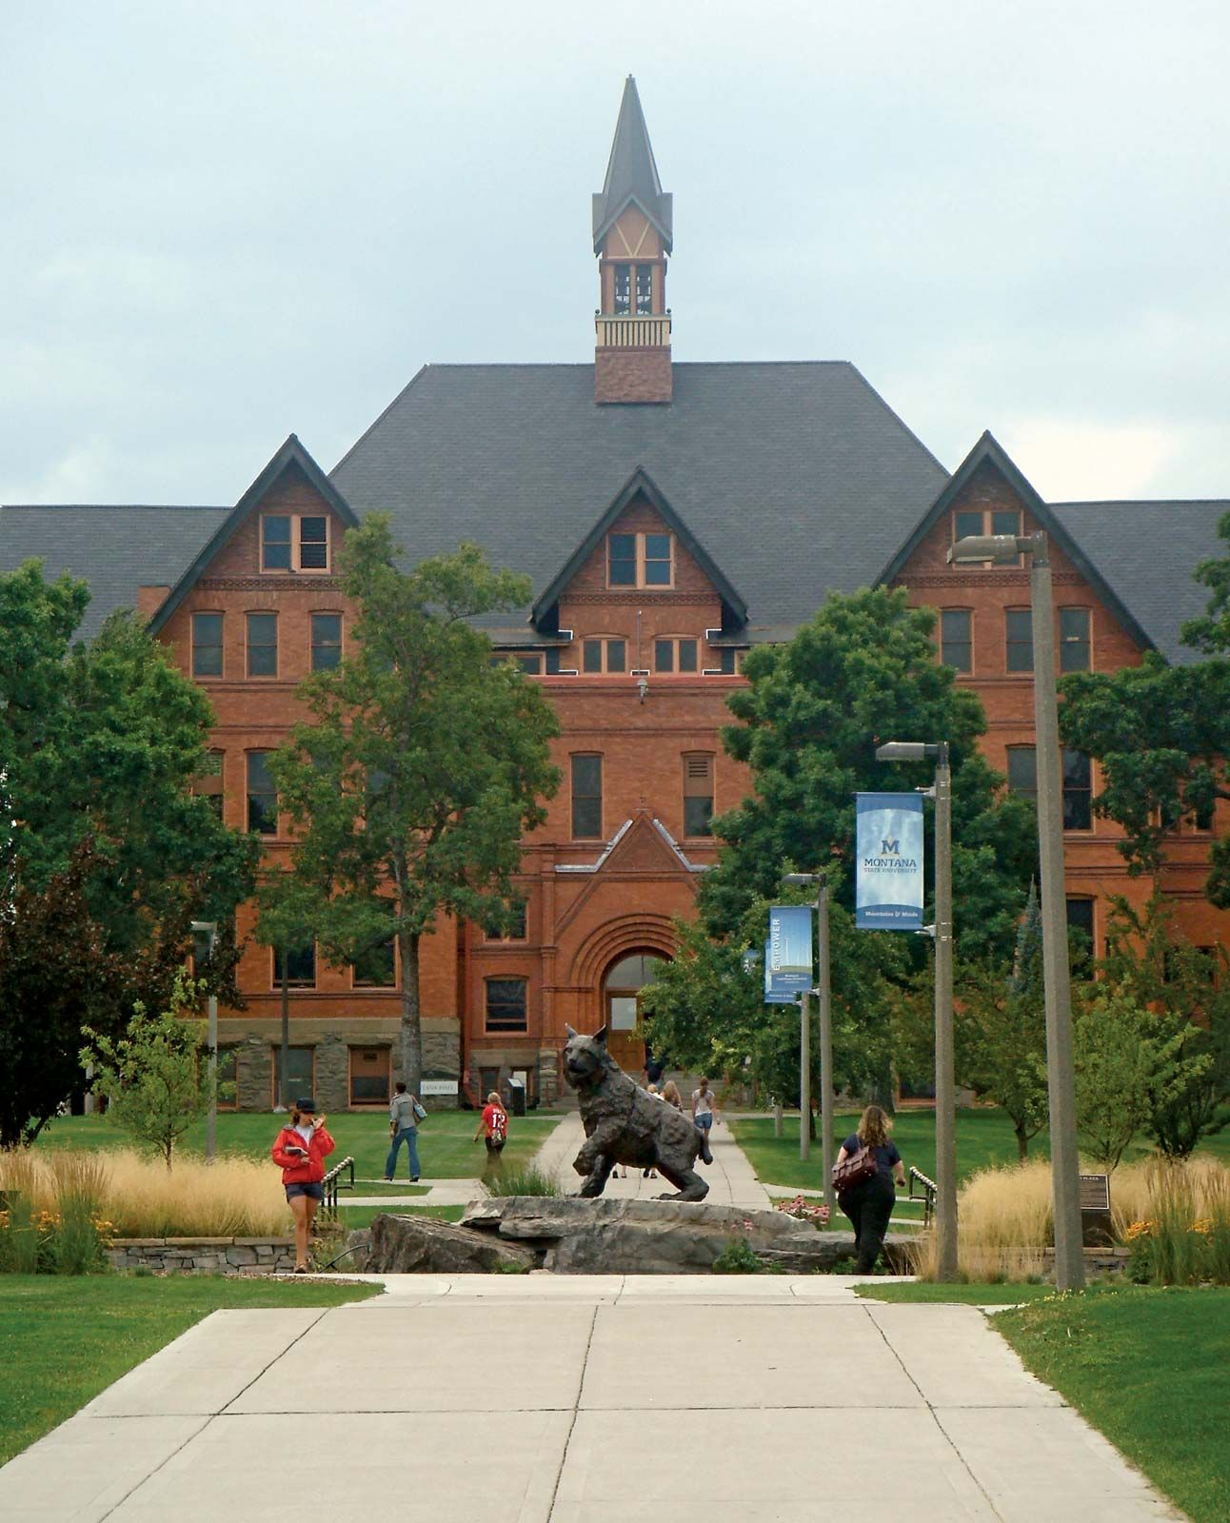

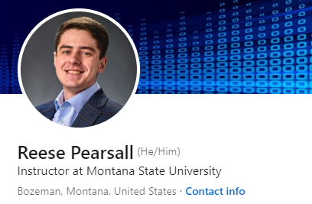

Thank You!
Thank you for your patience, flexibility, and kindness ☺
I know things were not perfect, but I am happy with how things went
I hope you enjoyed this class, and I hope the stuff you learned will be helpful in your career. With most devices connected to the internet, its important to understand these basic networks concepts!
I will be teaching 232 and 132 next semester
Connect with me on LinkedIn!
Congrats to those that are graduating next weekend! I hope you find a job that you love!
If I can be of assistance to you for anything in the future, please let me know!

