Slide 1

CSCI 476: Computer Security
Buffer Overflow Attack (Part 1)
The stack, stack frames, function prologue and epilogue
Reese Pearsall
Fall 2023
*all images are stolen from the internet
https://www.cs.montana.edu/pearsall/classes/fall2023/476/main.html

Slide 2
Announcements
Lab 2 (Shellshock) due on Sunday 10/1
VM Issues
Often times, the fastest solution is to create a brand new VM
Crank up video memory

Slide 3
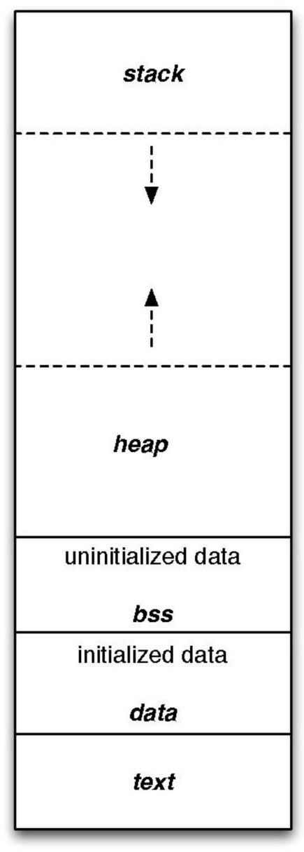
Program layout in memory
High addresses
int x = 100; int main()
{
int a =2; float b = 2.5;
static int y;
int *ptr = (int *) malloc(2*sizeof(int));
ptr[0] = 5;
ptr[1] = 6;
free(ptr)
return 1;
}
Low addresses

Slide 4



Program layout in memory
High addresses
int x = 100; int main()
{
int a =2; float b = 2.5;
static int y;
int *ptr = (int *) malloc(2*sizeof(int));
ptr[0] = 5;
ptr[1] = 6;
free(ptr)
return 1;
}
Low addresses

Slide 5






Program layout in memory
High addresses
int x = 100; int main()
{
int a =2; float b = 2.5;
static int y;
int *ptr = (int *) malloc(2*sizeof(int));
ptr[0] = 5;
ptr[1] = 6;
free(ptr)
return 1;
}
Low addresses

Slide 6





Program layout in memory
High addresses
int x = 100; int main()
{
int a =2; float b = 2.5;
static int y;
int *ptr = (int *) malloc(2*sizeof(int));
ptr[0] = 5;
ptr[1] = 6;
free(ptr)
return 1;
}
Low addresses

Slide 7





Program layout in memory
High addresses
int x = 100; int main()
{
int a =2; float b = 2.5;
static int y;
int *ptr = (int *) malloc(2*sizeof(int));
ptr[0] = 5;
ptr[1] = 6;
free(ptr)
return 1;
}
Low addresses

Slide 8
Stack and Function Invocation
int main(){
int x = 3; int y = 3;
foo(x,y)
int a = 0; foo2(a);
return 0;
}
int foo(x,y){
printf(x);
printf(y);
int z = 1; foo2(z) return 0;
}
int foo2(p){
printf(p);
return 0;
}

Slide 9
Stack and Function Invocation
The Stack
0xFFFFF
int main(){
int x = 3; int y = 3;
foo(x,y)
int a = 0; foo2(a);
return 0;
}
int foo(x,y){
printf(x);
printf(y);
int z = 1; foo2(z) return 0;
}
int foo2(p){
printf(p);
Every time a function is called, memory gets allocated on the stack to hold function values and information
return 0;
}

Slide 10
Stack and Function Invocation
The Stack
0xFFFFF
int main(){
int x = 3; int y = 3;
foo(x,y)
int a = 0; foo2(a);
return 0;
}
int foo(x,y){
printf(x);
printf(y);
int z = 1; foo2(z) return 0;
}
This memory on the stack is called a stack frame
int foo2(p){
printf(p);
Every time a function is called, memory gets allocated on the stack to hold function values and information
return 0;
}

Slide 11
Stack and Function Invocation
The Stack
0xFFFFF
int main(){
int x = 3; int y = 3;
foo(x,y)
int a = 0; foo2(a);
return 0;
}
int foo(x,y){
printf(x);
printf(y);
int z = 1; foo2(z) return 0;
}
Stack Frame Format
Value of Arg 1
Value of Arg 2
Return Address
Previous Frame Pointer
Value of Var 1
Value of Var 1
int foo2(p){
printf(p);
The stack frame consists of local variables, function arguments, and addresses
return 0;
}

Slide 12
Stack and Function Invocation
Value of Arg 1
Value of Arg 2
Return Address
Previous Frame Pointer
Value of Var 1
Value of Var 1
The Stack
Stack Frame Format
Return Address for Main
Previous Frame Pointer
X = 3
Y = 3
0xFFFFF
int main(){
int x = 3; int y = 3;
foo(x,y)
int a = 0; foo2(a);
return 0;
}
int foo(x,y){
printf(x);
printf(y);
int z = 1; foo2(z) return 0;
}
Stack frame for main()
int foo2(p){
printf(p);
return 0;
}

Slide 13
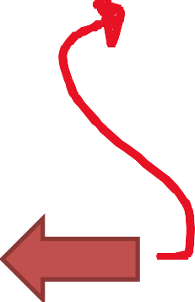
Stack and Function Invocation
Value of Arg 1
Value of Arg 2
Return Address
Previous Frame Pointer
Value of Var 1
Value of Var 1
The Stack
Stack Frame Format
Return Address for Main
Previous Frame Pointer
X = 3
Y = 3
0xFFFFF
int main(){
int x = 3; int y = 3;
foo(x,y)
int a = 0; foo2(a);
return 0;
}
int foo(x,y){
printf(x);
printf(y);
int z = 1; foo2(z) return 0;
}
Stack frame for main()
int foo2(p){
printf(p);
return 0;
}

Slide 14
Stack and Function Invocation
Value of Arg 1
Value of Arg 2
Return Address
Previous Frame Pointer
Value of Var 1
Value of Var 1
The Stack
Stack Frame Format
Return Address for Main
Previous Frame Pointer
X = 3
Y = 3
0xFFFFF
int main(){
int x = 3; int y = 3;
foo(x,y)
int a = 0; foo2(a);
return 0;
}
int foo(x,y){
Stack frame for main()
printf(x);
printf(y);
int z = 1;
foo2(z)
return 0;
We need to know where to return to when this function finishes
}
int foo2(p){
printf(p);
X = 3
Y = 3
Return Address for foo()
Previous Frame Pointer
Z = 1
Stack frame for foo()
return 0;
}

Slide 15
Stack and Function Invocation
Value of Arg 1
Value of Arg 2
Return Address
Previous Frame Pointer
Value of Var 1
Value of Var 1
The Stack
Stack Frame Format
Return Address for Main
Previous Frame Pointer
X = 3
Y = 3
0xFFFFF
int main(){
int x = 3; int y = 3;
foo(x,y)
int a = 0; foo2(a);
return 0;
}
int foo(x,y){
Stack frame for main()
printf(x);
printf(y);
int z = 1;
foo2(z)
return 0;
We need to know where to return to when this function finishes
}
int foo2(p){
printf(p);
X = 3
Y = 3
Return Address for foo()
Previous Frame Pointer
Z = 1
Stack frame for foo()
return 0;
}

Slide 16
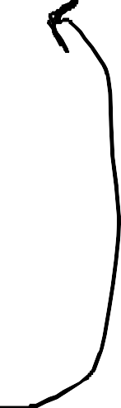
Stack and Function Invocation
Value of Arg 1
Value of Arg 2
Return Address
Previous Frame Pointer
Value of Var 1
Value of Var 1
The Stack
Stack Frame Format
Return Address for Main
Previous Frame Pointer
X = 3
Y = 3
X = 3
Y = 3
Return Address for foo()
Previous Frame Pointer
Z = 1
0xFFFFF
int main(){
int x = 3; int y = 3;
foo(x,y)
int a = 0; foo2(a);
return 0;
}
int foo(x,y){
Stack frame for main()
printf(x);
printf(y);
int z = 1;
Stack frame for foo()
foo2(z)
return 0;
}
int foo2(p){
printf(p);
return 0;
}

Slide 17
Stack and Function Invocation
Value of Arg 1
Value of Arg 2
Return Address
Previous Frame Pointer
Value of Var 1
Value of Var 1
The Stack
Stack Frame Format
Return Address for Main
Previous Frame Pointer
X = 3
Y = 3
X = 3
Y = 3
Return Address for foo()
Previous Frame Pointer
Z = 1
0xFFFFF
int main(){
int x = 3; int y = 3;
foo(x,y)
int a = 0; foo2(a);
return 0;
}
int foo(x,y){
Stack frame for main()
printf(x);
printf(y);
int z = 1;
Stack frame for foo()
foo2(z)
return 0;
}
int foo2(p){
printf(p);
p = 1
Return Address for foo2
Previous Frame Pointer
Stack frame for foo2()
return 0;
}

Slide 18
Stack and Function Invocation
Value of Arg 1
Value of Arg 2
Return Address
Previous Frame Pointer
Value of Var 1
Value of Var 1
The Stack
Stack Frame Format
Return Address for Main
Previous Frame Pointer
X = 3
Y = 3
X = 3
Y = 3
Return Address for foo()
Previous Frame Pointer
Z = 1
0xFFFFF
int main(){
int x = 3; int y = 3;
foo(x,y)
int a = 0; foo2(a);
return 0;
}
int foo(x,y){
Stack frame for main()
printf(x);
printf(y);
int z = 1;
Stack frame for foo()
foo2(z)
return 0;
}
int foo2(p){
printf(p);
p = 1
Return Address for foo2
Previous Frame Pointer
Stack frame for foo2()
return 0;
}

Slide 19
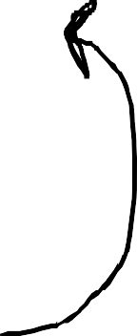
Stack and Function Invocation
Value of Arg 1
Value of Arg 2
Return Address
Previous Frame Pointer
Value of Var 1
Value of Var 1
The Stack
Stack Frame Format
Return Address for Main
0xFFFFF
int main(){
int x = 3; int y = 3;
foo(x,y)
int a = 0; foo2(a);
return 0;
}
int foo(x,y){
Stack frame for main()
Previous Frame Pointer
printf(x);
printf(y);
X = 3
Y = 3
int z = 1;
X = 3
Stack frame for foo()
Y = 3
foo2(z)
Return Address for foo()
return 0;
Previous Frame Pointer
}
Z = 1
p = 1
int foo2(p){
printf(p);
Return Address for foo2
Previous Frame Pointer
return 0;
}

Slide 20
Stack and Function Invocation
Value of Arg 1
Value of Arg 2
Return Address
Previous Frame Pointer
Value of Var 1
Value of Var 1
The Stack
Stack Frame Format
Return Address for Main
0xFFFFF
int main(){
int x = 3; int y = 3;
foo(x,y)
int a = 0; foo2(a);
return 0;
}
int foo(x,y){
Stack frame for main()
Previous Frame Pointer
printf(x);
printf(y);
X = 3
Y = 3
int z = 1;
X = 3
Stack frame for foo()
Y = 3
foo2(z)
Return Address for foo()
return 0;
Previous Frame Pointer
}
Z = 1
p = 1
int foo2(p){
printf(p);
Return Address for foo2
Previous Frame Pointer
This function is finished, so we need to determine where the next instruction of the program is
return 0;
}

Slide 21
Stack and Function Invocation
Value of Arg 1
Value of Arg 2
Return Address
Previous Frame Pointer
Value of Var 1
Value of Var 1
The Stack
Stack Frame Format
Return Address for Main
0xFFFFF
int main(){
int x = 3; int y = 3;
foo(x,y)
int a = 0; foo2(a);
return 0;
}
int foo(x,y){
Stack frame for main()
Previous Frame Pointer
printf(x);
printf(y);
X = 3
Y = 3
int z = 1;
X = 3
Stack frame for foo()
Y = 3
foo2(z)
Return Address for foo()
return 0;
Previous Frame Pointer
}
Z = 1
p = 1
int foo2(p){
printf(p);
Return Address for foo2
Previous Frame Pointer
This function is finished, so we need to determine where the next instruction of the program is
Look at the return address in the stack frame!
return 0;
}

Slide 22
Stack and Function Invocation
Value of Arg 1
Value of Arg 2
Return Address
Previous Frame Pointer
Value of Var 1
Value of Var 1
The Stack
Stack Frame Format
Return Address for Main
0xFFFFF
int main(){
int x = 3; int y = 3;
foo(x,y)
int a = 0; foo2(a);
return 0;
}
int foo(x,y){
Stack frame for main()
Previous Frame Pointer
printf(x);
printf(y);
X = 3
Y = 3
int z = 1;
X = 3
Stack frame for foo()
Y = 3
foo2(z)
Return Address for foo()
return 0;
Previous Frame Pointer
}
Z = 1
p = 1
int foo2(p){
printf(p);
Return Address for foo2
Return back to foo()
Previous Frame Pointer
This function is finished, so we need to determine where the next instruction of the program is
Look at the return address in the stack frame!
return 0;
}

Slide 23
Stack and Function Invocation
Value of Arg 1
Value of Arg 2
Return Address
Previous Frame Pointer
Value of Var 1
Value of Var 1
The Stack
Stack Frame Format
Return Address for Main
Previous Frame Pointer
X = 3
Y = 3
X = 3
Y = 3
Return Address for foo()
Previous Frame Pointer
Z = 1
0xFFFFF
int main(){
int x = 3; int y = 3;
foo(x,y)
int a = 0; foo2(a);
return 0;
}
int foo(x,y){
Stack frame for main()
printf(x);
printf(y);
int z = 1;
Stack frame for foo()
foo2(z)
return 0;
}
int foo2(p){
printf(p);
foo2() is finished, so we can remove their information from the stack
return 0;
}

Slide 24
Stack and Function Invocation
Value of Arg 1
Value of Arg 2
Return Address
Previous Frame Pointer
Value of Var 1
Value of Var 1
The Stack
Stack Frame Format
Return Address for Main
Previous Frame Pointer
X = 3
Y = 3
X = 3
Y = 3
Return Address for foo()
Previous Frame Pointer
Z = 1
0xFFFFF
int main(){
int x = 3; int y = 3;
foo(x,y)
int a = 0; foo2(a);
return 0;
}
int foo(x,y){
Stack frame for main()
printf(x);
printf(y);
int z = 1;
Stack frame for foo()
foo2(z)
return 0;
}
int foo2(p){
printf(p);
foo() is done, we now need to return back to main!
return 0;
}

Slide 25
Stack and Function Invocation
Value of Arg 1
Value of Arg 2
Return Address
Previous Frame Pointer
Value of Var 1
Value of Var 1
The Stack
Stack Frame Format
Return Address for Main
Previous Frame Pointer
X = 3
Y = 3
0xFFFFF
int main(){
int x = 3; int y = 3;
foo(x,y)
int a = 0; foo2(a);
return 0;
}
int foo(x,y){
Stack frame for main()
printf(x);
printf(y);
int z = 1;
foo2(z)
return 0;
}
int foo2(p){
printf(p);
foo() is done, we now need to return back to main!
return 0;
}

Slide 26
Stack and Function Invocation
Value of Arg 1
Value of Arg 2
Return Address
Previous Frame Pointer
Value of Var 1
Value of Var 1
The Stack
Stack Frame Format
Return Address for Main
Previous Frame Pointer
X = 3
Y = 3
a = 0
0xFFFFF
int main(){
int x = 3; int y = 3;
foo(x,y)
int a = 0; foo2(a);
return 0;
}
int foo(x,y){
Stack frame for main()
printf(x);
printf(y);
int z = 1;
foo2(z)
return 0;
}
int foo2(p){
printf(p);
return 0;
}

Slide 27

Stack and Function Invocation
Value of Arg 1
Value of Arg 2
Return Address
Previous Frame Pointer
Value of Var 1
Value of Var 1
The Stack
Stack Frame Format
Return Address for Main
Previous Frame Pointer
X = 3
Y = 3
a = 0
p = 0
Return Address for foo2
Previous Frame Pointer
0xFFFFF
int main(){
int x = 3; int y = 3;
foo(x,y)
int a = 0; foo2(a);
return 0;
}
int foo(x,y){
Stack frame for main()
printf(x);
printf(y);
int z = 1;
foo2(z)
Stack frame for foo2()
return 0;
}
int foo2(p){
printf(p);
foo2() is called again, so a new stack frame is created and put onto the stack
return 0;
}

Slide 28
Stack and Function Invocation
Value of Arg 1
Value of Arg 2
Return Address
Previous Frame Pointer
Value of Var 1
Value of Var 1
The Stack
Stack Frame Format
Return Address for Main
Previous Frame Pointer
X = 3
Y = 3
a = 0
p = 0
Return Address for foo2
Previous Frame Pointer
0xFFFFF
int main(){
int x = 3; int y = 3;
foo(x,y)
int a = 0; foo2(a);
return 0;
}
int foo(x,y){
Stack frame for main()
printf(x);
printf(y);
int z = 1;
foo2(z)
Stack frame for foo2()
return 0;
}
int foo2(p){
printf(p);
When foo2() is finished, it will return back to main()
return 0;
}

Slide 29
Stack and Function Invocation
Value of Arg 1
Value of Arg 2
Return Address
Previous Frame Pointer
Value of Var 1
Value of Var 1
The Stack
Stack Frame Format
Return Address for Main
Previous Frame Pointer
X = 3
Y = 3
a = 0
p = 0
Return Address for foo2
Previous Frame Pointer
0xFFFFF
int main(){
int x = 3; int y = 3;
foo(x,y)
int a = 0; foo2(a);
return 0;
}
int foo(x,y){
Stack frame for main()
printf(x);
printf(y);
int z = 1;
foo2(z)
Stack frame for foo2()
return 0;
}
int foo2(p){
printf(p);
When foo2() is finished, it will return back to main()
return 0;
}

Slide 30
Stack and Function Invocation
Value of Arg 1
Value of Arg 2
Return Address
Previous Frame Pointer
Value of Var 1
Value of Var 1
The Stack
Stack Frame Format
Return Address for Main
Previous Frame Pointer
X = 3
Y = 3
a = 0
0xFFFFF
int main(){
int x = 3; int y = 3;
foo(x,y)
int a = 0; foo2(a);
return 0;
}
int foo(x,y){
Stack frame for main()
printf(x);
printf(y);
int z = 1;
foo2(z)
return 0;
}
int foo2(p){
printf(p);
When foo2() is finished, it will return back to main()
return 0;
}

Slide 31
Stack and Function Invocation
Value of Arg 1
Value of Arg 2
Return Address
Previous Frame Pointer
Value of Var 1
Value of Var 1
The Stack
Stack Frame Format
Return Address for Main
Previous Frame Pointer
X = 3
Y = 3
a = 0
0xFFFFF
int main(){
int x = 3; int y = 3;
foo(x,y)
int a = 0; foo2(a);
return 0;
}
int foo(x,y){
Stack frame for main()
printf(x);
printf(y);
int z = 1;
foo2(z)
return 0;
}
int foo2(p){
printf(p);
Program done!
return 0;
}

Slide 32
Stack and Function Invocation
Value of Arg 1
Value of Arg 2
Return Address
Previous Frame Pointer
Value of Var 1
Value of Var 1
The Stack
Stack Frame Format
0xFFFFF
int main(){
int x = 3; int y = 3;
foo(x,y)
int a = 0; foo2(a);
return 0;
}
int foo(x,y){
printf(x);
printf(y);
int z = 1;
foo2(z)
return 0;
}
int foo2(p){
printf(p);
Program done!
return 0;
}

Slide 33
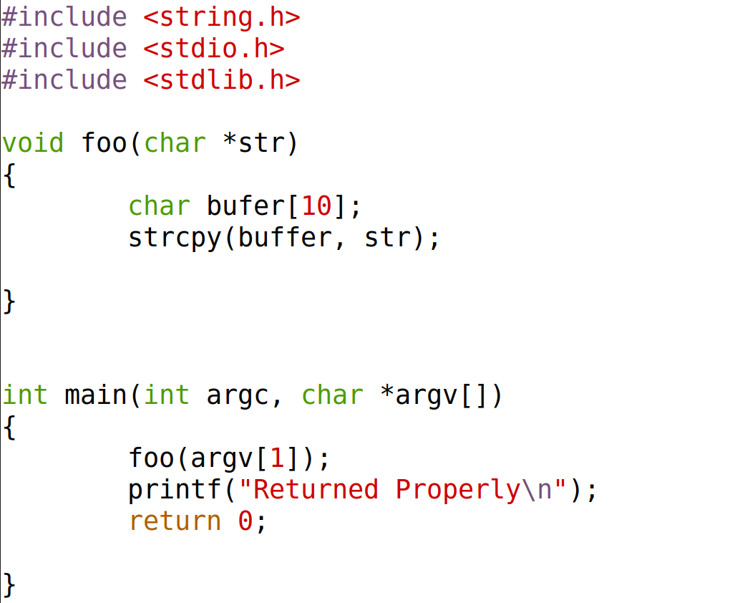


Slide 34
The Stack
0xFFFFF

Slide 35
The Stack
…
…
Return Address
..
0xFFFFF
main() stack frame

Slide 36
The Stack
…
…
Return Address
..
…
…
Return Address
CHAR BUFFER[]
0xFFFFF
main() stack frame
foo() stack frame

Slide 37
The Stack
…
…
Return Address
..
…
…
Return Address
CHAR BUFFER[]
0xFFFFF
main() stack frame
foo() stack frame

Slide 38
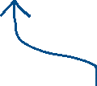

The Stack
…
…
Return Address
..
…
…
Return Address
CHAR BUFFER[]
0xFFFFF
main() stack frame
foo() stack frame
The input of this program eventually gets put on the stack!

Slide 39
The Stack
…
…
Return Address
..
…
…
Return Address
CHAR BUFFER[]
0xFFFFF
main() stack frame
foo() stack frame
AAAAAAAAAA
buffer[] can only hold 10 characters, right?

Slide 40

The Stack
…
…
Return Address
..
…
…
Return Address
CHAR BUFFER[]
0xFFFFF
main() stack frame
foo() stack frame
AAAAAAAAAA

Slide 41
The Stack
…
…
Return Address
..
…
…
Return Address
CHAR BUFFER[]
0xFFFFF
main() stack frame
foo() stack frame
reese
Instead of ./myprogram reese
What if we did…..

Slide 42
AAAAAAAAAAAAAAAAAAAAAAAAAAAAAAAAAAAAAAAAAAAAAAAAAAAAAAAAAAAAAA
The Stack
…
…
Return Address
..
…
…
Return Address
CHAR BUFFER[]
0xFFFFF
main() stack frame
foo() stack frame
Instead of ./myprogram reese
What if we did…..
./myprogram AAAAAAAAAAAAAAAAAAAAAAAAAAAAAAAAAAAAAAAAAAAAAAAAAAAAAAAAAAAAAAAAAAAAAAAAAAAAAAAAAAAAA

Slide 43
AAAAAAAAAAAAAAAAAAAAAAAAAAAAAAAAAAAAAAAAAAAAAAAAAAAAAAAAAAAAAA
The Stack
…
…
Return Address
..
…
…
Return Address
CHAR BUFFER[]
0xFFFFF
main() stack frame
foo() stack frame
We can overflow this buffer!
This will overwrite other values on the Stack

Slide 44
AAAAAAAAAAAAAAAAAAAAAAAAAAAAAAAAAAAAAAAAAAAAAAAAAAAAAAAAAAAAAA
The Stack
…
…
Return Address
..
…
…
Return Address
CHAR BUFFER[]
0xFFFFF
main() stack frame
foo() stack frame
We can overflow this buffer!
This will overwrite other values on the Stack
What can our input control ?

Slide 45
AAAAAAAAAAAAAAAAAAAAAAAAAAAAAAAAAAAAAAAAAAAAAAAAAAAAAAAAAAAAAA
The Stack
…
…
Return Address
..
…
…
Return Address
CHAR BUFFER[]
0xFFFFF
main() stack frame
foo() stack frame
We can overflow this buffer!
This will overwrite other values on the Stack
Our input can overwrite values on the stack, specifically, the return address

Slide 46
The Stack
…
…
Return Address
..
…
…
Return Address
CHAR BUFFER[]
0xFFFFF
AAAAAAA
AAAAAAA
main() stack frame
AAAAAAA
AAAAAAA
AAAAAAA
AAAAAAA
foo() stack frame
EVIL
AAAAAAA
./myprogram AAAAAAAAEVILAAAAAAAAAAAAAAAAAAAAAAAAAAAAAAAAAAAAAAAAAAAAAAAAAAAAAA

Slide 47
The Stack
…
…
Return Address
..
…
…
Return Address
CHAR BUFFER[]
0xFFFFF
AAAAAAA
AAAAAAA
main() stack frame
AAAAAAA
AAAAAAA
AAAAAAA
AAAAAAA
foo() stack frame
EVIL
AAAAAAA
./myprogram AAAAAAAAEVILAAAAAAAAAAAAAAAAAAAAAAAAAAAAAAAAAAAAAAAAAAAAAAAAAAAAAA
Instead of EVIL, what could we overwrite it with?

Slide 48

The Stack
…
…
Return Address
..
…
…
Return Address
CHAR BUFFER[]
0xFFFFF
AAAAAAA
AAAAAAA
main() stack frame
AAAAAAA
AAAAAAA
AAAAAAA
AAAAAAA
foo() stack frame
EVIL
AAAAAAA
./myprogram AAAAAAAAEVILAAAAAAAAAAAAAAAAAAAAAAAAAAAAAAAAAAAAAAAAAAAAAAAAAAAAAA
Instead of EVIL, what could we overwrite it with?
Our own malicious code

Slide 49
THE STACK
… previous stack frames…
Arguments
Return Address
Previous frame pointer
buffer[99] . . . . . buffer[0]
The CPU needs to keep track of two things:
1. The location of the top of stack
2. The location of the current stack frame we are executing

Slide 50
THE STACK
… previous stack frames…
Arguments
Return Address
Previous frame pointer
buffer[99] . . . . . buffer[0]
The CPU needs to keep track of two things:
1. The location of the top of stack
2. The location of the current stack frame we are executing
?????

Slide 51
THE STACK
… previous stack frames…
Arguments
Return Address
Previous frame pointer
buffer[99] . . . . . buffer[0]
The CPU needs to keep track of two things:
1. The location of the top of stack
The register $esp points to the top of the stack
2. The location of the current stack frame we are executing
$esp

Slide 52
THE STACK
… previous stack frames…
Arguments
Return Address
Previous frame pointer
buffer[99] . . . . . buffer[0]
The CPU needs to keep track of two things:
1. The location of the top of stack
The register $esp points to the top of the stack
$ebp
2. The location of the current stack frame we are executing
The register $ebp points to the base of the current stack frame
$esp

Slide 53
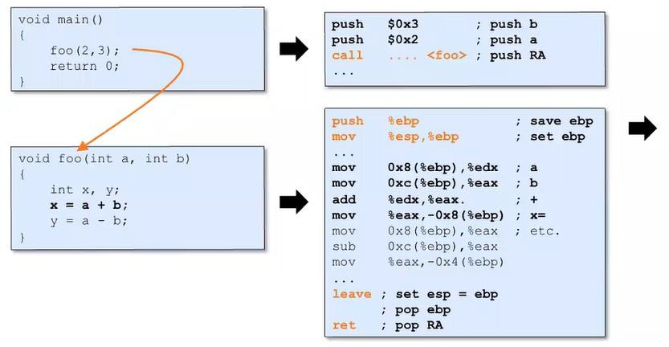
THE STACK
Every time a function is called, the function prologue occurs
$ ebp
… previous stack frames…
$ esp

Slide 54

THE STACK
Every time a function is called, the function prologue occurs
$ ebp
… previous stack frames…
Value of B
$ esp

Slide 55

THE STACK
Every time a function is called, the function prologue occurs
$ ebp
… previous stack frames…
Value of B
Value of A
$ esp

Slide 56
THE STACK
Every time a function is called, the function prologue occurs
$ ebp
… previous stack frames…
Value of B
Value of A
Return Address back to main()
$ esp

Slide 57
THE STACK
Every time a function is called, the function prologue occurs
$ ebp
… previous stack frames…
Value of B
Value of A
Return Address back to main()
$ esp

Slide 58
THE STACK
Every time a function is called, the function prologue occurs
$ ebp
… previous stack frames…
Value of B
Value of A
Return Address back to main()
$ esp

Slide 59

THE STACK
Every time a function is called, the function prologue occurs
$ ebp
… previous stack frames…
Value of B
Value of A
Return Address back to main()
Previous Frame Pointer
$ esp

Slide 60
THE STACK
Every time a function is called, the function prologue occurs
… previous stack frames…
Value of B
Value of A
Return Address back to main()
Previous Frame Pointer
$ esp
$ebp

Slide 61
THE STACK
Every time a function is called, the function prologue occurs
… previous stack frames…
Value of B
Value of A
Return Address back to main()
Previous Frame Pointer
Value of x
Value of y
$ebp
$ esp

Slide 62
THE STACK
Every time a function is called, the function prologue occurs
… previous stack frames…
Value of B
Value of A
Return Address back to main()
Previous Frame Pointer
Value of x
Value of y
Why is this helpful knowledge?
This tells us how the return address in put onto the stack, and how these important pointers are managed
$ebp
$ esp

Slide 63
THE STACK
Every time a function is called, the function prologue occurs
… previous stack frames…
Value of B
Value of A
Return Address back to main()
Previous Frame Pointer
Value of x
Value of y
ebp + 12
Why is this helpful knowledge?
ebp + 8
ebp + 4
This tells us how the return address in put onto the stack, and how these important pointers are managed
$ebp
$ esp

Slide 64
THE STACK
Every time a function is called, the function prologue occurs
… previous stack frames…
Value of B
Value of A
Return Address back to main()
Previous Frame Pointer
Value of x
Value of y
ebp + 12
Why is this helpful knowledge?
ebp + 8
ebp + 4
This tells us how the return address in put onto the stack, and how these important pointers are managed
$ebp
$ esp

Slide 65

THE STACK
Every time a function is called, the function prologue occurs
… previous stack frames…
When a function finishes, a function epilogue occurs and cleans up the stack

Slide 66
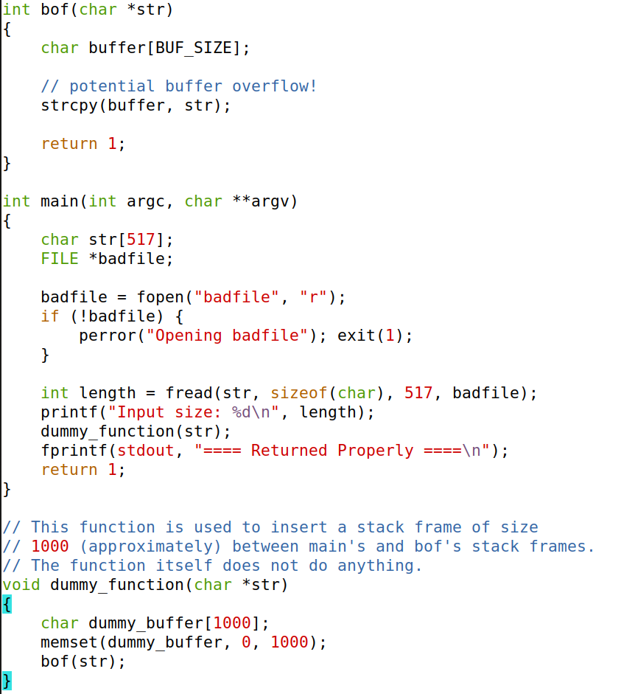

Slide 67
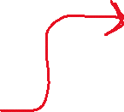
Reads (up to) 517 bytes of data from badfile

Slide 68
Reads (up to) 517 bytes of data from badfile
Storing the file contents into a str variable of size 517 bytes

Slide 69

Reads (up to) 517 bytes of data from badfile
Storing the file contents into a str variable of size 517 bytes
Calls the dummy_function() which calls bof()

Slide 70

bof() function uses strcopy to copy function argument into buffer
BUF_SIZE = 100
Reads (up to) 517 bytes of data from badfile
Storing the file contents into a str variable of size 517 bytes
Calls the dummy_function() which calls bof()

Slide 71

bof() function uses strcopy to copy function argument into buffer
BUF_SIZE = 100
There is no check if str is bigger than the buffer, so buffer overflow can occur!
Reads (up to) 517 bytes of data from badfile
Storing the file contents into a str variable of size 517 bytes
Calls the dummy_function() which calls bof()

Slide 72
bof() function uses strcopy to copy function argument into buffer
BUF_SIZE = 100
There is no check if str is bigger than the buffer, so buffer overflow can occur!
Reads (up to) 517 bytes of data from badfile
Storing the file contents into a str variable of size 517 bytes
Calls the dummy_function() which calls bof()
buffer is a stack variable, so we can overwrite other values on the stack with a buffer overflow!

Slide 73

THE STACK
… previous stack frames…
Arguments
Return Address
Previous frame pointer
buffer[99] . . . . . buffer[0]
Here is the current stack frame in bof()
We can control the contents of
buffer[] with our badfile

Slide 74

THE STACK
… previous stack frames…
Arguments
Return Address
Previous frame pointer
buffer[99] . . . . . buffer[0]
Here is the current stack frame in bof()
We can control the contents of
buffer[] with our badfile
Badfile = AAAAAAAAAAAAAAA AAAAAAAAAAAAAAA AAAAAAAAAAAAAAA AAAAAAAAAAAAAAA AAAAAAAAAAAAAAA AAAAAAAAAAAAAA
We can overflow this buffer and overwrite the contents above it

Slide 75
THE STACK
… previous stack frames…
Arguments
Return Address
Previous frame pointer
buffer[99] . . . . . buffer[0]
The juicy piece of information here in the return address
The program will jump to that address and continue to execute code
buffer[99]
.
.
.
.
.
buffer[0]

Slide 76
THE STACK
The juicy piece of information here in the return address
The program will jump to that address and continue to execute code
… previous stack frames…
Arguments
Return Address
Previous frame pointer
buffer[99] . . . . . buffer[0]
Overwriting the return address with something else can lead to:
Non-existent address
➔ CRASH
buffer[99]
.
.
.
.
.
buffer[0]
Access Violation
➔ CRASH
Invalid Instruction
➔ CRASH
Execution of attacker’s code! ➔ Oh no!!

Slide 77
THE STACK
The juicy piece of information here in the return address
The program will jump to that address and continue to execute code
… previous stack frames…
Arguments
Return Address
Previous frame pointer
buffer[99] . . . . . buffer[0]
We can overwrite it, so if it points to the location of our own code we also inject, it will execute that code!
buffer[99]
.
.
.
.
.
buffer[0]

Slide 78
THE STACK
The juicy piece of information here in the return address
The program will jump to that address and continue to execute code
… previous stack frames…
Arguments
Return Address
Previous frame pointer
buffer[99] . . . . . buffer[0]
We can overwrite it, so if it points to the location of our own code we also inject, it will execute that code!
buffer[99]
.
.
.
.
.
buffer[0]
And our code will
get a root shell
(there are many things our code can do, but we will be focused on getting a root shell)

