Slide 1

CSCI 476: Computer Security
Buffer Overflow Attack (Part 2)
Exploiting a vulnerable program
Reese Pearsall
Fall 2023
*all images are stolen from the internet
https://www.cs.montana.edu/pearsall/classes/fall2023/476/main.html

Slide 2
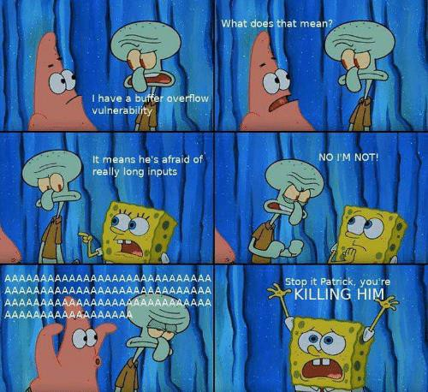
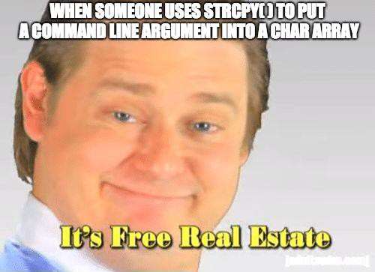
Announcements
Lab 2 (Shellshock) due on Sunday 10/1
Next Thursday (10/5) will be a lab 3 help session (optional) (no lecture)

Slide 3
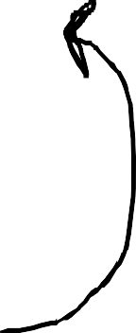
Stack and Function Invocation
The Stack
Return Address for Main
0xFFFFF
int main(){
int x = 3; int y = 3;
foo(x,y)
int a = 0; foo2(a);
return 0;
}
int foo(x,y){
Stack frame for main()
Previous Frame Pointer
printf(x);
printf(y);
X = 3
Y = 3
int z = 1;
X = 3
Stack frame for foo()
Y = 3
foo2(z)
Return Address for foo()
return 0;
Previous Frame Pointer
}
Z = 1
Stack frame for foo2()
p = 1
int foo2(p){
printf(p);
Argument 1
Argument 2
Return Address
Previous Frame Pointer
Local Variable 1
Local Variable 2
Return Address for foo2
Stack Frame Format
Previous Frame Pointer
return 0;
}

Slide 4
THE STACK
… previous stack frames…
Arguments
Return Address
Previous frame pointer
buffer[99] . . . . . buffer[0]
The CPU needs to keep track of two things:
1. The location of the top of stack
The register $esp points to the top of the stack
$ebp
2. The location of the current stack frame we are executing
The register $ebp points to the base of the current stack frame
$esp

Slide 5
THE STACK
Every time a function is called, the function prologue occurs
… previous stack frames…
Value of B
Value of A
Return Address back to main()
Previous Frame Pointer
Value of x
Value of y
ebp + 12
Why is this helpful knowledge?
ebp + 8
ebp + 4
This tells us how the return address in put onto the stack, and how these important pointers are managed
$ebp
$ esp

Slide 6
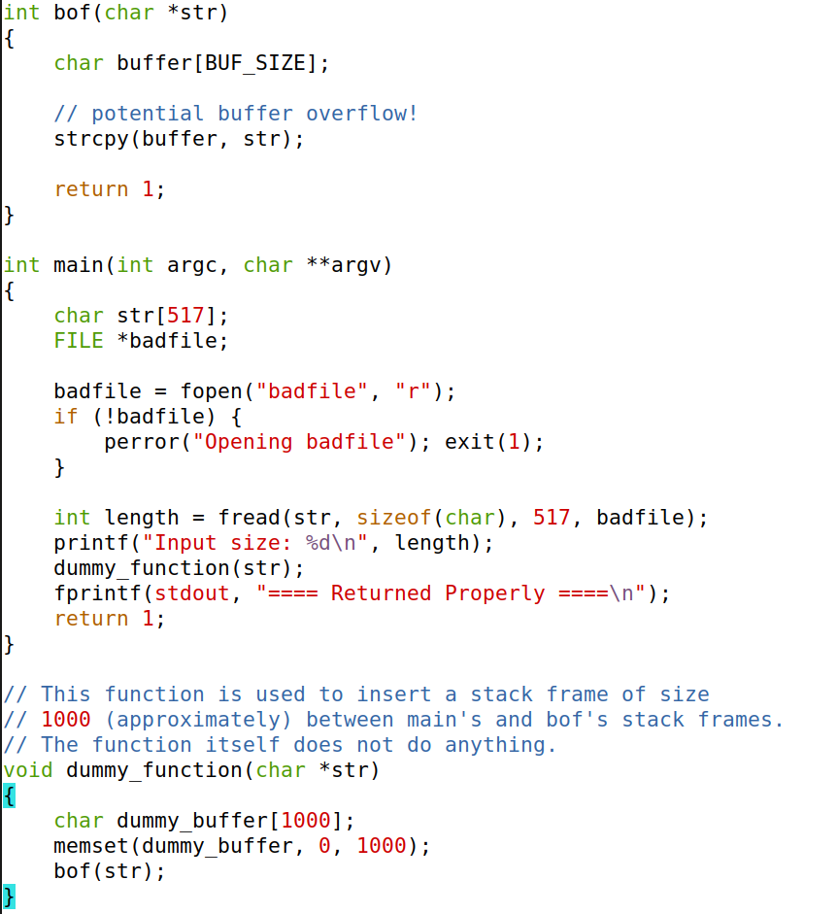

Slide 7
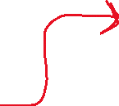
Reads (up to) 517 bytes of data from badfile

Slide 8
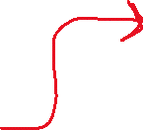
Reads (up to) 517 bytes of data from badfile
Storing the file contents into a str variable of size 517 bytes

Slide 9

Reads (up to) 517 bytes of data from badfile
Storing the file contents into a str variable of size 517 bytes
Calls the dummy_function() which calls bof()

Slide 10


bof() function uses strcopy to copy function argument into buffer
BUF_SIZE = 100
Reads (up to) 517 bytes of data from badfile
Storing the file contents into a str variable of size 517 bytes
Calls the dummy_function() which calls bof()

Slide 11


bof() function uses strcopy to copy function argument into buffer
BUF_SIZE = 100
There is no check if str is bigger than the buffer, so buffer overflow can occur!
Reads (up to) 517 bytes of data from badfile
Storing the file contents into a str variable of size 517 bytes
Calls the dummy_function() which calls bof()

Slide 12
bof() function uses strcopy to copy function argument into buffer
BUF_SIZE = 100
There is no check if str is bigger than the buffer, so buffer overflow can occur!
Reads (up to) 517 bytes of data from badfile
Storing the file contents into a str variable of size 517 bytes
Calls the dummy_function() which calls bof()
buffer is a stack variable, so we can overwrite other values on the stack with a buffer overflow!

Slide 13
bof() function uses strcopy to copy function argument into buffer
BUF_SIZE = 100
There is no check if str is bigger than the buffer, so buffer overflow can occur!
Reads (up to) 517 bytes of data from badfile
Storing the file contents into a str variable of size 517 bytes
Calls the dummy_function() which calls bof()
buffer is a stack variable, so we can overwrite other values on the stack with a buffer overflow!

Slide 14

THE STACK
… previous stack frames…
Arguments
Return Address
Previous frame pointer
buffer[99] . . . . . buffer[0]
Here is the current stack frame in bof()
We can control the contents of
buffer[] with our badfile

Slide 15

THE STACK
buffer[99] . . . . . buffer[0]
… previous stack frames…
Arguments
Return Address Previous frame pointer
Here is the current stack frame in bof()
We can control the contents of
buffer[] with our badfile
Badfile = AAAAAAAAAAAAAAA AAAAAAAAAAAAAAA AAAAAAAAAAAAAAA AAAAAAAAAAAAAAA AAAAAAAAAAAAAAA AAAAAAAAAAAAAA
We can overflow this buffer and overwrite the contents above it

Slide 16
THE STACK
… previous stack frames…
Arguments
Return Address
Previous frame pointer
buffer[99] . . . . . buffer[0]
The juicy piece of information here in the return address
The program will jump to that address and continue to execute code
buffer[99]
.
.
.
.
.
buffer[0]

Slide 17
THE STACK
The juicy piece of information here in the return address
The program will jump to that address and continue to execute code
… previous stack frames…
Arguments
Return Address
Previous frame pointer
buffer[99] . . . . . buffer[0]
Overwriting the return address with something else can lead to:
Non-existent address
➔ CRASH
buffer[99]
.
.
.
.
.
buffer[0]
Access Violation
➔ CRASH
Invalid Instruction
➔ CRASH
Execution of attacker’s code! ➔ Oh no!!

Slide 18
THE STACK
The juicy piece of information here in the return address
The program will jump to that address and continue to execute code
… previous stack frames…
Arguments
Return Address
Previous frame pointer
buffer[99] . . . . . buffer[0]
We can overwrite it, so if it points to the location of our own code we also inject, it will execute that code!
buffer[99]
.
.
.
.
.
buffer[0]

Slide 19
THE STACK
The juicy piece of information here in the return address
The program will jump to that address and continue to execute code
… previous stack frames…
Arguments
Return Address
Previous frame pointer
buffer[99] . . . . . buffer[0]
We can overwrite it, so if it points to the location of our own code we also inject, it will execute that code!
buffer[99]
.
.
.
.
.
buffer[0]
And our code will
……..

Slide 20
THE STACK
The juicy piece of information here in the return address
The program will jump to that address and continue to execute code
… previous stack frames…
Arguments
Return Address
Previous frame pointer
buffer[99] . . . . . buffer[0]
We can overwrite it, so if it points to the location of our own code we also inject, it will execute that code!
buffer[99]
.
.
.
.
.
buffer[0]
And our code will
get a root shell
(there are many things our code can do, but we will be focused on getting a root shell)

Slide 21


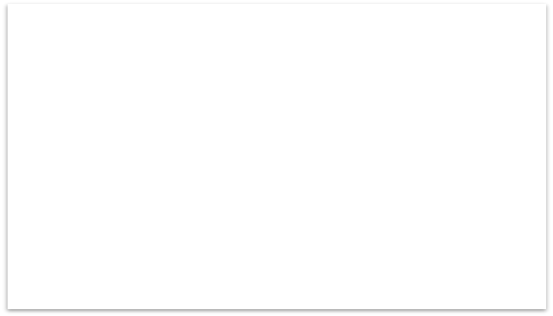

THE STACK
… previous stack frames…
Arguments
Return Address
Previous frame pointer
buffer[99] . . . . . buffer[0]
Malicious Code
Stuff
New return address
buffer[99]
.
.
.
.
.
buffer[0]
Stuff
“badfile”
bof() stack frame (stack.c)

Slide 22



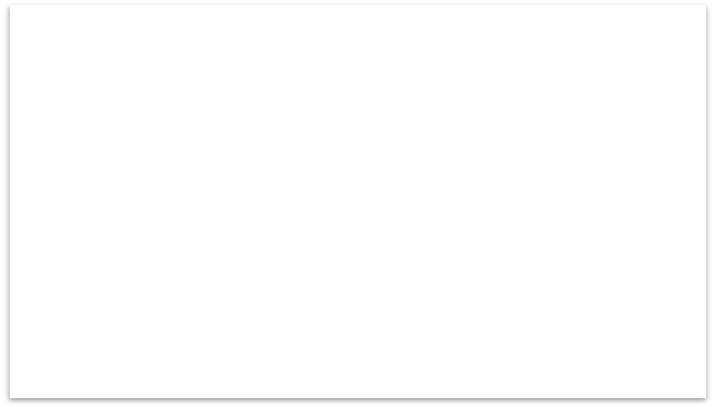


THE STACK
THE STACK
… previous stack frames…
Arguments
Return Address
Previous frame pointer
buffer[99] . . . . . buffer[0]
Malicious Code
Malicious Code
… previous stack frames…
Stuff
(Overwrite)
New return address
New return address
Return Address
(Overwrite)
(Overwrite)
buffer[99]
.
.
.
.
.
buffer[0]
buffer[99]
.
.
.
.
.
buffer[0]
(Overwrite)
(Overwrite)
Stuff
(Overwrite)
(Overwrite)
(Overwrite)
“badfile”
bof() stack frame (stack.c)
bof() stack frame (stack.c)

Slide 23

THE STACK
THE STACK
… previous stack frames…
Arguments
Return Address
Previous frame pointer
buffer[99] . . . . . buffer[0]
/bin/sh
Malicious Code
… previous stack frames…
Stuff
(Overwrite)
New return address
New return address
Return Address
(Overwrite)
(Overwrite)
buffer[99]
.
.
.
.
.
buffer[0]
buffer[99]
.
.
.
.
.
buffer[0]
(Overwrite)
(Overwrite)
Stuff
(Overwrite)
(Overwrite)
(Overwrite)
“badfile”
bof() stack frame (stack.c)
bof() stack frame (stack.c)

Slide 24
THE STACK
THE STACK
… previous stack frames…
Arguments
Return Address
Previous frame pointer
buffer[99] . . . . . buffer[0]
/bin/sh
Malicious Code
… previous stack frames…
Stuff
(Overwrite)
New return address
New return address
Return Address
(Overwrite)
(Overwrite)
buffer[99]
.
.
.
.
.
buffer[0]
buffer[99]
.
.
.
.
.
buffer[0]
(Overwrite)
(Overwrite)
Stuff
(Overwrite)
(Overwrite)
(Overwrite)
“badfile”
Pretty easy, right?
bof() stack frame (stack.c)
bof() stack frame (stack.c)

Slide 25
Our first buffer overflow attack
(but first we need to change some settings)
Turn off address randomization (countermeasure) (for now)
sudo sysctl -w kernel.randomize_va_space=0
Set /bin/sh to a shell with no RUID != EUID privilege drop countermeasure (for now…)
sudo ln -sf /bin/zsh /bin/sh
Compile a root owned set-uid version of stack.c w/ executable stack enabled + no stack guard
(In the lab, this is already done for you with the makefile )
gcc -o stack -z execstack -fno-stack-protector stack.c
sudo chown root stack
sudo chmod 4755 stack

Slide 26

GOAL:
Overflow a buffer to insert code and a new return address
Our first buffer overflow attack
Malicious Code
Step 1: Find the offset between the base of the buffer and the return address
Stuff
Arguments
Return Address
Previous frame pointer
buffer[99] . . . . . buffer[0]
New return address
We don’t know where the return address is… but it is somewhere on the stack!
Stuff
Step 1
“badfile”

Slide 27
GOAL:
Overflow a buffer to insert code and a new return address
Our first buffer overflow attack
Malicious Code
Step 2: Find the address to place our malicious shellcode
Stuff
New return address
We do not know where exactly our malicious code is
We only know that our code we inject gets copied into a buffer on stack
Stuff
Step 1
We do not know the exact memory location of buffer, because it varies depending on program memory usage
“badfile”

Slide 28

GOAL:
Overflow a buffer to insert code and a new return address
Our first buffer overflow attack
Malicious Code
We do not know where exactly our malicious code is
Arguments
Return Address
Previous frame pointer
buffer[99] . . . . . buffer[0]
???
We only know that our code we inject gets copied into a buffer on stack
We do not know the exact memory location of buffer, because it varies depending on program memory usage
???
We do control where in the buffer we inject our malicious code

Slide 29

GOAL:
Overflow a buffer to insert code and a new return address
Our first buffer overflow attack
Malicious Code
We do not know where exactly our malicious code is
Arguments
Return Address
Previous frame pointer
buffer[99] . . . . . buffer[0]
???
We only know that our code we inject gets copied into a buffer on stack
We do not know the exact memory location of buffer, because it varies depending on program memory usage
(sometimes)
We are going to guess ☺
???
We can get the values for $ebp and $esp to help!

Slide 30
Our first buffer overflow attack
GOAL:
Overflow a buffer to insert code and a new return address
Malicious Code
Step 1: Find the offset between the base of the buffer and the return address
Stuff
Arguments
Return Address
Previous frame pointer
buffer[99] . . . . . buffer[0]
New return address
Stuff
Step 1
“badfile”

Slide 31
Our first buffer overflow attack
GOAL:
Overflow a buffer to insert code and a new return address
Malicious Code
Step 1: Find the offset between the base of the buffer and the return address
Stuff
Arguments
Return Address
Previous frame pointer
buffer[99] . . . . . buffer[0]
New return address
$ebp
Stuff
(This might seem obvious, but often times we might not know how big the buffer is!)
Beginning of buffer
“badfile”

Slide 32

Our first buffer overflow attack
GOAL:
Overflow a buffer to insert code and a new return address
Malicious Code
Step 1: Find the offset between the base of the buffer and the return address
Stuff
Arguments
Return Address
Previous frame pointer
buffer[99] . . . . . buffer[0]
New return address
+4
$ebp
Stuff
Return address =
($ebp – beginning of buffer)+4
Beginning of buffer
“badfile”

Slide 33

Our first buffer overflow attack
GOAL:
Overflow a buffer to insert code and a new return address
Malicious Code
Step 1: Find the offset between the base of the buffer and the return address
Stuff
Arguments
Return Address
Previous frame pointer
buffer[99] . . . . . buffer[0]
New return address
+4
$ebp
Stuff
Return address =
($ebp – beginning of buffer)+4
Beginning of buffer
“badfile”
(esp != beginning of the buffer)

Slide 34
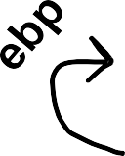
Our first buffer overflow attack
GOAL:
Overflow a buffer to insert code and a new return address
Step 1: Find the offset between the base of the buffer and the return address
Malicious Code
We can use gdb to debug and find addresses in memory
Stuff
New return address
Prev frame pointer (overwritten)
$ebp
Stuff
Buffer
“badfile”

Slide 35
Our first buffer overflow attack
GOAL:
Overflow a buffer to insert code and a new return address
Step 1: Find the offset between the base of the buffer and the return address
Malicious Code
We can use gdb to debug and find addresses in memory
Stuff
New return address
(clone repository and run make)
Prev frame pointer (overwritten)
$ebp
Stuff
Buffer
“badfile”

Slide 36
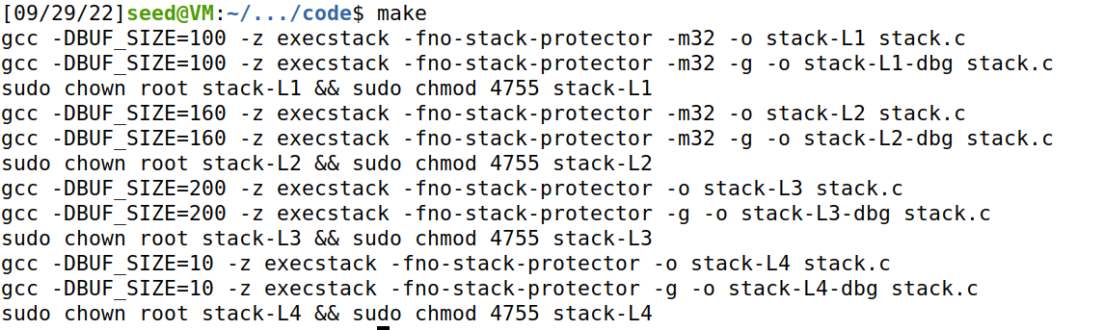
Our first buffer overflow attack
GOAL:
Overflow a buffer to insert code and a new return address
Step 1: Find the offset between the base of the buffer and the return address
Malicious Code
We can use gdb to debug and find addresses in memory
Stuff
New return address
Prev frame pointer (overwritten)
$ebp
Stuff
Buffer
“badfile”

Slide 37

Our first buffer overflow attack
GOAL:
Overflow a buffer to insert code and a new return address
Step 1: Find the offset between the base of the buffer and the return address
Malicious Code
Set a breakpoint at bof()
Stuff
Run the command gdb stack-L1-dbg
New return address
Prev frame pointer (overwritten)
$ebp
Stuff
Buffer
“badfile”

Slide 38

Our first buffer overflow attack
GOAL:
Overflow a buffer to insert code and a new return address
Step 1: Find the offset between the base of the buffer and the return address
Malicious Code
Set a breakpoint at bof()
Run the program until it reaches the breakpoint
Stuff
New return address
Prev frame pointer (overwritten)
$ebp
Stuff
(a lot of output will be displayed here)
Buffer
“badfile”

Slide 39
Our first buffer overflow attack
GOAL:
Overflow a buffer to insert code and a new return address
Step 1: Find the offset between the base of the buffer and the return address
Malicious Code
Set a breakpoint at bof()
Run the program until it reaches the breakpoint
Stuff
New return address
Prev frame pointer (overwritten)
$ebp
Stuff
(a lot of output will be displayed here)
Buffer
“badfile”
3. Step into the bof function

Slide 40

Step 1: Find the offset between the base
of the buffer and the return address
Set a breakpoint at bof()
Run the program until it reaches the breakpoint
Step into the bof function
Find the address of $ebp
Malicious Code
Stuff
New return address
Prev frame pointer (overwritten)
$ebp
Address of ebp!
Stuff
Buffer
“badfile”

Slide 41
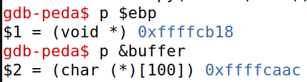
Step 1: Find the offset between the base
of the buffer and the return address
Set a breakpoint at bof()
Run the program until it reaches the breakpoint
Step into the bof function
Find the address of $ebp
Find the address of buffer
Malicious Code
Stuff
New return address
Prev frame pointer (overwritten)
$ebp
Address of buffer!
Stuff
Buffer
“badfile”

Slide 42
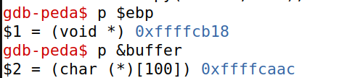

Step 1: Find the offset between the base
of the buffer and the return address
Set a breakpoint at bof()
Run the program until it reaches the breakpoint
Step into the bof function
Find the address of $ebp
Find the address of buffer
Calculate the difference between ebp and buffer
Malicious Code
Stuff
New return address
Prev frame pointer (overwritten)
$ebp
Stuff
Buffer
Our offset!!! (almost)
“badfile”

Slide 43
Step 1: Find the offset between the base
of the buffer and the return address
Set a breakpoint at bof()
Run the program until it reaches the breakpoint
Step into the bof function
Find the address of $ebp
Find the address of buffer
Calculate the difference between ebp and buffer
Malicious Code
Stuff
New return address
Prev frame pointer (overwritten)
$ebp
Stuff
Buffer
We need to add 4 to reach the return address 108 + 4 = 112 is our total offset
“badfile”
109

Slide 44
Step 1: Find the offset between the base
of the buffer and the return address
Set a breakpoint at bof()
Run the program until it reaches the breakpoint
Step into the bof function
Find the address of $ebp
Find the address of buffer
Calculate the difference between ebp and buffer
Malicious Code
Stuff
New return address
Prev frame pointer (overwritten)
$ebp
Stuff
Buffer
We need to add 4 to reach the return address 108 + 4 = 112 is our total offset
“badfile”
109

Slide 45
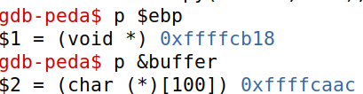

1. Set a breakpoint at bof()
(…)
(…)
Run the program until it reaches the breakpoint
Step into the bof function
4. Find the address of $ebp
5. Find the address of buffer
6. Calculate the difference between ebp and buffer
TL;DR GDB

Slide 46




Step 2: Find the address of our malicious shellcode
We are going to guess where our malicious code is going to be!
Malicious Code
Stuff Stuff
???
Stuff
New return address
Prev frame pointer (overwritten)
Stuff
112

Slide 47




Step 2: Find the address of our malicious shellcode
We are going to guess where our malicious code is going to be!
Malicious Code
Stuff Stuff
???
What should our stuff be in the payload?
Does it matter?
Stuff
New return address
Prev frame pointer (overwritten)
Stuff
112

Slide 48




Step 2: Find the address of our malicious shellcode
We are going to guess where our malicious code is going to be!
Malicious Code
000000000
Let’s guess!
00000000000
0000000000
Program crashes!
New return address
00000000000
0000000000
112

Slide 49
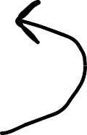
Step 2: Find the address of our malicious shellcode
We are going to guess where our malicious code is going to be!
Malicious Code
000000000
Let’s guess!
00000000000
0000000000
Program crashes!
New return address
00000000000
0000000000
112

Slide 50

Step 2: Find the address of our malicious shellcode
We are going to guess where our malicious code is going to be!
Malicious Code
000000000
Let’s guess!
Program crashes!
00000000000
0000000000
New return address
00000000000
This could potentially go on for a very long time ☹
0000000000
112
We need a better approach to guessing!

Slide 51
Step 2: Find the address of our malicious shellcode
We are going to guess where our malicious code is going to be!
Malicious Code
000000000
Let’s guess!
Program crashes!
00000000000
0000000000
New return address
Instead of garbage, we will fill it with executable instructions
But we don’t want that instruction to do
anything…
00000000000
0000000000
112

Slide 52



Step 2: Find the address of our malicious shellcode
Malicious Code
000000000
00000000000
0000000000
New return address
0X90
00000000000
0000000000

Slide 53

Step 2: Find the address of our malicious shellcode
Malicious Code
000000000
00000000000
0000000000
The NOP instruction does nothing, and the advances to the next instruction
New return address
00000000000
0000000000

Slide 54




Step 2: Find the address of our malicious shellcode
Malicious Code
NOP NOP NOP NOP NOP NOP
NOP NOP NOP NOP NOP NOP
NOP NOP NOP NOP NOP NOP
New return address
Guess!
NOP NOP NOP NOP NOP NOP
Incorrect guess, but the program does not crash!
NOP NOP NOP NOP NOP NOP NOP NOP NOP NOP NOP NOP NOP NOP NOP NOP NOP NOP NOP NOP NOP NOP NOP NOP NOP NOP NOP NOP NOP NOP NOP NOP NOP NOP NOP

Slide 55


Step 2: Find the address of our malicious shellcode
This large sequence of NOPs is called a NOP sled ☺
Malicious Code
NOP NOP NOP NOP NOP NOP
NOP NOP NOP NOP NOP NOP
NOP NOP NOP NOP NOP NOP
New return address
Guess!
NOP NOP NOP NOP NOP NOP
Incorrect guess, but the program does not crash!
NOP NOP NOP NOP NOP NOP NOP NOP NOP NOP NOP NOP NOP NOP NOP NOP NOP NOP NOP NOP NOP NOP NOP NOP NOP NOP NOP NOP NOP NOP NOP NOP NOP NOP NOP
NOP advances to the next instruction

Slide 56



Step 2: Find the address of our malicious shellcode
Malicious Code
NOP NOP NOP NOP NOP NOP
NOP NOP NOP NOP NOP NOP
NOP NOP NOP NOP NOP NOP
New return address
Guess!
NOP NOP NOP NOP NOP NOP
Next: We need to construct the contents of our badfile
NOP NOP NOP NOP NOP NOP NOP NOP NOP NOP NOP NOP NOP NOP NOP NOP NOP NOP NOP NOP NOP NOP NOP NOP NOP NOP NOP NOP NOP NOP NOP NOP NOP NOP NOP

Slide 57
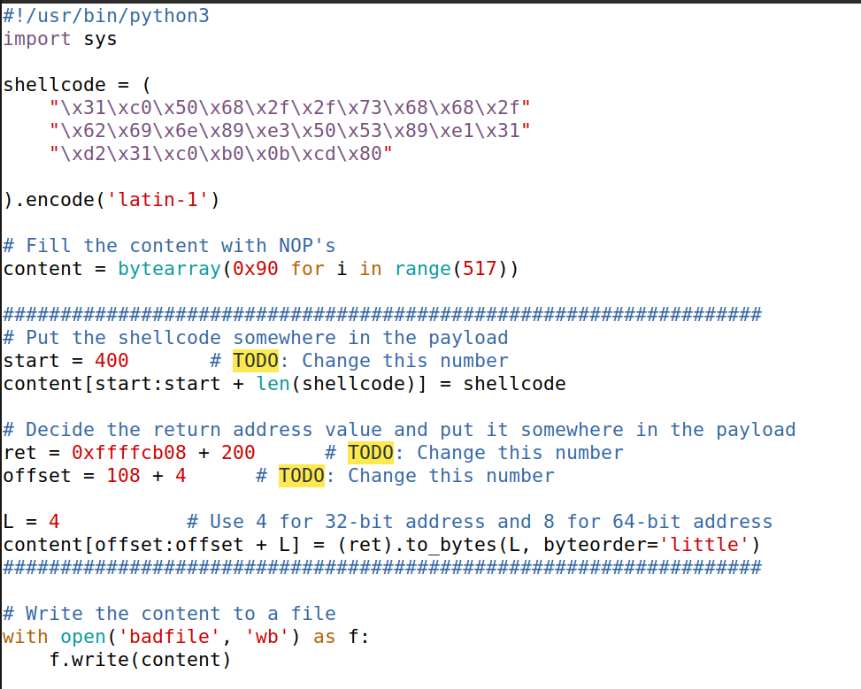
exploit.py
This script will construct our badfile for us!

Slide 58
exploit.py
This script will construct our badfile for us!
Malicious code to be injected (/bin/sh)
(we will talk later about what exactly this is)

Slide 59
exploit.py
This script will construct our badfile for us!
Malicious code to be injected (/bin/sh)
(we will talk later about what exactly this is)
Initially fill entire payload with NOP operators (0x90)

Slide 60
exploit.py
This script will construct our badfile for us!
Malicious code to be injected (/bin/sh)
(we will talk later about what exactly this is)
Initially fill entire payload with NOP operators (0x90)
Place malicious code somewhere in the payload
(This can be many different values, I just arbitrary selected 400)
400
CODE
NOP
NOP
NOP
NOP
NOP
NOP
NOP
NOP
NOP

Slide 61
exploit.py
This script will construct our badfile for us!
Malicious code to be injected (/bin/sh)
(we will talk later about what exactly this is)
Initially fill entire payload with NOP operators (0x90)
Place malicious code somewhere in the payload
(This can be many different values, I just arbitrary selected 400)
Place return address (a guess) at offset 112
112
400
ret
CODE
NOP
NOP
NOP
NOP
NOP
NOP
NOP
NOP

Slide 62
exploit.py
This script will construct our badfile for us!
Malicious code to be injected (/bin/sh)
(we will talk later about what exactly this is)
Initially fill entire payload with NOP operators (0x90)
Place malicious code somewhere in the payload
(This can be many different values, I just arbitrary selected 400)
Place return address (a guess) at offset 112
112
400
ret
CODE
NOP
NOP
NOP
NOP
NOP
NOP
NOP
NOP

Slide 63

exploit.py
This script will construct our badfile for us!
Malicious code to be injected (/bin/sh)
(we will talk later about what exactly this is)
This is the value of $ebp that you got from the GDB
YOURS MIGHT BE SLIGHTLY DIFFERENT
Initially fill entire payload with NOP operators (0x90)
Place malicious code somewhere in the payload
(This can be many different values, I just arbitrary selected 400)
Place return address (a guess) at offset 112
112
400
ret
CODE
NOP
NOP
NOP
NOP
NOP
NOP
NOP
NOP

Slide 64


exploit.py
This script will construct our badfile for us!
Malicious code to be injected (/bin/sh)
(we will talk later about what exactly this is)
When we debugged with GDB, GDB puts some information on the stack, which means that the memory address are slightly different when we run the program without GDB, so we need to apply an offset
For most students 200 works, for other 0x78 works
Initially fill entire payload with NOP operators (0x90)
Place malicious code somewhere in the payload
(This can be many different values, I just arbitrary selected 400)
Place return address (a guess) at offset 112
112
400
ret
CODE
NOP
NOP
NOP
NOP
NOP
NOP
NOP
NOP

Slide 65
exploit.py
This script will construct our badfile for us!
Malicious code to be injected (/bin/sh)
(we will talk later about what exactly this is)
Initially fill entire payload with NOP operators (0x90)
Place malicious code somewhere in the payload
(This can be many different values, I just arbitrary selected 400)
Place return address (a guess) at offset 112
112
400
ret
CODE
NOP
NOP
NOP
NOP
NOP
NOP
NOP
NOP

Slide 66

exploit.py
This script will construct our badfile for us!
This script build constructs a python list, and writes out the list to badfile
start will determine where in the list the malicious code will be inserted
0
400
517
ret
CODE
NOP
NOP
NOP
NOP
NOP
NOP
NOP
NOP
NOP
NOP
NOP
NOP
NOP
NOP

Slide 67


exploit.py
This script will construct our badfile for us!
This script build constructs a python list, and writes out the list to badfile
0xffffcb08 = address of $ebp
200 = GDB offset
ret is the value we put at the return address (our guess!!)
0
400
517
ret
CODE
NOP
NOP
NOP
NOP
NOP
NOP
NOP
NOP
NOP
NOP
NOP
NOP
NOP
NOP

Slide 68


exploit.py
This script will construct our badfile for us!
This script build constructs a python list, and writes out the list to badfile
0xffffcb08 = address of $ebp
200 = GDB offset
offset is where in our list we place the return address (ret)
0
112
400
517
ret
CODE
NOP
NOP
NOP
NOP
NOP
NOP
NOP
NOP
NOP
NOP
NOP
NOP
NOP
NOP

Slide 69

exploit.py
This script will construct our badfile for us!
This script build constructs a python list, and writes out the list to badfile
0xfffcb28
We have some wiggle room with our guess, we can make it slightly bigger or smaller and our attack will still work
0
112
400
517
ret
CODE
NOP
NOP
NOP
NOP
NOP
NOP
NOP
NOP
NOP
NOP
NOP
NOP
NOP
NOP
Our guess still lands in the NOP sled, so we are good!

Slide 70
exploit.py
This script will construct our badfile for us!
450
0xfffcb28
We have some wiggle room with where we place our malicious code, we can make it slightly bigger or smaller and our attack will still work
0
112
450
517
ret
CODE
NOP
NOP
NOP
NOP
NOP
NOP
NOP
NOP
NOP
NOP
NOP
NOP
NOP
NOP
Our guess still lands in the NOP sled, so we are good!

Slide 71
exploit.py
This script will construct our badfile for us!
This script build constructs a python list, and writes out the list to badfile
500
0xfffcb28
We cant go too far, otherwise it will not be read by badfile (the vulnerable program only reads up to 517 bytes)
0
112
500
517
ret
CODE
NOP
NOP
NOP
NOP
NOP
NOP
NOP
NOP
NOP
NOP
NOP
NOP
NOP
NOP
Malicious code that will not be read in by badfile
Our attack no longer works, because our payload got cut off

Slide 72
exploit.py
This script will construct our badfile for us!
This script build constructs a python list, and writes out the list to badfile
400
0xfffffff
We can’t guess too far, otherwise we won’t hit our NOP sled
0
112
400
517
ret
CODE
NOP
NOP
NOP
NOP
NOP
NOP
NOP
NOP
NOP
NOP
NOP
NOP
NOP
NOP
Our attack no longer works, because our NOP sled never hits the malicious code

Slide 73

exploit.py
This script will construct our badfile for us!
This script build constructs a python list, and writes out the list to badfile
400
0xfffffff
We can’t guess too far, otherwise we won’t hit the correct NOP sled
0
112
400
517
ret
CODE
NOP
NOP
NOP
NOP
NOP
NOP
NOP
NOP
NOP
NOP
NOP
NOP
NOP
NOP
This also won’t work, because our NOP sled never hits the malicious code

Slide 74

exploit.py
This script will construct our badfile for us!
This script build constructs a python list, and writes out the list to badfile
400
0xfffffff
We can’t guess too far, otherwise we might hit somewhere in the middle of our malicious code
0
112
400
517
ret
CODE
NOP
NOP
NOP
NOP
NOP
NOP
NOP
NOP
NOP
NOP
NOP
NOP
NOP
NOP
This also won’t work, because the start of malicious code is never executed (and thus errors will occur)

Slide 75

exploit.py
This script will construct our badfile for us!
This script build constructs a python list, and writes out the list to badfile
100
= true return address location
ret
NOP
Invalid return address → CRASH
We must be exactly correct with the location of the return address
0
104
400
517
ret
CODE
NOP
NOP
NOP
NOP
NOP
NOP
NOP
NOP
NOP
NOP
NOP
NOP
NOP
NOP
NOP
NOP
This also won’t work, because the return address is invalid

Slide 76
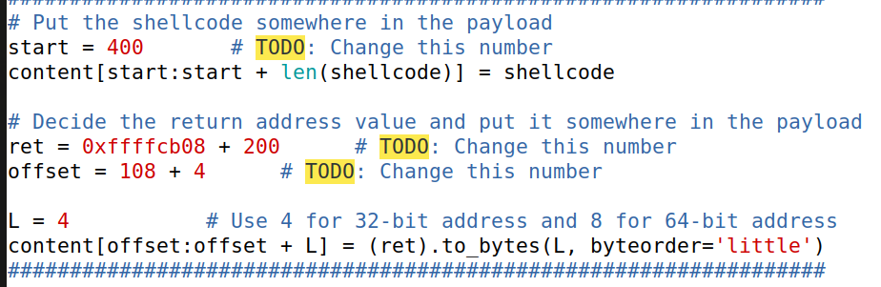
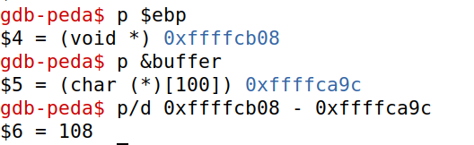






Conducting our first Buffer Overflow Attack
1. Turn off countermeasures
3. Update values in exploit.py
# Turn off ASLR!
sudo sysctl –w kernel.randomize_va_space=0
# link /bin/sh to /bin/zsh (no setuid countermeasure)
sudo ln -sf /bin/zsh /bin/sh
2. Get offset (step 1) from GDB
4. Run ./exploit.py to fill contents of badfile
5. Run the vulnerable program
(Your addresses might slightly be different, but your offset should still be 108)
ROOT SHELL!!

