Slide 1

CSCI 476: Computer Security
Buffer Overflow Attack (Part 3)
Shellcode, Bypassing Countermeasures
Reese Pearsall
Fall 2023
*all images are stolen from the internet
https://www.cs.montana.edu/pearsall/classes/fall2023/476/main.html

Slide 2
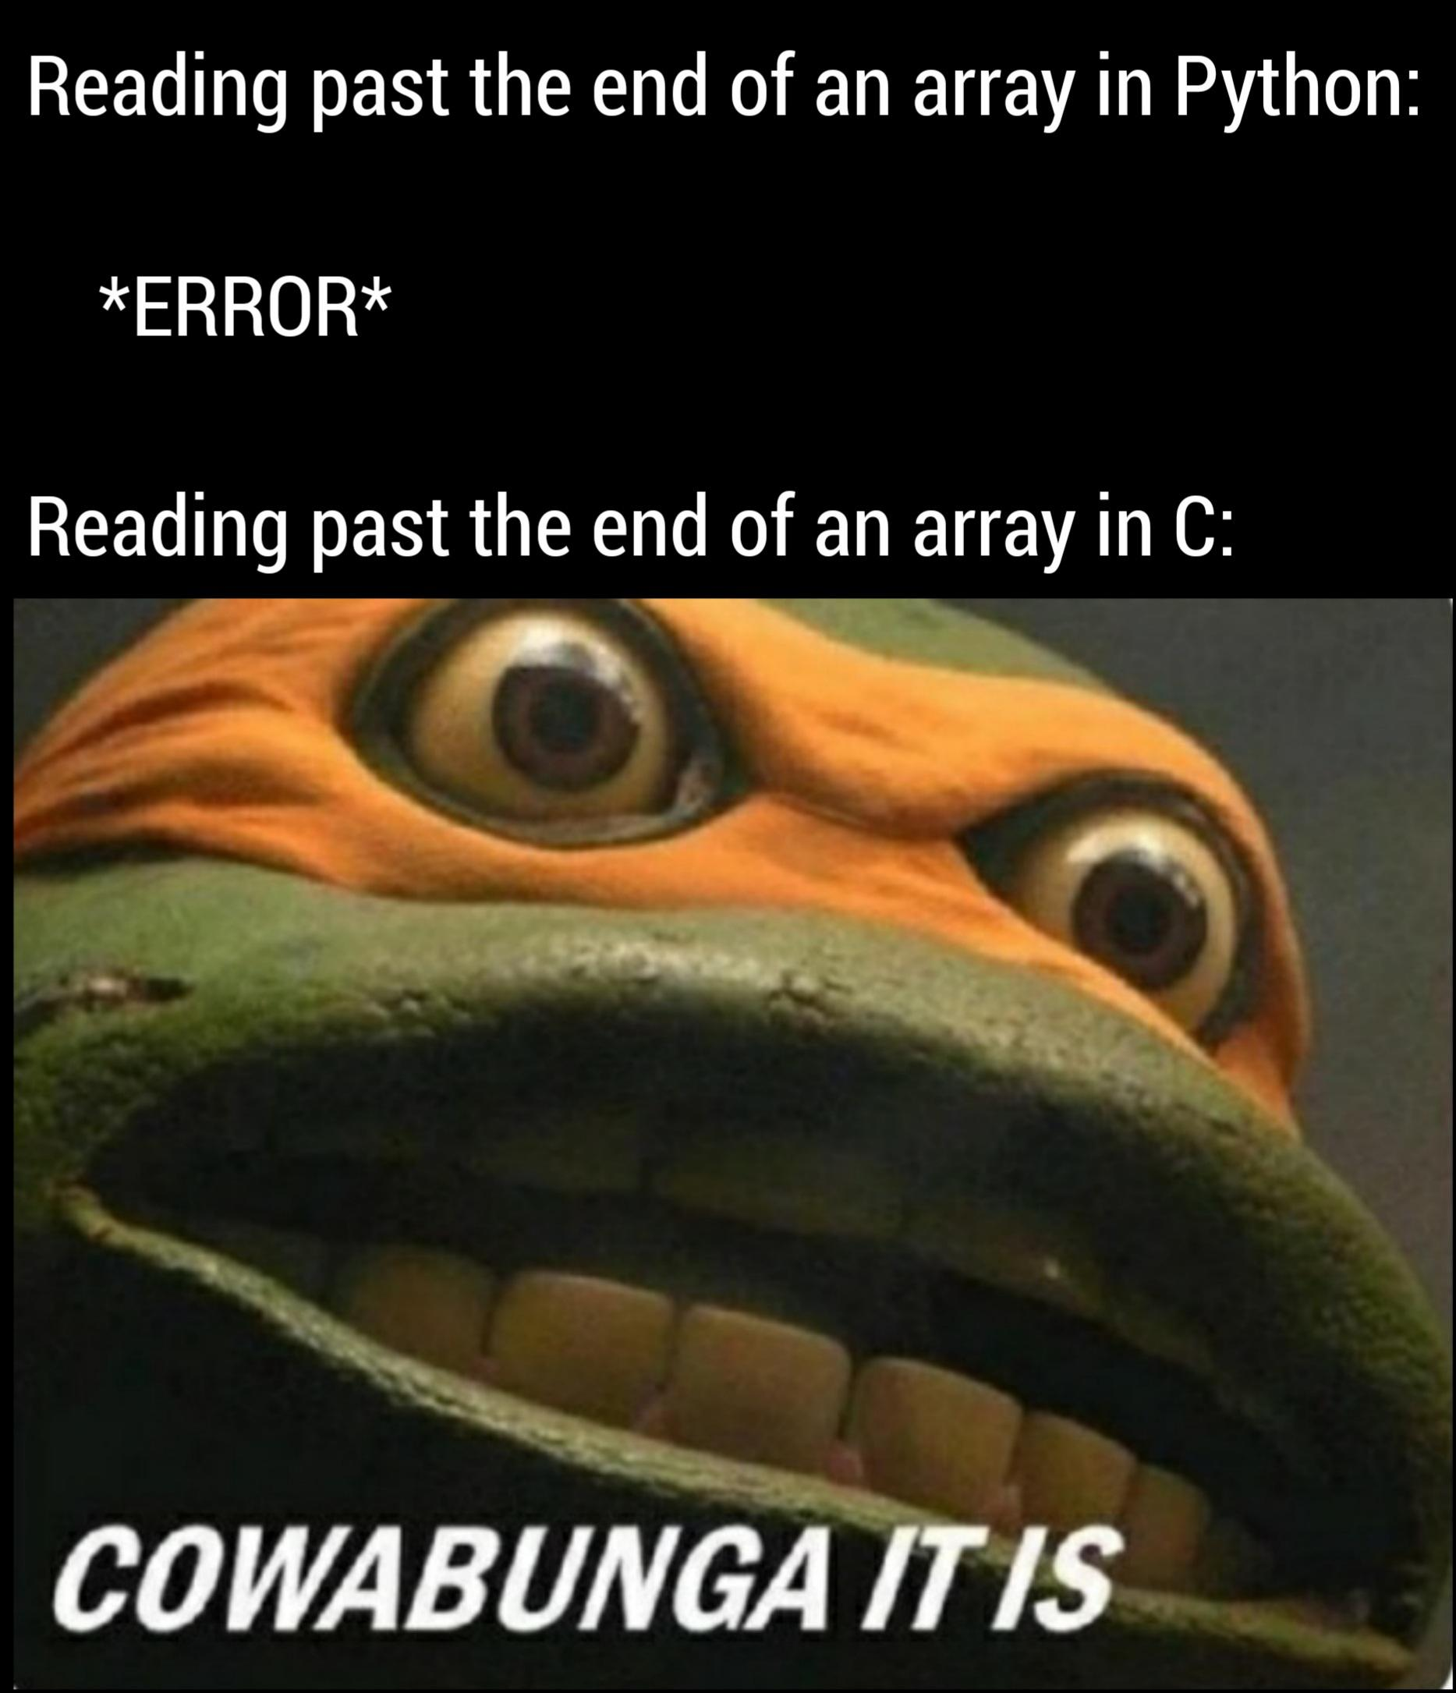
Announcements
Go to the career fair
Lab 3 (Buffer Overflow) will be posted sometime in the next few days. Won’t be due until October 15th
Thursday will be a help session for lab 3 (no lecture)

Slide 3
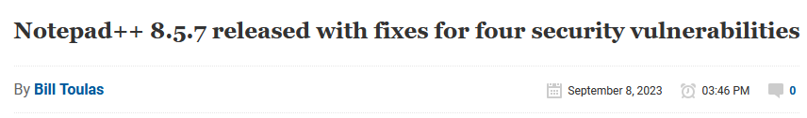
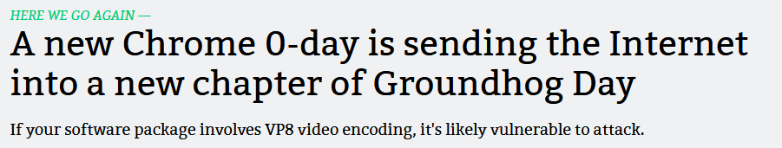
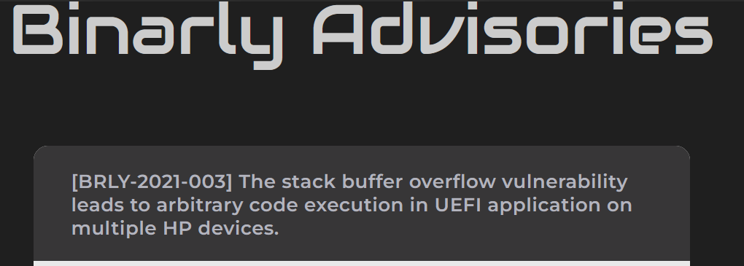

Slide 4










THE STACK
THE STACK
… previous stack frames…
Arguments
Return Address
Previous frame pointer
buffer[99] . . . . . buffer[0]
/bin/sh
Malicious Code
… previous stack frames…
Stuff
(Overwrite)
New return address
New return address
Return Address
(Overwrite)
(Overwrite)
buffer[99]
.
.
.
.
.
buffer[0]
buffer[99]
.
.
.
.
.
buffer[0]
(Overwrite)
(Overwrite)
Stuff
(Overwrite)
(Overwrite)
(Overwrite)
“badfile”
bof() stack frame (stack.c)
bof() stack frame (stack.c)

Slide 5







Step 2: Find the address of our malicious shellcode
Malicious Code
000000000
00000000000
0000000000
The NOP instruction does nothing, and the advances to the next instruction
New return address
00000000000
0000000000

Slide 6




Step 2: Find the address of our malicious shellcode
There are two important values we need in a buffer overflow attack
The address of the return address
The memory address of our malicious code that we put as the new return address
Malicious Code
NOP NOP NOP NOP NOP NOP
NOP NOP NOP NOP NOP NOP
2
NOP NOP NOP NOP NOP NOP
New return address
Guess!
1
NOP NOP NOP NOP NOP NOP
NOP NOP NOP NOP NOP NOP NOP NOP NOP NOP NOP NOP NOP NOP NOP NOP NOP NOP NOP NOP NOP NOP NOP NOP NOP NOP NOP NOP NOP NOP NOP NOP NOP NOP NOP

Slide 7
Step 2: Find the address of our malicious shellcode
There are two important values we need in a buffer overflow attack
The address of the return address
The memory address of our malicious code that we put as the new return address
Malicious Code
NOP NOP NOP NOP NOP NOP
NOP NOP NOP NOP NOP NOP
2
NOP NOP NOP NOP NOP NOP
Guess!
We found the location of the return address (relative to the buffer), by using gdb
New return address
1
NOP NOP NOP NOP NOP NOP
$ebp
NOP NOP NOP NOP NOP NOP NOP NOP NOP NOP NOP NOP NOP NOP NOP NOP NOP NOP NOP NOP NOP NOP NOP NOP NOP NOP NOP NOP NOP NOP NOP NOP NOP NOP NOP
For the memory address of our malicious code, we made a guess (somewhere above ebp), and hope it lands somewhere in our NOP sled

Slide 8
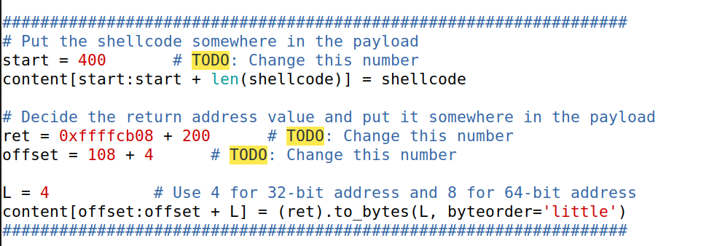

exploit.py
This script will construct our badfile for us!
This script build constructs a python list, and writes out the list to badfile
start will determine where in the list the malicious code will be inserted
0
400
517
ret
CODE
NOP
NOP
NOP
NOP
NOP
NOP
NOP
NOP
NOP
NOP
NOP
NOP
NOP
NOP

Slide 9


exploit.py
This script will construct our badfile for us!
This script build constructs a python list, and writes out the list to badfile
0xffffcb08 = address of $ebp
200 = GDB offset
ret is the value we put at the return address (our guess!!)
0
400
517
ret
CODE
NOP
NOP
NOP
NOP
NOP
NOP
NOP
NOP
NOP
NOP
NOP
NOP
NOP
NOP

Slide 10



exploit.py
This script will construct our badfile for us!
This script build constructs a python list, and writes out the list to badfile
0xffffcb08 = address of $ebp
200 = GDB offset
offset is where in our list we place the return address (ret)
0
112
400
517
ret
CODE
NOP
NOP
NOP
NOP
NOP
NOP
NOP
NOP
NOP
NOP
NOP
NOP
NOP
NOP

Slide 11

exploit.py
This script will construct our badfile for us!
This script build constructs a python list, and writes out the list to badfile
0xfffcb28
We have some wiggle room with our guess, we can make it slightly bigger or smaller and our attack will still work
0
112
400
517
ret
CODE
NOP
NOP
NOP
NOP
NOP
NOP
NOP
NOP
NOP
NOP
NOP
NOP
NOP
NOP
Our guess still lands in the NOP sled, so we are good!

Slide 12

exploit.py
This script will construct our badfile for us!
This script build constructs a python list, and writes out the list to badfile
450
0xfffcb28
We have some wiggle room with where we place our malicious code, we can make it slightly bigger or smaller and our attack will still work
0
112
450
517
ret
CODE
NOP
NOP
NOP
NOP
NOP
NOP
NOP
NOP
NOP
NOP
NOP
NOP
NOP
NOP
Our guess still lands in the NOP sled, so we are good!

Slide 13
exploit.py
This script will construct our badfile for us!
This script build constructs a python list, and writes out the list to badfile
500
0xfffcb28
We cant go too far, otherwise it will not be read by badfile (the vulnerable program only reads up to 517 bytes)
0
112
500
517
ret
CODE
NOP
NOP
NOP
NOP
NOP
NOP
NOP
NOP
NOP
NOP
NOP
NOP
NOP
NOP
Malicious code that will not be read in by badfile
Our attack no longer works, because our payload got cut off

Slide 14
exploit.py
This script will construct our badfile for us!
This script build constructs a python list, and writes out the list to badfile
400
0xfffffff
We can’t guess too far, otherwise we won’t hit our NOP sled
0
112
400
517
ret
CODE
NOP
NOP
NOP
NOP
NOP
NOP
NOP
NOP
NOP
NOP
NOP
NOP
NOP
NOP
Our attack no longer works, because our NOP sled never hits the malicious code

Slide 15

exploit.py
This script will construct our badfile for us!
This script build constructs a python list, and writes out the list to badfile
400
0xfffffff
We can’t guess too far, otherwise we won’t hit the correct NOP sled
0
112
400
517
ret
CODE
NOP
NOP
NOP
NOP
NOP
NOP
NOP
NOP
NOP
NOP
NOP
NOP
NOP
NOP
This also won’t work, because our NOP sled never hits the malicious code

Slide 16

exploit.py
This script will construct our badfile for us!
This script build constructs a python list, and writes out the list to badfile
400
0xfffffff
We can’t guess too far, otherwise we might hit somewhere in the middle of our malicious code
0
112
400
517
ret
CODE
NOP
NOP
NOP
NOP
NOP
NOP
NOP
NOP
NOP
NOP
NOP
NOP
NOP
NOP
This also won’t work, because the start of malicious code is never executed (and thus errors will occur)

Slide 17

exploit.py
This script will construct our badfile for us!
This script build constructs a python list, and writes out the list to badfile
100
= true return address location
ret
NOP
Invalid return address → CRASH
We must be exactly correct with the location of the return address
0
104
400
517
ret
CODE
NOP
NOP
NOP
NOP
NOP
NOP
NOP
NOP
NOP
NOP
NOP
NOP
NOP
NOP
NOP
NOP
This also won’t work, because the return address is invalid

Slide 18
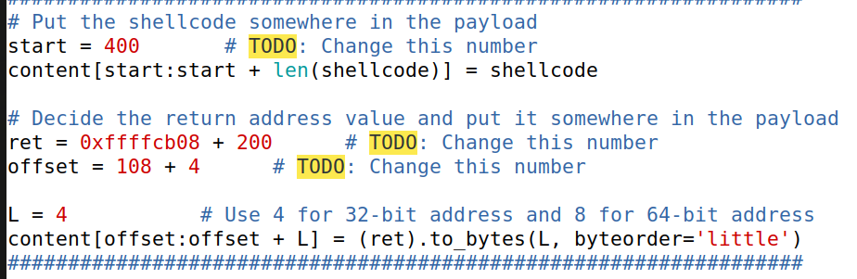
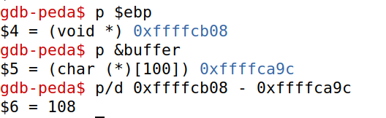






Conducting our first Buffer Overflow Attack
1. Turn off countermeasures
3. Update values in exploit.py
# Turn off ASLR!
sudo sysctl –w kernel.randomize_va_space=0
# link /bin/sh to /bin/zsh (no setuid countermeasure)
sudo ln -sf /bin/zsh /bin/sh
2. Get offset (step 1) from GDB
4. Run ./exploit.py to fill contents of badfile
5. Run the vulnerable program
(Your addresses might slightly be different, but your offset should still be 108)
ROOT SHELL!!

Slide 19
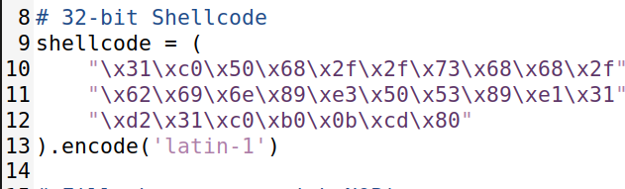
Shellcode
This is the code we are executing
What does this mean?

Slide 20
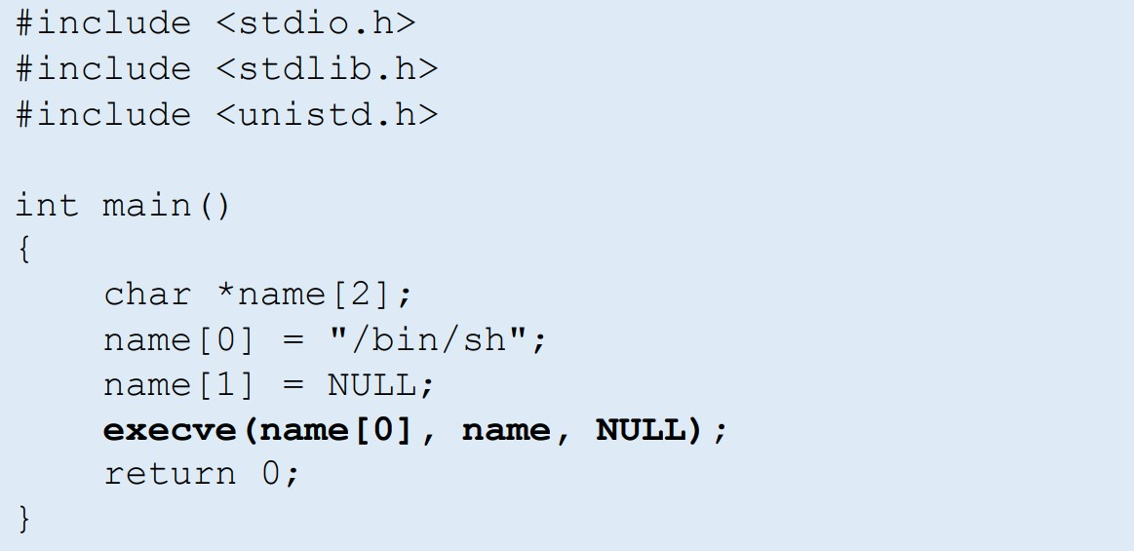
Shellcode
This is the code we want to inject
We need this program as executable instructions (binary)
How could we get the binary instructions for this?

Slide 21
Shellcode
This is the code we want to inject
We need this program as executable instructions (binary)
How could we get the binary instructions for this?
Compile and copy/paste it into our badfile!!
(Run demo)

Slide 22
Shellcode
This is the code we want to inject
We need this program as executable instructions (binary)
How could we get the binary instructions for this?
Compile and copy/paste it into our badfile!!
Problem: Compiling adds on a lot of junk into our program that will give us issues
Compile and copy/paste it into our badfile!!
(If our malicious code is too big, the entire thing might not be placed on the stack)

Slide 23
Shellcode
This is the code we want to inject
We need this program as executable instructions (binary)
How could we get the binary instructions for this?
Compile and copy/paste it into our badfile!!
Problem: Compiling adds on a lot of junk into our program that will give us issues
(When compiled, this program is about 15,000 bytes in size)
Bad!!!
Compile and copy/paste it into our badfile!!
(If our malicious code is too big, the entire thing might not be placed on the stack)

Slide 24
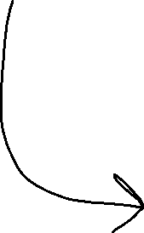
Shellcode
Shellcode is a compact, minimal set of binary instructions to do some malicious task
Often times in our payloads, we might not be able to fit an entire compiled program, so we have to write it to be much more compact
MUCH smaller in size, and it still does the exact same thing!!

Slide 25
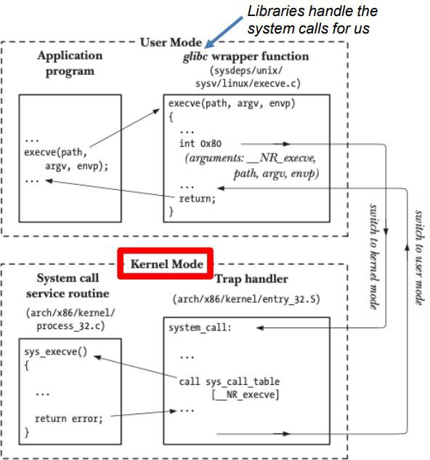
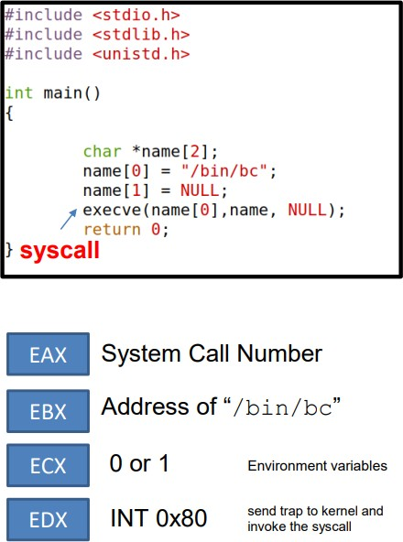
Shellcode
execve is a system call!
execve will look in certain registers for which command to execute

Slide 26
Shellcode
execve is a system call!
execve will look in certain registers for which command to execute
New Goal: Write the assembly instructions for loading the
correct arguments into registers, and then calling exec!

Slide 27
Shellcode
New Goal: Write the assembly instructions for loading the correct arguments into registers, and then calling exec!
➔ execve(“/bin/sh”, argv, 0)

Slide 28
Shellcode
New Goal: Write the assembly instructions for loading the correct arguments into registers, and then calling exec!
➔ execve(“/bin/sh”, argv, 0)
1. Load the registers
EAX
= 0x0000000b (11)
EBX
= address of “/bin/sh” string
ECX
= address of argv array
EDX
= 0

Slide 29
Shellcode
New Goal: Write the assembly instructions for loading the correct arguments into registers, and then calling exec!
➔ execve(“/bin/sh”, argv, 0)
1. Load the registers
EAX
= 0x0000000b (11)
EBX
= address of “/bin/sh” string
ECX
= address of argv array
EDX
= 0
2. Invoke the syscall!! ➔ Int 0x80

Slide 30
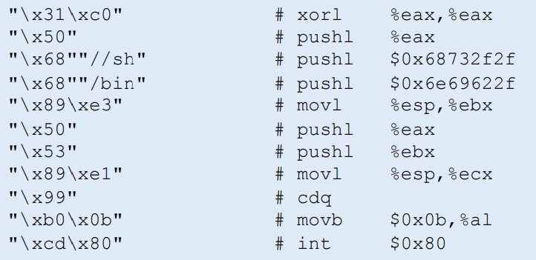
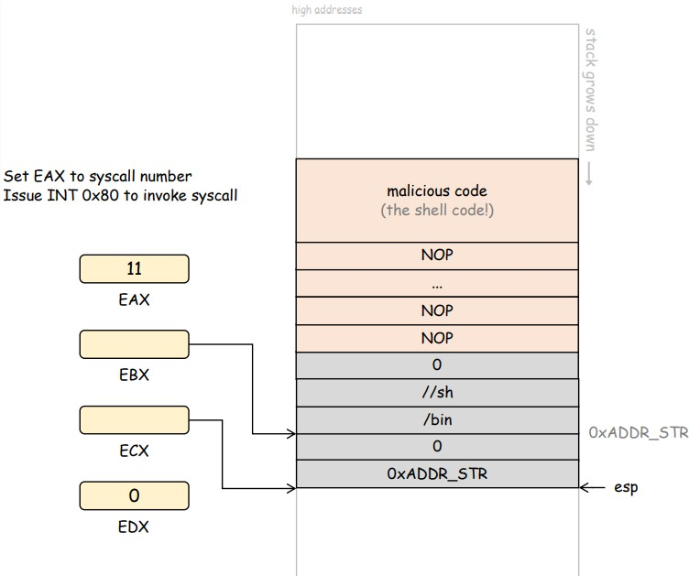
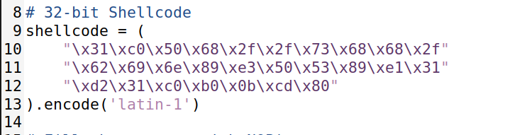
Shellcode
New Goal: Write the assembly instructions for loading the correct arguments into registers, and then calling exec!
➔ execve(“/bin/sh”, argv, 0)
(you wont need to write shellcode, but it is important to know what it is doing ☺ )

Slide 31
Shellcode
New Goal: Write the assembly instructions for loading the correct arguments into registers, and then calling exec!
➔ execve(“/bin/sh”, argv, 0)
tl;dr The shellcode in our payload
Loads the registers with he correct values
Calls the execve() system call to create a shell
(you wont need to write shellcode, but it is important to know what it is doing ☺ )

Slide 32
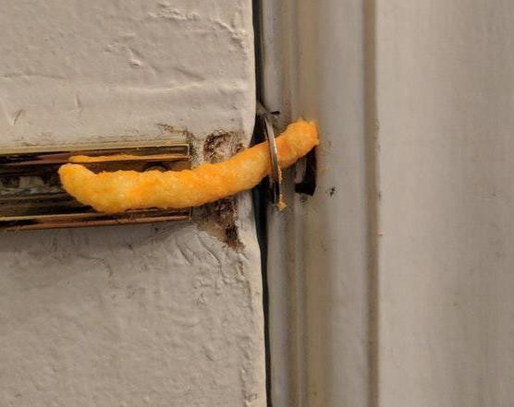
Defeating Countermeasures

Slide 33
Countermeasure #1: Dash Secure Shell
On the VM, /bin/sh points to a secure shell, /bin/dash, which has a countermeasure
It drops root privileges if RUID != EUID when being executed inside a setuid process
What did we do previously to get past this?

Slide 34
Countermeasure #1: Dash Secure Shell
On the VM, /bin/sh points to a secure shell, /bin/dash, which has a countermeasure
It drops root privileges if RUID != EUID when being executed inside a setuid process
What did we do previously to get past this?
Linked /bin/sh to a different shell (zsh) !
# link /bin/sh to /bin/zsh (no setuid countermeasure)
sudo ln -sf /bin/zsh /bin/sh

Slide 35
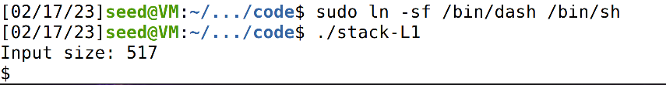
Countermeasure #1: Dash Secure Shell
On the VM, /bin/sh points to a secure shell, /bin/dash, which has a countermeasure
It drops root privileges if RUID != EUID when being executed inside a setuid process
Let’s turn on this countermeasure and see what happens

Slide 36
Countermeasure #1: Dash Secure Shell
On the VM, /bin/sh points to a secure shell, /bin/dash, which has a countermeasure
It drops root privileges if RUID != EUID when being executed inside a setuid process
Let’s turn on this countermeasure and see what happens
We still get a shell, but not a root shell. A SERIOUS DOWNGRADE

Slide 37
Countermeasure #1: Dash Secure Shell
On the VM, /bin/sh points to a secure shell, /bin/dash, which has a countermeasure
It drops root privileges if RUID != EUID when being executed inside a setuid process
Any ideas for how we can bypass this?
(Hint: it involves adding some code to our shellcode)

Slide 38
Countermeasure #1: Dash Secure Shell
On the VM, /bin/sh points to a secure shell, /bin/dash, which has a countermeasure
It drops root privileges if RUID != EUID when being executed inside a setuid process
Any ideas for how we can bypass this?
Solution: run the command setuid(0) in our shellcode before running /bin/sh

Slide 39
Countermeasure #1: Dash Secure Shell
On the VM, /bin/sh points to a secure shell, /bin/dash, which has a countermeasure
It drops root privileges if RUID != EUID when being executed inside a setuid process
Any ideas for how we can bypass this?
Solution: run the command setuid(0) in our shellcode before running /bin/sh
setuid(0) will set the process’s user ID’s to 0 (root), so now RUID == EUID

Slide 40
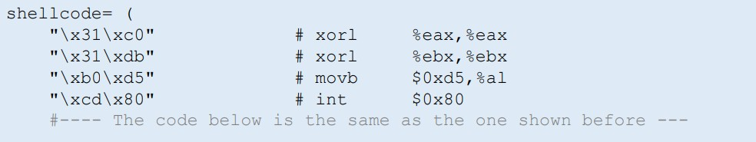
Countermeasure #1: Dash Secure Shell
On the VM, /bin/sh points to a secure shell, /bin/dash, which has a countermeasure
It drops root privileges if RUID != EUID when being executed inside a setuid process
Any ideas for how we can bypass this?
Solution: run the command setuid(0) in our shellcode before running /bin/sh
setuid(0) will set the process’s user ID’s to 0 (root), so now RUID == EUID
Shellcode that
Loads the registers
Calls the setuid() system call

Slide 41
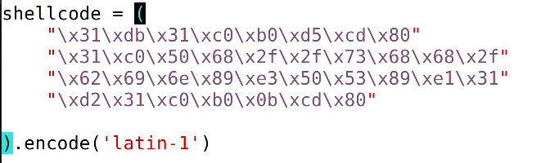
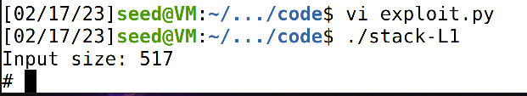


Countermeasure #1: Dash Secure Shell
To bypass /dash/, we add shellcode that sets the real user uid of the process to be 0 (root)
setuid(0)
execve(/bin/sh)
We got our root shell back!!

Slide 42
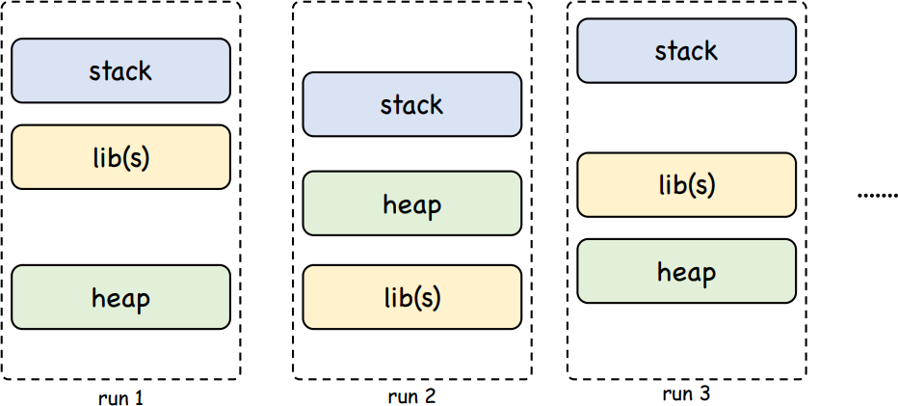
Countermeasure #2: ASLR
(address space layout randomization)
ASLR = Randomize the start location of the stack, heap, libs, etc
This makes guessing stack addresses more difficult!

Slide 43
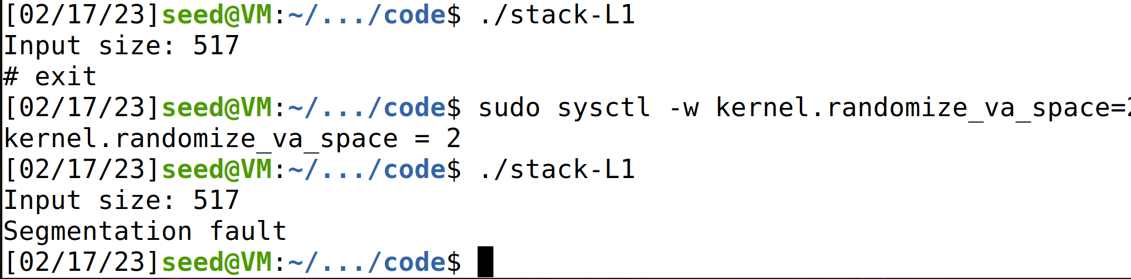
Countermeasure #2: ASLR
(address space layout randomization)
When we turn on this countermeasure, our attack now fails
The address of the buffer we got from GDB is no longer accurate, because the address of buffer changes every time the program is run

Slide 44
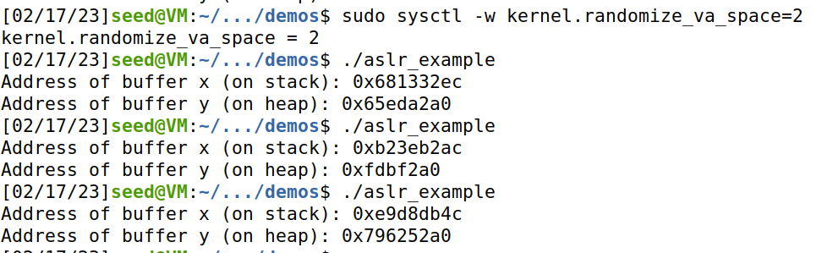
Countermeasure #2: ASLR
(address space layout randomization)
ASLR in action

Slide 45
Countermeasure #2: ASLR
(address space layout randomization)
The stack now starts at a random spot every time that we run ./stack-L1
Any ideas how we can bypass this countermeasure ???

Slide 46
Countermeasure #2: ASLR
(address space layout randomization)
The stack now starts at a random spot every time that we run ./stack-L1
Any ideas how we can bypass this countermeasure ???
Suppose you are trying to find a 1 in an array of 0s. The 1 will be at a random spot every time
0 | 0 | 0 | 0 | 0 | 0 | 1 | 0 | 0 | 0
You must find this 1, otherwise the world will end, you have unlimited tries, what do you do??
0 | 1 | 0 | 0 | 0 | 0 | 0 | 0 | 0 | 0
0 | 0 | 0 | 0 | 1 | 0 | 0 | 0 | 0 | 0

Slide 47
Countermeasure #2: ASLR
(address space layout randomization)
The stack now starts at a random spot every time that we run ./stack-L1
Any ideas how we can bypass this countermeasure ???
Suppose you are trying to find a 1 in an array of 0s. The 1 will be at a random spot every time
0 | 0 | 0 | 0 | 0 | 0 | 1 | 0 | 0 | 0
You must find this 1, otherwise the world will end, you have unlimited tries, what do you do??
0 | 1 | 0 | 0 | 0 | 0 | 0 | 0 | 0 | 0
0 | 0 | 0 | 0 | 1 | 0 | 0 | 0 | 0 | 0
Just keep running guessing until you get it right

Slide 48



Countermeasure #2: ASLR
(address space layout randomization)
Let’s make a guess (0xffffcb18 + 200), and let's run the program over and over again until our guess works
Heap
Libs
Stack
Code
Ret

Slide 49




Countermeasure #2: ASLR
(address space layout randomization)
Let’s make a guess (0xffffcb18 + 200), and let's run the program over and over again until our guess works
Heap
Libs
Libs
Stack
Code
Ret
Stack
Code
Heap
Ret

Slide 50




Countermeasure #2: ASLR
(address space layout randomization)
Let’s make a guess (0xffffcb18 + 200), and let's run the program over and over again until our guess works
Heap
Libs
Code
Stack
Ret
Libs
Stack
Heap
Code
Ret
Stack
Code
Heap
Libs
Ret

Slide 51



Countermeasure #2: ASLR
(address space layout randomization)
Let’s make a guess (0xffffcb18 + 200), and let's run the program over and over again until our guess works
Heap
Libs
Code
Heap
Stack
Ret
Stack
Code
Libs
Stack
Heap
Ret
Code
Ret
Stack
Libs
Code
Heap
Libs
Ret

Slide 52
Countermeasure #2: ASLR
(address space layout randomization)
On Linux 32 based systems, the base stack address can have 2^19 = 524, 288 possible addresses
Is this brute force-able ?

Slide 53
Countermeasure #2: ASLR
(address space layout randomization)
On Linux 32 based systems, the base stack address can have 2^19 = 524, 288 possible addresses
Is this brute force-able ?
HELL YEAH IT IS

Slide 54
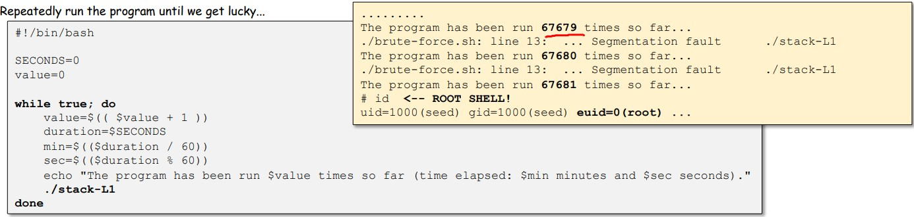
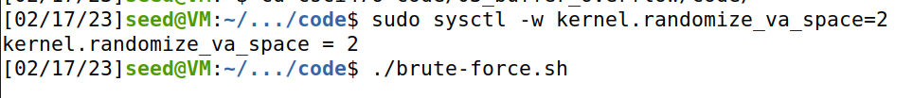
Countermeasure #2: ASLR
(address space layout randomization)
We are going to guess (a lot!!!) and hope that we eventually get lucky

Slide 55
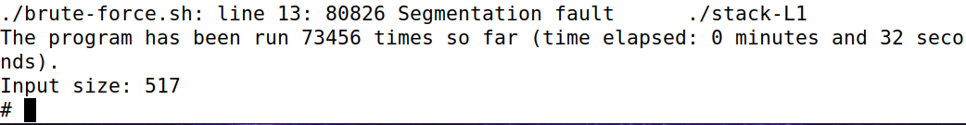
Countermeasure #2: ASLR
(address space layout randomization)
We are going to guess (a lot!!!) and hope that we eventually get lucky
After 32 seconds, I got a root shell

Slide 56
Buffer Overflow Countermeasures
Safe Shell (/bin/dash)
Address space layout randomization (ASLR)
Bypass: Add shellcode to our payload the sets RUID = 0
Bypass: Brute-Force / Wait to get lucky
Stack Guard
•
Non executable stack

Slide 57
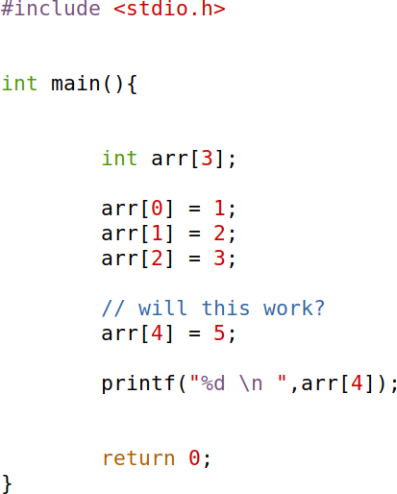
Stack Guard
THE STACK
Compiler Countermeasure***
… previous stack frames…
Arguments
Return Address
Previous frame pointer
Guard
buffer[99] . . . . . buffer[0]
Places a special value (guard) between the return address/previous frame pointer and local function values
When the function finishes, and the OS sees that the stack guard has ben overwritten, the program aborts and does not proceed

Slide 58
Stack Guard
THE STACK
Compiler Countermeasure***
… previous stack frames…
Arguments
Return Address
Previous frame pointer
Guard
buffer[99] . . . . . buffer[0]
Compile with stack guard turned off:
We overflowed the array!

Slide 59
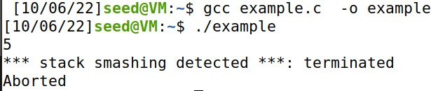
Stack Guard
THE STACK
Compiler Countermeasure***
… previous stack frames…
Arguments
Return Address
Previous frame pointer
Guard
buffer[99] . . . . . buffer[0]
Compile with stack guard turned off:
We overflowed the array!
Compile with stack guard turned on:
Aborted when we pass the stack guard

Slide 60
Stack Guard
Somewhere else in Memory (not on stack)
THE STACK
Compiler Countermeasure***
… previous stack frames…
Arguments
Return Address
Previous frame pointer
Guard (45)
buffer[99] . . . . . buffer[0]
Stack Canary Value: 45
How is stack guard implemented?
The compiler places a secret value (a stack canary) at the stack guard memory location, and in a safe location off the stack

Slide 61
Stack Guard
Somewhere else in Memory (not on stack)
THE STACK
Compiler Countermeasure***
… previous stack frames…
Arguments
Return Address
Previous frame pointer
Guard (45)
buffer[99] . . . . . buffer[0]
Stack Canary Value: 45
How is stack guard implemented?
The compiler places a secret value (a stack canary) at the stack guard memory location, and in a safe location off the stack
When the function finishes, check the stack canary value.
If the stack canary on the stack has not been modified, then no buffer overflow has occurred

Slide 62
Stack Guard
Somewhere else in Memory (not on stack)
THE STACK
Compiler Countermeasure***
… previous stack frames…
Arguments
Return Address
Previous frame pointer
Guard (45)
buffer[99] . . . . . buffer[0]
Stack Canary Value: 45
How is stack guard implemented?
The compiler places a secret value (a stack canary) at the stack guard memory location, and in a safe location off the stack
NOP NOP NOP
NOP NOP NOP
NOP NOP NOP
NOP NOP NOP
NOP NOP NOP
NOP NOP NOP
NOP NOP NOP
NOP NOP NOP
NOP NOP NOP
NOP NOP NOP
NOP NOP NOP
NOP NOP NOP
NOP NOP NOP
When the function finishes, check the stack canary value.
If the stack canary on the stack has not been modified, then no buffer overflow has occurred
If the stack canary on the stack has been modified, then our stack guard has been overwritten– Potential overflow detected! Abort

Slide 63
Stack Guard
Somewhere else in Memory (not on stack)
THE STACK
Compiler Countermeasure***
… previous stack frames…
Arguments
Return Address
Previous frame pointer
Guard (45)
buffer[99] . . . . . buffer[0]
Stack Canary Value: 45
How is stack guard implemented?
The compiler places a secret value (a stack canary) at the stack guard memory location, and in a safe location off the stack
NOP NOP NOP
NOP NOP NOP
NOP NOP NOP
NOP NOP NOP
NOP NOP NOP
NOP NOP NOP
NOP NOP NOP
NOP NOP NOP
NOP NOP NOP
NOP NOP NOP
NOP NOP NOP
NOP NOP NOP
NOP NOP NOP
When the function finishes, check the stack canary value.
If the stack canary on the stack has not been modified, then no buffer overflow has occurred
If the stack canary on the stack has been modified, then our stack guard has been overwritten– Potential overflow detected! Abort
The insertion, checking, and aborting for stack guard/canary is done for us in the Function Prologue and Epilogue!

Slide 64
Stack Guard
Somewhere else in Memory (not on stack)
THE STACK
Compiler Countermeasure***
… previous stack frames…
Arguments
Return Address
Previous frame pointer
Guard (45)
buffer[99] . . . . . buffer[0]
Stack Canary Value: 45
How to bypass stack guard?

Slide 65
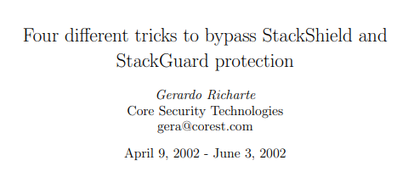
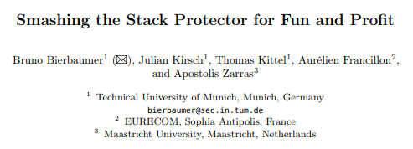
Stack Guard
Somewhere else in Memory (not on stack)
THE STACK
Compiler Countermeasure***
… previous stack frames…
Arguments
Return Address
Previous frame pointer
Guard (45)
buffer[99] . . . . . buffer[0]
Stack Canary Value: 45
How to bypass stack guard?
We won’t discuss these techniques in this class, as they involve some advanced memory manipulation and magic, but just know that techniques to bypass stack guard exist ☺

Slide 66
Stack Guard
Somewhere else in Memory (not on stack)
THE STACK
Compiler Countermeasure***
… previous stack frames…
Arguments
Return Address
Previous frame pointer
Guard (45)
buffer[99] . . . . . buffer[0]
Stack Canary Value: 45
How to bypass stack guard?
We won’t discuss these techniques in this class, as they involve some advanced memory manipulation and magic, but just know that techniques to bypass stack guard exist ☺

Slide 67
Buffer Overflow Countermeasures
Safe Shell (/bin/dash)
Address space layout randomization (ASLR)
Bypass: Add shellcode to our payload the sets RUID = 0
Bypass: Brute-Force / Wait to get lucky
Stack Guard
Bypass: Don’t worry about it (advanced memory manipulation, PRNG manipulation)
•
Non executable stack

Slide 68

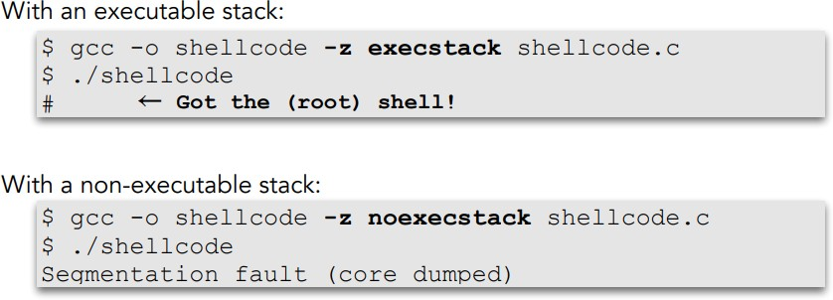
Non-Executable Stack
THE STACK
Malicious Code
NOP NOP NOP ONP
Arguments
Return Address
Previous frame pointer
buffer[99] . . . . . buffer[0]
In a normal program, executable code is not put on the stack
Non-Executable Stack: Writeable areas of program data & are not executable

Slide 69
Non-Executable Stack
THE STACK
Malicious Code
NOP NOP NOP ONP
Arguments
Return Address
Previous frame pointer
buffer[99] . . . . . buffer[0]
Non-Executable Stack: Writeable areas of program data & are not executable
This does not prevent buffer overflow, however
Instead of injecting our own code,
we could….

Slide 70
Non-Executable Stack
THE STACK
Malicious Code
NOP NOP NOP ONP
Arguments
Return Address
Previous frame pointer
buffer[99] . . . . . buffer[0]
Non-Executable Stack: Writeable areas of program data & are not executable
This does not prevent buffer overflow, however
Instead of injecting our own code,
jump to existing code
Which existing code?

Slide 71
Non-Executable Stack
Instead of injecting our own code, we will jump to existing code
Libc Shared Library
Printf
fopen
Malloc
…
………
Arguments
Return Address
Previous frame pointer
Executable

Slide 72
Non-Executable Stack
Instead of injecting our own code, we will jump to existing code
Libc Shared Library
Printf
fopen
Malloc
…
system()
Arguments
Return Address
Previous frame pointer
Executable

Slide 73
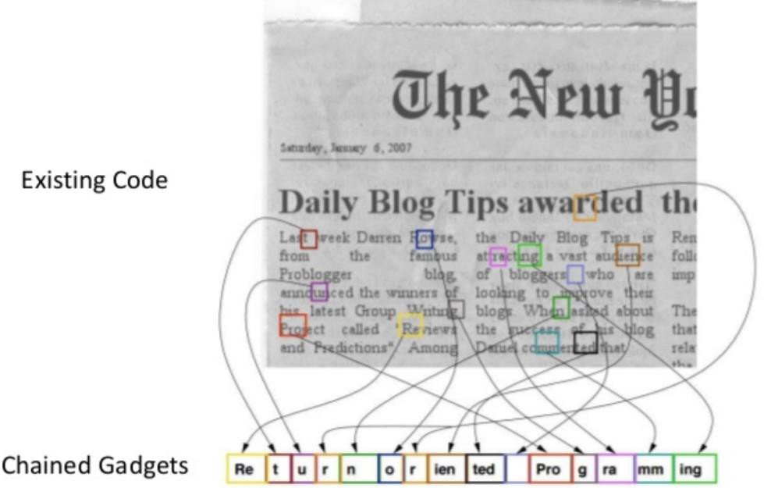
Return-to-libc Attack
Libc Shared Library
Printf
fopen
Malloc
…
system()
(Bypass for non-executable stack)
Arguments
Return Address
Previous frame pointer
Construct Payload using code and data that is already on the system

Slide 74
Return-to-libc Attack
Libc Shared Library
Printf
fopen
Malloc
…
system()
(Bypass for non-executable stack)
Arguments
Return Address
Previous frame pointer
Goal: Run the command
system(“bin/sh”)
General Plan of Attack for Return-to-Lib
1. Find address of system()
Overwrite the return address with system()’s address
2. Find the address of the “/bin/sh” string
To get system() to run this command
3. Construct arguments for system()
To find the location in the stack to place the address to the “/bin/sh” string (arg for system())

Slide 75
Return-to-libc Attack
Libc Shared Library
Printf
fopen
Malloc
…
system()
(Bypass for non-executable stack)
Arguments
Return Address
Previous frame pointer
Goal: Run the command
system(“bin/sh”)
General Plan of Attack for Return-to-Lib
1. Find address of system()
Overwrite the return address with system()’s address

Slide 76
Return-to-libc Attack
Libc Shared Library
Printf
fopen
Malloc
…
system()
(Bypass for non-executable stack)
Arguments
Return Address
Previous frame pointer
Goal: Run the command
system(“bin/sh”)
General Plan of Attack for Return-to-Lib
1. Find address of system()
Overwrite the return address with system()’s address
This can be found by using gdb

Slide 77
Return-to-libc Attack
Libc Shared Library
Printf
fopen
Malloc
…
system()
(Bypass for non-executable stack)
Arguments
Return Address
Previous frame pointer
Goal: Run the command
system(“bin/sh”)
General Plan of Attack for Return-to-Lib
1. Find address of system()
Overwrite the return address with system()’s address
2. Find the address of the “/bin/sh” string
To get system() to run this command

Slide 78
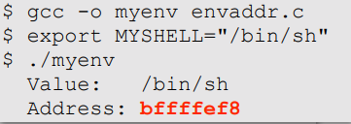
Return-to-libc Attack
Libc Shared Library
Printf
fopen
Malloc
…
system()
(Bypass for non-executable stack)
Arguments
Return Address
Previous frame pointer
Goal: Run the command
system(“bin/sh”)
General Plan of Attack for Return-to-Lib
1. Find address of system()
Overwrite the return address with system()’s address
2. Find the address of the “/bin/sh” string
To get system() to run this command
We can define an environment variable that has the value “bin/sh”
The environment variable gets loaded into the program and placed onto the stack

Slide 79
Return-to-libc Attack
Libc Shared Library
Printf
fopen
Malloc
…
system()
(Bypass for non-executable stack)
Arguments
Return Address
Previous frame pointer
Goal: Run the command
system(“bin/sh”)
General Plan of Attack for Return-to-Lib
1. Find address of system()
Overwrite the return address with system()’s address
2. Find the address of the “/bin/sh” string
To get system() to run this command

Slide 80
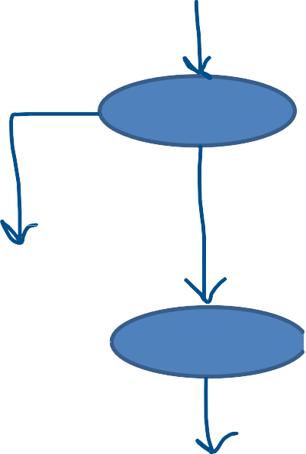
Return-to-libc Attack
Libc Shared Library
Printf
fopen
Malloc
…
system()
(Bypass for non-executable stack)
Arguments
Return Address
Previous frame pointer
Goal: Run the command
system(“bin/sh”)
General Plan of Attack for Return-to-Lib
1. Find address of system()
Overwrite the return address with system()’s address
Remember that system(“/bin/ls”) will fork and spawn a new process
./stack
2. Find address of “/bin/sh” string
To get system() to run this command
/bin/sh
./stack
3. Construct arguments for system()
To find the location in the stack to place the address to the “/bin/sh” string (arg for system())
**We also need to find the address for the exit() function so the original process can terminate gracefully
exit()

Slide 81
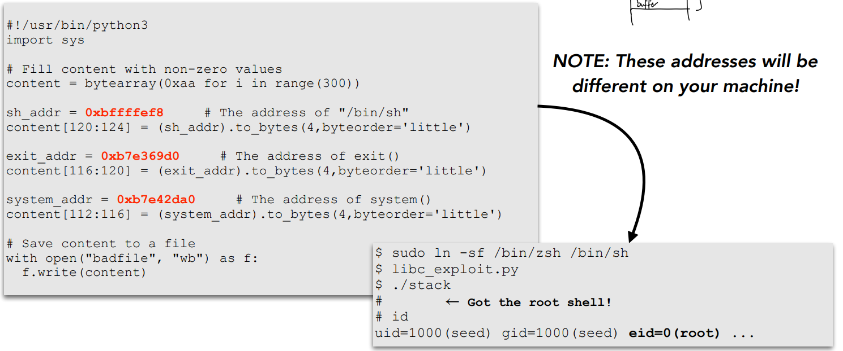
Return-to-libc Attack
Libc Shared Library
Printf
fopen
Malloc
…
system()
(Bypass for non-executable stack)
Arguments
Return Address
Previous frame pointer
Goal: Run the command
system(“bin/sh”)
In this example, we are only chaining two functions together, but we can generalize this to chain multiple function calls
ex. bof() → setuid(0) → /bin/sh → exit

Slide 82
Return-to-libc Attack
Libc Shared Library
Printf
fopen
Malloc
…
system()
(Bypass for non-executable stack)
Arguments
Return Address
Previous frame pointer
Goal: Run the command
system(“bin/sh”)
In this example, we are only chaining two functions together, but we can generalize this to chain multiple function calls
ex. bof() → setuid(0) → /bin/sh → exit
(This attack is much more complicated than a normal BOF attack, and we won’t cover it in this class)

Slide 83
Buffer Overflow Countermeasures
Safe Shell (/bin/dash)
Address space layout randomization (ASLR)
Bypass: Add shellcode to our payload the sets RUID = 0
Bypass: Brute-Force / Wait to get lucky
Stack Guard
Bypass: Don’t worry about it (advanced memory manipulation, PRNG manipulation)
•
Non executable stack
Bypass: Return-to-libc, Return-Oriented Programming (ROP)

Slide 84
“What ifs”
In our basic buffer overflow attack (stack.c), we have the privilege of having important information that made our attack much easier
Size of buffer
Location of buffer
Location of EBP
Let’s look at a scenario where we don’t know some of this information

Slide 85
Unknown Buffer Size
THE STACK
… previous stack frames…
Arguments
Return Address
Previous frame pointer
buffer[99] . . . . . buffer[0]
The size of the buffer is important, because we need it in order to determine where to place the new return address
buffer[???]
buffer[99]
.
.
.
.
.
buffer[0]

Slide 86
Unknown Buffer Size
THE STACK
… previous stack frames…
Arguments
Return Address
Previous frame pointer
buffer[99] . . . . . buffer[0]
The size of the buffer is important, because we need it in order to determine where to place the new return address
Solution: Instead of placing the new return address at one specific, let’s place it at many locations, and hopefully one of the locations works
buffer[???]
buffer[99]
.
.
.
.
.
buffer[0]

Slide 87
Unknown Buffer Size
THE STACK
… previous stack frames…
Arguments
Return Address
Previous frame pointer
buffer[99] . . . . . buffer[0]
The size of the buffer is important, because we need it in order to determine where to place the new return address
New Return Address
Solution: Instead of placing the new return address at one specific, let’s place it at many locations, and hopefully one of the locations works
New Return Address
New Return Address
buffer[???]
New Return Address
buffer[99]
.
.
.
.
.
buffer[0]
This process is known as Address Spraying
New Return Address
New Return Address
From the program’s behavior, we might be able to derive a range of possible buffer sizes, so place the same return address at all possible return address locations
New Return Address

Slide 88
Unknown Buffer Location
THE STACK
… previous stack frames…
Arguments
Return Address
Previous frame pointer
buffer[99] . . . . . buffer[0]
The location of the buffer is important, because we need it in order to determine where to place the new return address
We also used the buffer location in order figure out what our guess should be, so now we need to figure out what we should guess
buffer[99]
buffer[99]
.
.
.
.
.
buffer[0]
Suppose that we do know the range of possible starting locations [A, A + 100]

Slide 89



Unknown Buffer Location
Malicious Code
The location of the buffer is important, because we need it in order to determine where to place the new return address
NOP NOP NOP NOP NOP NOP
Solution: We will still use address spraying, but now we need to derive the possible location(s) of our NOP sled
NOP NOP NOP NOP NOP NOP
NOP NOP NOP NOP NOP NOP
If we know we insert 150 bytes of NOPs after the return address, we can iterate through all possible locations of our NOP sled
New return address
New Return Address
NOP NOP NOP NOP NOP NOP
Buffer Address | NOP Section
A | [A + 120, A +270]
A + 4 | [A + 124, A +274]
A + 8 | [A + 128, A +278]
…
A + 100 | [A + 220, A +370]
New Return Address
NOP NOP NOP NOP NOP NOP NOP NOP NOP NOP NOP NOP NOP NOP NOP NOP NOP NOP NOP NOP NOP NOP NOP NOP NOP NOP NOP NOP NOP NOP NOP NOP NOP NOP NOP
New Return Address
New Return Address
New Return Address
New Return Address
New Return Address

Slide 90
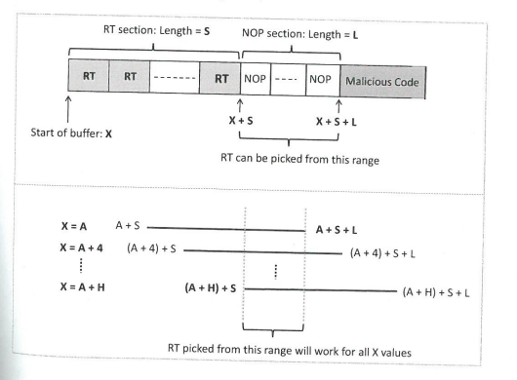
Unknown Buffer Location
Buffer Address | NOP Section
A | [A + 120, A +270]
A + 4 | [A + 124, A +274]
A + 8 | [A + 128, A +278]
…
A + 100 | [A + 220, A +370]
Malicious Code
NOP NOP NOP NOP NOP NOP
NOP NOP NOP NOP NOP NOP
NOP NOP NOP NOP NOP NOP
New return address
New Return Address
NOP NOP NOP NOP NOP NOP
Try to find a NOP section range that will work for ALL values of A
New Return Address
NOP NOP NOP NOP NOP NOP NOP NOP NOP NOP NOP NOP NOP NOP NOP NOP NOP NOP NOP NOP NOP NOP NOP NOP NOP NOP NOP NOP NOP NOP NOP NOP NOP NOP NOP
New Return Address
New Return Address
New Return Address
New Return Address
New Return Address

Slide 91
Small Buffer Size
Main() Stack Frame
In a buffer of 517, we can fit quite a lot of stuff in our payload,
But what if the buffer is small, or if we are not allowed to overflow into other stack frames ?
… previous stack frames…
Arguments
Return Address
Previous frame pointer
buffer[99] . . . . . buffer[0]
Important Function’s Stack Frame
BOF’s Stack Frame
In 64-bit systems, we are not able to overflow stuff after the return address
New Return Address
NOP NOP NOP NOP NOP NOP
NOP NOP NOP NOP NOP NOP
Malicious Code
buffer[99]
So, our malicious code needs to be injected below the return address, and have much less space to work with
buffer[99]
.
.
.
.
.
buffer[0]
NOP NOP NOP NOP NOP NOP
NOP NOP NOP NOP NOP NOP
NOP NOP NOP NOP NOP NOP

Slide 92
Small Buffer Size
Main() Stack Frame
In a buffer of 517, we can fit quite a lot of stuff in our payload,
But what if the buffer is small, or if we are not allowed to overflow into other stack frames ?
Important Function’s Stack Frame
NOP
NOP
NOP
NOP
BOF’s Stack Frame
Malicious Code

Slide 93
Small Buffer Size
Main() Stack Frame
Malicious Code
In a buffer of 517, we can fit quite a lot of stuff in our payload,
But what if the buffer is small, or if we are not allowed to overflow into other stack frames ?
Important Function’s Stack Frame
NOP
NOP
NOP
NOP
BOF’s Stack Frame
Solution: Place the malicious code in another stack frame
(As long as we can figure out its address, we really do not care if the malicious code is in the BOF stack frame)

Slide 94
Lessons Learned?

Slide 95
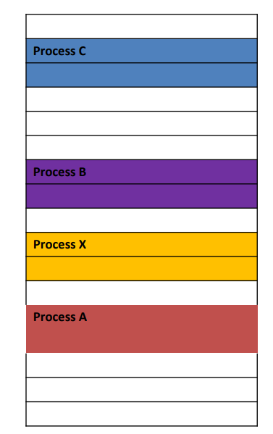


Address spaces for processes should be isolated from one another,
and there should be no interference between two address spaces
Security Principle #3
Lessons Learned
Process D | Buffer
Process A | Overflow

Slide 96





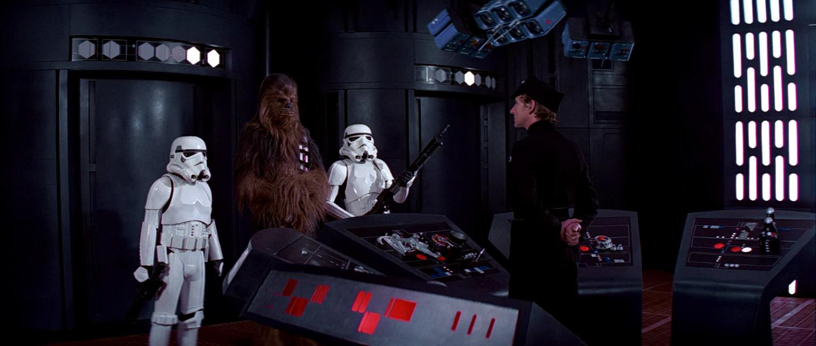
Security Principle #4
In a process or system FAILS for whatever reason, it will default to a
SAFE outcome
Lessons Learned
(Think Stack Guard)

