Slide 1

CSCI 476: Computer Security
SYN Flooding, TCP Reset, TCP Hijacking
Reese Pearsall
Fall 2023
https://www.cs.montana.edu/pearsall/classes/fall2023/476/main.html

Slide 2



Our packet currently has
Some application-level message (HTTP Request)
Port number of that application process (TCP header)
Mechanism to ensure our packet arrives correctly (TCP Header)
A way to locate the computer (IP address/IP Header)
A unique identifier for our destination (MAC Address/Frame)
GET WWW.BLAH.COM
Headers
HTPP Request
Body
Our final packet!
TCP Header
IP Header
Our initially packet gets encapsulated multiple times, sort of like a nesting doll!
Ethernet Frame

Slide 3
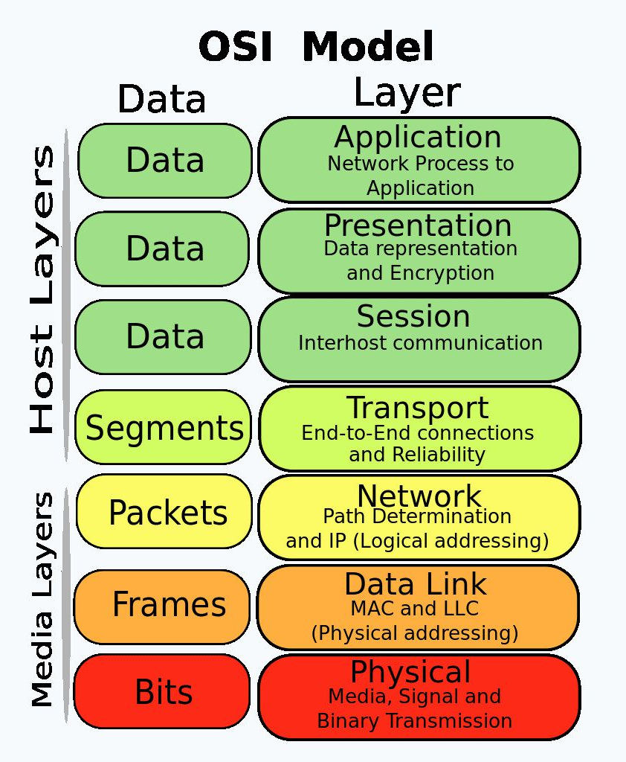
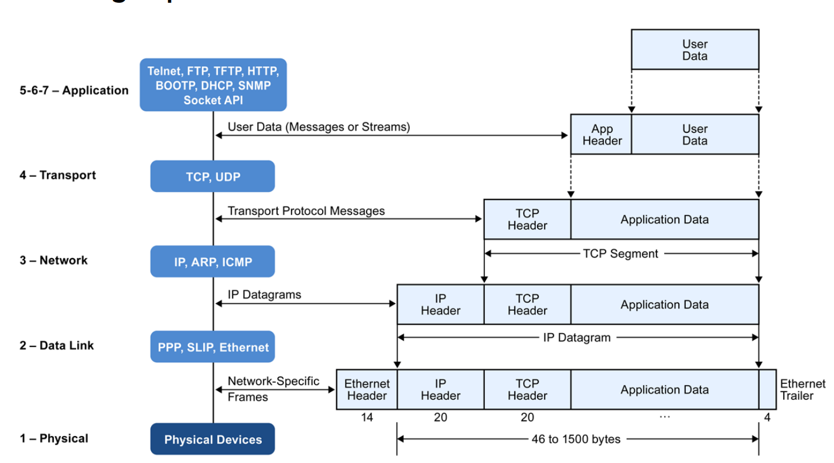






The Journey of a packet
Packets are encapsulated in various protocol layers; each has a header and payload
Our focus in the next few weeks will be on the transport layer (TCP/UDP), network layer (IP), and application layer

Slide 4
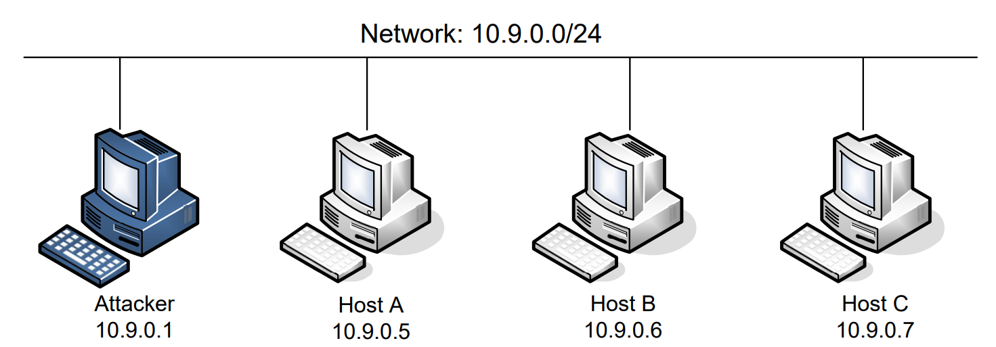
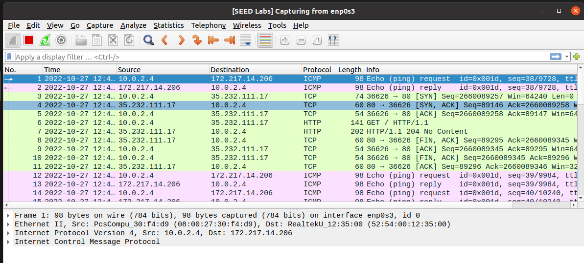
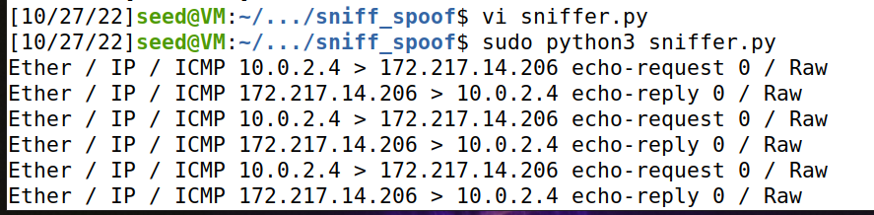
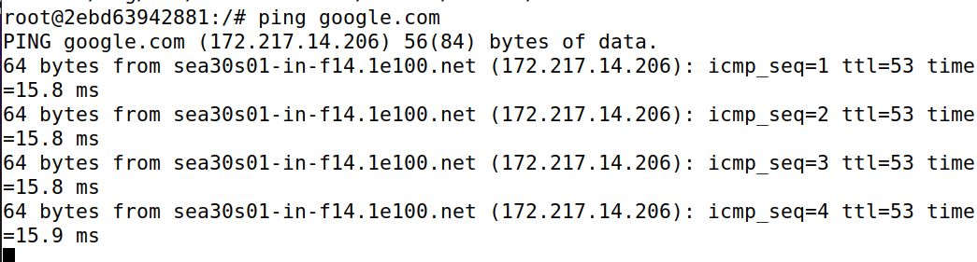
Setup
docker-compose up -d
On the attacker machine, we can also see these packets in Wireshark!
dock sh 2ebd
For this lab, we will logged into our attacker machine (our VM) and logged into a victim machine (a container)

Slide 5

Attacks on TCP
SYN Flooding
TCP Reset
TCP session hijack
me
Please don’t try to do this stuff on real servers outside of the VM

Slide 6


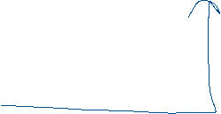
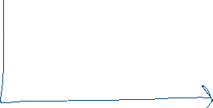
Application Layer
HTTP Request
Application Layer
Transport Layer
TCP Connection
Transport Layer
Network Layer
Network Layer
…
When using the internet, you are commonly using a TCP protocol. You (a TCP client) connect to a TCP server to exchange information to ensure delivery
…

Slide 7

Application Layer
HTTP Request
Application Layer
Transport Layer
TCP Connection
Transport Layer
Network Layer
Network Layer
…
When using the internet, you are commonly using a TCP protocol. You (a TCP client) connect to a TCP server to exchange information to ensure delivery
…
This process of establishing a TCP connection has a very specific process → TCP Handshake

Slide 8
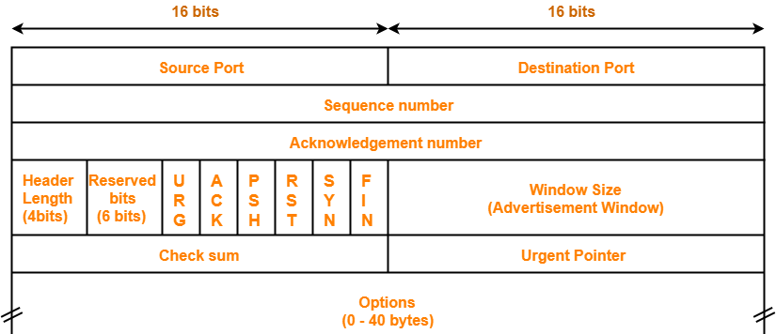
TCP Client
TCP Server
TCP Header
Data
Packet

Slide 9

TCP Client
SYN
TCP Server
TCP Header
Data
SYN flag is set!
TCP Handshake:
Client sends a SYN to the server
Packet

Slide 10

TCP Client
SYN
TCP Server
SYN + ACK
TCP Header
TCP Handshake:
Client sends a SYN to the server
Server sends back a SYN + ACK
Data
SYN flag is set!
ACK flag is set!
Packet

Slide 11
TCP Client
SYN
TCP Server
SYN + ACK
ACK
TCP Header
TCP Handshake:
Client sends a SYN to the server
Server sends back a SYN + ACK
Client sends back an ACK
Data
ACK flag is set!
Packet

Slide 12
TCP Client
SYN
TCP Server
SYN + ACK
ACK
(Data can start being sent!)
TCP Header
TCP Handshake:
Client sends a SYN to the server
Server sends back a SYN + ACK
Client sends back an ACK
Data
ACK flag is set!
Packet

Slide 13
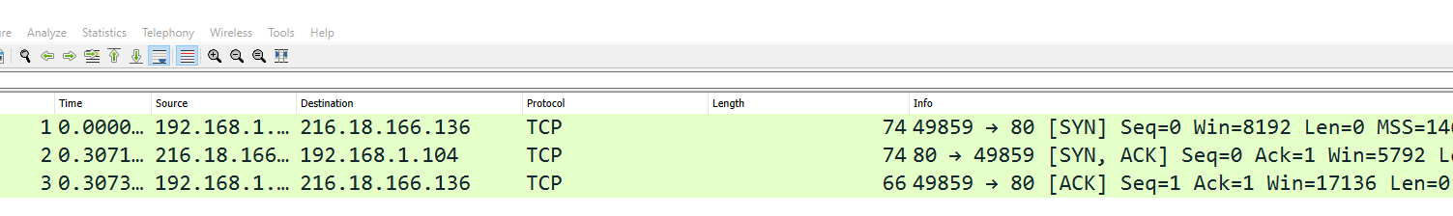






You can see this happening in Wireshark
SYN = 0
SYN = 0 + ACK = 1
ACK = 1

Slide 14
Let’s do some evil stuff
Suppose that we find a server that accepts TCP connections
This TCP server will accept SYN requests, send out a SYN+ACK, and then wait to receive an ACK
TCP Client
TCP Server

Slide 15
Let’s do some evil stuff
Suppose that we find a server that accepts TCP connections
This TCP server will accept SYN requests, send out a SYN+ACK, and then wait to receive an ACK
TCP Client
TCP Server
SYN
SYN + ACK
Waiting for an ACK…

Slide 16
Let’s do some evil stuff
Suppose that we find a server that accepts TCP connections
This TCP server will accept SYN requests, send out a SYN+ACK, and then wait to receive an ACK
TCP Client
TCP Server
SYN
SYN + ACK
SYN + ACK
Waiting for an ACK…
SYN + ACK
If it does not get an ACK after some amount of time, it will retransmit

Slide 17
Let’s do some evil stuff
Suppose that we find a server that accepts TCP connections
This TCP server will accept SYN requests, send out a SYN+ACK, and then wait to receive an ACK
TCP Client
TCP Server
SYN
SYN + ACK
SYN + ACK
Waiting for an ACK…
SYN + ACK
If it does not get an ACK after some amount of time, it will retransmit
How many times should we retransmit before giving up?
Set by the operating system!

Slide 18
Let’s do some evil stuff
Suppose that we find a server that accepts TCP connections
This TCP server will accept SYN requests, send out a SYN+ACK, and then wait to receive an ACK
TCP Client
TCP Server
SYN
The TCP server will hold our request until we drop it
SYN + ACK
SYN + ACK
TCP Request SYN Queue
(This queue has a finite size…)
SYN + ACK
There is a time period where our request is held in the SYN queue before it is dropped
SYN + ACK
SYN + ACK
SYN + ACK
What can we do with our knowledge of spoofing?

Slide 19
Let’s do some evil stuff
Suppose that we find a server that accepts TCP connections
This TCP server will accept SYN requests, send out a SYN+ACK, and then wait to receive an ACK
TCP Client
TCP Server
SYN
The TCP server will hold our request until we drop it
SYN + ACK
SYN + ACK
TCP Request SYN Queue
(This queue has a finite size…)
SYN + ACK
There is a time period where our request is held in the SYN queue before it is dropped
SYN + ACK
SYN + ACK
What can we do with our knowledge of spoofing?
SYN + ACK
Send out a lot of SYN requests from spoofed source IP address

Slide 20
Let’s do some evil stuff
Suppose that we find a server that accepts TCP connections
This TCP server will accept SYN requests, send out a SYN+ACK, and then wait to receive an ACK
TCP Client
TCP Server
SYN
SYN
The TCP server will hold our request until we drop it
SYN
SYN
SYN
TCP Request SYN Queue
SYN
We can quickly the SYN queue buffer with our spoofed request
SYN
SYN
The TCP server will hold those requests in the queue while it waits
SYN
If the buffer is full…

Slide 21
Let’s do some evil stuff
Suppose that we find a server that accepts TCP connections
This TCP server will accept SYN requests, send out a SYN+ACK, and then wait to receive an ACK
TCP Client
TCP Server
SYN
SYN
The TCP server will hold our request until we drop it
SYN
SYN
SYN
TCP Request SYN Queue
SYN
We can quickly the SYN queue buffer with our spoofed request
SYN
SYN
The TCP server will hold those requests in the queue while it waits
SYN
If the buffer is full…
The TCP server won’t be able to accept new connections!

Slide 22
Let’s do some evil stuff
Suppose that we find a server that accepts TCP connections
This TCP server will accept SYN requests, send out a SYN+ACK, and then wait to receive an ACK
TCP Client
TCP Server
SYN
SYN
The TCP server will hold our request until we drop it
SYN
SYN
SYN
TCP Request SYN Queue
SYN
We can quickly the SYN queue buffer with our spoofed request
SYN
SYN
The TCP server will hold those requests in the queue while it waits
SYN
If the buffer is full…
The TCP server won’t be able to accept new connections!

Slide 23
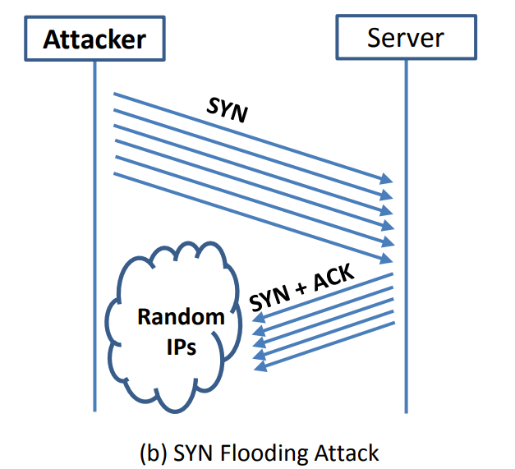
(The size of this buffer is also set by the operating system)
If a new SYN comes in (from a legitimate user), they will be denied

Slide 24
(The size of this buffer is also set by the operating system)
The goal of a SYN Flooding attack is to overwhelm/crash a server that accepts TCP connections by flooding the server with SYN requests coming from spoofed, random IP addresses

Slide 25
(The size of this buffer is also set by the operating system)
The goal of a SYN Flooding attack is to overwhelm/crash a server that accepts TCP connections by flooding the server with SYN requests coming from spoofed, random IP addresses

Slide 26
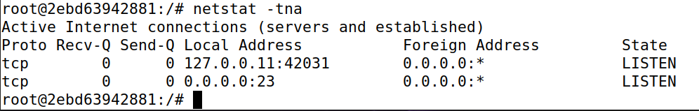
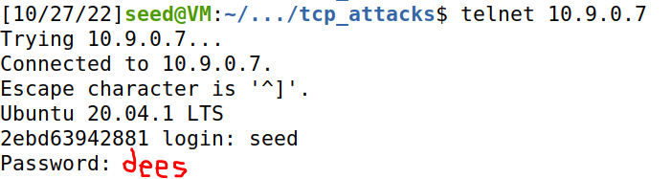
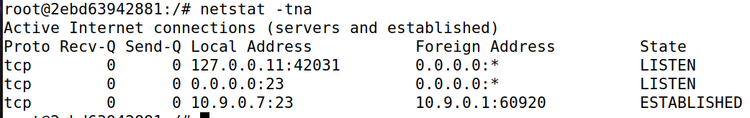



Turn off countermeasures…
sysctl –w net.ipv4.tcp_syncookies = 0
Turn off SYN cookies
Use netstat to see the current status of server’s TCP connections
From another machine, use telnet to establish a TCP connection

Slide 27
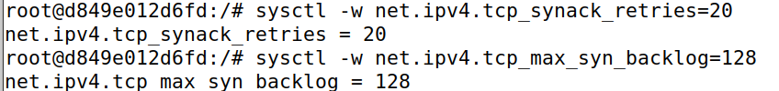
We will also increase the number of retries (SYN + ACK) the server will do before giving up
AND
Make the SYN queue smaller
(We are running these commands on the docker container for the victim server)

Slide 28
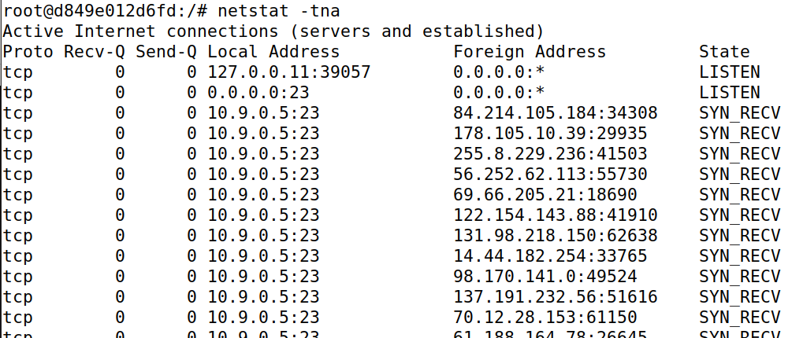
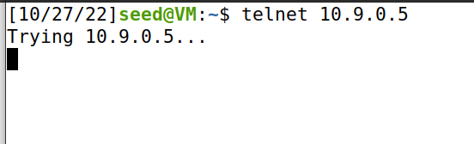
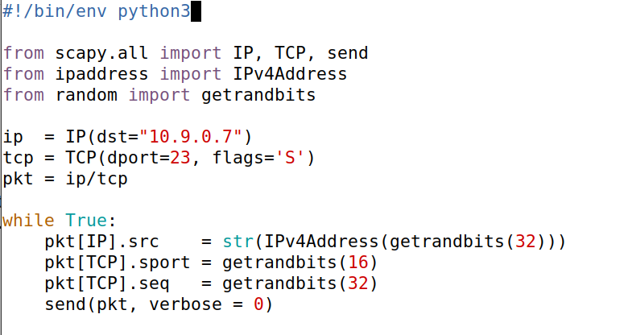




Victim Server
3
Verify server is receiving packets
Attacker
Run script to send spoofed packets
2
New terminal
Server is full!
synflood.py
We’ve filled this server with spoofed SYN requests
Denied
1
Repeatedly send a TCP packet to 10.9.0.7, with a random source IP address
1

Slide 29
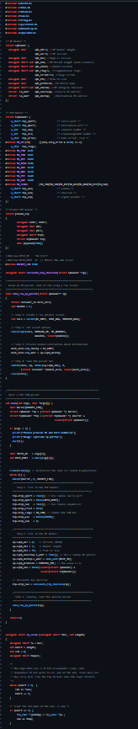
Issues:
synflood.c
We had to change the number of retries/queue size to make this attack easier for us
If the number of retries is low, and the waiting queue is large… we might not fill it in time!
Solution?
Use C (lmao)

Slide 30
Issues:
synflood.c
We had to change the number of retries/queue size to make this attack easier for us
Countermeasures
SYN Cookies- Allocate server resources only for established connections
If the number of retries is low, and the waiting queue is large… we might not fill it in time!
Waiting…
ACK received!
Solution?
Use C (lmao)
TCP Request SYN Queue

Slide 31
TCP Reset

Slide 32
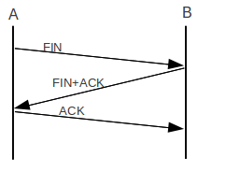

TCP Reset Attack
Goal: Break an established TCP connection by sending a spoofed RESET (RST) packet
This is different than sending a FIN packet
TCP Header
Data
Packet

Slide 33
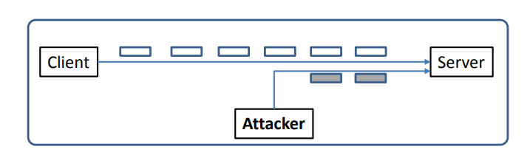
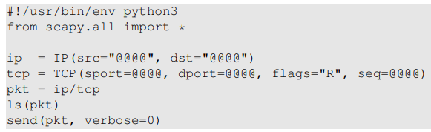

TCP Reset Attack
In order to do our attack, we first need to find an ongoing TCP communication between two users!
A server reads data in some order (typically by sequence number)
10.9.0.6
10.9.0.5
SEQ # = 4440
10.9.0.1
In our spoofed packet, we need to make sure we select a sequence number that matches the sequence number the server is expecting!
(@@@ are placeholder. You will fill them in)
We also need to select the same ports!

Slide 34
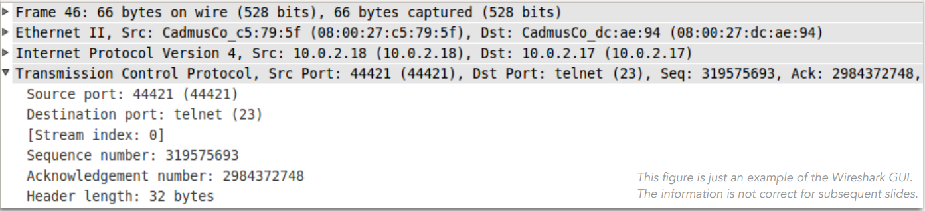
TCP Reset Attack
In order to do our attack, we first need to find an ongoing TCP communication between two users!
A server reads data in some order (typically by sequence number)
10.9.0.6
10.9.0.5
10.9.0.1
Since we can sniff all the packets going from 10.9.0.6 to 10.9.0.5,
We can pull all the information we need from wireshark!
(@@@ are placeholder. You will fill them in)

Slide 35
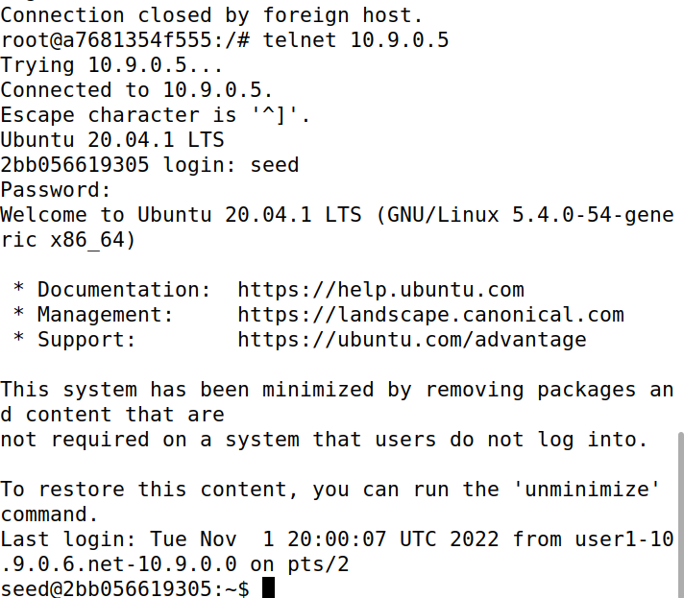
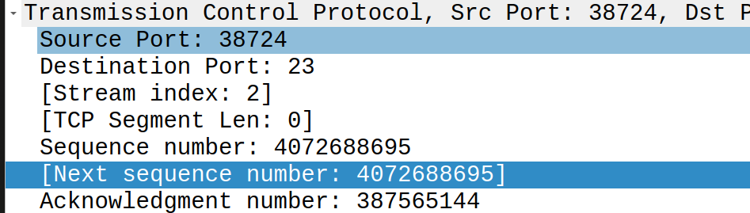
TCP Reset Attack
We need the information to generate our spoofed packet:
1. Open up Wireshark, and start generating some TCP traffic between Client 1 container and victim server
Logged into the user 1 container
Look at the most recent packet sent between client and server
Your information may be different
10.9.0.6
10.9.0.5
Port 38724
Port 23
Telnet connection established
10.9.0.1

Slide 36
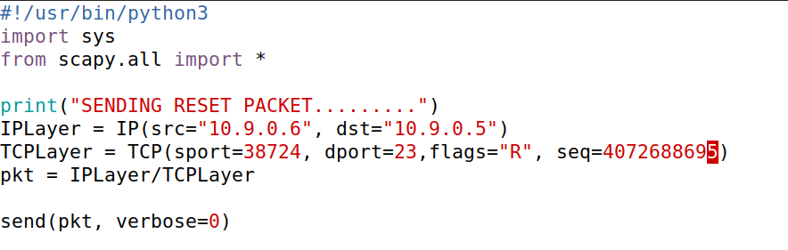



TCP Reset Attack
We need the information to generate our spoofed packet:
Open up Wireshark, and start generating some TCP traffic between Client 1 container and victim server
Fill in src IP, dst IP, src port, dst port, and sequence number into reset.py
Your information will be different
10.9.0.6
10.9.0.5
Port 38724
Port 23
10.9.0.1

Slide 37

TCP Reset Attack
We need the information to generate our spoofed packet:
Open up Wireshark, and start generating some TCP traffic between Client 1 container and victim server
Fill in src IP, dst IP, src port, dst port, and sequence number into reset.py
Hop back to client 1 container, press enter, connection should be closed!
Your information will be different
10.9.0.6
10.9.0.5
Port 38724
Port 23
10.9.0.1

Slide 38
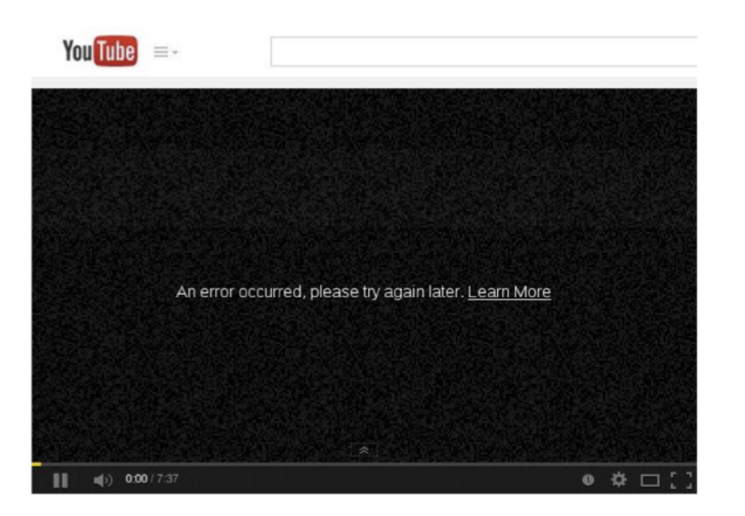
TCP Reset Attack

Slide 39
TCP Hijack Attack

Slide 40
TCP Hijack Attack
Goal: Hijack an existing TCP connection (telnet), and get a server to execute a command of our choice
10.9.0.6
10.9.0.5
10.9.0.1
“cat /etc/shadow”
We spoof a packet with a command the run, and this packet looks like it came from the client (10.9.0.6)

Slide 41
TCP Hijack Attack
Hijack a current TCP connection and get a TCP server to execute commands of our choice
Open up Wireshark, and start generating some TCP traffic between Client 1 container and victim server
Look at most recent TCP/Telnet Packet in Wireshark
Just like with the TCP reset, we need this information for our packet
Your information will be different

Slide 42
TCP Hijack Attack
Hijack a current TCP connection and get a TCP server to execute commands of our choice
Open up Wireshark, and start generating some TCP traffic between Client 1 container and victim server
Look at most recent TCP/Telnet Packet in Wireshark
Just like with the TCP reset, we need this information for our packet
Your information will be different
For TCP Hijack, we will also be sending a command to run. What commands could we run?

Slide 43
TCP Hijack Attack
Hijack a current TCP connection and get a TCP server to execute commands of our choice
Open up Wireshark, and start generating some TCP traffic between Client 1 container and victim server
Look at most recent TCP/Telnet Packet in Wireshark
Just like with the TCP reset, we need this information for our packet
Your information will be different
For TCP Hijack, we will also be sending a command to run. What commands could we run?
We could steal a file (demo), or we could create a root shell reverse shell

Slide 44
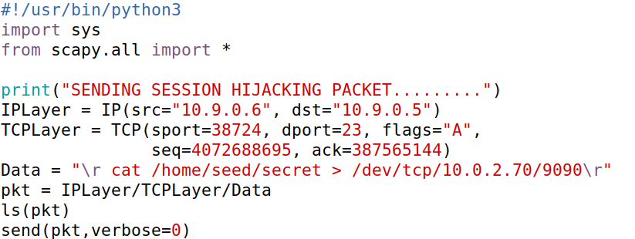
TCP Hijack Attack
Hijack a current TCP connection and get a TCP server to execute commands of our choice
Open up Wireshark, and start generating some TCP traffic between Client 1 container and victim server
Look at most recent TCP/Telnet Packet in Wireshark
Fill in packet information in sessionhijack.py
Your information will be different

Slide 45








TCP Hijack Attack
Hijack a current TCP connection and get a TCP server to execute commands of our choice
Open up Wireshark, and start generating some TCP traffic between Client 1 container and victim server
Look at most recent TCP/Telnet Packet in Wireshark
Fill in packet information in sessionhijack.py
Your information will be different

Slide 46
TCP Hijack Attack
Hijack a current TCP connection and get a TCP server to execute commands of our choice
Open up Wireshark, and start generating some TCP traffic between Client 1 container and victim server
Look at most recent TCP/Telnet Packet in Wireshark
Fill in packet information in sessionhijack.py
Summon a netcat server on attack machine (separate terminal)
netcat –lnv 9090

Slide 47
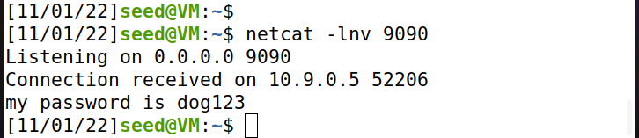
TCP Hijack Attack
Hijack a current TCP connection and get a TCP server to execute commands of our choice
Open up Wireshark, and start generating some TCP traffic between Client 1 container and victim server
Look at most recent TCP/Telnet Packet in Wireshark
Fill in packet information in sessionhijack.py\
Summon a netcat server on attack machine (separate terminal)
Run session hijack program
TCP server sent us the output of the cat command!

Slide 48
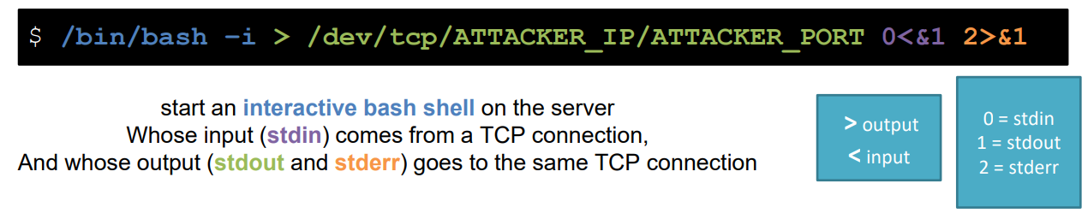
Reverse Shell
A reverse shell gives us (an attacker) a bash shell that we can remotely use → Total control!!
In our spoofed packet, that will be the command that we want to run!
(remember to have netcat server also running!)

