Slide 1



CSCI 476: Computer Security
Network Security: DNS Cache Poisoning
Reese Pearsall
Fall 2023
https://www.cs.montana.edu/pearsall/classes/fall2023/476/main.html

Slide 2
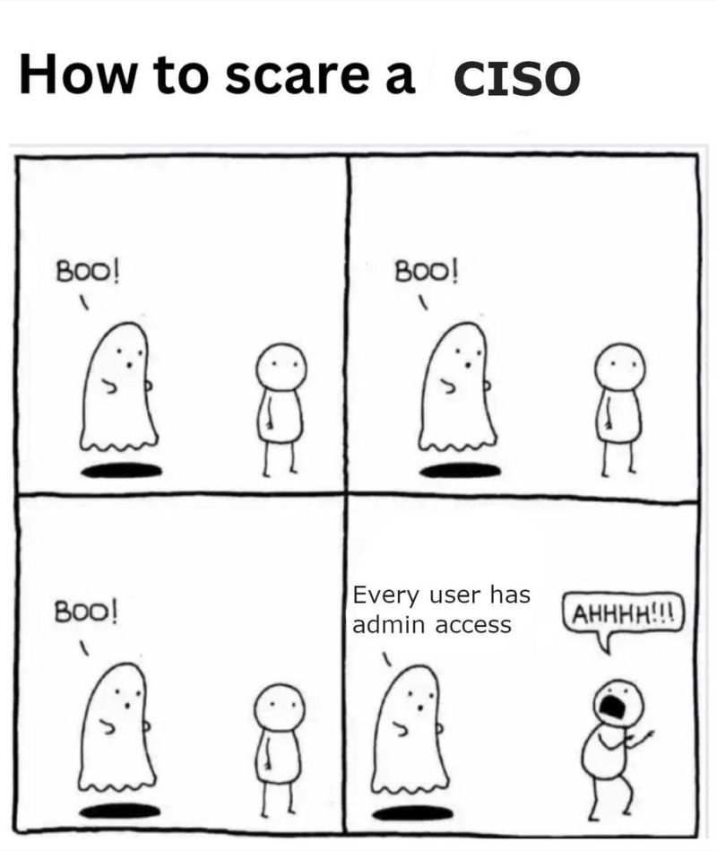
Announcement
CSCI 476 student
Lab 5 (XSS) due tonight at 11:59 PM
Lab 6 (TCP/IP Attacks) Due Tuesday 11/7 @ 11:59 PM
Happy halloween

Slide 3
Reverse Shell w/ Session Hijack Attack

Slide 4


When browsing the web, computers need the IP address of the host we are communicating with
Humans do not use IP addresses when using the internet, they use hostnames (English)
We need a way to go from hostnames to IP addresses
Humans browse the web using hostnames
(They need English)
Computers understand numbers
(They need IP addresses)
153.90.127.197

Slide 5
When browsing the web, computers need the IP address of the host we are communicating with
Humans do not use IP addresses when using the internet, they use hostnames (English)
We need a way to go from hostnames to IP addresses
Humans browse the web using hostnames
(They need English)
Computers understand numbers
(They need IP addresses)
DNS
153.90.127.197

Slide 6




DNS Architecture
youtube.com
irs.gov
Clients will first need to resolve hostnames with DNS
montana.edu
3.
DNS
HTTP
1.
153.90.3.95
montana.edu ?
153.90.3.95
2.
Clients

Slide 7
DNS Architecture
youtube.com
irs.gov
montana.edu
DNS
DNS
DNS
.gov
.com
.edu
Clients

Slide 8
DNS Architecture
(how big would that map be?)
DNS is a distributed, hierarchical database (no DNS server has all the records!)
Hierarchy consists of different types of DNS servers:

Slide 9
DNS Architecture
(how big would that map be?)
DNS is a distributed, hierarchical database (no DNS server has all the records!)
Hierarchy consists of different types of DNS servers:
Authoritative DNS servers- Organization’s own DNS with up-to-date records
facebook.com DNS
amazon.com DNS
montana.edu DNS
harvard.edu DNS

Slide 10




DNS Architecture
(how big would that map be?)
DNS is a distributed, hierarchical database (no DNS server has all the records!)
Hierarchy consists of different types of DNS servers:
Authoritative DNS servers- Organization’s own DNS with up-to-date records
.com TLD DNS server
.edu TLD DNS server
Top-level domain (TLD) servers- responsible for keeping IP addresses for authoritative DNS servers for each top-level domain (.com, .edu, .jp, etc)
facebook.com DNS
amazon.com DNS
montana.edu DNS
harvard.edu DNS

Slide 11
DNS Architecture
(how big would that map be?)
DNS is a distributed, hierarchical database (no DNS server has all the records!)
Hierarchy consists of different types of DNS servers:
Authoritative DNS servers- Organization’s own DNS with up-to-date records
.com TLD DNS server
.edu TLD DNS server
Top-level domain (TLD) servers- responsible for keeping IP addresses for authoritative DNS servers for each top-level domain (.com, .edu, .jp, etc)
facebook.com DNS
amazon.com DNS
montana.edu DNS
harvard.edu DNS

Slide 12


DNS Architecture
(how big would that map be?)
DNS is a distributed, hierarchical database (no DNS server has all the records!)
Hierarchy consists of different types of DNS servers:
root DNS server
Authoritative DNS servers- Organization’s own DNS with up-to-date records
.com TLD DNS server
.edu TLD DNS server
Top-level domain (TLD) servers- responsible for keeping IP addresses for authoritative DNS servers for each top-level domain (.com, .edu, .jp, etc)
facebook.com DNS
amazon.com DNS
montana.edu DNS
harvard.edu DNS
Root DNS servers- responsible for maintaining IP addresses for TLD servers

Slide 13
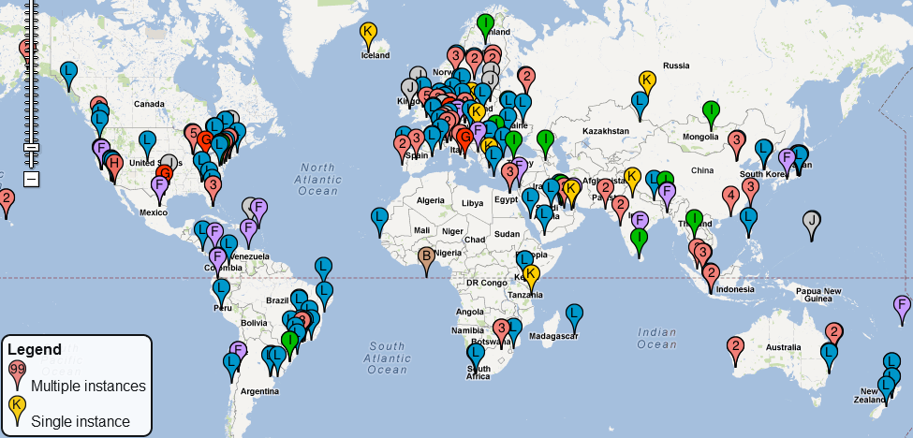
DNS Root server locations
https://root-servers.org/

Slide 14
Domain Name System (DNS)
Application-level protocol used to map Domain Names to IP Addresses
DNS uses UDP as the transport layer protocol
No handshake
No guarantee that packet will arrive
DNS Packet
UDP Header
IP Header
Anatomy of a DNS Packet

Slide 15
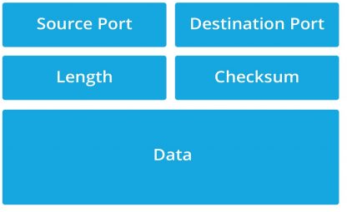


Domain Name System (DNS)
Application-level protocol used to map Domain Names to IP Addresses
DNS uses UDP as the transport layer protocol
No handshake
No guarantee that packet will arrive
UDP header Format
DNS Packet
UDP Header
IP Header
Anatomy of a DNS Packet

Slide 16
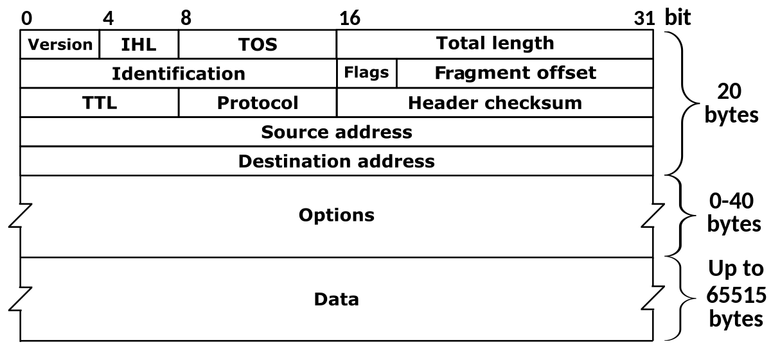


Domain Name System (DNS)
Application-level protocol used to map Domain Names to IP Addresses
DNS uses UDP as the transport layer protocol
No handshake
No guarantee that packet will arrive
DNS Packet
UDP Header
IP Header
Anatomy of a DNS Packet

Slide 17
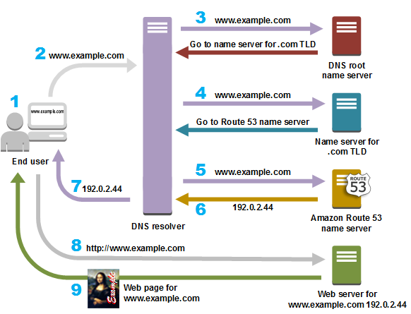
Suppose the user wants to go to www.example.com

Slide 18
Suppose the user wants to go to www.example.com
Step 0: The computer first checks its local cache to see if an entry exists

Slide 19

Suppose the user wants to go to www.example.com
Step 0: The computer first checks its local cache to see if an entry exists
Step 1: The user contacts a DNS resolver, which contacts a DNS root name server for the .com TLD

Slide 20

Suppose the user wants to go to www.example.com
Step 0: The computer first checks its local cache to see if an entry exists
Step 1: The user contacts a DNS resolver, which contacts a DNS root name server for the .com TLD
Step 2: The DNS resolver now contacts the .com TLD server, which returns the IP address of the example.com’s Authorative server

Slide 21




Suppose the user wants to go to www.example.com
Step 0: The computer first checks its local cache to see if an entry exists
Step 1: The user contacts a DNS resolver, which contacts a DNS root name server for the .com TLD
Step 2: The DNS resolver now contacts the .com TLD server, which returns the IP address of the example.com’s Authorative server
Step 3: The Authorative server gives us the IP address for www.example.com, and we can now send an HTTP request to that IP address!

Slide 22




Suppose the user wants to go to www.example.com
Step 0: The computer first checks its local cache to see if an entry exists
Step 1: The user contacts a DNS resolver, which contacts a DNS root name server for the .com TLD
Step 2: The DNS resolver now contacts the .com TLD server, which returns the IP address of the example.com’s Authorative server
Step 3: The Authorative server gives us the IP address for www.example.com, and we can now send an HTTP request to that IP address!
IMPORTANT
The user’s machine will now save the IP address for www.example.com in its cache

Slide 23
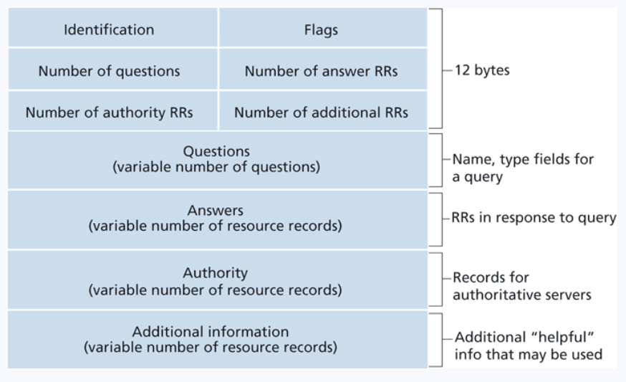
DNS Header
The domain name of the request
Ie. Google.com
If the IP address was found, it will go here
Contains records that point towards authoritative nameservers
Contains records that point towards authoritative nameservers

Slide 24
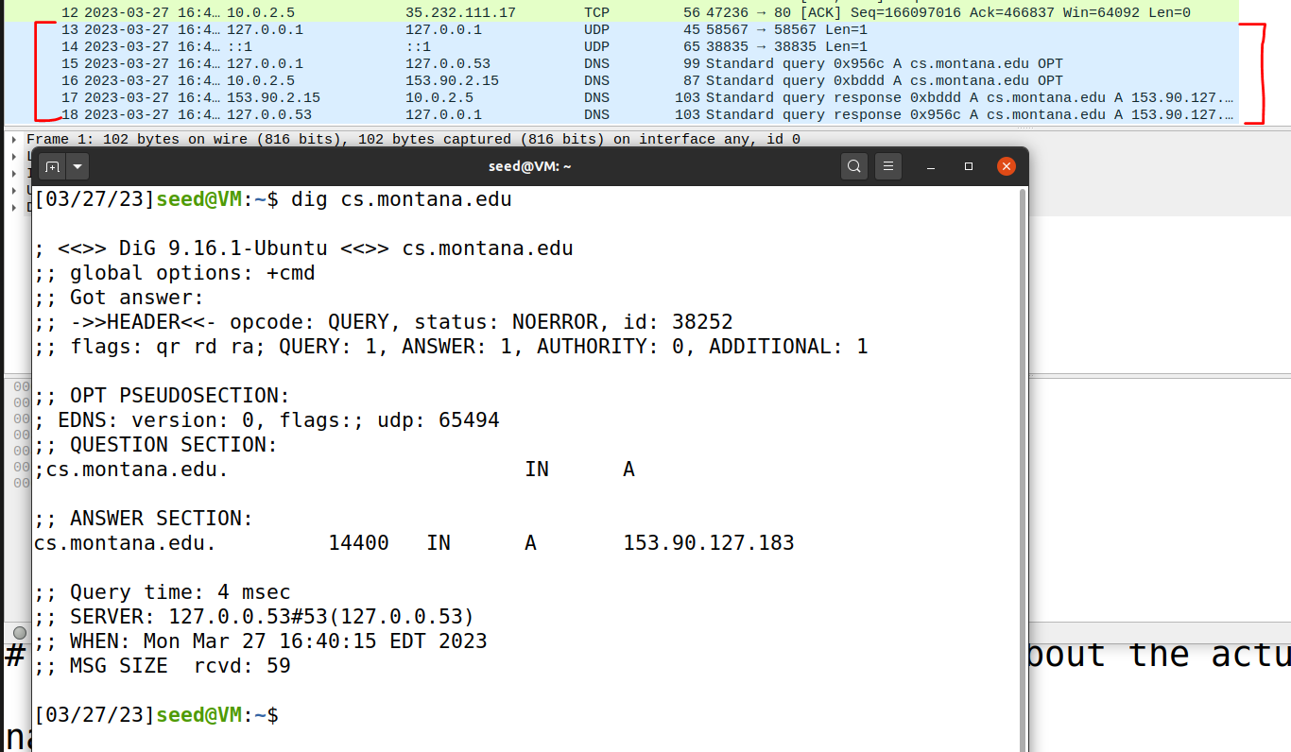

DNS In Wireshark
The dig command is used to issue DNS requests via the command line

Slide 25
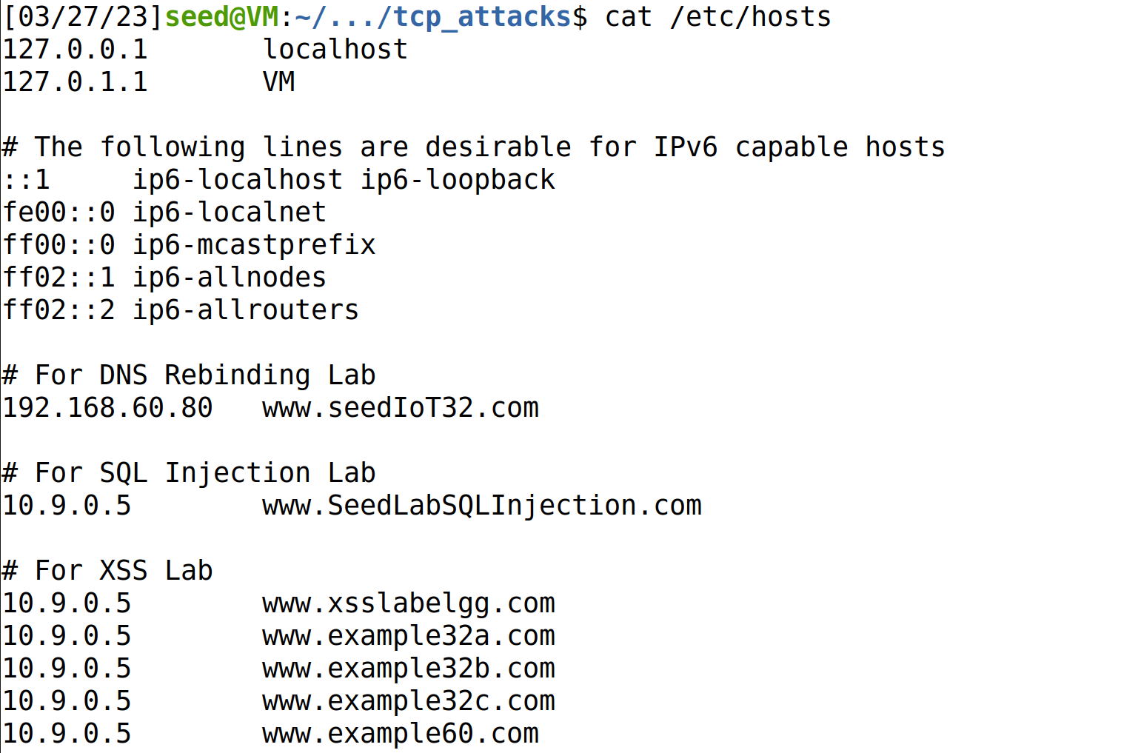
On Linux, the /etc/hosts holds static IP mappings for domain names
If we can compromise a machine, we can update /etc/hosts and inject IP address for malicious webpages

Slide 26
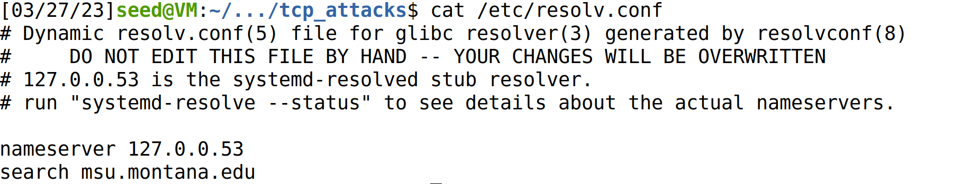
On Linux, the /etc/resolv.conf holds IP mappings for DNS server
If we can compromise a machine, we can update /etc/resolv.conf and inject IP address for malicious DNS servers**
**much more difficult

Slide 27
Attacks on the DNS protocol
When the user sends out a DNS request for a website they want to visit, they will have to wait for a response from a DNS server
This process of DNS resolving can take some time…
If an attacker wanted to cause some trouble, they could ???

Slide 28
Attacks on the DNS protocol
When the user sends out a DNS request for a website they want to visit, they will have to wait for a response from a DNS server
This process of DNS resolving can take some time…
If an attacker wanted to cause some trouble, they could spoof a packet to the user that has a malicious DNS response

Slide 29
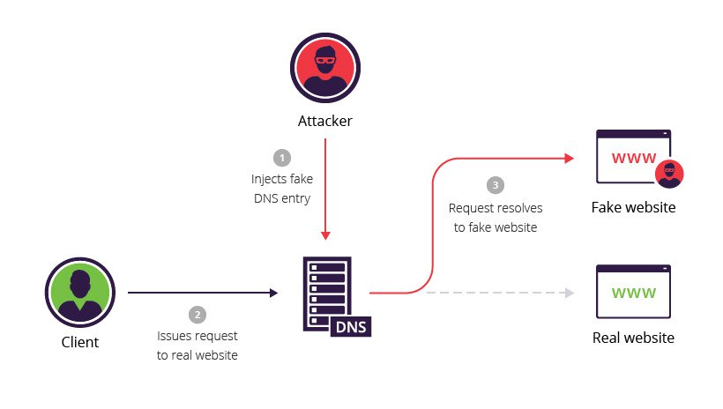
DNS Cache Poisoning Attack
A DNS cache poisoning attack is done by tricking a server into accepting malicious, spoofed DNS information
Instead of going to the IP address of the legitime website, they will go to the IP address that we place in our malicious DNS response (spoofed)
The DNS response is CACHED, which means the user will visit the malicious website in future visits**

Slide 30
DNS In Wireshark
The dig command is used to issue DNS requests via the command line

Slide 31
On Linux, the /etc/hosts holds static IP mappings for domain names
If we can compromise a machine, we can update /etc/hosts and inject IP address for malicious webpages

Slide 32
On Linux, the /etc/resolv.conf holds IP mappings for DNS server
If we can compromise a machine, we can update /etc/resolv.conf and inject IP address for malicious DNS servers**
**much more difficult

Slide 33




Lab Setup
Internet
We will once again use docker to setup our network environment
10.9.0.0/24
10.9.0.1
Attacker VM
10.9.0.5
Client Container
10.9.0.53
Local DNS Server
10.9.0.153
Attacker’s Nameserver (authoritative)
zone: attacker32.com
Because all these devices are on the same network (10.9.0.X), we can sniff their traffic!

Slide 34
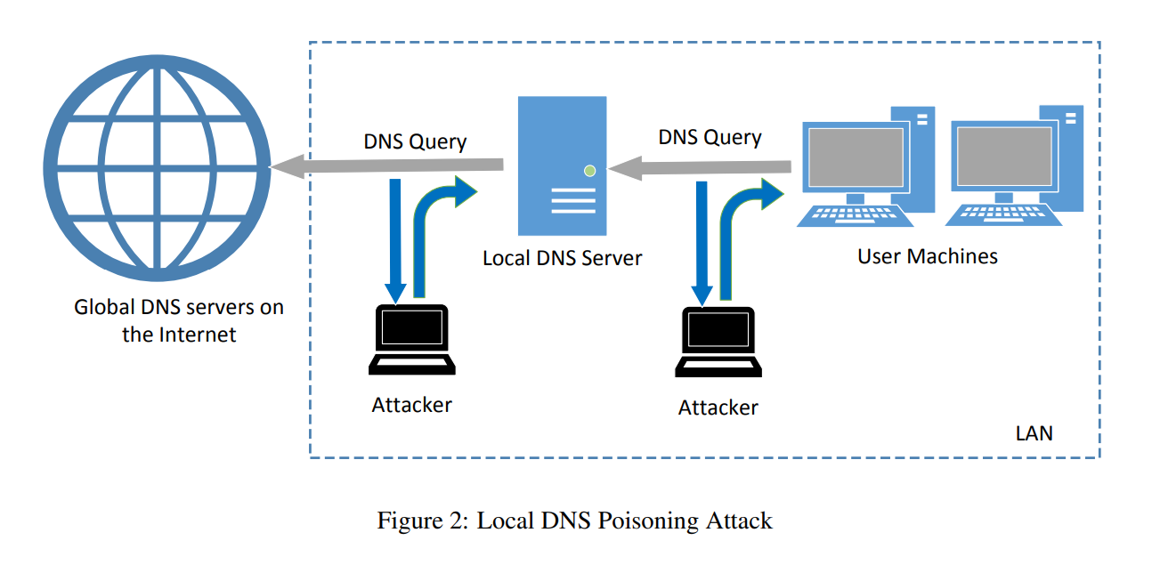
Attack Surface of DNS Poisoning
10.9.0.53
10.9.0.5
Cache
2
1
We have 2 options:
1. Send a spoofed DNS response packet to the client (10.9.0.5) that looks like it came from the local DNS server (10.9.0.53)
2. Send a spoofed DNS response packet to the local DNS server (10.9.0.53) that looks like it came from a global DNS server (????)

Slide 35

Spoofing a DNS response to a client (Task 1)
What is the IP address for example.com?
DNS Query
10.9.0.5
Client Container
10.9.0.53
Local DNS Server
Step 1. Sniff for DNS traffic going to the local DNS server

Slide 36

Spoofing a DNS response to a client (Task 1)
Internet
Waiting…
What is the IP address for example.com?
10.9.0.5
Client Container
10.9.0.53
Local DNS Server
DNS Query
Step 1. Sniff for DNS traffic going to the local DNS server
Step 2. Spoof a DNS response to the client with using information from the packet we sniffed!

Slide 37


Spoofing a DNS response to a client (Task 1)
Internet
Got a response!
What is the IP address for example.com?
10.9.0.5
Client Container
10.9.0.53
Local DNS Server
Spoofed DNS
Response
DNS Query
Step 1. Sniff for DNS traffic going to the local DNS server
Step 2. Spoof a DNS response to the client with using information from the packet we sniffed!
Step 3. The user receives a packet that looks like it came from the Local DNS server, and the client accepts the packet and uses the IP address

Slide 38
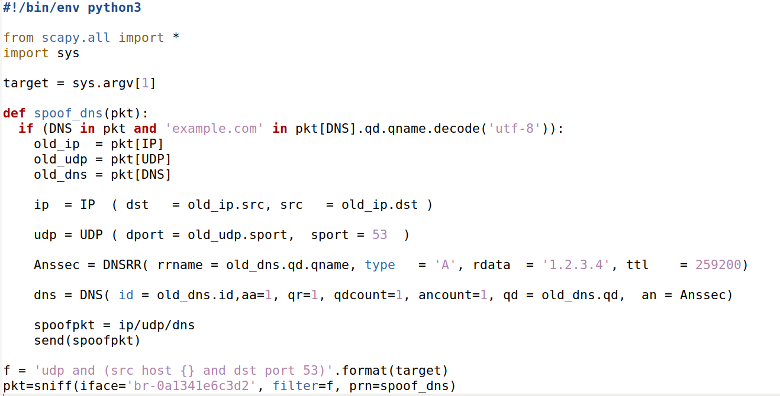
Spoofing a DNS Response Code
1
1. Sniff for DNS Traffic (Port 53)
You will need to change this value to match your network interface

Slide 39
Spoofing a DNS Response Code
2
2. We sniff for DNS traffic that has a SRC IP address of <command_line_argument>
1
1. Sniff for DNS Traffic (Port 53)
You will need to change this value to match your network interface

Slide 40
Spoofing a DNS Response Code
2
2. We sniff for DNS traffic that has a SRC IP address of <command_line_argument>
3
3. Pull the IP, port, and DNS information from the sniffed packet
1
1. Sniff for DNS Traffic (Port 53)
You will need to change this value to match your network interface

Slide 41
Spoofing a DNS Response Code
2
2. We sniff for DNS traffic that has a SRC IP address of <command_line_argument>
3
3. Pull the IP, port, and DNS information from the sniffed packet
4. Fill in fields for the IP header, UDP header, and DNS header
4
1
1. Sniff for DNS Traffic (Port 53)
You will need to change this value to match your network interface

Slide 42
Spoofing a DNS Response Code
2
2. We sniff for DNS traffic that has a SRC IP address of <command_line_argument>
3
3. Pull the IP, port, and DNS information from the sniffed packet
4. Fill in fields for the IP header, UDP header, and DNS header
4
5
5. Instead of the actual IP address of example.com, our spoofed DNS response will tell the user that the IP address is 1.2.3.4 (malicious IP)
1
1. Sniff for DNS Traffic (Port 53)
You will need to change this value to match your network interface

Slide 43
Spoofing a DNS Response Code
Attacker VM (10.9.0.1)
1. On the attacker VM, run the sniff/spoof python script
(make sure you changed the network interface in the script)

Slide 44
Spoofing a DNS Response Code
Attacker VM (10.9.0.1)
Local DNS Sever (10.9.0.53)
1. On the attacker VM, run the sniff/spoof python script
2. docksh into the local DNS server container and flush the cache

Slide 45
Spoofing a DNS Response Code
Attacker VM (10.9.0.1)
Local DNS Sever (10.9.0.53)
Victim Container (10.9.0.5)
1. On the attacker VM, run the sniff/spoof python script
2. docksh into the local DNS server container and flush the cache
3. docksh into the victim container and run the dig command to send a DNS query for example.com

Slide 46
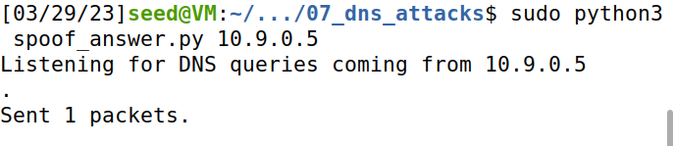
Spoofing a DNS Response Code
Attacker VM (10.9.0.1)
Local DNS Sever (10.9.0.53)
Victim Container (10.9.0.5)
1. On the attacker VM, run the sniff/spoof python script
2. docksh into the local DNS server container and flush the cache
3. docksh into the victim container and run the dig command to send a DNS query for example.com
4. Our sniffer picks up the DNS query, and spoofs a response to the Victim
“The IP Address for example.com is 1.2.3.4”

Slide 47
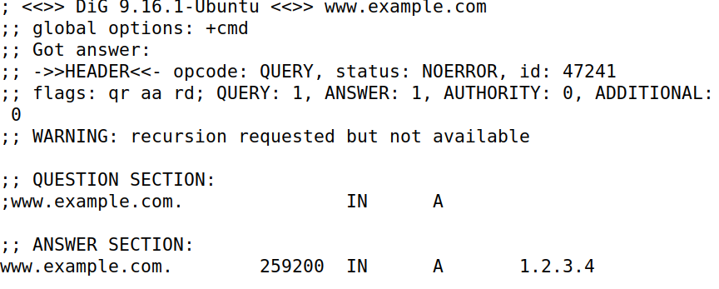


Spoofing a DNS Response Code
Attacker VM (10.9.0.1)
Local DNS Sever (10.9.0.53)
Victim Container (10.9.0.5)
1. On the attacker VM, run the sniff/spoof python script
2. docksh into the local DNS server container and flush the cache
3. docksh into the victim container and run the dig command to send a DNS query for example.com
4. Our sniffer picks up the DNS query, and spoofs a response to the Victim
5. The response of our Dig command should be 1.2.3.4
(the malicious IP that came from our spoofed packet)!
“The IP Address for example.com is 1.2.3.4”

Slide 48



Spoofing a DNS Response Code
Instead of going to the actual IP address for example.com (93.184.216.34), they will now go to the malicious IP address from the spoofed packet (1.2.3.4) which is an IP address the attacker controls!!
Attacker VM (10.9.0.1)
Local DNS Sever (10.9.0.53)
Victim Container (10.9.0.5)
1. On the attacker VM, run the sniff/spoof python script
2. docksh into the local DNS server container and flush the cache
3. docksh into the victim container and run the dig command to send a DNS query for example.com
4. Our sniffer picks up the DNS query, and spoofs a response to the Victim
5. The response of our Dig command should be 1.2.3.4
(the malicious IP that came from our spoofed packet)!
(We won’t design this evil website, but it really could be anything we want (we control it!) )
“The IP Address for example.com is 1.2.3.4”
this was suppose to be a png…

