Slide 1

CSCI 476: Computer Security
Network Security: DNS Cache Poisoning (Part 2)
Reese Pearsall
Spring 2023
https://www.cs.montana.edu/pearsall/classes/spring2023/476/main.html

Slide 2







DNS Architecture
DNS is a distributed, hierarchical database that maps domain names to IP addresses
Hierarchy consists of different types of DNS servers:
root DNS server
Authoritative DNS servers- Organization’s own DNS with up-to-date records
.com TLD DNS server
.edu TLD DNS server
Top-level domain (TLD) servers- responsible for keeping IP addresses for authoritative DNS servers for each top-level domain (.com, .edu, .jp, etc)
facebook.com DNS
amazon.com DNS
montana.edu DNS
harvard.edu DNS
Root DNS servers- responsible for maintaining IP addresses for TLD servers

Slide 3
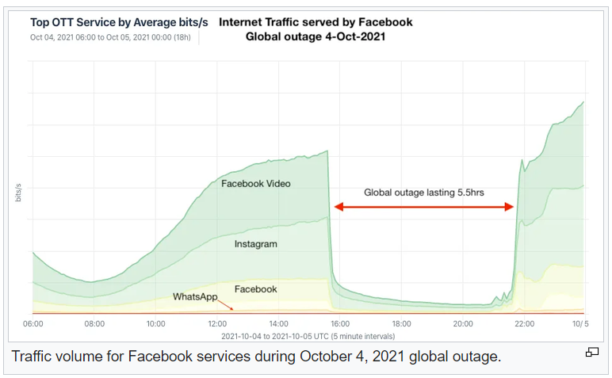

Slide 4
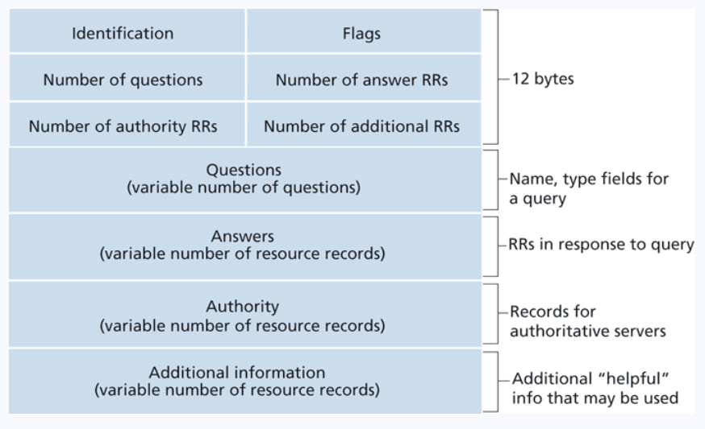
Domain Name System (DNS)
Application-level protocol used to map Domain Names to IP Addresses
DNS uses UDP as the transport layer protocol
No handshake
No guarantee that packet will arrive
DNS Packet
UDP Header
IP Header
Anatomy of a DNS Packet

Slide 5
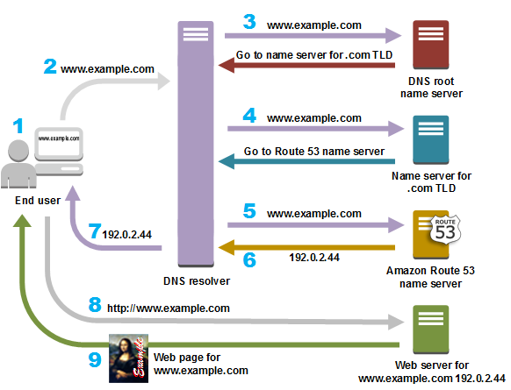





Suppose the user wants to go to www.example.com
Step 0: The computer first checks its local cache to see if an entry exists
Step 1: The user contacts a DNS resolver, which contacts a DNS root name server for the .com TLD
Step 2: The DNS resolver now contacts the .com TLD server, which returns the IP address of the example.com’s Authorative server
Step 3: The Authorative server gives us the IP address for www.example.com, and we can now send an HTTP request to that IP address!
IMPORTANT
The user’s machine will now save the IP address for www.example.com in its cache

Slide 6
Attacks on the DNS protocol
When the user sends out a DNS request for a website they want to visit, they will have to wait for a response from a DNS server
This process of DNS resolving can take some time…
If an attacker wanted to cause some trouble, they could spoof a packet to the user that has a malicious DNS response

Slide 7
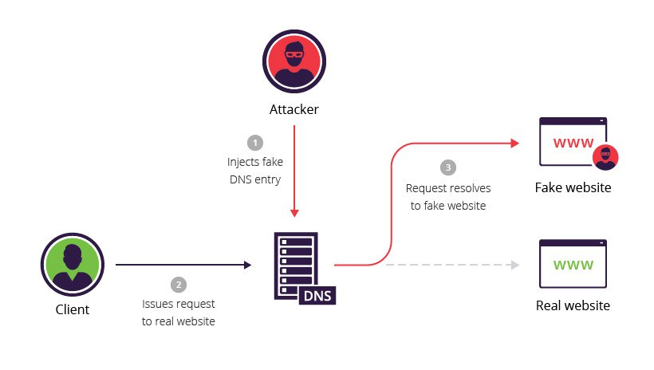
DNS Cache Poisoning Attack
A DNS cache poisoning attack is done by tricking a server into accepting malicious, spoofed DNS information
Instead of going to the IP address of the legitime website, they will go to the IP address that we place in our malicious DNS response (spoofed)
The DNS response is CACHED, which means the user will visit the malicious website in future visits**

Slide 8
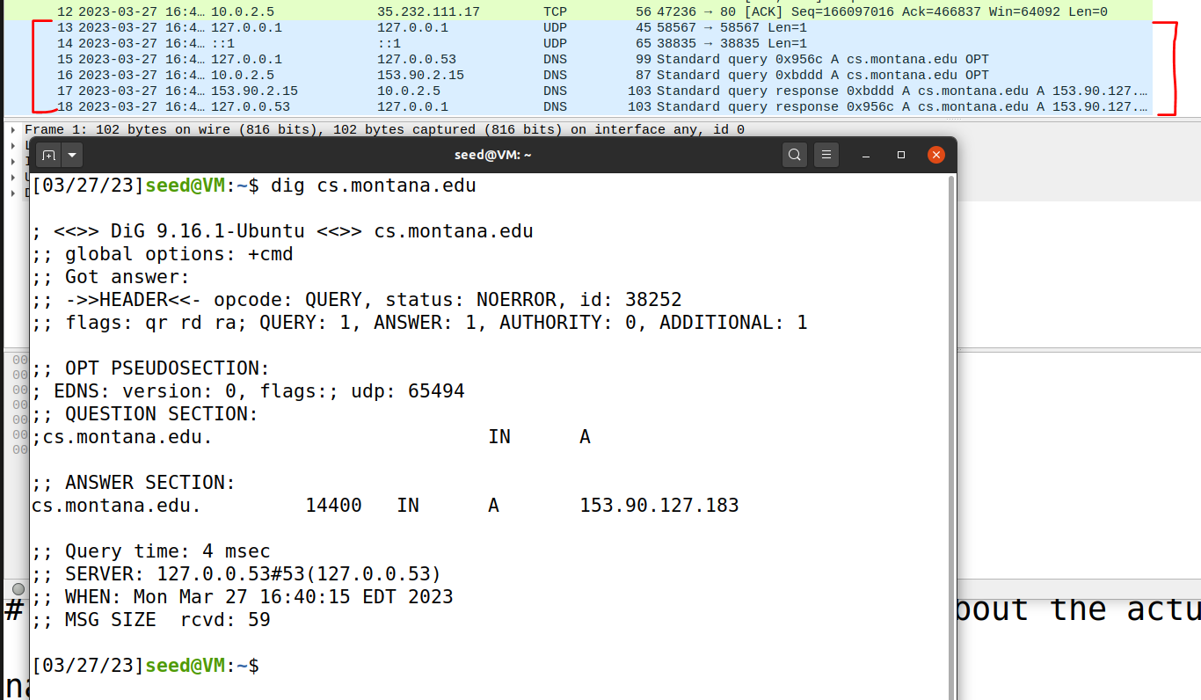

DNS In Wireshark
The dig command is used to issue DNS requests via the command line

Slide 9
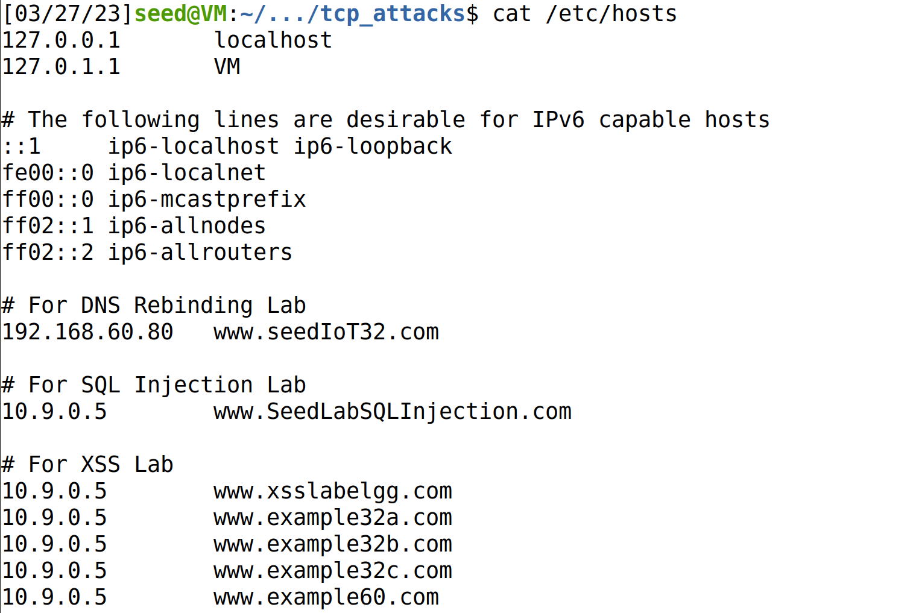
On Linux, the /etc/hosts holds static IP mappings for domain names
If we can compromise a machine, we can update /etc/hosts and inject IP address for malicious webpages

Slide 10
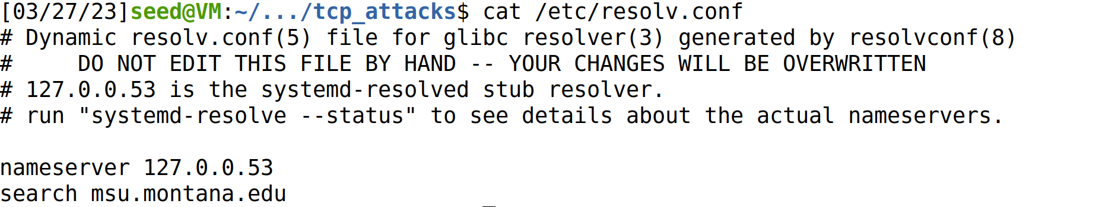
On Linux, the /etc/resolv.conf holds IP mappings for DNS server
If we can compromise a machine, we can update /etc/resolv.conf and inject IP address for malicious DNS servers**
**much more difficult

Slide 11





Lab Setup
Internet
We will once again use docker to setup our network environment
10.9.0.0/24
10.9.0.1
Attacker VM
10.9.0.5
Client Container
10.9.0.53
Local DNS Server
10.9.0.153
Attacker’s Nameserver (authoritative)
zone: attacker32.com
Because all these devices are on the same network (10.9.0.X), we can sniff their traffic!

Slide 12
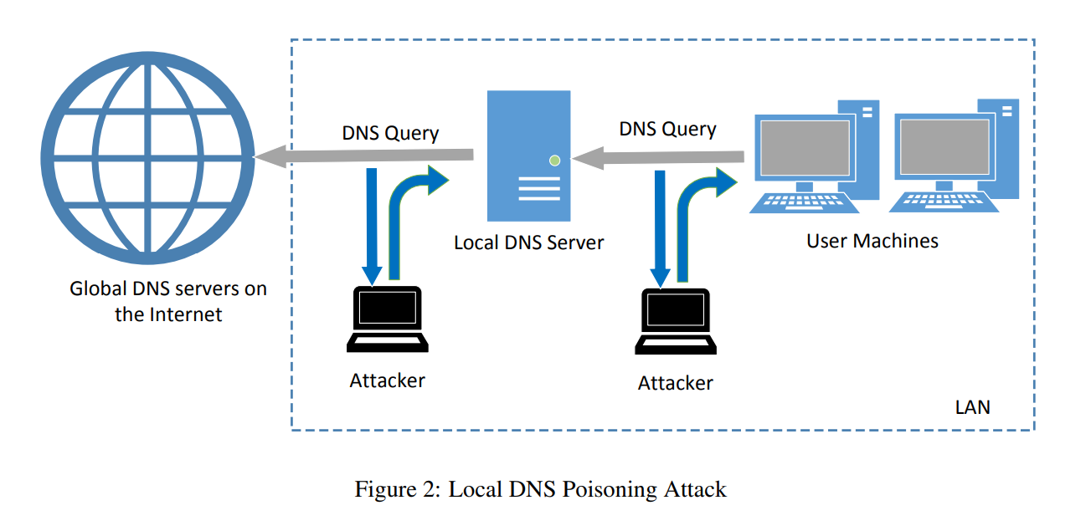
Attack Surface of DNS Poisoning
10.9.0.53
10.9.0.5
Cache
2
1
We have 2 options:
1. Send a spoofed DNS response packet to the client (10.9.0.5) that looks like it came from the local DNS server (10.9.0.53)
2. Send a spoofed DNS response packet to the local DNS server (10.9.0.53) that looks like it came from a global DNS server (????)

Slide 13

Spoofing a DNS response to a client (Task 1)
What is the IP address for example.com?
DNS Query
10.9.0.5
Client Container
10.9.0.53
Local DNS Server
Step 1. Sniff for DNS traffic going to the local DNS server

Slide 14

Spoofing a DNS response to a client (Task 1)
Internet
Waiting…
What is the IP address for example.com?
10.9.0.5
Client Container
10.9.0.53
Local DNS Server
DNS Query
Step 1. Sniff for DNS traffic going to the local DNS server
Step 2. Spoof a DNS response to the client with using information from the packet we sniffed!

Slide 15


Spoofing a DNS response to a client (Task 1)
Internet
Got a response!
What is the IP address for example.com?
10.9.0.5
Client Container
10.9.0.53
Local DNS Server
Spoofed DNS
Response
DNS Query
Step 1. Sniff for DNS traffic going to the local DNS server
Step 2. Spoof a DNS response to the client with using information from the packet we sniffed!
Step 3. The user receives a packet that looks like it came from the Local DNS server, and the client accepts the packet and uses the IP address

Slide 16
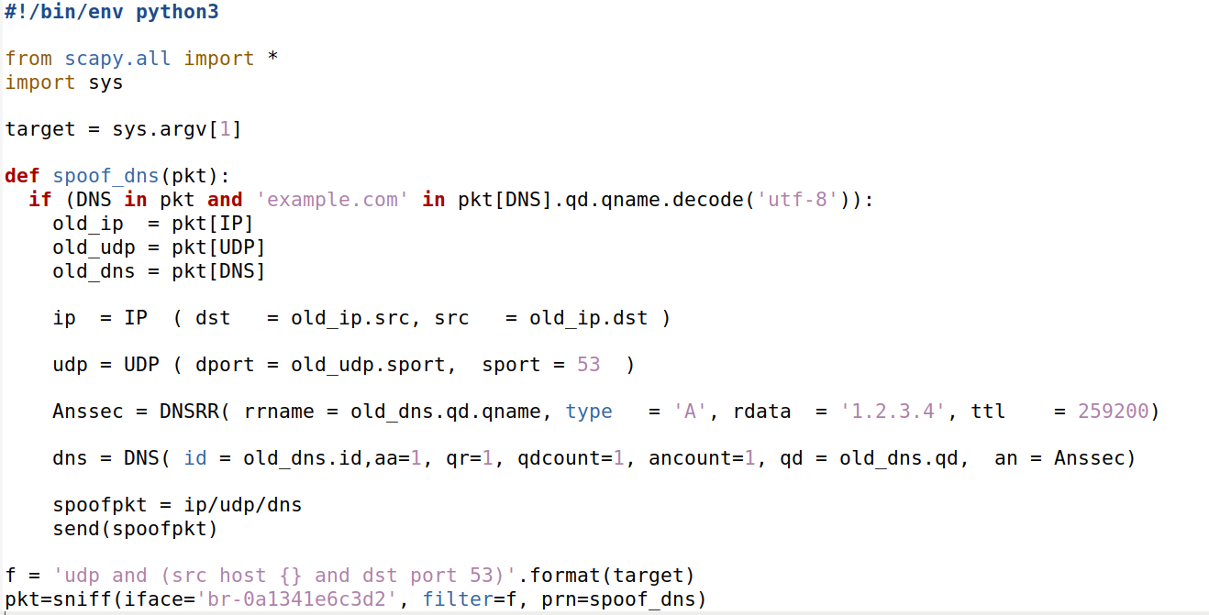
Spoofing a DNS Response Code
1
1. Sniff for DNS Traffic (Port 53)
You will need to change this value to match your network interface

Slide 17
Spoofing a DNS Response Code
2
2. We sniff for DNS traffic that has a SRC IP address of <command_line_argument>
1
1. Sniff for DNS Traffic (Port 53)
You will need to change this value to match your network interface

Slide 18
Spoofing a DNS Response Code
2
2. We sniff for DNS traffic that has a SRC IP address of <command_line_argument>
3
3. Pull the IP, port, and DNS information from the sniffed packet
1
1. Sniff for DNS Traffic (Port 53)
You will need to change this value to match your network interface

Slide 19
Spoofing a DNS Response Code
2
2. We sniff for DNS traffic that has a SRC IP address of <command_line_argument>
3
3. Pull the IP, port, and DNS information from the sniffed packet
4. Fill in fields for the IP header, UDP header, and DNS header
4
1
1. Sniff for DNS Traffic (Port 53)
You will need to change this value to match your network interface

Slide 20
Spoofing a DNS Response Code
2
2. We sniff for DNS traffic that has a SRC IP address of <command_line_argument>
3
3. Pull the IP, port, and DNS information from the sniffed packet
4. Fill in fields for the IP header, UDP header, and DNS header
4
5
5. Instead of the actual IP address of example.com, our spoofed DNS response will tell the user that the IP address is 1.2.3.4 (malicious IP)
1
1. Sniff for DNS Traffic (Port 53)
You will need to change this value to match your network interface

Slide 21
Spoofing a DNS Response Code
Attacker VM (10.9.0.1)
1. On the attacker VM, run the sniff/spoof python script
(make sure you changed the network interface in the script)

Slide 22
Spoofing a DNS Response Code
Attacker VM (10.9.0.1)
Local DNS Sever (10.9.0.53)
1. On the attacker VM, run the sniff/spoof python script
2. docksh into the local DNS server container and flush the cache

Slide 23
Spoofing a DNS Response Code
Attacker VM (10.9.0.1)
Local DNS Sever (10.9.0.53)
Victim Container (10.9.0.5)
1. On the attacker VM, run the sniff/spoof python script
2. docksh into the local DNS server container and flush the cache
3. docksh into the victim container and run the dig command to send a DNS query for example.com

Slide 24
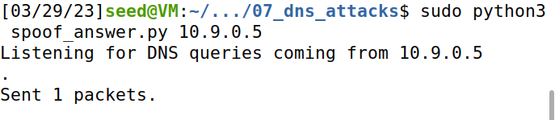
Spoofing a DNS Response Code
Attacker VM (10.9.0.1)
Local DNS Sever (10.9.0.53)
Victim Container (10.9.0.5)
1. On the attacker VM, run the sniff/spoof python script
2. docksh into the local DNS server container and flush the cache
3. docksh into the victim container and run the dig command to send a DNS query for example.com
4. Our sniffer picks up the DNS query, and spoofs a response to the Victim
“The IP Address for example.com is 1.2.3.4”

Slide 25
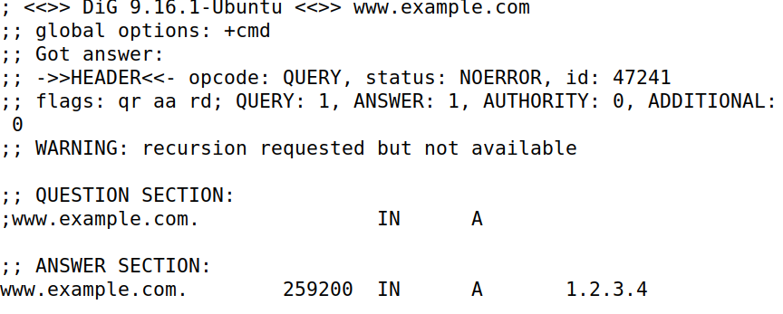


Spoofing a DNS Response Code
Attacker VM (10.9.0.1)
Local DNS Sever (10.9.0.53)
Victim Container (10.9.0.5)
1. On the attacker VM, run the sniff/spoof python script
2. docksh into the local DNS server container and flush the cache
3. docksh into the victim container and run the dig command to send a DNS query for example.com
4. Our sniffer picks up the DNS query, and spoofs a response to the Victim
5. The response of our Dig command should be 1.2.3.4
(the malicious IP that came from our spoofed packet)!
“The IP Address for example.com is 1.2.3.4”

Slide 26



Spoofing a DNS Response Code
Instead of going to the actual IP address for example.com (93.184.216.34), they will now go to the malicious IP address from the spoofed packet (1.2.3.4) which is an IP address the attacker controls!!
Attacker VM (10.9.0.1)
Local DNS Sever (10.9.0.53)
Victim Container (10.9.0.5)
1. On the attacker VM, run the sniff/spoof python script
2. docksh into the local DNS server container and flush the cache
3. docksh into the victim container and run the dig command to send a DNS query for example.com
4. Our sniffer picks up the DNS query, and spoofs a response to the Victim
5. The response of our Dig command should be 1.2.3.4
(the malicious IP that came from our spoofed packet)!
(We won’t design this evil website, but it really could be anything we want (we control it!) )
“The IP Address for example.com is 1.2.3.4”
this was suppose to be a png…

Slide 27

Spoofing a DNS response to the local DNS server (Task 2)
Internet
Waiting…
Cache
What is the IP address for example.com?
10.9.0.5
Client Container
10.9.0.53
Local DNS Server
DNS Query
Step 1. Sniff for outgoing DNS traffic from the local DNS server

Slide 28

Spoofing a DNS response to the local DNS server (Task 2)
Internet
Waiting…
Waiting…
Cache
10.9.0.5
Client Container
10.9.0.53
Local DNS Server
“The IP Address for example.com is 1.2.3.4”
Step 1. Sniff for outgoing DNS traffic from the local DNS server
Step 2. Using information from the sniffed packet, spoof a packet to the Local DNS server that looks like the packet came from a Global DNS server

Slide 29

Spoofing a DNS response to the local DNS server (Task 2)
Internet
Got a response!
Got a response!
Cache
10.9.0.5
Client Container
10.9.0.53
Local DNS Server
“The IP Address for example.com is 1.2.3.4”
Step 1. Sniff for outgoing DNS traffic from the local DNS server
Step 2. Using information from the sniffed packet, spoof a packet to the Local DNS server that looks like the packet came from a Global DNS server
Step 3. The Local DNS Server accepts packet and caches it and send a DNS response to the client

Slide 30

We use the exact same program, but we sniff for a different IP address now (10.9.0.53)

Slide 31


Our attack method is the exact same, except we sniff for a different IP address
Spoofing a DNS Response packet to the LOCAL DNS Server
Attacker VM (10.9.0.1)
Local DNS Sever (10.9.0.53)
Victim Container (10.9.0.5)
1. On the attacker VM, run the sniff/spoof python script
2. docksh into the local DNS server container and flush the cache
3. docksh into the victim container and run the dig command to send a DNS query for example.com
4. Our sniffer picks up the DNS query, and spoofs a response to the Victim
5. The response of our Dig command should be 1.2.3.4
(the malicious IP that came from our spoofed packet)!
“The IP Address for example.com is 1.2.3.4”

Slide 32
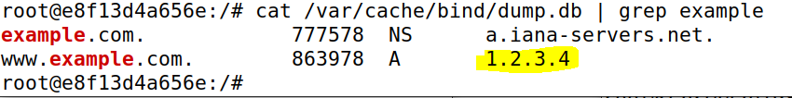

Spoofing a DNS Response packet to the LOCAL DNS Server
Local DNS Sever (10.9.0.53)
Cache
Important: When we attack the Local DNS Sever, our spoofed DNS response gets cached by the DNS server
Whenever someone asks this local DNS server for the IP address of example.com, it will always return 1.2.3.4 right away
We have “poisoned” this DNS server

Slide 33




Spoofing a DNS Response packet to the LOCAL DNS Server
Local DNS Sever (10.9.0.53)
Cache
DNS Servers hold DNS Records
Type A Records: IPv4 Addresses. Ie. the IP Address for www.example.com is 1.2.3.4
Type NS Records: Authoritative DNS Servers for a domain. Ie. the Authoritative DNS Server for www.example.com is a.iana-servers.net

Slide 34

Spoofing a DNS Response packet to the LOCAL DNS Server
Local DNS Sever (10.9.0.53)
Cache
DNS Servers hold DNS Records
Type A Records: IPv4 Addresses. Ie. the IP Address for www.example.com is 1.2.3.4
Type NS Records: Authoritative DNS Servers for a domain. Ie. the Authoritative DNS Server for www.example.com is a.iana-servers.net
Other types:
Type AAA: IPv6 Address
Type CNAME: “Canonical name” aka an alias for another domain

Slide 35
Spoofing a DNS Response packet to the LOCAL DNS Server
Local DNS Sever (10.9.0.53)
Cache
DNS Servers hold DNS Records
Type A Records: IPv4 Addresses. Ie. the IP Address for www.example.com is 1.2.3.4
Type NS Records: Authoritative DNS Servers for a domain. Ie. the Authoritative DNS Server for www.example.com is a.iana-servers.net
Our next text will be to poison a local DNS cache with NS type records.
→ Visitor that want to access any webpage in the domain example.com will use the attackers nameserver

Slide 36
Spoofing NS Records (Task 3)
Real nameserver for example.com
www.blah.example.com
DNS Queries
Cache
10.9.0.53
Local DNS Server
10.9.0.153
Attacker’s Nameserver (authoritative)
zone: attacker32.com
www.products.example.com
DNS Records on 10.9.0.53 (the “cache”)
www.safe.example.com
example.com | NS | attacker32.com
www.reese.com | A | 5.6.7.8
Facebook.com | NS | 192.68.7.223
We must contact the example.com authoritative nameserver to get the IP address. If we poison the local DNS server with malicious NS records, it will use the attackers nameserver

Slide 37
Spoofing NS Records (Task 3)
Real nameserver for example.com
www.blah.example.com
DNS Queries
Cache
1.2.3.4
10.9.0.53
Local DNS Server
10.9.0.153
Attacker’s Nameserver (authoritative)
zone: attacker32.com
www.products.example.com
1.2.3.4
DNS Records on 10.9.0.53 (the “cache”)
www.safe.example.com
example.com | NS | attacker32.com
www.reese.com | A | 5.6.7.8
Facebook.com | NS | 192.68.7.223
1.2.3.4
We must contact the example.com authoritative nameserver to get the IP address. If we poison the local DNS server with malicious NS records, it will use the attackers nameserver

Slide 38
Spoofing NS Records
Attacker VM (10.9.0.1)
Local DNS Sever (10.9.0.53)
Victim Container (10.9.0.5)
1. Flush the Local DNS Cache

Slide 39
Spoofing NS Records
Attacker VM (10.9.0.1)
Local DNS Sever (10.9.0.53)
Victim Container (10.9.0.5)
2. Run Python script that will sniff and spoof DNS responses
1. Flush the Local DNS Cache

Slide 40
Spoofing NS Records
Attacker VM (10.9.0.1)
Local DNS Sever (10.9.0.53)
Victim Container (10.9.0.5)
3. Run dig command to generate DNS traffic
2. Run Python script that will sniff and spoof DNS responses
1. Flush the Local DNS Cache

Slide 41
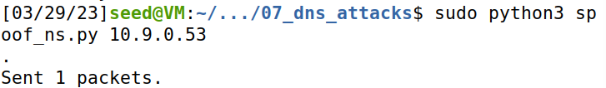
Spoofing NS Records
Attacker VM (10.9.0.1)
Local DNS Sever (10.9.0.53)
Victim Container (10.9.0.5)
3. Run dig command to generate DNS traffic
2. Run Python script that will sniff and spoof DNS responses
1. Flush the Local DNS Cache
4. Our sniffer program detects a new DNS query, and spoofs an NS response

Slide 42
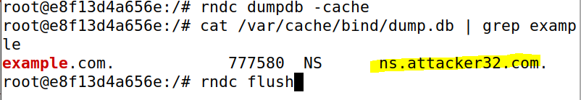

Spoofing NS Records
Attacker VM (10.9.0.1)
Local DNS Sever (10.9.0.53)
Victim Container (10.9.0.5)
3. Run dig command to generate DNS traffic
2. Run Python script that will sniff and spoof DNS responses
1. Flush the Local DNS Cache
5. Check the cache on the local DNS server
4. Our sniffer program detects a new DNS query, and spoofs an NS response
Whenever somebody contacts a domain under example.com, it will use the attacker’s nameserver!!

