Slide 1

CSCI 132: Basic Data Structures and Algorithms
Final Exam Review
Reese Pearsall
Spring 2023
https://www.cs.montana.edu/pearsall/classes/spring2023/132/main.html
*All images are stolen from the internet

Slide 2


Announcements
Program 5 due Sunday
Fill out the course evaluation
Current Response Rate: 91%
Extra credit has been achieved!
Final Exam on Monday (5/8) at 2:00 PM – 3:50 PM in our normal classroom
Take some time this week to double check your grades
Meatball wishes you good luck on your final exams

Slide 3
Final Exam Logistics
Same format/rules as the midterm exam
Bring your laptop if you need
Roughly about the same length
3% will be added to your exam score
Probably wont curve it
Basic Java Class Structure
Stacks
Searching
Short Answer
Sorting
Multiple Choice
Recursion
Queues

Slide 4
Basic Java Class Structure
Be able to identify/define instance fields and methods
Write a constructor
Understand basic Java keywords
Write a basic method that does a simple operation

Slide 5
Stacks
Be able to understand basic stack methods (push pop peek)
Given code that utilizes a stack, be able to visualize and illustrate the contents of a stack
Know the running time of stack operations
Write code the uses a stack

Slide 6
Searching
Understand the differences between linear search and binary search
Understand the running times of those algorithms
Be able to look at code for linear search and binary search and understand what is happening

Slide 7
Short Answer
Basic Java Classes, Class Structure, Methods, Operations, if statements, loops, OOP
Basic Linked Lists
Big-O Notation, How to determine running time of an algorithm
Stacks
Queues
Bubble Sort
Selection Sort
Merge Sort
Quick Sort
Linear Search/Binary Search
Recursion

Slide 8
Sorting
Bubble sort, selection sort, merge sort, quick sort
Be able to describe/illustrate the steps of these sorting algorithms
Know the running time for each sorting algorithm
Know which ones are efficient/not efficient

Slide 9
Multiple Choice
Basic Java Classes, Class Structure, Methods, Operations, if statements, loops, OOP
Basic Linked Lists
Big-O Notation, How to determine running time of an algorithm
Stacks
Queues
Bubble Sort
Selection Sort
Merge Sort
Quick Sort
Linear Search/Binary Search
Recursion

Slide 10
Recursion
Given a basic recursion function, derive the output and number of recursive calls made
Understand how to calculate the running time of a recursive algorithm
Understand limitations/benefits of recursion

Slide 11
Queues
Be able to understand basic queue methods (enqueue dequeue peek)
Given code that utilizes a queue, be able to visualize and illustrate the contents of a stack
Know the running time of queue operations
Write code the uses a queue

Slide 12
Final Exam Study Guide

Slide 13
Course Goals
Design and Implement programs of simple and moderate complexity in Java
Explain the concept of an ADT (meh)
Understand and implement basic data structures: Linked lists, stacks, and queues
Given a simple algorithm, determine the time complexity using Big-O notation
Understand basic searching and sorting algorithms and their runtime
Understand how recursion works, be able to analyze recursion runtime, and be able to implement recursion in a program
Be able to debug programs and become an independent problem solver

Slide 14
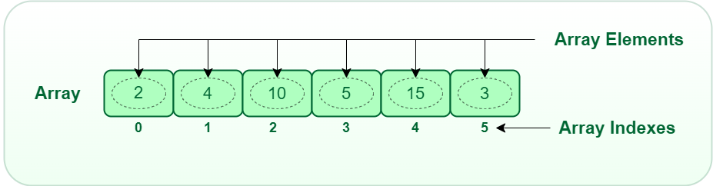
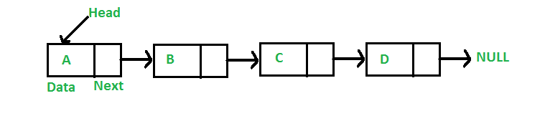


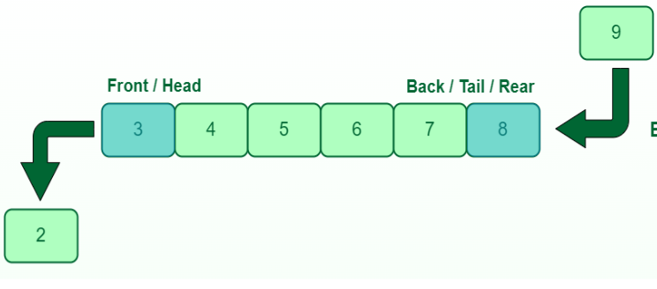
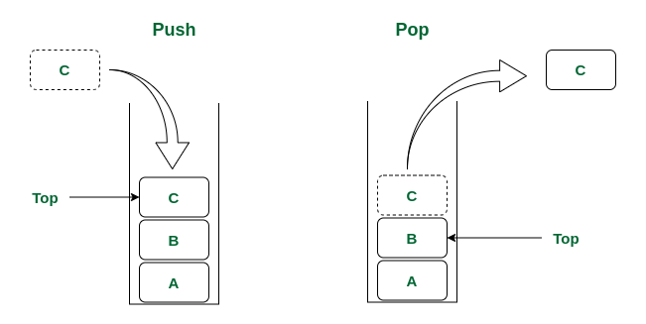
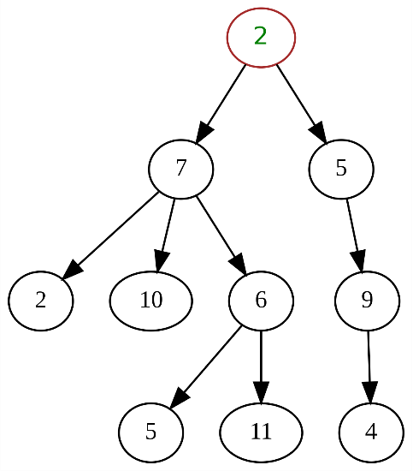

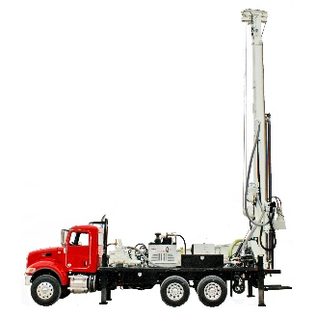
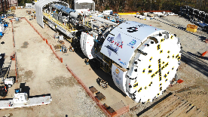
Takeaways
We have different data structures that handle data differently.
There are tradeoffs between using these data structures
Linked List
Arrays
Queue
Given a problem, you should be able to identify a good candidate for a data structure and provide a justification
Stack
Trees

Slide 15
Takeaways
There be many different types of algorithms.
Some algorithms are much more efficient than others
The algorithm you select is important. It can be the difference between your program finishing in 6 seconds, or you program never finishing at all
We have methods for measuring the efficiency of some algorithm (big-O notation).
When you write an algorithm, you should be able to broadly describe the effectiveness and efficiency of it

Slide 16
Takeaways
Bubble Sort | Iterate through array and swap pairs of numbers. Large numbers (“bubbles”) will rise to the top naturally | O(n²)
Selection Sort | Iterate through the array and find the minimum value n times, and place minimum in correct position | O(n²)
Merge Sort | Use recursion to split array in sub-arrays of size. Sort the sub-arrays while merging until you solve the original problem | O(n log n)
Quick Sort | Partition array around a pivot value. Use recursion and place pivot in correct spot and repeat until array is sorted | O(n²)** **Put usually performs much better (O(n log n())
We cannot sort faster than O(n log n). There are no (known) algorithms that can sort in O(n), O(logn), or O(1) … why?

Slide 17
My Goals for you
Get you comfortable with writing basic Java programs
Give you a good toolset that can help you solve a variety of problems (Data Structures)
Give you techniques and methods for solving a variety of problems (Algorithms)
Give you the skills to analyze the algorithms that you write (Big-O notation)

Slide 18
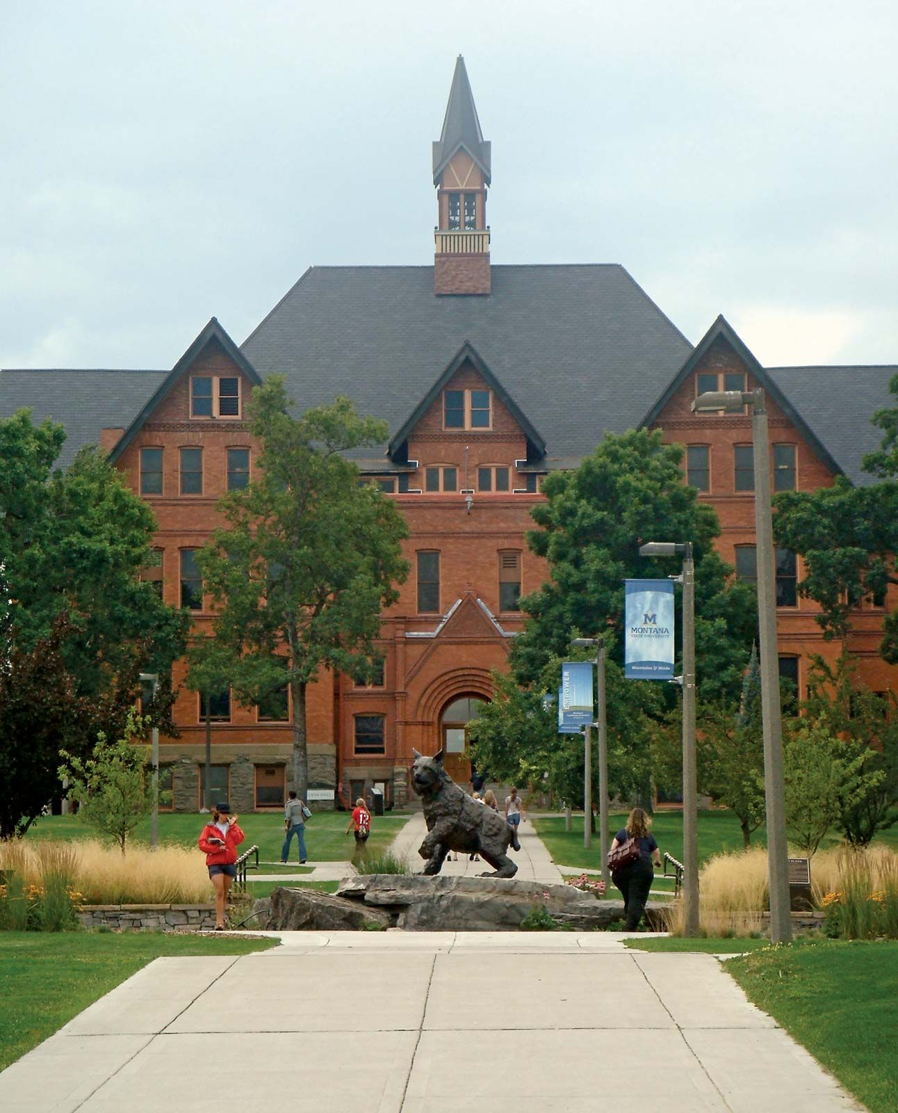
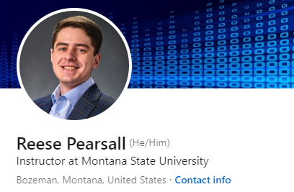

Thank You!
This class has been a blast to teach. Thank you for your patience, flexibility, kindness, and for laughing at my jokes ☺
There were a lot of long nights, and I know things were not perfect, but I am happy with how things went
I hope you enjoyed this class, and I hope the stuff you learned will be helpful in your career/future classes
If I can be of assistance to you for anything in the future (reference, advising, support), please let me know!
I will be teaching CSCI 460, 466, and 132 next semester
Connect with me on LinkedIn!
Congrats to those that are graduating next weekend! I hope you find a job that you love!
If you are taking 232 with me this Summer, I’ll see you again soon ☺

