Slide 1

CSCI 132: Basic Data Structures and Algorithms
Lessons Learned so far + Intro to Stacks
Reese Pearsall
Spring 2023
https://www.cs.montana.edu/pearsall/classes/spring2023/132/main.html
*All images are stolen from the internet

Slide 2

Announcements
Come get your midterm exam
Exam average was in the mid-80s (after curve)
Don’t stress if you didn’t do well
Make sure I calculated your score correctly
Lab 7 due tomorrow @ 11:59 PM
Program 3 will be posted very soon

Slide 3
Big-O
Big-O notation is a way to describe the running-time/time complexity of an algorithm regarding the number of operations that are executed in the algorithm (in relation to some input n)
Focus on worst-case scenario, and how the algorithm scales as n gets really big

Slide 4
Big-O
Big-O notation is a way to describe the running-time/time complexity of an algorithm regarding the number of operations that are executed in the algorithm (in relation to some input n)
Focus on worst-case scenario, and how the algorithm scales as n gets really big
A very powerful computer and a very weak computer running the same algorithm will both execute the same number of operations (the speed at which they execute these operations will be different)
Takeaway: the asymptotic running time (the big-o running time) will be the same for each computer

Slide 5
Big-O
Big-O notation is a way to describe the running-time/time complexity of an algorithm regarding the number of operations that are executed in the algorithm (in relation to some input n)
Focus on worst-case scenario, and how the algorithm scales as n gets really big
To find the total running time of an algorithm, we calculate the running-time of each operation in the algorithm and then add everything together
In Big-O, we can drop non-dominant factors and multiplicative constants (coefficients)
O(n) + O(n) + O(n): Total running time = O(3n) O(n)
∈

Slide 6
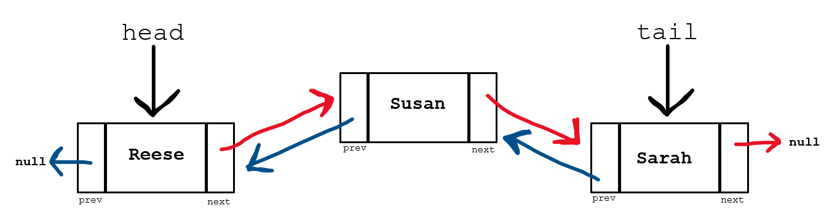
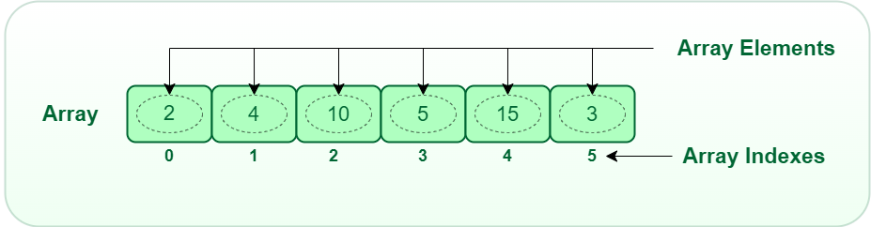
Data Structures so far:
ArrayLists (Arrays)
Linked Lists

Slide 7
Data Structures so far:
ArrayLists (Arrays)
Linked Lists
Can hold one data type
Can hold multiple data types

Slide 8
Data Structures so far:
ArrayLists (Arrays)
Linked Lists
Can hold one data type
Can also store objects, which allow for multiple data types
Nodes in the linked list can hold multiple data types

Slide 9
Data Structures so far:
ArrayLists (Arrays)
Linked Lists
Can hold one data type
Can also store objects, which allow for multiple data types
Nodes in the linked list can hold multiple data types
Entire array is stored at a contiguous spot in memory
Linked list nodes are stored at non-contiguous spots in memory

Slide 10
Data Structures so far:
ArrayLists (Arrays)
Linked Lists
Can hold one data type
Can also store objects, which allow for multiple data types
Nodes in the linked list can hold multiple data types
Entire array is stored at a contiguous spot in memory
Linked list nodes are stored at non-contiguous spots in memory
Traversing a linked list requires more work than traversing an array

Slide 11
Data Structures so far:
ArrayLists (Arrays)
Linked Lists
Can add new elements to data structure (resizable)
Can add new elements to data structure (resizable)
Both data structures can grow dynamically, and new elements can be added, but they way they add new elements is drastically different

Slide 12
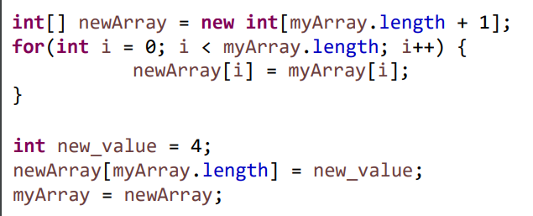
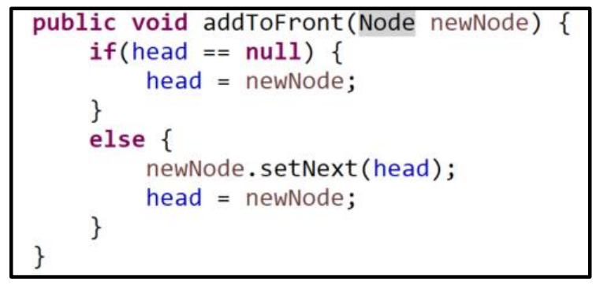
Data Structures so far:
ArrayLists (Arrays)
Linked Lists
Create a brand-new array, copy everything over from old array
Update pointers

Slide 13
Data Structures so far:
ArrayLists (Arrays)
Linked Lists
Create a brand-new array, copy everything over from old array
Update pointers
O(1)
O(n)

Slide 14
Data Structures so far:
ArrayLists (Arrays)
Linked Lists
Takeaway: Adding a new element to an ArrayList requires much more work than adding a new element to a Linked List

Slide 15
Data Structures so far:
ArrayLists (Arrays)
Linked Lists
Arrays are generally much easier to sort than Nodes in a Linked List
If you are constantly needing to add new elements to the data structure, using a Linked List requires much less work in the long run
Arrays are more memory efficient (adding is not very memory efficient though)

Slide 16
Data Structures so far:
ArrayLists (Arrays)
Linked Lists
When to use each data structure?
It depends on how you are using your data and if you know how much data you have
If you don’t know how much data you need to store, or if you are constantly needing to add new elements to the data structure → Linked Lists
If you know how much data you need to store, and if you can add all your data at once → Arrays/ArrayLists

Slide 17
Data Structures so far:
ArrayLists (Arrays)
Linked Lists
These two data structures are implementations of a List Abstract Data Type (ADT)
ADT is a class whose behavior is defined by a set of operations and how a user interacts with it.
A list data type must be able to get an element, add an element, remove an element, etc
→ How they do these operations is up to the subclass (LL and AL)
As programmers, we use handy methods that were written by other people that allows us to use these data structures

Slide 18
The Linked List Class
We will no longer be writing our own Linked List class, instead we will now import the Java-provided Linked List Class
import java.util.LinkedList;

Slide 19
The Linked List Class
We will no longer be writing our own Linked List class, instead we will now import the Java-provided Linked List Class
import java.util.LinkedList;
LinkedList<String> names = new LinkedList<String>();
The data type the linked list will be holding
Reference variable for LL

Slide 20

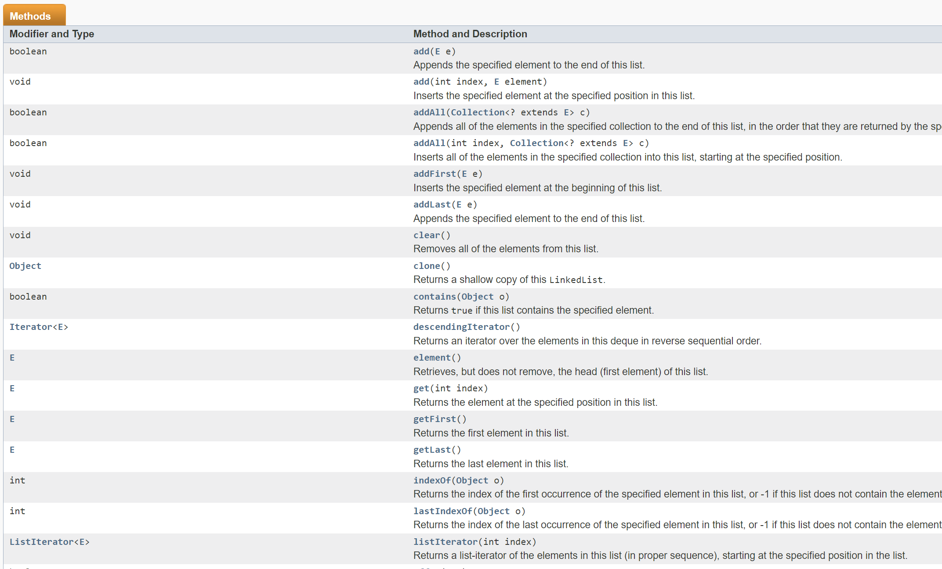
The Linked List Class
https://docs.oracle.com/javase/7/docs/api/java/util/LinkedList.html
The documentation describe how the LinkedList class was implemented, and all the methods/operations we can do with the Linked List class

Slide 21
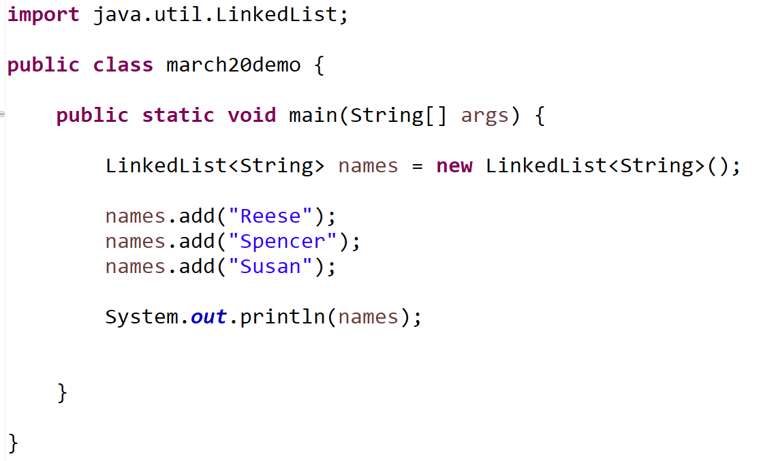
The Linked List Class

Slide 22
A stack is a data structure that can hold data, however the way we interact with a stack is a little bit different
Top of Stack
Sarah
Elements of Data Structure
Susan
Reese

Slide 23
A stack is a data structure that can hold data, however the way we interact with a stack is a little bit different
Spencer
When only interact with the top of the stack.
If we want to add a new element, we must put it on the top of the stack
Top of Stack
Sarah
Elements of Data Structure
Susan
Reese

Slide 24
A stack is a data structure that can hold data, however the way we interact with a stack is a little bit different
Top of Stack
Spencer
Sarah
Adding something to a stack is known as the push operation
Elements of Data Structure
Susan
Reese

Slide 25
A stack is a data structure that can hold data, however the way we interact with a stack is a little bit different
If we want to remove something, we must always remove the element on the top of the stack
Top of Stack
Spencer
Sarah
Elements of Data Structure
Susan
Reese

Slide 26
A stack is a data structure that can hold data, however the way we interact with a stack is a little bit different
Spencer
Removing an element is known as the pop operation
Top of Stack
Sarah
Elements of Data Structure
Susan
Reese
stack.pop() → Top node (spencer) is removed

Slide 27

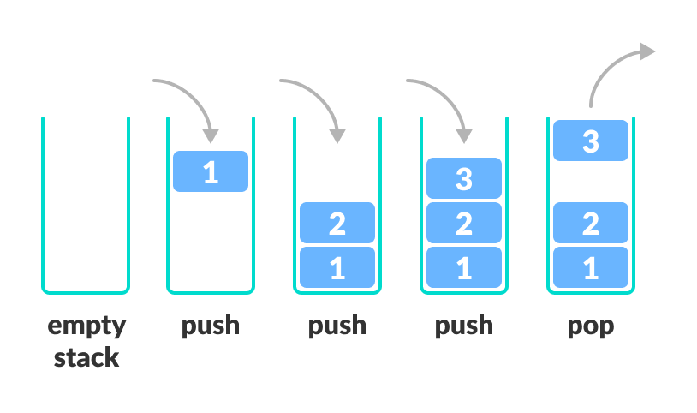
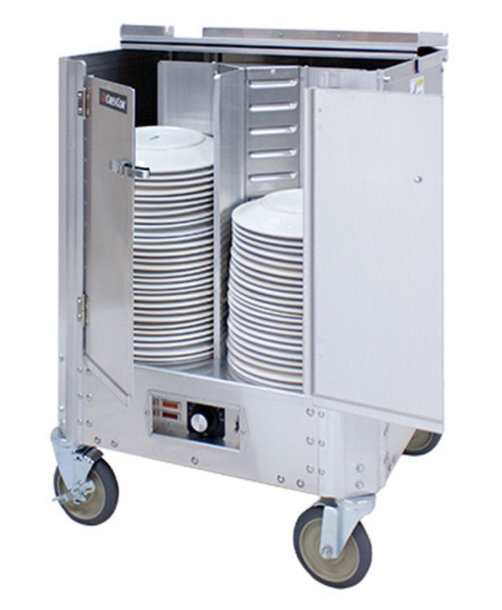
A stack is a data structure that can hold data, and follows the last in first out (LIFO) principle
We can:
Add an element to the top of the stack (push)
Remove the top element (pop)

