Slide 1

CSCI 132: Basic Data Structures and Algorithms
Queues (Linked List implementation)
Reese Pearsall
Spring 2023
https://www.cs.montana.edu/pearsall/classes/spring2023/132/main.html
*All images are stolen from the internet

Slide 2

Other Announcements
Lab 8 due tomorrow @ 11:59 PM
Program 3 due Sunday 4/2
Friday’s lecture will likely be a help session for Program 3

Slide 3
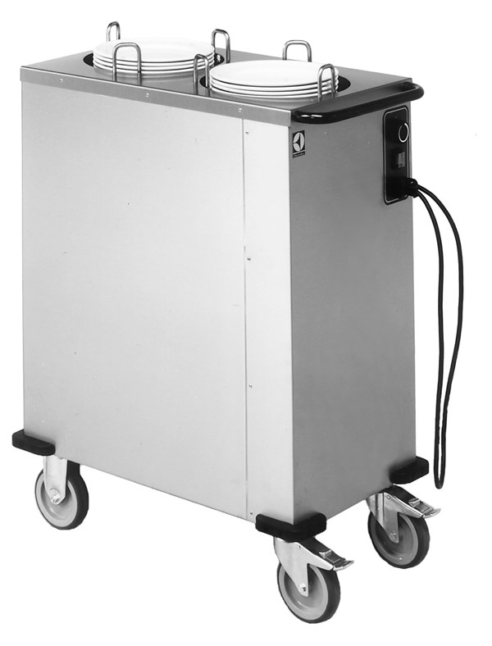
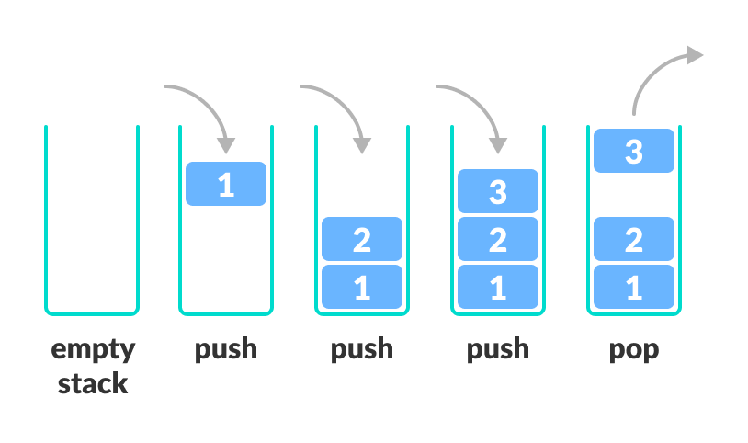
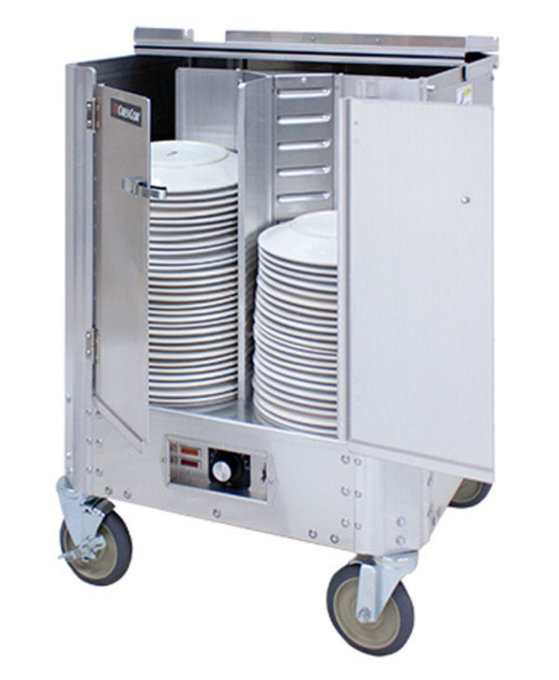
A stack is a data structure that can hold data, and follows the last in first out (LIFO) principle
We can:
Add an element to the top of the stack (push)
Remove the top element (pop)

Slide 4
public void pop() {
if(this.size == 0) {
return;
}
else {
this.data.removeFirst();
this.top_of_stack =
this.data.getFirst();
this.size--;
}
}
If pop() is called on a stack with one element, our program might crash
Stack has no data!!

Slide 5
public void printStack() {
for(int i = 0; i < this.data.size(); i++) {
this.data.get(i).printInfo();
}
}
Running time?

Slide 6
public void printStack() {
for(int i = 0; i < this.data.size(); i++) {
this.data.get(i).printInfo();
}
}
O(n)
Running time?

Slide 7
public void printStack() {
for(int i = 0; i < this.data.size(); i++) {
this.data.get(i).printInfo();
}
}
O(n)
O(???)
The running time of this operation depends how the get() operation is implemented
Running time?

Slide 8
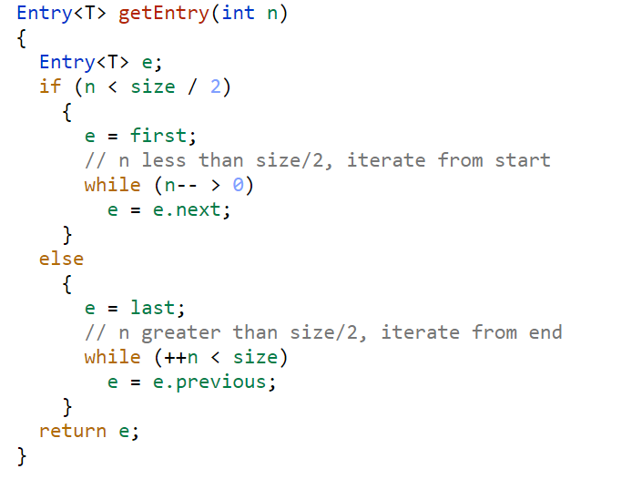
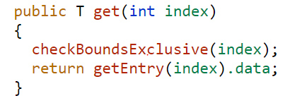
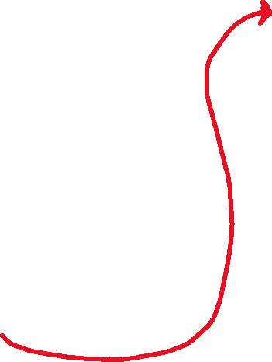
public void printStack() {
for(int i = 0; i < this.data.size(); i++) {
this.data.get(i).printInfo();
}
}
O(n)
O(???)
Running time?

Slide 9

public void printStack() {
for(int i = 0; i < this.data.size(); i++) {
this.data.get(i).printInfo();
}
}
O(n)
O(???)
O(N/2)
Running time?
O(N/2)

Slide 10
public void printStack() {
for(int i = 0; i < this.data.size(); i++) {
this.data.get(i).printInfo();
}
}
O(n)
O(???)
O(N)
Running time?
O(N)

Slide 11
public void printStack() {
for(int i = 0; i < this.data.size(); i++) {
this.data.get(i).printInfo();
}
}
O(n)
O(???)
Running time?
Total running time of get(): O(N)

Slide 12
public void printStack() {
for(int i = 0; i < this.data.size(); i++) {
this.data.get(i).printInfo();
}
}
O(n)
O(n)
Running time?

Slide 13
public void printStack() {
for(int i = 0; i < this.data.size(); i++) {
this.data.get(i).printInfo();
}
}
O(n)
O(n)
Running time?
O(n²)
Can we do better?

Slide 14

Old Way
O(n^2)
public void printStack() {
for(int i = 0; i < this.data.size(); i++) {
this.data.get(i).printInfo();
}
}
New Way
for(String each: this.data) {
System.out.println(each);
}
O(n)
O(1)
Running time?
O(n)

Slide 15
Algorithm | w/ Array | w/ Linked List
Creation | O(n) | O(1)
Push() | O(1) | O(1)
Pop() | O(1) | O(1)
peek() | O(1) | O(1)
Print() | O(n) | O(n)

Slide 16
Stack Runtime Analysis
Algorithm | w/ Array | w/ Linked List
Creation | O(n) | O(1)
Push() | O(1) | O(1)
Pop() | O(1) | O(1)
peek() | O(1) | O(1)
Print() | O(n) | O(n)

Slide 17
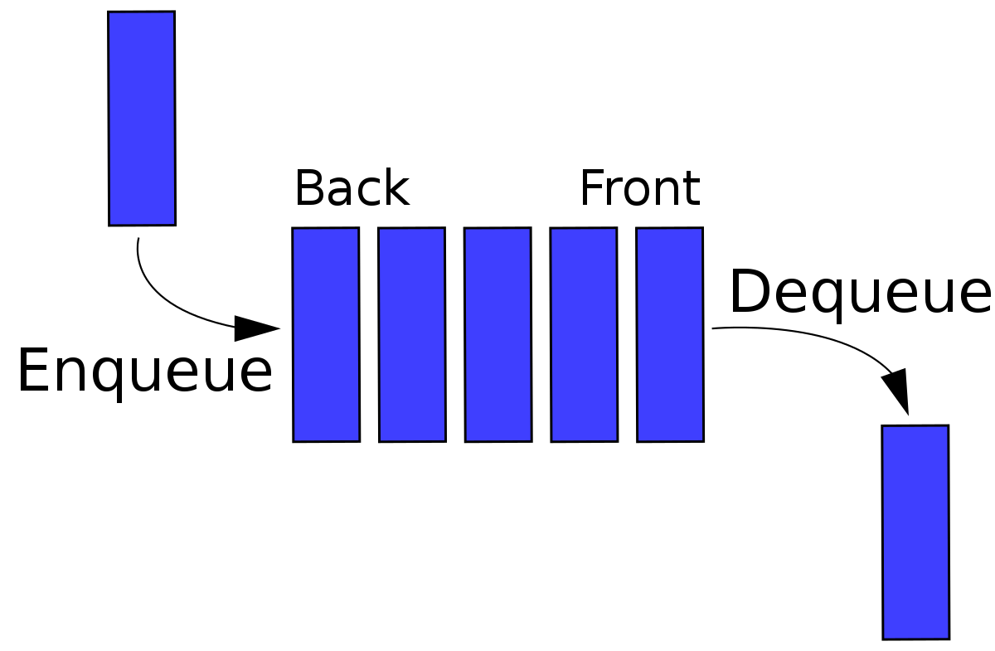
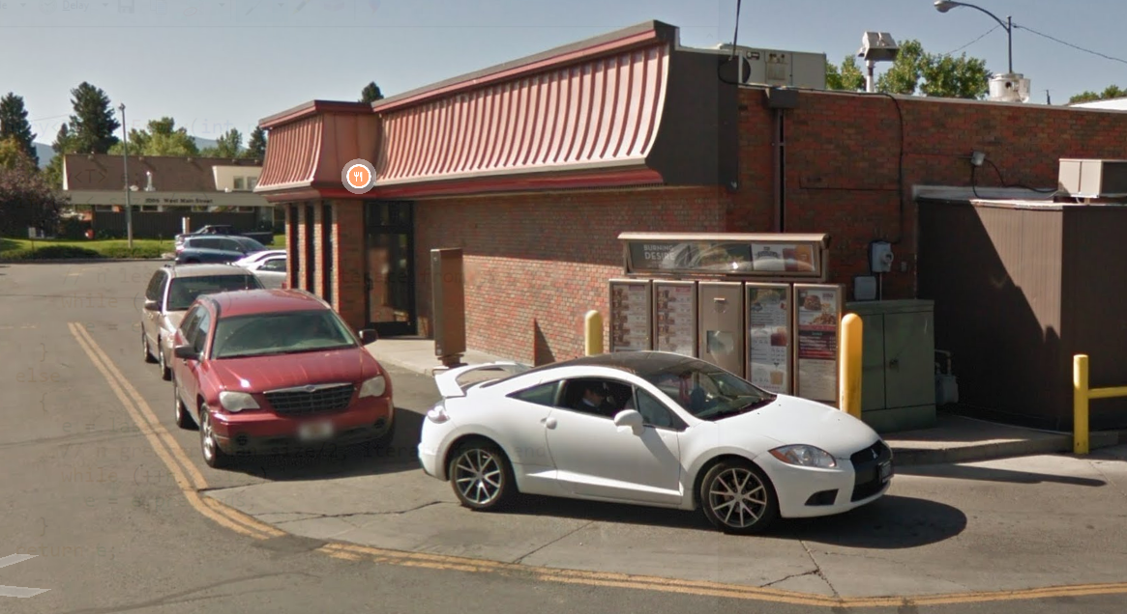
A Queue is a data structure that holds data, but operates in a First-in First-out (FIFO) fashion

Slide 18

A Queue is a data structure that holds data, but operates in a First-in First-out (FIFO) fashion
Elements get added to the Back of the Queue.
Elements get removed from the Front of the queue
Once again, we need a data structure to hold the data of the queue
Linked List (today)
Array (tomorrow)

Slide 19
A Queue is a data structure that holds data, but operates in a First-in First-out (FIFO) fashion
The Queue ADT has the following methods:
Enqueue- Add new element to the queue
Dequeue- Remove element from the queue
** Always remove the front-most element
Peek()- Return the element that is at the front of the queue
IsEmpty() – Returns true if queue is empty, returns false is queue is not empty

Slide 20
A Queue is a data structure that holds data, but operates in a First-in First-out (FIFO) fashion
Back
Queue
Front
Reese
queue.enqueue(“Reese”);

Slide 21
A Queue is a data structure that holds data, but operates in a First-in First-out (FIFO) fashion
Back
Queue
Front
Susan
Reese
queue.enqueue(“Reese”);
queue.enqueue(“Susan”);

Slide 22
A Queue is a data structure that holds data, but operates in a First-in First-out (FIFO) fashion
Back
Queue
Front
Sarah
Susan
Reese
queue.enqueue(“Reese”);
queue.enqueue(“Susan”);
queue.enqueue(“Sarah”);

Slide 23
A Queue is a data structure that holds data, but operates in a First-in First-out (FIFO) fashion
Back
Queue
Front
Spencer
Sarah
Susan
Reese
queue.enqueue(“Reese”);
queue.enqueue(“Susan”);
queue.enqueue(“Sarah”);
queue.enqueue(“Spencer”);

Slide 24
A Queue is a data structure that holds data, but operates in a First-in First-out (FIFO) fashion
Back
Queue
Front
Spencer
Sarah
Susan
Reese
queue.enqueue(“Reese”);
queue.enqueue(“Susan”);
queue.enqueue(“Sarah”);
queue.enqueue(“Spencer”);
queue.deque()

Slide 25
A Queue is a data structure that holds data, but operates in a First-in First-out (FIFO) fashion
Back
Queue
Front
Spencer
Sarah
Susan
queue.enqueue(“Reese”);
queue.enqueue(“Susan”);
queue.enqueue(“Sarah”);
queue.enqueue(“Spencer”);
queue.deque()

Slide 26
A Queue is a data structure that holds data, but operates in a First-in First-out (FIFO) fashion
Back
Queue
Front
Spencer
Sarah
Susan
queue.enqueue(“Reese”);
queue.enqueue(“Susan”);
queue.enqueue(“Sarah”);
queue.enqueue(“Spencer”);
queue.deque()
queue.deque()

Slide 27
A Queue is a data structure that holds data, but operates in a First-in First-out (FIFO) fashion
Back
Queue
Front
Matt
Spencer
Sarah
queue.enqueue(“Reese”);
queue.enqueue(“Susan”);
queue.enqueue(“Sarah”);
queue.enqueue(“Spencer”);
queue.deque()
queue.deque()
queue.enqueue(“Matt”);

Slide 28
A Queue is a data structure that holds data, but operates in a First-in First-out (FIFO) fashion
Back
Queue
Front
Matt
Spencer
Sarah
queue.enqueue(“Reese”);
queue.enqueue(“Susan”);
queue.enqueue(“Sarah”);
queue.enqueue(“Spencer”);
queue.deque()
queue.deque()
queue.enqueue(“Matt”);
queue.peek()
→ “Sarah”

Slide 29
A Queue is a data structure that holds data, but operates in a First-in First-out (FIFO) fashion
Back
Queue
Front
Matt
Spencer
Sarah
Tail
Head
Linked List Implementation
When we enqueue, we add the element to ???
When we dequeue, we remove the element from ???

Slide 30
A Queue is a data structure that holds data, but operates in a First-in First-out (FIFO) fashion
Back
Queue
Front
Matt
Spencer
Sarah
Tail
Head
Linked List Implementation
When we enqueue, we add the element to the end of the linked list
When we dequeue, we remove the element from the beginning of the linked list

Slide 31
A Queue is a data structure that holds data, but operates in a First-in First-out (FIFO) fashion
Back
Queue
Front
Matt
Spencer
Sarah
As we use our queue, we need to keep track of a few things
The size of the queue
The front of the queue (not when we use LLs)
The rear of the queue (not when we use LLs)

