Slide 1

CSCI 132: Basic Data Structures and Algorithms
Queues (Array Implementation)
Reese Pearsall
Spring 2023
https://www.cs.montana.edu/pearsall/classes/spring2023/132/main.html
*All images are stolen from the internet

Slide 2
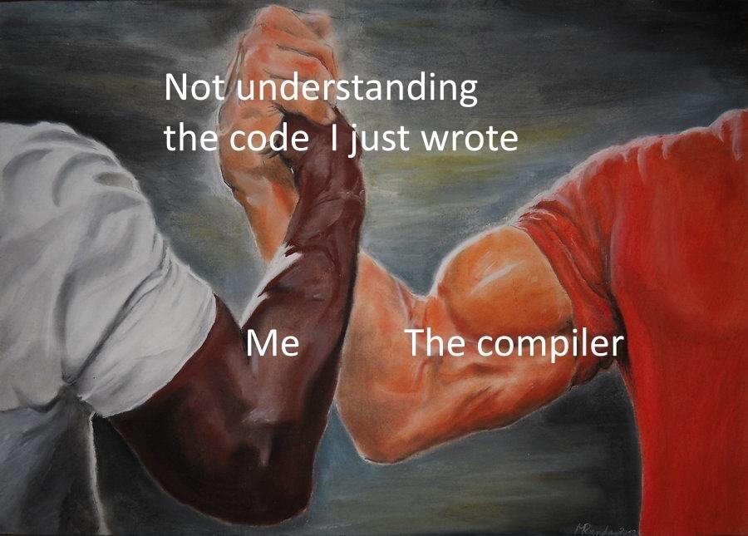
Announcements
Lab 9 due tomorrow @ 11:59 PM
Program 4 due Sunday 4/16*
Next Monday’s lecture (4/10) will be asynchronous (don’t come to class)

Slide 3
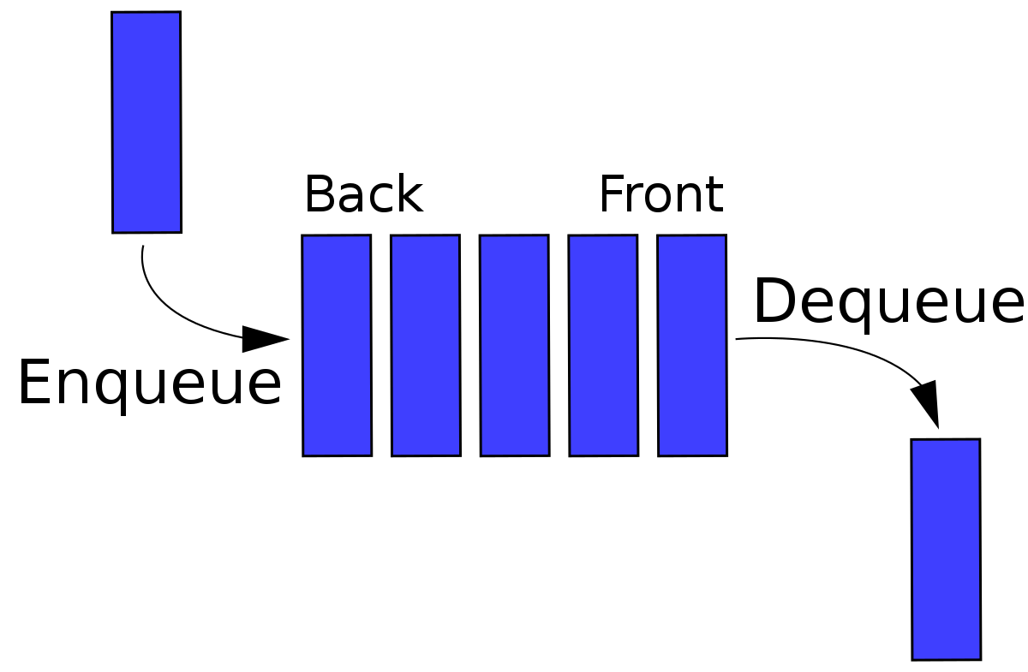
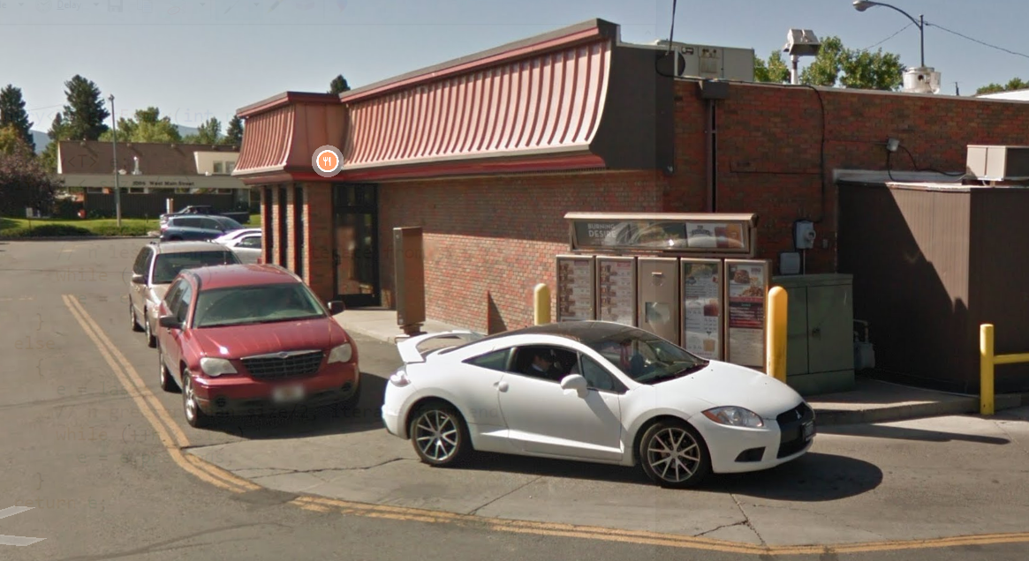

A Queue is a data structure that holds data, but operates in a First-in First-out (FIFO) fashion
Elements get added to the Back of the Queue.
Elements get removed from the Front of the queue
Once again, we need a data structure to hold the data of the queue
Linked List (today)
Array (tomorrow)

Slide 4
A Queue is a data structure that holds data, but operates in a First-in First-out (FIFO) fashion
The Queue ADT has the following methods:
Enqueue- Add new element to the queue
Dequeue- Remove element from the queue
** Always remove the front-most element
Peek()- Return the element that is at the front of the queue
IsEmpty() – Returns true if queue is empty, returns false is queue is not empty

Slide 5
A Queue is a data structure that holds data, but operates in a First-in First-out (FIFO) fashion
public void enqueue(Order newOrder) {
if(rear == capacity) {
System.out.println("full...");
return;
}
else {
this.data[rear] = newOrder;
rear++;
this.size++;
}
}
Order
Tom
Order
Jane
0
1
2
3
4
5
capacity = 6
size = 2
front = 0
rear = 2
In our previous array implementation, rear pointed to the next empty spot in the array

Slide 6
A Queue is a data structure that holds data, but operates in a First-in First-out (FIFO) fashion
public void enqueue(Order newOrder) {
if(rear == capacity) {
System.out.println("full...");
return;
}
else {
this.data[rear] = newOrder;
rear++;
this.size++;
}
}
Order
Tom
Order
Jane
Order
John
0
1
2
3
4
5
capacity = 6
size = 2
front = 0
rear = 2

Slide 7
A Queue is a data structure that holds data, but operates in a First-in First-out (FIFO) fashion
public void enqueue(Order newOrder) {
if(rear == capacity) {
System.out.println("full...");
return;
}
else {
this.data[rear] = newOrder;
rear++;
this.size++;
}
}
Order
Tom
Order
Jane
Order
John
0
1
2
3
4
5
capacity = 6
size = 2
front = 0
rear = 2

Slide 8
A Queue is a data structure that holds data, but operates in a First-in First-out (FIFO) fashion
public void enqueue(Order newOrder) {
if(rear == capacity) {
System.out.println("full...");
return;
}
else {
this.data[rear] = newOrder;
rear++;
this.size++;
}
}
Order
Tom
Order
Jane
Order
John
0
1
2
3
4
5
capacity = 6
size = 3
front = 0
rear = 3

Slide 9
A Queue is a data structure that holds data, but operates in a First-in First-out (FIFO) fashion
public void enqueue(Order newOrder) {
if(rear == capacity) {
System.out.println("full...");
return;
}
else {
this.data[rear] = newOrder;
rear++;
this.size++;
}
}
Order
Tom
Order
Jane
Order
John
Order
Sarah
0
1
2
3
4
5
capacity = 6
size = 3
front = 0
rear = 3

Slide 10
A Queue is a data structure that holds data, but operates in a First-in First-out (FIFO) fashion
public void enqueue(Order newOrder) {
if(rear == capacity) {
System.out.println("full...");
return;
}
else {
this.data[rear] = newOrder;
rear++;
this.size++;
}
}
Order
Tom
Order
Jane
Order
John
Order
Sarah
0
1
2
3
4
5
capacity = 6
size = 3
front = 0
rear = 3

Slide 11
A Queue is a data structure that holds data, but operates in a First-in First-out (FIFO) fashion
public void enqueue(Order newOrder) {
if(rear == capacity) {
System.out.println("full...");
return;
}
else {
this.data[rear] = newOrder;
rear++;
this.size++;
}
}
Order
Tom
Order
Jane
Order
John
Order
Sarah
0
1
2
3
4
5
capacity = 6
size = 4
front = 0
rear = 4

Slide 12
A Queue is a data structure that holds data, but operates in a First-in First-out (FIFO) fashion
public void dequeue() {
if(this.size == 0) {
System.out.println("empty...");
return;
}
else {
for (int i = 0; i < rear - 1; i++) {
this.data[i] = this.data[i + 1];
}
rear--;
this.size--;
if(rear < capacity) {
this.data[rear] = null;
}
}
}
Order
Tom
Order
Jane
Order
John
Order
Sarah
0
1
2
3
4
5
capacity = 6
size = 4
front = 0
rear = 4

Slide 13



A Queue is a data structure that holds data, but operates in a First-in First-out (FIFO) fashion
public void dequeue() {
if(this.size == 0) {
System.out.println("empty...");
return;
}
else {
for (int i = 0; i < rear - 1; i++) {
this.data[i] = this.data[i + 1];
}
rear--;
this.size--;
if(rear < capacity) {
this.data[rear] = null;
}
}
}
Order
Tom
Order
Jane
Order
John
Order
Sarah
0
1
2
3
4
5
capacity = 6
size = 4
front = 0
rear = 4
Shift everything over one spot!

Slide 14
A Queue is a data structure that holds data, but operates in a First-in First-out (FIFO) fashion
public void dequeue() {
if(this.size == 0) {
System.out.println("empty...");
return;
}
else {
for (int i = 0; i < rear - 1; i++) {
this.data[i] = this.data[i + 1];
}
rear--;
this.size--;
if(rear < capacity) {
this.data[rear] = null;
}
}
}
Order
Jane
Order
John
Order
Sarah
Order
Sarah
0
1
2
3
4
5
capacity = 6
size = 3
front = 0
rear = 3
Shift everything over one spot!

Slide 15
A Queue is a data structure that holds data, but operates in a First-in First-out (FIFO) fashion
public void dequeue() {
if(this.size == 0) {
System.out.println("empty...");
return;
}
else {
for (int i = 0; i < rear - 1; i++) {
this.data[i] = this.data[i + 1];
}
rear--;
this.size--;
if(rear < capacity) {
this.data[rear] = null;
}
}
}
Order
Jane
Order
John
Order
Sarah
0
1
2
3
4
5
capacity = 6
size = 3
front = 0
rear = 3
Shift everything over one spot!

Slide 16
A Queue is a data structure that holds data, but operates in a First-in First-out (FIFO) fashion
public void dequeue() {
if(this.size == 0) {
System.out.println("empty...");
return;
}
else {
for (int i = 0; i < rear - 1; i++) {
this.data[i] = this.data[i + 1];
}
rear--;
this.size--;
if(rear < capacity) {
this.data[rear] = null;
}
}
}
Order
Jane
Order
John
Order
Sarah
0
1
2
3
4
5
capacity = 6
size = 3
front = 0
rear = 3
Shift everything over one spot!

Slide 17
A Queue is a data structure that holds data, but operates in a First-in First-out (FIFO) fashion
public void dequeue() {
if(this.size == 0) {
System.out.println("empty...");
return;
}
else {
for (int i = 0; i < rear - 1; i++) {
this.data[i] = this.data[i + 1];
}
rear--;
this.size--;
if(rear < capacity) {
this.data[rear] = null;
}
}
}
Order
John
Order
Sarah
Order
Sarah
0
1
2
3
4
5
capacity = 6
size = 3
front = 0
rear = 3
Shift everything over one spot!

Slide 18
A Queue is a data structure that holds data, but operates in a First-in First-out (FIFO) fashion
public void dequeue() {
if(this.size == 0) {
System.out.println("empty...");
return;
}
else {
for (int i = 0; i < rear - 1; i++) {
this.data[i] = this.data[i + 1];
}
rear--;
this.size--;
if(rear < capacity) {
this.data[rear] = null;
}
}
}
Order
John
Order
Sarah
Order
Sarah
0
1
2
3
4
5
capacity = 6
size = 2
front = 0
rear = 2
Shift everything over one spot!

Slide 19
A Queue is a data structure that holds data, but operates in a First-in First-out (FIFO) fashion
public void dequeue() {
if(this.size == 0) {
System.out.println("empty...");
return;
}
else {
for (int i = 0; i < rear - 1; i++) {
this.data[i] = this.data[i + 1];
}
rear--;
this.size--;
if(rear < capacity) {
this.data[rear] = null;
}
}
}
Order
John
Order
Sarah
0
1
2
3
4
5
capacity = 6
size = 2
front = 0
rear = 2
Shift everything over one spot!

Slide 20
A Queue is a data structure that holds data, but operates in a First-in First-out (FIFO) fashion
public void dequeue() {
if(this.size == 0) {
System.out.println("empty...");
return;
}
else {
for (int i = 0; i < rear - 1; i++) {
this.data[i] = this.data[i + 1];
}
rear--;
this.size--;
if(rear < capacity) {
this.data[rear] = null;
}
}
}
Order
John
Order
Sarah
0
1
2
3
4
5
capacity = 6
size = 2
front = 0
rear = 2
Shift everything over one spot!

Slide 21
public void dequeue() {
if(this.size == 0) {
System.out.println("empty...");
return;
}
else {
for (int i = 0; i < rear - 1; i++) {
this.data[i] = this.data[i + 1];
}
rear--;
this.size--;
if(rear < capacity) {
this.data[rear] = null;
}
}
}
This algorithm works fine, but the issue is that shifting data can be costly
(think about if this queue has 1000000 things in it→ we must shift 999999 elements!)
O(n-1)

Slide 22
public void dequeue() {
if(this.size == 0) {
System.out.println("empty...");
return;
}
else {
for (int i = 0; i < rear - 1; i++) {
this.data[i] = this.data[i + 1];
}
rear--;
this.size--;
if(rear < capacity) {
this.data[rear] = null;
}
}
}
This algorithm works fine, but the issue is that shifting data can be costly
(think about if this queue has 1000000 things in it→ we must shift 999999 elements!)
O(n-1)
We need a better algorithm that runs in constant time for enqueuing and dequeuing

Slide 23
A Queue is a data structure that holds data, but operates in a First-in First-out (FIFO) fashion
We are going to make use of the modulus (%) operator !
Order
Tom
Order
Jane
Order
John
Order
Sarah
10 % 6 = 4
3 % 6 = 3
6 % 6 = 0
0
1
2
3
4
5
capacity = 6
size = 4
front = 0

Slide 24
A Queue is a data structure that holds data, but operates in a First-in First-out (FIFO) fashion
Let’s enqueue
Here is the formula for determining where to insert the new element
Order
Tom
Order
Jane
Order
John
Order
Sarah
insert_spot = (front + size) % 6
0
1
2
3
4
5
capacity = 6
size = 4
front = 0

Slide 25
A Queue is a data structure that holds data, but operates in a First-in First-out (FIFO) fashion
Let’s enqueue
Here is the formula for determining where to insert the new element
Order
Tom
Order
Jane
Order
John
Order
Sarah
insert_spot = (front + size) % 6
Order
Todd
0
1
2
3
4
5
capacity = 6
size = 4
front = 0
insert_spot = 4
(0 + 4) % 6 = Insert at spot 4

Slide 26
A Queue is a data structure that holds data, but operates in a First-in First-out (FIFO) fashion
Let’s enqueue
Here is the formula for determining where to insert the new element
Order
Tom
Order
Jane
Order
John
Order
Sarah
Order
Todd
insert_spot = (front + size) % 6
0
1
2
3
4
5
capacity = 6
size = 4
front = 0
insert_spot = 4

Slide 27
A Queue is a data structure that holds data, but operates in a First-in First-out (FIFO) fashion
Let’s dequeue
data[front] = null
Order
Tom
Order
Jane
Order
John
Order
Sarah
Order
Todd
0
1
2
3
4
5
capacity = 6
size = 4
front = 0
insert_spot = 4

Slide 28
A Queue is a data structure that holds data, but operates in a First-in First-out (FIFO) fashion
Let’s dequeue
data[front] = null
Order
Jane
Order
John
Order
Sarah
Order
Todd
front = (front + 1) % 6
move the front pointer to the next element
= (0 + 1) % 6 = 1
0
1
2
3
4
5
capacity = 6
size = 4
front = 1
insert_spot = 4

Slide 29
A Queue is a data structure that holds data, but operates in a First-in First-out (FIFO) fashion
Let’s dequeue (again)
data[front] = null
Order
Jane
Order
John
Order
Sarah
Order
Todd
front = (front + 1) % 6
move the front pointer to the next element
= (0 + 1) % 6 = 1
0
1
2
3
4
5
capacity = 6
size = 4
front = 1
insert_spot = 4

Slide 30
A Queue is a data structure that holds data, but operates in a First-in First-out (FIFO) fashion
Let’s dequeue (again)
data[front] = null
Order
John
Order
Sarah
Order
Todd
front = (front + 1) % 6
move the front pointer to the next element
= (1 + 1) % 6 = 2
0
1
2
3
4
5
capacity = 6
size = 3
front = 2
insert_spot = 4

Slide 31
A Queue is a data structure that holds data, but operates in a First-in First-out (FIFO) fashion
Let’s enqueue (again)
Order
John
Order
Sarah
Order
Todd
insert_spot = (front + size) % 6
insert_spot = (2 + 3) % 6
1
Order
Sam
0
2
3
4
5
5%6 = 5
capacity = 6
size = 3
front = 2
insert_spot = 5

Slide 32
A Queue is a data structure that holds data, but operates in a First-in First-out (FIFO) fashion
Let’s enqueue (again)
Order
John
Order
Sarah
Order
Todd
Order
Sam
insert_spot = (front + size) % 6
insert_spot = (2 + 3) % 6
0
1
2
3
4
5
5%6 = 5
capacity = 6
size = 4
front = 2
insert_spot = 5

Slide 33
A Queue is a data structure that holds data, but operates in a First-in First-out (FIFO) fashion
Let’s enqueue (again)
Order
John
Order
Sarah
Order
Todd
Order
Sam
insert_spot = (front + size) % 6
(2 + 4) % 6 = 0
0
1
2
3
4
5
Order
Jin
capacity = 6
size = 4
front = 2
insert_spot = 0

Slide 34
A Queue is a data structure that holds data, but operates in a First-in First-out (FIFO) fashion
Let’s enqueue (again)
Order
Jin
Order
John
Order
Sarah
Order
Todd
Order
Sam
insert_spot = (front + size) % 6
(2 + 4) % 6 = 0
0
1
2
3
4
5
The modulus operator allows us to “wrap around” in our array!
capacity = 6
size = 4
front = 2
insert_spot = 0

Slide 35
A Queue is a data structure that holds data, but operates in a First-in First-out (FIFO) fashion
Let’s dequqe (again)
data[front] = null
Order
Jin
Order
John
Order
Sarah
Order
Todd
Order
Sam
front = (front + 1) % 6
0
1
2
3
4
5
The modulus operator allows us to “wrap around” in our array!
capacity = 6
size = 4
front = 2
insert_spot = 0

Slide 36
A Queue is a data structure that holds data, but operates in a First-in First-out (FIFO) fashion
Let’s dequqe (again)
data[front] = null
Order
Jin
Order
Sarah
Order
Todd
Order
Sam
front = (front + 1) % 6
(2+1) % 6 = 3
0
1
2
3
4
5
The modulus operator allows us to “wrap around” in our array!
capacity = 6
size = 4
front = 3
insert_spot = 0

Slide 37
A Queue is a data structure that holds data, but operates in a First-in First-out (FIFO) fashion
Let’s dequqe (again)
data[front] = null
Order
Jin
Order
Sam
front = (front + 1) % 6
0
1
2
3
4
5
capacity = 6
size = 2
front = 5
insert_spot = 0

Slide 38
A Queue is a data structure that holds data, but operates in a First-in First-out (FIFO) fashion
Let’s dequqe (again)
data[front] = null
Order
Jin
Order
Sam
front = (front + 1) % 6
Front = (5 + 1) % 6 = 0
0
1
2
3
4
5
capacity = 6
size = 2
front = 5
insert_spot = 0

Slide 39
A Queue is a data structure that holds data, but operates in a First-in First-out (FIFO) fashion
Let’s dequqe (again)
data[front] = null
Order
Jin
front = (front + 1) % 6
Front = (5 + 1) % 6 = 0
0
1
2
3
4
5
capacity = 6
size = 1
front = 0
insert_spot = 0

Slide 40
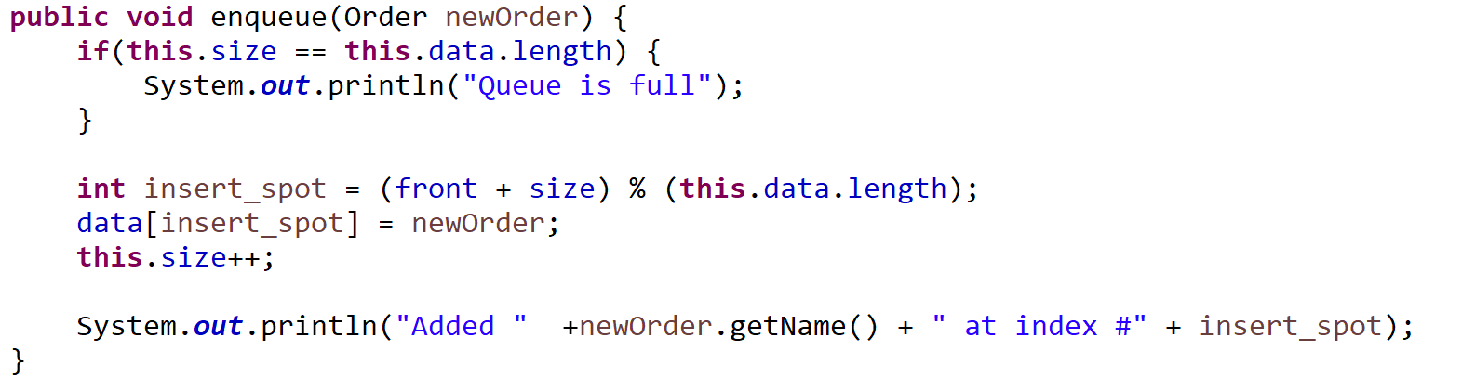
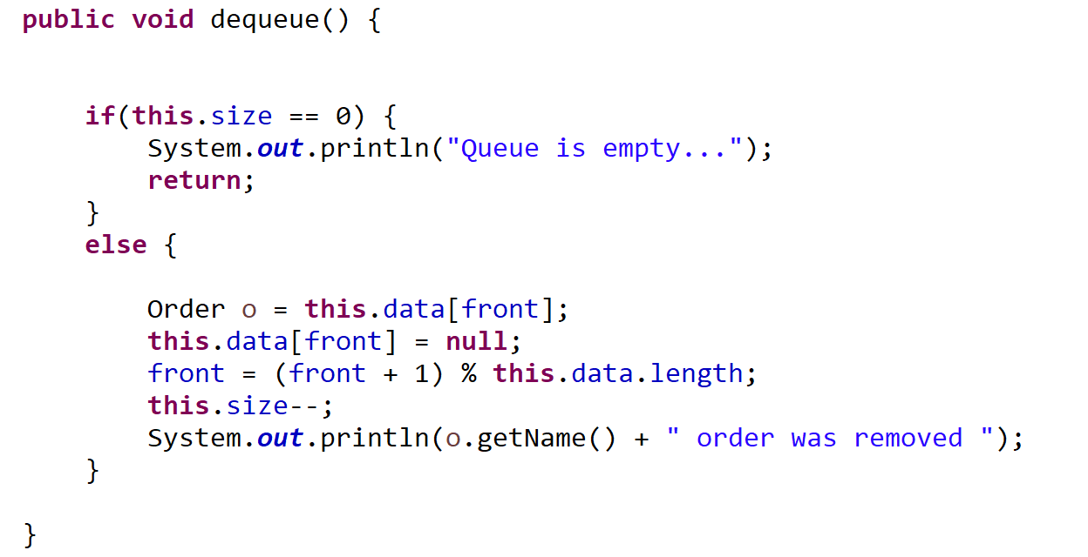

Slide 41
public void printQueue() {
int start = front;
int counter = 1;
int n = 0;
while( n != this.size ) {
System.out.println(counter + ". " + this.data[start].getName());
start = (start+1) % this.data.length;
counter++;
n++;
}
}
This method will print out the queue in the correct order (there is probably a better way to write this)
The while loop stops once we’ve printed all N elements in the queue

Slide 42
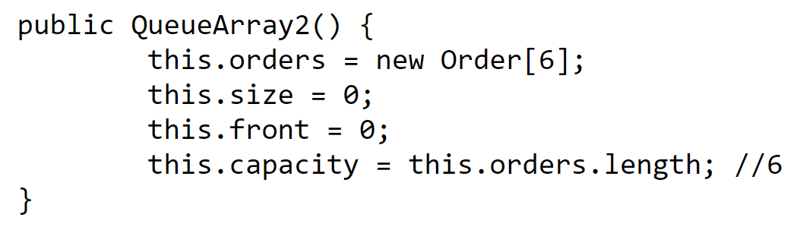
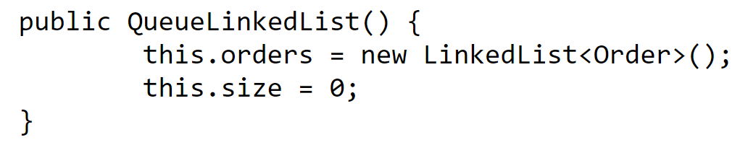
Queue Runtime Analysis
 | Linked List | Array
Creation
Enqueue
Dequeue
Peek
Print Queue

Slide 43
Queue Runtime Analysis
O(1)
O(n), n = | array |
 | Linked List | Array
Creation | O(1) | O(n)
Enqueue
Dequeue
Peek
Print Queue

Slide 44
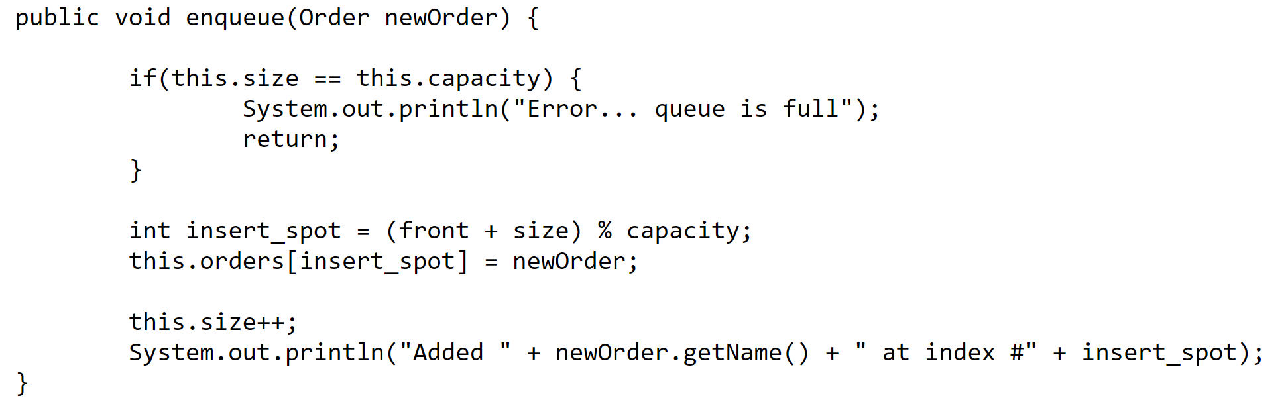
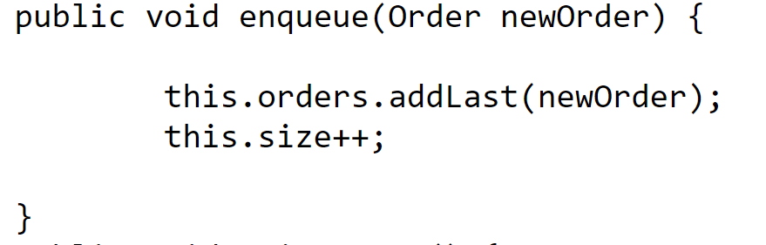
Queue Runtime Analysis
 | Linked List | Array
Creation | O(1) | O(n)
Enqueue
Dequeue
Peek
Print Queue

Slide 45
Queue Runtime Analysis
O(1)
O(1)
O(1)
O(1)
O(1)
O(1)
O(1)
O(1)
 | Linked List | Array
Creation | O(1) | O(n)
Enqueue | O(1) | O(1)
Dequeue
Peek
Print Queue

Slide 46
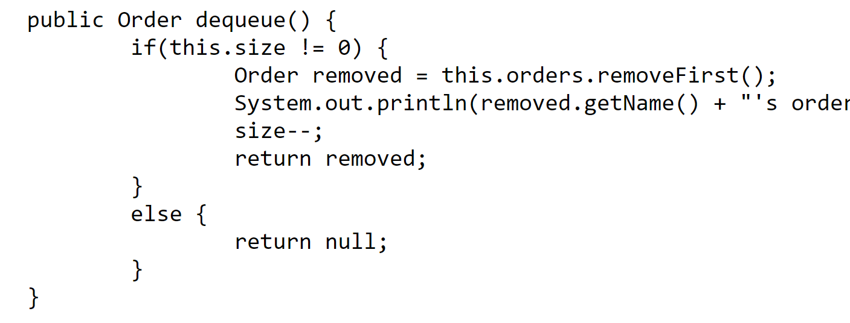
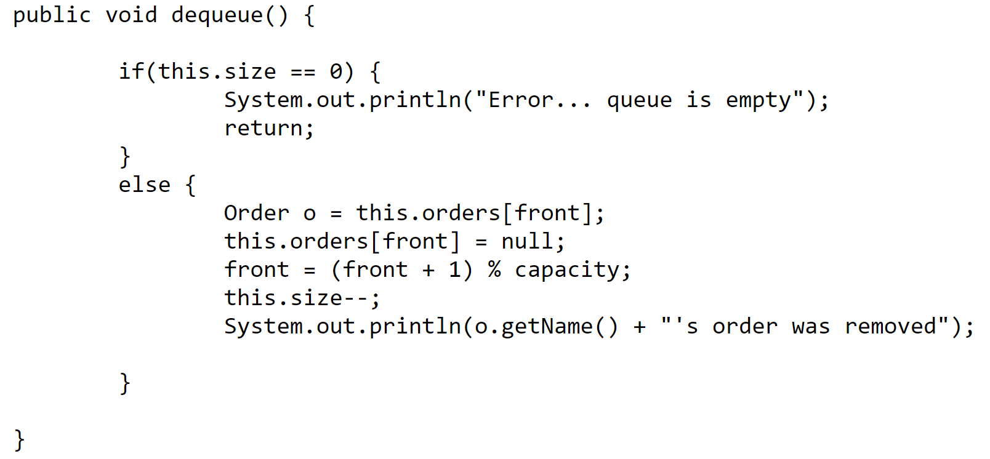
Queue Runtime Analysis
 | Linked List | Array
Creation | O(1) | O(n)
Enqueue | O(1) | O(1)
Dequeue
Peek
Print Queue

Slide 47
Queue Runtime Analysis
O(1)
O(1)
O(1)
O(1)
 | Linked List | Array
Creation | O(1) | O(n)
Enqueue | O(1) | O(1)
Dequeue | O(1) | O(1)
Peek
Print Queue

Slide 48
Queue Runtime Analysis
return this.orders.getFirst()
return this.orders[front]
 | Linked List | Array
Creation | O(1) | O(n)
Enqueue | O(1) | O(1)
Dequeue | O(1) | O(1)
Peek
Print Queue

Slide 49
Queue Runtime Analysis
return this.orders.getFirst()
O(1)
return this.orders[front]
O(1)
 | Linked List | Array
Creation | O(1) | O(n)
Enqueue | O(1) | O(1)
Dequeue | O(1) | O(1)
Peek | O(1) | O(1)
Print Queue

Slide 50
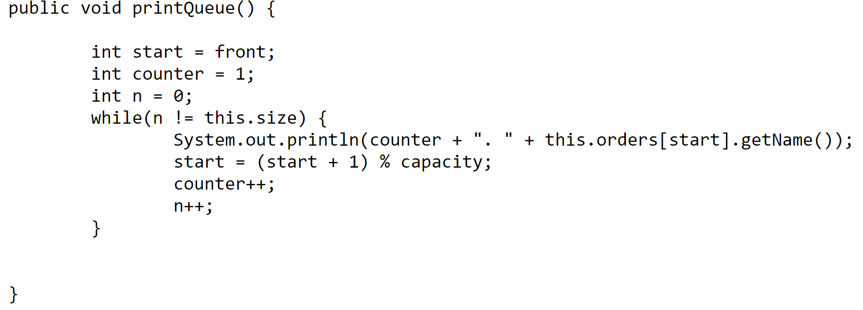
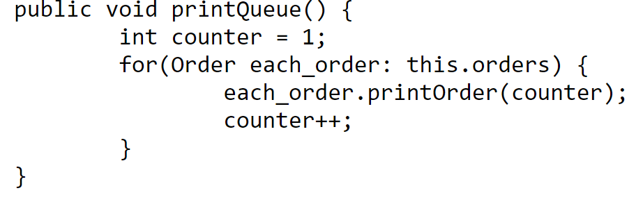
Queue Runtime Analysis
 | Linked List | Array
Creation | O(1) | O(n)
Enqueue | O(1) | O(1)
Dequeue | O(1) | O(1)
Peek | O(1) | O(1)
Print Queue

Slide 51
Queue Runtime Analysis
O(1)
O(1)
O(1)
O(1)
O(n)
O(n)
O(1)
O(1)
O(1)
n = # of elements in queue
n = # of elements in queue
 | Linked List | Array
Creation | O(1) | O(n)
Enqueue | O(1) | O(1)
Dequeue | O(1) | O(1)
Peek | O(1) | O(1)
Print Queue | O(n) | O(n)

Slide 52
Queue Runtime Analysis
 | Linked List | Array
Creation | O(1) | O(n)
Enqueue | O(1) | O(1)
Dequeue | O(1) | O(1)
Peek | O(1) | O(1)
Print Queue | O(n) | O(n)
Takeaway: Adding and removing elements from a queue runs in constant time ( O(1) )
(FIFO)
Stack Runtime Analysis
 | w/ Array | w/ Linked List
Creation | O(n) | O(1)
Push() | O(1) | O(1)
Pop() | O(1) | O(1)
peek() | O(1) | O(1)
Print() | O(n) | O(n)
Takeaway: Adding and removing elements from a stack runs in constant time ( O(1) )
(LIFO)

