Slide 1

CSCI 132: Basic Data Structures and Algorithms
Queues (Array Implementation)
Reese Pearsall
Spring 2023
https://www.cs.montana.edu/pearsall/classes/spring2023/132/main.html
*All images are stolen from the internet

Slide 2
Announcements
No class on Friday
Program 4 due Wednesday 4/19*
Monday’s lecture (4/10) will be asynchronous (don’t come to class)

Slide 3
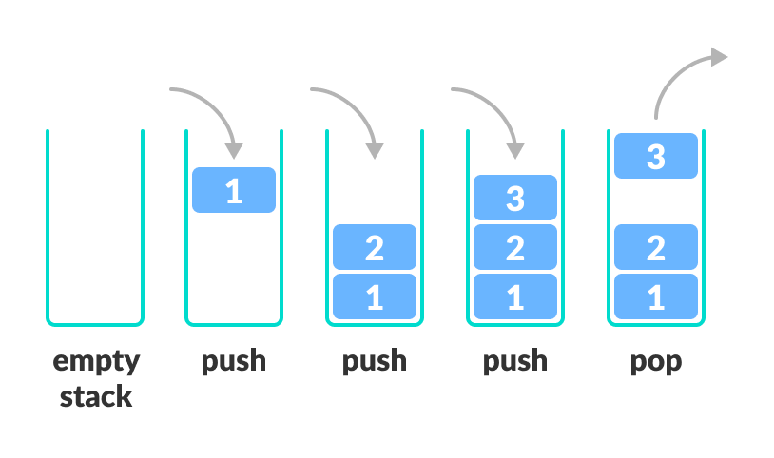
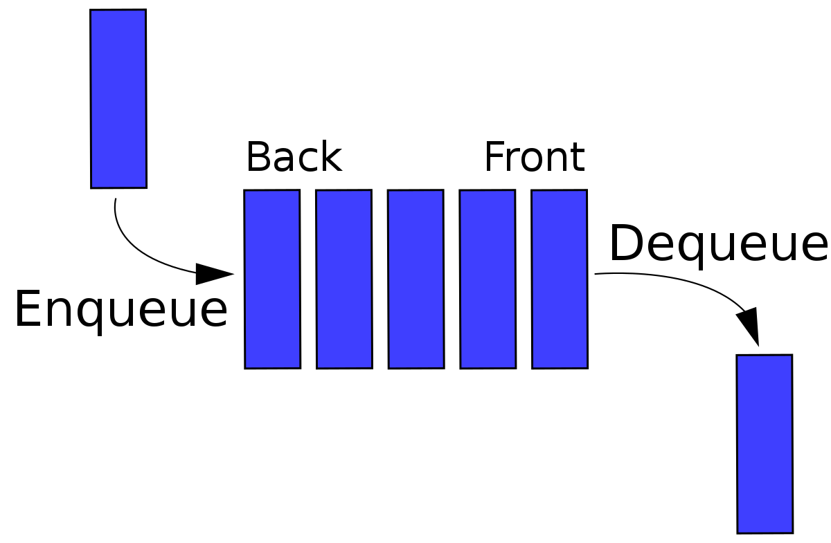
A Queue is a data structure that holds data, but operates in a First-in First-out (FIFO) fashion
A stack is a data structure that can hold data, and follows the last in first out (LIFO) principle
enqueue(), dequeue()
push(), pop()
We implemented both data structures using an Array or a Linked List

Slide 4
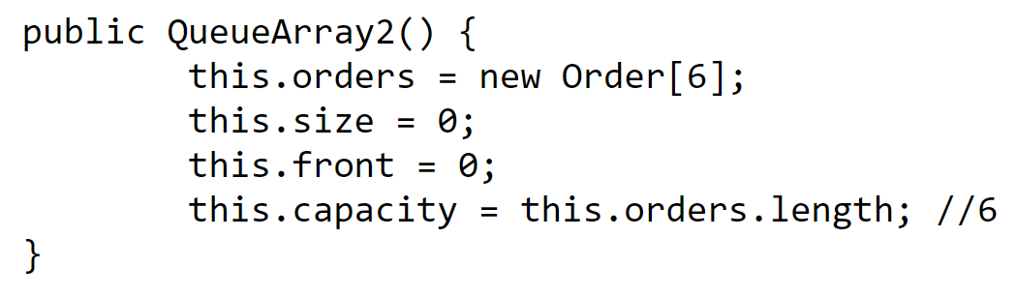
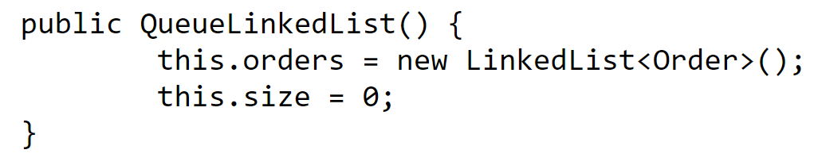
Queue Runtime Analysis
 | Linked List | Array
Creation
Enqueue
Dequeue
Peek
Print Queue

Slide 5
Queue Runtime Analysis
O(1)
O(n), n = | array |
 | Linked List | Array
Creation | O(1) | O(n)
Enqueue
Dequeue
Peek
Print Queue

Slide 6
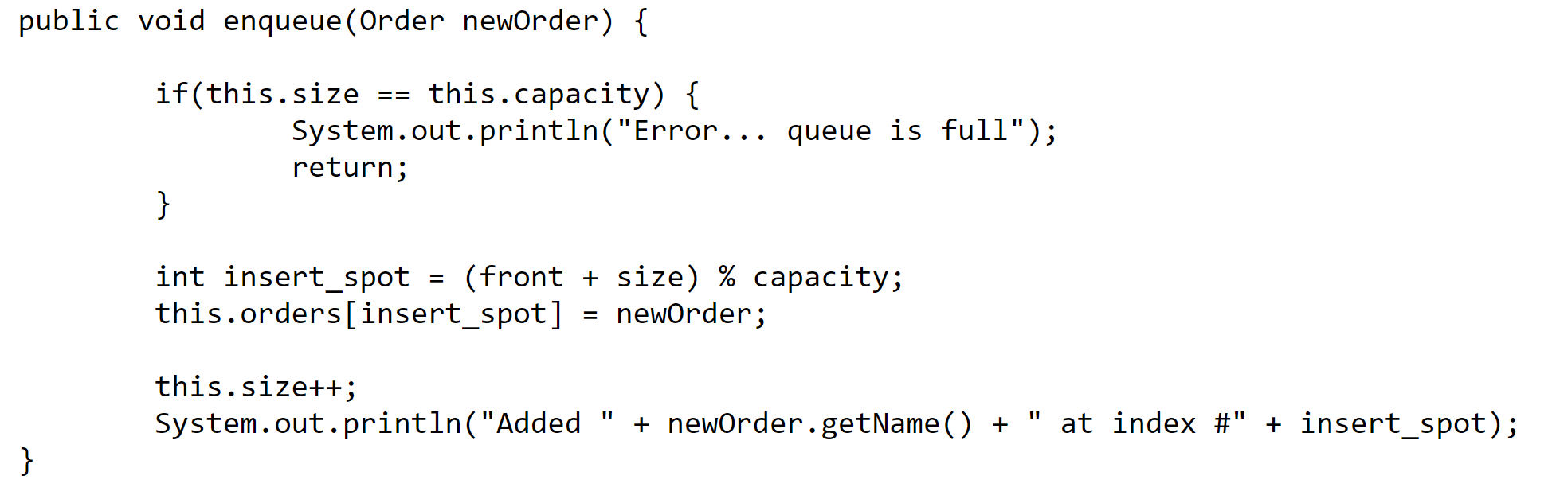
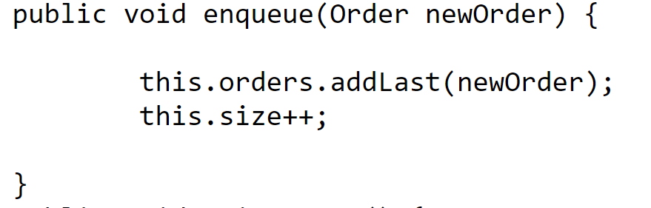
Queue Runtime Analysis
 | Linked List | Array
Creation | O(1) | O(n)
Enqueue
Dequeue
Peek
Print Queue

Slide 7
Queue Runtime Analysis
O(1)
O(1)
O(1)
O(1)
O(1)
O(1)
O(1)
O(1)
 | Linked List | Array
Creation | O(1) | O(n)
Enqueue | O(1) | O(1)
Dequeue
Peek
Print Queue

Slide 8
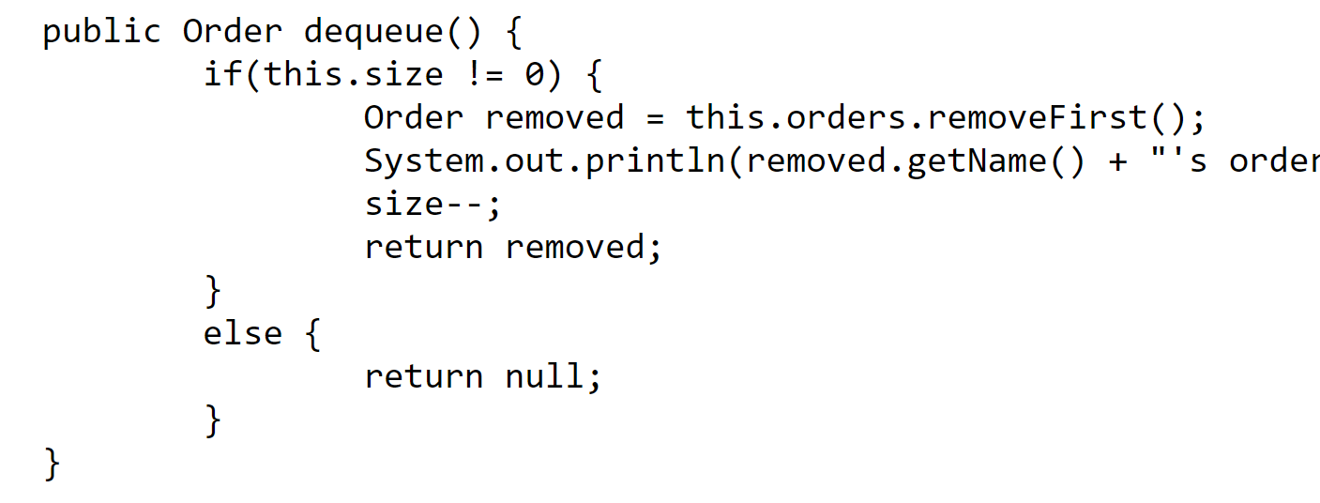
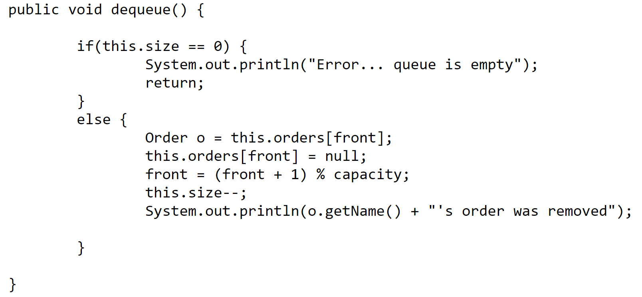
Queue Runtime Analysis
 | Linked List | Array
Creation | O(1) | O(n)
Enqueue | O(1) | O(1)
Dequeue
Peek
Print Queue

Slide 9
Queue Runtime Analysis
O(1)
O(1)
O(1)
O(1)
 | Linked List | Array
Creation | O(1) | O(n)
Enqueue | O(1) | O(1)
Dequeue | O(1) | O(1)
Peek
Print Queue

Slide 10
Queue Runtime Analysis
return this.orders.getFirst()
return this.orders[front]
 | Linked List | Array
Creation | O(1) | O(n)
Enqueue | O(1) | O(1)
Dequeue | O(1) | O(1)
Peek
Print Queue

Slide 11
Queue Runtime Analysis
return this.orders.getFirst()
O(1)
return this.orders[front]
O(1)
 | Linked List | Array
Creation | O(1) | O(n)
Enqueue | O(1) | O(1)
Dequeue | O(1) | O(1)
Peek | O(1) | O(1)
Print Queue

Slide 12
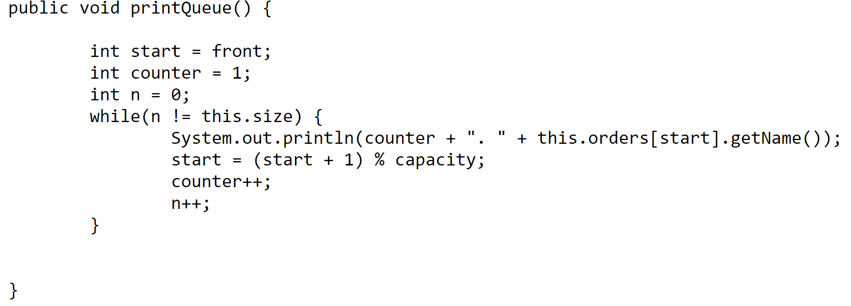
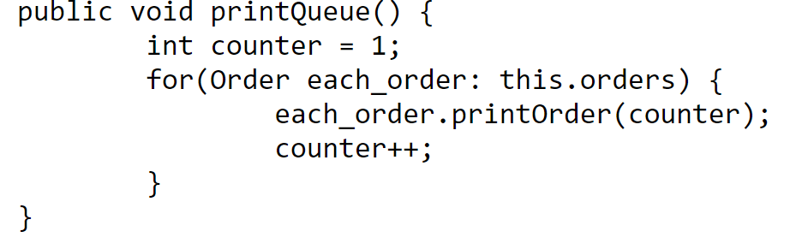
Queue Runtime Analysis
 | Linked List | Array
Creation | O(1) | O(n)
Enqueue | O(1) | O(1)
Dequeue | O(1) | O(1)
Peek | O(1) | O(1)
Print Queue

Slide 13
Queue Runtime Analysis
O(1)
O(1)
O(1)
O(1)
O(n)
O(n)
O(1)
O(1)
O(1)
n = # of elements in queue
n = # of elements in queue
 | Linked List | Array
Creation | O(1) | O(n)
Enqueue | O(1) | O(1)
Dequeue | O(1) | O(1)
Peek | O(1) | O(1)
Print Queue | O(n) | O(n)

Slide 14
Queue Runtime Analysis
 | Linked List | Array
Creation | O(1) | O(n)
Enqueue | O(1) | O(1)
Dequeue | O(1) | O(1)
Peek | O(1) | O(1)
Print Queue | O(n) | O(n)
Takeaway: Adding and removing elements from a queue runs in constant time ( O(1) )
(FIFO)
Stack Runtime Analysis
 | w/ Array | w/ Linked List
Creation | O(n) | O(1)
Push() | O(1) | O(1)
Pop() | O(1) | O(1)
peek() | O(1) | O(1)
Print() | O(n) | O(n)
Takeaway: Adding and removing elements from a stack runs in constant time ( O(1) )
(LIFO)

Slide 15
Queue Runtime Analysis
Which data structure should you use?
 | Linked List | Array
Creation | O(1) | O(n)
Enqueue | O(1) | O(1)
Dequeue | O(1) | O(1)
Peek | O(1) | O(1)
Print Queue | O(n) | O(n)
it depends
Stack Runtime Analysis
 | w/ Array | w/ Linked List
Creation | O(n) | O(1)
Push() | O(1) | O(1)
Pop() | O(1) | O(1)
peek() | O(1) | O(1)
Print() | O(n) | O(n)

Slide 16
Queue Runtime Analysis
Which data structure should you use?
 | Linked List | Array
Creation | O(1) | O(n)
Enqueue | O(1) | O(1)
Dequeue | O(1) | O(1)
Peek | O(1) | O(1)
Print Queue | O(n) | O(n)
it depends
Data structures always have tradeoffs.
With stacks and queues, the important thing to consider is the order of how you want your data to be read
Stack Runtime Analysis
 | w/ Array | w/ Linked List
Creation | O(n) | O(1)
Push() | O(1) | O(1)
Pop() | O(1) | O(1)
peek() | O(1) | O(1)
Print() | O(n) | O(n)
Stacks → LIFO
Queues → FIFO*

Slide 17
Queue Runtime Analysis
Applications of Queue Data Structures
Online waiting rooms
Operating System task scheduling
Web Server Request Handlers
Network Communication
CSCI 232 Algorithms
 | Linked List | Array
Creation | O(1) | O(n)
Enqueue | O(1) | O(1)
Dequeue | O(1) | O(1)
Peek | O(1) | O(1)
Print Queue | O(n) | O(n)
Stack Runtime Analysis
Applications of Stack Data Structures
Tracking function calls in programming
Web browser history
Undo/Redo buttons
Recursion/Backtracking
CSCI 232 Algorithms
 | w/ Array | w/ Linked List
Creation | O(n) | O(1)
Push() | O(1) | O(1)
Pop() | O(1) | O(1)
peek() | O(1) | O(1)
Print() | O(n) | O(n)

Slide 18
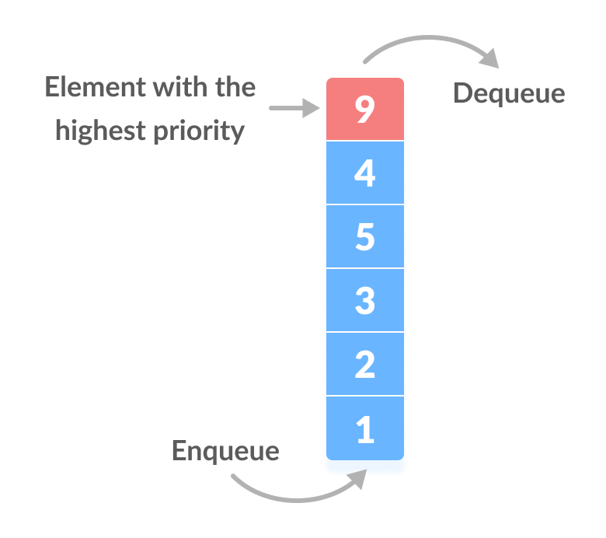
Most of the time, queues will operate in a FIFO fashion, however there may be times we want to dequeue the item with the highest priority
Priority queue in a data structure is an extension of a linear queue that possesses the following properties: Every element has a certain priority assigned to it
When we enqueue something, we might need to “shuffle” that item into the correct spot of the priority queue

Slide 19
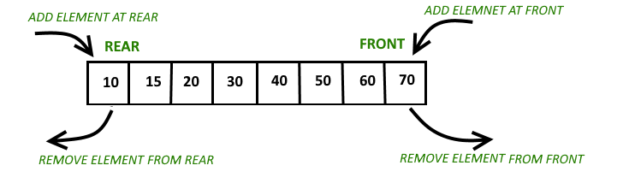
A double-ended queue, or a deque (deck) is a type of queue in which insertion and removal of elements can either be performed from the front or the rear

Slide 20
In the real world, when you want to use a Queue, Stack, Deque, or a Priority Queue, you will likely import this data structure
import.java.util.Stack
import.java.util.Queue
java.util.Queue is an interface. We cannot create a Queue object.
Instead, we create an instance of an object that implements this interface
Some of the Classes that implement the Queue interface:
PriorityQueue (java.util.PriorityQueue)
Linked List (java.util.LinkedList)
(If you need a FIFO queue, Linked List is the way to go…)

Slide 21
