Slide 1

CSCI 132: Basic Data Structures and Algorithms
Recursion (Part 1)
Reese Pearsall
Spring 2023
https://www.cs.montana.edu/pearsall/classes/spring2023/132/main.html
*All images are stolen from the internet

Slide 2
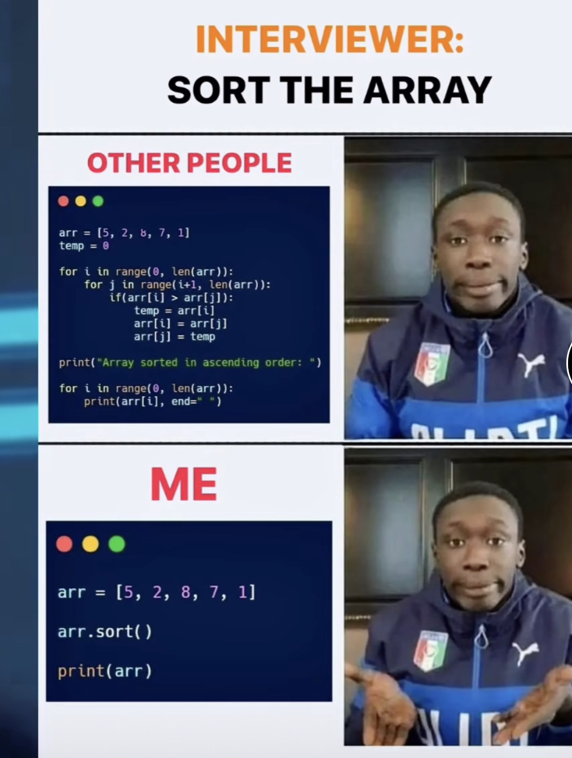
Announcements
Program 4 Due April 19th

Slide 3
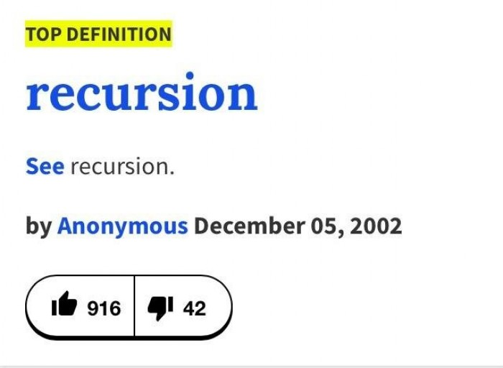
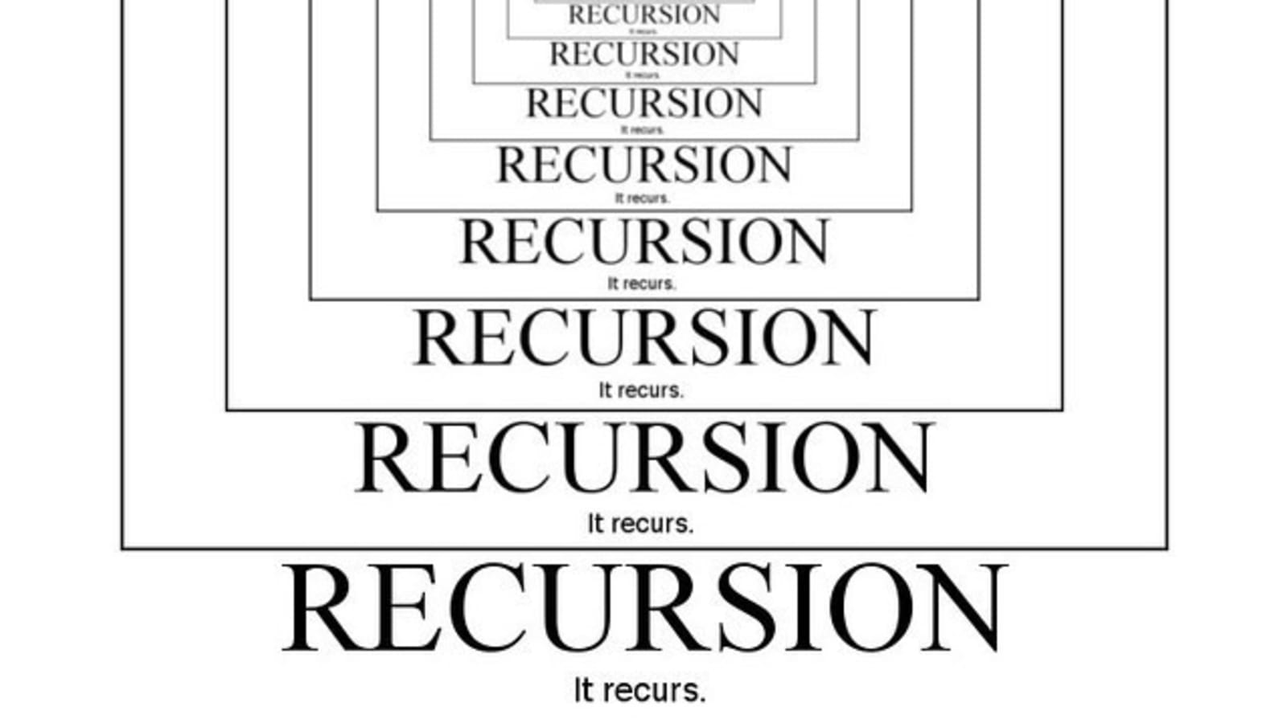
Recursion is a problem-solving technique that involves a method calling itself to solve some smaller problem
static int factorial(int n)
{
if (n == 0)
return 1;
return n * factorial(n - 1);
}

Slide 4
static int factorial(int n)
{
if (n == 0)
return 1;
return n * factorial(n - 1);
}
We can solve the factorial for n by solving smaller problems ( factorial of n-1 ) !
factorial(5)
factorial(4)
factorial(3)
factorial(2)
factorial(1)
factorial(0)

Slide 5
We can solve the factorial for n by solving smaller problems ( factorial of n-1 ) !
static int factorial(int n)
{
if (n == 0)
return 1;
return n * factorial(n - 1);
}
(base case)
(recursive case)
factorial(5)
factorial(4)
factorial(3)
Recursive solutions must have the two following conditions:
factorial(2)
Base Case
Recursive Case
factorial(1)
factorial(0)

Slide 6


We can solve the factorial for n by solving smaller problems ( factorial of n-1 ) !
static int factorial(int n)
{
if (n == 0)
return 1;
return n * factorial(n - 1);
}
(base case)
(recursive case)
120
factorial(5)
factorial(4)
24
6
factorial(3)
Recursive solutions must have the two following conditions:
factorial(2)
Base Case
Recursive Case
2
factorial(1)
1
factorial(0)
1

Slide 7
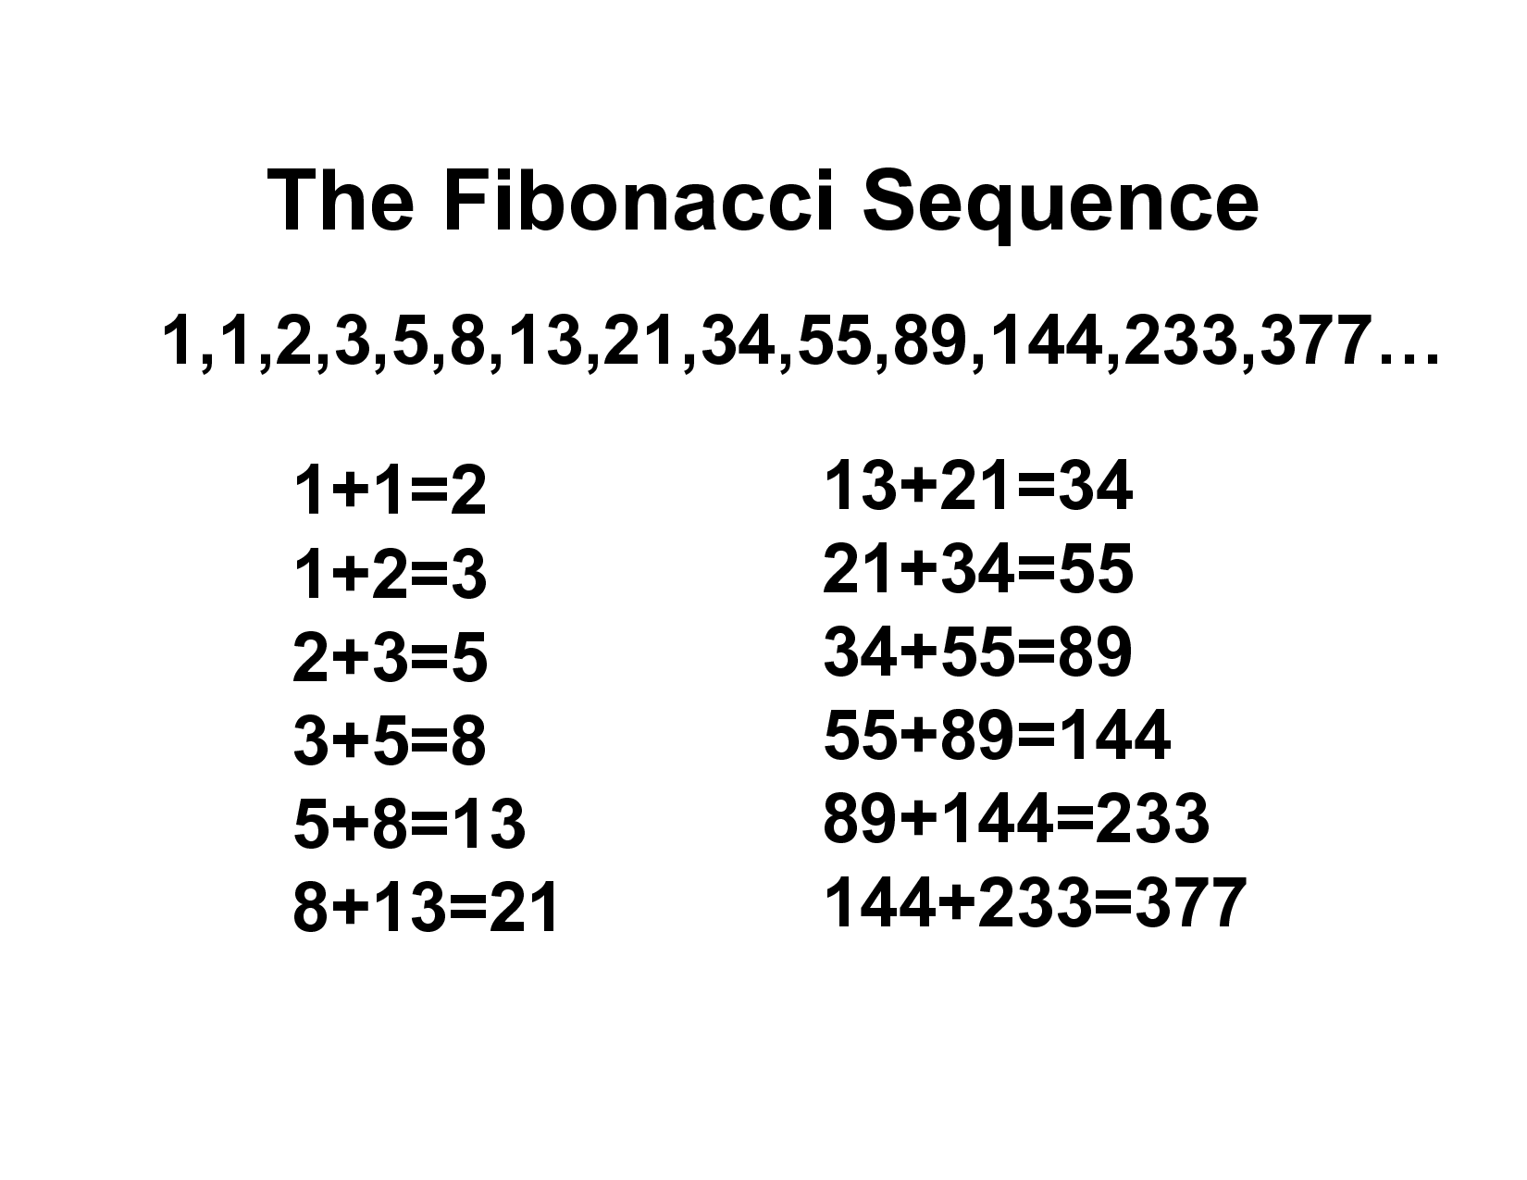
The Fibonacci sequence is a sequence in which each number is the sum of the two preceding ones
So, the N^{th} digit of the Fibonacci Sequence = f(N-1) + f(N-2)
Because the solution to some problem can be expressed in terms of some smaller problem(s), recursion may be a good fit here

Slide 8
The Fibonacci sequence is a sequence in which each number is the sum of the two preceding ones
So, the N^{th} digit of the Fibonacci Sequence = f(N-1) + f(N-2)
Base Case?
Recursive Case?
Calculate

Slide 9
The Fibonacci sequence is a sequence in which each number is the sum of the two preceding ones
So, the N^{th} digit of the Fibonacci Sequence = f(N-1) + f(N-2)
Base Case?
Recursive Case?
If finding the 1st or 2nd digit, return 1
Calculate the previous two digits, f(n-1), f(n-2)

Slide 10
The Fibonacci sequence is a sequence in which each number is the sum of the two preceding ones
So, the N^{th} digit of the Fibonacci Sequence = f(N-1) + f(N-2)
Base Case?
Recursive Case?
If finding the 1st or 2nd digit, return 1
Calculate the previous two digits, f(n-1), f(n-2)

Slide 11
fib(5)
private static int fib(int n) {
if(n == 1 || n == 2) {
return 1;
}
else {
return fib(n-1) + fib(n-2);
}
}

Slide 12
fib(5)
private static int fib(int n) {
if(n == 1 || n == 2) {
return 1;
}
else {
return fib(n-1) + fib(n-2);
}
}
fib(4)
+
fib(3)

Slide 13
Number of recursive calls = 8
fib(5)
private static int fib(int n) {
if(n == 1 || n == 2) {
return 1;
}
else {
return fib(n-1) + fib(n-2);
}
}
fib(4)
+
fib(3)
fib(3)
+
fib(2)
fib(2)
fib(1)
+
fib(2)
+
fib(1)

Slide 14
Number of recursive calls = 8
fib(5)
private static int fib(int n) {
if(n == 1 || n == 2) {
return 1;
}
else {
return fib(n-1) + fib(n-2);
}
}
fib(4)
+
fib(3)
fib(3)
+
1
1
1
+
1
+
1

Slide 15
Number of recursive calls = 8
fib(5)
private static int fib(int n) {
if(n == 1 || n == 2) {
return 1;
}
else {
return fib(n-1) + fib(n-2);
}
}
fib(4)
+
fib(3)
2
+
1
1
1
+

Slide 16
Number of recursive calls = 8
fib(5)
private static int fib(int n) {
if(n == 1 || n == 2) {
return 1;
}
else {
return fib(n-1) + fib(n-2);
}
}
3
2
+

Slide 17
Number of recursive calls = 8
5
private static int fib(int n) {
if(n == 1 || n == 2) {
return 1;
}
else {
return fib(n-1) + fib(n-2);
}
}
Final answer!

Slide 18
private static int fib(int n) {
if(n == 1 || n == 2) {
return 1;
}
else {
return fib(n-1) + fib(n-2);
}
}
Running Time?

Slide 19
private static int fib(int n) {
if(n == 1 || n == 2) {
return 1;
}
else {
return fib(n-1) + fib(n-2);
}
}
Running Time?
O(1)
O(1)
O(1) ?
O(1)
O(1)

Slide 20
private static int fib(int n) {
if(n == 1 || n == 2) {
return 1;
}
else {
return fib(n-1) + fib(n-2);
}
}
Running Time?
O(1)
O(1)
O(1) ?
O(1)
O(1)
No!
When we are analyzing recursive algorithms, we have to calculate running time slightly different

Slide 21
private static int fib(int n) {
if(n == 1 || n == 2) {
return 1;
}
else {
return fib(n-1) + fib(n-2);
}
}
Generally speaking, we can compute the running time of a recursive algorithm by using the following formula:
Running time = # of recursive calls made * amount of work done in each call

Slide 22
private static int fib(int n) {
if(n == 1 || n == 2) {
return 1;
}
else {
return fib(n-1) + fib(n-2);
}
}
O(1)
O(1)
O(1)
O(1)
Generally speaking, we can compute the running time of a recursive algorithm by using the following formula:
Running time = # of recursive calls made * amount of work done in each call
Running time = ??? * O(1)

Slide 23
Number of recursive calls = 8
fib(5)
private static int fib(int n) {
if(n == 1 || n == 2) {
return 1;
}
else {
return fib(n-1) + fib(n-2);
}
}
fib(4)
+
fib(3)
fib(3)
+
fib(2)
fib(2)
fib(1)
+
fib(2)
+
fib(1)

Slide 24
Number of recursive calls = 14
fib(6)
private static int fib(int n) {
if(n == 1 || n == 2) {
return 1;
}
else {
return fib(n-1) + fib(n-2);
}
}
fib(5)
fib(4)
fib(4)
fib(3)
fib(3)
fib(2)
fib(2)
fib(1)
fib(3)
fib(2)
fib(2)
fib(1)
fib(2)
fib(1)

Slide 25
Number of recursive calls = 24
private static int fib(int n) {
if(n == 1 || n == 2) {
return 1;
}
else {
return fib(n-1) + fib(n-2);
}
}
fib(7)
fib(6)
fib(5)
fib(5)
fib(4)
fib(4)
fib(3)
fib(4)
fib(3)
fib(3)
fib(2)
fib(3)
fib(2)
fib(2)
fib(1)
fib(2)
fib(1)
fib(3)
fib(2)
fib(2)
fib(1)
fib(2)
fib(1)
fib(2)
fib(1)

Slide 26

private static int fib(int n) {
if(n == 1 || n == 2) {
return 1;
}
else {
return fib(n-1) + fib(n-2);
}
}
If we were to plot the number of recursive calls made as n increases, it would look something like his:
Exponential
Recursive Calls
Aka. O(2^{n})
N (input to program)

Slide 27
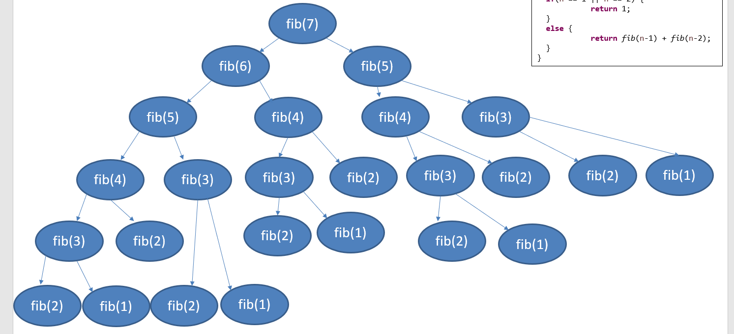
private static int fib(int n) {
if(n == 1 || n == 2) {
return 1;
}
else {
return fib(n-1) + fib(n-2);
}
}
O(2^{n})
O(1)
O(1)
O(1)
O(1)
Generally speaking, we can compute the running time of a recursive algorithm by using the following formula:
Running time = # of recursive calls made * amount of work done in each call
Running time = O(2^{n}) * O(1)
Total running time = O(2^{n})
n = requested Fibonacci digit
O(2^{n}) is very bad…

Slide 28
Number of recursive calls = 24
private static int fib(int n) {
if(n == 1 || n == 2) {
return 1;
}
else {
return fib(n-1) + fib(n-2);
}
}
fib(7)
fib(6)
fib(5)
fib(5)
fib(4)
fib(4)
fib(3)
fib(4)
fib(3)
fib(3)
fib(2)
fib(3)
fib(2)
fib(2)
fib(1)
fib(2)
fib(1)
fib(3)
fib(2)
fib(2)
fib(1)
fib(2)
fib(1)
fib(2)
fib(1)
Any ideas for how to improve this algorithm?

Slide 29
Number of recursive calls = 24
private static int fib(int n) {
if(n == 1 || n == 2) {
return 1;
}
else {
return fib(n-1) + fib(n-2);
}
}
fib(7)
fib(6)
fib(5)
fib(5)
fib(4)
fib(4)
fib(3)
fib(4)
fib(3)
fib(3)
fib(2)
fib(3)
fib(2)
fib(2)
fib(1)
fib(2)
fib(1)
fib(3)
fib(2)
fib(2)
fib(1)
fib(2)
fib(1)
fib(2)
fib(1)
There is a lot of overlap…

Slide 30
Number of recursive calls = 24
private static int fib(int n) {
if(n == 1 || n == 2) {
return 1;
}
else {
return fib(n-1) + fib(n-2);
}
}
fib(7)
fib(1) | 1
fib(2) | 1
fib(3) | 3
fib(4) | …
fib(5) | …
fib(6)
fib(5)
fib(5)
fib(4)
fib(4)
fib(3)
fib(4)
fib(3)
fib(3)
fib(2)
fib(3)
fib(2)
fib(2)
fib(1)
fib(2)
fib(1)
fib(3)
fib(2)
fib(2)
fib(1)
fib(2)
fib(2)
fib(1)
Solution: Introduce a data structure to store Fibonacci digits in that we can reference later on (memoization)
fib(1)
(These lookups happen in constant time!)

Slide 31
Limitations of recursion?

Slide 32
Bubble Sorting Recursively
2 | 5 | 1 | 3 | 4
Bubble sort can be solved be solving smaller instances of bubble sort!
2 | 1 | 3 | 4 | 5
Base Case:
If the unsorted portion of the array is of size 1, return current array
Recursive Case:
Do one iteration of bubble sort, recursively call method and pass smaller array
1 | 2 | 3 | 4 | 5
1 | 2 | 3 | 4 | 5
1 | 2 | 3 | 4 | 5

Slide 33
static void bubbleSort(int arr[], int n)
{
// Base case
if (n == 1)
return;
int count = 0;
for (int i=0; i<n-1; i++)
if (arr[i] > arr[i+1])
{
// swap
int temp = arr[i];
arr[i] = arr[i+1];
arr[i+1] = temp;
count = count+1;
}
if (count == 0)
return;
bubbleSort(arr, n-1);
}
Recursive case

