Slide 1

CSCI 476: Computer Security
Network Security: Packet Sniffing and Spoofing
Reese Pearsall
Spring 2023
https://www.cs.montana.edu/pearsall/classes/spring2023/476/main.html

Slide 2
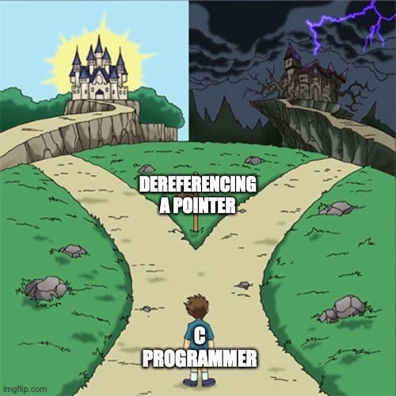
Announcement
Lab 5 (XSS) Due Sunday 3/26 @ 11:59 PM

Slide 3
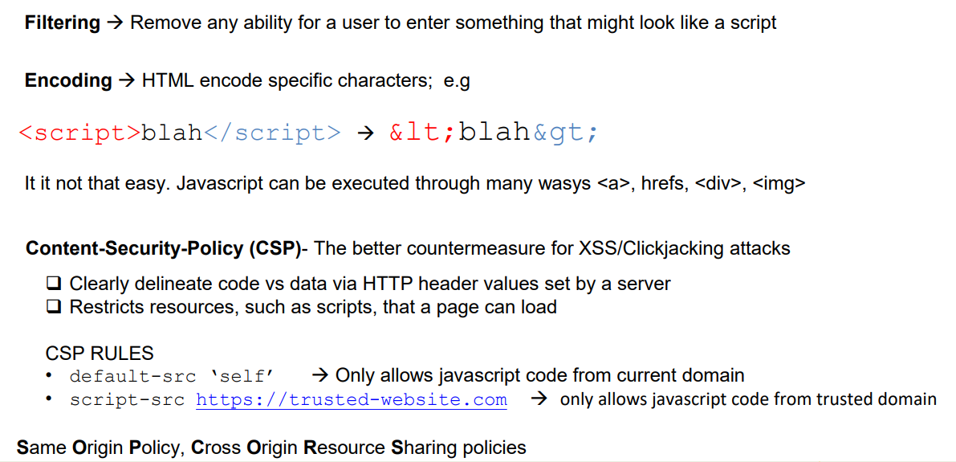
XSS Countermeasures

Slide 4

Router
SRC
HTPP Request
GET WWW.BLAH.COM
Headers
Body
Sending our packet to a destination is not a simple task
DST

Slide 5
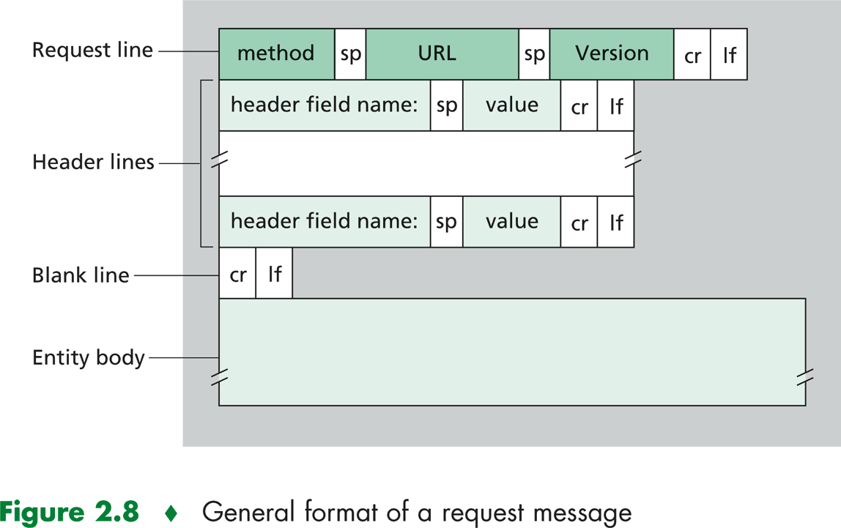
There is a lot of stuff that gets added onto our data being send
HTPP Request
GET WWW.BLAH.COM
Headers
Body
“User Data”

Slide 6

There are a few pieces of information a packet needs in order to arrive to its destination
HTPP Request
GET WWW.BLAH.COM
Headers
Body

Slide 7



There are a few pieces of information a packet needs in order to arrive to its destination
HTPP Request
GET WWW.BLAH.COM
Headers
Body
A packet arriving to a machine needs to know which process/application to go to

Slide 8


There are a few pieces of information a packet needs in order to arrive to its destination
HTPP Request
GET WWW.BLAH.COM
Headers
Port 802
Port 222
Port 6001
Body
Each application is bound to a port, so each packet will need to know what port they need to go to

Slide 9



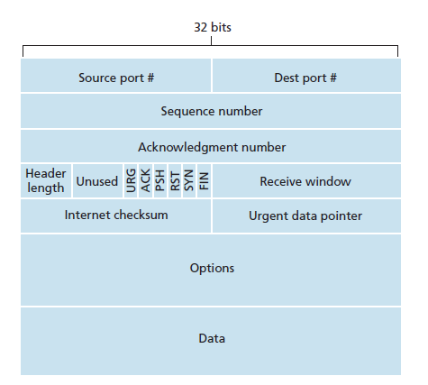


TCP is a transport-layer protocol that ensures data gets delivered, and controls how the two endpoints communicate with each other
GET WWW.BLAH.COM
Port 80
Port 222
Port 6001
Headers
HTPP Request
Body
TCP Header
Our packet of information gets wrapped in a TCP Header
Ensures that data gets delivered reliably (Seq/Ack #s)
Ensures data gets delivered to the correct process (Port #s)

Slide 10
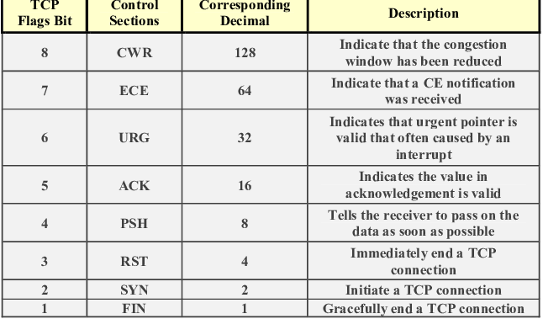
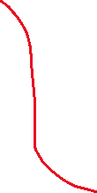


TCP is a transport-layer protocol that ensures data gets delivered, and controls how the two endpoints communicate with each other
GET WWW.BLAH.COM
Port 80
Port 222
Port 6001
Headers
HTPP Request
Body
TCP Header
Our packet of information gets wrapped in a TCP Header
Ensures that data gets delivered reliably (Seq/Ack #s)
Ensures data gets delivered to the correct process (Port #s)

Slide 11
Our packet currently has
Some application-level message (HTTP Request)
Port number of that application process (TCP header)
Mechanism to ensure our packet arrives correctly (TCP Header)
GET WWW.BLAH.COM
Headers
HTPP Request
Body
TCP Header

Slide 12
Our packet currently has
Some application-level message (HTTP Request)
Port number of that application process (TCP header)
Mechanism to ensure our packet arrives correctly (TCP Header)
GET WWW.BLAH.COM
Headers
HTPP Request
Body
Applications will either user TCP or UDP to send their data. UDP adds on port #s just like TCP, but does not ensure reliable delivery
UDP Header
HTTP/HTTPS uses TCP, DNS protocol uses UDP

Slide 13









Our packet currently has
Some application-level message (HTTP Request)
Port number of that application process (TCP header)
Mechanism to ensure our packet arrives correctly (TCP Header)
We also need to know which device to send to → IP Address
GET WWW.BLAH.COM
Headers
HTPP Request
Body
TCP Header
10.9.0.5
Think of the internet as a bunch of islands. The IP address helps us locate the correct island to send the packet to
(Routers look at the IP address to determine where to forward the packet to)
(IP address is more important for locating a machine rather than identifying a machine)

Slide 14
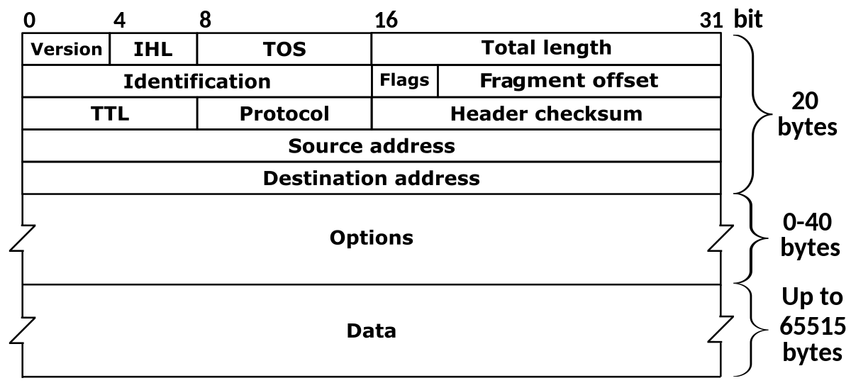




Our packet currently has
Some application-level message (HTTP Request)
Port number of that application process (TCP header)
Mechanism to ensure our packet arrives correctly (TCP Header)
A way to locate the computer (IP address/IP Header)
GET WWW.BLAH.COM
To add an IP address to our packet, we add another header, called the IP Header
Headers
HTPP Request
Body
TCP Header
IP Header
There are two types of IP addresses: IPv4 (32 bits) and IPv6 (128 bits), we use IPv4 in this class ☺

Slide 15


Our packet currently has
Some application-level message (HTTP Request)
Port number of that application process (TCP header)
Mechanism to ensure our packet arrives correctly (TCP Header)
A way to locate the computer (IP address/IP Header)
GET WWW.BLAH.COM
To add an IP address to our packet, we add another header, called the IP Header
Headers
HTPP Request
Body
TCP Header
IP Header
IP Addresses are dynamic (generally), can be public/private, and can sometimes be shared between multiple devices

Slide 16
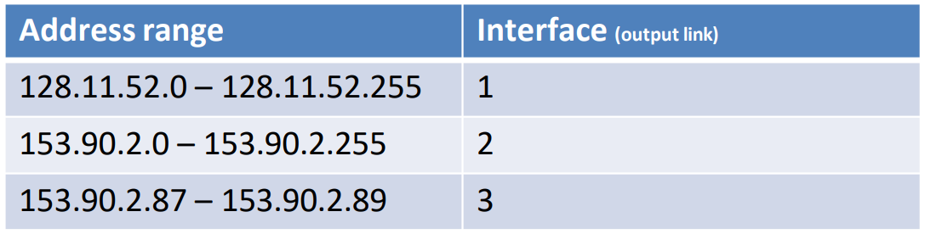







Our packet currently has
Some application-level message (HTTP Request)
Port number of that application process (TCP header)
Mechanism to ensure our packet arrives correctly (TCP Header)
A way to locate the computer (IP address/IP Header)
GET WWW.BLAH.COM
Headers
Routers maintain a table that will forward a packet to the next router based on the packet’s destination IP address*
HTPP Request
Body
TCP Header
IP Header
10.9.0.5

Slide 17


Our packet currently has
Some application-level message (HTTP Request)
Port number of that application process (TCP header)
Mechanism to ensure our packet arrives correctly (TCP Header)
A way to locate the computer (IP address/IP Header)
GET WWW.BLAH.COM
Headers
HTPP Request
A packet may arrive to a network, but there is likely many devices under one network
Body
10.9.0.1
We now need a unique identifier to find the destination device on this local network
TCP Header
10.9.0.2
IP Header
Devices in a subnet share a common prefix for their IP addresses
10.9.0.3
10.9.0.4

Slide 18


Our packet currently has
Some application-level message (HTTP Request)
Port number of that application process (TCP header)
Mechanism to ensure our packet arrives correctly (TCP Header)
A way to locate the computer (IP address/IP Header)
GET WWW.BLAH.COM
Headers
HTPP Request
A packet may arrive to a network, but there is likely many devices under one network
Body
10.9.0.1
We now need a unique identifier to find the destination device on this local network
TCP Header
10.9.0.2
IP Header
A MAC address is a unique, hard-coded value given to each device connected to a network
Devices in a subnet share a common prefix for their IP addresses
10.9.0.3
10.9.0.4
(Additionally, there might be times computers communicate without IP address)

Slide 19
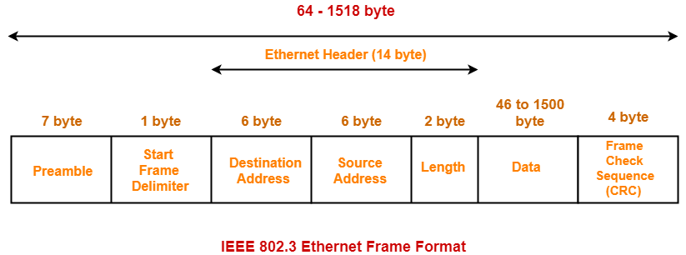

Our packet currently has
Some application-level message (HTTP Request)
Port number of that application process (TCP header)
Mechanism to ensure our packet arrives correctly (TCP Header)
A way to locate the computer (IP address/IP Header)
A unique identifier for our destination (MAC Address/Frame)
GET WWW.BLAH.COM
Headers
To add the MAC Address to our packet, we wrap our packet in an ethernet frame (usually)
HTPP Request
Body
TCP Header
IP Header
Ethernet Frame
(We have protocols that can map IP Address → Mac Address)

Slide 20


Our packet currently has
Some application-level message (HTTP Request)
Port number of that application process (TCP header)
Mechanism to ensure our packet arrives correctly (TCP Header)
A way to locate the computer (IP address/IP Header)
A unique identifier for our destination (MAC Address/Frame)
GET WWW.BLAH.COM
Headers
HTPP Request
Body
Our final packet!
TCP Header
IP Header
Our initially packet gets encapsulated multiple times, sort of like a nesting doll!
Ethernet Frame

Slide 21
(Jump scare warning for CSCI 466 people)

Slide 22
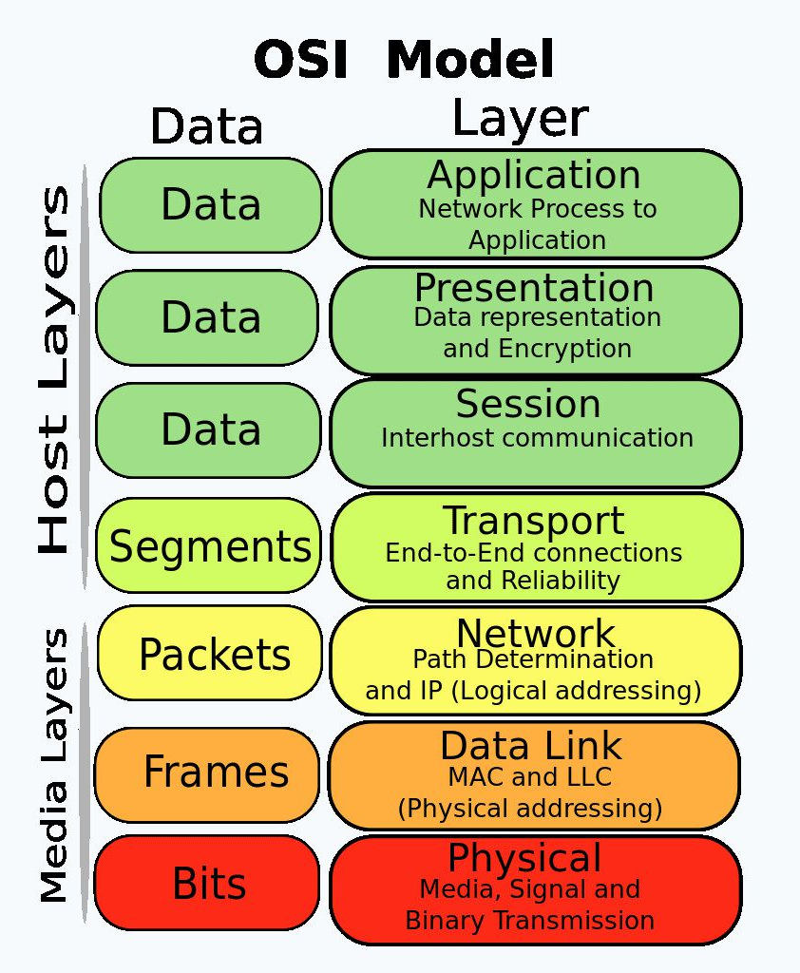
The Journey of a packet
Packets are encapsulated in various protocol layers; each has a header and payload
HTTP Request
(Encryption, Authentication, Management, HTTPS)
The OSI Model is a very popular internet stack model that describes the layers of the internet, and the different responsibilities of each layer
TCP Header
IP Header
Ethernet Frame

Slide 23
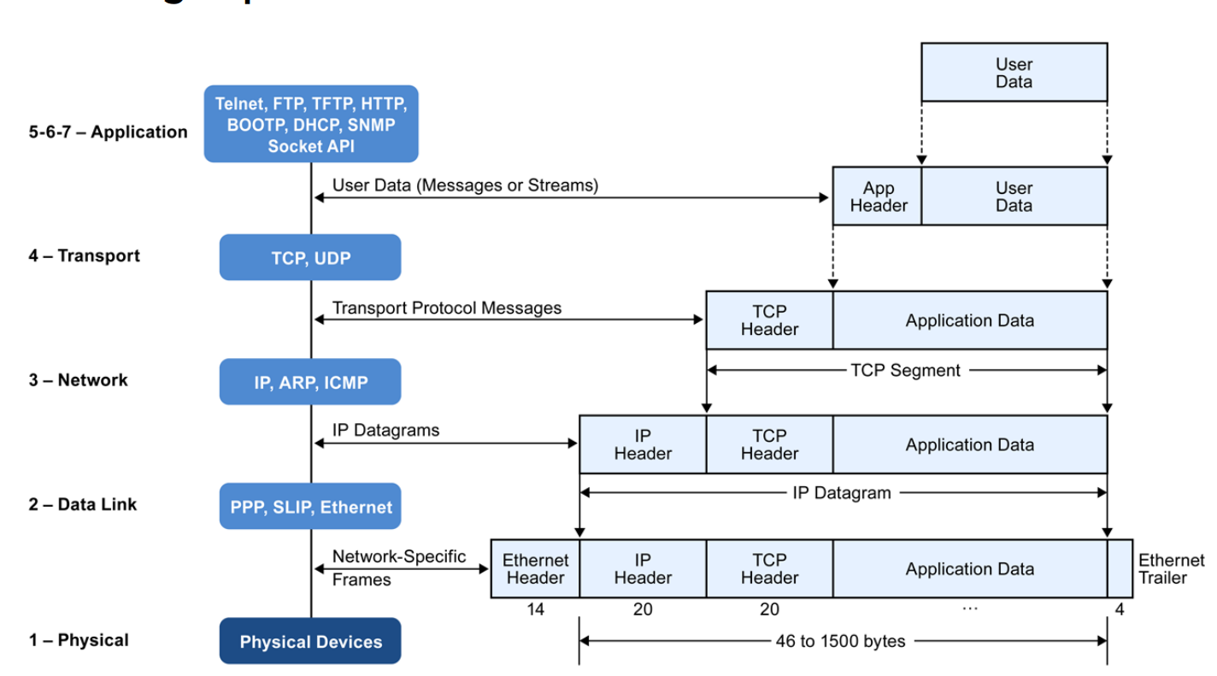






The Journey of a packet
Packets are encapsulated in various protocol layers; each has a header and payload
Our focus in the next few weeks will be on the transport layer (TCP/UDP), network layer (IP), and application layer

Slide 24
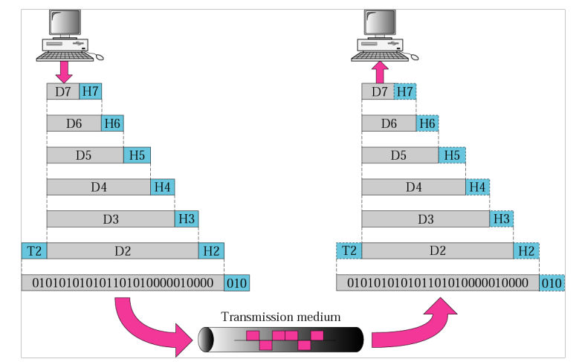




WIFI, Fiber optic, Copper Wire, Birds
** Many devices are sharing this medium

Slide 25
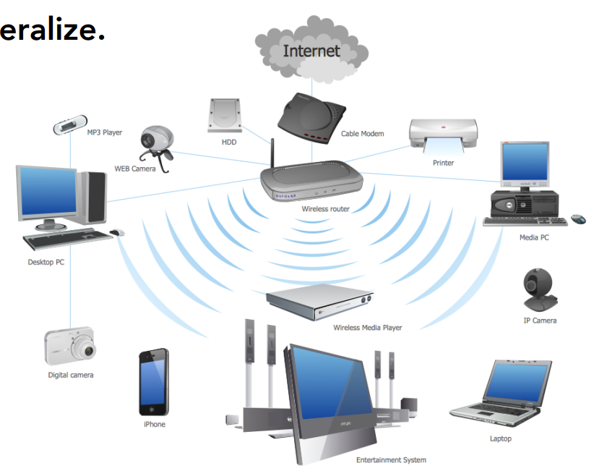
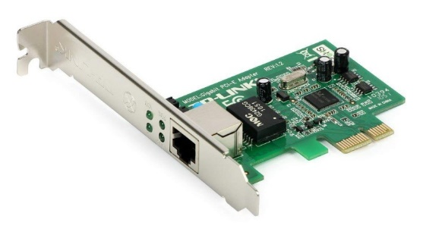
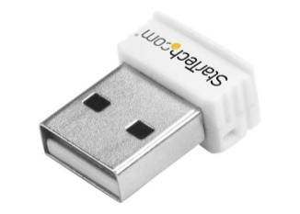
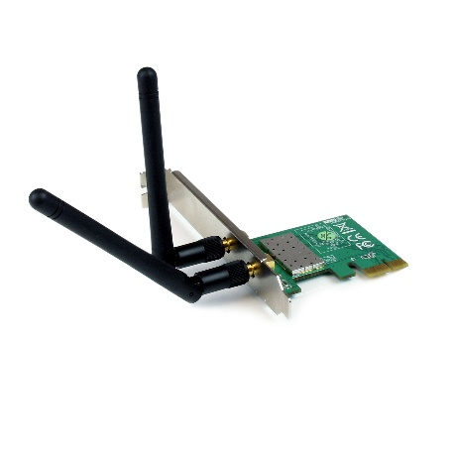
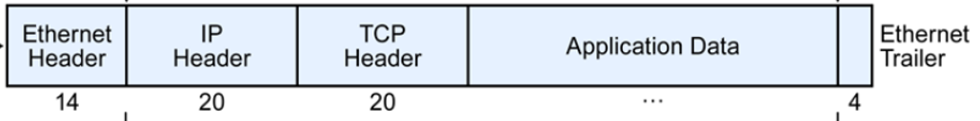


Devices connect to a network via a Network Interface Card (NIC)
25-6B-78-1D-A0-57
Each NIC as a Medium Access Control (MAC) address
Every NIC “hears” all the frames “on the wire” (or “in the air”)
NIC checks destination (dst) address of the packet’s link layer header
Accept packets that match the NIC’s MAC address, “drop” other packets
25-6B-78-1D-A0-57
41-91-31-CB-F0-BD

Slide 26
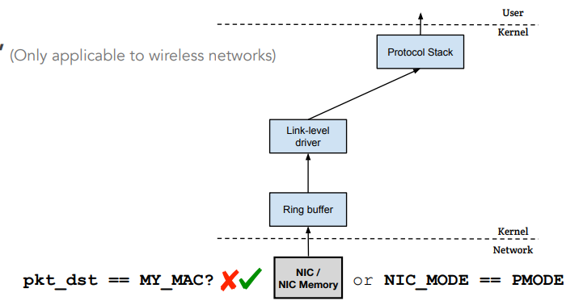

How do we get all the network traffic?
Promiscuous Mode
• Frames that are not destined to a given NIC are normally discarded
• When operating in promiscuous mode, the NIC passes every frame received from the network to the kernel
• If a sniffer program is registered with the kernel, it will be able to see all the packets
There are tons of packets. We don’t need all of them…
The interesting ones are TCP, UDP, DNS, HTTPS
Lets start “sniffing” for packets!
We can write a python program that will sniff packets for us!

Slide 27
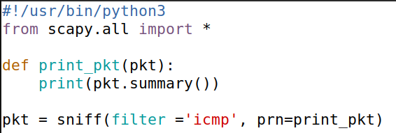




Packet Sniffing (Python)
scapy is a python module designed for packet sniffing and spoofing
sniffer.py
When a matching packet is caught, run the print_pkt function
Sniff only icmp packets
Scapy uses Berkeley Packet Filter (BPF) syntax to filter packets

Slide 28
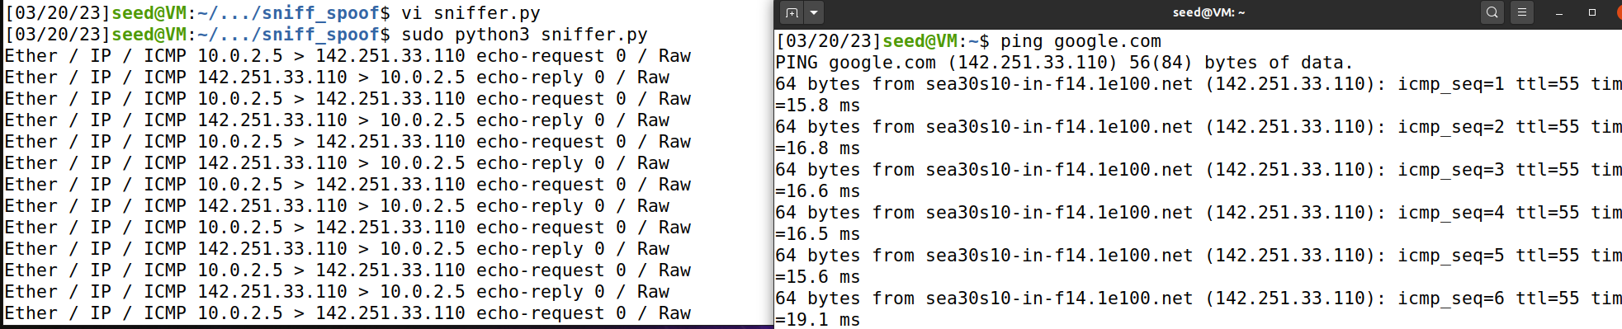



Packet Sniffing (Python)
1. Start the sniffer program
2. In another terminal, start generating ICMP packets
We can see all the packets being sent in the ping request

Slide 29
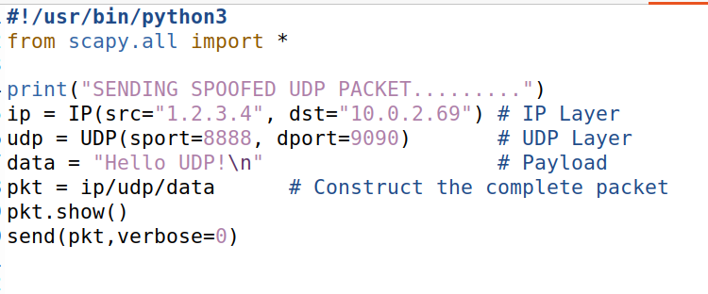
We can write a program that will craft and send out packets that we create
We can modify
Src/dst IP address
Port #s
TCP Header information
1
2
1
We can set the packets source IP and destination IP
Souce ip: 1.2.3.4 (bogus)
Destination IP: 10.0.2.69 (also bogus)
We can set the packets source port and destination port (udp)
2
Source port: 8888 (bogus)
Destination port: 9090 (also bogus)

Slide 30
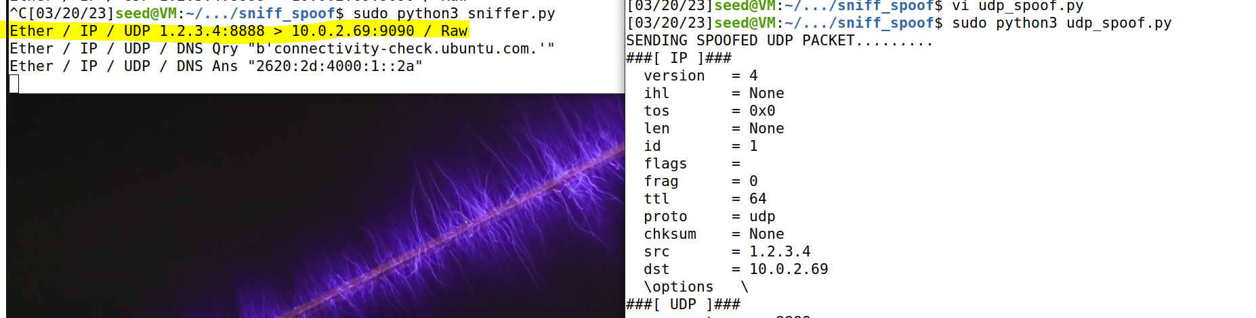

Slide 31
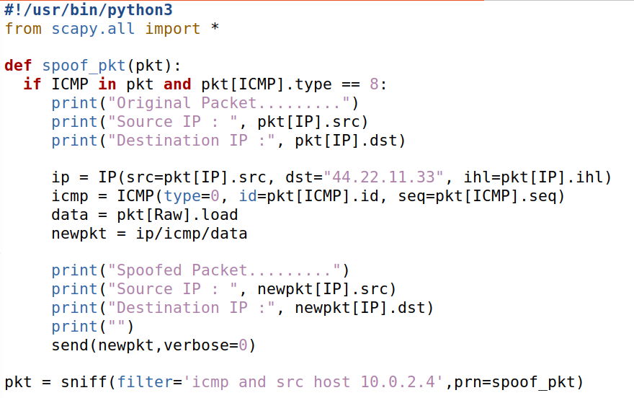
1
Sniff/listen for ICMP packets coming from 10.0.2.4
2
When we intercept an ICMP packet, extract the packets source IP, and then create a spoofed packet
44.22.11.33 will receive a packet from 10.0.2.4
We can sniff for packets, and then spoof packets using the sniffed information!
icmp_sniff_spoof.py
2
1

Slide 32

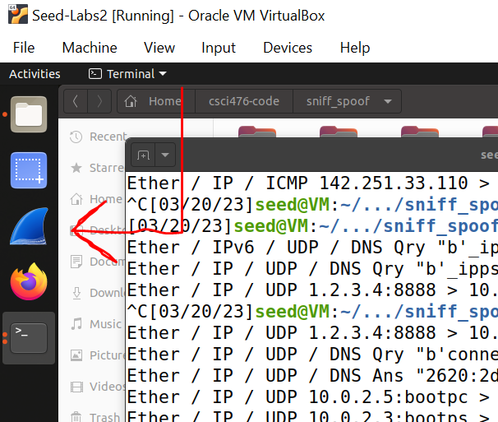
Wireshark is a very popular network analysis tool that allows you to analyze and view network traffic
We will use Wireshark to sniff packets instead of Python ☺
And it’s installed on your VM!!

Slide 33
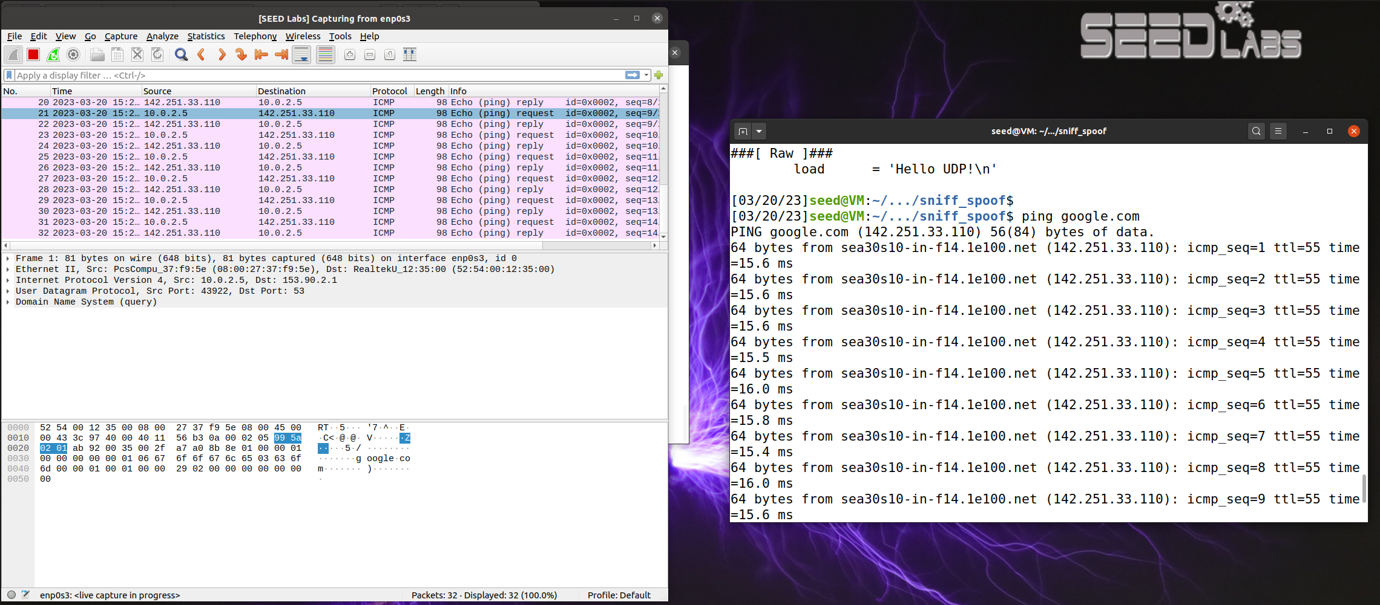
Sniffing packets using Wireshark

Slide 34
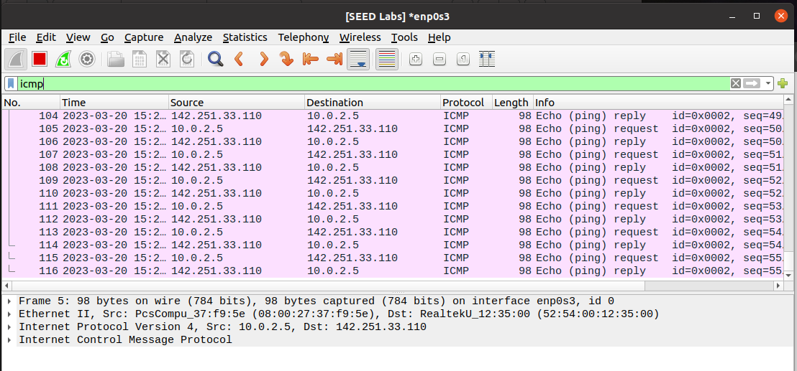
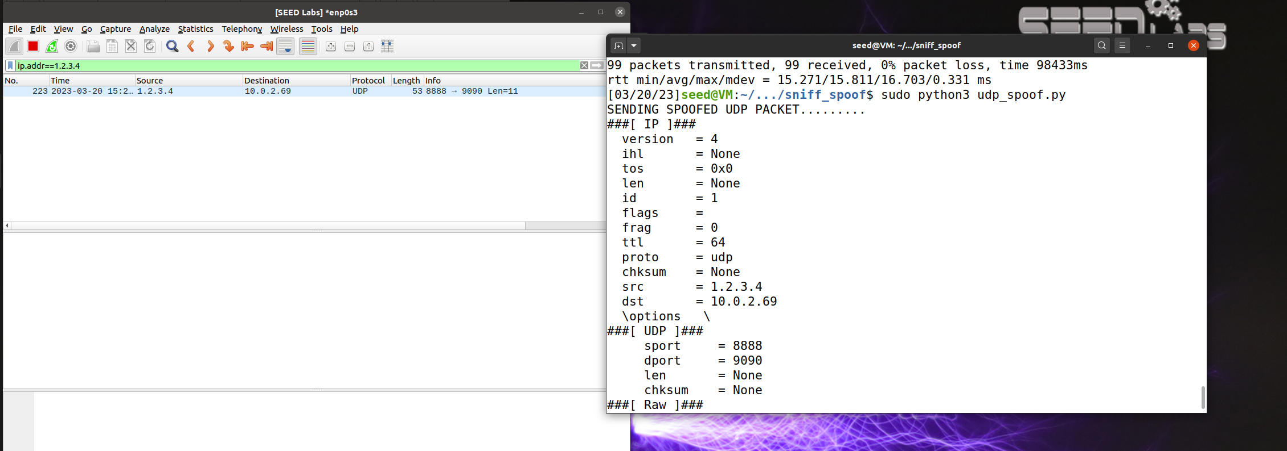
Sniffing packets using Wireshark
We can apply filters in Wireshark to sniff for certain packers
Show only ICMP packets
Show packets going to/coming from a certain IP address
Spoof
Sniff

