Slide 1

CSCI 476: Computer Security
Asymmetric Cryptography
Reese Pearsall
Fall 2022
https://www.cs.montana.edu/pearsall/classes/fall2022/476/main.html

Slide 2
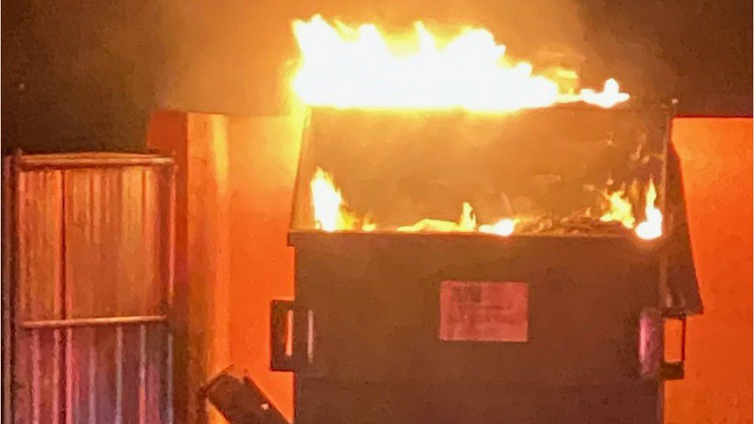
Announcement
Lab 9 Due Sunday December 4th
Lab 10 Due Sunday December 11th
Will post a final exam study guide on Thursday
Grading ???
Next Tuesday will be a project workday
Thursday’s class ???

Slide 3
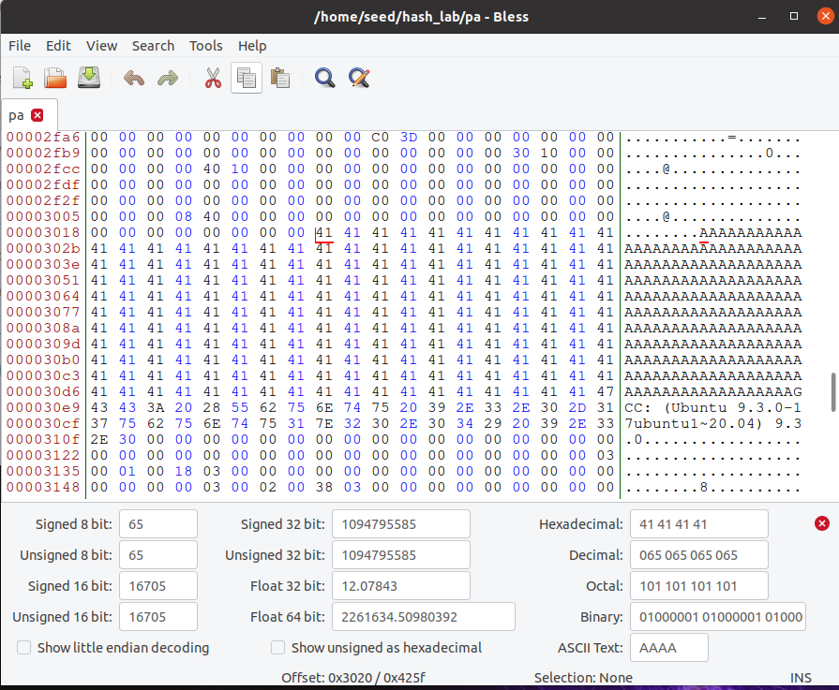
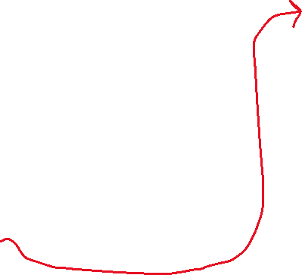

Hash Collisions (Generating Two executable files with the same MD5 hash but behave very differently)
We can find where xyz begins in our program easily, because we filled it with A’s
First Byte of xyz array
Start of XYZ = 0x3020 (Hexadecimal)
12320 (decimal)

Slide 4
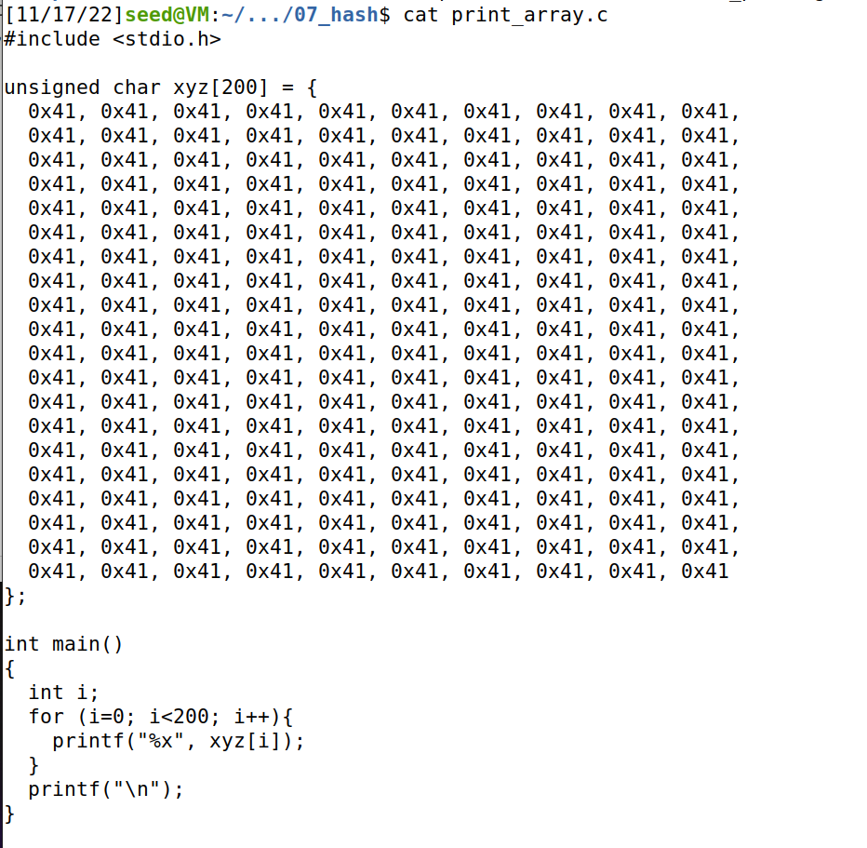
Task 4 on the lab

Slide 5
Task 4 on the lab
0
Prefix
Our prefix will be bytes 0-12320 of the program!
12320
We want our P and Q to be 128 bytes
Why 128?
Multiple of 64
Wont overflow an array of size 200

Slide 6
Task 4 on the lab
0
Prefix
Our prefix will be bytes 0-12320 of the program!
12320
P
Q
We want our P and Q to be 128 bytes
Why 128?
Multiple of 64
Wont overflow an array of size 200

Slide 7
Task 4 on the lab
0
Prefix
Our prefix will be bytes 0-12320 of the program!
12320
P
Q
We want our P and Q to be 128 bytes
Why 128?
Multiple of 64
Wont overflow an array of size 200
128 bytes
12448
Therefore, our suffix will begin at byte # 12320 + 128 = 12448
Suffix
16992 (size of executable)

Slide 8
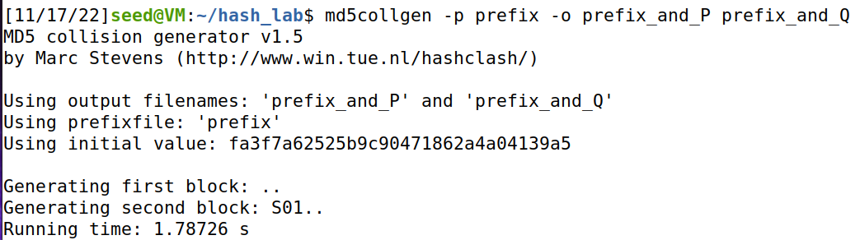
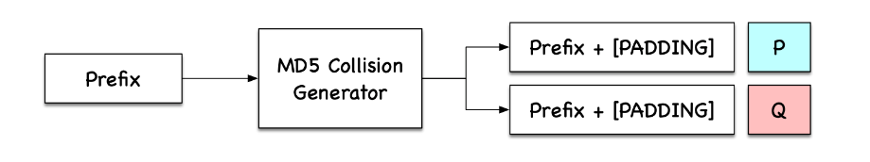


Task 4 on the lab
Get contents of prefix and suffix
0
Prefix
12320
P
Q
Use collision tool to get (prefix + P) and (prefix + Q)
128 bytes
12448
Suffix
(We don’t have to worry about padding because our values are (nicely) divisible by 64)
16992 (size of executable)

Slide 9
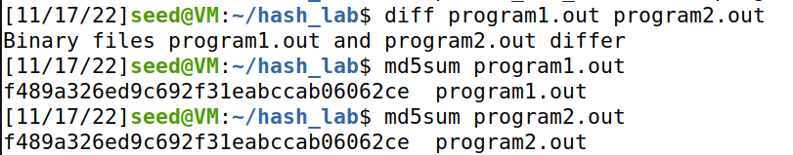


Task 4 on the lab
Get contents of prefix and suffix
0
Prefix
12320
P
Q
Use collision tool to get (prefix + P) and (prefix + Q)
128 bytes
12448
Add suffix to programs
Suffix
Verify that executables are different, but have the same hash
16992 (size of executable)

Slide 10
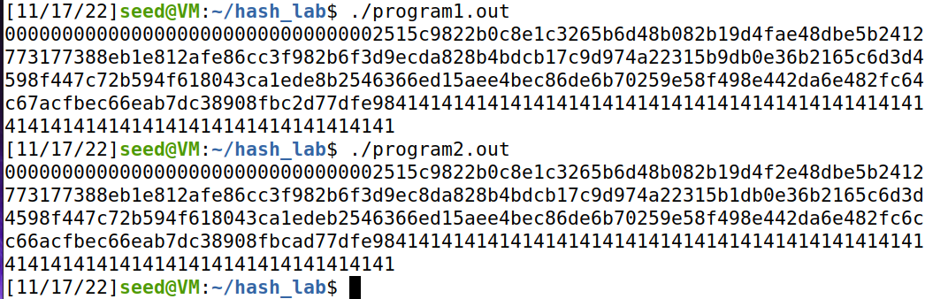

Task 4 on the lab
0
Prefix
12320
Make sure you still have a valid program ☺
P
Q
128 bytes
12448
Suffix
Somewhere in this output, you should find a small difference
16992 (size of executable)

Slide 11
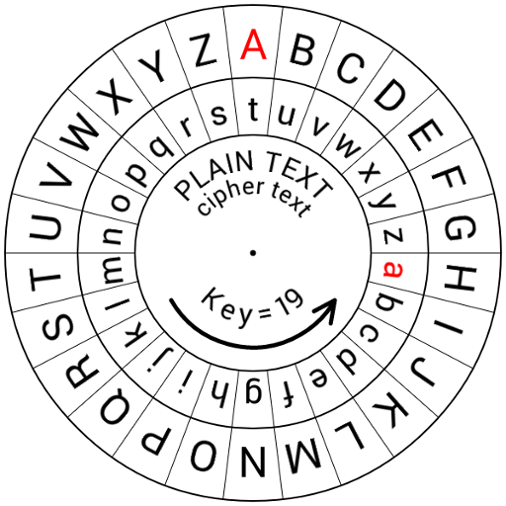
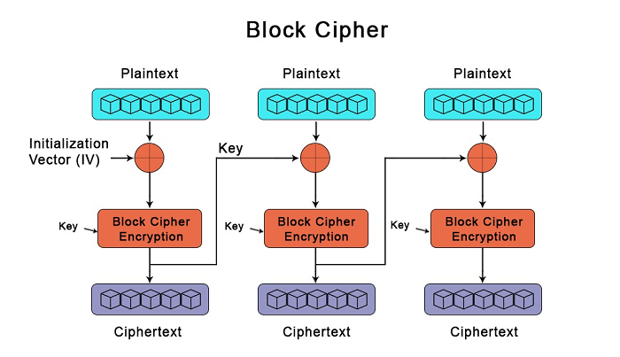
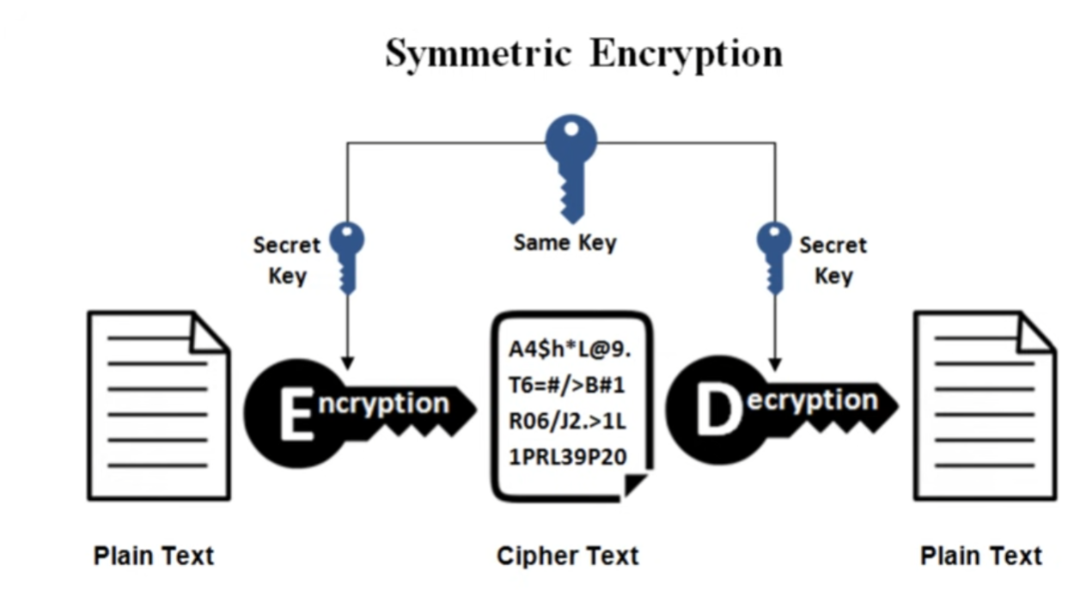
Symmetric key encryption uses the same, shared, key for encrypting and decrypting
What is the one major hurdle we have not discussed yet?
How do the keys get sent without being intercepted? Do the keys get encrypted?

Slide 12
Asymmetric Cryptography
AKA Public key Cryptography
The keys used for encrypting and decrypting data are different
Additionally, each user now gets two-keys. A public key, and a private key
This involves some complicated math, and I won’t go super deep into it. YouTube videos can explain it much better than I can
RSA (Rivest–Shamir–Adleman) is the most popular public key cryptosystem. We rely on it whenever we do communicate securely on the internet

Slide 13
Asymmetric Cryptography
AKA Public key Cryptography
The keys used for encrypting and decrypting data are different
Additionally, each user now gets two-keys. A public key, and a private key
This involves some complicated math, and I won’t go super deep into it. YouTube videos can explain it much better than I can
RSA (Rivest–Shamir–Adleman) is the most popular public key cryptosystem. We rely on it whenever we do communicate securely on the internet

Slide 14


Asymmetric Cryptography (RSA)
Alice
Bob
Plaintext
Alice has a plaintext that she wants to send to bob

Slide 15
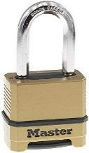

Asymmetric Cryptography (RSA)
Alice
Bob
Public Key
Encrypt!
Plaintext
Ciphertext
She uses Bob’s public key to encrypt her message

Slide 16

Asymmetric Cryptography (RSA)
Alice
Bob
Public Key
Plaintext
Ciphertext
Ciphertext is sent over some medium
Eve can intercept this message,
But can’t decrypt it (public key is not used for decrypting!)

Slide 17
Asymmetric Cryptography (RSA)
Alice
Bob
Public Key
Private Key
Plaintext
Plaintext
Bob uses his private key to decrypt the message. Nobody else knows Bob’s private key
Decrypt
Ciphertext
Ciphertext
Ciphertext is sent over some medium
Eve can intercept this message,
But can’t decrypt it (public key is not used for decrypting!)

Slide 18
Asymmetric Cryptography (RSA)
If you multiply two prime numbers (p and q) together, the product can only be divisible by those two number
5183
??? * ??? = 5183
This is very difficult to figure out for the people that don’t know p or q
In fact, there is not an efficient program that can calculate the factors of integers
This problem is in NP

Slide 19
Asymmetric Cryptography (RSA)
If you multiply two prime numbers (p and q) together, the product can only be divisible by those two number
RSA is based on large numbers that are difficult to factorize
The public and private keys are derived from these prime numbers
How long should RSA keys be? 1024 or 2048 bits long!
The longer the key = the more difficult to crack (exponentially)

Slide 20
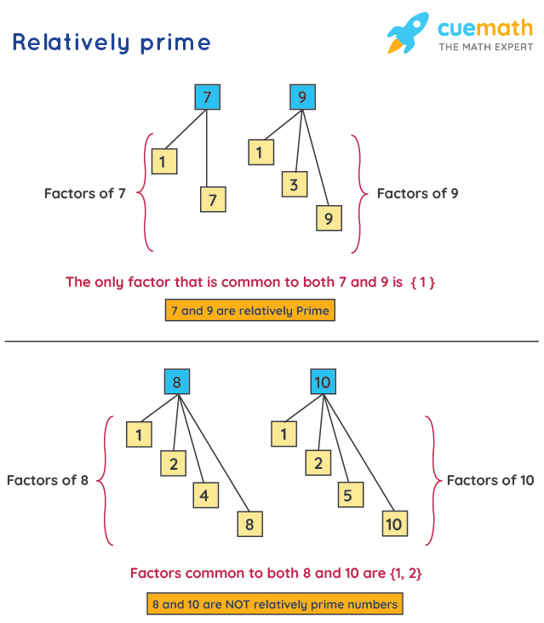
Euler’s Totient Function
Φ(n) = number of values less than n which are relatively prime to n
Φ(3127)
1
2
3
…
3125
3126
How many of these numbers are relatively prime w/ 3127?
Difficult.. But very easy for the product of two prime #s!
The Φ(n) of a product of two prime numbers will always be (p-1)(q-1)
A number is relatively prime to n if they share no common factors

Slide 21
Asymmetric Cryptography (RSA)
Eve’s stolen goods
Alice
Bob
p = 53
q = 59
Step 1: Choose two large primer numbers, p and q

Slide 22
Asymmetric Cryptography (RSA)
Eve’s stolen goods
Alice
Bob
p = 53
q = 59
n = 3127
Step 1: Choose two large primer numbers, p and q
Step 2: Calculate the product n

Slide 23
Asymmetric Cryptography (RSA)
Eve’s stolen goods
Alice
Bob
p = 53
q = 59
n = 3127
Φ(n) = number of values less than n which are relatively prime to n
1
2
3
…
3125
3126
How many of these numbers are relatively prime w/ 3127?
Step 1: Choose two large primer numbers, p and q
Step 2: Calculate the product n
Step 3: Calculate Φ(n)

Slide 24
Asymmetric Cryptography (RSA)
Eve’s stolen goods
Alice
Bob
p = 53
q = 59
n = 3127
Φ(n) = number of values less than n which are relatively prime to n
1
2
3
…
3125
3126
How many of these numbers are relatively prime w/ 3127?
Step 1: Choose two large primer numbers, p and q
Step 2: Calculate the product n
Step 3: Calculate Φ(n)
Difficult.. But very easy for the product of two prime #s!

Slide 25
Asymmetric Cryptography (RSA)
Eve’s stolen goods
Alice
Bob
p = 53
q = 59
n = 3127
Φ(n) = number of values less than n which are relatively prime to n
The Φ(n) of a product of two prime numbers will always be (p-1)(q-1)
Step 1: Choose two large primer numbers, p and q
Step 2: Calculate the product n
Step 3: Calculate Φ(n)

Slide 26
Asymmetric Cryptography (RSA)
Eve’s stolen goods
Alice
Bob
p = 53
q = 59
n = 3127
Φ(n) = 52*28 = 3016
Φ(n) = number of values less than n which are relatively prime to n
The Φ(n) of a product of two prime numbers will always be (p-1)(q-1)
Step 1: Choose two large primer numbers, p and q
Step 2: Calculate the product n
Step 3: Calculate Φ(n)

Slide 27
Asymmetric Cryptography (RSA)
Φ(n) = number of values less than n which are relatively prime to n
Eve’s stolen goods
Alice
Bob
p = 53
q = 59
n = 3127
Φ(n) = 3016
e = 1 < e < Φ(n)
Not be a factor of n, but an integer
Step 1: Choose two large primer numbers, p and q
Step 2: Calculate the product n
Step 3: Calculate Φ(n)
Step 4: Choose public exponent e

Slide 28
Asymmetric Cryptography (RSA)
Φ(n) = number of values less than n which are relatively prime to n
Eve’s stolen goods
Alice
Bob
p = 53
q = 59
n = 3127
Φ(n) = 3016
e = 3
e = 1 < e < Φ(n)
Not be a factor of n, but an integer
Step 1: Choose two large primer numbers, p and q
Step 2: Calculate the product n
Step 3: Calculate Φ(n)
Step 4: Choose public exponent e

Slide 29





Asymmetric Cryptography (RSA)
Φ(n) = number of values less than n which are relatively prime to n
Eve’s stolen goods
Alice
Bob
p = 53
q = 59
n = 3127
Φ(n) = 3016
e = 3
Step 1: Choose two large primer numbers, p and q
Step 2: Calculate the product n
Step 3: Calculate Φ(n)
Step 4: Choose public exponent e
Step 5: Select private exponent d
K = some integer that will make the quotient an integer

Slide 30





Asymmetric Cryptography (RSA)
Φ(n) = number of values less than n which are relatively prime to n
Eve’s stolen goods
Alice
Bob
p = 53
q = 59
n = 3127
Φ(n) = 3016
e = 3
Step 1: Choose two large primer numbers, p and q
Step 2: Calculate the product n
Step 3: Calculate Φ(n)
Step 4: Choose public exponent e
Step 5: Select private exponent d
K = some integer that will make the quotient an integer

Slide 31




Asymmetric Cryptography (RSA)
Φ(n) = number of values less than n which are relatively prime to n
Eve’s stolen goods
Alice
Bob
p = 53
q = 59
n = 3127
Φ(n) = 3016
e = 3
d = 2011
Step 1: Choose two large primer numbers, p and q
Step 2: Calculate the product n
Step 3: Calculate Φ(n)
Step 4: Choose public exponent e
Step 5: Select private exponent d
K = some integer that will make the quotient an integer

Slide 32
Asymmetric Cryptography (RSA)
Φ(n) = number of values less than n which are relatively prime to n
Eve’s stolen goods
Alice
Bob
Alice’s Public Key
n = 3127
e = 3
Secret Information
p = 53
q = 59
Φ(n) = 3016
d = 2011

Slide 33
Asymmetric Cryptography (RSA)
Φ(n) = number of values less than n which are relatively prime to n
Eve’s stolen goods
Alice
Bob
Alice’s Public Key
n = 3127
e = 3
Bob has a message to send to Alice
HI → 89
Secret Information
Message must be converted into a number
p = 53
q = 59
Φ(n) = 3016
d = 2011

Slide 34




Asymmetric Cryptography (RSA)
Φ(n) = number of values less than n which are relatively prime to n
Eve’s stolen goods
Alice
n = 3127
e = 3
Bob
Alice’s Public Key
n = 3127
e = 3
Bob has a message to send to Alice
89
Secret Information
Use Alice’s Public Key to encrypt
p = 53
q = 59
Φ(n) = 3016
d = 2011

Slide 35






Asymmetric Cryptography (RSA)
Φ(n) = number of values less than n which are relatively prime to n
Eve’s stolen goods
Alice
n = 3127
e = 3
Bob
Alice’s Public Key
n = 3127
e = 3
Bob has a message to send to Alice
89
Secret Information
Use Alice’s Public Key to encrypt
p = 53
q = 59
Φ(n) = 3016
d = 2011

Slide 36










Asymmetric Cryptography (RSA)
Φ(n) = number of values less than n which are relatively prime to n
Eve’s stolen goods
Alice
n = 3127
e = 3
c=1394
Bob
p = 53
q = 59
Φ(n) = 3016
d = 2011
Alice’s Public Key
n = 3127
e = 3
Bob has a message to send to Alice
89
Use Alice’s Public Key to encrypt
Alice decrypts message using her private key

Slide 37





Asymmetric Cryptography (RSA)
Φ(n) = number of values less than n which are relatively prime to n
Eve’s stolen goods
Alice
n = 3127
e = 3
c=1394
Bob
p = 53
q = 59
Φ(n) = 3016
d = 2011
Alice’s Public Key
n = 3127
e = 3
Bob has a message to send to Alice
89
Use Alice’s Public Key to encrypt
89
Alice decrypts message using her private key

Slide 38

Asymmetric Cryptography (RSA)
Φ(n) = number of values less than n which are relatively prime to n
Eve’s stolen goods
Alice
n = 3127
e = 3
c=1394
Bob
p = 53
q = 59
Φ(n) = 3016
d = 2011
Alice’s Public Key
n = 3127
e = 3
Bob has a message to send to Alice
89
Alice’s Private Key
n = 3127
d = 2011
What does eve know??
Use Alice’s Public Key to encrypt
These is very difficult to figure out, since she does not know the factorization of n

Slide 39
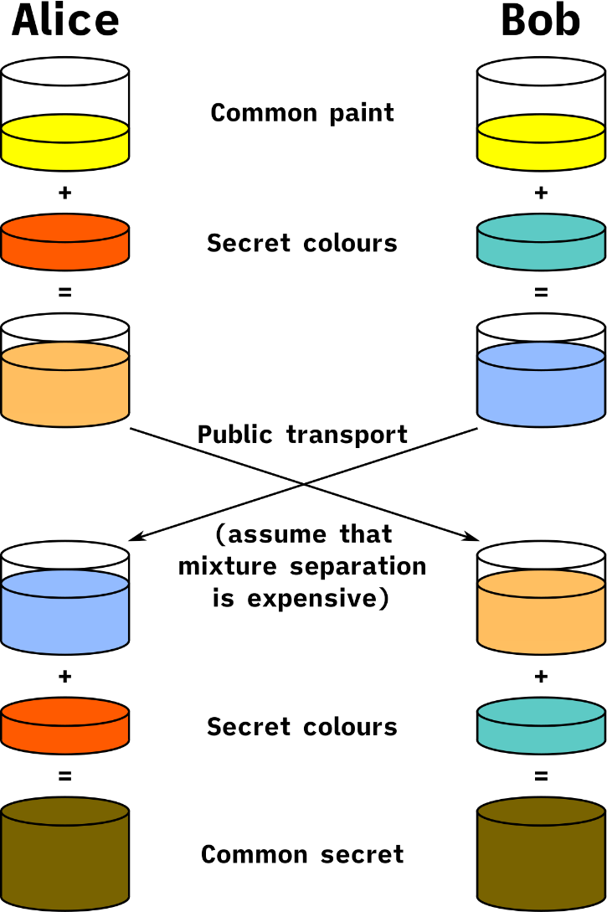
Asymmetric Cryptography (RSA)
We now have a method for sending secure messages over a possibly unsecure channel!
Limitation of RSA: Can only encrypted data that is smaller or equal to key length ( < 2048 bits )

Slide 40
Asymmetric Cryptography (RSA)
We now have a method for sending secure messages over a possibly unsecure channel!
Limitation of RSA: Can only encrypted data that is smaller or equal to key length ( < 2048 bits )
What could we encrypt instead??

Slide 41
Asymmetric Cryptography (RSA)
We now have a method for sending secure messages over a possibly unsecure channel!
Limitation of RSA: Can only encrypted data that is smaller or equal to key length ( < 2048 bits )
What could we encrypt instead??
The key for a symmetric cryptography algorithm! ( < 2048 bits)

Slide 42
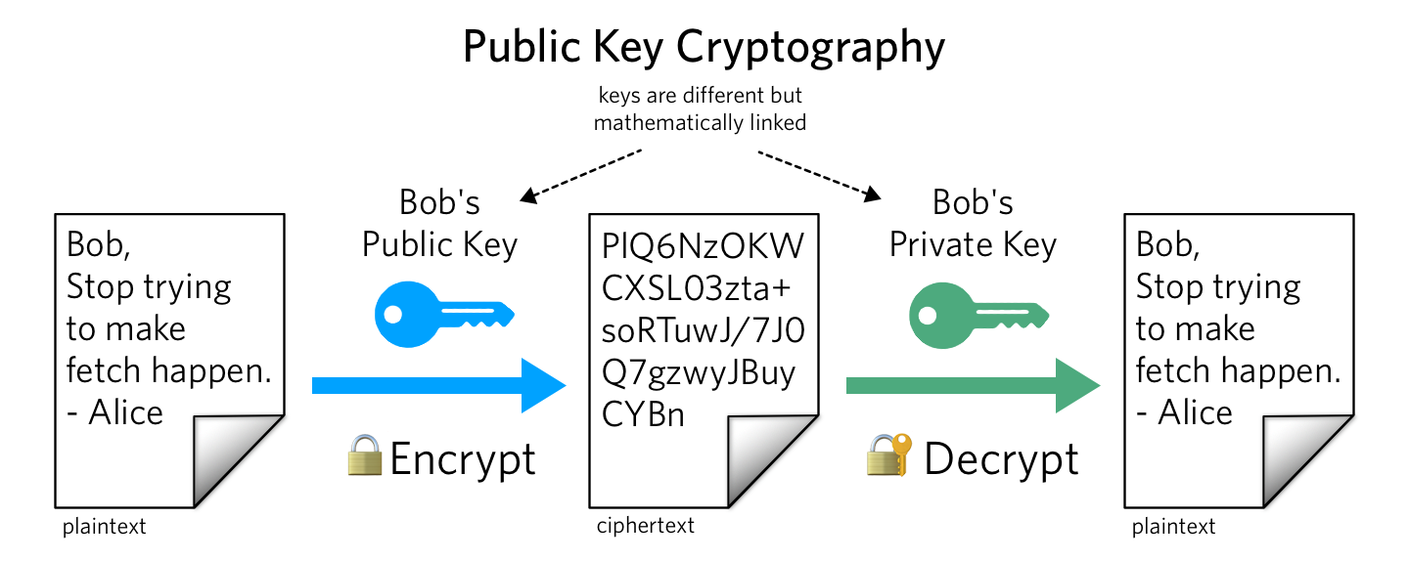
Same key used for encrypting and decrypting
Using block ciphers (AES), we can encrypt an arbitrary size of data
Issue: How to securely share secret keys with each other?
Two keys: Public Key (a lock), and a price key (the key)
Public key is used to encrypt. Private key used to decrypt message
Using math, we can securely send messages over an unsecure channel without sharing any sensitive information
Issue: We can not encrypt stuff bigger than our key (2048 bits)
Often times, symmetric and asymmetric cryptography are used together
(use RSA to send the key for symmetric crypto!)

Slide 43
We know that Public and Private keys are derived from big prime numbers
(We are talking hundreds of digits long…)
Our computer can't compute products and exponents for such large numbers
OpenSSL on our VMs has tools for generating public/private RSA keys

Slide 44
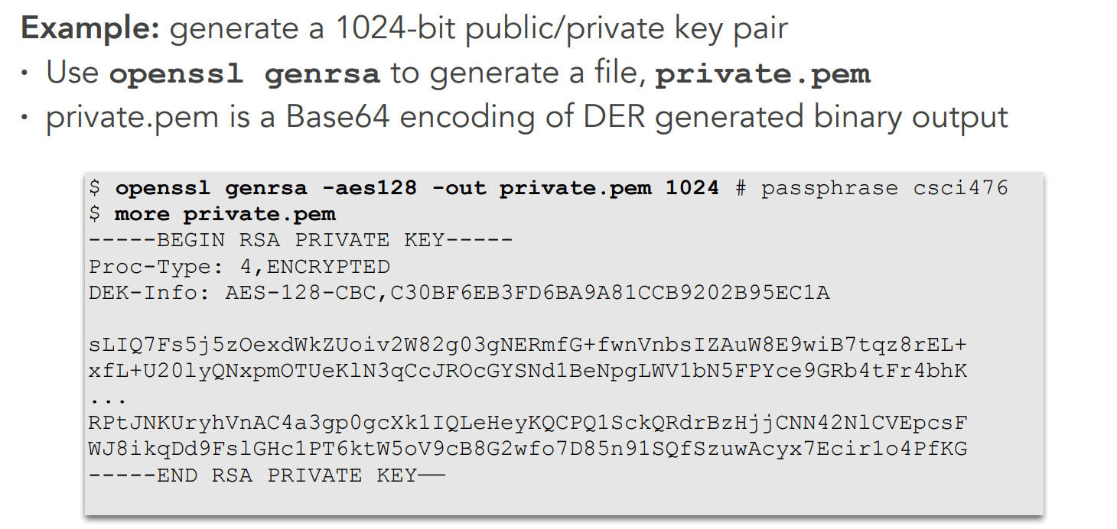

Slide 45
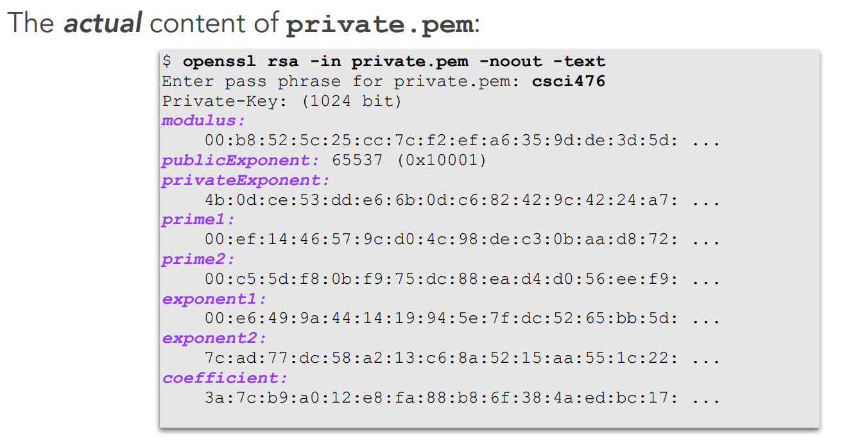

Slide 46
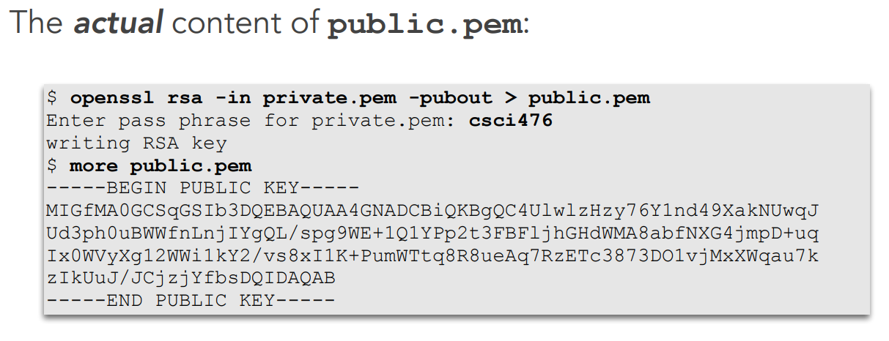
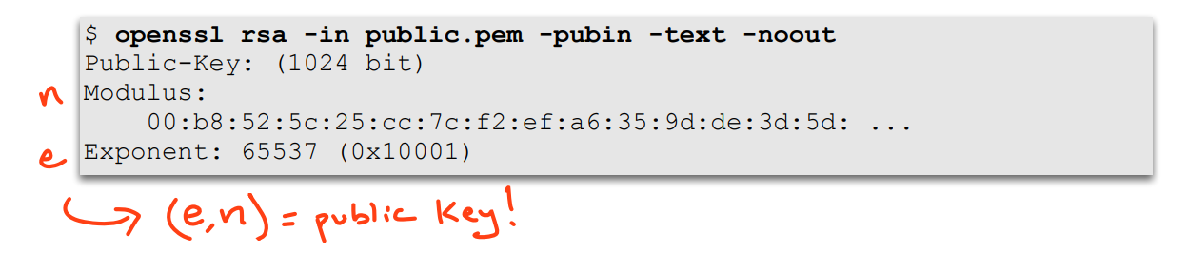

Slide 47
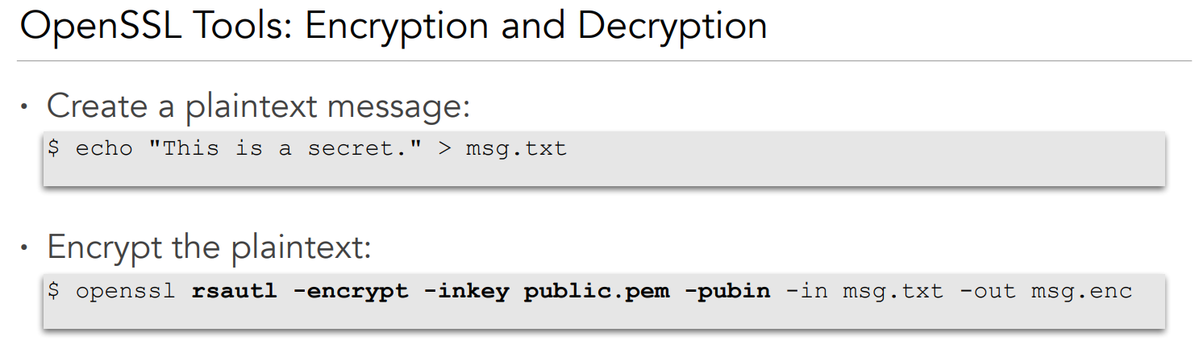

Slide 48
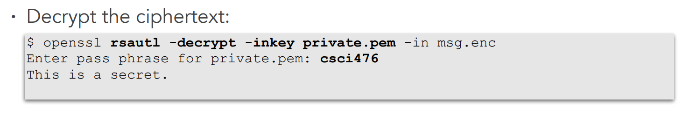

Slide 50
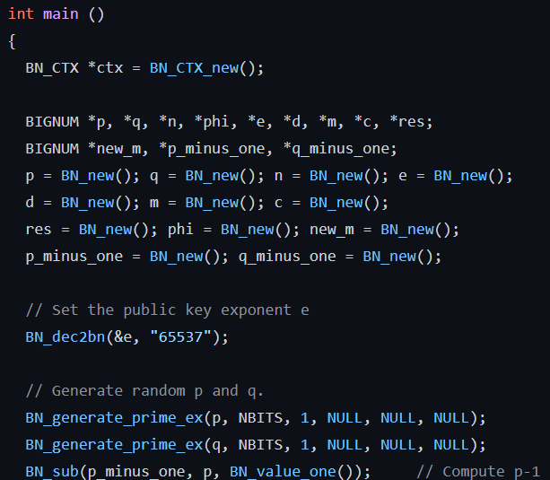
BIG NUM API

Slide 51
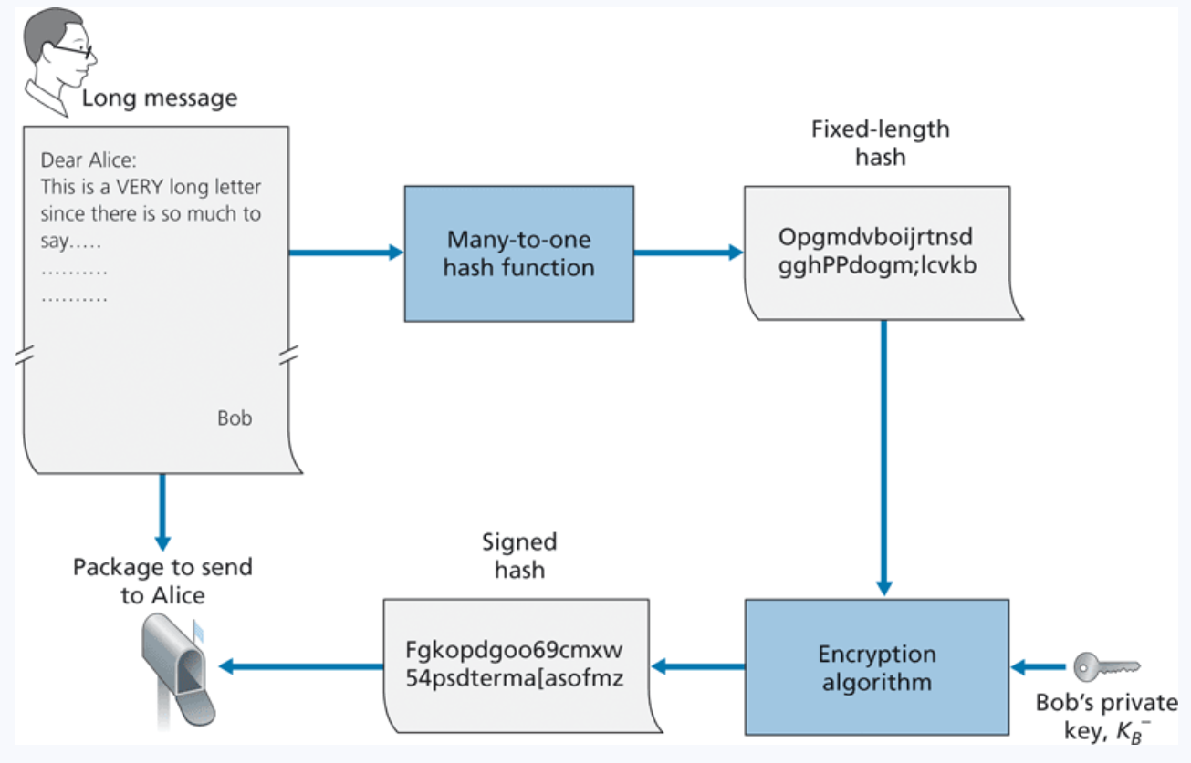
Digital Signatures
What is a unique identifier for bob? What is something that only bob knows and nobody else?
His private key
Bob encrypts his hashed message using his private key, and sends the signed hash, along with message to Alice
When Alice receives this message, she must find a way to decrypt the signed hash
She will use Bob’s public key

Slide 52
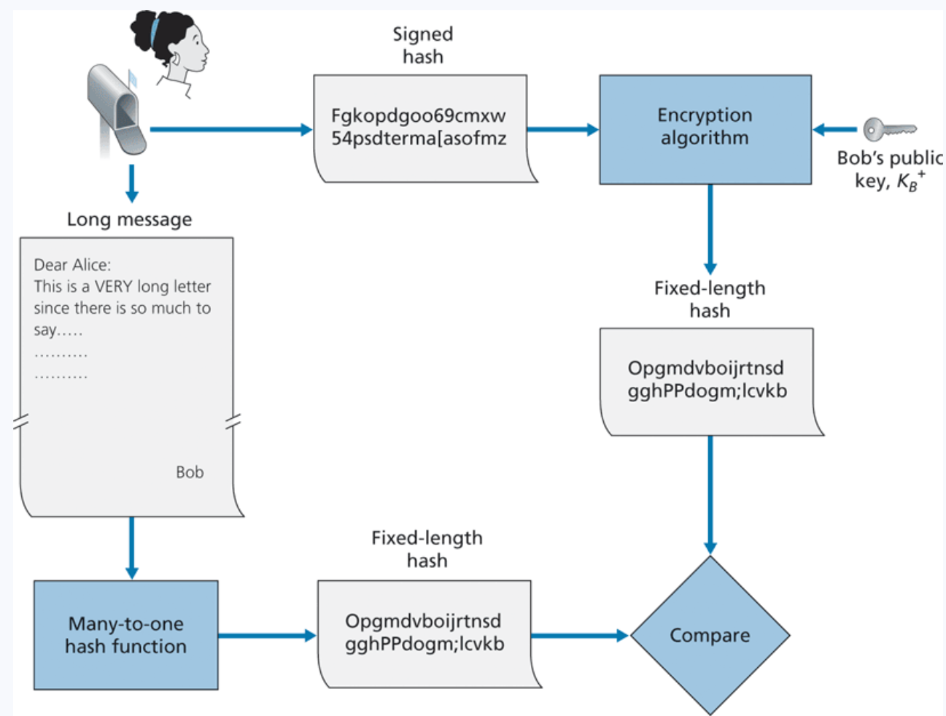
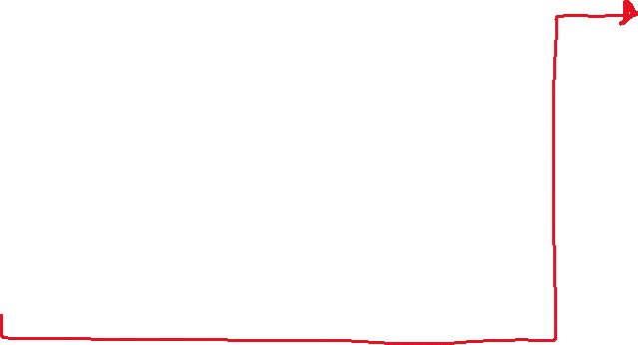
Digital Signatures
What is a unique identifier for bob? What is something that only bob knows and nobody else?
His private key
Bob encrypts his hashed message using his private key, and sends the signed hash, along with message to Alice. Alice decrypts using his public key and verifies that the hashes match
Sending a digital Signature
Verifying a digital signature

Slide 53
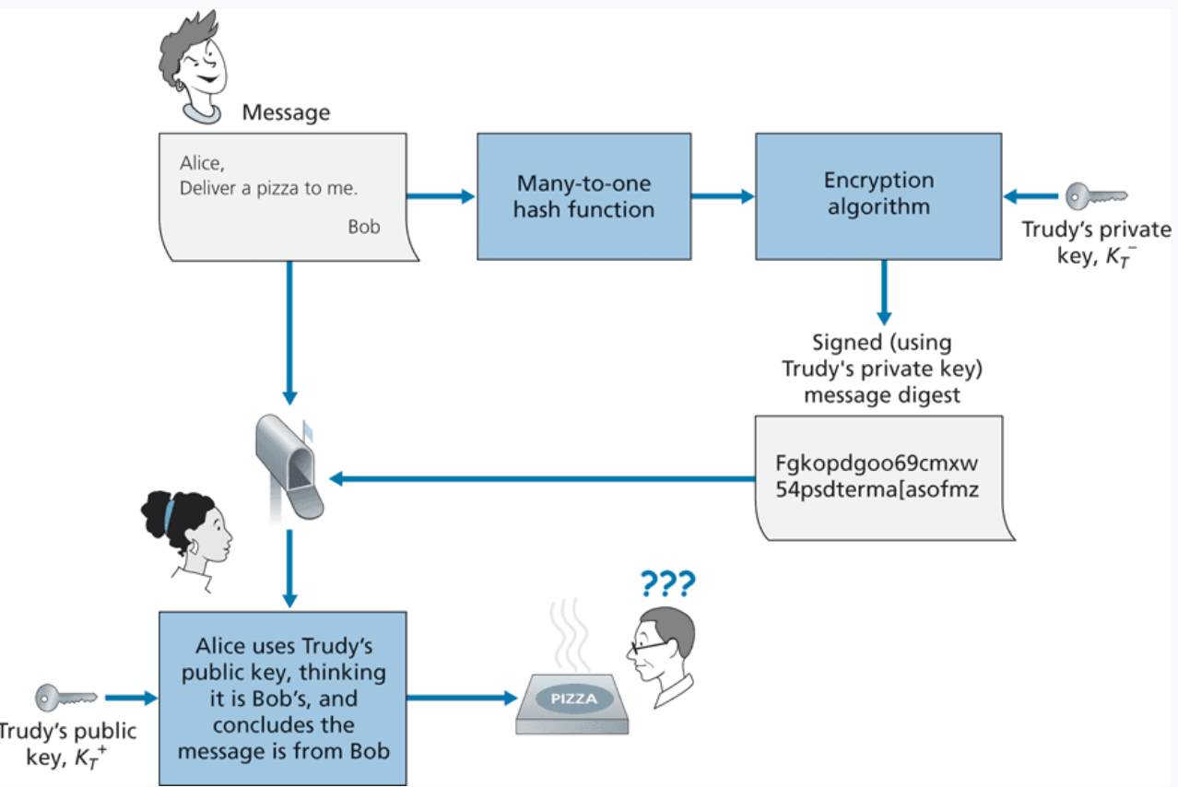

Digital Signatures
How do we know that this is Bob’s public key ?
We don’t have a way to link entities to their public keys

Slide 54
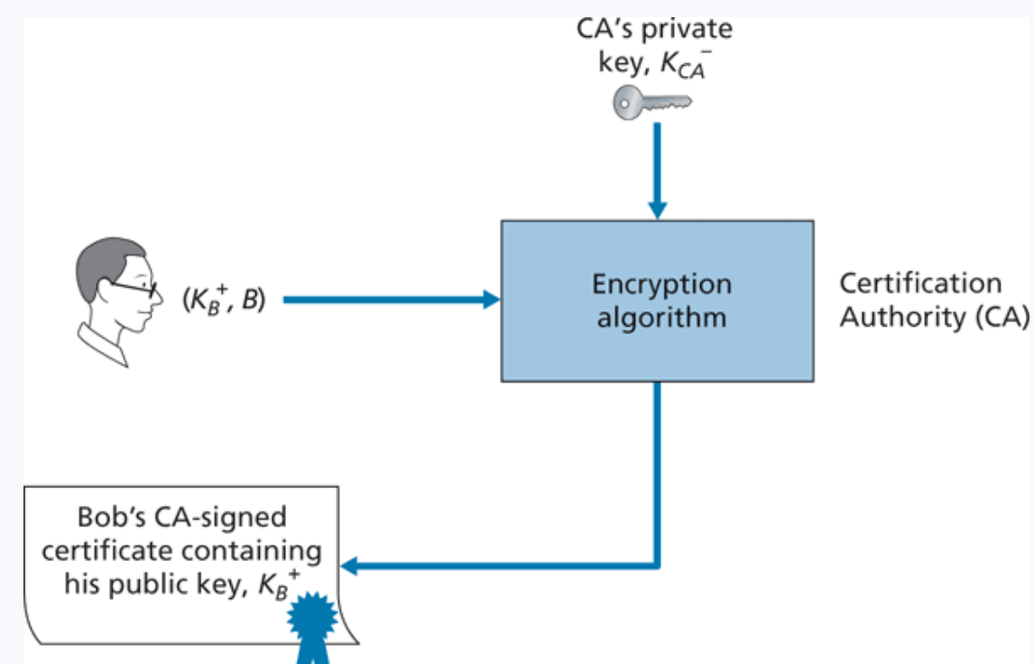
Digital Certificates
Certificates are an authoritative document that links entities (person, router, organization) to their public key
Creating certificates are done by a Certification Authority (digicert, lets encrypt, comodo)
Some are more trustworthy than others…
On your web browser, you exchange certificate information with the websites you are visiting

Slide 55
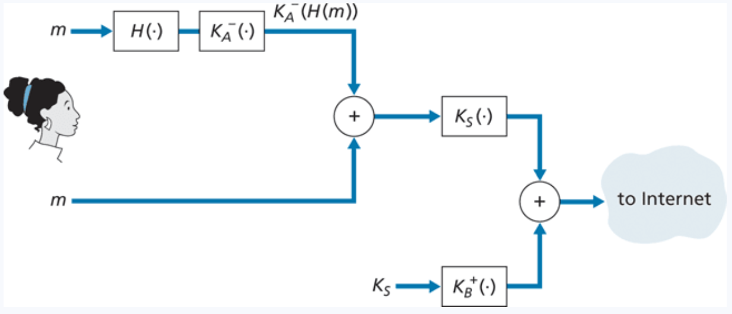






Symmetric Crypto, Asymmetric Crypto, and Hashing all work together to send secure, authentic messages

Slide 56
What you should know

