Slide 1

CSCI 476: Computer Security
Network Security: TCP Reset and TCP Hijacking
Reese Pearsall
Spring 2023
https://www.cs.montana.edu/pearsall/classes/spring2023/476/main.html

Slide 2
Announcement
Project due in about a month from now (April 23rd)
Lab 5 (XSS) Due Sunday 3/26 @ 11:59 PM

Slide 3


Slide 4
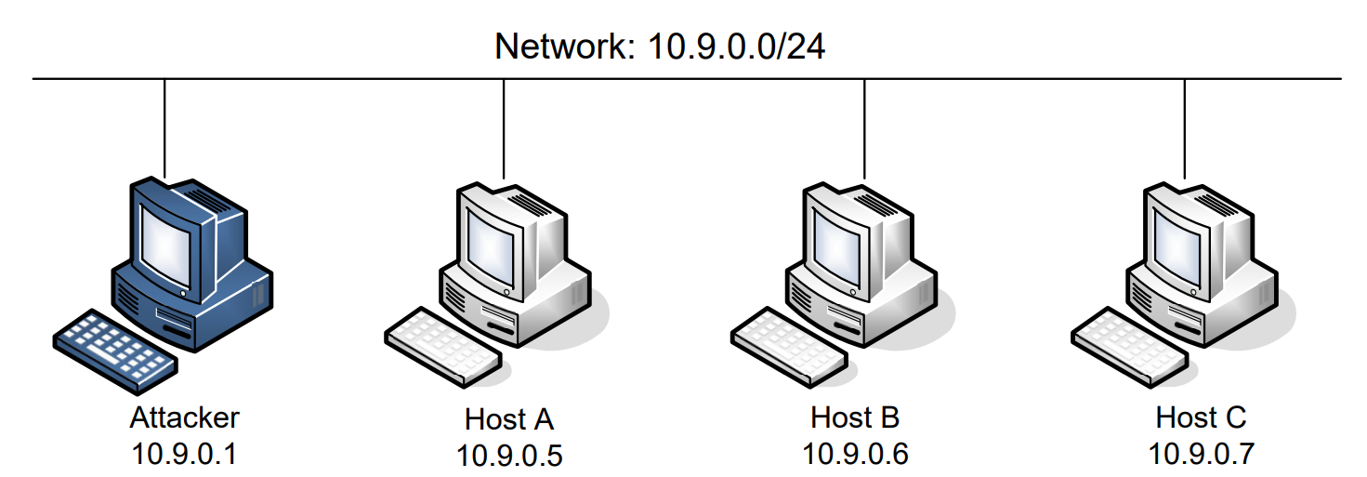
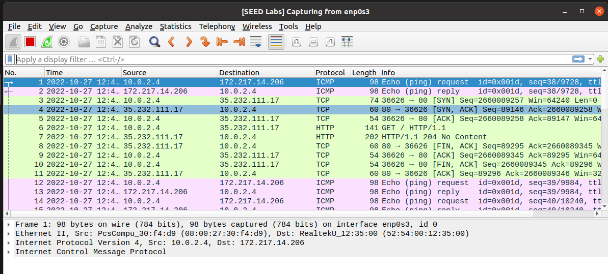
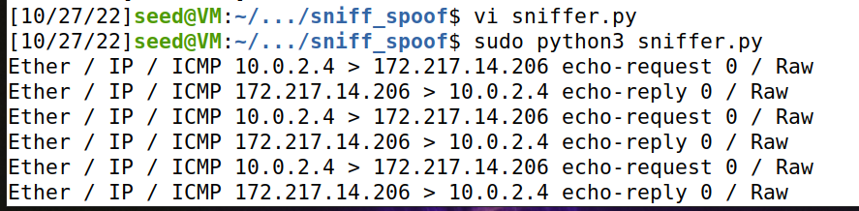
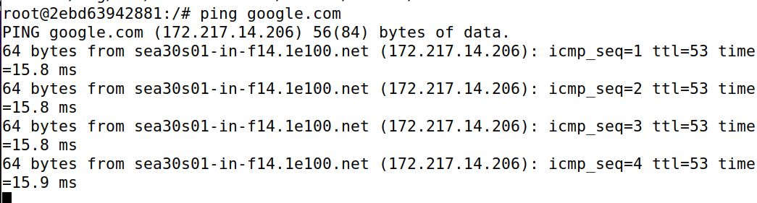
Setup
docker-compose up -d
On the attacker machine, we can also see these packets in Wireshark!
dock sh 2ebd
For this lab, we will logged into our attacker machine (our VM) and logged into a victim machine (a container)

Slide 5

Attacks on TCP
SYN Flooding
SYN Reset
TCP session hijack
me
Please don’t try to do this stuff on real servers outside of the VM

Slide 6
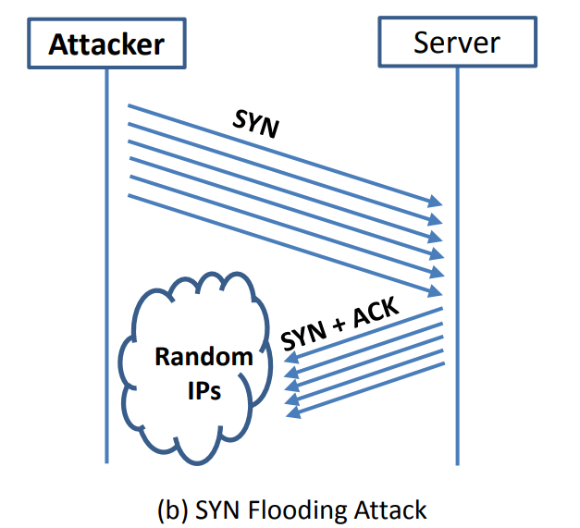
Queue for new TCP Connections
= SYN request to the server
The goal of a SYN Flooding attack is to overwhelm/crash a server that accepts TCP connections by flooding the server with SYN requests coming from spoofed, random IP addresses

Slide 7
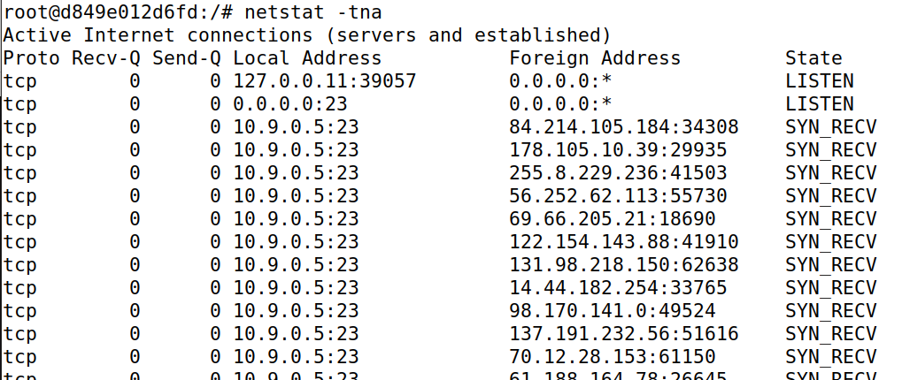
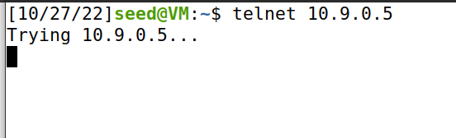
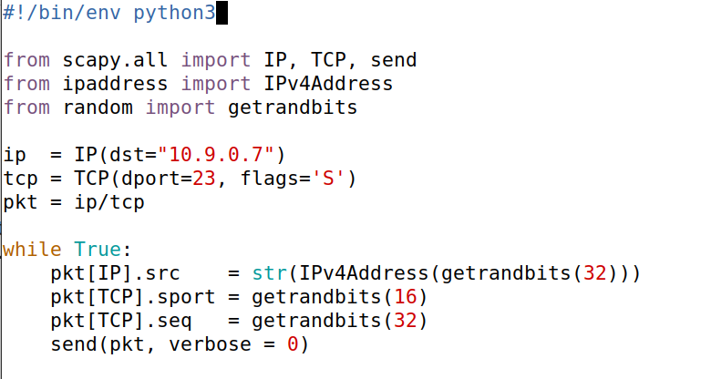




Victim Server
3
Verify server is receiving packets
Attacker
Run script to send spoofed packets
2
New terminal
Server is full!
synflood.py
We’ve filled this server with spoofed SYN requests
Denied
1
Repeatedly send a TCP packet to 10.9.0.7, with a random source IP address
1

Slide 8
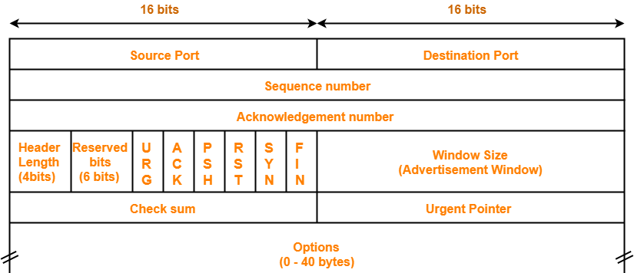
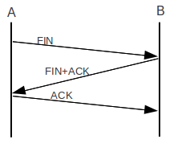

TCP Reset Attack
Goal: Break an established TCP connection by sending a spoofed RESET (RST) packet
This is different than sending a FIN packet
TCP Header
Data
Packet

Slide 9
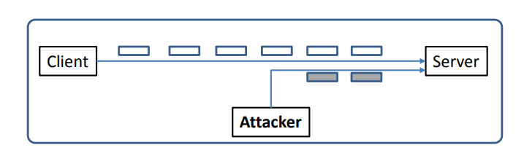
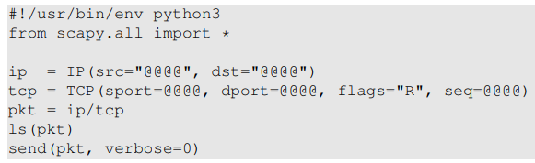

TCP Reset Attack
In order to do our attack, we first need to find an ongoing TCP communication between two users!
A server reads data in some order (typically by sequence number)
10.9.0.6
10.9.0.5
SEQ # = 4440
10.9.0.1
In our spoofed packet, we need to make sure we select a sequence number that matches the sequence number the server is expecting!
(@@@ are placeholder. You will fill them in)
We also need to select the same ports!

Slide 10
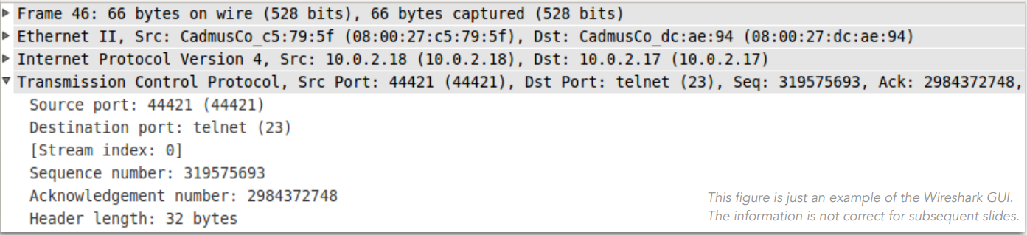
TCP Reset Attack
In order to do our attack, we first need to find an ongoing TCP communication between two users!
A server reads data in some order (typically by sequence number)
10.9.0.6
10.9.0.5
10.9.0.1
Since we can sniff all the packets going from 10.9.0.6 to 10.9.0.5,
We can pull all the information we need from wireshark!
(@@@ are placeholder. You will fill them in)

Slide 11
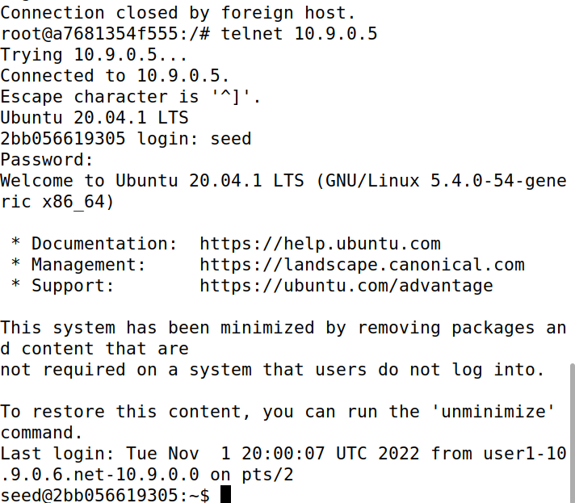
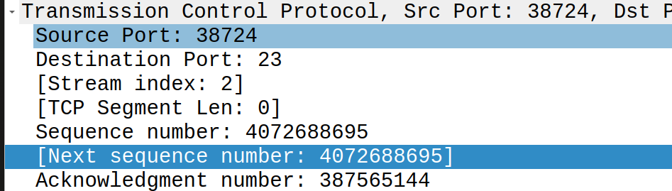
TCP Reset Attack
We need the information to generate our spoofed packet:
1. Open up Wireshark, and start generating some TCP traffic between Client 1 container and victim server
Logged into the user 1 container
Look at the most recent packet sent between client and server
Your information may be different
10.9.0.6
10.9.0.5
Port 38724
Port 23
Telnet connection established
10.9.0.1

Slide 12
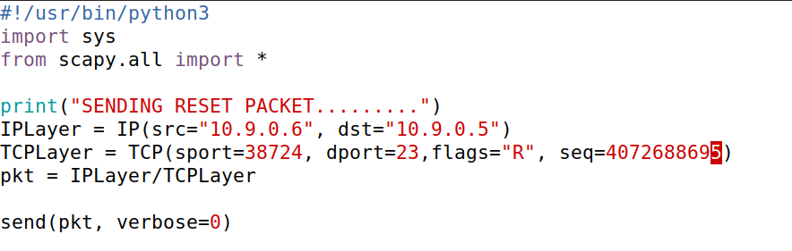



TCP Reset Attack
We need the information to generate our spoofed packet:
Open up Wireshark, and start generating some TCP traffic between Client 1 container and victim server
Fill in src IP, dst IP, src port, dst port, and sequence number into reset.py
Your information will be different
10.9.0.6
10.9.0.5
Port 38724
Port 23
10.9.0.1

Slide 13

TCP Reset Attack
We need the information to generate our spoofed packet:
Open up Wireshark, and start generating some TCP traffic between Client 1 container and victim server
Fill in src IP, dst IP, src port, dst port, and sequence number into reset.py
Hop back to client 1 container, press enter, connection should be closed!
Your information will be different
10.9.0.6
10.9.0.5
Port 38724
Port 23
10.9.0.1

Slide 14
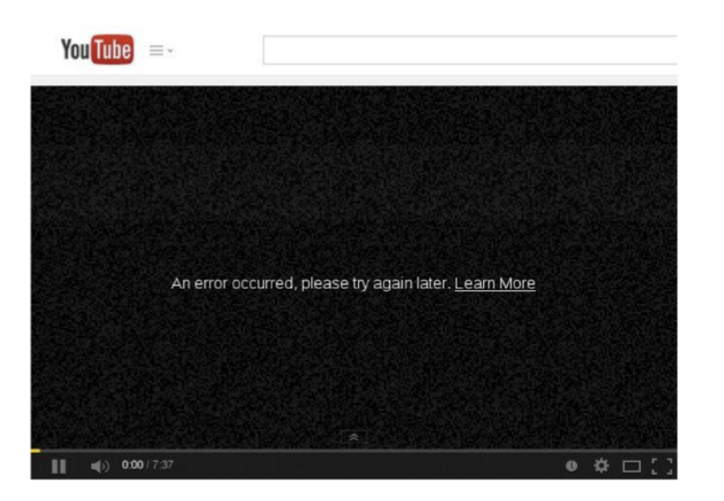
TCP Reset Attack

Slide 15
TCP Hijack Attack
Goal: Hijack an existing TCP connection (telnet), and get a server to execute a command of our choice
10.9.0.6
10.9.0.5
10.9.0.1
“cat /etc/shadow”
We spoof a packet with a command the run, and this packet looks like it came from the client (10.9.0.6)

Slide 16
TCP Hijack Attack
Hijack a current TCP connection and get a TCP server to execute commands of our choice
Open up Wireshark, and start generating some TCP traffic between Client 1 container and victim server
Look at most recent TCP/Telnet Packet in Wireshark
Just like with the TCP reset, we need this information for our packet
Your information will be different

Slide 17
TCP Hijack Attack
Hijack a current TCP connection and get a TCP server to execute commands of our choice
Open up Wireshark, and start generating some TCP traffic between Client 1 container and victim server
Look at most recent TCP/Telnet Packet in Wireshark
Just like with the TCP reset, we need this information for our packet
Your information will be different
For TCP Hijack, we will also be sending a command to run. What commands could we run?

Slide 18
TCP Hijack Attack
Hijack a current TCP connection and get a TCP server to execute commands of our choice
Open up Wireshark, and start generating some TCP traffic between Client 1 container and victim server
Look at most recent TCP/Telnet Packet in Wireshark
Just like with the TCP reset, we need this information for our packet
Your information will be different
For TCP Hijack, we will also be sending a command to run. What commands could we run?
We could steal a file (demo), or we could create a root shell reverse shell

Slide 19
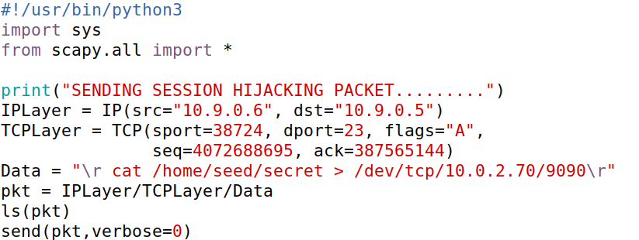
TCP Hijack Attack
Hijack a current TCP connection and get a TCP server to execute commands of our choice
Open up Wireshark, and start generating some TCP traffic between Client 1 container and victim server
Look at most recent TCP/Telnet Packet in Wireshark
Fill in packet information in sessionhijack.py
Your information will be different

Slide 20








TCP Hijack Attack
Hijack a current TCP connection and get a TCP server to execute commands of our choice
Open up Wireshark, and start generating some TCP traffic between Client 1 container and victim server
Look at most recent TCP/Telnet Packet in Wireshark
Fill in packet information in sessionhijack.py
Your information will be different

Slide 21
TCP Hijack Attack
Hijack a current TCP connection and get a TCP server to execute commands of our choice
Open up Wireshark, and start generating some TCP traffic between Client 1 container and victim server
Look at most recent TCP/Telnet Packet in Wireshark
Fill in packet information in sessionhijack.py
Summon a netcat server on attack machine (separate terminal)
netcat –lnv 9090

Slide 22
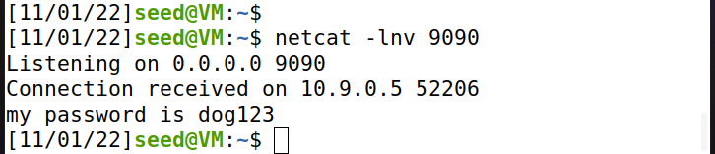
TCP Hijack Attack
Hijack a current TCP connection and get a TCP server to execute commands of our choice
Open up Wireshark, and start generating some TCP traffic between Client 1 container and victim server
Look at most recent TCP/Telnet Packet in Wireshark
Fill in packet information in sessionhijack.py\
Summon a netcat server on attack machine (separate terminal)
Run session hijack program
TCP server sent us the output of the cat command!

Slide 23
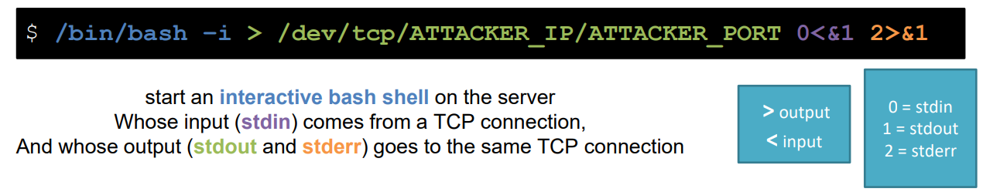
Reverse Shell
A reverse shell gives us (an attacker) a bash shell that we can remotely use → Total control!!
In our spoofed packet, that will be the command that we want to run!
(remember to have netcat server also running!)

