Slide 1

CSCI 476: Computer Security
Network Security: DNS Cache Poisoning
Reese Pearsall
Spring 2023
https://www.cs.montana.edu/pearsall/classes/spring2023/476/main.html

Slide 2

Announcement
Guest Speaker Hill AFB
Lab 6 (TCP/IP Attacks) Due Sunday 4/2 @ 11:59 PM
Friday’s lecture will be a help session for Lab 6

Slide 3


When browsing the web, computers need the IP address of the host we are communicating with
Humans do not use IP addresses when using the internet, they use hostnames (English)
We need a way to go from hostnames to IP addresses
Humans browse the web using hostnames
(They need English)
Computers understand numbers
(They need IP addresses)
153.90.127.197

Slide 4
When browsing the web, computers need the IP address of the host we are communicating with
Humans do not use IP addresses when using the internet, they use hostnames (English)
We need a way to go from hostnames to IP addresses
Humans browse the web using hostnames
(They need English)
Computers understand numbers
(They need IP addresses)
DNS
153.90.127.197

Slide 5




DNS Architecture
youtube.com
irs.gov
Clients will first need to resolve hostnames with DNS
montana.edu
3.
DNS
HTTP
1.
153.90.3.95
montana.edu ?
153.90.3.95
2.
Clients

Slide 6
DNS Architecture
youtube.com
irs.gov
montana.edu
DNS
DNS
DNS
.gov
.com
.edu
Clients

Slide 7
DNS Architecture
(how big would that map be?)
DNS is a distributed, hierarchical database (no DNS server has all the records!)
Hierarchy consists of different types of DNS servers:

Slide 8
DNS Architecture
(how big would that map be?)
DNS is a distributed, hierarchical database (no DNS server has all the records!)
Hierarchy consists of different types of DNS servers:
Authoritative DNS servers- Organization’s own DNS with up-to-date records
facebook.com DNS
amazon.com DNS
montana.edu DNS
harvard.edu DNS

Slide 9




DNS Architecture
(how big would that map be?)
DNS is a distributed, hierarchical database (no DNS server has all the records!)
Hierarchy consists of different types of DNS servers:
Authoritative DNS servers- Organization’s own DNS with up-to-date records
.com TLD DNS server
.edu TLD DNS server
Top-level domain (TLD) servers- responsible for keeping IP addresses for authoritative DNS servers for each top-level domain (.com, .edu, .jp, etc)
facebook.com DNS
amazon.com DNS
montana.edu DNS
harvard.edu DNS

Slide 10
DNS Architecture
(how big would that map be?)
DNS is a distributed, hierarchical database (no DNS server has all the records!)
Hierarchy consists of different types of DNS servers:
Authoritative DNS servers- Organization’s own DNS with up-to-date records
.com TLD DNS server
.edu TLD DNS server
Top-level domain (TLD) servers- responsible for keeping IP addresses for authoritative DNS servers for each top-level domain (.com, .edu, .jp, etc)
facebook.com DNS
amazon.com DNS
montana.edu DNS
harvard.edu DNS

Slide 11


DNS Architecture
(how big would that map be?)
DNS is a distributed, hierarchical database (no DNS server has all the records!)
Hierarchy consists of different types of DNS servers:
root DNS server
Authoritative DNS servers- Organization’s own DNS with up-to-date records
.com TLD DNS server
.edu TLD DNS server
Top-level domain (TLD) servers- responsible for keeping IP addresses for authoritative DNS servers for each top-level domain (.com, .edu, .jp, etc)
facebook.com DNS
amazon.com DNS
montana.edu DNS
harvard.edu DNS
Root DNS servers- responsible for maintaining IP addresses for TLD servers

Slide 12
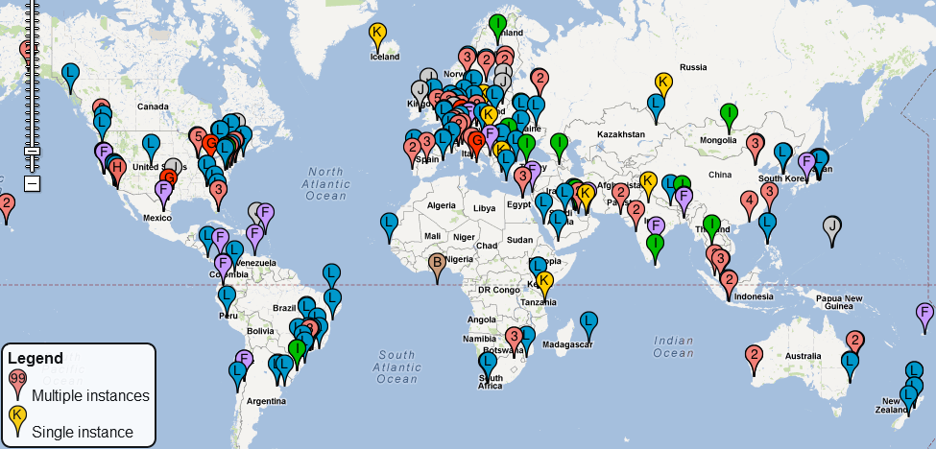
DNS Root server locations
https://root-servers.org/

Slide 13
Domain Name System (DNS)
Application-level protocol used to map Domain Names to IP Addresses
DNS uses UDP as the transport layer protocol
No handshake
No guarantee that packet will arrive
DNS Packet
UDP Header
IP Header
Anatomy of a DNS Packet

Slide 14
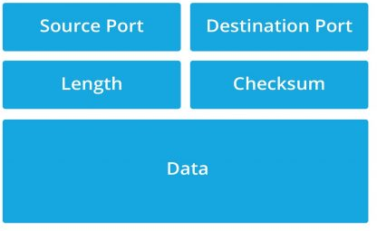


Domain Name System (DNS)
Application-level protocol used to map Domain Names to IP Addresses
DNS uses UDP as the transport layer protocol
No handshake
No guarantee that packet will arrive
UDP header Format
DNS Packet
UDP Header
IP Header
Anatomy of a DNS Packet

Slide 15
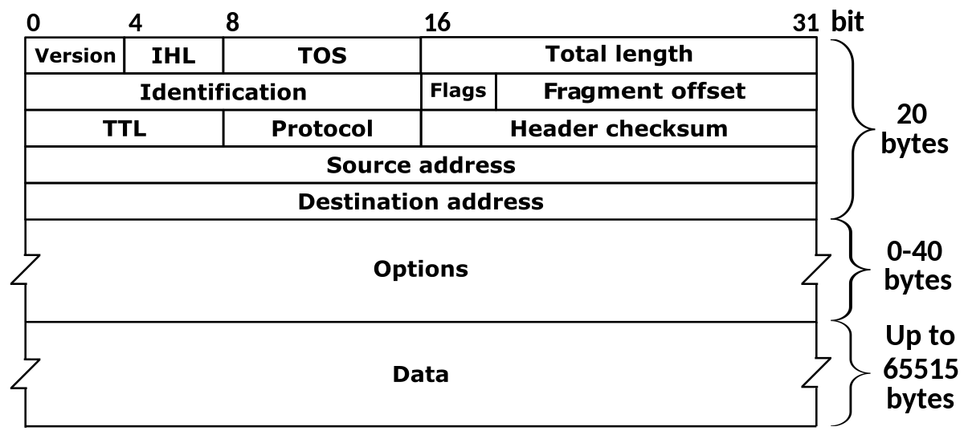


Domain Name System (DNS)
Application-level protocol used to map Domain Names to IP Addresses
DNS uses UDP as the transport layer protocol
No handshake
No guarantee that packet will arrive
DNS Packet
UDP Header
IP Header
Anatomy of a DNS Packet

Slide 16
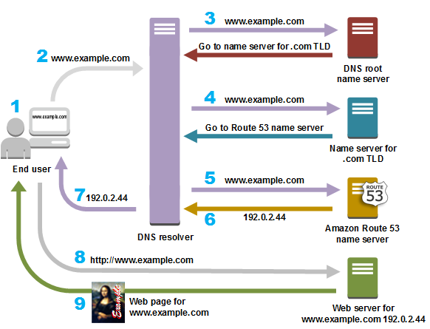
Suppose the user wants to go to www.example.com

Slide 17
Suppose the user wants to go to www.example.com
Step 0: The computer first checks its local cache to see if an entry exists

Slide 18

Suppose the user wants to go to www.example.com
Step 0: The computer first checks its local cache to see if an entry exists
Step 1: The user contacts a DNS resolver, which contacts a DNS root name server for the .com TLD

Slide 19

Suppose the user wants to go to www.example.com
Step 0: The computer first checks its local cache to see if an entry exists
Step 1: The user contacts a DNS resolver, which contacts a DNS root name server for the .com TLD
Step 2: The DNS resolver now contacts the .com TLD server, which returns the IP address of the example.com’s Authorative server

Slide 20




Suppose the user wants to go to www.example.com
Step 0: The computer first checks its local cache to see if an entry exists
Step 1: The user contacts a DNS resolver, which contacts a DNS root name server for the .com TLD
Step 2: The DNS resolver now contacts the .com TLD server, which returns the IP address of the example.com’s Authorative server
Step 3: The Authorative server gives us the IP address for www.example.com, and we can now send an HTTP request to that IP address!

Slide 21




Suppose the user wants to go to www.example.com
Step 0: The computer first checks its local cache to see if an entry exists
Step 1: The user contacts a DNS resolver, which contacts a DNS root name server for the .com TLD
Step 2: The DNS resolver now contacts the .com TLD server, which returns the IP address of the example.com’s Authorative server
Step 3: The Authorative server gives us the IP address for www.example.com, and we can now send an HTTP request to that IP address!
IMPORTANT
The user’s machine will now save the IP address for www.example.com in its cache

Slide 22
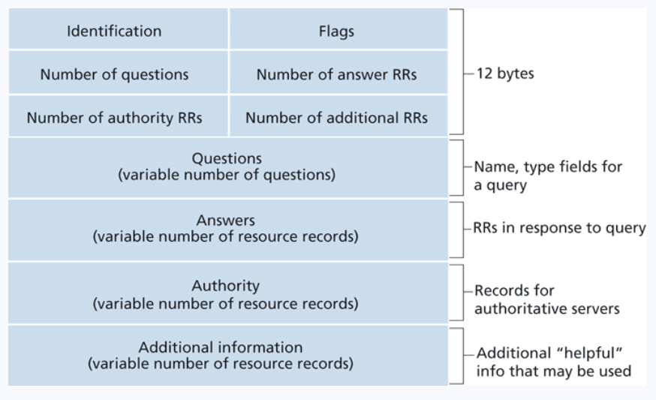
DNS Header
The domain name of the request
Ie. Google.com
If the IP address was found, it will go here
Contains records that point towards authoritative nameservers
Contains records that point towards authoritative nameservers

Slide 23
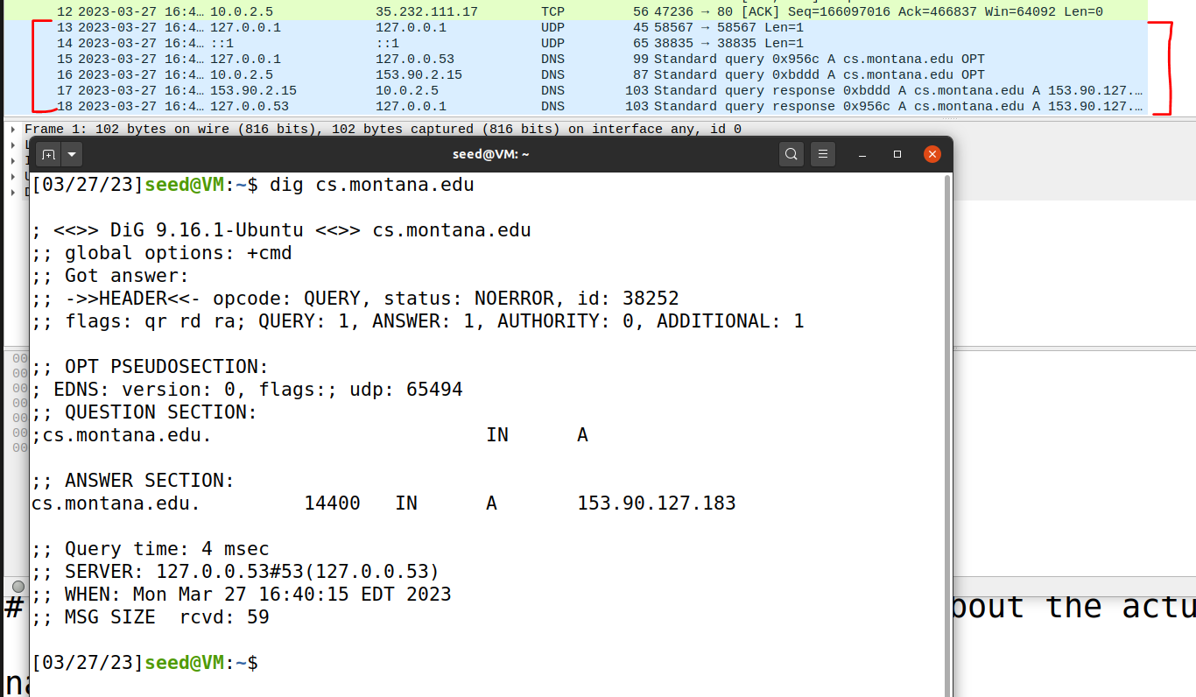

DNS In Wireshark
The dig command is used to issue DNS requests via the command line

Slide 24
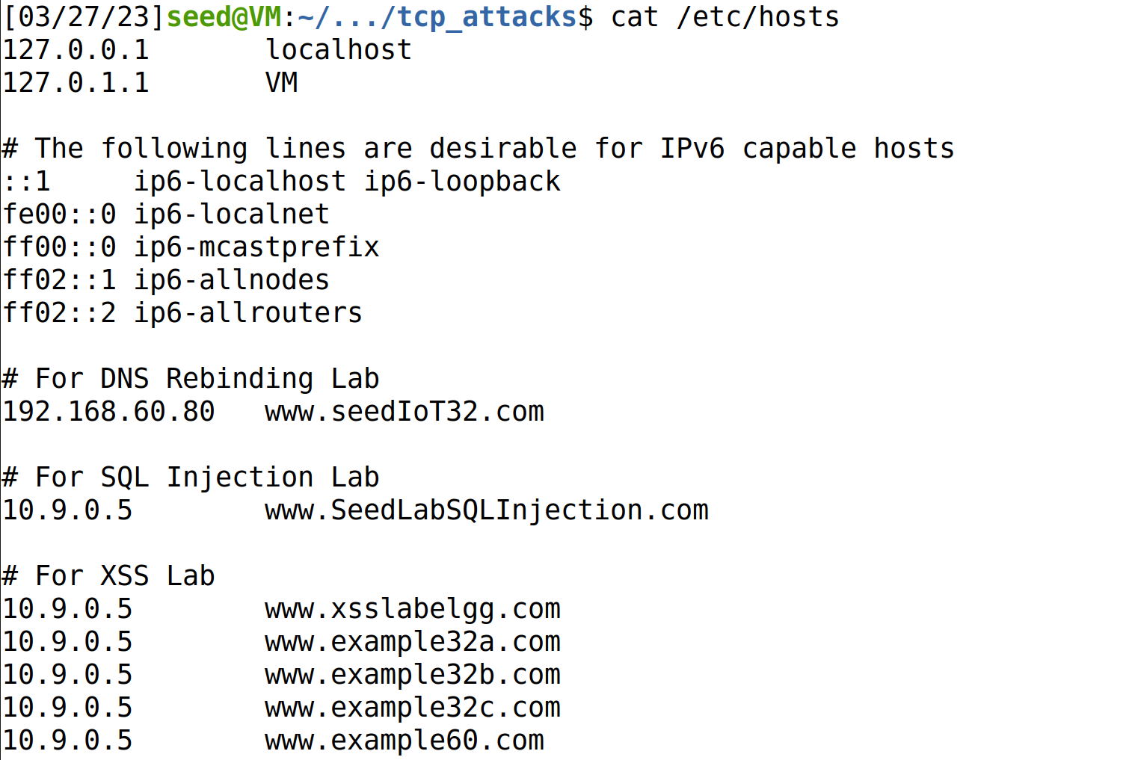
On Linux, the /etc/hosts holds static IP mappings for domain names
If we can compromise a machine, we can update /etc/hosts and inject IP address for malicious webpages

Slide 25
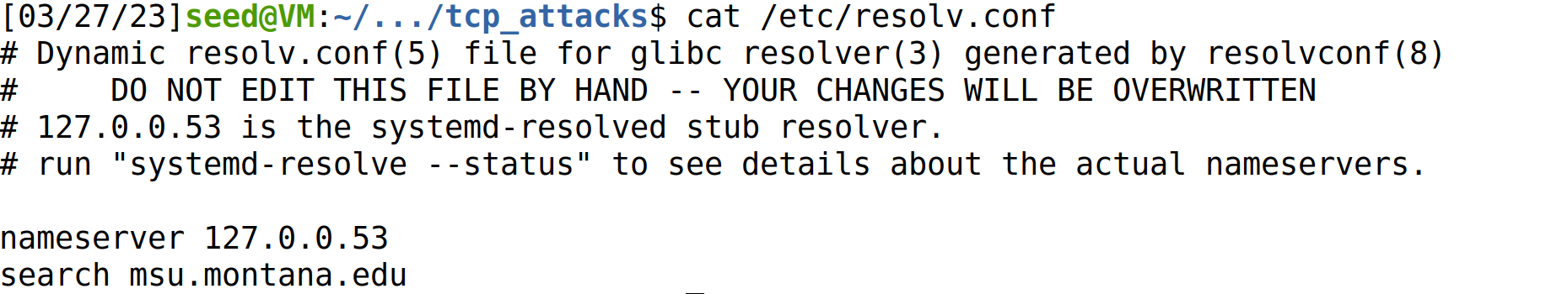
On Linux, the /etc/resolv.conf holds IP mappings for DNS server
If we can compromise a machine, we can update /etc/resolv.conf and inject IP address for malicious DNS servers**
**much more difficult

Slide 26
Attacks on the DNS protocol
When the user sends out a DNS request for a website they want to visit, they will have to wait for a response from a DNS server
This process of DNS resolving can take some time…
If an attacker wanted to cause some trouble, they could ???

Slide 27
Attacks on the DNS protocol
When the user sends out a DNS request for a website they want to visit, they will have to wait for a response from a DNS server
This process of DNS resolving can take some time…
If an attacker wanted to cause some trouble, they could spoof a packet to the user that has a malicious DNS response

Slide 28
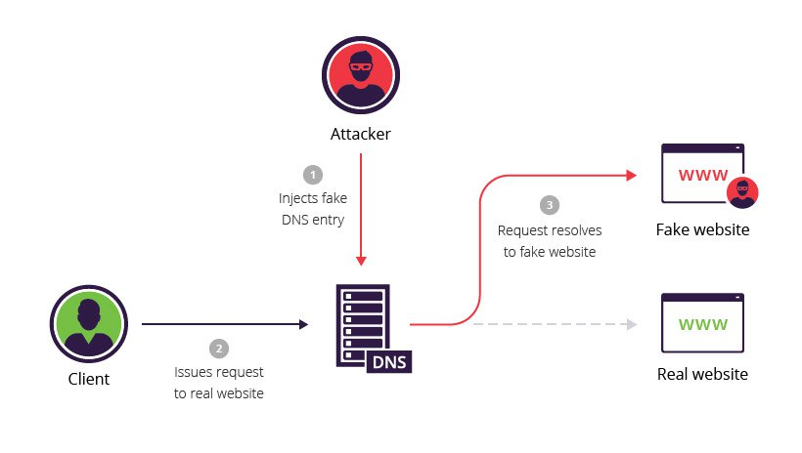
DNS Cache Poisoning Attack
A DNS cache poisoning attack is done by tricking a server into accepting malicious, spoofed DNS information
Instead of going to the IP address of the legitime website, they will go to the IP address that we place in our malicious DNS response (spoofed)
The DNS response is CACHED, which means the user will visit the malicious website in future visits**

