Slide 1

CSCI 476: Computer Security
Network Security: DNS Cache Poisoning (Part 2)
Reese Pearsall
Spring 2023
https://www.cs.montana.edu/pearsall/classes/spring2023/476/main.html

Slide 2

Announcements
No Class on Friday
Lab 7 (DNS Attacks) due Monday 4/10
Next Monday’s lecture will be asynchronous (don’t come to class)

Slide 3






Spoofing a DNS response to the local DNS server (Task 2)
Internet
Got a response!
Got a response!
Cache
10.9.0.5
Client Container
10.9.0.53
Local DNS Server
“The IP Address for example.com is 1.2.3.4”
Step 1. Sniff for outgoing DNS traffic from the local DNS server
Step 2. Using information from the sniffed packet, spoof a packet to the Local DNS server that looks like the packet came from a Global DNS server
Step 3. The Local DNS Server accepts packet and caches it and send a DNS response to the client

Slide 4

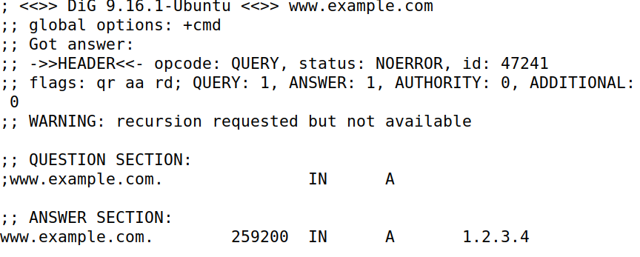
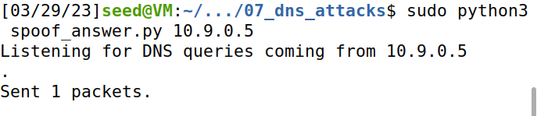



Our attack method is the exact same, except we sniff for a different IP address
Spoofing a DNS Response packet to the LOCAL DNS Server
Attacker VM (10.9.0.1)
Local DNS Sever (10.9.0.53)
Victim Container (10.9.0.5)
1. On the attacker VM, run the sniff/spoof python script
2. docksh into the local DNS server container and flush the cache
3. docksh into the victim container and run the dig command to send a DNS query for example.com
4. Our sniffer picks up the DNS query, and spoofs a response to the Victim
5. The response of our Dig command should be 1.2.3.4
(the malicious IP that came from our spoofed packet)!
“The IP Address for example.com is 1.2.3.4”

Slide 5
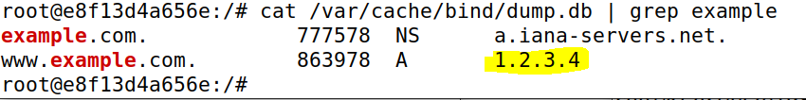

Spoofing a DNS Response packet to the LOCAL DNS Server
Local DNS Sever (10.9.0.53)
Cache
Important: When we attack the Local DNS Sever, our spoofed DNS response gets cached by the DNS server
Whenever someone asks this local DNS server for the IP address of example.com, it will always return 1.2.3.4 right away
We have “poisoned” this DNS server

Slide 6




Spoofing a DNS Response packet to the LOCAL DNS Server
Local DNS Sever (10.9.0.53)
Cache
DNS Servers hold DNS Records
Type A Records: IPv4 Addresses. Ie. the IP Address for www.example.com is 1.2.3.4
Type NS Records: Authoritative DNS Servers for a domain. Ie. the Authoritative DNS Server for www.example.com is a.iana-servers.net

Slide 7

Spoofing a DNS Response packet to the LOCAL DNS Server
Local DNS Sever (10.9.0.53)
Cache
DNS Servers hold DNS Records
Type A Records: IPv4 Addresses. Ie. the IP Address for www.example.com is 1.2.3.4
Type NS Records: Authoritative DNS Servers for a domain. Ie. the Authoritative DNS Server for www.example.com is a.iana-servers.net
Our next task will be to poison a local DNS cache with NS type records.
→ Visitor that want to access any webpage in the domain example.com will use the attackers nameserver

Slide 8
Spoofing NS Records (Task 3)
Real nameserver for example.com
(a.iana-servers.net)
DNS Queries
www.blah.example.com
Cache
10.9.0.53
Local DNS Server
10.9.0.153
Attacker’s Nameserver (authoritative)
zone: attacker32.com
www.products.example.com
DNS Records on 10.9.0.53 (the “cache”)
www.safe.example.com
example.com | NS | a.iana-servers.net
www.reese.com | A | 5.6.7.8
Facebook.com | NS | 192.68.7.223

Slide 9


Spoofing NS Records (Task 3)
Real nameserver for example.com
www.blah.example.com
DNS Queries
Cache
1.2.3.4
10.9.0.53
Local DNS Server
10.9.0.153
Attacker’s Nameserver (authoritative)
zone: attacker32.com
www.products.example.com
1.2.3.4
DNS Records on 10.9.0.53 (the “cache”)
www.safe.example.com
example.com | NS | attacker32.com
www.reese.com | A | 5.6.7.8
Facebook.com | NS | 192.68.7.223
1.2.3.4
We must contact the example.com authoritative nameserver to get the IP address. If we poison the local DNS server with malicious NS records, it will use the attackers nameserver

Slide 10
Spoofing NS Records
Attacker VM (10.9.0.1)
Local DNS Sever (10.9.0.53)
Victim Container (10.9.0.5)
1. Flush the Local DNS Cache

Slide 11
Spoofing NS Records
Attacker VM (10.9.0.1)
Local DNS Sever (10.9.0.53)
Victim Container (10.9.0.5)
2. Run Python script that will sniff and spoof DNS responses
1. Flush the Local DNS Cache

Slide 12
Spoofing NS Records
Attacker VM (10.9.0.1)
Local DNS Sever (10.9.0.53)
Victim Container (10.9.0.5)
3. Run dig command to generate DNS traffic
2. Run Python script that will sniff and spoof DNS responses
1. Flush the Local DNS Cache

Slide 13
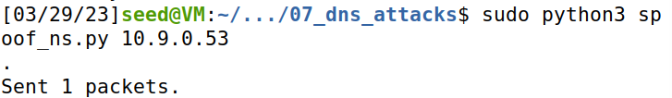
Spoofing NS Records
Attacker VM (10.9.0.1)
Local DNS Sever (10.9.0.53)
Victim Container (10.9.0.5)
3. Run dig command to generate DNS traffic
2. Run Python script that will sniff and spoof DNS responses
1. Flush the Local DNS Cache
4. Our sniffer program detects a new DNS query, and spoofs an NS response

Slide 14
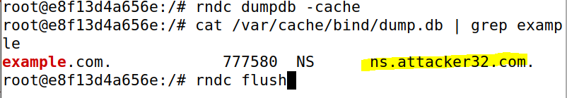

Spoofing NS Records
Attacker VM (10.9.0.1)
Local DNS Sever (10.9.0.53)
Victim Container (10.9.0.5)
3. Run dig command to generate DNS traffic
2. Run Python script that will sniff and spoof DNS responses
1. Flush the Local DNS Cache
5. Check the cache on the local DNS server
4. Our sniffer program detects a new DNS query, and spoofs an NS response
Whenever somebody contacts a domain under example.com, it will use the attacker’s nameserver!!

Slide 15
Remote DNS servers?
Packet spoofing countermeasures?
Coming soon ™

Slide 16
Lab 7

Slide 17
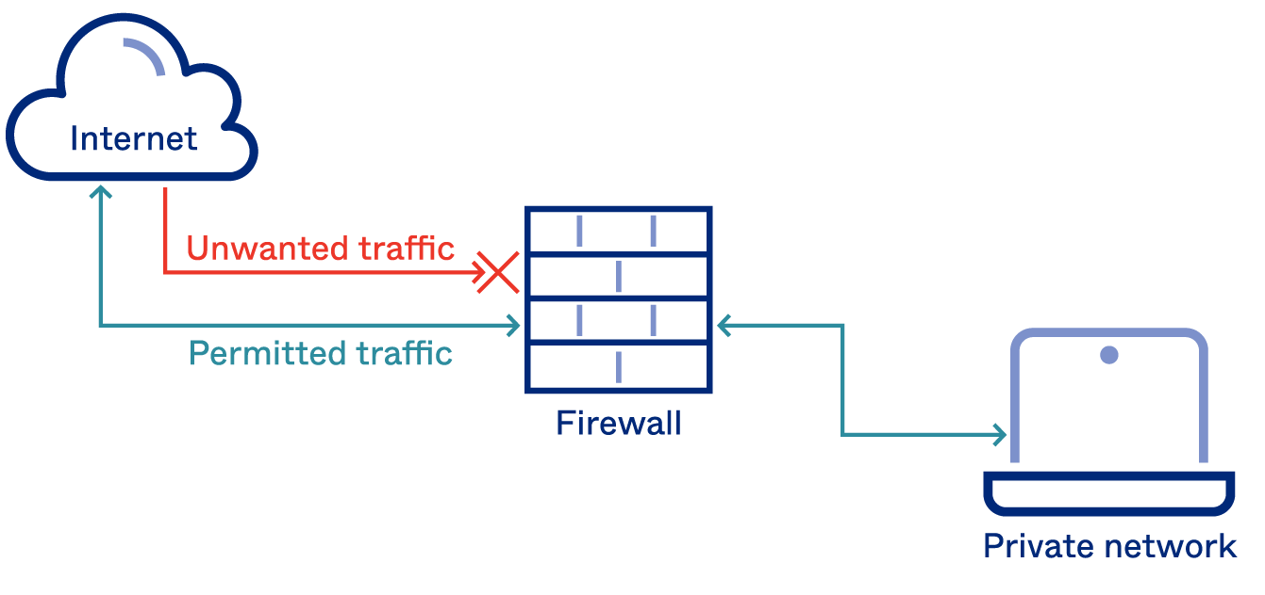
A firewall is a part of a computer system or network that is designed to stop unauthorized traffic from one network to another.
All traffic must “pass” through the firewall
Only authorized traffic should be allowed to pass through
The firewall itself must be immune to penetration

Slide 18
A firewall is a part of a computer system or network that is designed to stop unauthorized traffic from one network to another.
All traffic must “pass” through the firewall
Only authorized traffic should be allowed to pass through
The firewall itself must be immune to penetration
Packets are analyzed by the Firewall, and are:
Accepted
Denied/Dropped
Rejected (source of packet gets a rejection message)

Slide 19
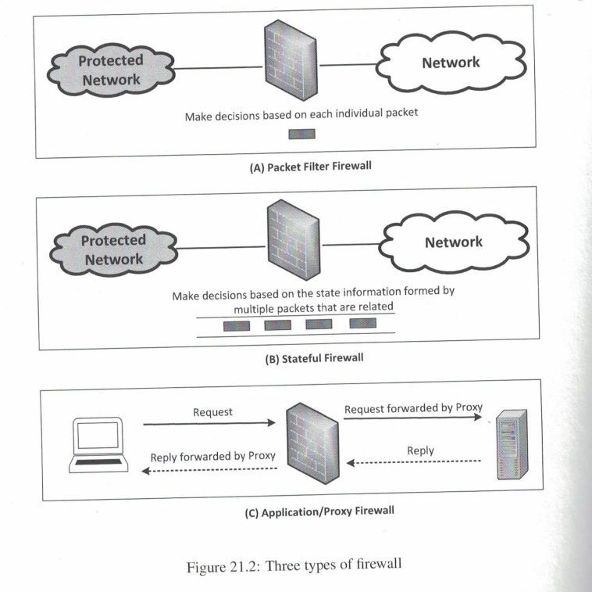
Three types of firewalls
Packet Filter
→ Makes decisions based on information within packet (IP address, port #s, etc)
2. Stateful Firewall
→ Makes decisions based “sessions” and streams of related packets
3. Application/Proxy Firewall
Can inspect traffic at many layers of the OSI model
Acts as a middleman between sender and recipient
Proxy can handle authentication, which can prevent IP spoofing attacks on the server

Slide 20
Implementing a Firewall in Linux
Linux has a built-in Firewall that we can play around with, called iptables
Iptables consists of three tables, and tables consist of chains (rules)
Table Name | Purpose
filter | Packet Filtering
nat | Modifying source or destination network address
mangle | Packet content modification
We will only focus on the filter table

Slide 21




Implementing a Firewall in Linux
Tables consist of chains (rules)
Three types of chains:
INPUT- rule for incoming traffic
OUTPUT- rule for outgoing traffic
FORWARD- rule for forwarding traffic
Input
Output
Forward

Slide 22


Implementing a Firewall in Linux
Tables consist of chains (rules)
We can add a rule to a chain by following this format
iptables –t filter –A input <rule information>
Add rule to filter table
(if table name is not provided, filter will be used by default)
Rule is getting Appended to the input chain, which means it’s a rule for incoming traffic

Slide 23
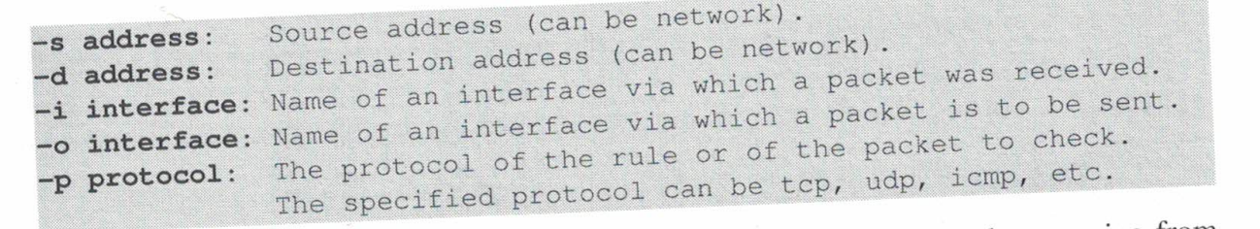
Implementing a Firewall in Linux
iptables –t filter –A input <rule information>
We can provide a variety of flags to provide rule information
Putting this all together, we can now add a rule:
iptables –t filter –A INPUT –s 192.168.60.6 –j ACCEPT

Slide 24










Implementing a Firewall in Linux
iptables –t filter –A input <rule information>
We can provide a variety of flags to provide rule information
Putting this all together, we can now add a rule:
iptables –t filter –A INPUT –s 192.168.60.6 –j ACCEPT
Add a rule for incoming traffic to the filter table: accept packets that have a source IP address of 192.168.60.6
(There is a default rule to accept everything for all chains, so this doesn’t really do anything…)

Slide 25
Implementing a Firewall in Linux
iptables –t filter –A input <rule information> -j action
We can provide a variety of flags to provide rule information
Putting this all together, we can now add a rule:
iptables –t filter –A INPUT –s 10.9.0.1 –j DROP
Block (drop) all incoming traffic that comes from 10.9.0.1 (The attacker VM!!)

Slide 26
Implementing a Firewall in Linux
iptables –t filter –A input <rule information> -j action
We can provide a variety of flags to provide rule information
Putting this all together, we can now add a rule:
iptables –t filter –A OUTPUT –d 10.9.0.1 –j DROP
Block (drop) all outgoing traffic that is going to 10.9.0.1 (The attacker VM!!)

Slide 27
Implementing a Firewall in Linux
iptables –t filter –A input <rule information> -j action
We can provide a variety of flags to provide rule information
Putting this all together, we can now add a rule:
iptables –t filter –A INPUT –p tcp –j DROP
Block all incoming traffic that is using the TCP protocol

Slide 28
Implementing a Firewall in Linux
iptables –t filter –A input <rule information> -j action
We can provide a variety of flags to provide rule information
Putting this all together, we can now add a rule:
iptables –t filter –A INPUT –p tcp –j DROP
Block all incoming traffic that is using the TCP protocol
This will help prevent TCP flooding/reset/hijack… but this rule is a very bad idea

Slide 29
Implementing a Firewall in Linux
iptables –t filter –A input <rule information> -j action
We can provide a variety of flags to provide rule information
Putting this all together, we can now add a rule:
iptables –t filter –A INPUT –i eth0 -p tcp –-dport 443 –j ACCEPT
We can have multiple conditions in one rule:
Accept all incoming traffic on the eth0 interface and is TCP traffic for destination port 443 (???)

Slide 30
Implementing a Firewall in Linux
iptables –t filter –A input <rule information> -j action
We can provide a variety of flags to provide rule information
Putting this all together, we can now add a rule:
iptables –t filter –A INPUT –i eth0 -p tcp –-dport 443 –j ACCEPT
We can have multiple conditions in one rule:
Accept all incoming traffic on the eth0 interface and is TCP traffic for destination port 443 (HTTPS)

Slide 31
Implementing a Firewall in Linux
iptables –t filter –A input <rule information> -j action
We can provide a variety of flags to provide rule information
Putting this all together, we can now add a rule:
iptables -A OUTPUT -o eth0 -p tcp --dport 22 -j ACCEPT
iptables -A INPUT -i eth0 -p tcp --sport 22 -j ACCEPT
Allow for SSH connections (port 22)

Slide 32
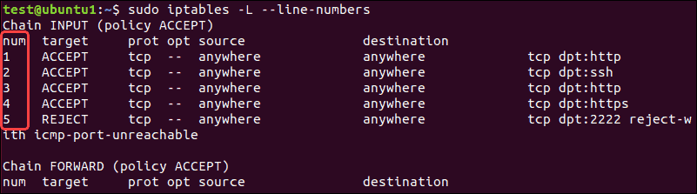
Implementing a Firewall in Linux
We can use iptables –n –L to view our tables + chains
Rules at the top of the chain have higher priority. If a packet matches one of the rules, it won’t check the remaining rules
(so, it is very common practice to move around rules in the chain)

