Slide 1

CSCI 476: Computer Security
Hashing (Part 1)
Reese Pearsall
Fall 2022
https://www.cs.montana.edu/pearsall/classes/fall2022/476/main.html

Slide 2
Announcements
Lab 8 due Wednesday April 19th
Research Project due April 23rd

Slide 3

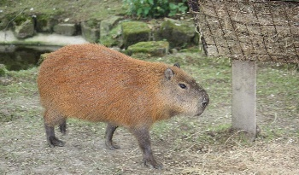

Applications of Hashing
Output space of MD5 (128 bits)
00000000000000000000000000000000
31973ff867a5a4c2546ec4cca1c126b4
MD5
73bd1ddd3ef1051bf5c4bde7a2b5a6c2
c527fc24f5932e932f44c31f1f8c674e
password123
e2ee5b2d1719edef3f8120cff39f0180
FFFFFFFFFFFFFFFFFFFFFFFFFFFFFFFF

Slide 4
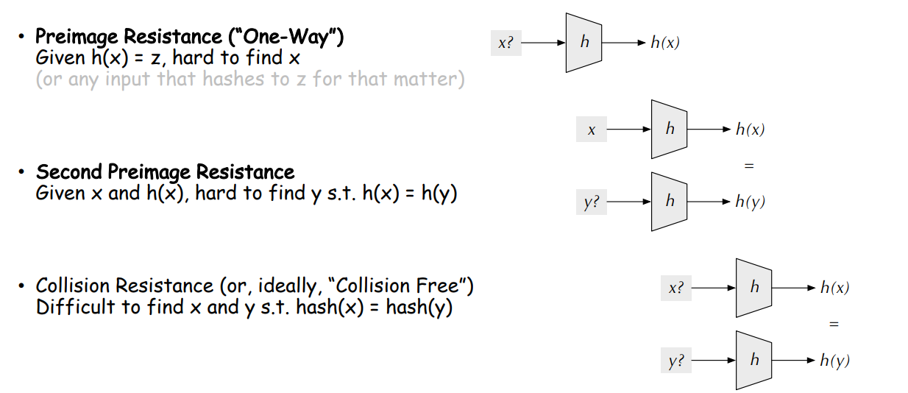
Hash Functions Properties

Slide 5
Hash Functions Properties (tl;dr)
Gives an arbitrary size input a fixed-size unique* hash identifier
Hash values are very difficult to reverse. They were designed to be one-way
The go-to way to reverse a hash is through brute force

Slide 6
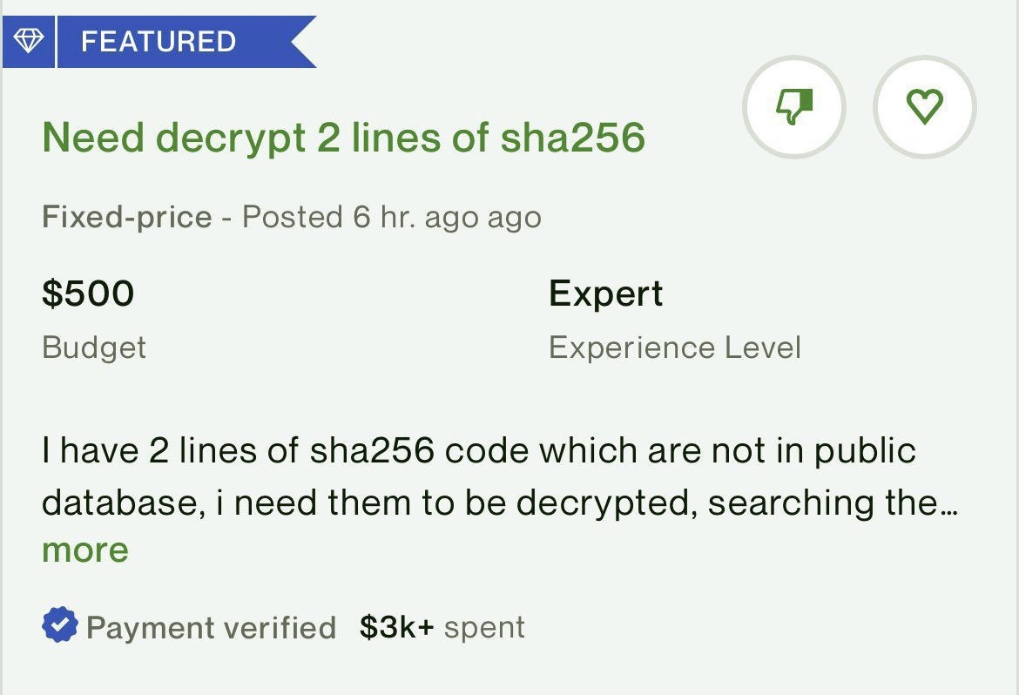

Slide 7
Brute Force Approaches
Long time, and for very unfeasible for cryptographically secure hash functions
Given a hashed password, can you brute force the original password?
afc285bebb3dd733796cb06db01cd59a
Techniques
Dictionary Attack
Rainbow Tables

Slide 8
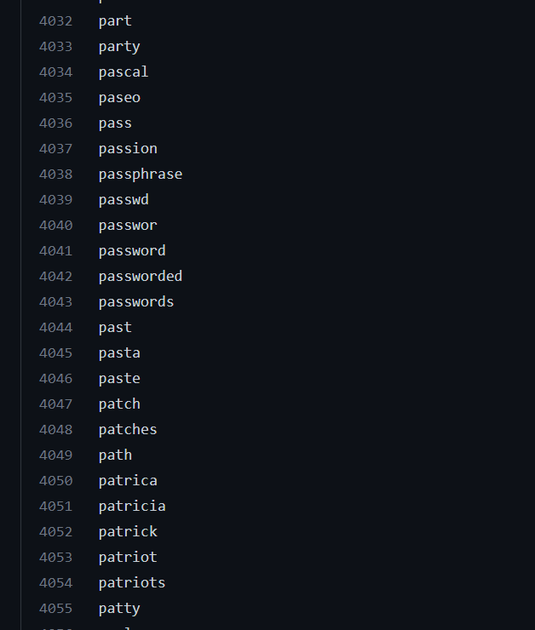




Dictionary Attack
We will use an existing list of common passwords
Iterate through each line of file
Compute hash of word
Check for match
This works for cracking weak, unsalted passwords

Slide 9
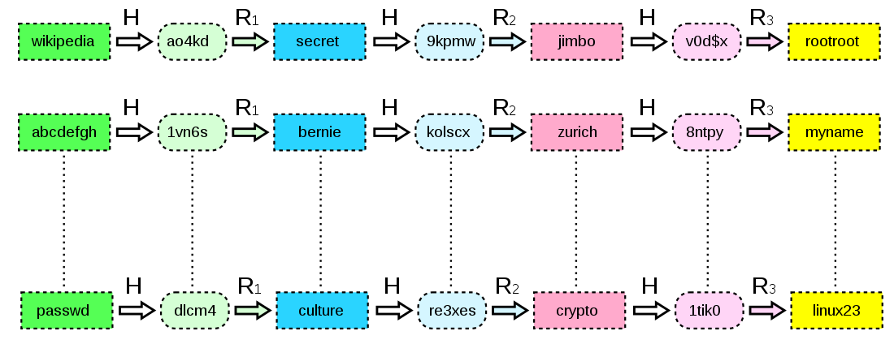
Rainbow Tables
A large file of pre-computed hashes
Efficient way to store password hashes. Consists of plaintext-hash chains
Hash
Reduce
Hash
Reduce
Word
Hash
Word
Hash
Looking up a value in the rainbow table can happen quick, but these files are typically very large
Not efficient for complex, salted passwords
(Brute force can take years, with rainbow tables, it can take weeks/months)
Project-RainbowCrack

Slide 10
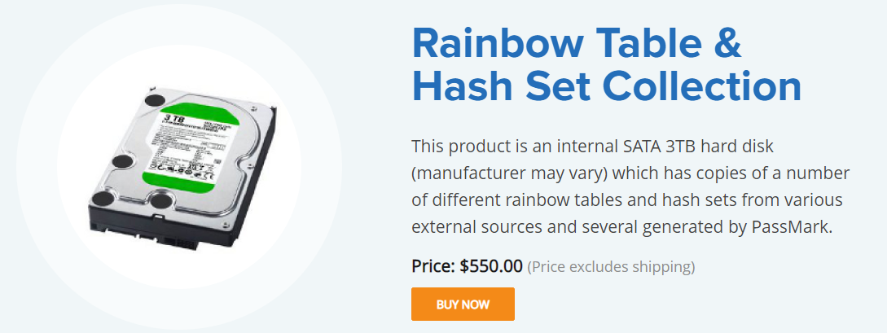
Rainbow Tables
Tables for alphanumeric, special character passwords can take a long time to generate, so instead of doing it yourself, you can buy rainbow tables that other people have generated!
There are free, open-source tools that can generate rainbow tables for you
Project-RainbowCrack

Slide 11
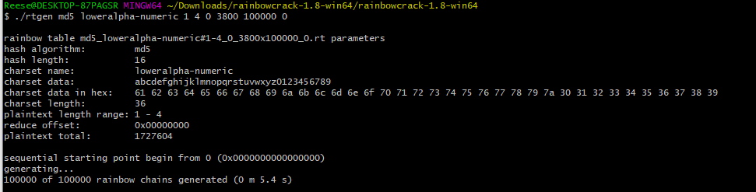
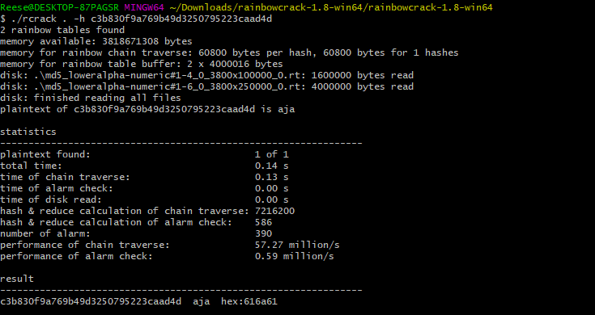



Rainbow Tables using RainbowCrack

Slide 12
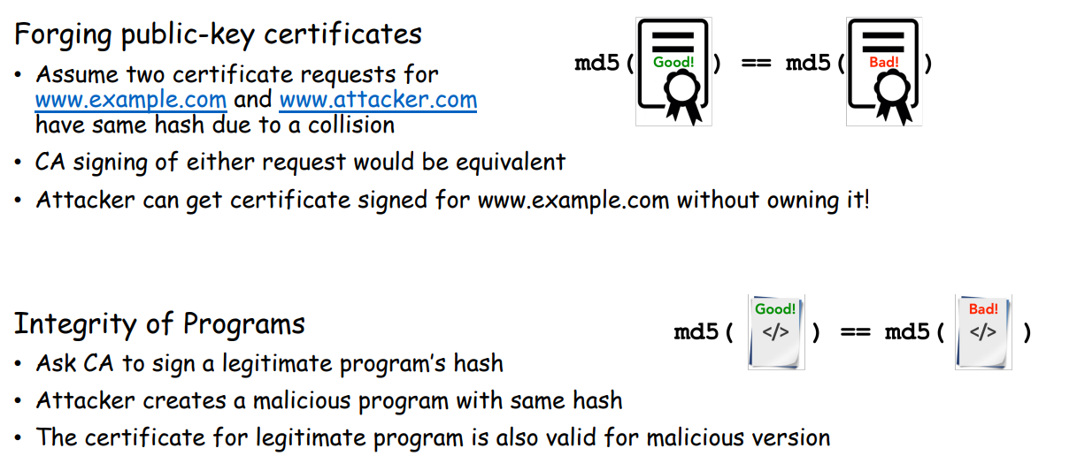
Hash Collisions
Goal: Create two different files with the same md5 hash
Our ultimate goal would be to create two executables (one benign, one malicious) with the same hash
(This is difficult to do, but we will show that it can theoretically happen)
Motivation

Slide 13
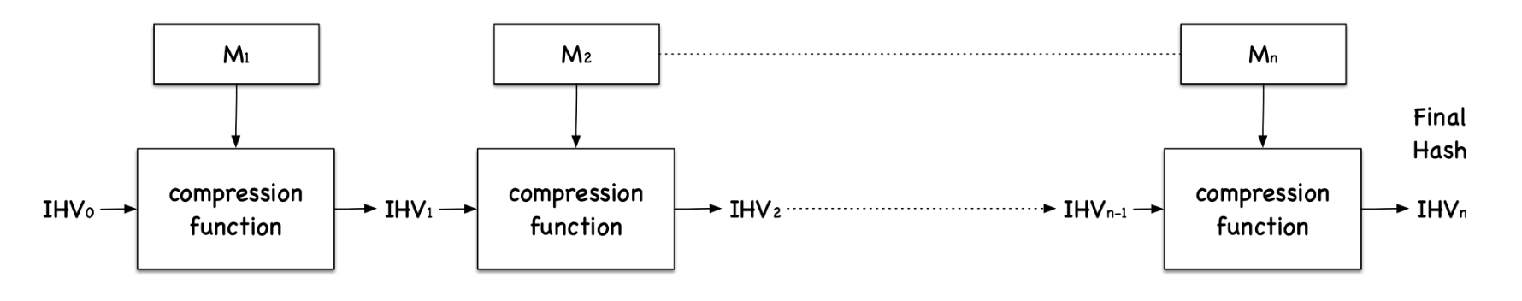
Hash Collisions (MD5collgen)
On our VM, we have a tool called md5collgen that will generate two files with the same prefix
We get to choose this prefix!
MD5 Under the hood
Fact: Message is divided into blocks, and each block is run through a compression function
Important Fact: Each block will be 64 bytes

Slide 14
Hash Collisions (MD5collgen)
On our VM, we have a tool called md5collgen that will generate two files with the same prefix
We get to choose this prefix!

Slide 15
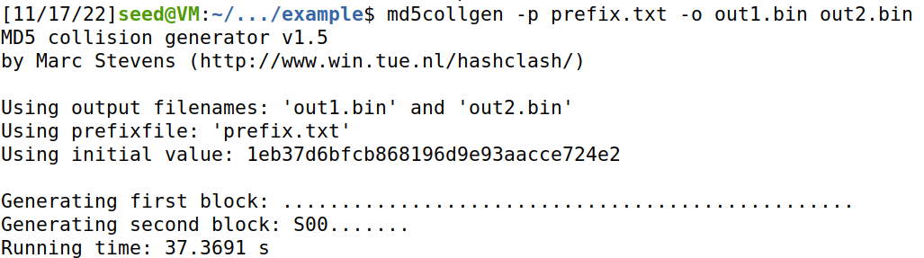
Hash Collisions (MD5collgen)
On our VM, we have a tool called md5collgen that will generate two files with the same prefix
We get to choose this prefix!

Slide 16
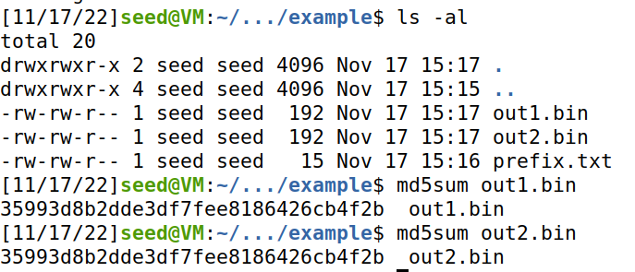
Hash Collisions (MD5collgen)
On our VM, we have a tool called md5collgen that will generate two files with the same prefix
We get to choose this prefix!
Same Hash!

Slide 17
Hash Collisions (MD5collgen)
On our VM, we have a tool called md5collgen that will generate two files with the same prefix
We get to choose this prefix!
Same Hash!
Compare with xxd

Slide 18
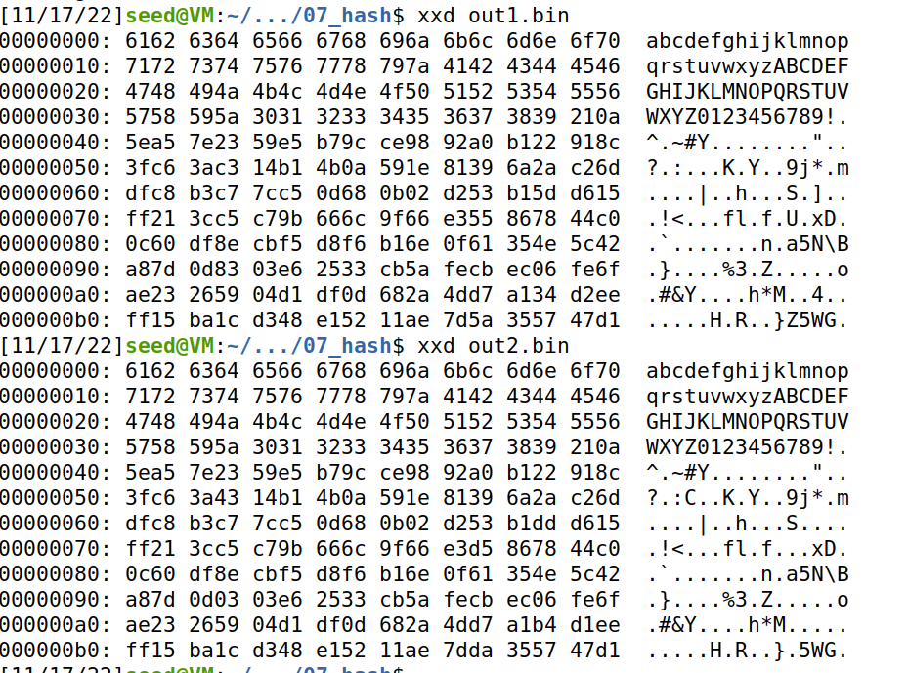
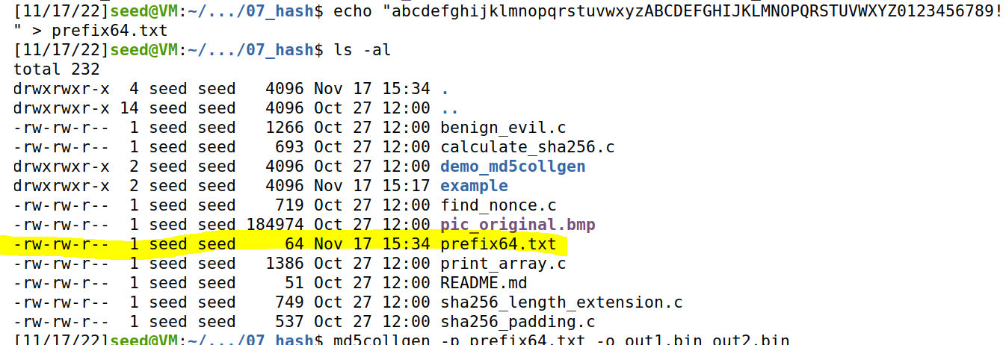
Hash Collisions (MD5collgen)
What if out prefix is a multiple of 64?
Our prefix is exactly 64 bytes
→ No padding is added!

Slide 19
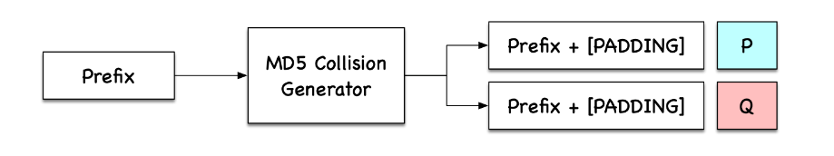
Hash Collisions (MD5collgen)
What if out prefix is a multiple of 64?

Slide 20
Hash Collisions (Suffix Extension)
M
N
H(m) == H(n)

Slide 21
Hash Collisions (Suffix Extension)
H
H
H
H
H
H
H
H
H
Final Hash (same for each)
M
N
64 64 64 64 64 64
64 64 64
H(m) == H(n)

Slide 22
Hash Collisions (Suffix Extension)
If we append the same suffix, then this computation will also be the exact same for M and N
H
H
H
H
H
H
H
H
H
H
H
H
H
M
Suffix
N
Suffix
64 64 64 64 64 64
64 64 64
H(m) == H(n)

Slide 23
Hash Collisions (Suffix Extension)
If we append the same suffix, then this computation will also be the exact same for M and N
H
H
H
H
H
H
H
H
H
H
H
H
H
M
Suffix
N
Suffix
64 64 64 64 64 64
64 64 64
H(m) == H(n)
H(m || s) == H(n || s)
s = shared suffix

Slide 24
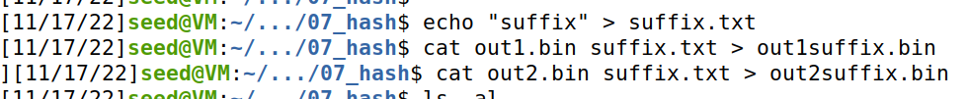
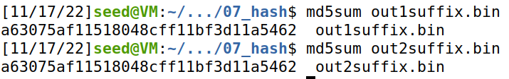
Hash Collisions (Suffix Extension)
If we append the same suffix, then this computation will also be the exact same for M and N
H
H
H
H
H
H
H
H
H
H
H
H
H
M
Suffix
N
Suffix
64 64 64 64 64 64
64 64 64
H(m) == H(n)
H(m || s) == H(n || s)
s = shared suffix
s = shared suffix

Slide 25
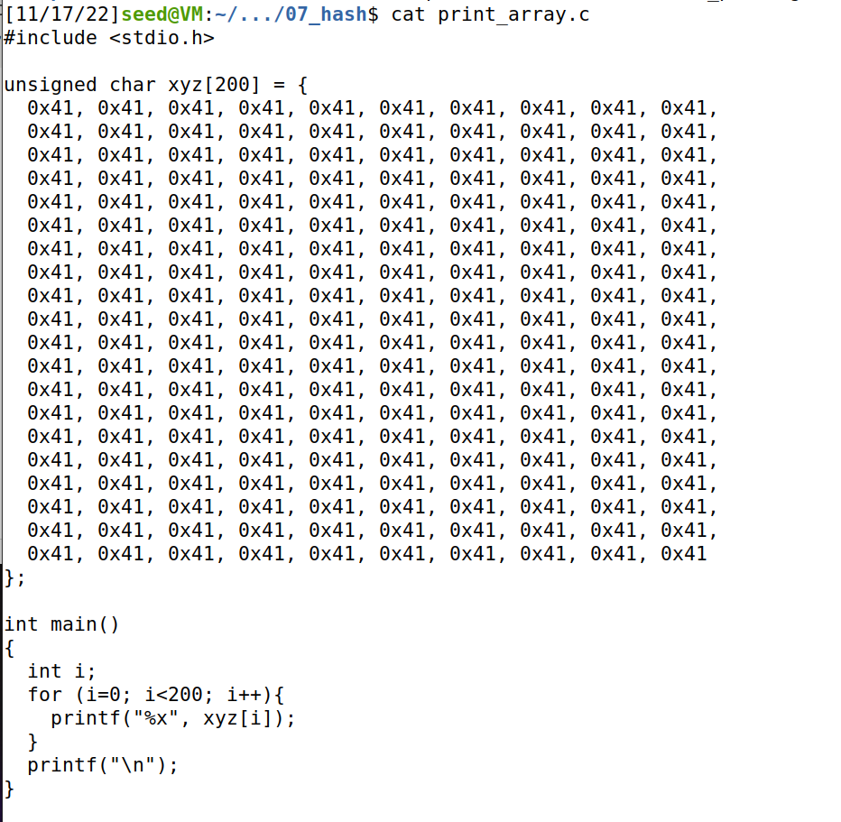
Hash Collisions (Generating Two executable files with the same MD5 hash)
This is a program that will print out the contents of an array
We will create two variants of this program, but the program will have the same hash
Prefix
P
Suffix
Prefix
Q
Suffix

Slide 26
Hash Collisions (Generating Two executable files with the same MD5 hash)
We will create two variants of this program, but the program will have the same hash
Prefix
Suffix

Slide 27
Hash Collisions (Generating Two executable files with the same MD5 hash)
We will create two variants of this program, but the program will have the same hash
Prefix
md5collgen( )
Prefix
P
Prefix
Q
These will have the same hash!
P and Q will be 128 bytes (multiple of 64)
Prefix
P
Suffix
Prefix
Q
Suffix
Because we know the suffix extension property holds true, we know the hash of these two programs will also be the same

Slide 28
Hash Collisions (Generating Two executable files with the same MD5 hash)
Prefix
Prefix
P
Q
Suffix
Suffix

Slide 29
Hash Collisions (Generating Two executable files with the same MD5 hash but behave very differently)
We can change the contents of this section of the program because it is just array data (it won’t break anything)
First, we need to find the starting location (the offset) of the xyz array → this will be the beginning of P and Q

Slide 30
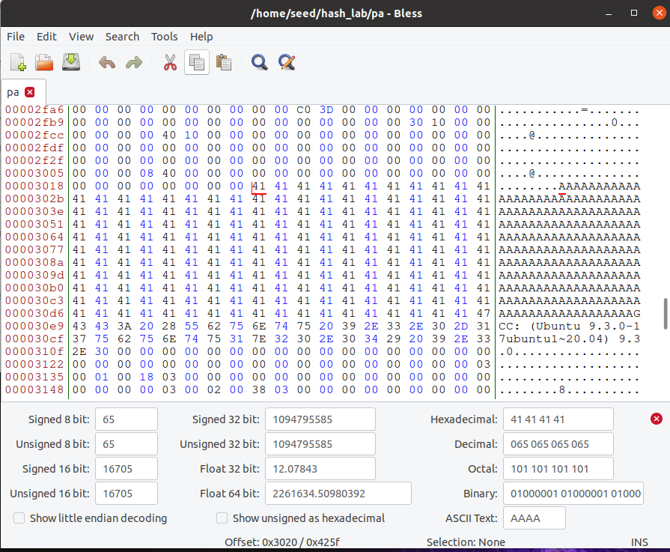
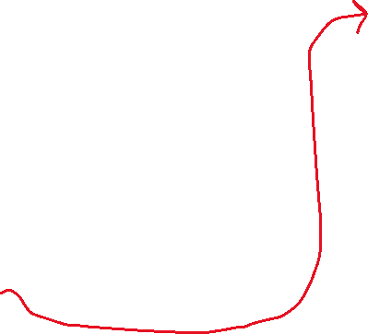

Hash Collisions (Generating Two executable files with the same MD5 hash but behave very differently)
We can find where xyz begins in our program easily, because we filled it with A’s
First Byte of xyz array
Start of XYZ = 0x3020 (Hexadecimal)
12320 (decimal)

Slide 31
Task 4 on the lab
0
Prefix
Our prefix will be bytes 0-12320 of the program!
12320
We want our P and Q to be 128 bytes
Why 128?
Multiple of 64
Wont overflow an array of size 200
(12320 is not a multiple of 64, which means that some padding will be added on, but in this case it’s fine because it will just go in our array section)

Slide 32
Task 4 on the lab
0
Prefix
Our prefix will be bytes 0-12320 of the program!
12320
P
Q
We want our P and Q to be 128 bytes
Why 128?
Multiple of 64
Wont overflow an array of size 200
128 bytes
(12320 is not a multiple of 64, which means that some padding will be added on, but in this case it’s fine because it will just go in our array section)

Slide 33
Task 4 on the lab
0
Prefix
Our prefix will be bytes 0-12320 of the program!
12320
P
Q
We want our P and Q to be 128 bytes
Why 128?
Multiple of 64
Wont overflow an array of size 200
128 bytes
13448
Therefore, our suffix will begin at byte # 12320 + 128 = 13448
Suffix
16992 (size of executable)

Slide 34
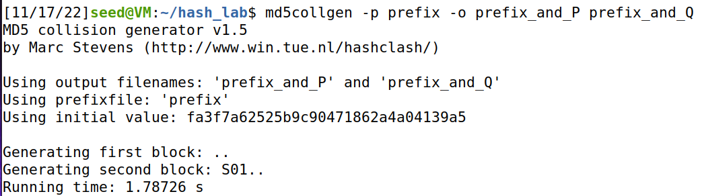
Task 4 on the lab
Get contents of prefix and suffix
0
Prefix
12320
P
Q
Use collision tool to get (prefix + P) and (prefix + Q)
128 bytes
13448
Suffix
16992 (size of executable)

Slide 35
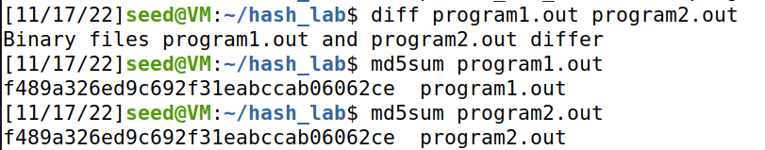


Task 4 on the lab
Get contents of prefix and suffix
0
Prefix
12320
P
Q
Use collision tool to get (prefix + P) and (prefix + Q)
128 bytes
13448
Add suffix to programs
Suffix
Verify that executables are different, but have the same hash
16992 (size of executable)

Slide 36
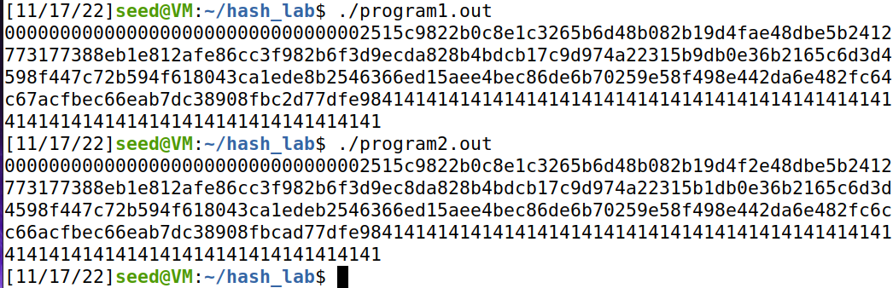

Task 4 on the lab
0
Prefix
12320
Make sure you still have a valid program ☺
P
Q
128 bytes
13448
Suffix
Somewhere in this output, you should find a small difference
16992 (size of executable)

