Slide 1

CSCI 476: Computer Security
Hashing (Part 3)
Reese Pearsall
Spring 2023
https://www.cs.montana.edu/pearsall/classes/spring2023/476/main.html

Slide 2
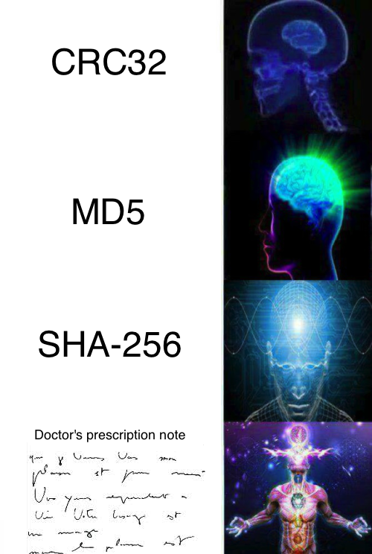
Announcements
Lab 8 due Wednesday April 19th
Research Project due April 23rd
Lab 9 due Sunday April 30th
Final Lab will be posted sometime after the research project
Due during finals week
You can earn extra credit for the final lab by attending lecture on 4/24, 4/26, 4/28, 5/1

Slide 3
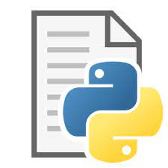
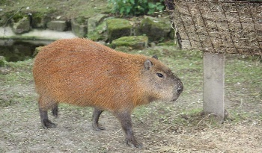

Applications of Hashing
Output space of MD5 (128 bits)
00000000000000000000000000000000
31973ff867a5a4c2546ec4cca1c126b4
MD5
73bd1ddd3ef1051bf5c4bde7a2b5a6c2
c527fc24f5932e932f44c31f1f8c674e
password123
e2ee5b2d1719edef3f8120cff39f0180
FFFFFFFFFFFFFFFFFFFFFFFFFFFFFFFF

Slide 4
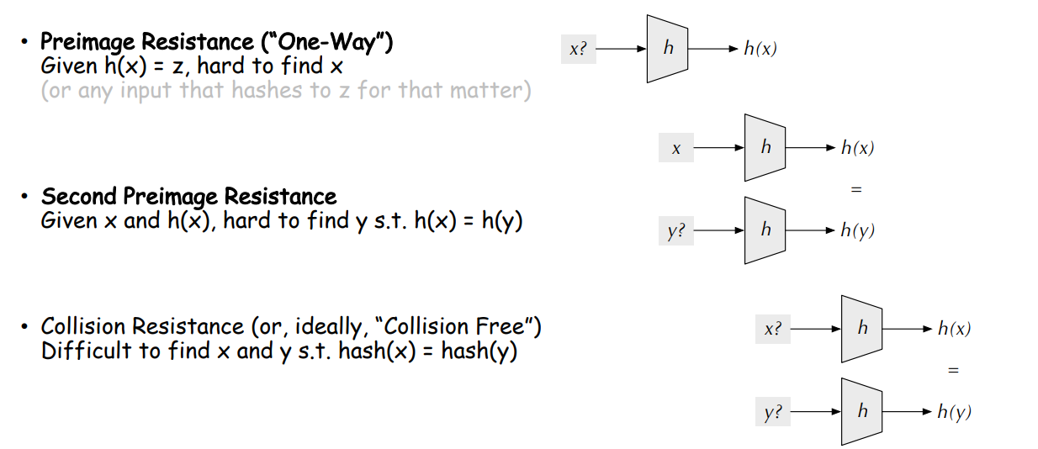
Hash Functions Properties

Slide 5
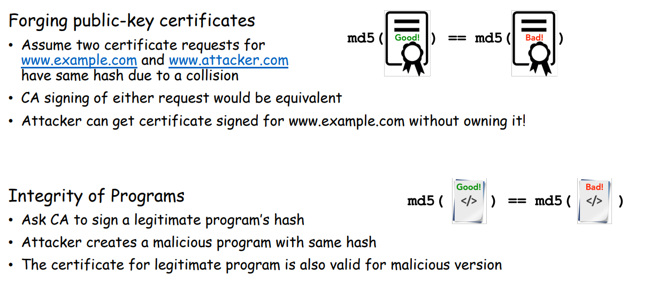
Hash Collisions
Goal: Create two different files with the same md5 hash
Our ultimate goal would be to create two executables (one benign, one malicious) with the same hash
(This is difficult to do, but we will show that it can theoretically happen)
Motivation

Slide 6
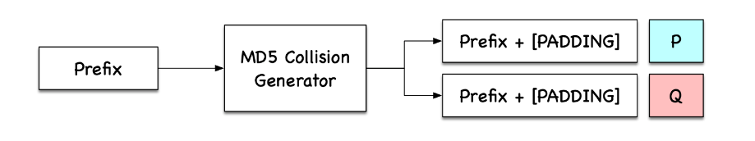
Hash Collisions (MD5collgen)

Slide 7
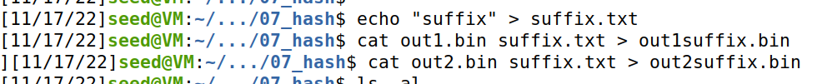
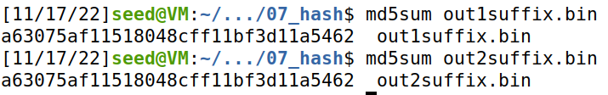
Hash Collisions (Suffix Extension)
If we append the same suffix, then this computation will also be the exact same for M and N
H
H
H
H
H
H
H
H
H
H
H
H
H
M
Suffix
N
Suffix
64 64 64 64 64 64
64 64 64
H(m) == H(n)
H(m || s) == H(n || s)
s = shared suffix
s = shared suffix

Slide 8
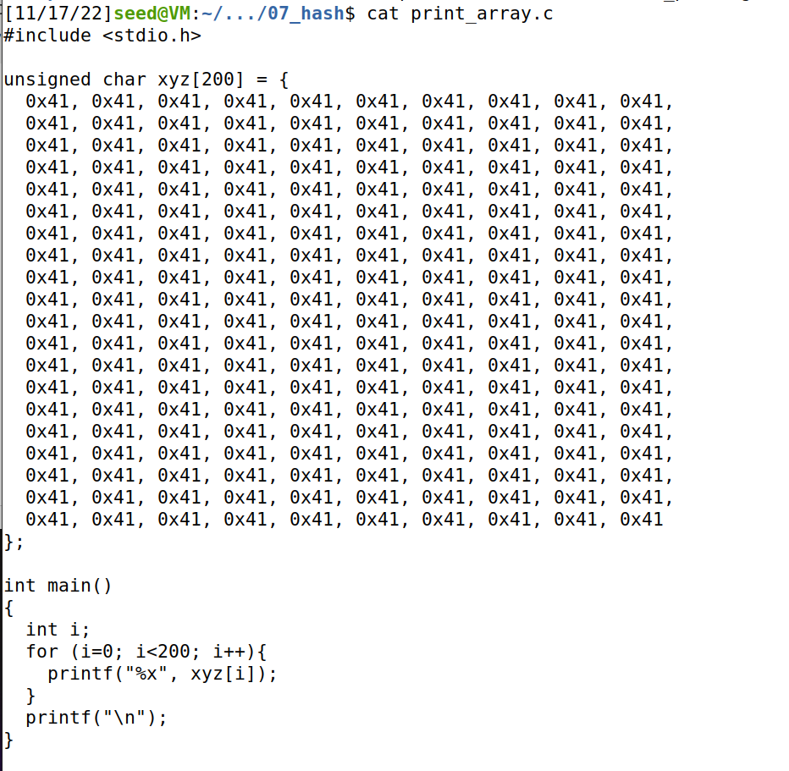
Hash Collisions (Generating Two executable files with the same MD5 hash)
This is a program that will print out the contents of an array
We will create two variants of this program, but the program will have the same hash
Prefix
P
Suffix
Prefix
Q
Suffix

Slide 9
Hash Collisions (Generating Two executable files with the same MD5 hash)
Prefix
Prefix
P
Q
Suffix
Suffix

Slide 10
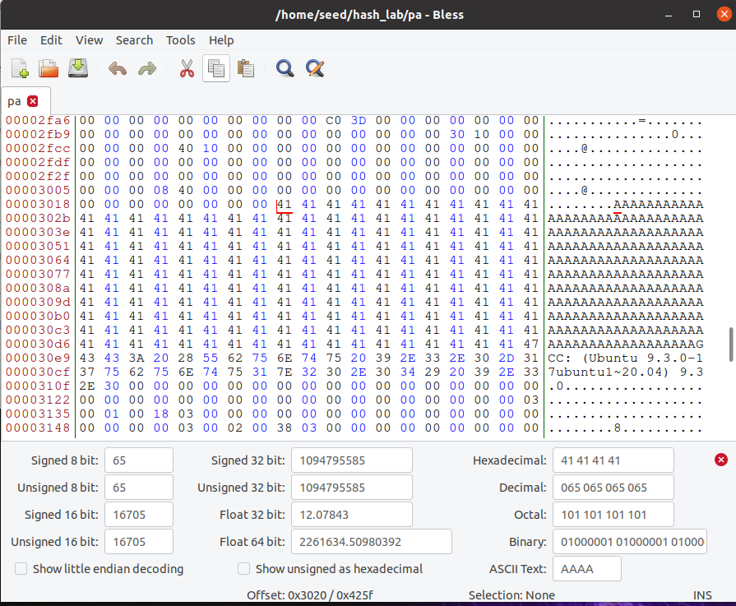
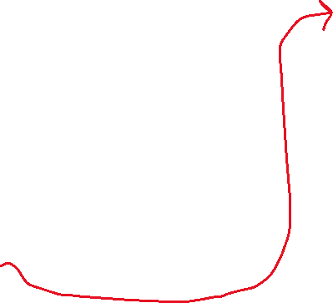

Hash Collisions (Generating Two executable files with the same MD5 hash but behave very differently)
We can find where xyz begins in our program easily, because we filled it with A’s
First Byte of xyz array
Start of XYZ = 0x3020 (Hexadecimal)
12320 (decimal)

Slide 11
Task 4 on the lab
0
Prefix
Our prefix will be bytes 0-12320 of the program!
12320
P
Q
We want our P and Q to be 128 bytes
Why 128?
Multiple of 64
Wont overflow an array of size 200
128 bytes
13448
Therefore, our suffix will begin at byte # 12320 + 128 = 13448
Suffix
16992 (size of executable)

Slide 12
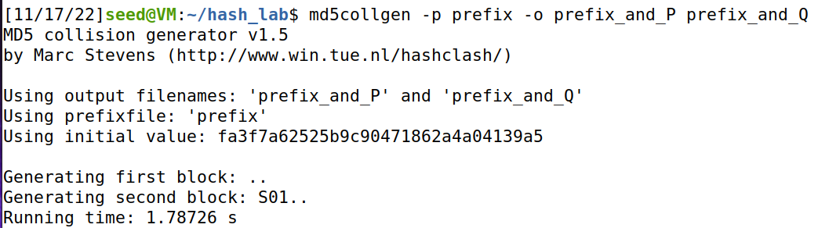
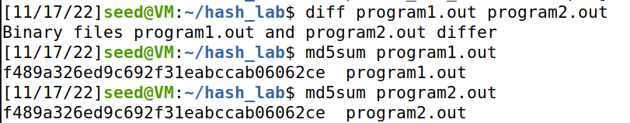


Task 4 on the lab
Get contents of prefix and suffix
0
Prefix
12320
P
Q
Use collision tool to get (prefix + P) and (prefix + Q)
128 bytes
13448
Add suffix to programs
Suffix
Verify that executables are different, but have the same hash
16992 (size of executable)

Slide 13
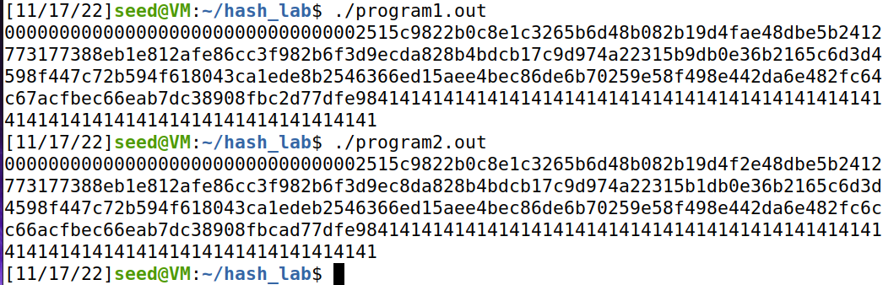

Task 4 on the lab
0
Prefix
12320
Make sure you still have a valid program ☺
P
Q
128 bytes
13448
Suffix
Somewhere in this output, you should find a small difference
16992 (size of executable)

Slide 14

Task 4 on the lab
0
Prefix
12320
Make sure you still have a valid program ☺
P
Q
128 bytes
13448
These programs print out different things, which is very benign
Our next goal is to write two programs with the same MD5 hash, but one does something malicious, and the other does something benign
Suffix
16992 (size of executable)

Slide 15
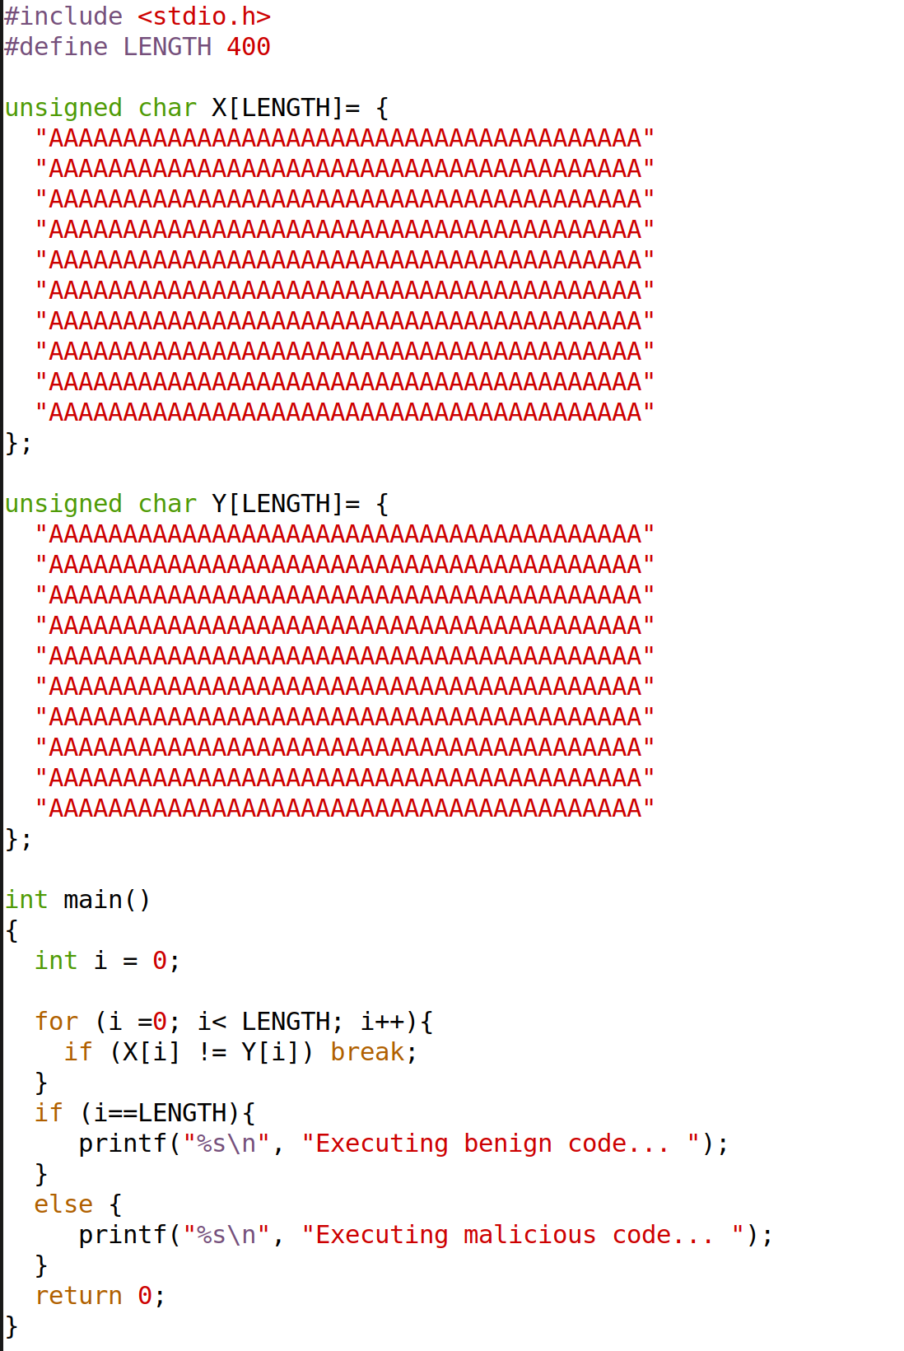
This program has two arrays X and Y
The program compares the contents of these two arrays

Slide 16



This program has two arrays X and Y
The program compares the contents of these two arrays
If the two arrays are the same, then it will execute the benign code

Slide 17


This program has two arrays X and Y
The program compares the contents of these two arrays
If the two arrays are the same, then it will execute the benign code
If the two arrays are different, then it will execute the benign code

Slide 18
Goal: Generate two variants of this program. One variant where the two arrays are the same (benign version), and one variant where the two arrays are different (malicious version)

Slide 19
Goal: Generate two variants of this program. One variant where the two arrays are the same (benign version), and one variant where the two arrays are different (malicious version)
P
P
Q
P
Because we can overwrite Array data without crashing the program, we will once again place P and Q (from md5collgen) into our arrays

Slide 20
Prefix
Prefix
P
P
Q
P

Slide 21
Prefix
Prefix
P
P
Because we are inserting P/Q at two different points into our program, we will have two suffixes
suffix1
suffix1
Q
P

Slide 22
Prefix
Prefix
P
P
Because we are inserting P/Q at two different points into our program, we will have two suffixes
suffix1
suffix1
Q
P
suffix2
suffix2

Slide 23
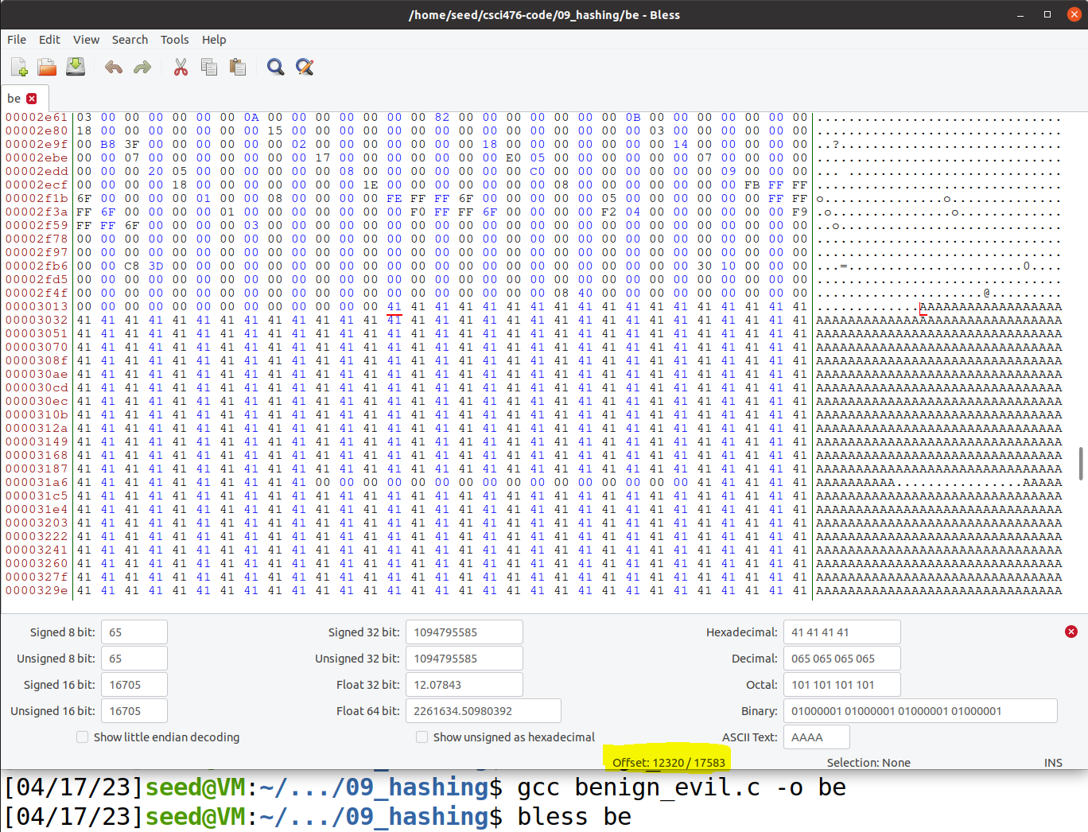
Memory Locations (Bytes)
Prefix
First, we must get the starting location of our array X
P
suffix1
Q
suffix2

Slide 24
Memory Locations (Bytes)
Prefix
First, we must get the starting location of our array X
P
suffix1
Q
Offset = 12320
Padding will mess up out attack, so we must make sure that padding doesn’t get added
suffix2
Offset = 12352 (multiple of 64)

Slide 25
Memory Locations (Bytes)
Prefix
First, we must get the starting location of our array X
P
suffix1
Q
Offset = 12320
Padding will mess up out attack, so we must make sure that padding doesn’t get added
suffix2
Offset = 12352 (multiple of 64)

Slide 26
Memory Locations (Bytes)
Offset = 12352
prefix
Prefix
12352
P
P and Q will once again be 128 bytes long
128 bytes
Therefore, P ends at (12352 + 128)
= 12480
12481
suffix
suffix1
(we have to add +1 when getting the suffix to prevent getting an extra byte)
Q
128 bytes
suffix2

Slide 27
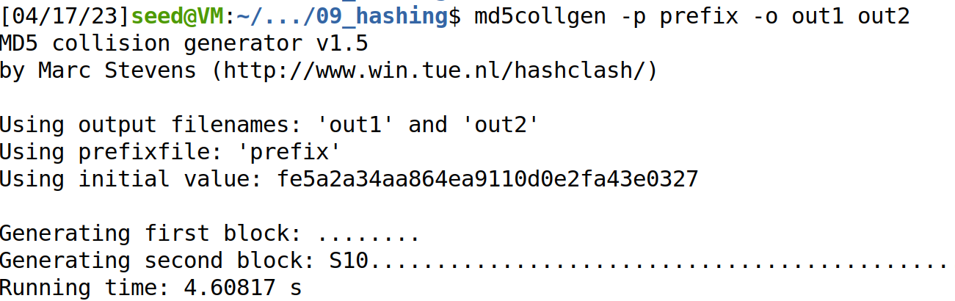
Memory Locations (Bytes)
prefix
Prefix
12352
P
Q
Now that we have the prefix, we can generate P and Q
P
128 bytes
12481
suffix
suffix1
Q
128 bytes
Because we just want P and Q (not the prefix), we will take the final 128 bytes of the output of out1 and out2
suffix2

Slide 28
Memory Locations (Bytes)
prefix
Prefix
To avoid padding, we had to move the beginning of P up 32 bytes into the array X, so when we insert P/Q into array Y, we need to make sure we also do 32 bytes
12352
P
Q
P
128 bytes
12481
suffix
suffix1
Array Y starts at 12736, but we need to inject at byte (12736 + 28) = 12768
12768
Q
128 bytes
suffix2

Slide 29
Memory Locations (Bytes)
prefix
Prefix
To avoid padding, we had to move the beginning of P up 32 bytes into the array X, so when we insert P/Q into array Y, we need to make sure we also do 32 bytes
12352
P
Q
P
128 bytes
12481
288 bytes
suffix
suffix1
Array Y starts at 12736, but we need to inject at byte (12736 + 28) = 12768
12768
Q
128 bytes
Therefore, the size of suffix1 will be
12768 – 12481 = 288
suffix2

Slide 30
Memory Locations (Bytes)
prefix
Prefix
To avoid padding, we had to move the beginning of P up 32 bytes into the array X, so when we insert P/Q into array Y, we need to make sure we also do 32 bytes
12352
P
Q
P
128 bytes
12481
288 bytes
suffix
suffix1
Array Y starts at 12736, but we need to inject at byte (12736 + 28) = 12768
12768
Q
128 bytes
Therefore, the size of suffix1 will be
12768 – 12481 = 288
417
Suffix 2 will begin at byte 288 + 128 = 416 of suffix (but we add +1 to prevent getting an extra byte)
suffix2

Slide 31
Memory Locations (Bytes)
prefix
Prefix
12352
P
Q
P
128 bytes
Now, we put everything together
12481
288 bytes
suffix
suffix1
12768
Q
128 bytes
417
suffix2

Slide 32
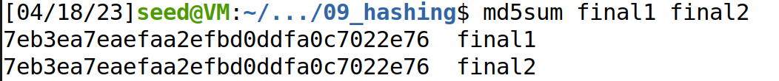

Memory Locations (Bytes)
prefix
Prefix
12352
P
Q
P
128 bytes
Now, we put everything together
12481
288 bytes
suffix
suffix1
12768
Q
Verify that hashes match:
128 bytes
417
suffix2

Slide 33
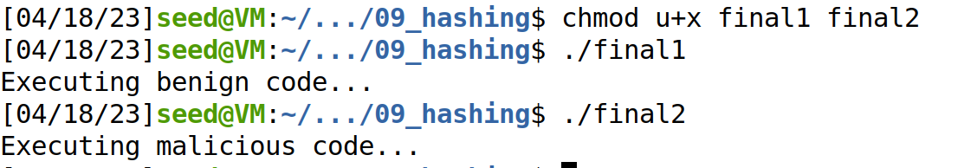


Memory Locations (Bytes)
prefix
Prefix
12352
P
Q
P
128 bytes
Now, we put everything together
12481
288 bytes
suffix
suffix1
12768
Q
Verify that hashes match:
128 bytes
417
Make programs executable and run them!
suffix2

