Slide 1

CSCI 476: Computer Security
Security + Threat Modeling
Reese Pearsall
Spring 2023
*all images are stolen from the internet
https://www.cs.montana.edu/pearsall/classes/spring2023/476/main.html

Slide 2
Announcements
Lab 9 due Sunday 4/30
Fill out the course evaluation (Lab 10)
→ If 85%+ of the class fills out the course evaluation, then everyone will get 1% added to their final grade
Final Lab will be posted soon
Next 3 lectures after this will be guest speakers, you can earn extra credit for the final lab

Slide 3
Security Basics
The CIA Triad is a widely accepted model for evaluating the security of a system. Consists of three important principles
CIA Triad

Slide 4

Security Basics
C
The CIA Triad is a widely accepted model for evaluating the security of a system. Consists of three important principles
confidentiality
Confidentiality- protection from unauthorized access
CIA Triad

Slide 5

Security Basics
C
The CIA Triad is a widely accepted model for evaluating the security of a system. Consists of three important principles
confidentiality
Confidentiality- protection from unauthorized access
Integrity- protection from unauthorized modifications
I
CIA Triad
integrity

Slide 6

Security Basics
C
The CIA Triad is a widely accepted model for evaluating the security of a system. Consists of three important principles
confidentiality
Confidentiality- protection from unauthorized access
Integrity- protection from unauthorized modifications
I
CIA Triad
A
Availability- protection from interruption
integrity
availability

Slide 7
Common Threats & Attack Vectors
Denial of Service (DoS / DDos)- attack with intent to shut down a machine or network
Violates the availability property

Slide 8
Common Threats & Attack Vectors
Denial of Service (DoS / DDos)- attack with intent to shut down a machine or network
Violates the availability property
Information Leakage / Data Corruption- unauthorized or accidental reveal of sensitive information
Violates the confidentiality property
Violates the integrity property

Slide 9
Common Threats & Attack Vectors
Denial of Service (DoS / DDos)- attack with intent to shut down a machine or network
Violates the availability property
Information Leakage / Data Corruption- unauthorized or accidental reveal of sensitive information
Violates the confidentiality property
Violates the integrity property
Privilege Escalation- gaining illicit permissions beyond what is intended for that user
Violates the confidentiality property
Violates the integrity property

Slide 10
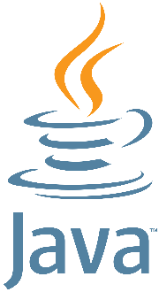

Defense Mechanisms
Countermeasures (ASLR, SYN Cookies, etc)
Software testing
Formal verification
Refactoring software and safe coding practices

Slide 11
Threat Modeling
NEED: a consistent and structured approach for defense and assessing risk

Slide 12
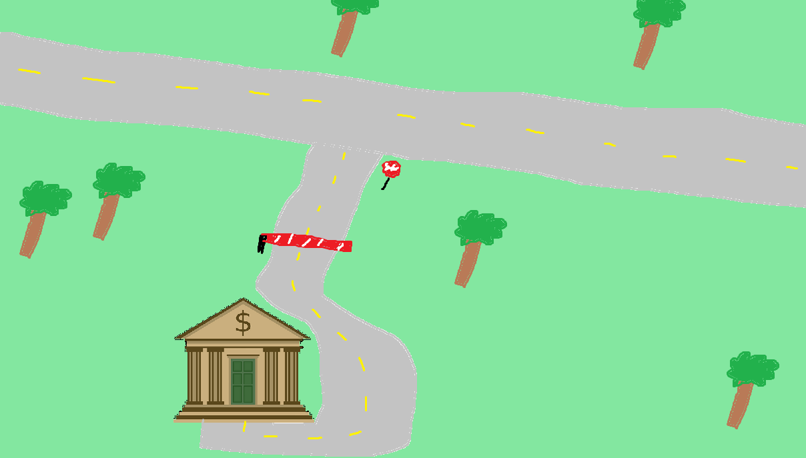


Assessing Risk
We expect users to interact with our system in a certain way

Slide 13
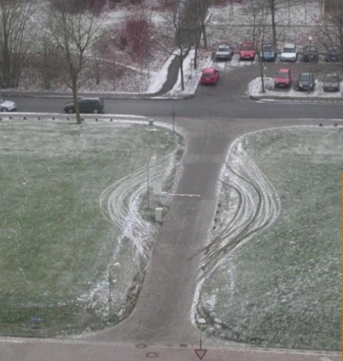

Assessing Risk
We expect users to interact with our system in a certain way
When someone interacts with our system in a way that we did not intend… it could have harmful consequences

Slide 14
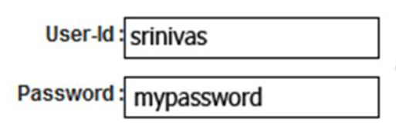
Assessing Risk
We expect users to interact with our system in a certain way
We might expect a user to input a valid username and password when they attempt to log in
When someone interacts with our system in a way that we did not intend… it could have harmful consequences

Slide 15
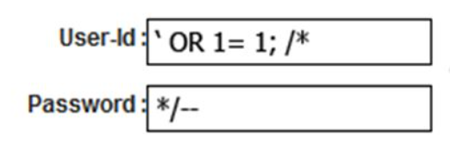
Assessing Risk
We expect users to interact with our system in a certain way
We might expect a user to input a valid username and password when they attempt to log in
When someone interacts with our system in a way that we did not intend… it could have harmful consequences
What if they did something…….. weird?

Slide 16
Assessing Risk
We expect users to interact with our system in a certain way
We might expect a user to input a valid username and password when they attempt to log in
When someone interacts with our system in a way that we did not intend… it could have harmful consequences
What if they did something…….. weird?
LOGIN SUCCESS

Slide 17
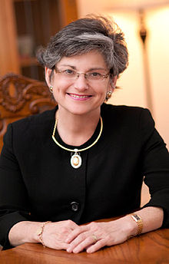

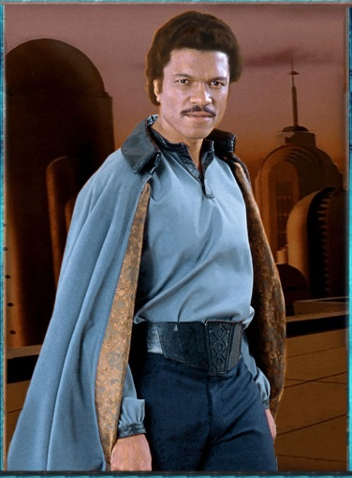

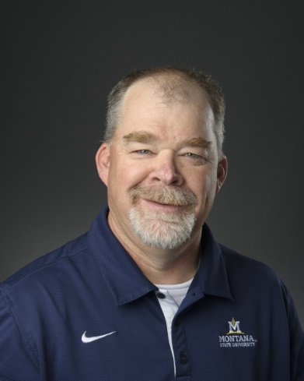
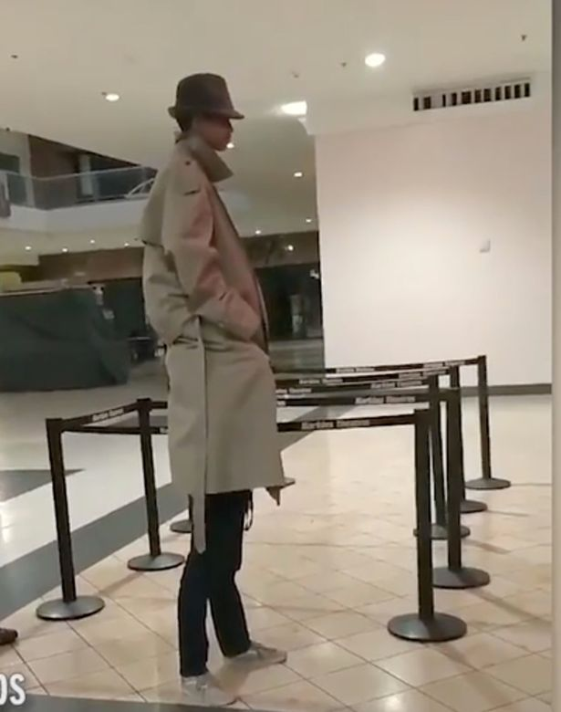
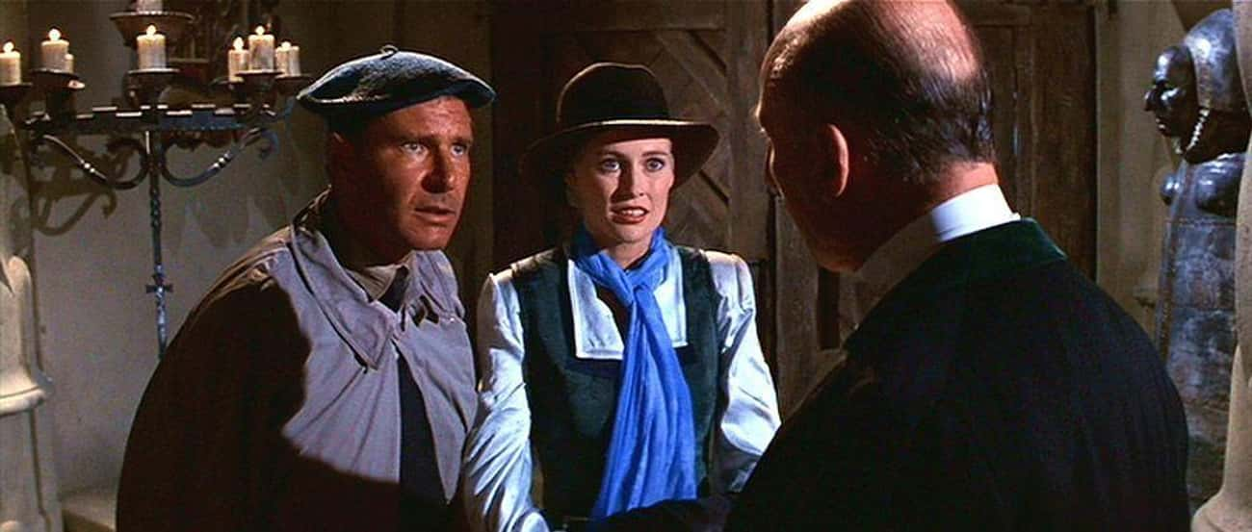

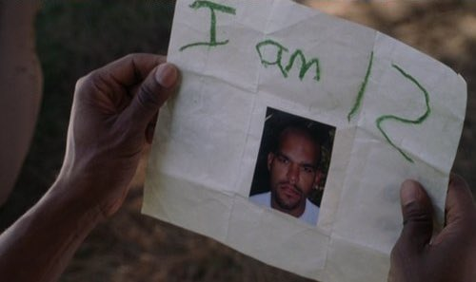

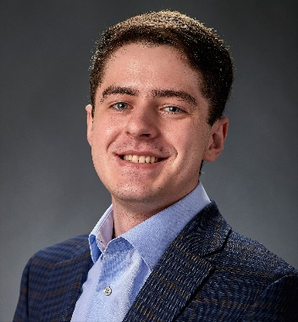
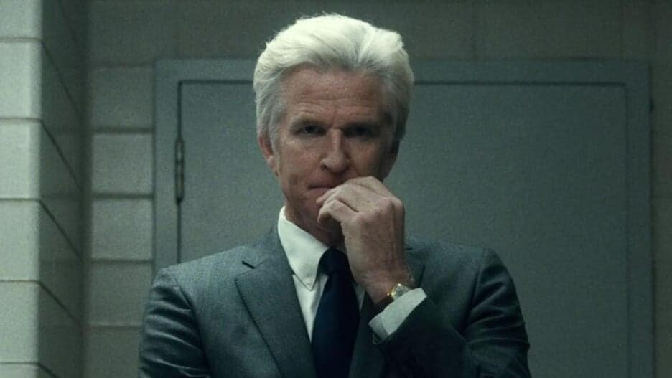
Who do we trust?
Are they honest? Are they reliable? Are they dependable? What are their intentions?

Slide 18
Who do we trust?
Trust as little as possible
Are they honest? Are they reliable? Are they dependable? What are their intentions?

Slide 19
Who do we trust?
Trust as little as possible
Distrust proportionally to level of risk
Are they honest? Are they reliable? Are they dependable? What are their intentions?

Slide 20
Who do we trust?
Trust as little as possible
Be aware of your technology
Distrust proportionally to level of risk
Are they honest? Are they reliable? Are they dependable? What are their intentions?

Slide 21
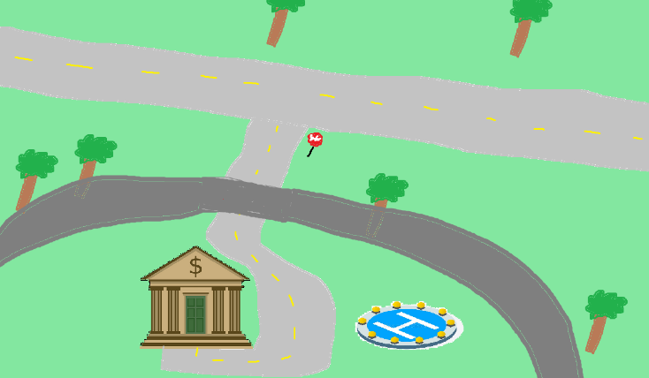
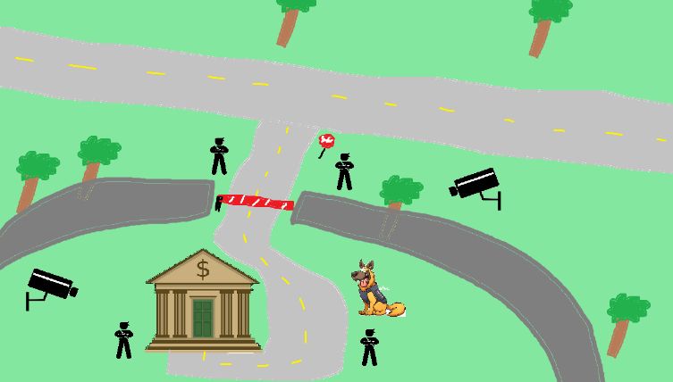
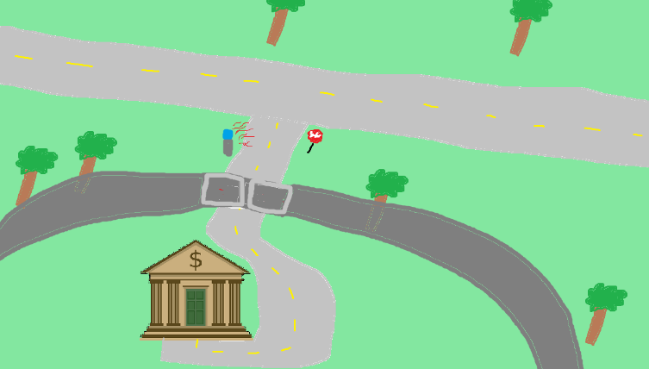
Perfect security is impossible

Slide 22
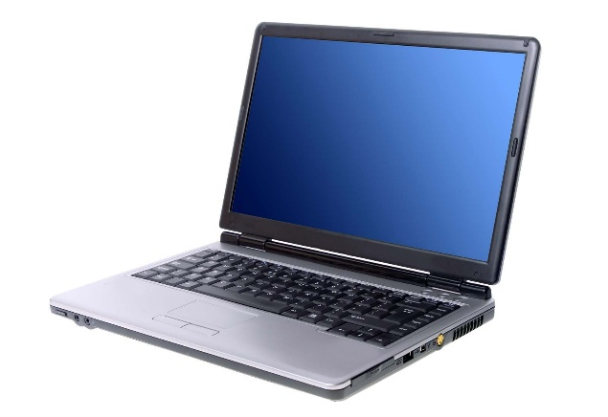
Perfect security is impossible
New assets

Slide 23
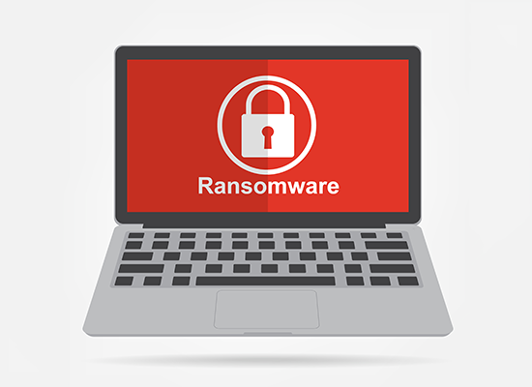
Perfect security is impossible
New assets
New threats

Slide 24
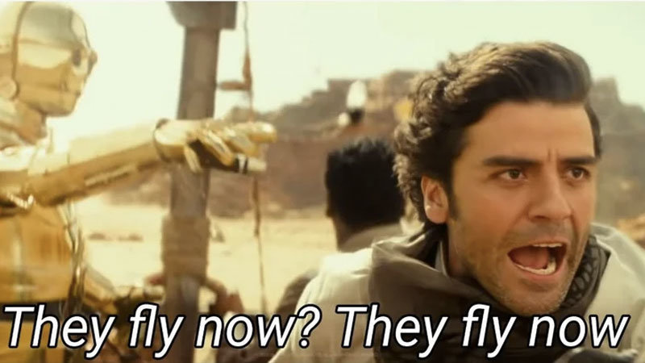
Perfect security is impossible
New assets
New threats
New capabilities

Slide 25
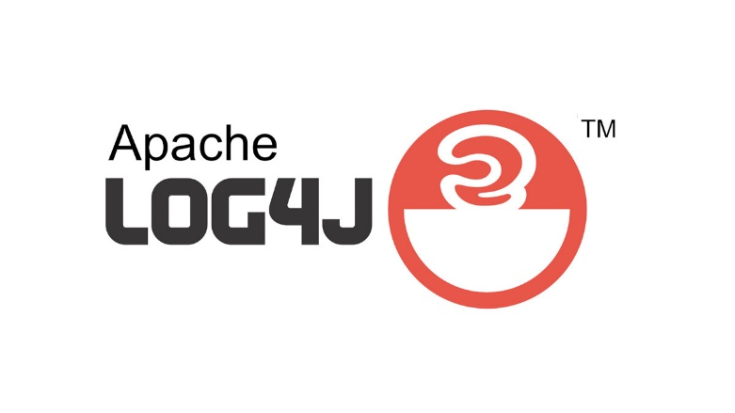
Perfect security is impossible
New assets
New threats
New capabilities
New technology

Slide 26
Perfect security is impossible
New assets
New threats
New capabilities
New technology
My goal is to teach you important cybersecurity principles that are universal across any system

Slide 27
Threat Modeling
You develop a threat model by focusing on five key questions
What are you building?
What are the assets?
What can go wrong? What are the threats?
What mechanisms can we implement to prevent things from going wrong?
Did you do a decent job of analysis?

Slide 28
Threat Modeling
Brainstorming
Free-form brainstorming- gather around a whiteboard; enumerate threats/possible defenses
Scenario Analysis- Propose a scenario and ask “what might go wrong?”
Pre-Mortem- Assuming a failure or compromise, what do you do next?
Movie plotting – Pick outrageous ideas; what happens next?
Literature review- study systems that are similar to yours

Slide 29
Threat Modeling Practice
Free-form brainstorming- gather around a whiteboard; enumerate threats/possible defenses
Scenario Analysis- Propose a scenario and ask “what might go wrong?”
Pre-Mortem- Assuming a failure or compromise, what do you do next?
Movie plotting – Pick outrageous ideas; what happens next?
Literature review- study systems that are similar to yours
Let's develop a threat model
You are at a bar, and you hand your phone to a cute person …

Slide 30
Threat Modeling Practice
Free-form brainstorming- gather around a whiteboard; enumerate threats/possible defenses
Scenario Analysis- Propose a scenario and ask “what might go wrong?”
Pre-Mortem- Assuming a failure or compromise, what do you do next?
Movie plotting – Pick outrageous ideas; what happens next?
Literature review- study systems that are similar to yours
Let's develop a threat model
You are at a bar, and you hand your phone to a cute person …
What are you building?
What are the assets?
What can go wrong? What are the threats?
What mechanisms can we implement to prevent things from going wrong?
Did you do a decent job of analysis?

Slide 31
Structured Approaches
WE NEED STRUCTURE
Asset-centric: focus on things of value: things attack want; things you want to protect
Attacker-centric: focus on attackers/archetypes/personas and their capabilities
Software-centric: focus of SW; most SW is backed by structured models (CFG, State diagrams, etc)
Methodologies
STRIDE
Spoofing, Tampering, Repudiation, Info Disclosure, Denial of Service, Elevation of Privilege
Attack Trees
Attack Lists & Libraries (ie. Common and Current vulnerabilities)
(https://docs.microsoft.com/en-us/azure/security/develop/threat-modeling-tool-threats)
There is no “right” choice

Slide 32
Structured Approaches
On the final lab, you will need to use the knowledge you’ve learned in this class to develop a threat model for some kind of software system
Asset-centric: focus on things of value: things attack want; things you want to protect
Attacker-centric: focus on attackers/archetypes/personas and their capabilities
Software-centric: focus of SW; most SW is backed by structured models (CFG, State diagrams, etc)
Methodologies
STRIDE
Spoofing, Tampering, Repudiation, Info Disclosure, Denial of Service, Elevation of Privilege
Attack Trees
Attack Lists & Libraries (ie. Common and Current vulnerabilities)
(https://docs.microsoft.com/en-us/azure/security/develop/threat-modeling-tool-threats)
There is no “right” choice

Slide 33
Structured Approaches
Asset-centric: focus on things of value: things attack want; things you want to protect
Attacker-centric: focus on attackers/archetypes/personas and their capabilities
Software-centric: focus of SW; most SW is backed by structured models (CFG, State diagrams, etc)
Methodologies
STRIDE
Spoofing, Tampering, Repudiation, Info Disclosure, Denial of Service, Elevation of Privilege
Attack Trees
Attack Lists & Libraries (ie. Common and Current vulnerabilities)
(https://docs.microsoft.com/en-us/azure/security/develop/threat-modeling-tool-threats)
There is no “right” choice

Slide 34
Attack Trees
Goal: Open bank safe

Slide 35
Attack Trees
Goal: Open bank safe
Pick Lock
Learn Combo
Cut Open Safe
Improperly install safe

Slide 36
Attack Trees
Goal: Open bank safe
Pick Lock
Learn Combo
Cut Open Safe
Improperly install safe
Find written combo
Get combo from target

Slide 37
Attack Trees
Goal: Open bank safe
Pick Lock
Learn Combo
Cut Open Safe
Improperly install safe
Find written combo
Get combo from target
Threaten
Blackmail
Eavesdrop
Bribe

Slide 38
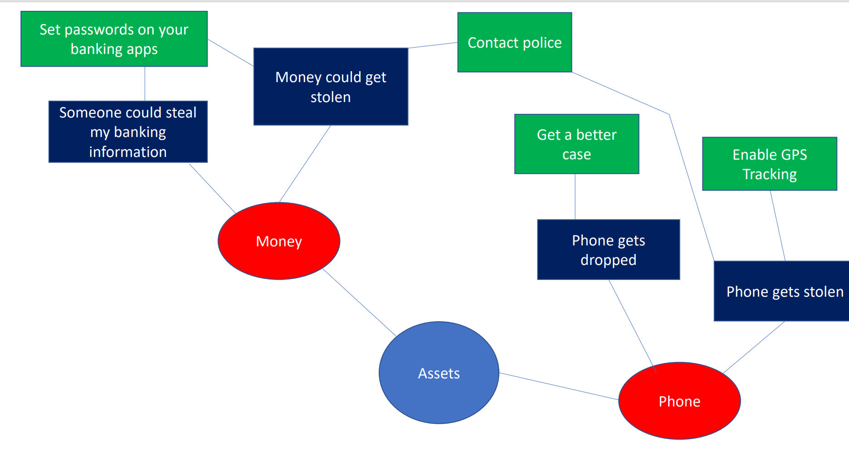
Mind Map

