Slide 1

CSCI 132: Basic Data Structures and Algorithms
Sorting (Merge Sort)
Reese Pearsall & Iliana Castillon
Fall 2024
https://www.cs.montana.edu/pearsall/classes/fall2024/132/main.html
*All images are stolen from the internet

Slide 2

Announcements
Lab 11 due tomorrow @ 11:59 PM
Program 4 Due Friday @ 11:59 PM
Reese’s office hours are 2PM – 3PM tomorrow

Slide 3
Merge Sort is a sorting algorithm that works by dividing an array into smaller subarrays, sorting each subarray, and then merging the subarrays back together to form the final sorted array
Merge sort is a Divide and Conquer algorithm, which involves dividing the problem into smaller sub-problems (divide), recursively solving the smaller problems (conquer), and combining the sub problems to get the final solution for the original problem

Slide 4

Merge sort and the next sorting algorithm we will discuss next week are rather complex. I don’t expect you to memorize the code, and if you don’t fully understand the code, that is fine!
You should, however, be able to describe how merge sort works from a high level, and be able to draw out the steps if given an example array
You should also know the time complexity of the sorting algorithms that we talk about

Slide 5
38 | 27 | 43 | 3 | 9 | 82 | 10
Goal: Divide array into two subarrays using recursion:
Base Case:
If an array is of size 1, return
Recursive Case:
Generate two subarrays leftArray, and rightArray
mergeSort(leftArray), mergeSort(rightArray)

Slide 6
38 | 27 | 43 | 3 | 9 | 82 | 10
38 | 27 | 43 | 3
9 | 82 | 10

Slide 7
38 | 27 | 43 | 3 | 9 | 82 | 10
38 | 27 | 43 | 3
9 | 82 | 10
38 | 27
43 | 3
9 | 82
10

Slide 8
38 | 27 | 43 | 3 | 9 | 82 | 10
38 | 27 | 43 | 3
9 | 82 | 10
38 | 27
43 | 3
9 | 82
10
38
27
43
3
9
82

Slide 9
38 | 27 | 43 | 3 | 9 | 82 | 10
38 | 27 | 43 | 3
9 | 82 | 10
38 | 27
43 | 3
9 | 82
10
38
27
43
3
9
82
We’ve hit all our base cases (arrays of size 1), now we will begin to merge the subarrays
When we merge, our merged array will be sorted

Slide 10
38
27
43
3
9
82
10
We’ve hit all our base cases (arrays of size 1), now we will begin to merge the subarrays
When we merge, our merged array will be sorted

Slide 11
38
27
43
3
9
82
10
27 | 38

Slide 12
38
27
43
3
9
82
10
27 | 38
3 | 43

Slide 13
38
27
43
3
9
82
10
27 | 38
3 | 43
9 | 82
10

Slide 14
38
27
43
3
9
82
10
27 | 38
3 | 43
9 | 82
10

Slide 15
38
27
43
3
9
82
10
27 | 38
3 | 43
9 | 82
10
3

Slide 16
38
27
43
3
9
82
10
27 | 38
3 | 43
9 | 82
10
3 | 27

Slide 17
38
27
43
3
9
82
10
27 | 38
3 | 43
9 | 82
10
3 | 27 | 38

Slide 18
38
27
43
3
9
82
10
27 | 38
3 | 43
9 | 82
10
3 | 27 | 38 | 43

Slide 19
38
27
43
3
9
82
10
27 | 38
3 | 43
9 | 82
10
3 | 27 | 38 | 43

Slide 20
38
27
43
3
9
82
10
27 | 38
3 | 43
9 | 82
10
3 | 27 | 38 | 43

Slide 21
38
27
43
3
9
82
10
27 | 38
3 | 43
9 | 82
10
3 | 27 | 38 | 43
9

Slide 22
38
27
43
3
9
82
10
27 | 38
3 | 43
9 | 82
10
3 | 27 | 38 | 43
9 | 10

Slide 23
38
27
43
3
9
82
10
27 | 38
3 | 43
9 | 82
10
3 | 27 | 38 | 43
9 | 10 | 82

Slide 24
38
27
43
3
9
82
10
27 | 38
3 | 43
9 | 82
10
3 | 27 | 38 | 43
9 | 10 | 82

Slide 25
38
27
43
3
9
82
10
27 | 38
3 | 43
9 | 82
10
3 | 27 | 38 | 43
9 | 10 | 82
Because we know the subarray that we are merging are already sorted, the smallest element will always be at the first index

Slide 26
38
27
43
3
9
82
10
27 | 38
3 | 43
9 | 82
10
3 | 27 | 38 | 43
9 | 10 | 82
3
Because we know the subarray that we are merging are already sorted, the smallest element will always be at the first index

Slide 27
38
27
43
3
9
82
10
27 | 38
3 | 43
9 | 82
10
3 | 27 | 38 | 43
9 | 10 | 82
3 | 9
Because we know the subarray that we are merging are already sorted, the smallest element will always be at the first index

Slide 28
38
27
43
3
9
82
10
27 | 38
3 | 43
9 | 82
10
3 | 27 | 38 | 43
9 | 10 | 82
3 | 9 | 10
Because we know the subarray that we are merging are already sorted, the smallest element will always be at the first index

Slide 29
38
27
43
3
9
82
10
27 | 38
3 | 43
9 | 82
10
3 | 27 | 38 | 43
9 | 10 | 82
3 | 9 | 10 | 27
Because we know the subarray that we are merging are already sorted, the smallest element will always be at the first index

Slide 30
38
27
43
3
9
82
10
27 | 38
3 | 43
9 | 82
10
3 | 27 | 38 | 43
9 | 10 | 82
3 | 9 | 10 | 27 | 38
Because we know the subarray that we are merging are already sorted, the smallest element will always be at the first index

Slide 31
38
27
43
3
9
82
10
27 | 38
3 | 43
9 | 82
10
3 | 27 | 38 | 43
9 | 10 | 82
3 | 9 | 10 | 27 | 38 | 43
Because we know the subarray that we are merging are already sorted, the smallest element will always be at the first index

Slide 32
38
27
43
3
9
82
10
27 | 38
3 | 43
9 | 82
10
3 | 27 | 38 | 43
9 | 10 | 82
3 | 9 | 10 | 27 | 38 | 43 | 82
Because we know the subarray that we are merging are already sorted, the smallest element will always be at the first index

Slide 33
38
27
43
3
9
82
10
27 | 38
3 | 43
9 | 82
10
3 | 27 | 38 | 43
9 | 10 | 82
3 | 9 | 10 | 27 | 38 | 43 | 82
Our original array is now sorted!!

Slide 34
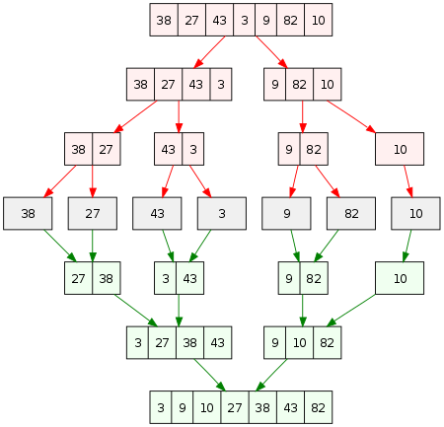
The entire merge sort process
Divide
(base case)
Merge

Slide 35
38 | 27 | 43 | 3 | 9 | 82 | 10
In our Java code, this will actually be the order of how things are done…
In practice, we will always prioritize solving the “left” tree first

Slide 36
38 | 27 | 43 | 3 | 9 | 82 | 10
38 | 27 | 43 | 3

Slide 37
38 | 27 | 43 | 3 | 9 | 82 | 10
38 | 27 | 43 | 3
38 | 27

Slide 38
38 | 27 | 43 | 3 | 9 | 82 | 10
38 | 27 | 43 | 3
38 | 27
38

Slide 39
38 | 27 | 43 | 3 | 9 | 82 | 10
38 | 27 | 43 | 3
38 | 27
38
27

Slide 40
38 | 27 | 43 | 3 | 9 | 82 | 10
38 | 27 | 43 | 3
38 | 27
38
27
27 | 38

Slide 41
38 | 27 | 43 | 3 | 9 | 82 | 10
38 | 27 | 43 | 3
38 | 27
43 | 3
38
27
27 | 38

Slide 42
38 | 27 | 43 | 3 | 9 | 82 | 10
38 | 27 | 43 | 3
38 | 27
43 | 3
38
27
43
27 | 38

Slide 43
38 | 27 | 43 | 3 | 9 | 82 | 10
38 | 27 | 43 | 3
38 | 27
43 | 3
38
27
43
3
27 | 38

Slide 44
38 | 27 | 43 | 3 | 9 | 82 | 10
38 | 27 | 43 | 3
38 | 27
43 | 3
38
27
43
3
27 | 38
3 | 43

Slide 45
38 | 27 | 43 | 3 | 9 | 82 | 10
38 | 27 | 43 | 3
38 | 27
43 | 3
38
27
43
3
27 | 38
3 | 43

Slide 46
38 | 27 | 43 | 3 | 9 | 82 | 10
38 | 27 | 43 | 3
38 | 27
43 | 3
38
27
43
3
27 | 38
3 | 43
3 | 27 | 38 | 43

Slide 47
38 | 27 | 43 | 3 | 9 | 82 | 10
38 | 27 | 43 | 3
38 | 27
43 | 3
38
27
43
3
27 | 38
3 | 43
3 | 27 | 38 | 43

Slide 48
38 | 27 | 43 | 3 | 9 | 82 | 10
38 | 27 | 43 | 3
9 | 82 | 10
38 | 27
43 | 3
38
27
43
3
27 | 38
3 | 43
3 | 27 | 38 | 43

Slide 49
38 | 27 | 43 | 3 | 9 | 82 | 10
38 | 27 | 43 | 3
9 | 82 | 10
38 | 27
43 | 3
9 | 82
38
27
43
3
27 | 38
3 | 43
3 | 27 | 38 | 43

Slide 50
38 | 27 | 43 | 3 | 9 | 82 | 10
38 | 27 | 43 | 3
9 | 82 | 10
38 | 27
43 | 3
9 | 82
38
27
43
3
9
27 | 38
3 | 43
3 | 27 | 38 | 43

Slide 51
38 | 27 | 43 | 3 | 9 | 82 | 10
38 | 27 | 43 | 3
9 | 82 | 10
38 | 27
43 | 3
9 | 82
38
27
43
3
9
82
27 | 38
3 | 43
3 | 27 | 38 | 43

Slide 52
38 | 27 | 43 | 3 | 9 | 82 | 10
38 | 27 | 43 | 3
9 | 82 | 10
38 | 27
43 | 3
9 | 82
38
27
43
3
9
82
27 | 38
3 | 43
9 | 82
3 | 27 | 38 | 43

Slide 53
38 | 27 | 43 | 3 | 9 | 82 | 10
38 | 27 | 43 | 3
9 | 82 | 10
38 | 27
43 | 3
9 | 82
10
38
27
43
3
9
82
27 | 38
3 | 43
9 | 82
3 | 27 | 38 | 43

Slide 54
38 | 27 | 43 | 3 | 9 | 82 | 10
38 | 27 | 43 | 3
9 | 82 | 10
38 | 27
43 | 3
9 | 82
10
38
27
43
3
9
82
27 | 38
3 | 43
9 | 82
3 | 27 | 38 | 43
9 | 10 | 82

Slide 55

38 | 27 | 43 | 3 | 9 | 82 | 10
38 | 27 | 43 | 3
9 | 82 | 10
38 | 27
43 | 3
9 | 82
10
38
27
43
3
9
82
27 | 38
3 | 43
9 | 82
3 | 27 | 38 | 43
9 | 10 | 82
3 | 9 | 10 | 27 | 38 | 43 | 82

Slide 56

38 | 27 | 43 | 3 | 9 | 82 | 10
Let’s code this!!
38 | 27 | 43 | 3
9 | 82 | 10
38 | 27
43 | 3
9 | 82
10
38
27
43
3
9
82
27 | 38
3 | 43
9 | 82
3 | 27 | 38 | 43
9 | 10 | 82
3 | 9 | 10 | 27 | 38 | 43 | 82

Slide 57

Running time of merge sort??

Slide 58
Running time of merge sort??
Running time = number of recursive calls made* · amount of work done in each call
*for merge sort, this won’t lead us to the correct answer

Slide 59
amount of work done in each call?
public static int[] merge_sort(int[] inputArray) {
int inputLength = inputArray.length;
if (inputLength < 2) {
return inputArray;
}
int midIndex = inputLength / 2;
int[] leftHalf = new int[midIndex];
int[] rightHalf = new int[inputLength - midIndex];
for (int i = 0; i < midIndex; i++) {
leftHalf[i] = inputArray[i];
}
for (int i = midIndex; i < inputLength; i++) {
rightHalf[i - midIndex] = inputArray[i];
}
merge_sort(leftHalf);
merge_sort(rightHalf);
inputArray = merge(inputArray, leftHalf, rightHalf);
return inputArray;
}

Slide 60
amount of work done in each call?
public static int[] merge_sort(int[] inputArray) {
int inputLength = inputArray.length;
if (inputLength < 2) {
return inputArray;
}
int midIndex = inputLength / 2;
int[] leftHalf = new int[midIndex];
int[] rightHalf = new int[inputLength - midIndex];
for (int i = 0; i < midIndex; i++) {
leftHalf[i] = inputArray[i];
}
for (int i = midIndex; i < inputLength; i++) {
rightHalf[i - midIndex] = inputArray[i];
}
merge_sort(leftHalf);
merge_sort(rightHalf);
inputArray = merge(inputArray, leftHalf, rightHalf);
return inputArray;
}
O(1)
O(1)
O(1)

Slide 61
amount of work done in each call?
public static int[] merge_sort(int[] inputArray) {
int inputLength = inputArray.length;
if (inputLength < 2) {
return inputArray;
}
int midIndex = inputLength / 2;
int[] leftHalf = new int[midIndex];
int[] rightHalf = new int[inputLength - midIndex];
for (int i = 0; i < midIndex; i++) {
leftHalf[i] = inputArray[i];
}
for (int i = midIndex; i < inputLength; i++) {
rightHalf[i - midIndex] = inputArray[i];
}
merge_sort(leftHalf);
merge_sort(rightHalf);
inputArray = merge(inputArray, leftHalf, rightHalf);
return inputArray;
}
O(1)
O(1)
O(1)
O(n/2)
O(n/2)

Slide 62
amount of work done in each call?
public static int[] merge_sort(int[] inputArray) {
int inputLength = inputArray.length;
if (inputLength < 2) {
return inputArray;
}
int midIndex = inputLength / 2;
int[] leftHalf = new int[midIndex];
int[] rightHalf = new int[inputLength - midIndex];
for (int i = 0; i < midIndex; i++) {
leftHalf[i] = inputArray[i];
}
for (int i = midIndex; i < inputLength; i++) {
rightHalf[i - midIndex] = inputArray[i];
}
merge_sort(leftHalf);
merge_sort(rightHalf);
inputArray = merge(inputArray, leftHalf, rightHalf);
return inputArray;
}
O(1)
O(1)
O(1)
O(n/2)
O(n/2)
O(n/2)
O(n/2)

Slide 63
amount of work done in each call?
public static int[] merge_sort(int[] inputArray) {
int inputLength = inputArray.length;
if (inputLength < 2) {
return inputArray;
}
int midIndex = inputLength / 2;
int[] leftHalf = new int[midIndex];
int[] rightHalf = new int[inputLength - midIndex];
for (int i = 0; i < midIndex; i++) {
leftHalf[i] = inputArray[i];
}
for (int i = midIndex; i < inputLength; i++) {
rightHalf[i - midIndex] = inputArray[i];
}
merge_sort(leftHalf);
merge_sort(rightHalf);
inputArray = merge(inputArray, leftHalf, rightHalf);
return inputArray;
}
O(1)
O(1)
O(1)
O(n/2)
O(n/2)
O(n/2)
O(n/2)
O(1)
O(1)
O(???)

Slide 64
amount of work done in each call?
public static int[] merge_sort(int[] inputArray) {
int inputLength = inputArray.length;
if (inputLength < 2) {
return inputArray;
}
int midIndex = inputLength / 2;
int[] leftHalf = new int[midIndex];
int[] rightHalf = new int[inputLength - midIndex];
for (int i = 0; i < midIndex; i++) {
leftHalf[i] = inputArray[i];
}
for (int i = midIndex; i < inputLength; i++) {
rightHalf[i - midIndex] = inputArray[i];
}
merge_sort(leftHalf);
merge_sort(rightHalf);
inputArray = merge(inputArray, leftHalf, rightHalf);
return inputArray;
}
O(1)
O(1)
O(1)
O(n/2)
O(n/2)
O(n/2)
O(n/2)
O(1)
O(1)
O(???)

Slide 65
amount of work done in each call?
private static int[] merge (int[] inputArray, int[]leftHalf, int[] rightHalf) {
int leftSize = leftHalf.length;
int rightSize = rightHalf.length;
int i = 0, j = 0, k = 0;
while (i < leftSize && j < rightSize) {
if (leftHalf[i] <= rightHalf[j]) {
inputArray[k] = leftHalf[i];
i++;
}
else {
inputArray[k] = rightHalf[j];
j++;
}
k++;
}
while (i < leftSize) {
inputArray[k] = leftHalf[i];
i++;
k++;
}
while (j < rightSize) {
inputArray[k] = rightHalf[j];
j++;
k++;
}
return inputArray;
}

Slide 66
amount of work done in each call?
private static int[] merge (int[] inputArray, int[]leftHalf, int[] rightHalf) {
int leftSize = leftHalf.length;
int rightSize = rightHalf.length;
int i = 0, j = 0, k = 0;
while (i < leftSize && j < rightSize) {
if (leftHalf[i] <= rightHalf[j]) {
inputArray[k] = leftHalf[i];
i++;
}
else {
inputArray[k] = rightHalf[j];
j++;
}
k++;
}
while (i < leftSize) {
inputArray[k] = leftHalf[i];
i++;
k++;
}
while (j < rightSize) {
inputArray[k] = rightHalf[j];
j++;
k++;
}
return inputArray;
}
O(1)
O(1)
O(n)
O(1)
O(1)

Slide 67
amount of work done in each call?
private static int[] merge (int[] inputArray, int[]leftHalf, int[] rightHalf) {
int leftSize = leftHalf.length;
int rightSize = rightHalf.length;
int i = 0, j = 0, k = 0;
while (i < leftSize && j < rightSize) {
if (leftHalf[i] <= rightHalf[j]) {
inputArray[k] = leftHalf[i];
i++;
}
else {
inputArray[k] = rightHalf[j];
j++;
}
k++;
}
while (i < leftSize) {
inputArray[k] = leftHalf[i];
i++;
k++;
}
while (j < rightSize) {
inputArray[k] = rightHalf[j];
j++;
k++;
}
return inputArray;
}
O(1)
O(1)
O(n)
O(1)
O(n) + O(n/2) + O(n/2) = O(2n)
O(1)
Running time of merge subroutine
O(n)
O(n/2)
O(1)
O(n/2)
O(1)
O(1)

Slide 68
amount of work done in each call?
public static int[] merge_sort(int[] inputArray) {
int inputLength = inputArray.length;
if (inputLength < 2) {
return inputArray;
}
int midIndex = inputLength / 2;
int[] leftHalf = new int[midIndex];
int[] rightHalf = new int[inputLength - midIndex];
for (int i = 0; i < midIndex; i++) {
leftHalf[i] = inputArray[i];
}
for (int i = midIndex; i < inputLength; i++) {
rightHalf[i - midIndex] = inputArray[i];
}
merge_sort(leftHalf);
merge_sort(rightHalf);
inputArray = merge(inputArray, leftHalf, rightHalf);
return inputArray;
}
O(1)
O(1)
O(1)
O(n/2)
O(n/2)
O(n/2)
O(n/2)
O(1)
O(1)
O(n)
O(1)

Slide 69
amount of work done in each call?
public static int[] merge_sort(int[] inputArray) {
int inputLength = inputArray.length;
if (inputLength < 2) {
return inputArray;
}
int midIndex = inputLength / 2;
int[] leftHalf = new int[midIndex];
int[] rightHalf = new int[inputLength - midIndex];
for (int i = 0; i < midIndex; i++) {
leftHalf[i] = inputArray[i];
}
for (int i = midIndex; i < inputLength; i++) {
rightHalf[i - midIndex] = inputArray[i];
}
merge_sort(leftHalf);
merge_sort(rightHalf);
inputArray = merge(inputArray, leftHalf, rightHalf);
return inputArray;
}
O(1)
O(1)
O(n) + O(n/2) + O(n/2) + O(n/2) + O(n)
O(1)
O(n/2)
O(n/2)
O(n/2)
Total running time of a single merge_sort call:
O(n)
O(n/2)
O(1)
O(1)
O(n)
O(1)

Slide 70
Running time of merge sort??
Running time = number of recursive calls made* · amount of work done in each call
Running time =
???
O(n)
*for merge sort, this won’t lead us to the correct answer

Slide 71

Merge Sort
Change Making (coinFinder)
38 | 27 | 43 | 3 | 9 | 82 | 10 | 11
coinFinder(18)
coinFinder(17)
38 | 27 | 43 | 3
mergeSort()
coinFinder(16)
38 | 27
mergeSort()
coinFinder(15)
…
38
mergeSort()
coinFinder(0)

Slide 72
Running time of merge sort??
Running time = number of recursive calls made* · amount of work done in each call
Running time =
???
O(n)
When we recursively call our method when dividing, we give a problem that is half the size of the original problem

Slide 73
c(n)
Suppose that the cost of solving a problem of size n can be expressed as c(n)

Slide 74
c(n)
c(n)
c(n)
c(n/2)
c(n/2)
c(n)
c(n/4)
c(n/4)
c(n/4)
c(n/4)
c(n)
c(n/8)
c(n/8)
c(n/8)
c(n/8)
c(n/8)
c(n/8)
c(n/8)
c(n/8)

Slide 75
c(n)
c(n)
c(n)
c(n/2)
c(n/2)
c(n)
c(n/4)
c(n/4)
c(n/4)
c(n/4)
c(n)
c(n/8)
c(n/8)
c(n/8)
c(n/8)
c(n/8)
c(n/8)
c(n/8)
c(n/8)
How much do we divide (in regards to n)? AKA what is the height of the recursion tree?

Slide 76
When n = 2, the height is 2
When n = 3, the height is 3
When n = 4, the height is 3
When n = 5, the height is 4

Slide 77
When n = 5, the height is 4
When n = 6, the height is 4
When n = 7, the height is 4
When n = 8, the height is 4

Slide 78
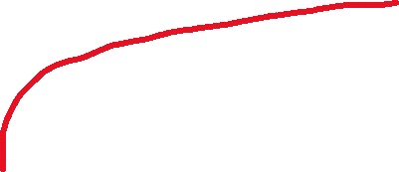
What is the growth rate of the height of our recursion tree (the # of recursive calls made) ?
If we were to continue this counting, the graph would look something like this:
Height of Recursion Tree
???
N (# of array elements)

Slide 79

What is the growth rate of the height of our recursion tree (the # of recursive calls made) ?
If we were to continue this counting, the graph would look something like this:
Logarithmic !!
Height of Recursion Tree
log(n)
N (# of array elements)

Slide 80
What is the growth rate of the height of our recursion tree (the # of recursive calls made) ?
If we were to continue this counting, the graph would look something like this:
Logarithmic !!
Height of Recursion Tree
log₂(n)
It will actually be log base 2, because we are dividing our array in half in each recursive call
However, in computer science, all logarithms are to the base 2 unless specified otherwise
N (# of array elements)

Slide 81
What is the growth rate of the height of our recursion tree (the # of recursive calls made) ?
If we were to continue this counting, the graph would look something like this:
Logarithmic !!
Height of Recursion Tree
log(n)
N (# of array elements)

Slide 82
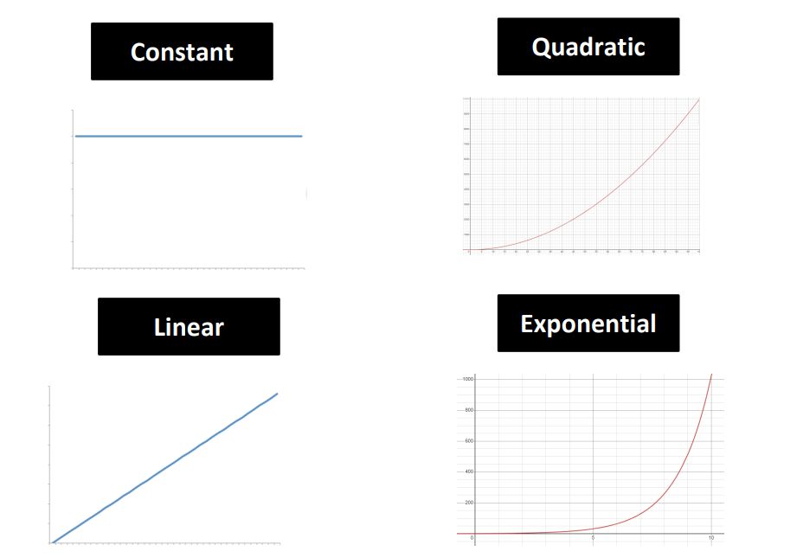
Growth Rates
We have a new member of the family!

Slide 83
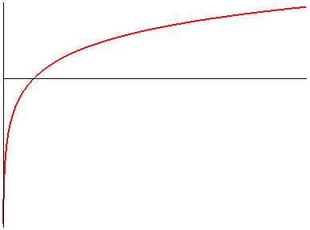
Growth Rates
We have a new member of the family!
log n is smaller than n
algorithms that run in O(log n) time are good!
Logarithmic
log n

Slide 84
Running time of merge sort??
Height of recursive tree
Running time = number of recursive calls made · amount of work done in each call
Running time =
???
O(n)

Slide 85
Running time of merge sort??
Height of recursive tree
Running time = number of recursive calls made · amount of work done in each call
Running time =
O(log n)
O(n)
Running time of merge sort = O(n * log n)

Slide 86
Running time of merge sort??
Height of recursive tree
Running time = number of recursive calls made · amount of work done in each call
Running time =
O(log n)
O(n)
Running time of merge sort = O(n * log n)
This is much faster than O(n^2)

Slide 87
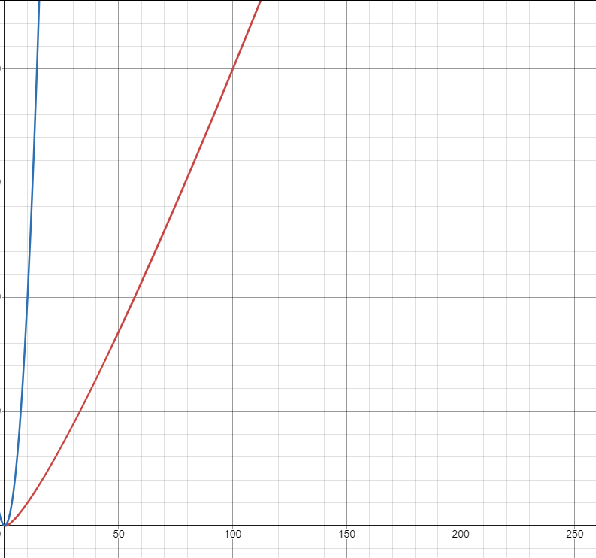
n²
nlogn

Slide 88
What about stack overflow errors?
We still have to worry about stack overflow errors if our input is reallyyyyyyyyyyy big
However, because merge sorts works from “left to right”, we won’t have n recursive calls active, and we are much more efficient with how many method calls we put on call stack

