Slide 1

CSCI 132: Basic Data Structures and Algorithms
Sorting (Part 4)
Reese Pearsall + Iliana Castillon
Fall 2024
https://www.cs.montana.edu/pearsall/classes/fall2024/132/main.html
*All images are stolen from the internet

Slide 2
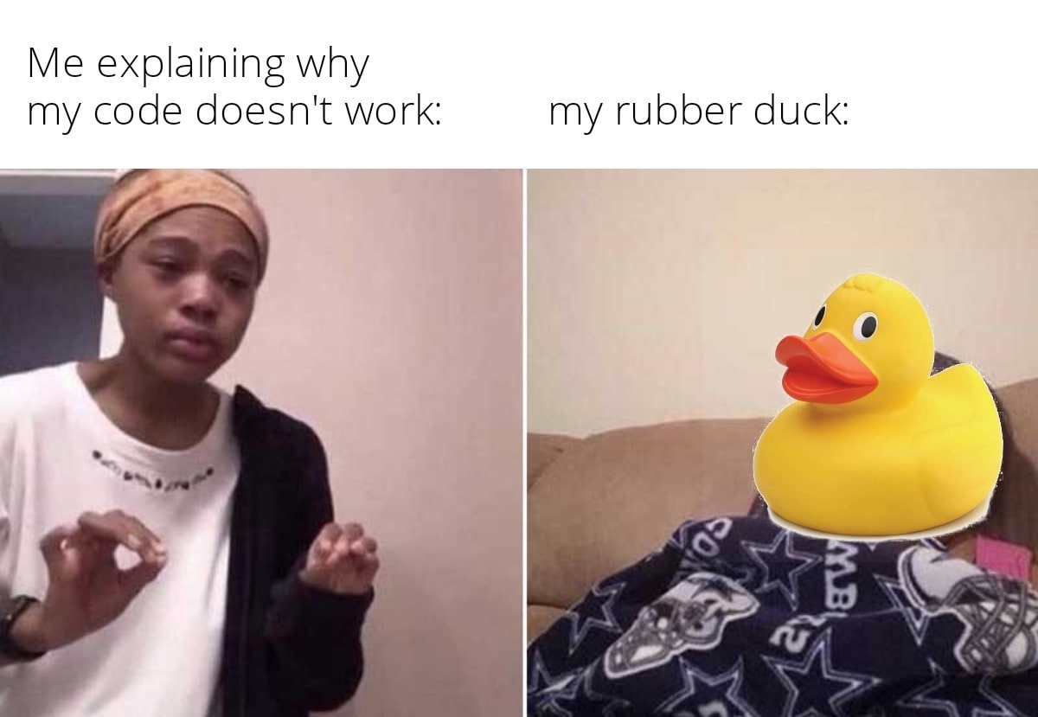
Announcements
Friday will be a workday (no lecture)
Lab 12 due tomorrow @ 11:59PM
Program 5 posted, Sunday due 12/8
Rubber duck extra credit will be posted soon

Slide 3
char[][] maze
[ [ #, #, #, # ,#],
[ #, . , . , . , #],
[ . , . ,# , . , #],
[ #, #, #, . , #],
[ #, . , . , . , . ],
]

Slide 4
char[][] maze
[ [ #, #, #, # ,#],
[ #, . , . , . , #],
[ . , . ,# , . , #],
[ #, #, #, . , #],
[ #, . , . , . , . ],
]
maze[0]

Slide 5
char[][] maze
[ [ #, #, #, # ,#],
[ #, . , . , . , #],
[ . , . ,# , . , #],
[ #, #, #, . , #],
[ #, . , . , . , . ],
]
maze[1]

Slide 6
char[][] maze
[ [ #, #, #, # ,#],
[ #, . , . , . , #],
[ . , . ,# , . , #],
[ #, #, #, . , #],
[ #, . , . , . , . ],
]
maze[1][0]

Slide 7
char[][] maze
[ [ #, #, #, # ,#],
[ #, . , . , . , #],
[ . , . ,# , . , #],
[ #, #, #, . , #],
[ #, . , . , . , . ],
]
maze[1][2]

Slide 8
char[][] maze
[ [ #, #, #, # ,#],
[ #, . , . , . , #],
[ . , . ,# , . , #],
[ #, #, #, . , #],
[ #, . , . , . , . ],
]
maze[y][x]

Slide 9
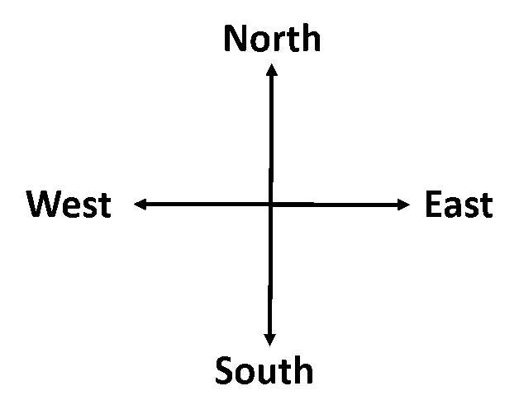




char[][] maze
[ [ #, #, #, # ,#],
[ #, . , . , . , #],
[ . , . ,# , . , #],
[ #, #, #, . , #],
[ #, . , . , . , . ],
]
(2, 1)
(2, 2)
Goal: Move forward one spot
We need to know which direction we are facing first!
maze[y][x]
How do we know direction we are facing?

Slide 10


char[][] maze
[ [ #, #, #, # ,#],
[ #, . , . , . , #],
[ . , . ,# , . , #],
[ #, #, #, . , #],
[ #, . , . , . , . ],
]
(2, 1)
(2, 2)
Goal: Move forward one spot
We need to know which direction we are facing first!
maze[y][x]
Our character Y value and our hand’s Y value is the same,
And our character’s X value is less than our hands’ X value

Slide 11
char[][] maze
[ [ #, #, #, # ,#],
[ #, . , . , . , #],
[ . , . ,# , . , #],
[ #, #, #, . , #],
[ #, . , . , . , . ],
]
(2, 1)
(2, 2)
if(y == hand_y && hand_x > x)
direction = "North";
}
maze[y][x]

Slide 12
char[][] maze
[ [ #, #, #, # ,#],
[ #, . , . , . , #],
[ . , . ,# , . , #],
[ #, #, #, . , #],
[ #, . , . , . , . ],
]
if(y == hand_y && hand_x > x)
direction = "North";
}
…
(2, 1)
(2, 2)
How do we detect if we can move forward?
maze[y][x]

Slide 13
char[][] maze
[ [ #, #, #, # ,#],
[ #, . , . , . , #],
[ . , . ,# , . , #],
[ #, #, #, . , #],
[ #, . , . , . , . ],
]
if(y == hand_y && hand_x > x)
direction = "North";
}
…
(2, 1)
(2, 2)
if(maze[hand_y][hand_x] == '#' && maze[y-1][x] == ‘.’){
}
maze[y][x]

Slide 14
char[][] maze
[ [ #, #, #, # ,#],
[ #, . , . , . , #],
[ . , . ,# , . , #],
[ #, #, #, . , #],
[ #, . , . , . , . ],
]
if(y == hand_y && hand_x > x)
direction = "North";
}
…
(2, 1)
(2, 2)
if(maze[hand_y][hand_x] == '#' && maze[y-1][x] == ‘.’){
}
Make one move by recursively calling the method with the new values
maze[y][x]
makeMove(x, y, hand_x, hand_y)

Slide 15
char[][] maze
[ [ #, #, #, # ,#],
[ #, . , . , . , #],
[ . , . ,# , . , #],
[ #, #, #, . , #],
[ #, . , . , . , . ],
]
if(y == hand_y && hand_x > x)
direction = "North";
}
…
(2, 1)
(2, 2)
if(maze[hand_y][hand_x] == '#' && maze[y-1][x] == ‘.’){
}
Make one move by recursively calling the method with the new values
maze[y][x]
makeMove(x, y, hand_x, hand_y)

Slide 16
char[][] maze
[ [ #, #, #, # ,#],
[ #, . , . , . , #],
[ . , . ,# , . , #],
[ #, #, #, . , #],
[ #, . , . , . , . ],
]
if(y == hand_y && hand_x > x)
direction = "North";
}
…
(1, 1)
(1, 2)
(2, 1)
(2, 2)
if(maze[hand_y][hand_x] == '#' && maze[y-1][x] == ‘.’){
}
makeMove(x, y-1, hand_x, hand_y-1);
maze[y][x]
makeMove(x, y, hand_x, hand_y)

Slide 17
char[][] maze
[ [ #, #, #, # ,#],
[ #, . , . , . , #],
[ . , . ,# , . , #],
[ #, #, #, . , #],
[ #, . , . , . , . ],
]
if(y == hand_y && hand_x > x)
direction = "North";
}
…
if(direction.equals("North")) {
(1, 1)
(1, 2)
(2, 1)
(2, 2)
if(maze[hand_y][hand_x] == '#' && maze[y-1][x] == ‘.’){
}
makeMove(x, y-1, hand_x, hand_y-1);
maze[y][x]
makeMove(x, y, hand_x, hand_y)

Slide 18
char[][] maze
[ [ #, #, #, # ,#],
[ #, . , . , . , #],
[ . , . ,# , . , #],
[ #, #, #, . , #],
[ #, . , . , . , . ],
]
if(y == hand_y && hand_x > x)
direction = "North";
}
…
if(direction.equals("North")) {
(1, 1)
(1, 2)
(2, 1)
(2, 2)
if(maze[hand_y][hand_x] == '#' && maze[y-1][x] == ‘.’){
}
makeMove(x, y-1, hand_x, hand_y-1);
maze[y][x]
Turn right and move forward one spot?
makeMove(x, y, hand_x, hand_y)

Slide 19
char[][] maze
[ [ #, #, #, # ,#],
[ #, . , . , . , #],
[ . , . ,# , . , #],
[ #, #, #, . , #],
[ #, . , . , . , . ],
]
if(y == hand_y && hand_x > x)
direction = "North";
}
…
if(direction.equals("North")) {
(1, 1)
(1, 2)
(2, 1)
(2, 2)
if(maze[hand_y][hand_x] == '#' && maze[y-1][x] == ‘.’){
}
if(maze[hand_y][hand_x] == ‘.’){
}
makeMove(x, y-1, hand_x, hand_y-1);
maze[y][x]
makeMove(x, y, hand_x, hand_y)

Slide 20


char[][] maze
[ [ #, #, #, # ,#],
[ #, . , . , . , #],
[ . , . ,# , . , #],
[ #, #, #, . , #],
[ #, . , . , . , . ],
]
if(y == hand_y && hand_x > x)
direction = "North";
}
…
if(direction.equals("North")) {
(1, 1)
(1, 2)
(2, 1)
(2, 2)
if(maze[hand_y][hand_x] == '#' && maze[y-1][x] == ‘.’){
}
if(maze[hand_y][hand_x] == ‘.’){
}
makeMove(x, y-1, hand_x, hand_y-1);
maze[y][x]
makeMove(??, ??, ??, ??);
makeMove(x, y, hand_x, hand_y)

Slide 21


char[][] maze
[ [ #, #, #, # ,#],
[ #, . , . , . , #],
[ . , . ,# , . , #],
[ #, #, #, . , #],
[ #, . , . , . , . ],
]
if(y == hand_y && hand_x > x)
direction = "North";
}
…
if(direction.equals("North")) {
(1, 1)
(1, 2)
(2, 1)
(2, 2)
if(maze[hand_y][hand_x] == '#' && maze[y-1][x] == ‘.’){
}
if(maze[hand_y][hand_x] == ‘.’){
}
makeMove(x, y-1, hand_x, hand_y-1);
maze[y][x]
makeMove(x+1, y, hand_x, hand_y+1);
makeMove(x, y, hand_x, hand_y)

Slide 22


char[][] maze
[ [ #, #, #, # ,#],
[ #, . , . , . , #],
[ . , . ,# , . , #],
[ #, #, #, . , #],
[ #, . , . , . , . ],
]
if(y == hand_y && hand_x > x)
direction = "North";
}
…
if(direction.equals("North")) {
(1, 1)
(1, 2)
(2, 1)
(2, 2)
if(maze[hand_y][hand_x] == '#' && maze[y-1][x] == ‘.’){
}
if(maze[hand_y][hand_x] == ‘.’){
}
makeMove(x, y-1, hand_x, hand_y-1);
maze[y][x]
makeMove(x+1, y, hand_x, hand_y+1);
makeMove(x, y, hand_x, hand_y)

Slide 23
char[][] maze
[ [ #, #, #, # ,#],
[ #, . , . , . , #],
[ . , . ,# , . , #],
[ #, #, #, . , #],
[ #, . , . , . , . ],
]
if(y == hand_y && hand_x > x)
direction = "North";
}
…
if(direction.equals("North")) {
(1, 1)
(1, 2)
(2, 1)
(2, 2)
if(maze[hand_y][hand_x] == '#' && maze[y-1][x] == ‘.’){
}
if(maze[hand_y][hand_x] == ‘.’){
}
makeMove(x, y-1, hand_x, hand_y-1);
maze[y][x]
makeMove(x+1, y, hand_x, hand_y+1);
makeMove(x, y, hand_x, hand_y)

Slide 24
char[][] maze
maze[y][x]
[ [ #, #, #, # ,#],
[ #, . , . , . , #],
[ . , . ,# , . , #],
[ #, #, #, . , #],
[ #, . , . , . , . ],
]
if(y == hand_y && hand_x > x)
direction = "North";
}
…
if(direction.equals("North")) {
(1, 1)
(1, 2)
(2, 1)
(2, 2)
if(maze[hand_y][hand_x] == '#' && maze[y-1][x] == ‘.’){
}
if(maze[hand_y][hand_x] == ‘.’){
}
makeMove(x, y-1, hand_x, hand_y-1);
makeMove(x+1, y, hand_x, hand_y+1);
Turn right
Go forward
Turn left
makeMove(x, y, hand_x, hand_y)

Slide 25
char[][] maze
maze[y][x]
[ [ #, #, #, # ,#],
[ #, . , . , . , #],
[ . , . ,# , . , #],
[ #, #, #, . , #],
[ #, . , . , . , . ],
]
if(y == hand_y && hand_x > x)
direction = "North";
}
…
if(direction.equals("North")) {
(1, 1)
(1, 2)
(2, 1)
(2, 2)
if(maze[hand_y][hand_x] == ‘.’){
}
if(maze[hand_y][hand_x] == '#' && maze[y-1][x] == ‘.’){
}
Right
makeMove(x+1, y, hand_x, hand_y+1);
Forward
Turn right
Go forward
Turn left
makeMove(x, y-1, hand_x, hand_y-1);
Left
// Turn left

Slide 26
char[][] maze
maze[y][x]
[ [ #, #, #, # ,#],
[ #, . , . , . , #],
[ . , . ,# , . , #],
[ #, #, #, . , #],
[ #, . , . , . , . ],
]
if(y == hand_y && hand_x > x)
direction = "North";
}
…
if(direction.equals("North")) {
(1, 1)
(1, 2)
(2, 1)
(2, 2)
if(maze[hand_y][hand_x] == ‘.’ && maze[y-1][x]=='#’){
}
if(maze[hand_y][hand_x] == '#' && maze[y-1][x] == ‘.’){
}
Right
makeMove(x+1, y, hand_x, hand_y+1);
Forward
makeMove(x, y-1, hand_x, hand_y-1);
You will have need if statements for North, East, South, and West
Lots of if statements ☺
Left
// Turn left

Slide 27
char[][] maze
maze[y][x]
[ [ #, #, #, # ,#],
[ #, . , . , . , #],
[ . , . ,# , . , #],
[ #, #, #, . , #],
[ #, . , . , . , . ],
]
if(y == hand_y && hand_x > x)
direction = "North";
}
…
if(direction.equals("North")) {
(1, 1)
(1, 2)
(2, 1)
(2, 2)
if(maze[hand_y][hand_x] == ‘.’ && maze[y-1][x]=='#’){
}
if(maze[hand_y][hand_x] == '#' && maze[y-1][x] == ‘.’){
}
This code is technically not complete, you will need to add some more code here (backtracking)
Right
makeMove(x+1, y, hand_x, hand_y+1);
Forward
makeMove(x, y-1, hand_x, hand_y-1);
You will have need if statements for North, East, South, and West
Lots of if statements ☺
Left
// Turn left

Slide 28
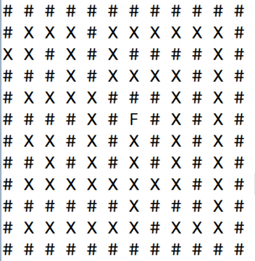
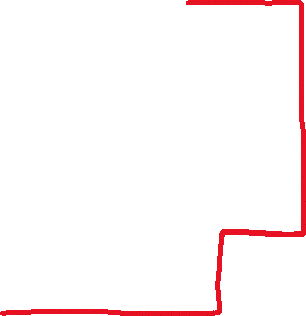


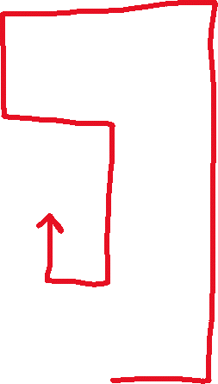




= Backtracking path

Slide 29
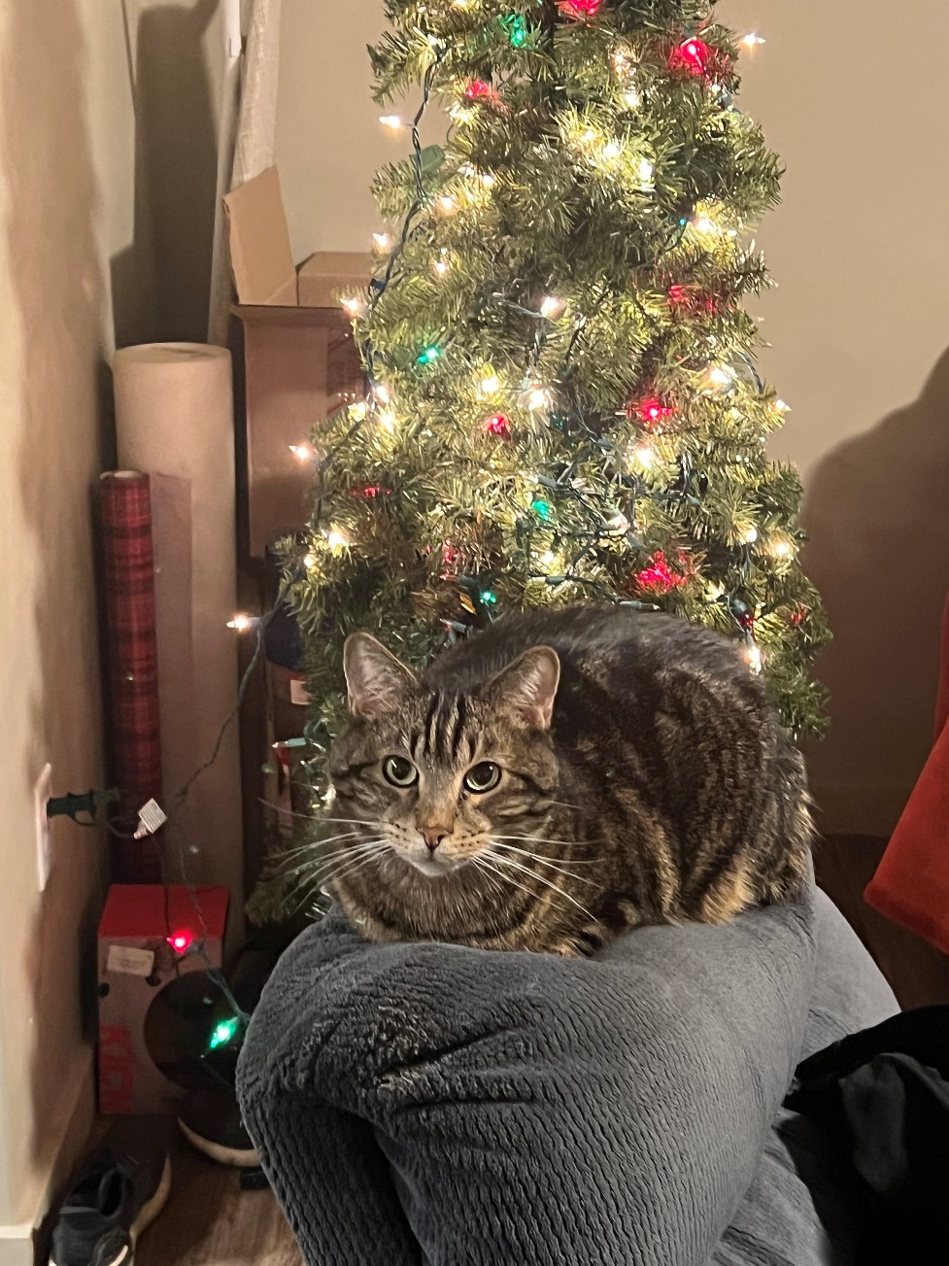

Slide 30
Running Time of Sorting Algorithms
Brief Description
Running Time
Bubble Sort | ??? | ???
Selection Sort | ??? | ???
Merge Sort | ??? | ???
Quick Sort | ??? | ???

Slide 31
public int[] selectionSort(int[] array) {
int n = array.length;
for(int i = 0; i < n -1; i++) {
int min_index_so_far = i;
for (int j = i + 1; j < n; j++) {
if(array[j] < array[min_index_so_far]) {
min_index_so_far = j;
}
}
int temp = array[i];
array[i] = array[min_index_so_far];
array[min_index_so_far] = temp;
}
return array;
}

Slide 32
You will not be tested about today’s sorting algorithms.

Slide 33
Insertion Sort
We divide our array into two sections. A sorted section, and an unsorted section. We iterate through the array, and for each iteration, we move one element from the unsorted section to the sorted section
38 | 27 | 43 | 3 | 9 | 82 | 10 | 14

Slide 34
Insertion Sort
We divide our array into two sections. A sorted section, and an unsorted section. We iterate through the array, and for each iteration, we move one element from the unsorted section to the sorted section
38 | 27 | 43 | 3 | 9 | 82 | 10 | 14
38 | 27 | 43 | 3 | 9 | 82 | 10 | 14

Slide 35

Insertion Sort
We divide our array into two sections. A sorted section, and an unsorted section. We iterate through the array, and for each iteration, we move one element from the unsorted section to the sorted section
38 | 27 | 43 | 3 | 9 | 82 | 10 | 14
38 | 27 | 43 | 3 | 9 | 82 | 10 | 14
38 | 27 | 43 | 3 | 9 | 82 | 10 | 14
27 | 38 | 43 | 3 | 9 | 82 | 10 | 14

Slide 36

Insertion Sort
We divide our array into two sections. A sorted section, and an unsorted section. We iterate through the array, and for each iteration, we move one element from the unsorted section to the sorted section
38 | 27 | 43 | 3 | 9 | 82 | 10 | 14
38 | 27 | 43 | 3 | 9 | 82 | 10 | 14
38 | 27 | 43 | 3 | 9 | 82 | 10 | 14
27 | 38 | 43 | 3 | 9 | 82 | 10 | 14
27 | 38 | 43 | 3 | 9 | 82 | 10 | 14

Slide 37

Insertion Sort
We divide our array into two sections. A sorted section, and an unsorted section. We iterate through the array, and for each iteration, we move one element from the unsorted section to the sorted section
38 | 27 | 43 | 3 | 9 | 82 | 10 | 14
38 | 27 | 43 | 3 | 9 | 82 | 10 | 14
38 | 27 | 43 | 3 | 9 | 82 | 10 | 14
27 | 38 | 43 | 3 | 9 | 82 | 10 | 14
27 | 38 | 43 | 3 | 9 | 82 | 10 | 14

Slide 38
Insertion Sort
We divide our array into two sections. A sorted section, and an unsorted section. We iterate through the array, and for each iteration, we move one element from the unsorted section to the sorted section
38 | 27 | 43 | 3 | 9 | 82 | 10 | 14
38 | 27 | 43 | 3 | 9 | 82 | 10 | 14
38 | 27 | 43 | 3 | 9 | 82 | 10 | 14
27 | 38 | 43 | 3 | 9 | 82 | 10 | 14
3 | 27 | 38 | 43 | 9 | 82 | 10 | 14

Slide 39
Insertion Sort
We divide our array into two sections. A sorted section, and an unsorted section. We iterate through the array, and for each iteration, we move one element from the unsorted section to the sorted section
38 | 27 | 43 | 3 | 9 | 82 | 10 | 14
38 | 27 | 43 | 3 | 9 | 82 | 10 | 14
38 | 27 | 43 | 3 | 9 | 82 | 10 | 14
27 | 38 | 43 | 3 | 9 | 82 | 10 | 14
3 | 27 | 38 | 43 | 9 | 82 | 10 | 14
3 | 9 | 27 | 38 | 43 | 82 | 10 | 14

Slide 40
Insertion Sort
We divide our array into two sections. A sorted section, and an unsorted section. We iterate through the array, and for each iteration, we move one element from the unsorted section to the sorted section
3 | 9 | 27 | 38 | 43 | 82 | 10 | 14

Slide 41
Insertion Sort
We divide our array into two sections. A sorted section, and an unsorted section. We iterate through the array, and for each iteration, we move one element from the unsorted section to the sorted section
3 | 9 | 27 | 38 | 43 | 82 | 10 | 14

Slide 42

Insertion Sort
We divide our array into two sections. A sorted section, and an unsorted section. We iterate through the array, and for each iteration, we move one element from the unsorted section to the sorted section
3 | 9 | 27 | 38 | 43 | 82 | 10 | 14
3 | 9 | 10 | 27 | 38 | 43 | 82 | 14

Slide 43


Insertion Sort
We divide our array into two sections. A sorted section, and an unsorted section. We iterate through the array, and for each iteration, we move one element from the unsorted section to the sorted section
3 | 9 | 27 | 38 | 43 | 82 | 10 | 14
3 | 9 | 10 | 27 | 38 | 43 | 82 | 14

Slide 44

Insertion Sort
We divide our array into two sections. A sorted section, and an unsorted section. We iterate through the array, and for each iteration, we move one element from the unsorted section to the sorted section
3 | 9 | 27 | 38 | 43 | 82 | 10 | 14
3 | 9 | 10 | 27 | 38 | 43 | 82 | 14
3 | 9 | 10 | 14 | 27 | 38 | 43 | 82

Slide 45

Insertion Sort
We divide our array into two sections. A sorted section, and an unsorted section. We iterate through the array, and for each iteration, we move one element from the unsorted section to the sorted section
3 | 9 | 27 | 38 | 43 | 82 | 10 | 14
3 | 9 | 10 | 27 | 38 | 43 | 82 | 14
3 | 9 | 10 | 14 | 27 | 38 | 43 | 82
Running time: O(n²)

Slide 46
Insertion Sort
void insertionSort(int array[]) {
int size = array.length;
for (int step = 1; step < size; step++) {
int key = array[step];
int j = step - 1;
// Compare key with each element on the left of it until an element smaller than
// it is found.
// For descending order, change key<array[j] to key>array[j].
while (j >= 0 && key < array[j]) {
array[j + 1] = array[j];
--j;
}
// Place key at after the element just smaller than it.
array[j + 1] = key;
}
}

Slide 47
Shell Sort
Compare items that are distant from each other. After each iteration, decrease the gap size.
N = 8
Gap = 4
38 | 27 | 43 | 3 | 9 | 82 | 10 | 14

Slide 48
Shell Sort
Compare items that are distant from each other. After each iteration, decrease the gap size.
N = 8
Gap = 4
38 | 27 | 43 | 3 | 9 | 82 | 10 | 14
4

Slide 49
Shell Sort
Compare items that are distant from each other. After each iteration, decrease the gap size.
N = 8
Gap = 4
9 | 27 | 43 | 3 | 38 | 82 | 10 | 14
4

Slide 50
Shell Sort
Compare items that are distant from each other. After each iteration, decrease the gap size.
N = 8
Gap = 4
9 | 27 | 43 | 3 | 38 | 82 | 10 | 14
4

Slide 51
Shell Sort
Compare items that are distant from each other. After each iteration, decrease the gap size.
N = 8
Gap = 4
9 | 27 | 43 | 3 | 38 | 82 | 10 | 14
4

Slide 52
Shell Sort
Compare items that are distant from each other. After each iteration, decrease the gap size.
N = 8
Gap = 4
9 | 27 | 10 | 3 | 38 | 82 | 43 | 14
4

Slide 53
Shell Sort
Compare items that are distant from each other. After each iteration, decrease the gap size.
N = 8
Gap = 4
9 | 27 | 10 | 3 | 38 | 82 | 43 | 14
4

Slide 54
Shell Sort
Compare items that are distant from each other. After each iteration, decrease the gap size.
N = 8
Gap = 4
Gap = 2
9 | 27 | 10 | 3 | 38 | 82 | 43 | 14
2

Slide 55
Shell Sort
Compare items that are distant from each other. After each iteration, decrease the gap size.
N = 8
Gap = 4
Gap = 2
9 | 27 | 10 | 3 | 38 | 82 | 43 | 14
2

Slide 56
Shell Sort
Compare items that are distant from each other. After each iteration, decrease the gap size.
N = 8
Gap = 4
Gap = 2
9 | 3 | 10 | 27 | 38 | 82 | 43 | 14
2

Slide 57
Shell Sort
Compare items that are distant from each other. After each iteration, decrease the gap size.
N = 8
Gap = 4
Gap = 2
9 | 3 | 10 | 27 | 38 | 82 | 43 | 14
2

Slide 58
Shell Sort
Compare items that are distant from each other. After each iteration, decrease the gap size.
N = 8
Gap = 4
Gap = 2
9 | 3 | 10 | 27 | 38 | 82 | 43 | 14
2

Slide 59
Shell Sort
Compare items that are distant from each other. After each iteration, decrease the gap size.
N = 8
Gap = 4
Gap = 2
9 | 3 | 10 | 27 | 38 | 82 | 43 | 14
2

Slide 60
Shell Sort
Compare items that are distant from each other. After each iteration, decrease the gap size.
N = 8
Gap = 4
Gap = 2
9 | 3 | 10 | 27 | 38 | 82 | 43 | 14
2

Slide 61
Shell Sort
Compare items that are distant from each other. After each iteration, decrease the gap size.
N = 8
Gap = 4
Gap = 2
9 | 3 | 10 | 27 | 38 | 14 | 43 | 82
2

Slide 62
Shell Sort
Compare items that are distant from each other. After each iteration, decrease the gap size.
N = 8
Gap = 4
Gap = 2
9 | 3 | 10 | 27 | 38 | 14 | 43 | 82
2

Slide 63
Shell Sort
Compare items that are distant from each other. After each iteration, decrease the gap size.
N = 8
Gap = 4
Gap = 2
Gap = 1
9 | 3 | 10 | 27 | 38 | 14 | 43 | 82
1

Slide 64
Shell Sort
Compare items that are distant from each other. After each iteration, decrease the gap size.
N = 8
Gap = 4
Gap = 2
Gap = 1
3 | 9 | 10 | 27 | 38 | 14 | 43 | 82
1

Slide 65
Shell Sort
Compare items that are distant from each other. After each iteration, decrease the gap size.
N = 8
Gap = 4
Gap = 2
Gap = 1
3 | 9 | 10 | 27 | 38 | 14 | 43 | 82
1

Slide 66
Shell Sort
Compare items that are distant from each other. After each iteration, decrease the gap size.
N = 8
Gap = 4
Gap = 2
Gap = 1
3 | 9 | 10 | 27 | 38 | 14 | 43 | 82
1

Slide 67
Shell Sort
Compare items that are distant from each other. After each iteration, decrease the gap size.
N = 8
Gap = 4
Gap = 2
Gap = 1
3 | 9 | 10 | 27 | 38 | 14 | 43 | 82
1

Slide 68
Shell Sort
Compare items that are distant from each other. After each iteration, decrease the gap size.
N = 8
Gap = 4
Gap = 2
Gap = 1
3 | 9 | 10 | 27 | 38 | 14 | 43 | 82
1

Slide 69
Shell Sort
Compare items that are distant from each other. After each iteration, decrease the gap size.
N = 8
Gap = 4
Gap = 2
Gap = 1
3 | 9 | 10 | 27 | 14 | 38 | 43 | 82
1

Slide 70
Shell Sort
Compare items that are distant from each other. After each iteration, decrease the gap size.
N = 8
Gap = 4
Gap = 2
Gap = 1
3 | 9 | 10 | 27 | 14 | 38 | 43 | 82
1

Slide 71
Shell Sort
Compare items that are distant from each other. After each iteration, decrease the gap size.
N = 8
Gap = 4
Gap = 2
Gap = 1
3 | 9 | 10 | 27 | 14 | 38 | 43 | 82
1

Slide 72
Shell Sort
Compare items that are distant from each other. After each iteration, decrease the gap size.
N = 8
Gap = 4
Gap = 2
Gap = 1
3 | 9 | 10 | 27 | 14 | 38 | 43 | 82
(do it again ??)

Slide 73
Shell Sort
Compare items that are distant from each other. After each iteration, decrease the gap size.
N = 8
Gap = 4
Gap = 2
Gap = 1
3 | 9 | 10 | 27 | 14 | 38 | 43 | 82
1

Slide 74
Shell Sort
Compare items that are distant from each other. After each iteration, decrease the gap size.
N = 8
Gap = 4
Gap = 2
Gap = 1
3 | 9 | 10 | 27 | 14 | 38 | 43 | 82
1

Slide 75
Shell Sort
Compare items that are distant from each other. After each iteration, decrease the gap size.
N = 8
Gap = 4
Gap = 2
Gap = 1
3 | 9 | 10 | 27 | 14 | 38 | 43 | 82
1

Slide 76
Shell Sort
Compare items that are distant from each other. After each iteration, decrease the gap size.
N = 8
Gap = 4
Gap = 2
Gap = 1
3 | 9 | 10 | 27 | 14 | 38 | 43 | 82
1

Slide 77
Shell Sort
Compare items that are distant from each other. After each iteration, decrease the gap size.
N = 8
Gap = 4
Gap = 2
Gap = 1
3 | 9 | 10 | 14 | 27 | 38 | 43 | 82
1

Slide 78

Shell Sort
Compare items that are distant from each other. After each iteration, decrease the gap size.
N = 8
Gap = 4
Gap = 2
Gap = 1
3 | 9 | 10 | 14 | 27 | 38 | 43 | 82
Running time: O(n²)

Slide 79
Cocktail Shaker Sort
Double Sided Bubble Sort
https://en.wikipedia.org/wiki/Cocktail_shaker_sort
Running time: O(n²)

Slide 80
Does anyone have any ideas for a very bad sorting algorithm, but still works?

Slide 81
Does anyone have any ideas for a very bad sorting algorithm, but still works?
If we are really lucky, our algorithm is insanely fast
If we are really unlucky, our algorithm will never finish

Slide 82
Bogo Sort (stupid sort) randomly shuffles the array until its sorted
while not sorted(array):
shuffle(array)
Running time: O(pain) / O(∞) if we don’t keep track of permutations checked
O(n!) if we keep track of permuations

Slide 83
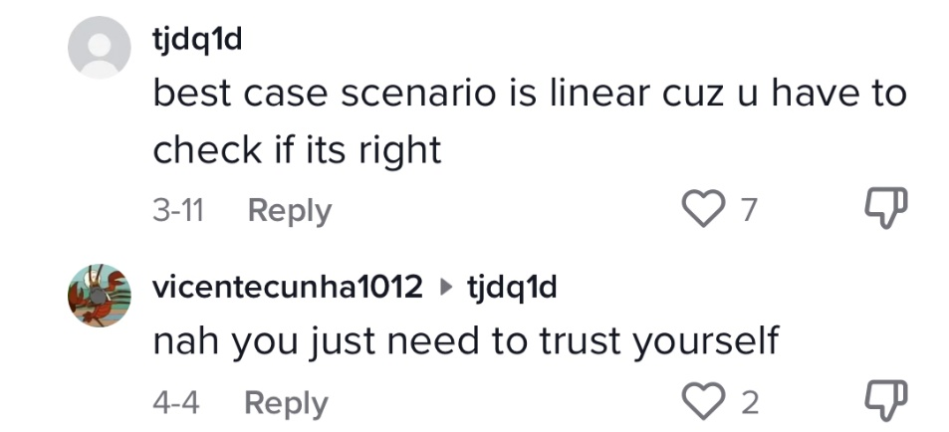
Bogo Sort (stupid sort) randomly shuffles the array until its sorted
while not sorted(array):
shuffle(array)
Best case scenario, this is the most efficient sorting algorithm!
Running time: O(pain) if we don’t keep track of permutations checked
O(n!) if we keep track of permutations
This sorting algorithm is a joke, please don’t take this one seriously…

Slide 84
Sorting Algorithms Visualized
https://youtu.be/kPRA0W1kECg

