Slide 1

CSCI 132: Basic Data Structures and Algorithms
Final Exam Review
Reese Pearsall & Iliana Castillon
Fall 2024
https://www.cs.montana.edu/pearsall/classes/fall2024/132/main.html
*All images are stolen from the internet

Slide 2
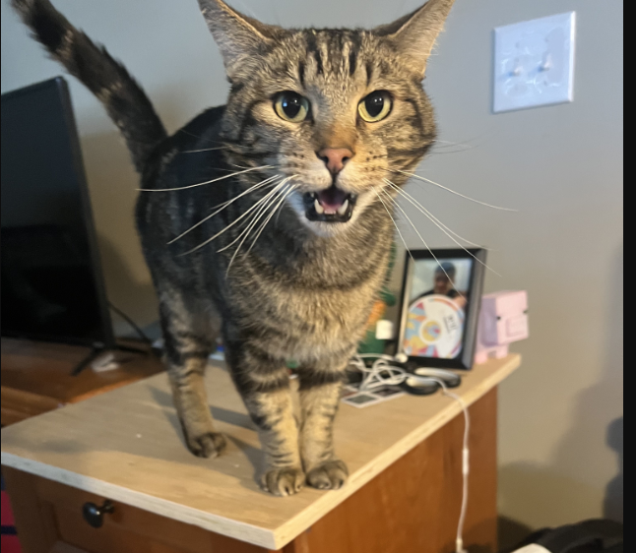


Announcements
Program 5 due Sunday
Final Exam on Monday (12/9) at
2:00 PM – 3:50 PM in our normal classroom
Rubber duck screenshot due tonight
Meatball and Sasha wish you good luck on your final exams

Slide 3
Final Exam Logistics
8 Parts
Same format/rules as the midterm exam
You can use notes, your IDE, lecture recordings, previous assignments, java documentation. No external resources
Bring your laptop if you need
Roughly about the same length as the Midterm, but you have 2 hours this time ☺
Multiple Choice
Short Answer
Sorting
Searching
Basic Java Classes
Stacks
Recursion
Queues

Slide 4
Basic Java Class Structure
Be able to identify/define instance fields and methods
Write a constructor
Understand basic Java keywords
Understand Java reference variables
Write a basic java method

Slide 5
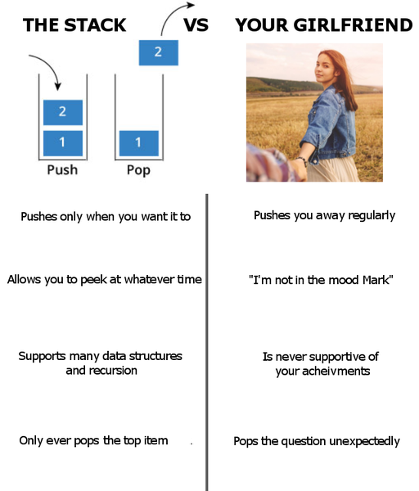
Stacks
Significant other
Be able to understand basic stack methods (push pop peek)
Given code that utilizes a stack, be able to visualize and illustrate the contents of a stack
Know the running time of stack operations
Write code the uses a stack

Slide 6
Queues
Be able to understand basic queue methods (enqueue dequeue peek)
Given code that utilizes a queue, be able to visualize and illustrate the contents of a stack
Know the running time of queue operations
Write code the uses a queue

Slide 7
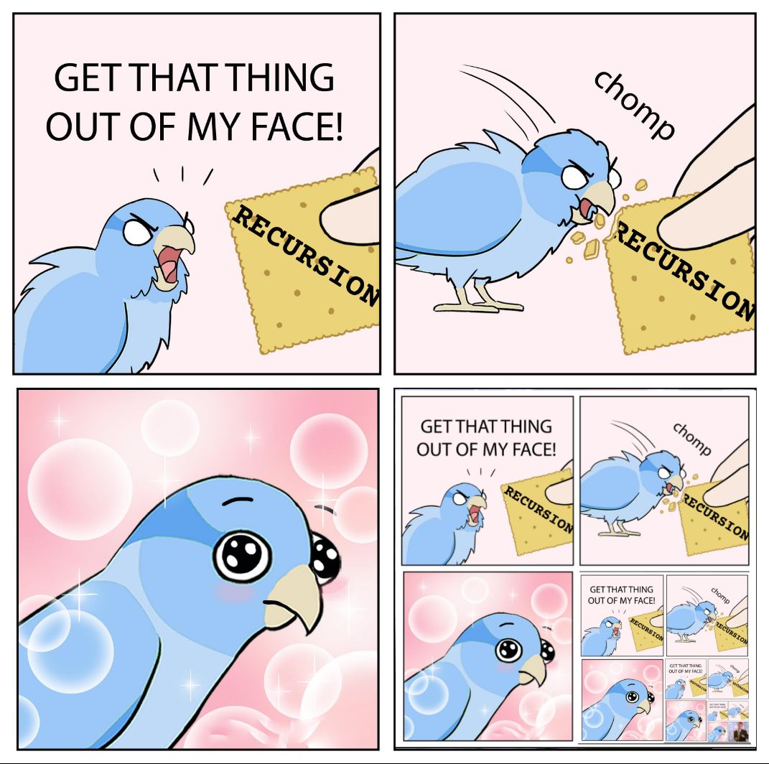
Recursion
Given a basic recursion function, derive the output and number of recursive calls made
Understand how to calculate the running time of a recursive algorithm
Understand limitations/benefits of recursion

Slide 8
Sorting
Bubble sort, selection sort, merge sort, quick sort
Be able to describe/illustrate the steps of these sorting algorithms
Know the running time for each sorting algorithm
Know which ones are efficient/not efficient

Slide 9
Searching
Understand the differences between linear search and binary search
Understand the running times of those algorithms
Be able to look at code for linear search and binary search and understand what is happening

Slide 10
Short Answer
Basic Java Classes, Class Structure, Methods, Operations, if statements, loops, OOP
Basic Linked Lists
Big-O Notation, How to determine running time of an algorithm
Stacks
Queues
Bubble Sort
Selection Sort
Merge Sort
Quick Sort
Linear Search/Binary Search
Recursion

Slide 11
Multiple Choice
Basic Java Classes, Class Structure, Methods, Operations, if statements, loops, OOP
Basic Linked Lists
Big-O Notation, How to determine running time of an algorithm
Stacks
Queues
Bubble Sort
Selection Sort
Merge Sort
Quick Sort
Linear Search/Binary Search
Recursion

Slide 12
Final Exam Study Guide

Slide 13
Course Goals
Design and Implement programs of simple and moderate complexity in Java
Explain the concept of an ADT (meh)
Understand and implement basic data structures: Linked lists, stacks, and queues
Given a simple algorithm, determine the time complexity using Big-O notation
Understand basic searching and sorting algorithms and their runtime
Understand how recursion works, be able to analyze recursion runtime, and be able to implement recursion in a program
Be able to debug programs and become an independent problem solver

Slide 14
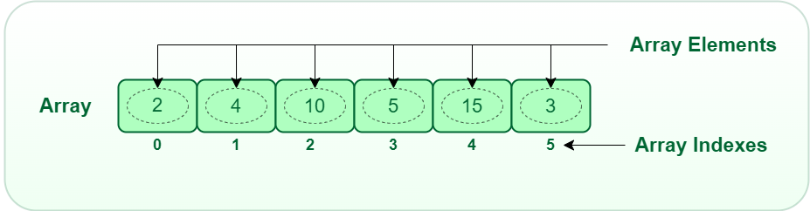
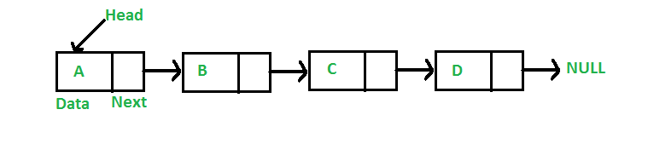


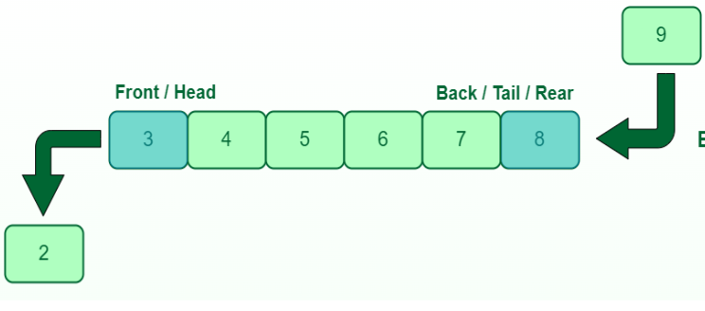
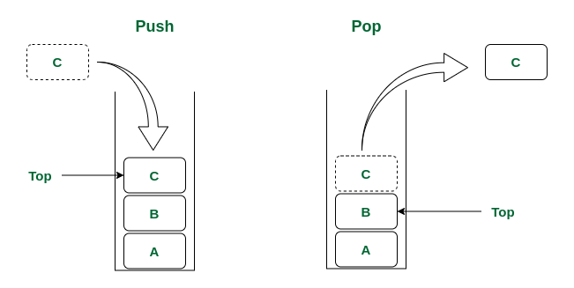
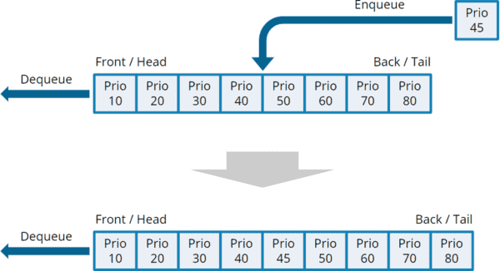

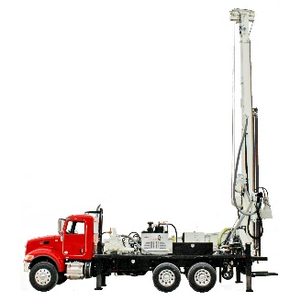

Takeaways
We have different data structures that handle data differently.
There are tradeoffs between using these data structures
Linked List
Arrays
Priority Queue
Queue
Given a problem, you should be able to identify a good candidate for a data structure and provide a justification
Stack

Slide 15

Takeaways
There be many different types of algorithms. Every algorithm has a running time, which is important to be aware of
The algorithm you select is important. It can be the difference between your program finishing in 6 seconds, or you program never finishing at all
The data structure you select is important. When deciding which data structure to use, you should have a reason to back it up
We have methods for measuring the efficiency of some algorithm (big-O notation).
When you write an algorithm, you should be able to broadly describe the effectiveness and efficiency of it

Slide 16
Our Goals for you
Get you comfortable with writing basic Java programs
Give you a good toolset that can help you solve a variety of problems (Data Structures)
Give you techniques and methods for solving a variety of problems (Algorithms)
Give you the skills to analyze the algorithms that you write (Big-O notation)

Slide 17

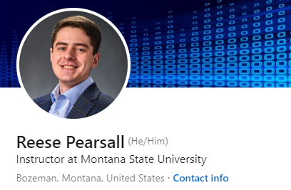
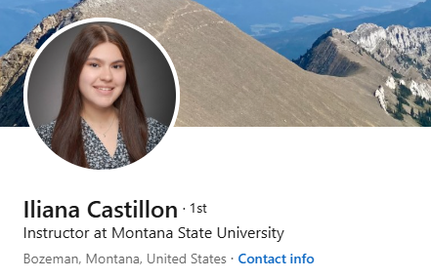

Thank You!
This class has been fun to teach for us to teach. I understand that there were certain parts that were not very exciting.
We hope you enjoyed this class, and we hope the stuff you learned will be helpful in your career/future classes
If we can be of assistance to you for anything in the future (reference, advising, support), please let me know!
There is a very good chance you will have in our classes in the future
CSCI 232 next semester
Connect with us on LinkedIn!
CSCI 132 students

