Slide 1

CSCI 466: Networks
Network Layer – Routing (Control Plane)
Reese Pearsall Fall 2024
https://www.cs.montana.edu/pearsall/classes/fall2024/466/main.html
*All images are stolen from the internet
1

Slide 2
Announcements
No class on Friday
Workday for PA2 (I’ll be in my office still if you need help)
PA2 due on Sunday at 11:59 PM
Make sure everything is inside of a /PA2 folder in your repo
Everyone needs to submit video demo link to D2L
ACM is hosting a guest speaker tonight at 5PM in Barnard Hall 347
Speaker has experience working at HP, Microsoft, Amazon
Great opportunity to learn about industry, careers, etc

Slide 3

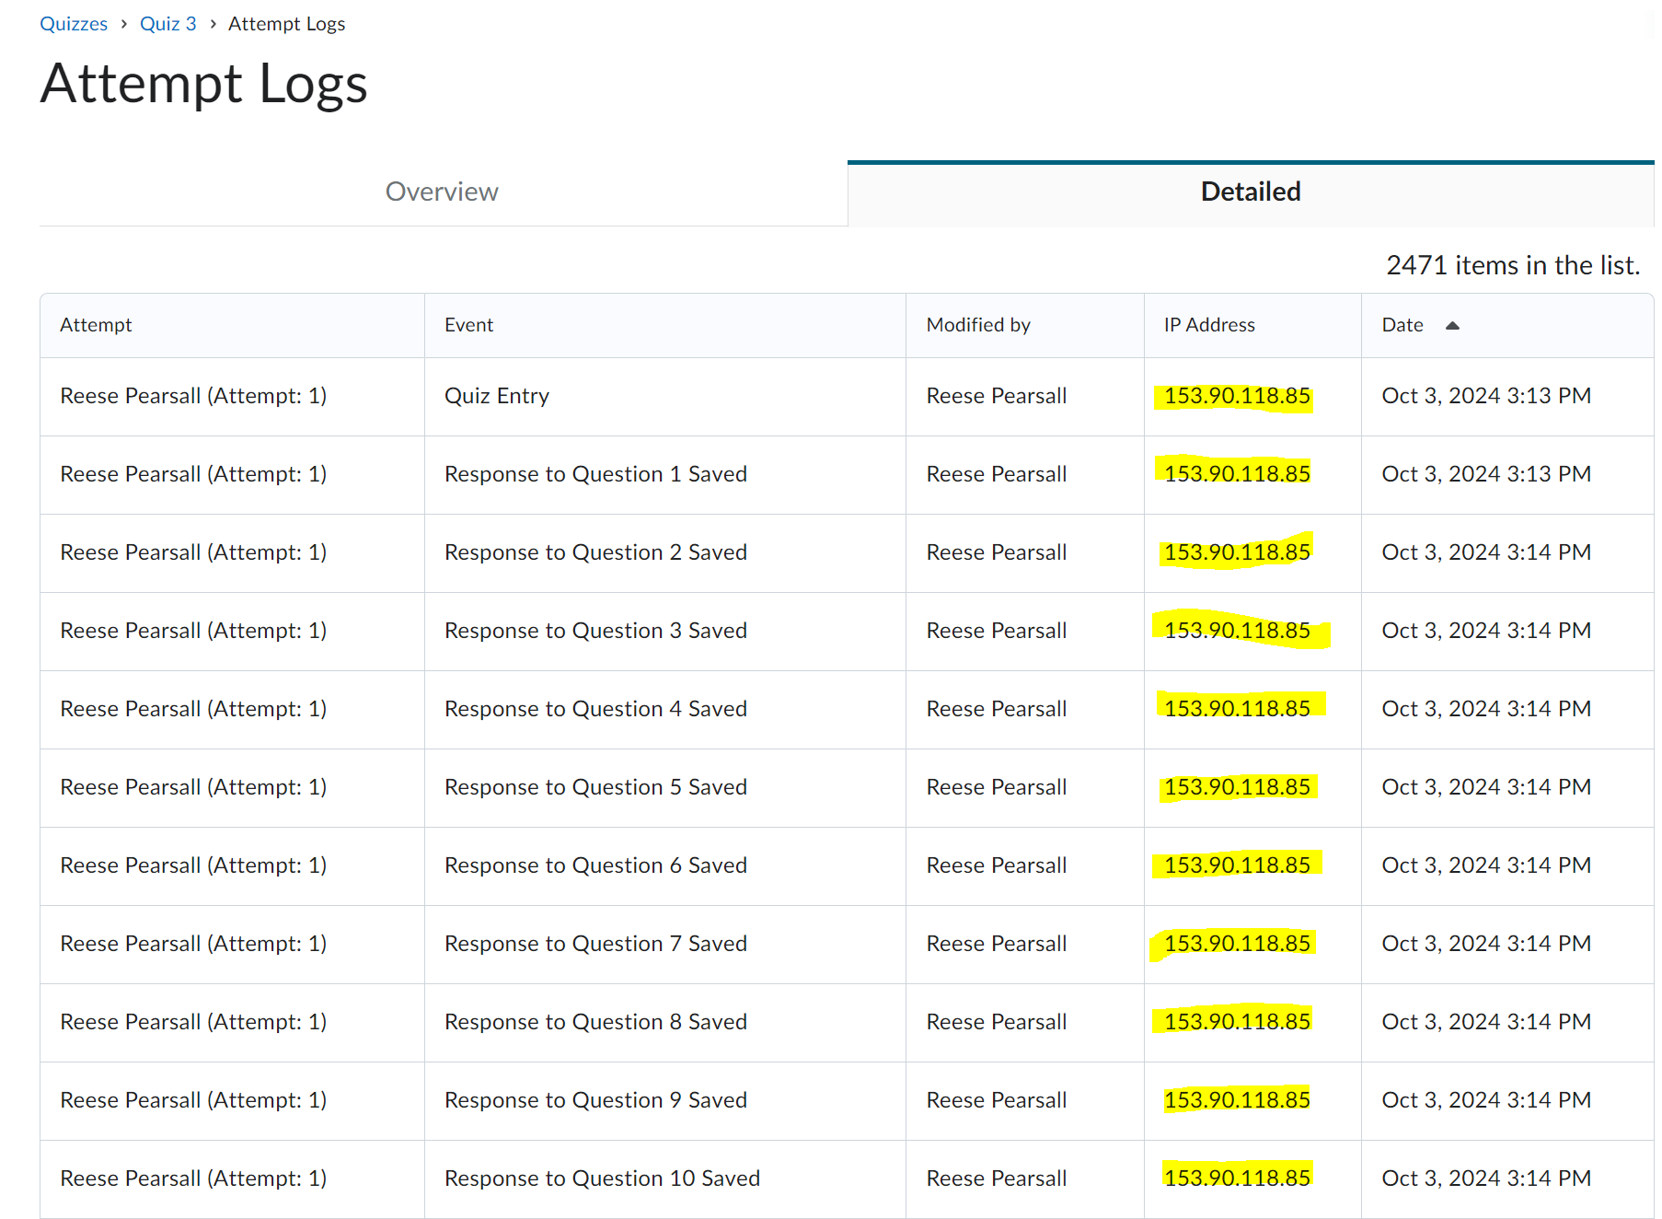
https://www.bozemandailychronicle.com/news/montana_state_university/exponent/kind-of-scary-montana-state-officials-confirm-learning-platform-tracks-student-locations/article_740f212e-859d-11ef-a536-771135b8a5d8.html

Slide 4
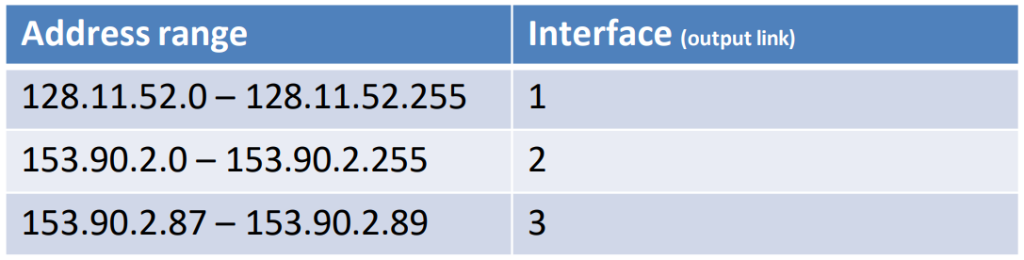

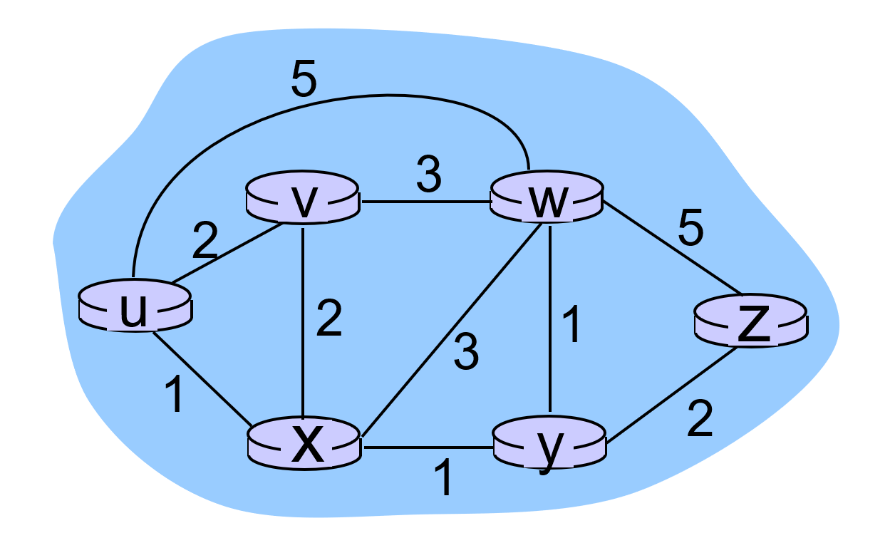
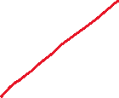
Forwarding refers to moving packets from a router’s input to appropriate router output, and is implemented in the data plane.
Ideally, this output links are the most optimal path to get to the destination
Routing refers to determining the route taken by packets from source to destination, and is implemented in the control plane.
Routing Metrics:
Shortest Path
Highest Throughput Path
Minimum Number of Hops
Lowest Congested Path
What is the best way to get from u to z?

Slide 5
Routing tables are filled via routing algorithms
There are two types of routing algorithms

Slide 6
Routing tables are filled via routing algorithms
There are two types of routing algorithms
Centralized/Global- we know the edge costs of the network
We can compute the shortest path from one node, to all other nodes in polynomial time.
Once we know the shortest path from A to B, we can update routing tables to reflect that shortest path
Link State algorithms
(Dijkstra’s Algorithm)

Slide 7


Shortest Path
0.22
1
0.29
5
3
0.1
0.39
0.28
7
0.34
0.35
2
0.52
0.37
0.26
0.35
0
0.4
0.38
0.58
4
6
0.93
7

Slide 8
Shortest Path
0.22
1
0.29
5
3
0.1
0.39
0.28
7
0.34
0.35
2
0.52
0.37
0.26
0.35
0
0.4
0.38
0.58
4
6
0.93
8

Slide 9
Shortest Path
0.22
1
0.29
5
3
0.1
0.39
0.28
7
0.34
0.35
2
0.52
0.37
0.26
0.35
0
0.4
0.38
0.58
Path with the smallest sum of edge weights.
4
6
0.93
What is the shortest path between vertex 0 and vertex 6?
9

Slide 10
Shortest Path
0.22
1
0.29
5
3
0.1
0.39
0.28
7
0.34
0.35
2
0.52
0.37
0.26
0.35
0
0.4
0.38
0.58
4
6
0.93
We are going to find the shortest path between vertex 0 and every other vertex, flooding out from 0.
10

Slide 11
Shortest Path
Distance from 0
0 | ?
1 | ?
2 | ?
3 | ?
4 | ?
5 | ?
6 | ?
7 | ?
0.22
1
0.29
5
3
0.1
0.39
0.28
7
0.34
0.35
2
0.52
0.37
0.26
0.35
0
0.4
0.38
0.58
4
6
0.93
11

Slide 12
Shortest Path
Distance from 0
0 | 0
1 | ∞
2 | ∞
3 | ∞
4 | ∞
5 | ∞
6 | ∞
7 | ∞
0.22
1
0.29
5
3
0.1
0.39
0.28
7
0.34
0.35
2
0.52
0.37
0.26
0.35
0
0.4
0.38
0.58
4
6
0.93
How can we keep track of routes?
12

Slide 13
Shortest Path
Distance from 0
Previous vertex
0 | 0
1 | ∞
2 | ∞
3 | ∞
4 | ∞
5 | ∞
6 | ∞
7 | ∞
0 | -
1
2
3
4
5
6
7
0.22
1
0.29
5
3
0.1
0.39
0.28
7
0.34
0.35
2
0.52
0.37
0.26
0.35
0
0.4
0.38
0.58
4
6
0.93
How can we keep track of routes?
13

Slide 14
Shortest Path
Distance from 0
Previous vertex
0 | 0
1 | ∞
2 | 0.26
3 | 0.99
4 | ∞
5 | ∞
6 | 1.51
7 | 0.60
0 | -
1
2 | 0
3 | 7
4
5
6 | 3
7 | 2
0.22
1
0.29
5
3
0.1
0.39
0.28
7
0.34
0.35
2
0.52
0.37
0.26
0.35
0
0.4
0.38
0.58
4
6
0.93
How can we keep track of routes?
14

Slide 15
Shortest Path
Distance from 0
Previous vertex
0 | 0
1 | ∞
2 | ∞
3 | ∞
4 | ∞
5 | ∞
6 | ∞
7 | ∞
0 | -
1
2 | 0
3 | 7
4
5
6 | 3
7 | 2
0.22
1
0.29
5
3
0.1
0.39
0.28
7
0.34
0.35
2
0.52
0.37
0.26
0.35
0
0.4
0.38
0.58
4
6
0.93
If this is the shortest path from 0 to 6, what can we say about the shortest path from 0 to 3?
15

Slide 16
Shortest Path
Distance from 0
Previous vertex
Priority queue
0 | 0
1 | ∞
2 | ∞
3 | ∞
4 | ∞
5 | ∞
6 | ∞
7 | ∞
0 | -
1
2
3
4
5
6
7
0.22
1
0.29
5
3
0.1
0.39
0.28
7
0.34
0.35
2
0.52
0.37
0.26
0.35
0
0.4
0.38
0.58
4
6
0.93
vertex (distance)
What can we reach from connected vertices and at what distance (from 0)?
16

Slide 17
Shortest Path
Distance from 0
Previous vertex
Priority queue
0 | 0
1 | ∞
2 | ∞
3 | ∞
4 | ∞
5 | ∞
6 | ∞
7 | ∞
0 | -
1
2
3
4
5
6
7
2 (0.26)
4 (0.38)
0.22
1
0.29
5
3
0.1
0.39
0.28
7
0.34
0.35
2
0.52
0.37
0.26
0.35
0
0.4
0.38
0.58
4
6
0.93
vertex (distance)
What can we reach from connected vertices and at what distance (from 0)?
17

Slide 18
Shortest Path
Distance from 0
Previous vertex
Priority queue
0 | 0
1 | ∞
2 | ∞
3 | ∞
4 | ∞
5 | ∞
6 | ∞
7 | ∞
0 | -
1
2 | 0
3
4 | 0
5
6
7
2 (0.26)
4 (0.38)
0.22
1
0.29
5
3
0.1
0.39
0.28
7
0.34
0.35
2
0.52
0.37
0.26
0.35
0
0.4
0.38
0.58
4
6
0.93
vertex (distance)
What can we reach from connected vertices and at what distance (from 0)?
18

Slide 19
Shortest Path
Distance from 0
Previous vertex
Priority queue
0 | 0
1 | ∞
2 | 0.26
3 | ∞
4 | 0.38
5 | ∞
6 | ∞
7 | ∞
0 | -
1
2 | 0
3
4 | 0
5
6
7
2 (0.26)
4 (0.38)
0.22
1
0.29
5
3
0.1
0.39
0.28
7
0.34
0.35
2
0.52
0.37
0.26
0.35
0
0.4
0.38
0.58
4
6
0.93
vertex (distance)
What can we reach from connected vertices and at what distance (from 0)?
19

Slide 20
Shortest Path
Distance from 0
Previous vertex
Priority queue
queue
top
= 2 (0.26)
0 | 0
1 | ∞
2 | 0.26
3 | ∞
4 | 0.38
5 | ∞
6 | ∞
7 | ∞
0 | -
1
2 | 0
3
4 | 0
5
6
7
4 (0.38)
0.22
1
0.29
5
3
0.1
0.39
0.28
7
0.34
0.35
2
0.52
0.37
0.26
0.35
0
0.4
0.38
0.58
4
6
0.93
vertex (distance)
What can we reach from connected vertices and at what distance (from 0)?
20

Slide 21
Shortest Path
Distance from 0
Previous vertex
Priority queue
queue
top
= 2 (0.26)
0 | 0
1 | ∞
2 | 0.26
3 | ∞
4 | 0.38
5 | ∞
6 | ∞
7 | ∞
0 | -
1
2 | 0
3
4 | 0
5
6
7
4 (0.38)
0.22
1
0.29
5
3
0.1
0.39
0.28
7
0.34
0.35
2
0.52
0.37
0.26
0.35
0
0.4
0.38
0.58
4
6
0.93
vertex (distance)
What can we reach from connected vertices and at what distance (from 0)?
21

Slide 22
Shortest Path
Distance from 0
Previous vertex
Priority queue
queue
top
= 2 (0.26)
0 | 0
1 | ∞
2 | 0.26
3 | ∞
4 | 0.38
5 | ∞
6 | ∞
7 | 0.60
0 | -
1
2 | 0
3
4 | 0
5
6
7 | 2
4 (0.38)
7 (0.60)
0.22
1
0.29
5
3
0.1
0.39
0.28
7
0.34
0.35
2
0.52
0.37
0.26
0.35
0
0.4
0.38
0.58
4
6
0.93
vertex (distance)
What can we reach from connected vertices and at what distance (from 0)?
22

Slide 23
Shortest Path
Distance from 0
Previous vertex
Priority queue
queue
top
= 4 (0.38)
0 | 0
1 | ∞
2 | 0.26
3 | ∞
4 | 0.38
5 | ∞
6 | ∞
7 | 0.60
0 | -
1
2 | 0
3
4 | 0
5
6
7 | 2
7 (0.60)
0.22
1
0.29
5
3
0.1
0.39
0.28
7
0.34
0.35
2
0.52
0.37
0.26
0.35
0
0.4
0.38
0.58
4
6
0.93
vertex (distance)
Repeat.
23

Slide 24
Shortest Path
Distance from 0
Previous vertex
Priority queue
queue
top
= 4 (0.38)
0 | 0
1 | ∞
2 | 0.26
3 | ∞
4 | 0.38
5 | ∞
6 | ∞
7 | 0.60
0 | -
1
2 | 0
3
4 | 0
5
6
7 | 2
7 (0.60)
0.22
1
0.29
5
3
0.1
0.39
0.28
7
0.34
0.35
2
0.52
0.37
0.26
0.35
0
0.4
0.38
0.58
4
6
0.93
vertex (distance)
Add neighbors to queue/previous.
24

Slide 25
Shortest Path
Distance from 0
Previous vertex
Priority queue
queue
top
= 4 (0.38)
0 | 0
1 | ∞
2 | 0.26
3 | ∞
4 | 0.38
5 | 0.73
6 | ∞
7 | 0.60
0 | -
1
2 | 0
3
4 | 0
5 | 4
6
7 | 2
7 (0.60)
5 (0.73)
0.22
1
0.29
5
3
0.1
0.39
0.28
7
0.34
0.35
2
0.52
0.37
0.26
0.35
0
0.4
0.38
0.58
4
6
0.93
vertex (distance)
Add neighbors to queue/previous.
25

Slide 26
Shortest Path
Distance from 0
Previous vertex
Priority queue
queue
top
= 4 (0.38)
0 | 0
1 | ∞
2 | 0.26
3 | ∞
4 | 0.38
5 | 0.73
6 | ∞
7 | 0.60
0 | -
1
2 | 0
3
4 | 0
5 | 4
6
7 | 2
7 (0.60)
5 (0.73)
0.22
1
0.29
5
3
0.1
0.39
0.28
7
0.34
0.35
2
0.52
0.37
0.26
0.35
0
0.4
0.38
0.58
4
6
0.93
vertex (distance)
Add neighbors to queue/previous.
We have another route to 7!
26

Slide 27
Shortest Path
Distance from 0
Previous vertex
Priority queue
queue
top
= 4 (0.38)
0 | 0
1 | ∞
2 | 0.26
3 | ∞
4 | 0.38
5 | 0.73
6 | ∞
7 | 0.60
0 | -
1
2 | 0
3
4 | 0
5 | 4
6
7 | 2
7 (0.60)
5 (0.73)
0.22
1
0.29
5
3
0.1
0.39
0.28
7
0.34
0.35
2
0.52
0.37
0.26
0.35
0
0.4
0.38
0.58
4
6
0.93
vertex (distance)
Add neighbors to queue/previous.
We have another route to 7! Check to see if it is shorter!
27

Slide 28
Shortest Path
Distance from 0
Previous vertex
Priority queue
queue
top
= 4 (0.38)
0 | 0
1 | ∞
2 | 0.26
3 | ∞
4 | 0.38
5 | 0.73
6 | ∞
7 | 0.60
0 | -
1
2 | 0
3
4 | 0
5 | 4
6
7 | 2
7 (0.60)
5 (0.73)
0.22
1
0.29
5
3
0.1
0.39
0.28
7
0.34
0.35
2
0.52
0.37
0.26
0.35
0
0.4
0.38
0.58
4
6
0.93
vertex (distance)
Add neighbors to queue/previous.
We have another route to 7! Check to see if it is shorter! It’s not (0.38 + 0.37 = 0.75 > 0.60).
28

Slide 29

Shortest Path
Distance from 0
Previous vertex
Priority queue
queue
top
= 4 (0.38)
0 | 0
1 | ∞
2 | 0.26
3 | ∞
4 | 0.38
5 | 0.73
6 | ∞
7 | 0.60
0 | -
1
2 | 0
3
4 | 0
5 | 4
6
7 | 2
7 (0.60)
5 (0.73)
0.22
1
0.29
5
3
0.1
0.39
0.28
7
0.34
0.35
2
0.52
0.37
0.26
0.35
0
0.4
0.38
0.58
4
6
0.93
vertex (distance)
Rule: When processing vertex v, only add/modify queue for neighbor u if and only if:
distance[v] + weight(v, u) < distance[u]
29

Slide 30
Shortest Path
Distance from 0
Previous vertex
Priority queue
queue
top
=
0 | 0
1 | ∞
2 | 0.26
3 | ∞
4 | 0.38
5 | 0.73
6 | ∞
7 | 0.60
0 | -
1
2 | 0
3
4 | 0
5 | 4
6
7 | 2
7 (0.60)
5 (0.73)
0.22
1
0.29
5
3
0.1
0.39
0.28
7
0.34
0.35
2
0.52
0.37
0.26
0.35
0
0.4
0.38
0.58
4
6
0.93
vertex (distance)
Repeat.
30

Slide 31
Shortest Path
Distance from 0
Previous vertex
Priority queue
queue
top
= 7 (0.60)
0 | 0
1 | ∞
2 | 0.26
3 | 0.99
4 | 0.38
5 | 0.73
6 | ∞
7 | 0.60
0 | -
1
2 | 0
3 | 7
4 | 0
5 | 4
6
7 | 2
5 (0.73)
3 (0.99)
0.22
1
0.29
5
3
0.1
0.39
0.28
7
0.34
0.35
2
0.52
0.37
0.26
0.35
0
0.4
0.38
0.58
4
6
0.93
vertex (distance)
Repeat.
31

Slide 32
Shortest Path
Distance from 0
Previous vertex
Priority queue
queue
top
= 7 (0.60)
0 | 0
1 | ∞
2 | 0.26
3 | 0.99
4 | 0.38
5 | 0.73
6 | ∞
7 | 0.60
0 | -
1
2 | 0
3 | 7
4 | 0
5 | 4
6
7 | 2
5 (0.73)
3 (0.99)
0.22
1
0.29
5
3
0.1
0.39
0.28
7
0.34
0.35
2
0.52
0.37
0.26
0.35
0
0.4
0.38
0.58
4
6
0.93
vertex (distance)
Repeat.
We have another route to 5, and at cost 0.7 < 0.73.
32

Slide 33
Shortest Path
Distance from 0
Previous vertex
Priority queue
queue
top
= 7 (0.60)
0 | 0
1 | ∞
2 | 0.26
3 | 0.99
4 | 0.38
5 | 0.73
6 | ∞
7 | 0.60
0 | -
1
2 | 0
3 | 7
4 | 0
5 | 4
6
7 | 2
5 (0.73)
3 (0.99)
0.22
1
0.29
5
3
0.1
0.39
0.28
7
0.34
0.35
2
0.52
0.37
0.26
0.35
0
0.4
0.38
0.58
4
6
0.93
vertex (distance)
Repeat. We have another route to 5, and at cost 0.7 < 0.73.
i.e., distance[v] + weight(v, u) < distance[u]
33

Slide 34
Shortest Path
Distance from 0
Previous vertex
Priority queue
queue
top
= 7 (0.60)
0.70
0 | 0
1 | ∞
2 | 0.26
3 | 0.99
4 | 0.38
5 | 0.73
6 | ∞
7 | 0.60
0 | -
1
2 | 0
3 | 7
4 | 0
5 | 4
6
7 | 2
5 (0.73)
3 (0.99)
0.22
1
0.29
5
3
0.1
0.39
0.28
7
0.34
0.35
2
0.52
0.70
0.26
7
0.35
0.37
0
0.4
0.38
0.58
4
6
0.93
vertex (distance)
Repeat. We have another route to 5, and at cost 0.7 < 0.73.
So updated queue/previous/distance.
34

Slide 35
Shortest Path
Distance from 0
Previous vertex
Priority queue
queue
top
= 7 (0.60)
0 | 0
1 | ∞
2 | 0.26
3 | 0.99
4 | 0.38
5 | 0.70
6 | ∞
7 | 0.60
0 | -
1
2 | 0
3 | 7
4 | 0
5 | 7
6
7 | 2
5 (0.70)
3 (0.99)
0.22
1
0.29
5
3
0.1
0.39
0.28
7
0.34
0.35
2
0.52
0.37
0.26
0.35
0
0.4
0.38
0.58
4
6
0.93
vertex (distance)
Repeat. We have another route to 5, and at cost 0.7 < 0.73.
So updated queue/previous/distance.
35

Slide 36
Shortest Path
Distance from 0
Previous vertex
Priority queue
queue
top
= 7 (0.60)
0 | 0
1 | ∞
2 | 0.26
3 | 0.99
4 | 0.38
5 | 0.70
6 | ∞
7 | 0.60
0 | -
1
2 | 0
3 | 7
4 | 0
5 | 7
6
7 | 2
5 (0.70)
3 (0.99)
0.22
1
0.29
5
3
0.1
0.39
0.28
7
0.34
0.35
2
0.52
0.37
0.26
0.35
0
0.4
0.38
0.58
4
6
0.93
vertex (distance)
Repeat.
36

Slide 37
Shortest Path
Distance from 0
Previous vertex
Priority queue
queue
top
= 5 (0.70)
0 | 0
1 | ∞
2 | 0.26
3 | 0.99
4 | 0.38
5 | 0.70
6 | ∞
7 | 0.60
0 | -
1
2 | 0
3 | 7
4 | 0
5 | 7
6
7 | 2
3 (0.99)
0.22
1
0.29
5
3
0.1
0.39
0.28
7
0.34
0.35
2
0.52
0.37
0.26
0.35
0
0.4
0.38
0.58
4
6
0.93
vertex (distance)
Repeat.
37

Slide 38
Shortest Path
Distance from 0
Previous vertex
Priority queue
queue
top
= 5 (0.70)
0 | 0
1 | ∞
2 | 0.26
3 | 0.99
4 | 0.38
5 | 0.70
6 | ∞
7 | 0.60
0 | -
1
2 | 0
3 | 7
4 | 0
5 | 7
6
7 | 2
3 (0.99)
0.22
1
0.29
5
3
0.1
0.39
0.28
7
0.34
0.35
2
0.52
0.37
0.26
0.35
0
0.4
0.38
0.58
4
6
0.93
vertex (distance)
Repeat.
38

Slide 39
Shortest Path
Distance from 0
Previous vertex
Priority queue
queue
top
= 5 (0.70)
0 | 0
1 | 0.92
2 | 0.26
3 | 0.99
4 | 0.38
5 | 0.70
6 | ∞
7 | 0.60
0 | -
1 | 5
2 | 0
3 | 7
4 | 0
5 | 7
6
7 | 2
1 (0.92)
3 (0.99)
0.22
1
0.29
5
3
0.1
0.39
0.28
7
0.34
0.35
2
0.52
0.37
0.26
0.35
0
0.4
0.38
0.58
4
6
0.93
vertex (distance)
Repeat.
39

Slide 40
Shortest Path
Distance from 0
Previous vertex
Priority queue
queue
top
= 5 (0.70)
0 | 0
1 | 0.92
2 | 0.26
3 | 0.99
4 | 0.38
5 | 0.70
6 | ∞
7 | 0.60
0 | -
1 | 5
2 | 0
3 | 7
4 | 0
5 | 7
6
7 | 2
1 (0.92)
3 (0.99)
0.22
1
0.29
5
3
0.1
0.39
0.28
7
0.34
0.35
2
0.52
0.37
0.26
0.35
0
0.4
0.38
0.58
4
6
0.93
vertex (distance)
Repeat.
What about neighbor 4?
40

Slide 41

Shortest Path
Distance from 0
Previous vertex
Priority queue
queue
top
= 5 (0.70)
0 | 0
1 | 0.92
2 | 0.26
3 | 0.99
4 | 0.38
5 | 0.70
6 | ∞
7 | 0.60
0 | -
1 | 5
2 | 0
3 | 7
4 | 0
5 | 7
6
7 | 2
1 (0.92)
3 (0.99)
0.22
1
0.29
5
3
0.1
0.39
0.28
7
0.34
0.35
2
0.52
0.37
0.26
0.35
0
0.4
0.38
0.58
4
6
0.93
vertex (distance)
Repeat.
What about neighbor 4?distance[5] + weight(5, 4) = 0.70 + 0.35 = 1.05 $≮$ 0.38 = distance[4]
41

Slide 42
Shortest Path
Distance from 0
Previous vertex
Priority queue
queue
top
= 5 (0.70)
0 | 0
1 | 0.92
2 | 0.26
3 | 0.99
4 | 0.38
5 | 0.70
6 | ∞
7 | 0.60
0 | -
1 | 5
2 | 0
3 | 7
4 | 0
5 | 7
6
7 | 2
1 (0.92)
3 (0.99)
0.22
1
0.29
5
3
0.1
0.39
0.28
7
0.34
0.35
2
0.52
0.37
0.26
0.35
0
0.4
0.38
0.58
4
6
0.93
vertex (distance)
Repeat. What about neighbor 7?
distance[5] + weight(5, 7) = 0.70 + 0.28 = 0.98 $≮$ 0.60 = distance[7]

Slide 43
Shortest Path
Distance from 0
Previous vertex
Priority queue
queue
top
= 1 (0.92)
0 | 0
1 | 0.92
2 | 0.26
3 | 0.99
4 | 0.38
5 | 0.70
6 | ∞
7 | 0.60
0 | -
1 | 5
2 | 0
3 | 7
4 | 0
5 | 7
6
7 | 2
3 (0.99)
0.22
1
0.29
5
3
0.1
0.39
0.28
7
0.34
0.35
2
0.52
0.37
0.26
0.35
0
0.4
0.38
0.58
4
6
0.93
vertex (distance)
Repeat.
43

Slide 44
Shortest Path
Distance from 0
Previous vertex
Priority queue
queue
top
= 1 (0.92)
0 | 0
1 | 0.92
2 | 0.26
3 | 0.99
4 | 0.38
5 | 0.70
6 | ∞
7 | 0.60
0 | -
1 | 5
2 | 0
3 | 7
4 | 0
5 | 7
6
7 | 2
3 (0.99)
0.22
1
0.29
5
3
0.1
0.39
0.28
7
0.34
0.35
2
0.52
0.37
0.26
0.35
0
0.4
0.38
0.58
4
6
0.93
vertex (distance)
Repeat.
What about neighbor 3? 0.92 + 0.29 = 1.21 > 0.99
44

Slide 45
Shortest Path
Distance from 0
Previous vertex
Priority queue
queue
top
= 3 (0.99)
0 | 0
1 | 0.92
2 | 0.26
3 | 0.99
4 | 0.38
5 | 0.70
6 | ∞
7 | 0.60
0 | -
1 | 5
2 | 0
3 | 7
4 | 0
5 | 7
6
7 | 2
0.22
1
0.29
5
3
0.1
0.39
0.28
7
0.34
0.35
2
0.52
0.37
0.26
0.35
0
0.4
0.38
0.58
4
6
0.93
vertex (distance)
Repeat.
45

Slide 46
Shortest Path
Distance from 0
Previous vertex
Priority queue
queue
top
= 3 (0.99)
0 | 0
1 | 0.92
2 | 0.26
3 | 0.99
4 | 0.38
5 | 0.70
6 | 1.51
7 | 0.60
0 | -
1 | 5
2 | 0
3 | 7
4 | 0
5 | 7
6 | 3
7 | 2
6 (1.51)
0.22
1
0.29
5
3
0.1
0.39
0.28
7
0.34
0.35
2
0.52
0.37
0.26
0.35
0
0.4
0.38
0.58
4
6
0.93
vertex (distance)
Repeat.
46

Slide 47
Shortest Path
Distance from 0
Previous vertex
Priority queue
queue
top
= 6 (1.51)
0 | 0
1 | 0.92
2 | 0.26
3 | 0.99
4 | 0.38
5 | 0.70
6 | 1.51
7 | 0.60
0 | -
1 | 5
2 | 0
3 | 7
4 | 0
5 | 7
6 | 3
7 | 2
0.22
1
0.29
5
3
0.1
0.39
0.28
7
0.34
0.35
2
0.52
0.37
0.26
0.35
0
0.4
0.38
0.58
4
6
0.93
vertex (distance)
Repeat.
47

Slide 48
Shortest Path
Distance from 0
Previous vertex
Priority queue
queue
top
= 6 (1.51)
0 | 0
1 | 0.92
2 | 0.26
3 | 0.99
4 | 0.38
5 | 0.70
6 | 1.51
7 | 0.60
0 | -
1 | 5
2 | 0
3 | 7
4 | 0
5 | 7
6 | 3
7 | 2
0.22
1
0.29
5
3
0.1
0.39
0.28
7
0.34
0.35
2
0.52
0.37
0.26
0.35
0
0.4
0.38
0.58
4
6
0.93
vertex (distance)
Repeat?
48

Slide 49
Shortest Path
Distance from 0
Previous vertex
Priority queue
queue
top
= 6 (1.51)
0 | 0
1 | 0.92
2 | 0.26
3 | 0.99
4 | 0.38
5 | 0.70
6 | 1.51
7 | 0.60
0 | -
1 | 5
2 | 0
3 | 7
4 | 0
5 | 7
6 | 3
7 | 2
0.22
1
0.29
5
3
0.1
0.39
0.28
7
0.34
0.35
2
0.52
0.37
0.26
0.35
0
0.4
0.38
0.58
4
6
0.93
vertex (distance)
Repeat?
Neighbor 4? 1.51 + 0.93 > 0.38
49

Slide 50
Shortest Path
Distance from 0
Previous vertex
Priority queue
queue
top
= 6 (1.51)
0 | 0
1 | 0.92
2 | 0.26
3 | 0.99
4 | 0.38
5 | 0.70
6 | 1.51
7 | 0.60
0 | -
1 | 5
2 | 0
3 | 7
4 | 0
5 | 7
6 | 3
7 | 2
0.22
1
0.29
5
3
0.1
0.39
0.28
7
0.34
0.35
2
0.52
0.37
0.26
0.35
0
0.4
0.38
0.58
4
6
0.93
vertex (distance)
Repeat?
Neighbor 0? 1.51 + 0.58 > 0
50

Slide 51
Shortest Path
Distance from 0
Previous vertex
Priority queue
queue
top
= 6 (1.51)
0 | 0
1 | 0.92
2 | 0.26
3 | 0.99
4 | 0.38
5 | 0.70
6 | 1.51
7 | 0.60
0 | -
1 | 5
2 | 0
3 | 7
4 | 0
5 | 7
6 | 3
7 | 2
0.22
1
0.29
5
3
0.1
0.39
0.28
7
0.34
0.35
2
0.52
0.37
0.26
0.35
0
0.4
0.38
0.58
4
6
0.93
vertex (distance)
Repeat?
Neighbor 2? 1.51 + 0.4 > 0.26
51

Slide 52
Shortest Path
Distance from 0
Previous vertex
Priority queue
queue
top
= 6 (1.51)
0 | 0
1 | 0.92
2 | 0.26
3 | 0.99
4 | 0.38
5 | 0.70
6 | 1.51
7 | 0.60
0 | -
1 | 5
2 | 0
3 | 7
4 | 0
5 | 7
6 | 3
7 | 2
0.22
1
0.29
5
3
0.1
0.39
0.28
7
0.34
0.35
2
0.52
0.37
0.26
0.35
0
0.4
0.38
0.58
4
6
0.93
vertex (distance)
When are we done?
52

Slide 53
Shortest Path
Distance from 0
Previous vertex
Priority queue
queue
top
= 6 (1.51)
0 | 0
1 | 0.92
2 | 0.26
3 | 0.99
4 | 0.38
5 | 0.70
6 | 1.51
7 | 0.60
0 | -
1 | 5
2 | 0
3 | 7
4 | 0
5 | 7
6 | 3
7 | 2
0.22
1
0.29
5
3
0.1
0.39
0.28
7
0.34
0.35
2
0.52
0.37
0.26
0.35
0
0.4
0.38
0.58
4
6
0.93
vertex (distance)
When are we done?
When the queue is empty!
53

Slide 54
Routing tables are filled via routing algorithms
There are two types of routing algorithms
Centralized/Global- we know the edge costs of the network
We can compute the shortest path from one node, to all other nodes in polynomial time.
Once we know the shortest path from A to B, we can update routing tables to reflect that shortest path
Link State algorithms
(Dijkstra’s Algorithm)

Slide 55
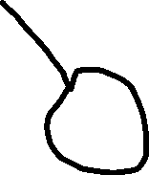




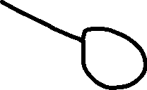





Routing tables are filled via routing algorithms
There are two types of routing algorithms
Decentralized- we do not know the edge costs of the entire network.
Only know edge costs to neighbors
Distance Vector algorithms

Slide 56
Routing tables are filled via routing algorithms
There are two types of routing algorithms
Based on Bellman-Ford (BF) equation (dynamic programming):
Bellman-Ford equation
Let D_{x}(y): cost of least-cost path from x to y.
Then:
D_{x}(y) = min_{v} { c_{x,v} + D_{v}(y) }
v’s estimated least-cost-path cost to y
min taken over all neighbors v of x
direct cost of link from x to v

Slide 57
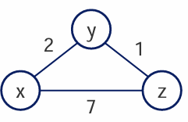



 |  |  | Cost | to
 |  | X | Y | Z
Cost | X | 0 | 2 | 7
From | Y
 | Z
 |  |  | Cost | to
 |  | X | Y | Z
Cost | X
From | Y | 2 | 0 | 1
 | Z
 |  |  | Cost | to
 |  | X | Y | Z
Cost | X
From | Y
 | Z | 7 | 1 | 0

Slide 58




 |  |  | Cost | to
 |  | X | Y | Z
Cost | X | 0 | 2 | 7
From | Y
 | Z
 |  |  | Cost | to
 |  | X | Y | Z
Cost | X | 0 | 2 | 3
From | Y | 2 | 0 | 1
 | Z | 7 | 1 | 0
 |  |  | Cost | to
 |  | X | Y | Z
Cost | X
From | Y | 2 | 0 | 1
 | Z
X learns that Y can reach Z with only a cost of 1
Meaning:
The cost to get to Y from X (2) plus the cost to get from Y to Z (1) is lower than my direct path to Y (7), so I have now learned a new shortest path!
 |  |  | Cost | to
 |  | X | Y | Z
Cost | X
From | Y
 | Z | 7 | 1 | 0

Slide 59

 |  |  | Cost | to
 |  | X | Y | Z
Cost | X | 0 | 2 | 7
From | Y
 | Z
 |  |  | Cost | to
 |  | X | Y | Z
Cost | X | 0 | 2 | 3
From | Y | 2 | 0 | 1
 | Z | 7 | 1 | 0
 |  |  | Cost | to
 |  | X | Y | Z
Cost | X
From | Y | 2 | 0 | 1
 | Z
 |  |  | Cost | to
 |  | X | Y | Z
Cost | X | 0 | 2 | 7
From | Y | 2 | 0 | 1
 | Z | 7 | 1 | 0
 |  |  | Cost | to
 |  | X | Y | Z
Cost | X
From | Y
 | Z | 7 | 1 | 0
 |  |  | Cost | to
 |  | X | Y | Z
Cost | X | 0 | 2 | 7
From | Y | 2 | 0 | 1
 | Z | 3 | 1 | 0

Slide 60
 |  |  | Cost | to
 |  | X | Y | Z
Cost | X | 0 | 2 | 7
From | Y
 | Z
 |  |  | Cost | to
 |  | X | Y | Z
Cost | X | 0 | 2 | 3
From | Y | 2 | 0 | 1
 | Z | 7 | 1 | 0
 |  |  | Cost | to
 |  | X | Y | Z
Cost | X | 0 | 2 | 3
From | Y | 2 | 0 | 1
 | Z | 3 | 1 | 0
 |  |  | Cost | to
 |  | X | Y | Z
Cost | X
From | Y | 2 | 0 | 1
 | Z
 |  |  | Cost | to
 |  | X | Y | Z
Cost | X | 0 | 2 | 7
From | Y | 2 | 0 | 1
 | Z | 7 | 1 | 0
 |  |  | Cost | to
 |  | X | Y | Z
Cost | X | 0 | 2 | 3
From | Y | 2 | 0 | 1
 | Z | 3 | 1 | 0
 |  |  | Cost | to
 |  | X | Y | Z
Cost | X
From | Y
 | Z | 7 | 1 | 0
 |  |  | Cost | to
 |  | X | Y | Z
Cost | X | 0 | 2 | 7
From | Y | 2 | 0 | 1
 | Z | 3 | 1 | 0
 |  |  | Cost | to
 |  | X | Y | Z
Cost | X | 0 | 2 | 3
From | Y | 2 | 0 | 1
 | Z | 3 | 1 | 0

Slide 61
 |  |  | Cost | to
 |  | X | Y | Z
Cost | X | 0 | 2 | 7
From | Y
 | Z
 |  |  | Cost | to
 |  | X | Y | Z
Cost | X | 0 | 2 | 3
From | Y | 2 | 0 | 1
 | Z | 7 | 1 | 0
 |  |  | Cost | to
 |  | X | Y | Z
Cost | X | 0 | 2 | 3
From | Y | 2 | 0 | 1
 | Z | 3 | 1 | 0
 |  |  | Cost | to
 |  | X | Y | Z
Cost | X
From | Y | 2 | 0 | 1
 | Z
 |  |  | Cost | to
 |  | X | Y | Z
Cost | X | 0 | 2 | 7
From | Y | 2 | 0 | 1
 | Z | 7 | 1 | 0
 |  |  | Cost | to
 |  | X | Y | Z
Cost | X | 0 | 2 | 3
From | Y | 2 | 0 | 1
 | Z | 3 | 1 | 0
We can update our routing table and then make sure we forward packets to the correct destination in the path
 |  |  | Cost | to
 |  | X | Y | Z
Cost | X
From | Y
 | Z | 7 | 1 | 0
 |  |  | Cost | to
 |  | X | Y | Z
Cost | X | 0 | 2 | 7
From | Y | 2 | 0 | 1
 | Z | 3 | 1 | 0
 |  |  | Cost | to
 |  | X | Y | Z
Cost | X | 0 | 2 | 3
From | Y | 2 | 0 | 1
 | Z | 3 | 1 | 0

Slide 62
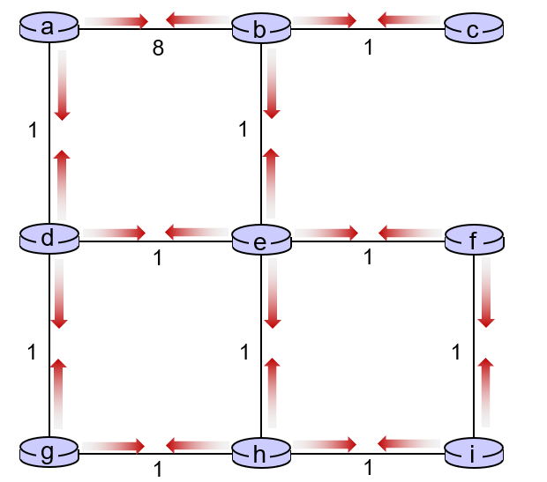
Routing tables are filled via routing algorithms
There are two types of routing algorithms
Centralized/Global- we know the edge costs of the network
Decentralized- we do not know the edge costs of the entire network.
Only know edge costs to neighbors
Link State algorithms
(Dijkstra’s Algorithm)
Distance Vector algorithms

Slide 63
Distance vector algorithm:
each node:
iterative, asynchronous: each local iteration caused by:
local link cost change
DV update message from neighbor
wait for (change in local link cost or msg from neighbor)
recompute DV estimates using DV received from neighbor
distributed, self-stopping: each node notifies neighbors only when its DV changes
  neighbors then notify their neighbors – only if necessary
  no notification received, no actions taken!
if DV to any destination has changed, notify neighbors

Slide 64
Distance vector: example
DV in a: D_{a}(a)=0
D_{a}(b) = 8
D_{a}(c) = ∞
D_{a}(d) = 1
D_{a}(e) = ∞
D_{a}(f) = ∞
D_{a}(g) = ∞
D_{a}(h) = ∞
D_{a}(i) = ∞
a
b
c
8
1
t=0
1
1
All nodes have distance estimates to nearest neighbors (only)
A few asymmetries:
missing link
larger cost
d
e
f
1
1
All nodes send their local distance vector to their neighbors
1
1
1
g
h
i
1
1

Slide 65
Distance vector example: iteration
a
b
c
8
1
t=1
1
1
All nodes:
receive distance vectors from neighbors
compute their new local distance vector
send their new local distance vector to neighbors
d
e
f
1
1
1
1
1
g
h
i
1
1

Slide 66
Distance vector example: iteration
a
compute
compute
compute
b
c
8
1
t=1
1
1
All nodes:
receive distance vectors from neighbors
compute their new local distance vector
send their new local distance vector to neighbors
d
compute
e
f
compute
compute
1
1
1
1
1
g
h
i
compute
compute
1
compute
1

Slide 67
Distance vector example: iteration
a
b
c
8
1
t=1
1
1
All nodes:
receive distance vectors from neighbors
compute their new local distance vector
send their new local distance vector to neighbors
d
e
f
1
1
1
1
1
g
h
i
1
1

Slide 68
Distance vector example: iteration
a
b
c
8
1
t=2
1
1
All nodes:
receive distance vectors from neighbors
compute their new local distance vector
send their new local distance vector to neighbors
d
e
f
1
1
1
1
1
g
h
i
1
1

Slide 69
Distance vector example: iteration
compute
compute
compute
a
b
c
2
1
t=2
1
1
All nodes:
receive distance vectors from neighbors
compute their new local distance vector
send their new local distance vector to neighbors
d
compute
compute
compute
e
f
1
1
1
1
1
g
compute
compute
compute
h
i
8
1

Slide 70
Distance vector example: iteration
a
b
c
8
1
t=2
1
1
All nodes:
receive distance vectors from neighbors
compute their new local distance vector
send their new local distance vector to neighbors
d
e
f
1
1
1
1
1
g
h
i
1
1

Slide 71
Routing tables are filled via routing algorithms
There are two types of routing algorithms
Centralized/Global- we know the edge costs of the network
Decentralized- we do not know the edge costs of the entire network.
Only know edge costs to neighbors
Link State algorithms
(Dijkstra’s Algorithm)
Distance Vector algorithms
These are not network protocols, these are simply general routing/shortest path algorithms

Slide 72
Routing tables are filled via routing algorithms
There are two types of routing algorithms
Centralized/Global- we know the edge costs of the network
Decentralized- we do not know the edge costs of the entire network.
Only know edge costs to neighbors
Link State algorithms
OSPF
BGP
(Dijkstra’s Algorithm)
Distance Vector algorithms

Slide 73









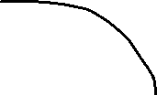
Intra-AS Routing: OSPF
An autonomous system is a group of routers that are under the same administrative control
AS 3
AS 1
AS 2

Slide 74


Intra-AS Routing: OSPF
Open Shortest Path First
OSPF is a link-state protocol that uses flooding of link-state information and Dijkstra’s least-cost algorithm
An autonomous system is a group of routers that are under the same administrative control
AS 1

Slide 75


Intra-AS Routing: OSPF
Open Shortest Path First
OSPF is a link-state protocol that uses flooding of link-state information and Dijkstra’s least-cost algorithm
An autonomous system is a group of routers that are under the same administrative control
1. Each router constructors a topological map of the AS
AS 1

Slide 76


Intra-AS Routing: OSPF
Open Shortest Path First
OSPF is a link-state protocol that uses flooding of link-state information and Dijkstra’s least-cost algorithm
An autonomous system is a group of routers that are under the same administrative control
1. Each router constructors a topological map of the AS
2. Run Dijikstra’s to determine shortest path to each subnet
(Edge costs will be set by a network administrator)
If I wanted to find the path with the shortest amount of hops, what should edge cost be?
AS 1

Slide 77
Intra-AS Routing: OSPF
Open Shortest Path First
OSPF is a link-state protocol that uses flooding of link-state information and Dijkstra’s least-cost algorithm
An autonomous system is a group of routers that are under the same administrative control
1. Each router constructors a topological map of the AS
2. Run Dijikstra’s to determine shortest path to each subnet
(Edge costs will be set by a network administrator)
(could set all edges to be a cost of 1)
A | 1
B | 2
C | 3
… | …
AS 1
3. Fill in routing table

Slide 78


Routing Among the ISPs: BGP
Inter-AS routing protocol involves coordination amongst multiple AS’s, a common protocol needs to be used
?
?
?
?
?
?
?
AS 1
Border Gateway Protocol (BGP) is used for exchanging routing information between AS

Slide 79


Routing Among the ISPs: BGP
Inter-AS routing protocol involves coordination amongst multiple AS’s, a common protocol needs to be used
AS 1
Border Gateway Protocol (BGP) is used for exchanging routing information between AS
BGP allows a router to tell other AS’s that it exists and needs to be connected

Slide 80
Routing Among the ISPs: BGP
AS consists of gateway routers and internal routers
Inter-AS routing protocol involves coordination amongst multiple AS’s, a common protocol needs to be used
AS6
AS3
AS2
AS4
AS5
AS6
AS 1
Border Gateway Protocol (BGP) is used for exchanging routing information between AS
BGP allows a router to tell other AS’s that it exists and needs to be connected

Slide 81
Routing Among the ISPs: BGP
AS consists of gateway routers and internal routers
Inter-AS routing protocol involves coordination amongst multiple AS’s, a common protocol needs to be used
AS6
AS3
AS2
AS4
AS5
AS6
AS 1
Border Gateway Protocol (BGP) is used for exchanging routing information between AS
BGP allows a router to tell other AS’s that it exists and needs to be connected

Slide 82
Routing Among the ISPs: BGP
AS consists of gateway routers and internal routers
Inter-AS routing protocol involves coordination amongst multiple AS’s, a common protocol needs to be used
AS6
“I am AS1 AND I EXIST!”
AS3
AS2
AS4
AS5
AS6
AS 1

Slide 83
Routing Among the ISPs: BGP
AS consists of gateway routers and internal routers
Inter-AS routing protocol involves coordination amongst multiple AS’s, a common protocol needs to be used
AS6
“I am AS1 AND I EXIST!”
AS3
AS2
AS4
AS5
AS6
AS 1
“A1 EXISTS AND FOUND THROUGH AS2”

Slide 84
Internet inter-AS routing: BGP
BGP (Border Gateway Protocol): the de facto inter-domain routing protocol
  “glue that holds the Internet together”
allows subnet to advertise its existence, and the destinations it can reach, to rest of Internet: “I am here, here is who I can reach, and how”
BGP provides each AS a means to:
  obtain destination network reachability info from neighboring ASes (eBGP)
  determine routes to other networks based on reachability information and policy
  propagate reachability information to all AS-internal routers (iBGP)
  advertise (to neighboring networks) destination reachability info

Slide 85
Routing Among the ISPs: BGP
BGP is the routing protocol used for routing amongst different ISPs + AS
Two important functions
Obtain prefix reachability information from neighboring ASs (CIDR)
→ Determine the “best” routes to the prefixes
2b
2a
2c
1b
3b
2d
∂
1a
1c
3a
3c
AS 2
1d
3d
AS 1
eBGP connectivity
AS 3
iBGP connectivity
1c
gateway routers run both eBGP and iBGP protools

Slide 86
Routing Among the ISPs: BGP
BGP is the routing protocol used for routing amongst different ISPs + AS
Two important functions
Obtain prefix reachability information from neighboring ASs
→ Determine the “best” routes to the prefixes
2b
2a
2c
1b
3b
Prefix X connect
2d
1a
1c
3a
3c
External BGP (eBGP)
AS 2
3a → 2c “Hey I have X”
2a → 1c “Hey AS 3 has X and I have AS3”
1d
3d
X
AS 1
eBGP connectivity
AS 3
iBGP connectivity
Internal BGP (iBGP)
2c → 2b
2c → 2d
2c → 2a
1c
gateway routers run both eBGP and iBGP protools

Slide 87
BGP basics
BGP session: two BGP routers (“peers”) exchange BGP messages over semi-permanent TCP connection:
  advertising paths to different destination network prefixes (BGP is a “path vector” protocol)
when AS3 gateway router 3a advertises path AS3,X to AS2 gateway router 2c:
  AS3 promises to AS2 it will forward datagrams towards X
AS 3
3b
AS 1
1b
3a
3c
1a
1c
AS 2
2b
3d
X
1d
2a
2c
BGP advertisement:
AS3, X
2d

Slide 88
BGP protocol messages
BGP messages exchanged between peers over TCP connection
BGP messages [RFC 4371]:
  OPEN: opens TCP connection to remote BGP peer and authenticates sending BGP peer
  UPDATE: advertises new path (or withdraws old)
  KEEPALIVE: keeps connection alive in absence of UPDATES; also ACKs OPEN request
  NOTIFICATION: reports errors in previous msg; also used to close connection

Slide 89
Path attributes and BGP routes
BGP advertised route: prefix + attributes
  prefix: destination being advertised
  two important attributes:
  AS-PATH: list of ASes through which prefix advertisement has passed
  NEXT-HOP: indicates specific internal-AS router to next-hop AS
policy-based routing:
  gateway receiving route advertisement uses import policy to accept/decline path (e.g., never route through AS Y).
  AS policy also determines whether to advertise path to other other neighboring ASes

Slide 90
BGP path advertisement
AS 3
3b
AS 1
1b
3a
3c
1a
1c
AS 2
3d
X
2b
1d
AS3, X
AS2,AS3,X
2a
2c
2d
AS2 router 2c receives path advertisement AS3,X (via eBGP) from AS3 router 3a
based on AS2 policy, AS2 router 2c accepts path AS3,X, propagates (via iBGP) to all AS2 routers
based on AS2 policy, AS2 router 2a advertises (via eBGP) path AS2, AS3, X to AS1 router 1c

Slide 91
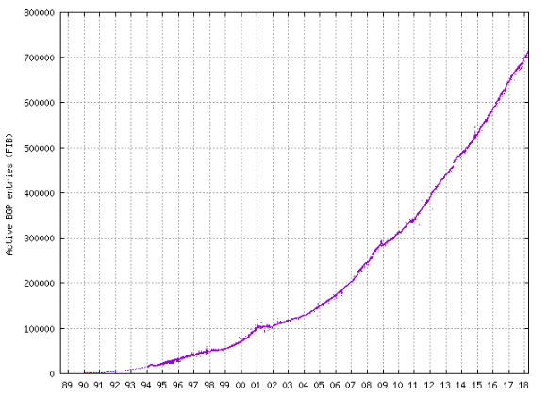

Slide 92
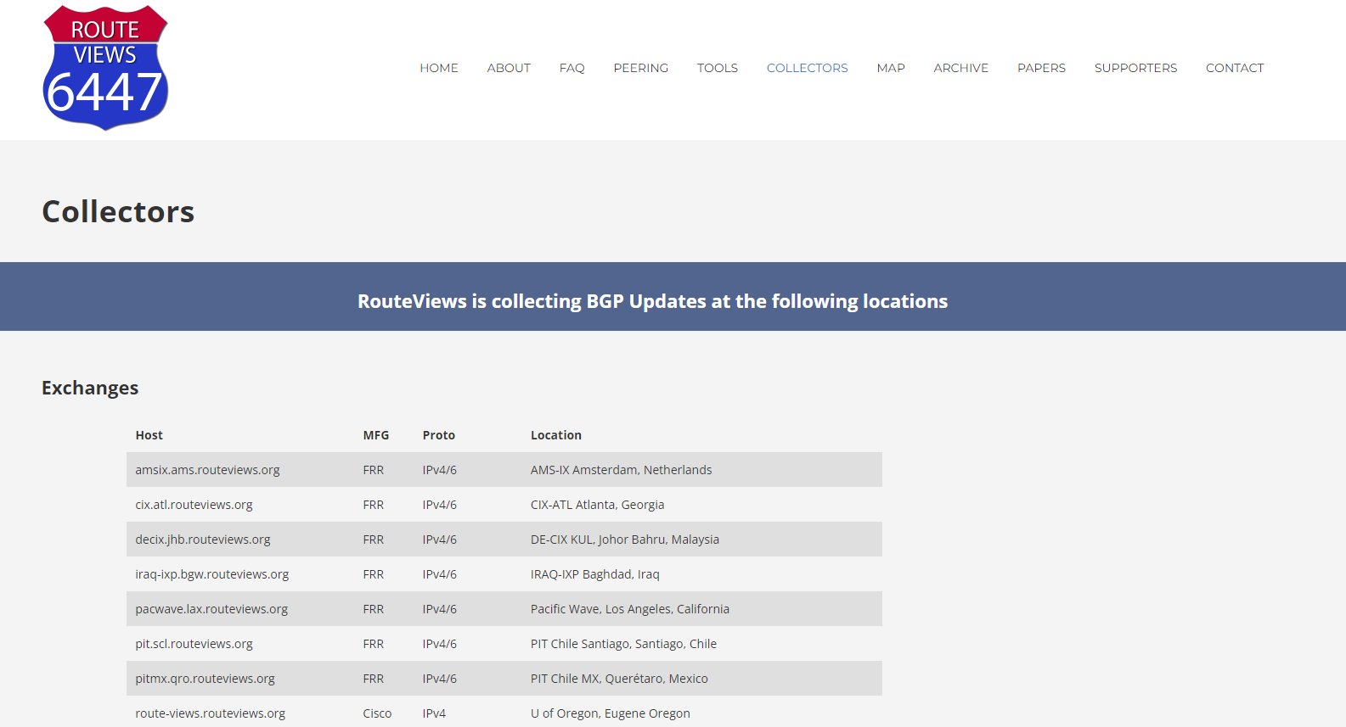
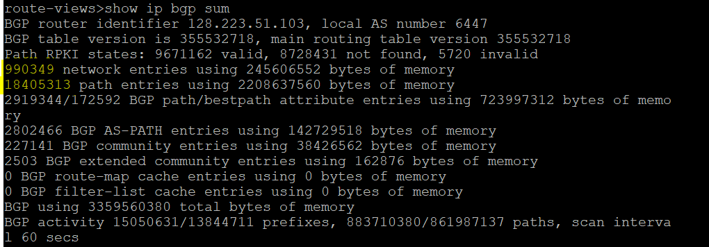
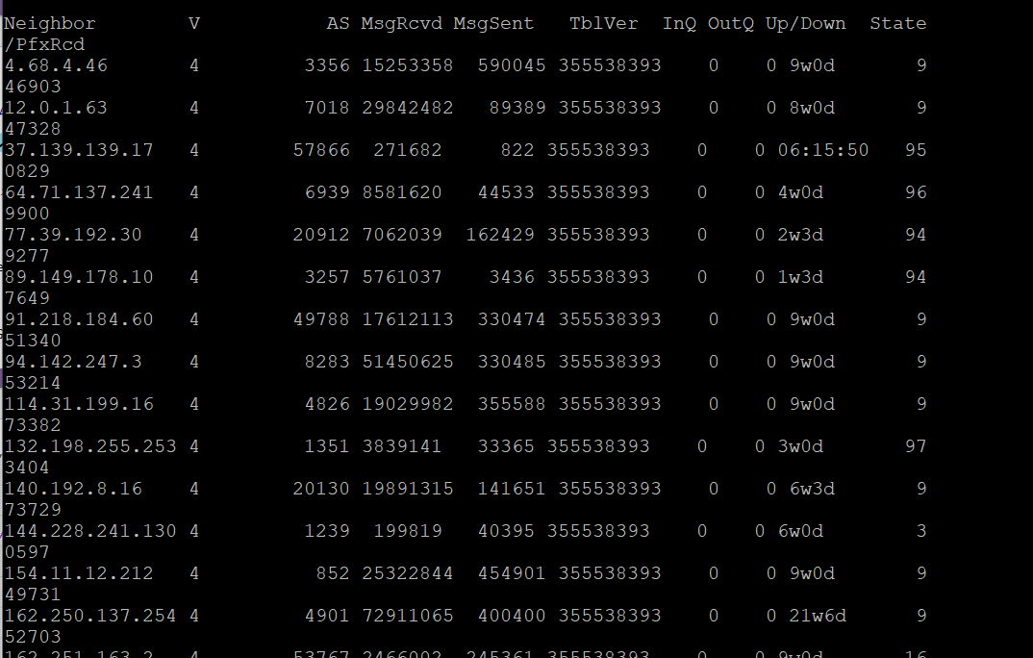
https://www.routeviews.org/routeviews/index.php/collectors/
Lots of network and path entries on this BGP router
The list of neighbors it interacts with

Slide 93
ICMP (Internet Control Message Protocol)
used by hosts & routers to communicate network-level information
  error reporting: unreachable host, network, port, protocol
  echo request/reply (used by ping)
network-layer “above” IP:
  ICMP msgs carried in IP datagrams
ICMP message: type, code plus first 8 bytes of IP datagram causing error
Type Code description
0 0 echo reply (ping)
3 0 dest. network unreachable
3 1 dest host unreachable
3 2 dest protocol unreachable
3 3 dest port unreachable
3 6 dest network unknown
3 7 dest host unknown
4 0 source quench (congestion
control - not used)
8 0 echo request (ping)
9 0 route advertisement
10 0 router discovery
11 0 TTL expired
12 0 bad IP header

