Slide 1

CSCI 466: Networks
Link Layer: Error Detection, Multiple Access Protocols
Reese Pearsall Fall 2024
https://www.cs.montana.edu/pearsall/classes/fall2024/466/main.html
*All images are stolen from the internet
1

Slide 2

Announcements
Quiz on Friday
No class on Quiz days
Next Wireshark lab will be posted later today

Slide 3

Application Layer
OSI Model
Presentation Layer
*
Application Layer
Session Layer
*
Messages from Network Applications
Transport Layer
Network Layer
Physical Layer
Data Link Layer
Bits being transmitted over a copper wire
Physical Layer
*In the textbook, they condense it to a 5-layer model, but 7 layers is what is most used

Slide 4


















Data Link Layer
The link layer is responsible for the actual node-to-node delivery of data and ensure error-free transmission of information
We have not addressed how we will overcome various transmission mediums!
terminology:
hosts and routers: nodes
communication channels that connect adjacent nodes along communication path: links
wired links
wireless links
LANs
layer-2 packet: frame, encapsulates datagram
data-link layer has responsibility of
transferring datagram from one node
to physically adjacent node over a link

Slide 5







Data Link Layer
transportation analogy:
trip from Princeton to Lausanne
limo: Princeton to JFK
plane: JFK to Geneva
train: Geneva to Lausanne
Princeton
JFK
Geneva
Lausanne

Slide 6
Data Link Layer
transportation analogy:
trip from Princeton to Lausanne
limo: Princeton to JFK
plane: JFK to Geneva
train: Geneva to Lausanne
tourist = datagram
transport segment = communication link
transportation mode = link-layer protocol
travel agent = routing algorithm
Princeton
JFK
Geneva
Lausanne

Slide 7
Data Link Layer
Services offered by the Link Layer
Framing
→ Encapsulate a network layer Datagram in another header
Link access
→ LL dictate the rules and process of transmitting a frame over a link
Reliable Delivery
→ For unreliable link, some reliable delivery mechanisms may need to be used
Error Detection and Correction
→ Bits can get messed up as the are transmitted through a medium
Why do we need RDT and error detection in the link layer when it is also offered in the transport layer?

Slide 8





Data Link Layer
flow control:
pacing between adjacent sending and receiving nodes
error detection:
errors caused by signal attenuation, noise.
receiver detects errors, signals retransmission, or drops frame
error correction:
receiver identifies and corrects bit error(s) without retransmission
half-duplex and full-duplex:
with half duplex, nodes at both ends of link can transmit, but not at same time
…
…
Cable access
cellular
Ethernet LANs
WiFi

Slide 9
Data Link Layer
Services offered by the Link Layer
Framing
→ Encapsulate a network layer Datagram in another header
Link access
→ LL dictate the rules and process of transmitting a frame over a link
Reliable Delivery
→ For unreliable link, some reliable delivery mechanisms may need to be used
Error Detection and Correction
→ Bits can get messed up as the are transmitted through a medium
Why do we need RDT and error detection in the link layer when it is also offered in the transport layer?
Some packets of data don’t even travel through the transport layer…

Slide 10
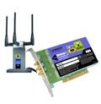
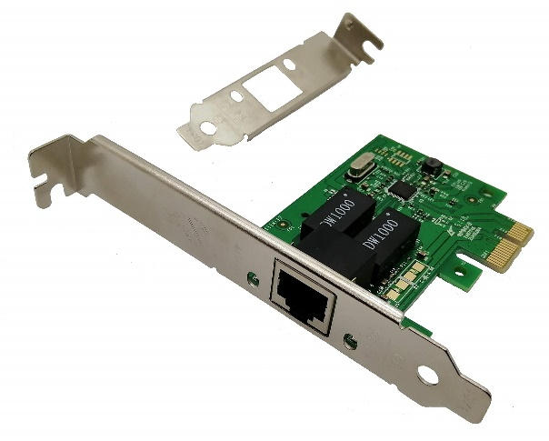

Data Link Layer
Implementation of Link Layer
Implemented within the hardware of your computer
NIC (Network Interface Controller)- Integrated into the motherboard and allows the machine to use LL services such as ethernet (combination of hardware, software, and some firmware)
application
transport
network
link
cpu
memory
link
physical
host
bus
(e.g., PCI)
controller
Wireshark uses your NIC to determine which packets should be sniffed!
physical
transmission
network adapter
card

Slide 11
Data Link Layer
datagram
datagram
controller
controller
sending host
receiving host
datagram
frame
receiving side
looks for errors, rdt, flow control, etc.
extracts datagram, passes to upper layer at receiving side
sending side:
encapsulates datagram in frame
adds error checking bits, rdt, flow control, etc.
Link Layer and LANs
6-11

Slide 12
Data Link Layer
Bits can get messed during the physical layer and link layer
Faulty wires
NIC issues
Unreliable mediums
EDC: error detection and correction bits
D: data protected by error checking, may include header fields
datagram
datagram
Error detection not 100% reliable!
protocol may miss some errors, but rarely
larger EDC field yields better detection and correction
otherwise
all
bits in D’
OK
?
N
detected
error
d data bits
D
EDC
D’
EDC’
bit-error prone link
Link Layer and LANs
6-12

Slide 13
Data Link Layer
0111000110101011
1
d data bits
parity bit
Even/odd parity: set parity bit so there is an even/odd number of 1’s
At receiver:
compute parity of d received bits
compare with received parity bit – if different than error detected
Link Layer and LANs
6-13

Slide 14


Data Link Layer
Can detect and correct errors (without retransmission!)
two-dimensional parity: detect and correct single bit errors
0111000110101011
1
d data bits
parity bit
row parity
d_{1,1}
. . .
d_{1,j}
d_{1,j+1}
Even/odd parity: set parity bit so there is an even/odd number of 1’s
d_{2,1}
. . .
d_{2,j}
d_{2,j+1}
. . .
. . .
. . .
. . .
At receiver:
compute parity of d received bits
compare with received parity bit – if different than error detected
d_{i,1}
. . .
d_{i,j}
d_{i,j+1}
column
parity
d_{i+1,1}
. . .
d_{i+1,j}
d_{i+1,j+1}
no errors:
1 0 1 0 1
1
detected
and
correctable
single-bit
error:
1 0 1 0 1 1
1 1 1 1 0
0
1 0 1 1 0 0
parity
error
0 1 1 1 0
1
0 1 1 1 0 1
1 0 1 0 1
0
1 0 1 0 1 0
Link Layer and LANs
6-14

Slide 15
Data Link Layer
Checksum
(Sender)
(Receiver)
0110011001100000
0101010101010101
1000111100001100
0100101011000010
0110011001100000
0101010101010101
1000111100001100
Binary sum of words
0100101011000010
(Binary Sum → One’s Complement)
(one’s complement)
1011010100111101
= 1111111111111111
Checksum!
All 1s = No error!

Slide 16
Data Link Layer
more powerful error-detection coding
D: data bits (given, think of these as a binary number)
G: bit pattern (generator), of r+1 bits (given, specified in CRC standard)
r CRC bits
d data bits
D
R
bits to send
<D,R> = D 2^{r} XOR R
formula for these bits
*
sender: compute r CRC bits, R, such that <D,R> exactly divisible by G (mod 2)
receiver knows G, divides <D,R> by G. If non-zero remainder: error detected!
can detect all burst errors less than r+1 bits
widely used in practice (Ethernet, 802.11 WiFi)
Sender/Receiver has D and G. Need to compute R
6-16

Slide 17
Data Link Layer
G
Sender wants to compute R such that:
D . 2^{r} XOR R = nG
1
0
1
0 1 1
1 0 0 1
1 0 1 1 1 0
0 0 0
1 0 0 1
1 0 1
D
2^{r} (here, r=3)
0 0 0
*
... or equivalently (XOR R both sides):
D . 2^{r} = nG XOR R
1 0 1 0
1 0 0 1
1 1 0
... which says:
if we divide D . 2^{r} by G, we want remainder R to satisfy:
0 0 0
1 1 0 0
1 0 0 1
1 0 1 0
1 0 0 1
D.2^{r}
G
algorithm for
computing R
R = remainder [ ]
0 1 1
R
6-17

Slide 18
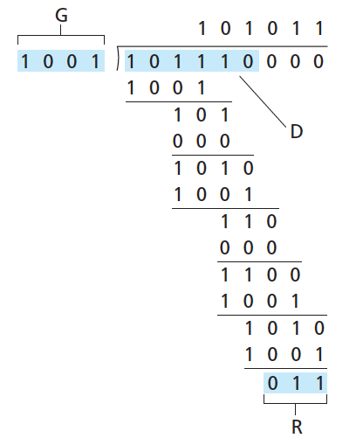
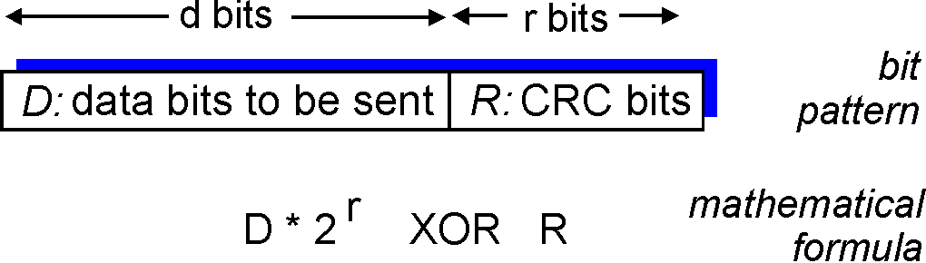

Data Link Layer
(Do some algebra to find R)
D.2^{r}
G
R = remainder[ ]
Sender sends D + R bits.
Receiver divides D + R bits by G. Result should always be Zero if no errors occurred
6-18

Slide 19

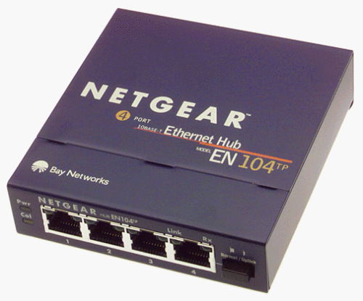




Data Link Layer
Access links
Point to Point – Single sender, Single Receiver at each end of link
Broadcast – shared medium
shared wire (e.g.,
cabled Ethernet)
shared RF
(e.g., 802.11 WiFi)
shared RF
(satellite)
humans at a
cocktail party
(shared air, acoustical)
6-19

Slide 20
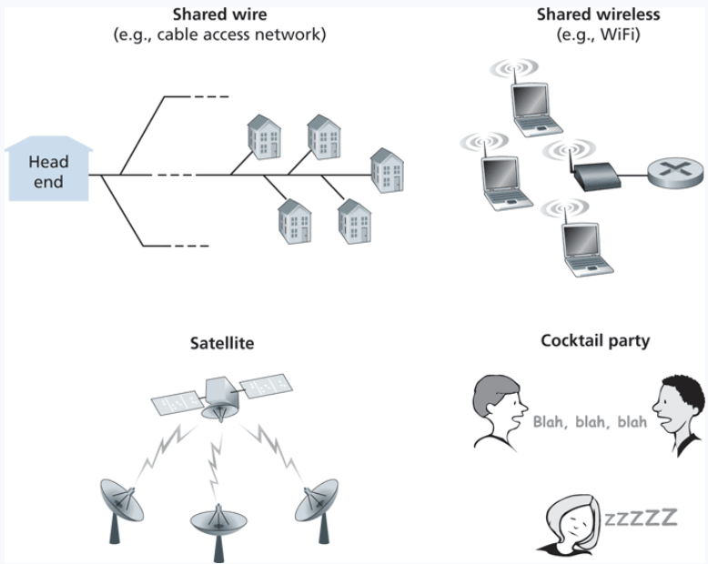
Multiple Access Links
Shared medium = possibility for receivers to get two frame at the same time, AKA a collision
Frame X
Frame y
Frames get tangled together, and neither frame can be read clearly by receiver

Slide 21
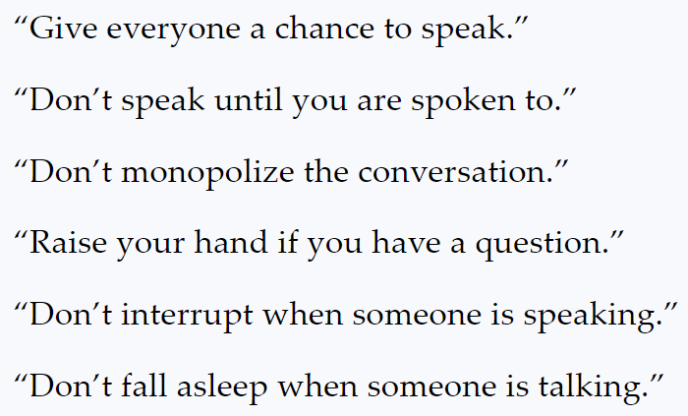
Multiple Access Links
Shared medium = possibility for receivers to get two frame at the same time, AKA a collision
Frame X
Frame y
Frames get tangled together, and neither frame can be read clearly by receiver
In English, we have some rules to prevent collisions from happening
In the link layer, we will discuss 3 multiple access protocols:
Channel Partitioning, Random Access, and Taking Turns

Slide 22
Channel Partitioning
Links total bandwidth = D
Divide channel into N slots
Each node gets (on average) D/N bandwidth
Get to transmit data for a fixed amount of time, and then next node gets to transmit
A
B
C
D
N nodes
A
B
C
D

Slide 23
Channel Partitioning
Links total bandwidth = D
Divide channel into N slots
Each node gets (on average) D/N bandwidth
Get to transmit data for a fixed amount of time, and then next node gets to transmit
A
B
C
D
N nodes
A
B
C
D

Slide 24
Channel Partitioning
Links total bandwidth = D
Divide channel into N slots
Each node gets (on average) D/N bandwidth
Get to transmit data for a fixed amount of time, and then next node gets to transmit
A
B
C
D
N nodes
A
B
C
D

Slide 25
Channel Partitioning
Links total bandwidth = D
Divide channel into N slots
Each node gets (on average) D/N bandwidth
Get to transmit data for a fixed amount of time, and then next node gets to transmit
A
B
C
D
N nodes
A
B
C
D

Slide 26
Channel Partitioning
Links total bandwidth = D
Divide channel into N slots
Each node gets (on average) D/N bandwidth
Get to transmit data for a fixed amount of time, and then next node gets to transmit
A
B
C
D
N nodes
A
B
C
D

Slide 27
Channel Partitioning
Links total bandwidth = D
Divide channel into N slots
Each node gets (on average) D/N bandwidth
Get to transmit data for a fixed amount of time, and then next node gets to transmit
A
B
C
D
N nodes
A
B
C
D

Slide 28
Channel Partitioning
Links total bandwidth = D
Divide channel into N slots
Each node gets (on average) D/N bandwidth
Get to transmit data for a fixed amount of time, and then next node gets to transmit
A
B
C
D
N nodes
A
B
C
D

Slide 29
Channel Partitioning
Links total bandwidth = D
Divide channel into N slots
Each node gets (on average) D/N bandwidth
Get to transmit data for a fixed amount of time, and then next node gets to transmit
A
B
C
D
N nodes
A
B
C
D

Slide 30
Channel Partitioning
Links total bandwidth = D
Divide channel into N slots
Each node gets (on average) D/N bandwidth
Get to transmit data for a fixed amount of time, and then next node gets to transmit
A
B
C
D
N nodes
A
B
C
D

Slide 31
Random Access
Collisions will occur, but we will try to recover from them
Slotted ALOHA: Divide up time into discrete L/R “slots”
L = size of frame
R = Bandwidth
If collisions occur, the colliding nodes will flip a coin to see who should retransmit
L/R = Time needed to transmit one frame
L/R
2 L/R
3 L/R
…
Can only transmit frames at beginning of slots. If collision occurs, the nodes can detect collision before the slot ends

Slide 32
Random Access
Collisions will occur, but we will try to recover from them
Slotted ALOHA: Divide up time into discrete L/R “slots”
L = size of frame
R = Bandwidth
If collisions occur, the colliding nodes will flip a coin to see who should retransmit
L/R = Time needed to transmit one frame
L/R
2 L/R
3 L/R
…
Collision

Slide 33
Random Access
Collisions will occur, but we will try to recover from them
Slotted ALOHA: Divide up time into discrete L/R “slots”
L = size of frame
R = Bandwidth
If collisions occur, the colliding nodes will flip a coin to see who should retransmit
L/R = Time needed to transmit one frame
L/R
2 L/R
3 L/R
…
Collision
Do some probability p and retransmit if needed

Slide 34
Random Access
Collisions will occur, but we will try to recover from them
Slotted ALOHA: Divide up time into discrete L/R “slots”
L = size of frame
R = Bandwidth
If collisions occur, the colliding nodes will flip a coin to see who should retransmit
L/R = Time needed to transmit one frame
L/R
2 L/R
3 L/R
…
Waiting a random delay
Collision
Empty
Collision

Slide 35
Random Access
Collisions will occur, but we will try to recover from them
Slotted ALOHA: Divide up time into discrete L/R “slots”
L = size of frame
R = Bandwidth
If collisions occur, the colliding nodes will flip a coin to see who should retransmit
L/R = Time needed to transmit one frame
L/R
2 L/R
3 L/R
…
Waiting a random delay
Waiting a random delay
Collision
Empty
Collision
Success

Slide 36
Random Access
Collisions will occur, but we will try to recover from them
Slotted ALOHA: Divide up time into discrete L/R “slots”
L = size of frame
R = Bandwidth
If collisions occur, the colliding nodes will flip a coin to see who should retransmit
L/R = Time needed to transmit one frame
L/R
2 L/R
3 L/R
…
Waiting a random delay
Waiting a random delay
Waiting a random delay
Collision
Empty
Collision
Success
Empty
Collision

Slide 37
Random Access
Collisions will occur, but we will try to recover from them
Slotted ALOHA: Divide up time into discrete L/R “slots”
L = size of frame
R = Bandwidth
If collisions occur, the colliding nodes will flip a coin to see who should retransmit
L/R = Time needed to transmit one frame
L/R
2 L/R
3 L/R
…
Waiting a random delay
Waiting a random delay
Waiting a random delay
Collision
Empty
Collision
Success
Empty
Collision
Success

Slide 38
Random Access
Collisions will occur, but we will try to recover from them
Slotted ALOHA: Divide up time into discrete L/R “slots”
L = size of frame
R = Bandwidth
If collisions occur, the colliding nodes will flip a coin to see who should retransmit
L/R = Time needed to transmit one frame
L/R
2 L/R
3 L/R
…
Waiting a random delay
Waiting a random delay
Waiting a random delay
Collision
Empty
Collision
Success
Empty
Collision
Success
Success

Slide 39
polling:
centralized controller “invites” other nodes to transmit in turn
typically used with “dumb” devices
concerns:
polling overhead
latency
single point of failure (master)
Bluetooth uses polling
data
poll
centralized controller
data
client devices

Slide 40

Taking Turns
Token Passing
Nodes are connected in a circular manner, and pass a special frame (token) between each other
Can only transmit messages if you have the token

Slide 41
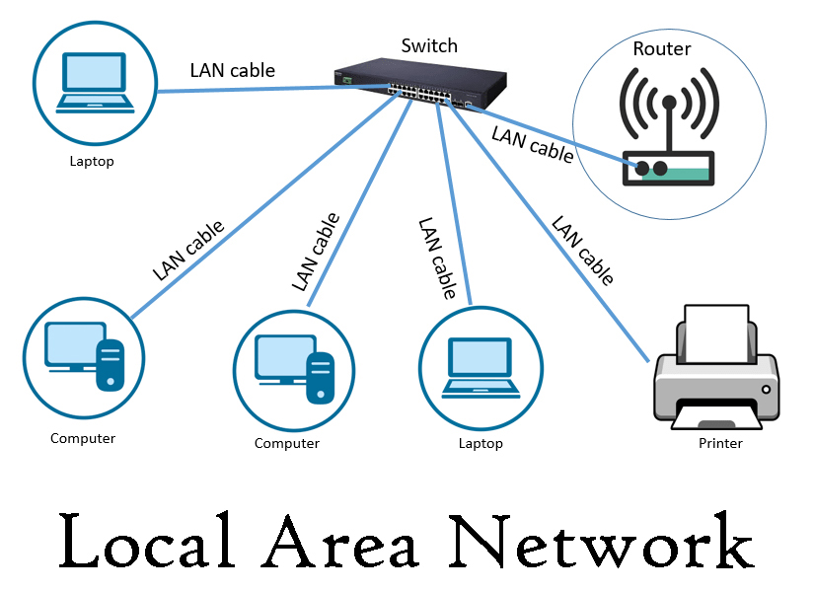
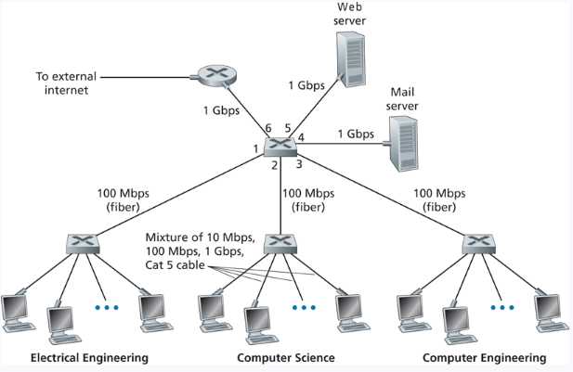
LAN
Local Area Network (LAN)- A collection of devices in one physical location, typically that share a centralized internet connection
Router
Switch
(Within a LAN, we could have several Subnets)

Slide 42
MAC addresses
32-bit IP address:
network-layer address for interface
used for layer 3 (network layer) forwarding
e.g.: 128.119.40.136
MAC (or LAN or physical or Ethernet) address:
function: used “locally” to get frame from one interface to another physically-connected interface (same subnet, in IP-addressing sense)
48-bit MAC address (for most LANs) burned in NIC ROM, also sometimes software settable
e.g.: 1A-2F-BB-76-09-AD
hexadecimal (base 16) notation
(each “numeral” represents 4 bits)

Slide 43
Why do we need MAC addresses?
We need a way to physically identify a device on a network
IP addresses change frequently, but a MAC address will always be the same
An IP address is used to locate a device, a MAC address is used to identify a device
IP Address = Street Address, MAC Address = Name of person living in House
We need both an IP address and a MAC address to transmit a message
Additionally, Ethernet and WiFi are all designed to use MAC address, not IP address

Slide 44


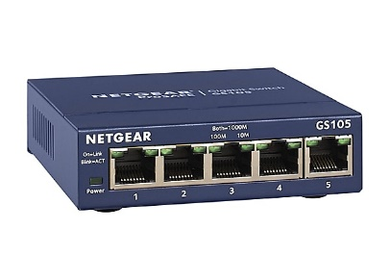




192.168.0.4
01-08-4C-42-1B-52
192.168.0.1
04-06-2C-58-C5-78
192.168.0.2
192.168.0.3
00-04-5A-63-A1-66
02-06-1B-45-A2-12

Slide 45





192.168.0.4
01-08-4C-42-1B-52
192.168.0.1
04-06-2C-58-C5-78
DST IP: 192.168.0.3
192.168.0.2
192.168.0.3
00-04-5A-63-A1-66
02-06-1B-45-A2-12

Slide 46
192.168.0.4
C
01-08-4C-42-1B-52
192.168.0.1
04-06-2C-58-C5-78
DST IP: 192.168.0.3
A
B
192.168.0.2
192.168.0.3
00-04-5A-63-A1-66
02-06-1B-45-A2-12
We need Computer B’s MAC address!

Slide 47
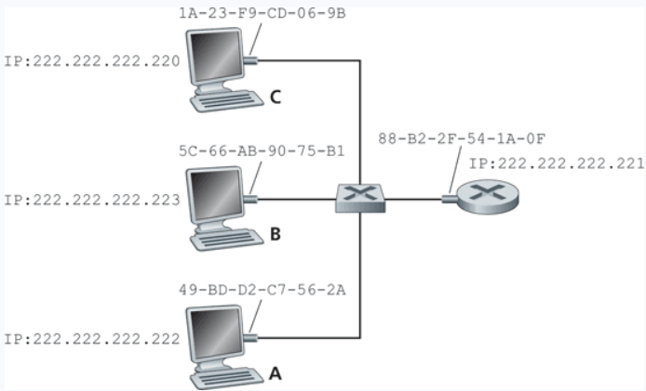
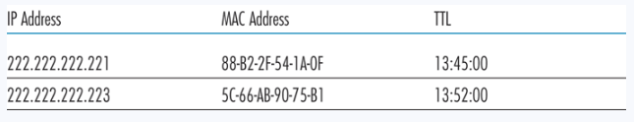
ARP
Protocol for mapping IP Addresses to MAC addresses
Used only for hosts and router interfaces on the same subnet
First the machine checks its ARP table
If the entry does not exist in the table, construct and send an ARP packet
Broadcasts the ARP packet to all interfaces on the LAN (255.255.255.255)
These tables are self-updated, and do not require manual entry*

Slide 48
ARP
A wants to send datagram to B
B’s MAC address not in A’s ARP table.
A broadcasts ARP query packet, containing B's IP address
destination MAC address = FF-FF-FF-FF-FF-FF
all nodes on LAN receive ARP query
B receives ARP packet, replies to A with its (B's) MAC address
frame sent to A’s MAC address (unicast)
A caches (saves) IP-to-MAC address pair in its ARP table until information becomes old (times out)
soft state: information that times out (goes away) unless refreshed
ARP is “plug-and-play”:
nodes create their ARP tables without intervention from net administrator

Slide 49
192.168.0.4
C
01-08-4C-42-1B-52
192.168.0.1
04-06-2C-58-C5-78
DST IP: 192.168.0.3
A
B
192.168.0.2
192.168.0.3
00-04-5A-63-A1-66
Computer A see’s that this IP is in its “group”, so it knows that Computer B must be in the same subnet!
02-06-1B-45-A2-12

Slide 50
192.168.0.4
C
01-08-4C-42-1B-52
192.168.0.1
04-06-2C-58-C5-78
DST IP: 192.168.0.3
A
B
192.168.0.2
192.168.0.3
00-04-5A-63-A1-66
Broadcast an ARP request to the subnet, and hope that we get a response back
02-06-1B-45-A2-12

Slide 51
192.168.0.4
C
01-08-4C-42-1B-52
192.168.0.1
04-06-2C-58-C5-78
Who is 192.168.0.3?
I need your MAC Address
DST IP: 192.168.0.3
A
B
192.168.0.2
192.168.0.3
00-04-5A-63-A1-66
Broadcast an ARP request to the subnet, and hope that we get a response back
02-06-1B-45-A2-12

Slide 52
192.168.0.4
C
01-08-4C-42-1B-52
192.168.0.1
04-06-2C-58-C5-78
Who is 192.168.0.3?
I need your MAC Address
DST IP: 192.168.0.3
!!!
My MAC Address is:
02-06-1B-45-A2-12
A
B
192.168.0.2
192.168.0.3
00-04-5A-63-A1-66
Broadcast an ARP request to the subnet, and hope that we get a response back
02-06-1B-45-A2-12

Slide 53


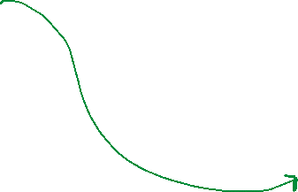
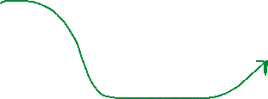
192.168.0.4
C
01-08-4C-42-1B-52
192.168.0.1
04-06-2C-58-C5-78
DST IP: 192.168.0.3
DST MAC: 02-06-1B-45-A2-12
!!!
My MAC Address is:
02-06-1B-45-A2-12
A
B
192.168.0.2
192.168.0.3
00-04-5A-63-A1-66
Broadcast an ARP request to the subnet, and hope that we get a response back
02-06-1B-45-A2-12

Slide 54
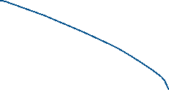

192.168.0.1
04-06-2C-58-C5-78
34.11.16.58
23.44.76.81
DST IP: 12.56.78.34
G
A
12.56.78.34
Google.com
192.168.0.2
00-04-5A-63-A1-66
Home LAN

Slide 55


192.168.0.1
04-06-2C-58-C5-78
34.11.16.58
23.44.76.81
DST IP: 12.56.78.34
G
A
12.56.78.34
Google.com
This IP address is not in its “group”, so it forwards it to the default gateway
192.168.0.2
00-04-5A-63-A1-66
(In most cases, we will need to issue an ARP request to get the MAC address of the default gateway)
Home LAN

Slide 56
192.168.0.1
04-06-2C-58-C5-78
34.11.16.58
23.44.76.81
DST IP: 12.56.78.34
G
A
12.56.78.34
Google.com
The gateway router will look at the IP address of the packet, and determine the best route to get to google.com (network layer)
192.168.0.2
00-04-5A-63-A1-66
Home LAN

Slide 57

192.168.0.1
04-06-2C-58-C5-78
34.11.16.58
23.44.76.81
DST IP: 12.56.78.34
G
A
12.56.78.34
Google.com
It now needs to forward the packet to 34.11.16.58, but it does not know its MAC address
192.168.0.2
00-04-5A-63-A1-66
Home LAN

Slide 58

Who is 34.11.16.58?
I need your MAC Address
192.168.0.1
04-06-2C-58-C5-78
34.11.16.58
23.44.76.81
DST IP: 12.56.78.34
G
A
12.56.78.34
Google.com
It now needs to forward the packet to 34.11.16.58, but it does not know its MAC address
192.168.0.2
00-04-5A-63-A1-66
Issue another ARP request!
Home LAN

Slide 59
Who is 34.11.16.58?
I need your MAC Address
My MAC address is:
05-52-3F-10-C5-57
192.168.0.1
04-06-2C-58-C5-78
34.11.16.58
23.44.76.81
05-52-3F-10-C5-57
DST IP: 12.56.78.34
G
A
12.56.78.34
Google.com
It now needs to forward the packet to 34.11.16.58, but it does not know its MAC address
192.168.0.2
00-04-5A-63-A1-66
Issue another ARP request!
Home LAN

Slide 60
192.168.0.1
04-06-2C-58-C5-78
34.11.16.58
23.44.76.81
05-52-3F-10-C5-57
DST IP: 12.56.78.34
G
A
12.56.78.34
Google.com
192.168.0.2
The next destination is 23.44.76.81, but we need its MAC address!
00-04-5A-63-A1-66
Home LAN

Slide 61






My MAC address is:
09-12-0D-25-D8-74
192.168.0.1
04-06-2C-58-C5-78
34.11.16.58
23.44.76.81
05-52-3F-10-C5-57
DST IP: 12.56.78.34
G
A
12.56.78.34
Google.com
192.168.0.2
The next destination is 23.44.76.81, but we need its MAC address!
Do another ARP!
00-04-5A-63-A1-66
(Remember that ARP gets broadcasted to all direct neighbors)
Home LAN

Slide 62

192.168.0.1
04-06-2C-58-C5-78
34.11.16.58
23.44.76.81
05-52-3F-10-C5-57
09-12-0D-25-D8-74
DST IP: 12.56.78.34
G
A
12.56.78.34
Google.com
192.168.0.2
00-04-5A-63-A1-66
Home LAN

Slide 63
Who is 12.56.78.34?
I need your MAC Address
192.168.0.1
04-06-2C-58-C5-78
34.11.16.58
23.44.76.81
My MAC address is:
01-33-2F-84-B8-55
05-52-3F-10-C5-57
09-12-0D-25-D8-74
DST IP: 12.56.78.34
G
A
12.56.78.34
Google.com
We need to issue one final ARP request, and get the MAC address of our final destination
192.168.0.2
00-04-5A-63-A1-66
Home LAN

Slide 64

192.168.0.1
04-06-2C-58-C5-78
34.11.16.58
23.44.76.81
05-52-3F-10-C5-57
09-12-0D-25-D8-74
DST IP: 12.56.78.34
G
A
12.56.78.34
Google.com
01-33-2F-84-B8-55
We need to issue one final ARP request, and get the MAC address of our final destination
192.168.0.2
00-04-5A-63-A1-66
Home LAN

Slide 65
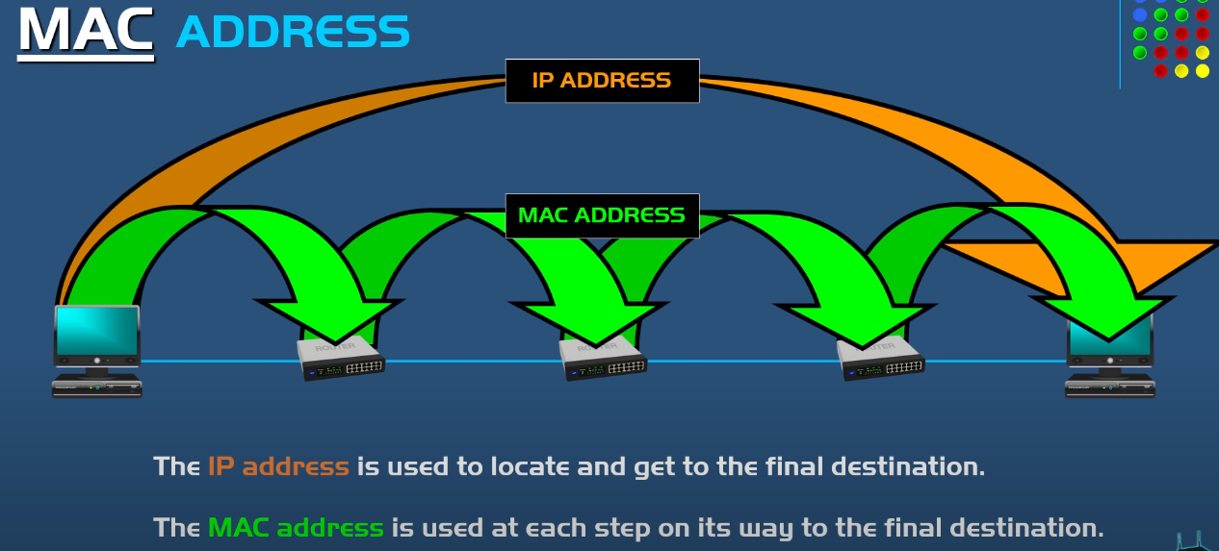

Slide 66
Finding your MAC Address
Ipconfig/all

Slide 67
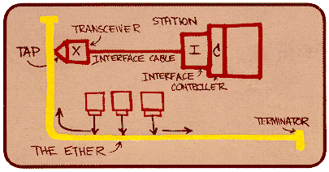
Ethernet
“dominant” wired LAN technology:
single chip, multiple speeds (e.g., Broadcom BCM5761)
first widely used LAN technology
simpler, cheap
kept up with speed race: 10 Mbps – 10 Gbps
Metcalfe’s Ethernet sketch

Slide 68


Ethernet
Ethernet Topology
switch
star
bus: coaxial cable
(outdated)
Link Layer and LANs

Slide 69
Ethernet frame structure
sending adapter encapsulates IP datagram (or other network layer protocol packet) in Ethernet frame
preamble:
7 bytes with pattern 10101010 followed by one byte with pattern 10101011
used to synchronize receiver, sender clock rates
type
preamble
dest.
address
source
address
data (payload)
CRC

Slide 70
Ethernet frame structure (more)
addresses: 6 byte source, destination MAC addresses
if adapter receives frame with matching destination address, or with broadcast address (e.g. ARP packet), it passes data in frame to network layer protocol
otherwise, adapter discards frame
type: indicates higher layer protocol (mostly IP but others possible, e.g., Novell IPX, AppleTalk)
CRC: cyclic redundancy check at receiver
error detected: frame is dropped
type
preamble
dest.
address
source
address
data (payload)
CRC

Slide 71


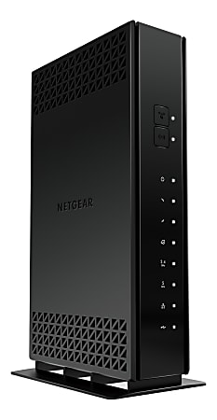






Ethernet switch
Switches will store and forward ethernet frames
Hosts have dedicated, direct connection to switch
Ethernet protocol used on each incoming link, but no collisions between links
Switching: A-A’ and B-B’ can transmit simultaneously, without collisions
Transparent: Hosts are not aware
they are connected to a switch
Plug and play; self-learning
A
C’
B
6
1
2
5
4
3
B’
C
= ethernet cable
A’

Slide 72
Switches vs. routers
application
transport
network
link
physical
both are store-and-forward:
routers: network-layer devices (examine network-layer headers)
switches: link-layer devices (examine link-layer headers)
both have forwarding tables:
routers: compute tables using routing algorithms, IP addresses
switches: learn forwarding table using flooding, learning, MAC addresses
datagram
frame
link
physical
frame
switch
network
link
physical
datagram
frame
application
transport
network
link
physical

Slide 73
https://www.youtube.com/watch?v=1z0ULvg_pW8

