Slide 1

CSCI 466: Networks
Network Security (Message Confidentiality)
Reese Pearsall Fall 2024
https://www.cs.montana.edu/pearsall/classes/fall2024/466/main.html
*All images are stolen from the internet
1

Slide 2
Announcements
Wireshark Lab 3 due tonight
PA3 posted. Due Sunday November 3rd
You can see the questions you got wrong on quizzes
Class registration begins this week

Slide 3
Programming Assignment 4

Slide 4
Wireshark Lab 4

Slide 5
Goal:
Two parties (Bob) and (Alice) want to communicate securely
Principles of secure communication
Confidentiality – only the sender and receiver should be able to understand the contents of the transmitted message
Message Integrity – the contents of the message have not been altered (maliciously or by accident)
Authentication – Both the sender and receiver should be able to confirm the identity of the other party involved in communication
Authorization- Should a user be allowed to do such action?
Operational Security- Infrastructure to help prevent hosts/networks from getting compromised (Firewalls, VPNs, etc)

Slide 6
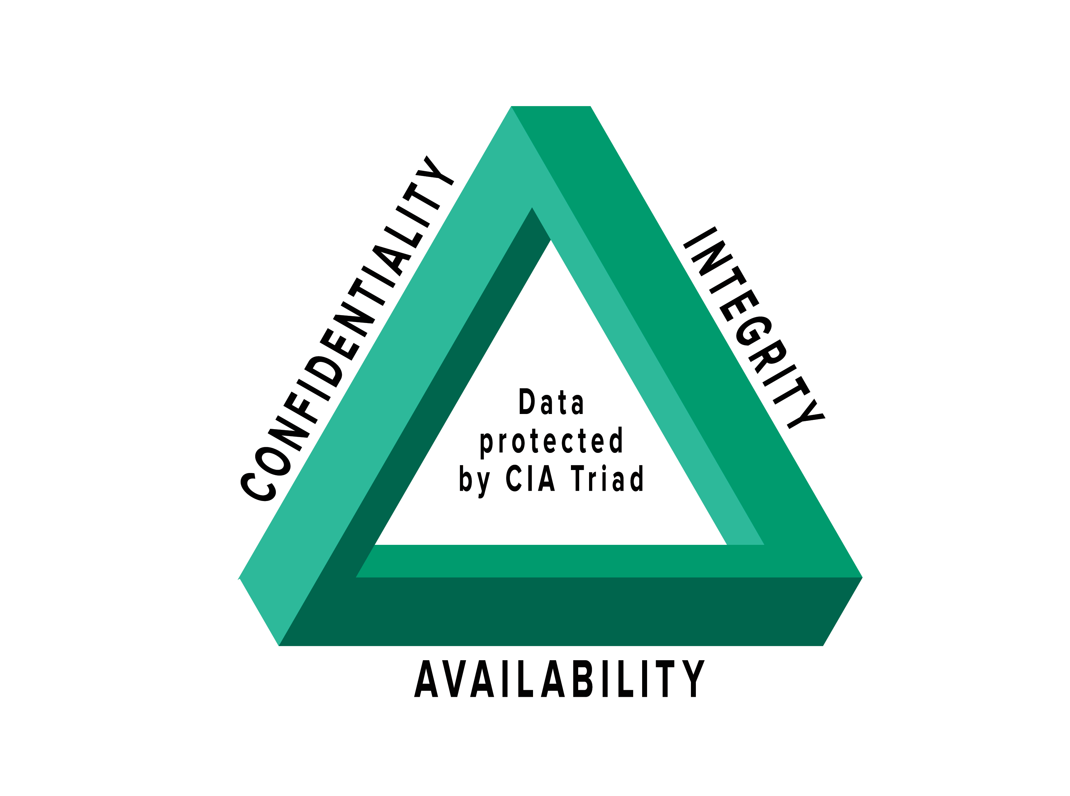
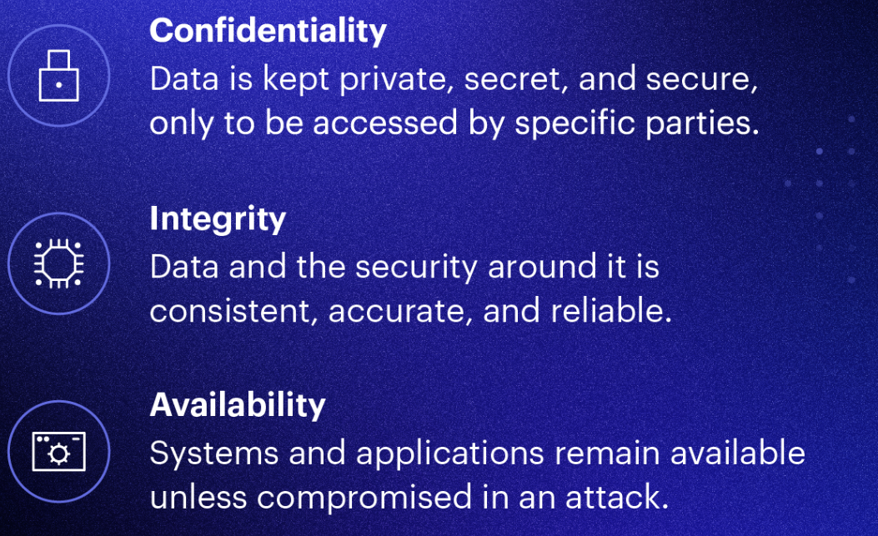

Slide 7
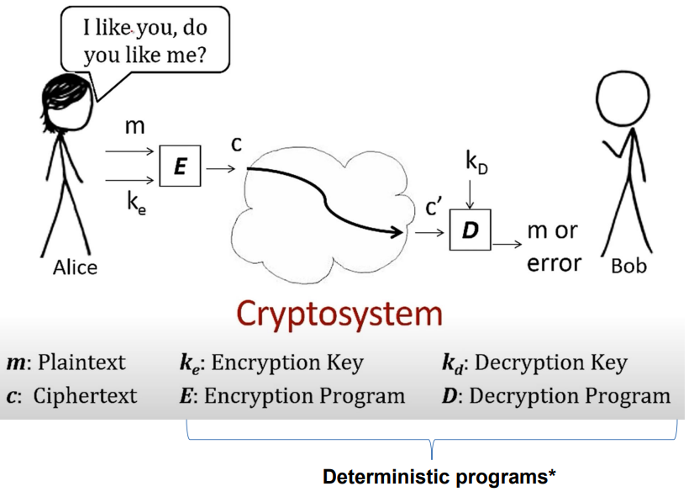
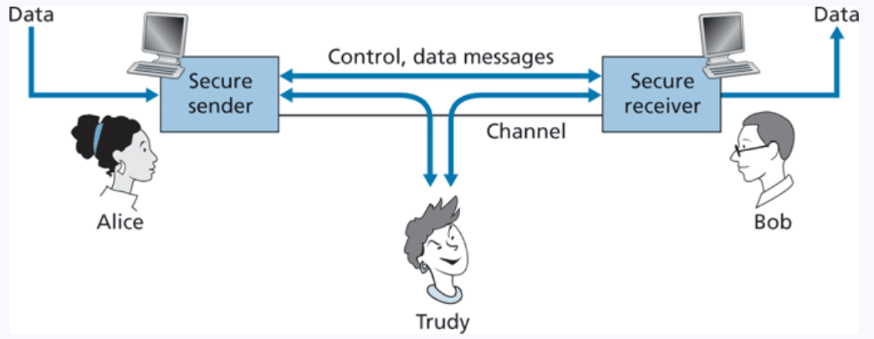
Principles of Cryptography
Presentation Layer
Goal: Only the sender and intended receiver should be able to understand the contents of a transmitted message (confidentiality), so sender must find a way to encrypt his message
Session Layer
(Trudy could steal information, modify information, or spoof her own message)

Slide 8
Principles of Cryptography
Presentation Layer
Goal: Only the sender and intended receiver should be able to understand the contents of a transmitted message (confidentiality), so sender must find a way to encrypt his message
Session Layer
*We also need to make sure that the message is not tampered with before arrival (message integrity) and that both parties can identify each other (authentication)

Slide 9
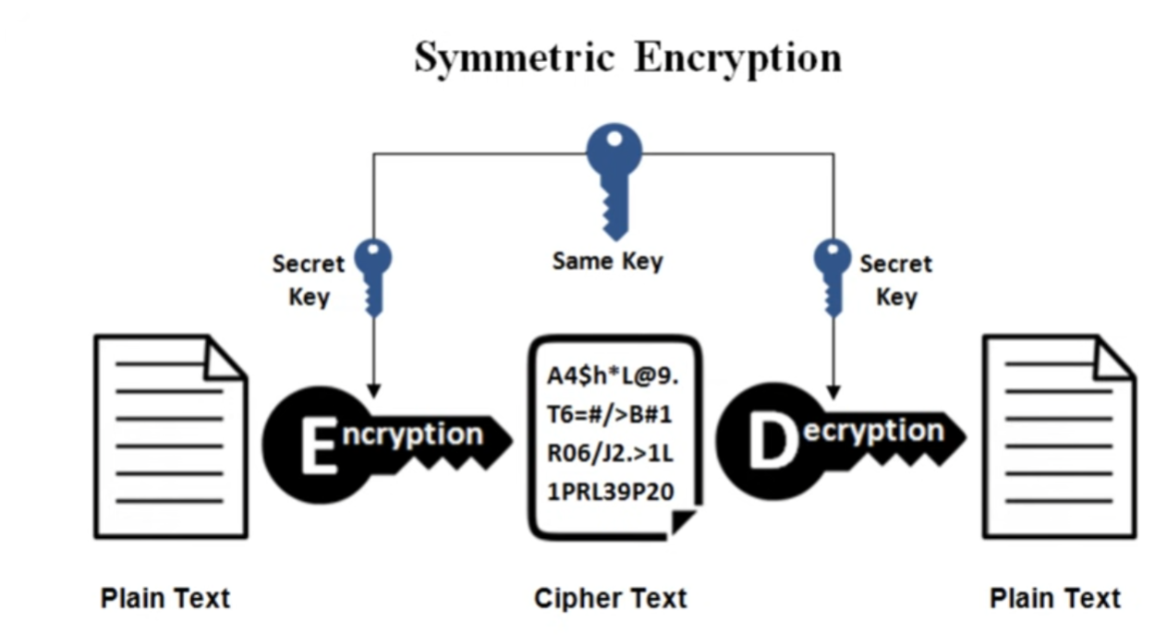
Symmetric Key Cryptography
Symmetric Key Cryptography is a type of encryption where only one key (a secret key) is used to both encrypt and decrypt electronic information

Slide 10
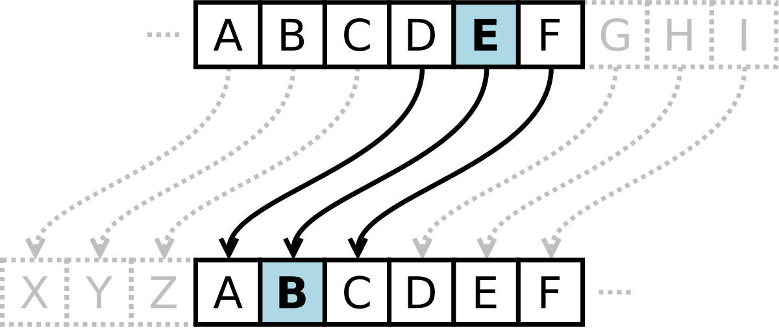
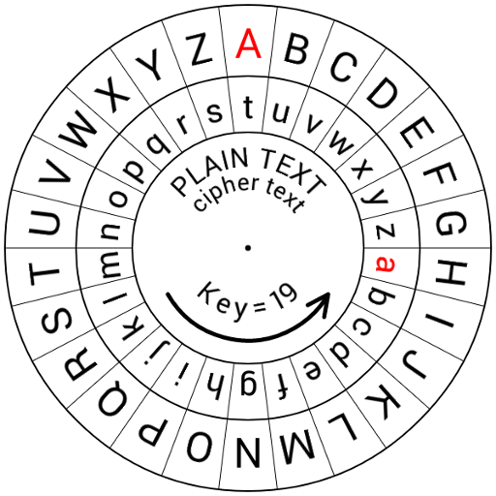
Early Symmetric Key Cryptography
Caesar Cipher- Each letter in plaintext is replaced by a letter some fixed number of positions down the alphabet
Shift of 3
Brown Lazy Fox → Eurzq Odcb Ira
If you did not know the key, how difficult would it be to crack a Caesar cipher?

Slide 11
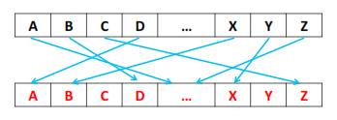
Early Symmetric Key Cryptography
What does a key look like?
Monolithic Substitution Cipher- each letter of the plain text is replaced with another letter of the alphabet (no fixed length position)
26-Characters
“EABZTIVGSKXFJPYCDWONMHQLRU”
If we don’t know the key, how difficult would it be to brute force this?

Slide 12
Early Symmetric Key Cryptography
What does a key look like?
Monolithic Substitution Cipher- each letter of the plain text is replaced with another letter of the alphabet (no fixed length position)
26-Characters
“EABZTIVGSKXFJPYCDWONMHQLRU”
If we don’t know the key, how difficult would it be to brute force this?
26! Possible permutations
However, we can leverage the fact that certain characters appear more commonly in the English language (a, e, i, t, r) to make guessing much easier
(frequency analysis)

Slide 13
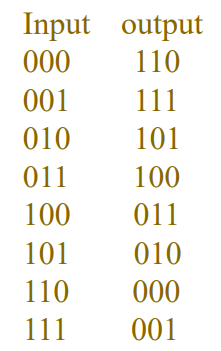
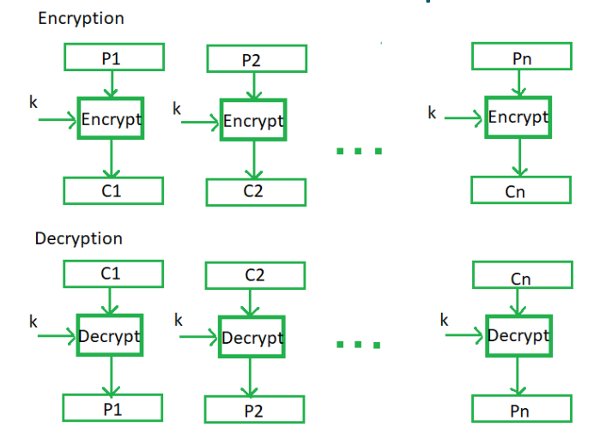
Block Cipher
Plaintext is divided into n-sized blocks and each block is encrypted independently
3-bit Block Cipher Table
Key!
010000111→

Slide 14
Block Cipher
Plaintext is divided into n-sized blocks and each block is encrypted independently
3-bit Block Cipher Table
Key!
010000111→101110001

Slide 15
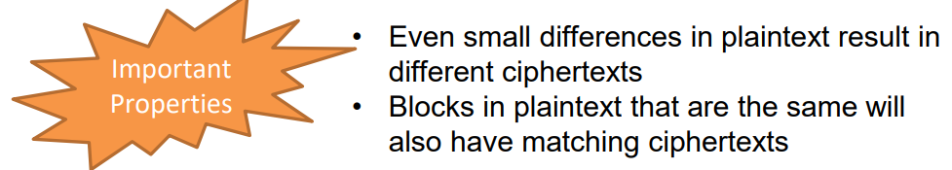
Block Cipher
Plaintext is divided into n-sized blocks and each block is encrypted independently
010000111→101110001
Typically, the block sizes are going to be 64 bits or even larger
# of mappings general formula: 2^{k}!

Slide 16
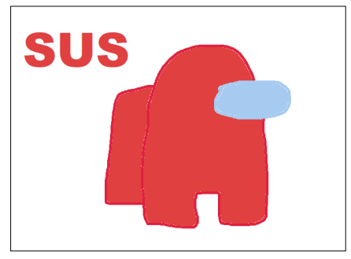
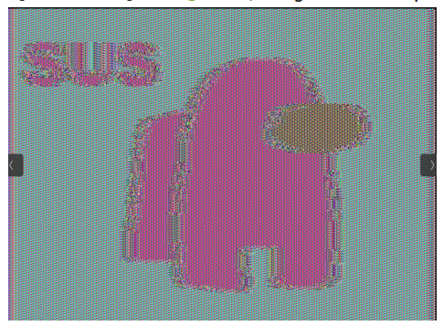
Block Cipher
If identical keys are used:
Think about storing table information for 64 block size ☹

Slide 17
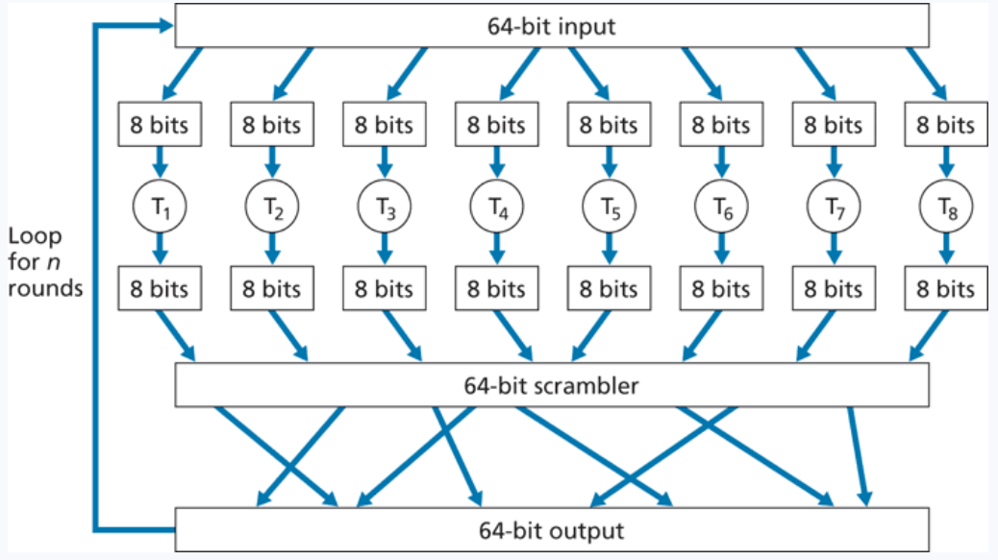
Block Cipher

Slide 18
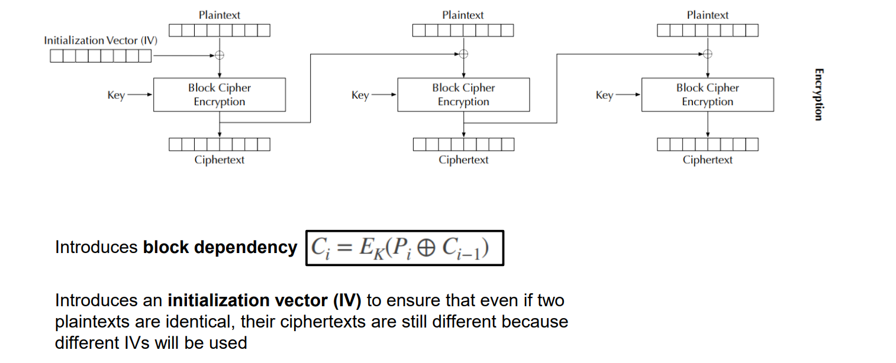
Block Cipher
Cipher Block Chaining (CBC) Mode
Rather than using predetermined tables, block ciphers usually use some type of function that simulate randomly permutated tables

Slide 19
Block Cipher
The two most common block ciphers are Advanced Encryption Standard (AES) and Data Encryption Standard (DES)
AES (2001) | DES (1977)
Keys can be of length 128, 192, and 256 | Key length can only be 56
Number of rounds: 10, 12, or 14 | Number of rounds: 16
Very secure (no known attacks) | Broken (can be cracked easily)
Can encrypt 128 bits of plaintext | Can encrypt 64 bits of plaintext
Faster that DES | Slower than AES
(AES is the most widely used symmetric block cipher algorithm nowadays, DES should never be used)

Slide 20
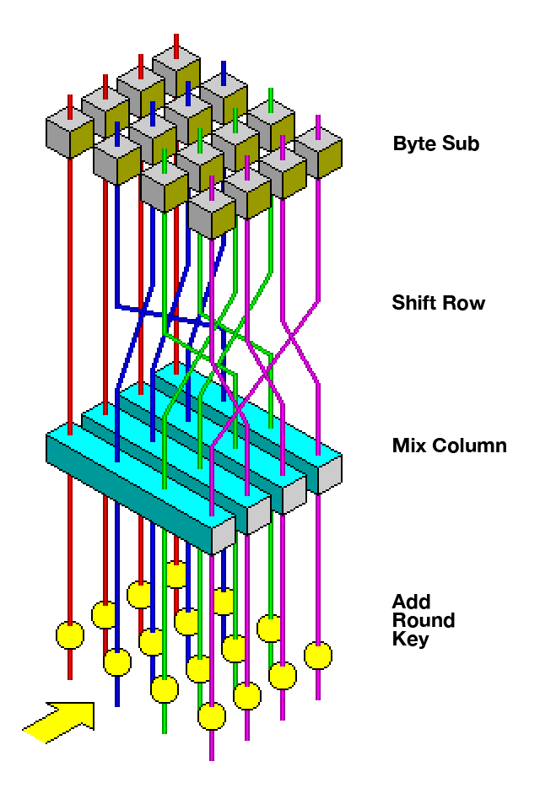

AES
AES is a rather complicated algorithm (for good reason), you can read more about it on your own
Several rounds of encrypting (“shifting”), using something like CBC

Slide 21
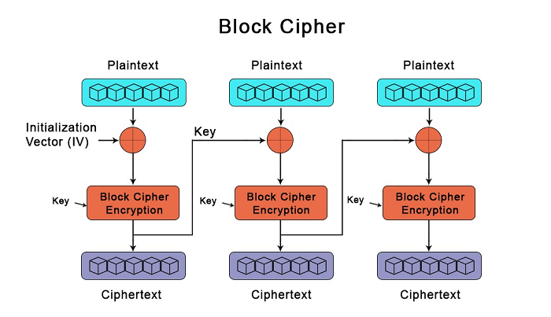
Symmetric key encryption uses the same, shared, key for encrypting and decrypting
What is the one major hurdle we have not discussed yet?
How do the keys get sent without being intercepted? Do the keys get encrypted?

Slide 22
Asymmetric Cryptography
AKA Public key Cryptography
The keys used for encrypting and decrypting data are different
Additionally, each user now gets two-keys. A public key, and a private key
This involves some complicated math, and I won’t go super deep into it. YouTube videos can explain it much better than I can
RSA (Rivest–Shamir–Adleman) is the most popular public key cryptosystem. We rely on it whenever we do communicate securely on the internet

Slide 23


Asymmetric Cryptography (RSA)
Alice
Bob
Plaintext
Alice has a plaintext that she wants to send to bob

Slide 24
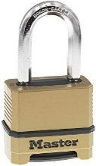

Asymmetric Cryptography (RSA)
Alice
Bob
Public Key
Encrypt!
Plaintext
Ciphertext
She uses Bob’s public key to encrypt her message

Slide 25

Asymmetric Cryptography (RSA)
Alice
Bob
Public Key
Plaintext
Ciphertext
Ciphertext is sent over some medium
Eve can intercept this message,
But can’t decrypt it (public key is not used for decrypting!)

Slide 26
Asymmetric Cryptography (RSA)
Alice
Bob
Public Key
Private Key
Plaintext
Plaintext
Bob uses his private key to decrypt the message. Nobody else knows Bob’s private key
Decrypt
Ciphertext
Ciphertext
Ciphertext is sent over some medium
Eve can intercept this message,
But can’t decrypt it (public key is not used for decrypting!)

Slide 27
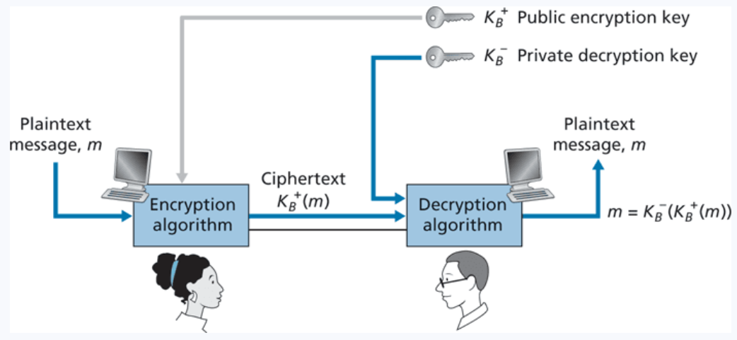

Slide 28
Asymmetric Cryptography (RSA)
If you multiply two prime numbers (p and q) together, the product can only be divisible by those two number
5183
??? * ??? = 5183
This is very difficult to figure out for the people that don’t know p or q
In fact, there is not an efficient program that can calculate the factors of integers
Remember what these are called?

Slide 29
Asymmetric Cryptography (RSA)
If you multiply two prime numbers (p and q) together, the product can only be divisible by those two number
5183
??? * ??? = 5183
This is very difficult to figure out for the people that don’t know p or q
In fact, there is not an efficient program that can calculate the factors of integers
This problem is in NP

Slide 30
Asymmetric Cryptography (RSA)
If you multiply two prime numbers (p and q) together, the product can only be divisible by those two number
RSA is based on large numbers that are difficult to factorize
The public and private keys are derived from these prime numbers
How long should RSA keys be? 1024 or 2048 bits long!
The longer the key = the more difficult to crack (exponentially)

Slide 31
Asymmetric Cryptography (RSA)
Eve’s stolen goods
Alice
Bob
p = 53
q = 59
Step 1: Choose two large primer numbers, p and q

Slide 32
Asymmetric Cryptography (RSA)
Eve’s stolen goods
Alice
Bob
p = 53
q = 59
n = 3127
Step 1: Choose two large primer numbers, p and q
Step 2: Calculate the product n

Slide 33
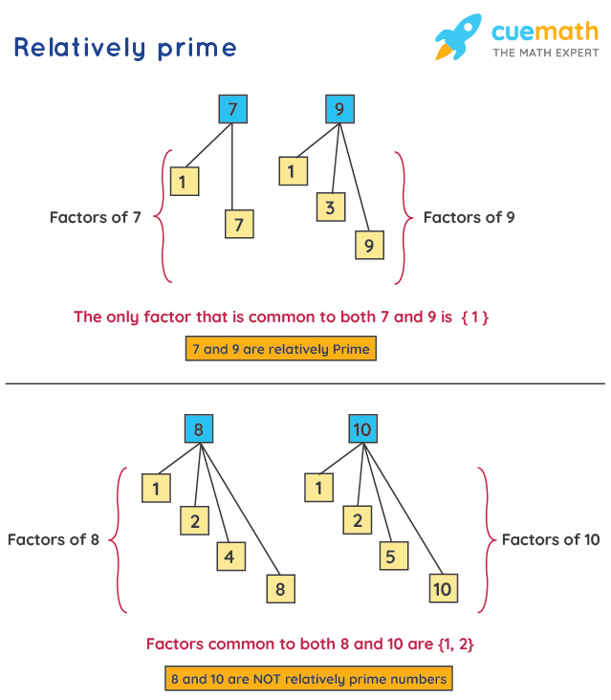
Asymmetric Cryptography (RSA)
Eve’s stolen goods
Alice
Bob
p = 53
q = 59
n = 3127
Φ(n) = number of values less than n which are relatively prime to n
1
2
3
…
3125
3126
How many of these numbers are relatively prime w/ 3127?
Step 1: Choose two large primer numbers, p and q
Step 2: Calculate the product n
Step 3: Calculate Φ(n)

Slide 34
Asymmetric Cryptography (RSA)
Eve’s stolen goods
Alice
Bob
p = 53
q = 59
n = 3127
Φ(n) = number of values less than n which are relatively prime to n
1
2
3
…
3125
3126
How many of these numbers are relatively prime w/ 3127?
Step 1: Choose two large primer numbers, p and q
Step 2: Calculate the product n
Step 3: Calculate Φ(n)
Difficult.. But very easy for the product of two prime #s!

Slide 35
Asymmetric Cryptography (RSA)
Eve’s stolen goods
Alice
Bob
p = 53
q = 59
n = 3127
Φ(n) = number of values less than n which are relatively prime to n
The Φ(n) of a product of two prime numbers will always be (p-1)(q-1)
Step 1: Choose two large primer numbers, p and q
Step 2: Calculate the product n
Step 3: Calculate Φ(n)

Slide 36
Asymmetric Cryptography (RSA)
Eve’s stolen goods
Alice
Bob
p = 53
q = 59
n = 3127
Φ(n) = 52*28 = 3016
Φ(n) = number of values less than n which are relatively prime to n
The Φ(n) of a product of two prime numbers will always be (p-1)(q-1)
Step 1: Choose two large primer numbers, p and q
Step 2: Calculate the product n
Step 3: Calculate Φ(n)

Slide 37
Asymmetric Cryptography (RSA)
Φ(n) = number of values less than n which are relatively prime to n
Eve’s stolen goods
Alice
Bob
p = 53
q = 59
n = 3127
Φ(n) = 3016
e = 1 < e < Φ(n)
Not be a factor of n, but an integer
Step 1: Choose two large primer numbers, p and q
Step 2: Calculate the product n
Step 3: Calculate Φ(n)
Step 4: Choose public exponent e

Slide 38
Asymmetric Cryptography (RSA)
Φ(n) = number of values less than n which are relatively prime to n
Eve’s stolen goods
Alice
Bob
p = 53
q = 59
n = 3127
Φ(n) = 3016
e = 3
e = 1 < e < Φ(n)
Not be a factor of n, but an integer
Step 1: Choose two large primer numbers, p and q
Step 2: Calculate the product n
Step 3: Calculate Φ(n)
Step 4: Choose public exponent e

Slide 39





Asymmetric Cryptography (RSA)
Φ(n) = number of values less than n which are relatively prime to n
Eve’s stolen goods
Alice
Bob
p = 53
q = 59
n = 3127
Φ(n) = 3016
e = 3
Step 1: Choose two large primer numbers, p and q
Step 2: Calculate the product n
Step 3: Calculate Φ(n)
Step 4: Choose public exponent e
Step 5: Select private exponent d
K = some integer that will make the quotient an integer

Slide 40





Asymmetric Cryptography (RSA)
Φ(n) = number of values less than n which are relatively prime to n
Eve’s stolen goods
Alice
Bob
p = 53
q = 59
n = 3127
Φ(n) = 3016
e = 3
Step 1: Choose two large primer numbers, p and q
Step 2: Calculate the product n
Step 3: Calculate Φ(n)
Step 4: Choose public exponent e
Step 5: Select private exponent d
K = some integer that will make the quotient an integer

Slide 41




Asymmetric Cryptography (RSA)
Φ(n) = number of values less than n which are relatively prime to n
Eve’s stolen goods
Alice
Bob
p = 53
q = 59
n = 3127
Φ(n) = 3016
e = 3
d = 2011
Step 1: Choose two large primer numbers, p and q
Step 2: Calculate the product n
Step 3: Calculate Φ(n)
Step 4: Choose public exponent e
Step 5: Select private exponent d
K = some integer that will make the quotient an integer

Slide 42
Asymmetric Cryptography (RSA)
Φ(n) = number of values less than n which are relatively prime to n
Eve’s stolen goods
Alice
Bob
Alice’s Public Key
n = 3127
e = 3
Secret Information
p = 53
q = 59
Φ(n) = 3016
d = 2011

Slide 43
Asymmetric Cryptography (RSA)
Φ(n) = number of values less than n which are relatively prime to n
Eve’s stolen goods
Alice
Bob
Alice’s Public Key
n = 3127
e = 3
Bob has a message to send to Alice
HI → 89
Secret Information
Message must be converted into a number
p = 53
q = 59
Φ(n) = 3016
d = 2011

Slide 44




Asymmetric Cryptography (RSA)
Φ(n) = number of values less than n which are relatively prime to n
Eve’s stolen goods
Alice
n = 3127
e = 3
Bob
Alice’s Public Key
n = 3127
e = 3
Bob has a message to send to Alice
89
Secret Information
Use Alice’s Public Key to encrypt
p = 53
q = 59
Φ(n) = 3016
d = 2011

Slide 45






Asymmetric Cryptography (RSA)
Φ(n) = number of values less than n which are relatively prime to n
Eve’s stolen goods
Alice
n = 3127
e = 3
Bob
Alice’s Public Key
n = 3127
e = 3
Bob has a message to send to Alice
89
Secret Information
Use Alice’s Public Key to encrypt
p = 53
q = 59
Φ(n) = 3016
d = 2011

Slide 46










Asymmetric Cryptography (RSA)
Φ(n) = number of values less than n which are relatively prime to n
Eve’s stolen goods
Alice
n = 3127
e = 3
c=1394
Bob
p = 53
q = 59
Φ(n) = 3016
d = 2011
Alice’s Public Key
n = 3127
e = 3
Bob has a message to send to Alice
89
Use Alice’s Public Key to encrypt
Alice decrypts message using her private key

Slide 47





Asymmetric Cryptography (RSA)
Φ(n) = number of values less than n which are relatively prime to n
Eve’s stolen goods
Alice
n = 3127
e = 3
c=1394
Bob
p = 53
q = 59
Φ(n) = 3016
d = 2011
Alice’s Public Key
n = 3127
e = 3
Bob has a message to send to Alice
89
Use Alice’s Public Key to encrypt
89
Alice decrypts message using her private key

Slide 48

Asymmetric Cryptography (RSA)
Φ(n) = number of values less than n which are relatively prime to n
Eve’s stolen goods
Alice
n = 3127
e = 3
c=1394
Bob
p = 53
q = 59
Φ(n) = 3016
d = 2011
Alice’s Public Key
n = 3127
e = 3
Bob has a message to send to Alice
89
Alice’s Private Key
n = 3127
d = 2011
What does eve know??
Use Alice’s Public Key to encrypt
These is very difficult to figure out, since she does not know the factorization of n

Slide 49
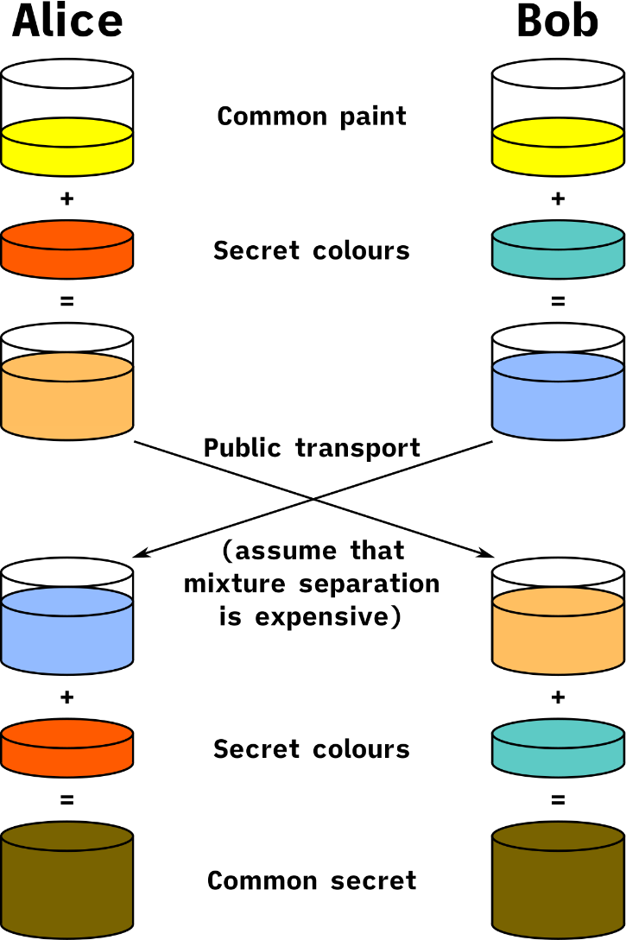
Asymmetric Cryptography (RSA)
We now have a method for sending secure messages over a possibly unsecure channel!
Limitation of RSA: Can only encrypted data that is smaller or equal to key length ( < 2048 bits )

Slide 50
Asymmetric Cryptography (RSA)
We now have a method for sending secure messages over a possibly unsecure channel!
Limitation of RSA: Can only encrypted data that is smaller or equal to key length ( < 2048 bits )
What could we encrypt instead??

Slide 51
Asymmetric Cryptography (RSA)
We now have a method for sending secure messages over a possibly unsecure channel!
Limitation of RSA: Can only encrypted data that is smaller or equal to key length ( < 2048 bits )
What could we encrypt instead??
The key for a symmetric cryptography algorithm! ( < 2048 bits)
RSA can be used to generate session key, which can then be used to encrypt many chunks of data (also much faster then asymmetric crypto)

Slide 52
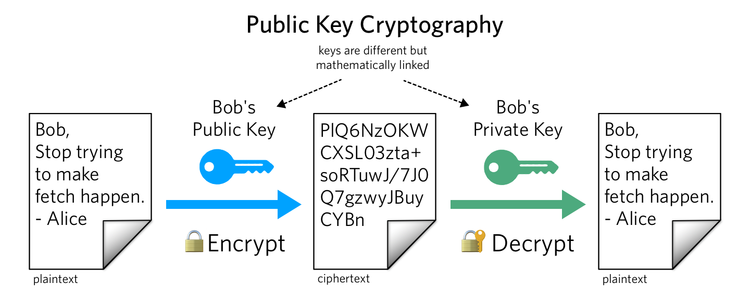
Review
Same key used for encrypting and decrypting
Using block ciphers (AES), we can encrypt an arbitrary size of data
Issue: How to securely share secret keys with each other?
Two keys: Public Key (a lock), and a price key (the key)
Public key is used to encrypt. Private key used to decrypt message
Using math, we can securely send messages over an unsecure channel without sharing any sensitive information
Issue: We can not encrypt stuff bigger than our key (2048 bits)
symmetric and asymmetric cryptography are used together
(use RSA to send the key for symmetric crypto!)

