Slide 1

CSCI 466: Networks
Network Security (Hashing)
Reese Pearsall Fall 2024
https://www.cs.montana.edu/pearsall/classes/fall2024/466/main.html
*All images are stolen from the internet
1

Slide 2
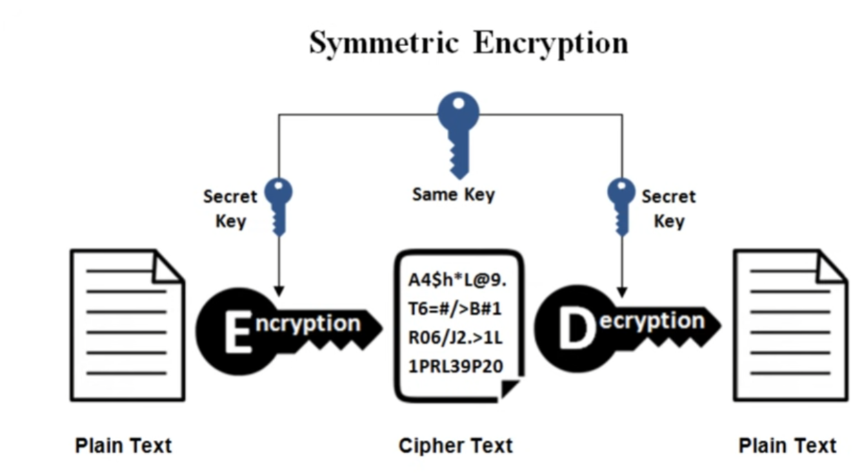
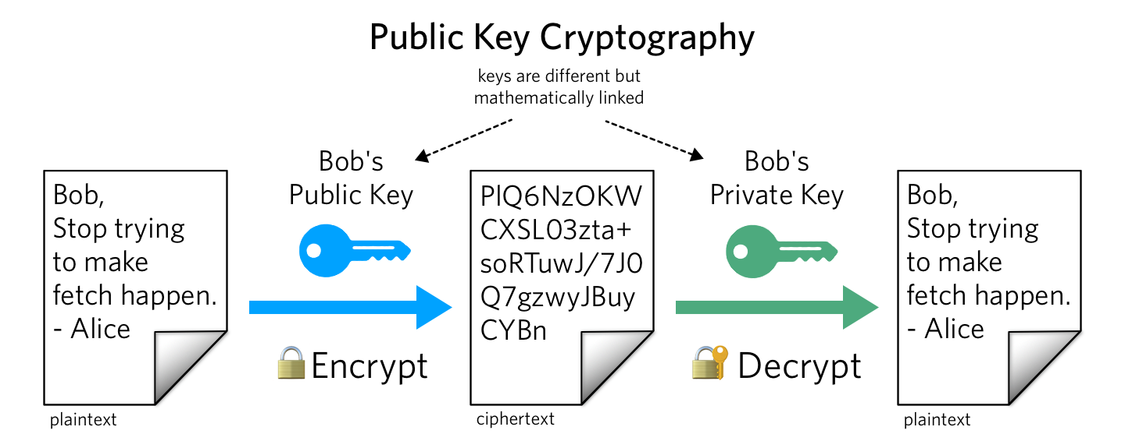
Review
Same key used for encrypting and decrypting
Using block ciphers (AES), we can encrypt an arbitrary size of data
Issue: How to securely share secret keys with each other?
Two keys: Public Key (a lock), and a price key (the key)
Public key is used to encrypt. Private key used to decrypt message
Using math, we can securely send messages over an unsecure channel without sharing any sensitive information
Issue: We can not encrypt stuff bigger than our key (2048 bits)
Symmetric and asymmetric cryptography are used together
(use RSA to send the key for symmetric crypto!)

Slide 3


Today’s Goals:
We need a way to make sure our message does not get tampered with before arrival (message integrity)
We need to find a way to make sure Bob knows these messages are truly coming from Alice (and not someone lying) → Authentication

Slide 4
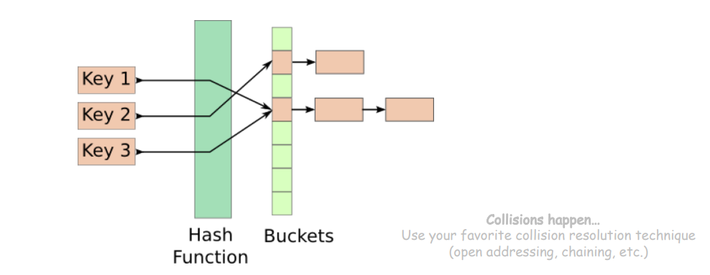
Hash Functions
Hash Functions map arbitrary size data to data of fixed size
An essential building block in cryptography, with desirable practical and security properties
Ex. f(x) = x mod 100
How many buckets?
What to do if two keys map to the same bucket?

Slide 5
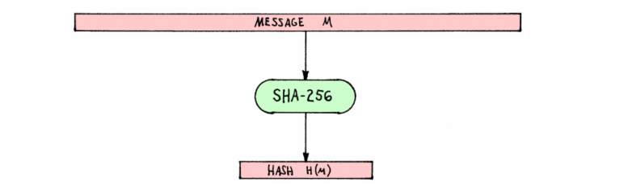
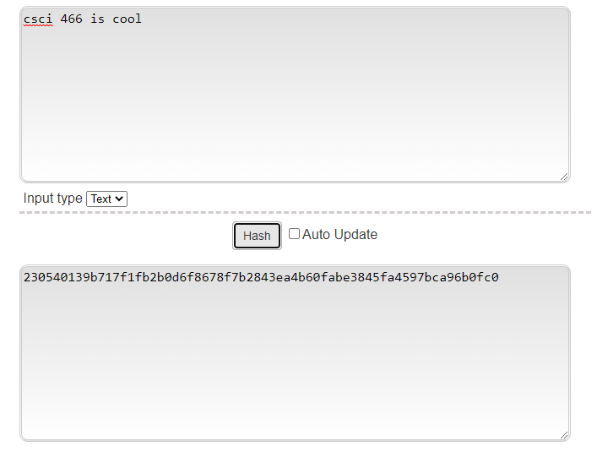
Hash Functions
Cryptographic Hash Functions map arbitrary size data to data of fixed size
But with three additional important properties
Input = Message M
SHA-256 = A cryptographically secure hashing function
Output = Hashed Message M

Slide 6
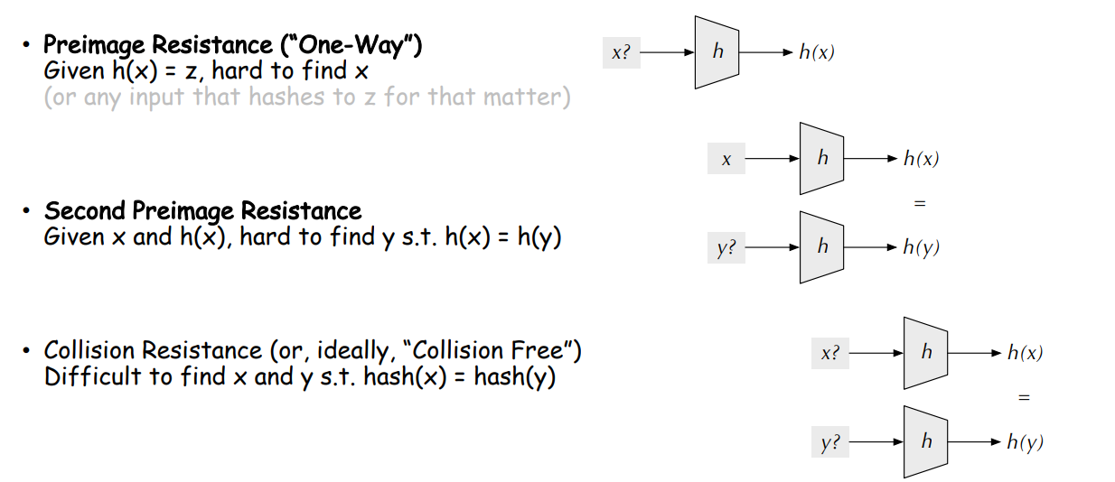
Hash Functions

Slide 7



Applications of Hashing
Output space of MD5 (128 bits)
31973ff867a5a4c2546ec4cca1c126b4
MD5
73bd1ddd3ef1051bf5c4bde7a2b5a6c2
c527fc24f5932e932f44c31f1f8c674e
password123
e2ee5b2d1719edef3f8120cff39f0180
FFFFFFFFFFFFFFFFFFFFFFFFFFFFFFFF
What are some uses for hashing?

Slide 8
Message Integrity
Message Received:
“I love you bob”
“I love you bob”
89defae676abd3e3a42b41df17c40096
Hash
Sarah computes the hash of message prior to sending
Bob receives the message, and computes the hash of the received message
89defae676abd3e3a42b41df17c40096
If the message was not tampered with, or modified, then the hashes should be the same

Slide 9

Message Integrity
Eve tampers with message
“I hate you bob”
Message Received:
“I love you bob”
“I hate you bob”
89defae676abd3e3a42b41df17c40096
Hash
Sarah computes the hash of message prior to sending
Bob receives the message, and computes the hash of the received message
b0608c4e1775ad8f92e7b5c191774c5d
Different hashes = something fishy is going on
If the message was not tampered with, or modified, then the hashes should be the same

Slide 10
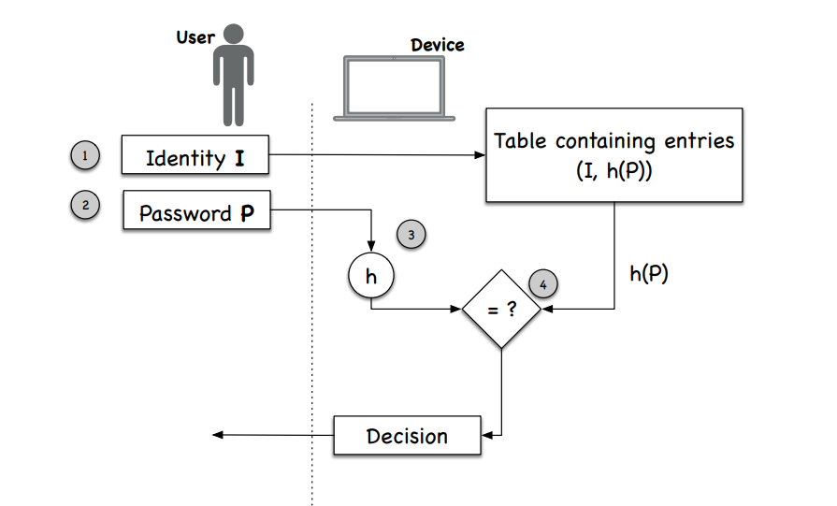
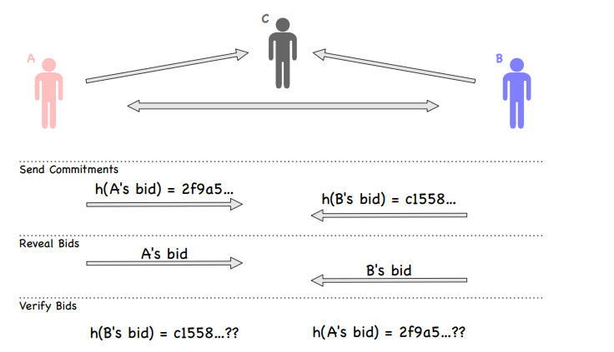
Other Applications of Hashing
Fairness and Commitment
Disclosing a hash does not disclose the original message
Useful for committing a secret without disclosing the secret itself
Password Storage
Websites don’t store your password in plaintext, instead they store the hash of your password

Slide 11
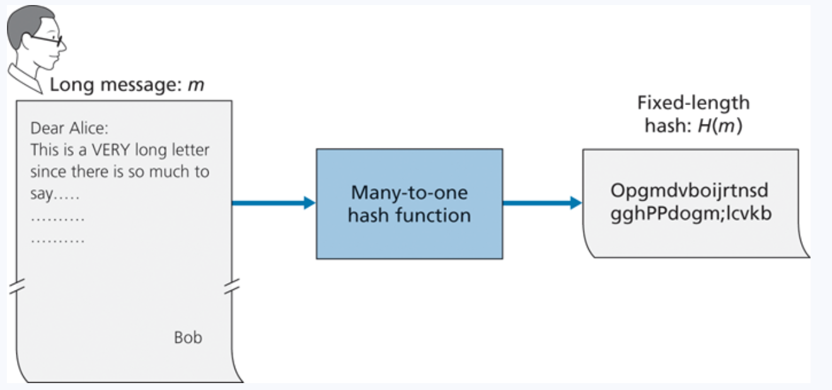
Message Integrity
Hashes provide an irreversible, unique* identifier for a message
*technically not totally true

Slide 12
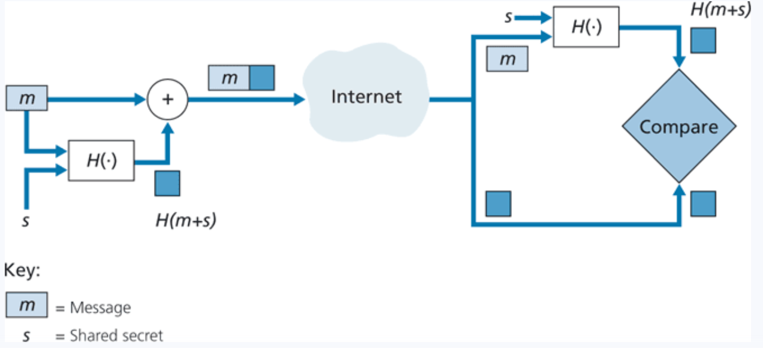
Message Authentication Code (MAC)
Append a message with a shared secret (m + s)
Compute hash of (m+s) → H(m+s)
Send H(m+s) with message m
Sender sends: ( H(m+s), m)
Receiver gets ( H(m+s), m)
Append m with shared secret s (m + s)
Compute H(m+s)
The value receiver computed should match the H(m+s) he received

Slide 13
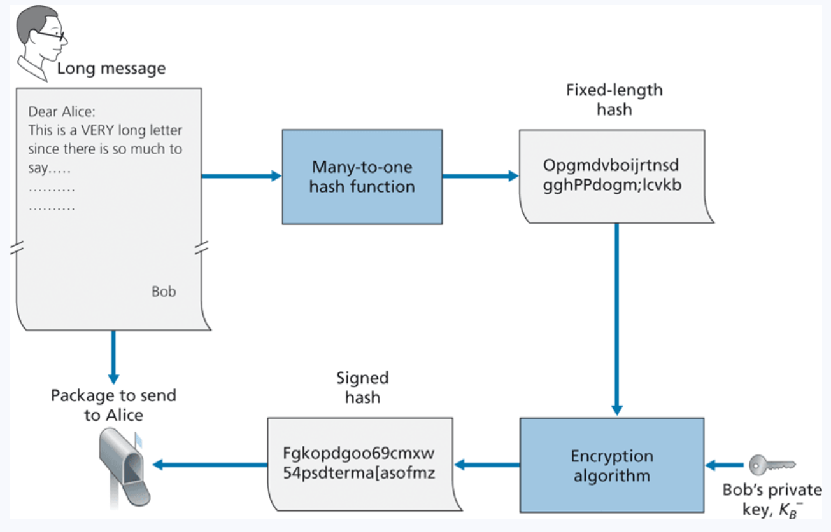
Digital Signatures
What is a unique identifier for bob? What is something that only bob knows and nobody else?
His private key
Bob encrypts his hashed message using his private key, and sends the signed hash, along with message to Alice
When Alice receives this message, she must find a way to decrypt the signed hash
She will use Bob’s public key

Slide 14
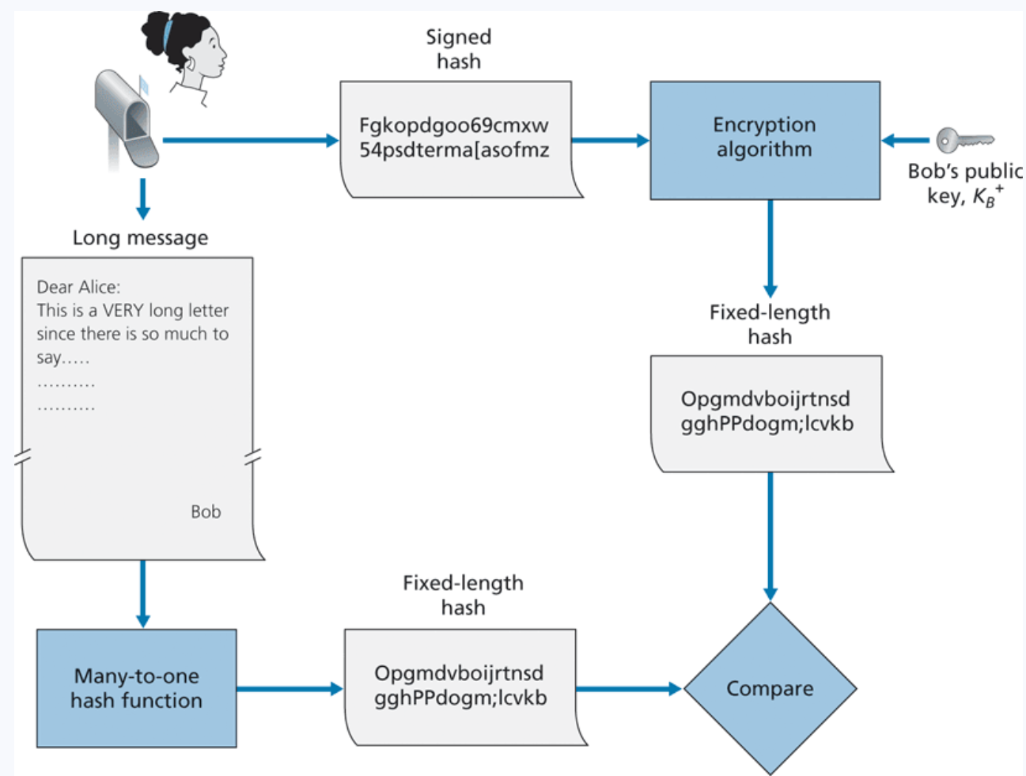

Digital Signatures
What is a unique identifier for bob? What is something that only bob knows and nobody else?
His private key
Bob encrypts his hashed message using his private key, and sends the signed hash, along with message to Alice. Alice decrypts using his public key and verifies that the hashes match
Sending a digital Signature
Verifying a digital signature

Slide 15
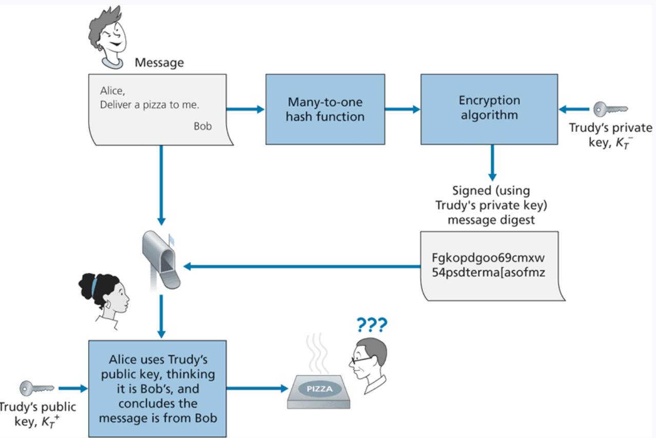

Digital Signatures
How do we know that this is Bob’s public key ?
We don’t have a way to link entities to their public keys

Slide 16
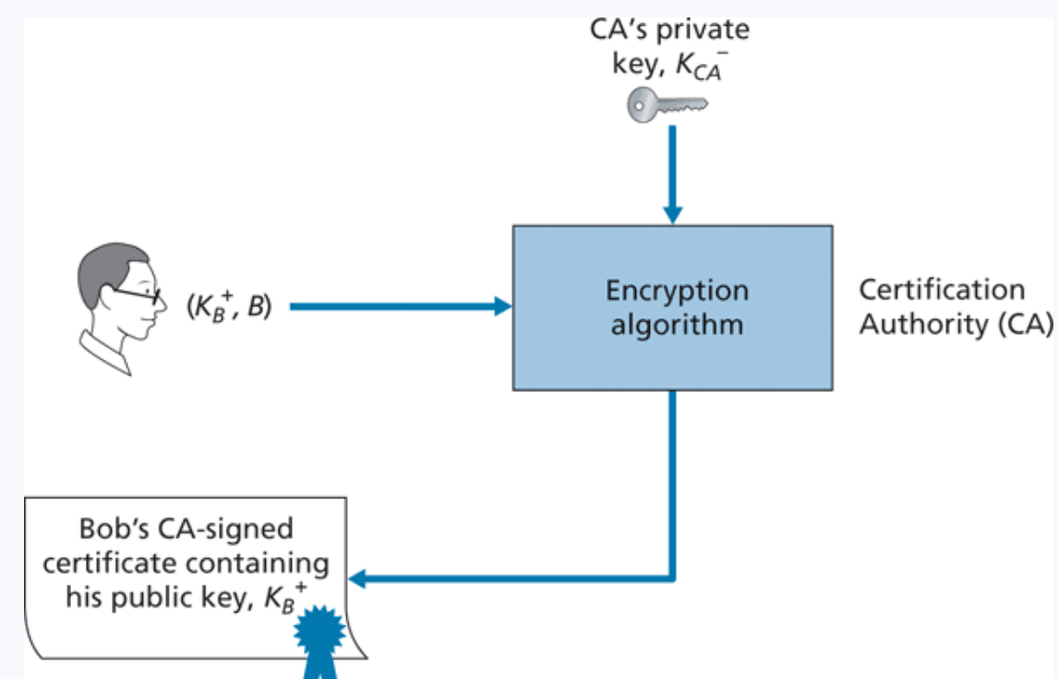
Digital Certificates
Certificates are an authoritative document that links entities (person, router, organization) to their public key
Creating certificates are done by a Certification Authority (digicert, lets encrypt, comodo)
Some are more trustworthy than others…
On your web browser, you exchange certificate information with the websites you are visiting

Slide 17
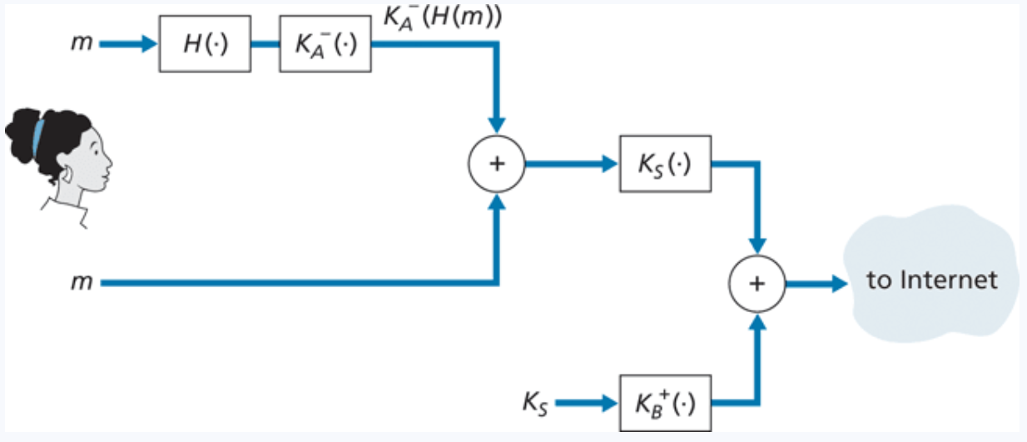
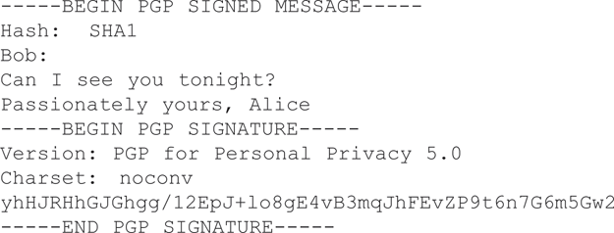
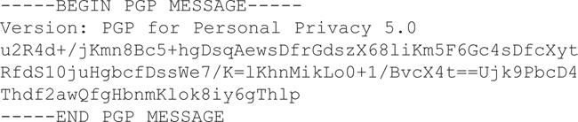
PGP (Pretty Good Privacy)
Email encryption scheme that involves sending a signed hash and encrypted message, and receiver decrypts with public key
PGP software is installed, and public key is generated for user
Private key is generated and protected by a user password
PGP provides a mechanism for public key certification.
Public keys are certified by a web of trust (other users will vouch for other users)

Slide 18
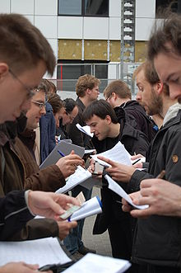
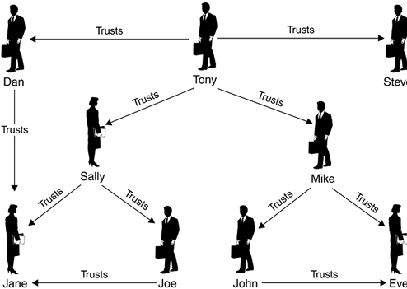
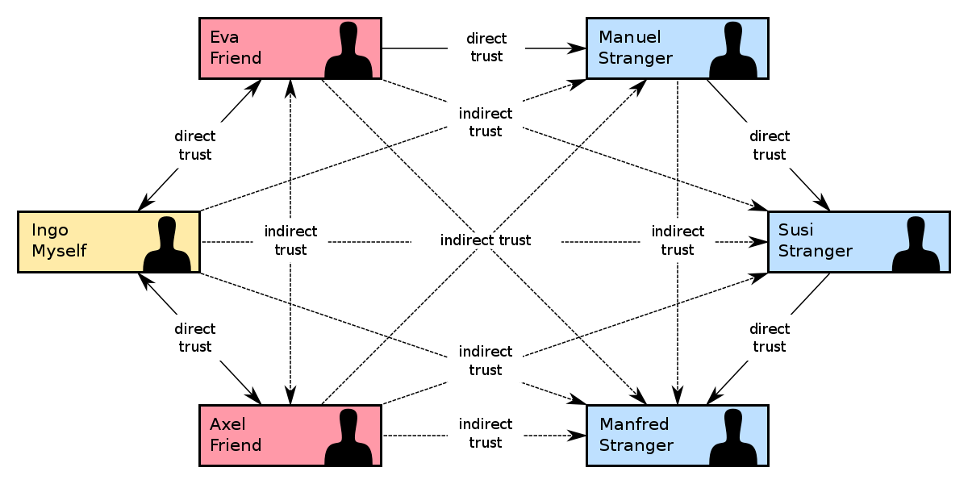
Web of Trust

Slide 19






Securing Email
Symmetric Crypto, Asymmetric Crypto, and Hashing all work together to send secure, authentic messages

