Slide 1

CSCI 466: Networks
Network Forensics
Reese Pearsall Fall 2024
https://www.cs.montana.edu/pearsall/classes/fall2024/466/main.html
*All images are stolen from the internet
1

Slide 2
Announcements
PA 4 Posted
Due 11/24
Wireshark Lab 4 Posted
Due 11/20
No Class on Monday (Veterans Day)

Slide 3
PA4

Slide 4
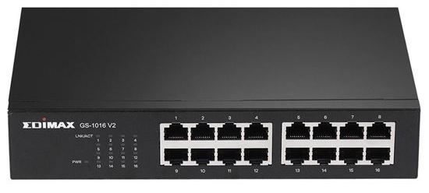
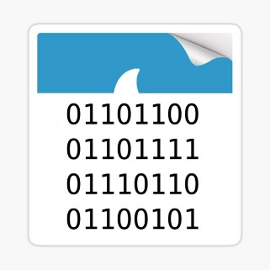
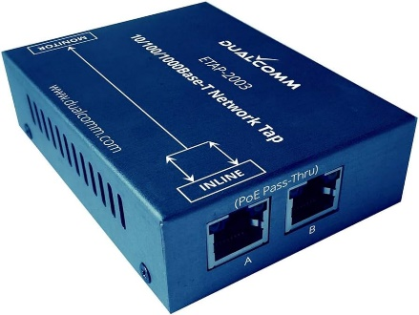
Network Forensics is a branch of Digital Forensics
Digital Forensics – Collection, analysis and interpretation of digital evidence.
Can help support or refute a theory of how an offense occurred or that address critical elements of the offense such as intent or an alibi
Digital Evidence plays a crucial part in many modern-day investigations
Network Forensics = digital evidence is coming from traffic of a computer network
Digital Evidence can be collected through combinations of software or hardware tools
You will usually be working with PCAP files

Slide 5

Goals of Network Forensics
Answer important questions such as:
When did the incident happen? What is the timeline?
What is the root cause of the incident?
Who attacked us?
Why did they attack us?
What is the scope of the damage?
Reflection
Did staff and organizations perform as expected?
What will our organization do next time?
What corrective actions need to happen?

Slide 6
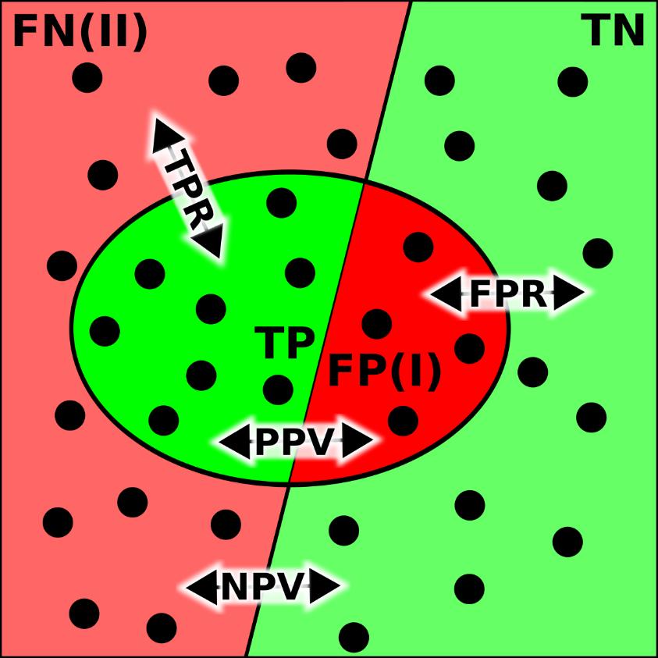
Investigation Errors
True Positive – The detection system correctly identifies malicious activity
False Positive – The detection system incorrectly flags legitimate activity as a threat (false alarm)
True Negative – The detection system correctly identifies normal, benign traffic
False Negative – The detection system fails to detect actual malicious traffic, thinking it is just benign traffic
False Negatives are the scariest, and we want to minimize the number of false negatives for an IDS

Slide 7
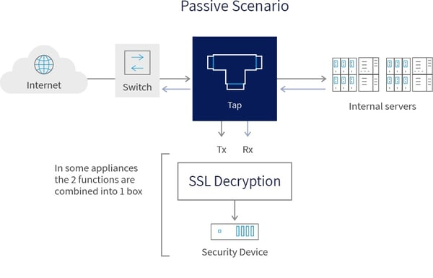
Challenges with Network Forensics
Capturing network traffic for analysis is becoming less and less feasible due to data transmission and storage limitations
Takes a long time to sift through thousands of packets
100 MBPS x 7 days per week = 7.56 TB
10 GBPS x 7 days per week = 756 TB
Think about keeping track of this for all machines at your organization…
May have to decrypt in-line/MITM traffic
Difficult to capture in a cloud network

Slide 8

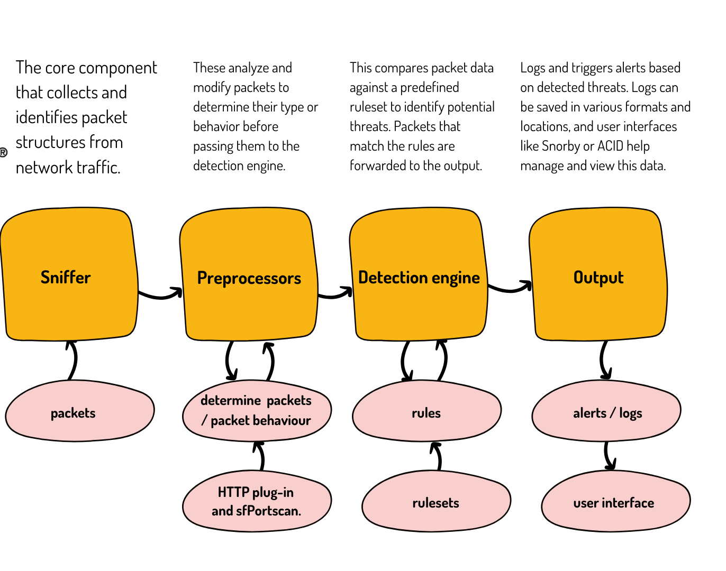
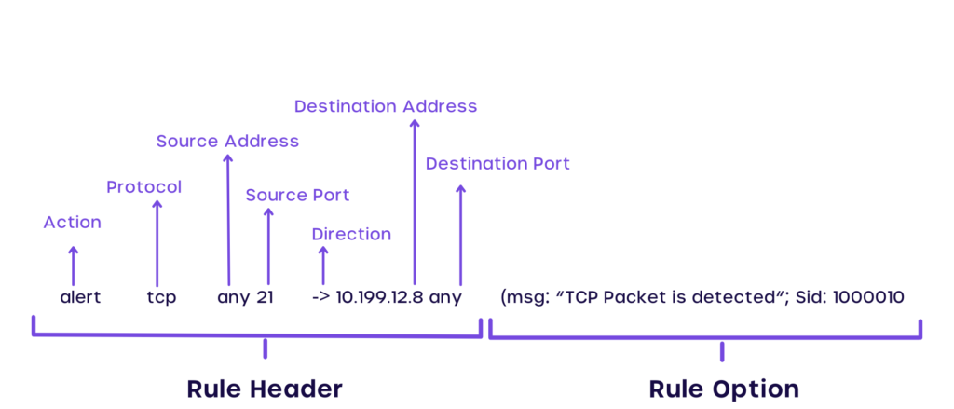
SNORT
A set of rules to detect suspicious/malicious traffic
If we satisfy a rule, an alert can be generated or that packet can be logged
Alerts for malicious IP addresses, typical malware behavior, log unusual ports
This rule would generate an alert for web traffic that is not using the secure version of HTTP
alert tcp any any → any 80 (msg:”Sus web traffic”; flags: S; sid: 100;)

Slide 9
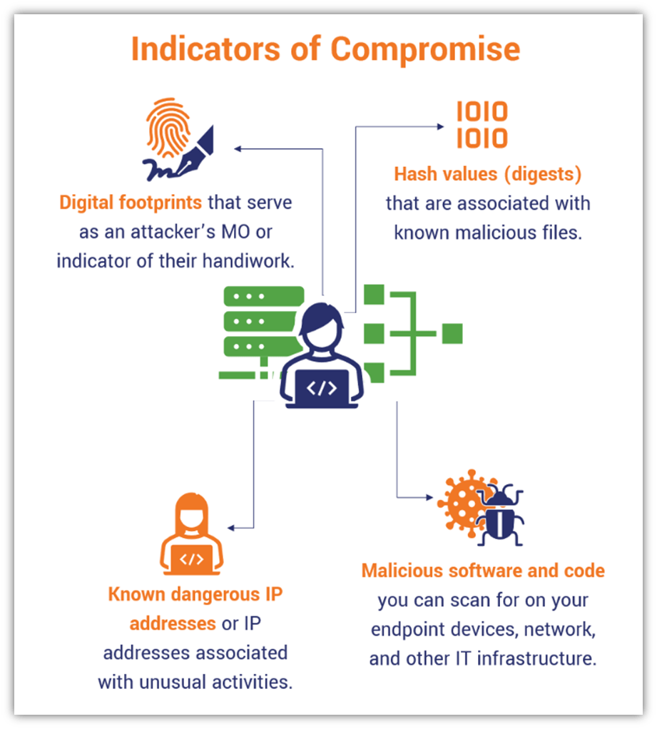
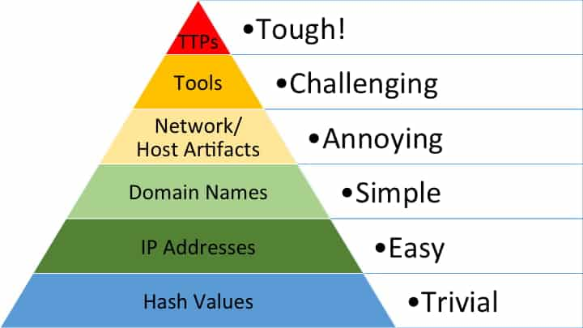
Indicators of Compromise (IOC)
The Pyramid of Pain describes a list of Indicators of Compromise that can be used to detect a threat
Stuff on lower part of pyramid- easy to detect, easy for attacker to change
Stuff on higher part of pyramid- harder to detect, harder for an attacker to change

Slide 10
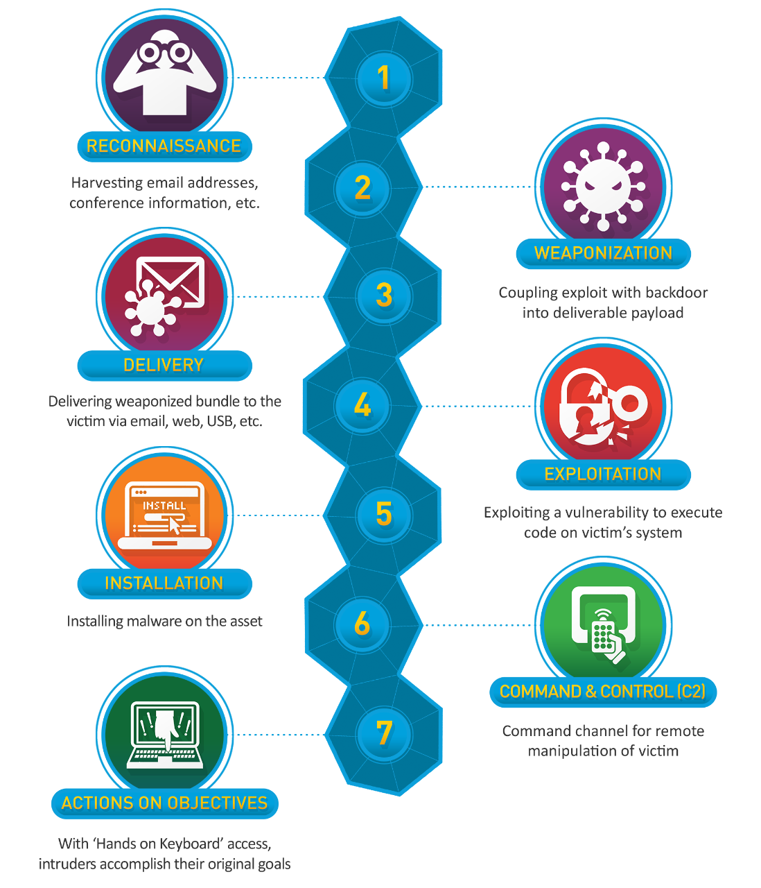
The Cyber Kill Chain describes the typical steps a malicious actor carries out to conduct a cyber attack
In network forensic investigations, we can see evidence of these steps occurring!

Slide 11
The Cyber Kill Chain describes the typical steps a malicious actor carries out to conduct a cyber attack
Step 1. Reconnaissance
Gather information about their target to understand potential vulnerabilities and points of entry
Open Source Intelligence (OSINT)
- look at public web pages, social media profiles, forums
Network Scanning
- Use nmap to discover open ports and/or services
Gather information for phishing
- Email lists, credentials, etc
WHOIS Lookup, DNS Record lookup

Slide 12
The Cyber Kill Chain describes the typical steps a malicious actor carries out to conduct a cyber attack
Step 2. Weaponization
Create a tailored payload for your attack
Malicious Emails
- Phishing email, malicious macro file (.docx, .xlsx), zip file
Trojan Software
- Hide malicious payload in benign-looking software
Language-specific payload for targeted vulnerability
Malicious USB Drives

Slide 13
The Cyber Kill Chain describes the typical steps a malicious actor carries out to conduct a cyber attack
Step 3. Delivery
Transmit payload to target victim
Phishing Email(s)
Send data to open port(s)
Send malicious USB

Slide 14
The Cyber Kill Chain describes the typical steps a malicious actor carries out to conduct a cyber attack
Step 4. Exploitation
Payload is triggered, and vulnerability is exploited
Victim opens malicious files
Victim opens malicious ZIP
Server accepts attacker’s payload
Victim plugs in USB device

Slide 15
The Cyber Kill Chain describes the typical steps a malicious actor carries out to conduct a cyber attack
Step 5. Installation
Find way to install malware to cause damage or gain persistence
Remote Access Trojans (RATs)
- Allows attack remote control over victim’s system
Keyloggers
- Discover passwords or credentials
Backdoor
- Can be used to re-enter system later on
Lateral Movement
- Try to spread to other devices on a network

Slide 16
The Cyber Kill Chain describes the typical steps a malicious actor carries out to conduct a cyber attack
Step 6. Command and Control
It is very common for attackers to “phone home” to a command and control (C2) server to be able to compromise the system remotely
HTTPS/HTTP
DNS Tunneling
Peer-to-Peer for Botnets

Slide 17
The Cyber Kill Chain describes the typical steps a malicious actor carries out to conduct a cyber attack
Step 7. Actions on Objectives
Malware is installed, attacker can remotely access a system, now do something evil
Data exfiltration – unauthorized transfer of data from a device or network
Delete Information
Ransomware
Deface website

Slide 18
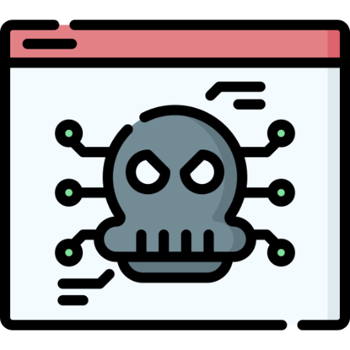

Common Malware Behavior
Downloading malware/malware dropper through HTTP
Communicate with a C2 server
- Cobalt Strike
- Metasploit
- Covenant
Unusual Outbound Traffic
Malware Beaconing
Suspicious DNS Queries to attacker domains
Spike in connections to other devices (lateral movement)
Failed login attempts/authentication

Slide 19


Cobalt Strike C2 Server Threat Hunting
Use of default SSL certificates
Increased usage of port 443, 80, 8443 with foreign IP address
Check default responses for HTTP 404 and DNS Queries

Slide 20
Malware File Types to Check for
.exe files - Windows executable files
.dll files - Dynamic Linked Libraries
.msi files – Windows installers
.bat files – Windows command line script
.vbs scripts – Visual Basic Scripts
.js scripts – Javascript file
.docx files – Microsoft Word Document (can contain macros)
.xlsx files – Microsoft Excel Spreadsheet (can contain macros)
.zip files – Compressed Archive Files (may have scripts when unzipped)
.pdf files – Can contain suspicious links, or a PDF reader vulnerability

Slide 21
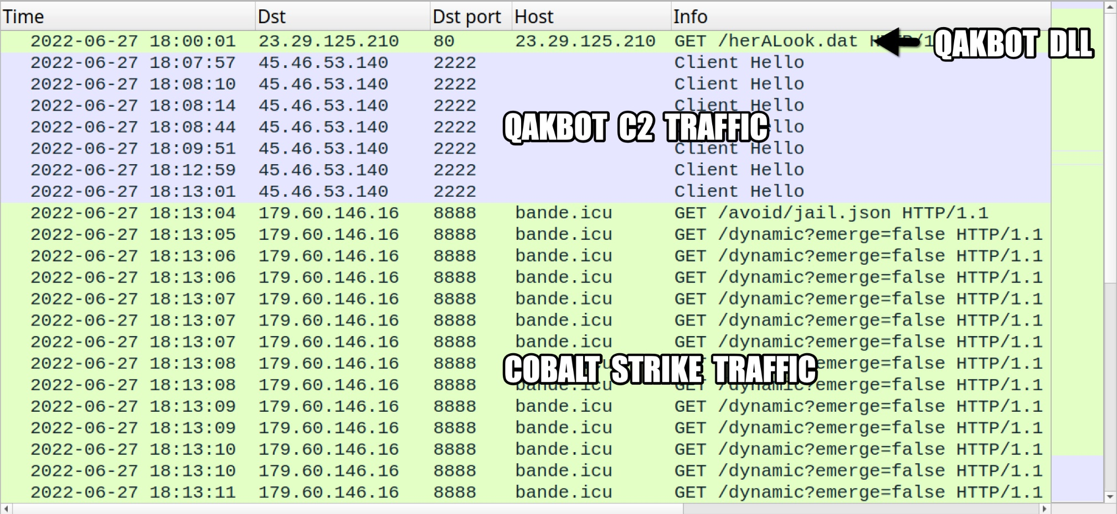
Wireshark
We can use Wireshark to identify specific malicious packets, and find the exact moment where the infection started
C2 server information, Victim information, other relevant evidence

Slide 22
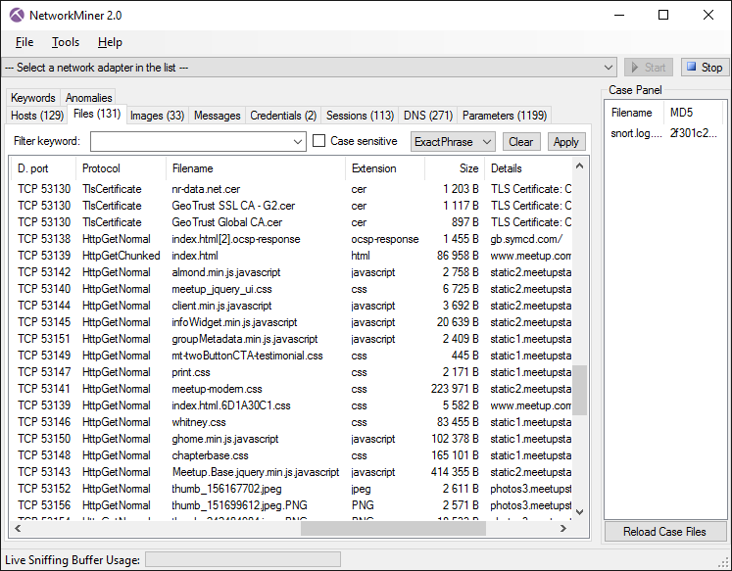

NetworkMiner
NetworkMiner is a automated flow analysis tool that will identify all hosts, downloaded files, emails, logins from a pcap file and attempt to reassemble them for analysis
Very powerful tool that can provide many helpful insights during an investigation
NetworkMiner should always be run in a sandbox environment (VM) that is disconnected from the network

Slide 23
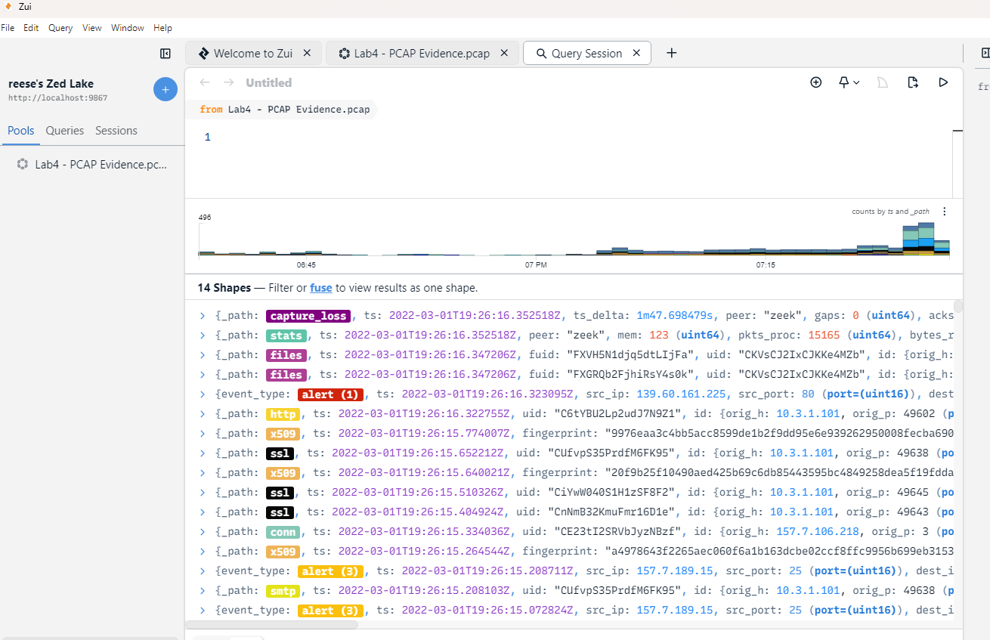
Zui
Zui (formerly known as brim) is a automated flow analysis tool that will identify any suspicious packets, emails, certificates, files from a pcap file and create a timeline
Won’t assemble the files, so it will be safer to use
Can help identify potential IOCs

Slide 24
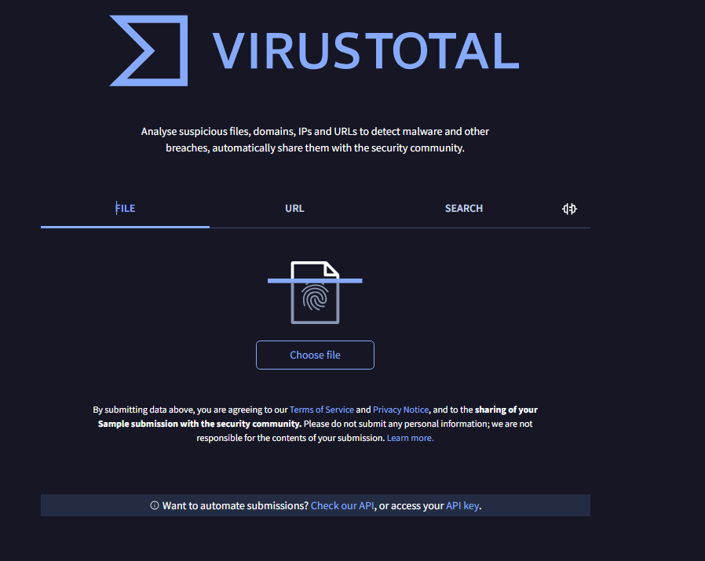
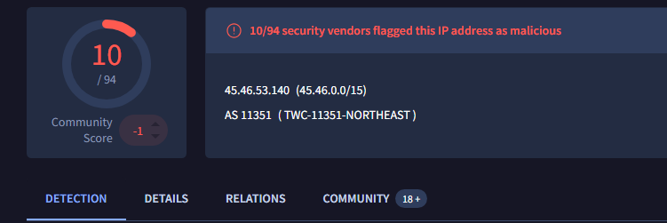

VirusTotal
VirusTotal is a massive database of known malware signatures and malicious fingerprints
We can provide signatures from our investigation to see if they have been flagged as malicious in the past
File Hashes
IP Addresses
Domain Names
The community tab will provide more context around the malicious signatures

Slide 25




Email Received from trustme@hacker.com
Example Timeline
Malicious link from email clicked on
Event
Malware Dropper Installed x1ksmv.js
Event
8:15 AM
Victim Machine contacts C2 server (45.132.22.7) and installs malware
What was contents of message?
8:27 AM
Event
What IP/Mail server did this come from?
Data Exfiltration to C2 server
What is the IP and MAC address of victim machine?
8:27 AM
Event
File Hash of this file?
How was the file downloaded?
What protocols were used?
8:28 AM
Event
File hash of files installed?
What data was stolen?
What ports were used?
8:33 AM
Any evidence of persistence?

