Slide 1

CSCI 466: Networks
Network Forensics: Tools and example investigation
Reese Pearsall Fall 2024
https://www.cs.montana.edu/pearsall/classes/fall2024/466/main.html
*All images are stolen from the internet
1

Slide 2

Goals of Network Forensics
Answer important questions such as:
When did the incident happen? What is the timeline?
What is the root cause of the incident?
Who attacked us?
Why did they attack us?
What is the scope of the damage?
Reflection
Did staff and organizations perform as expected?
What will our organization do next time?
What corrective actions need to happen?

Slide 3
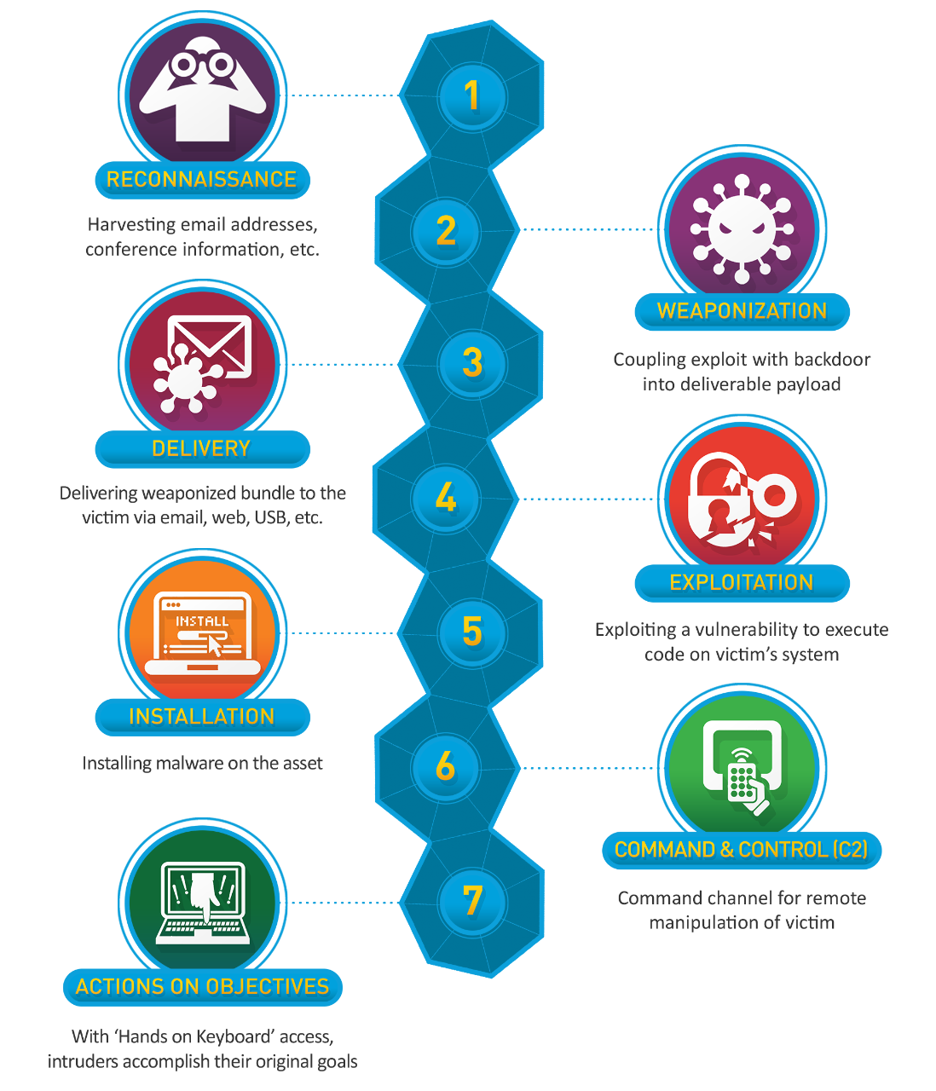
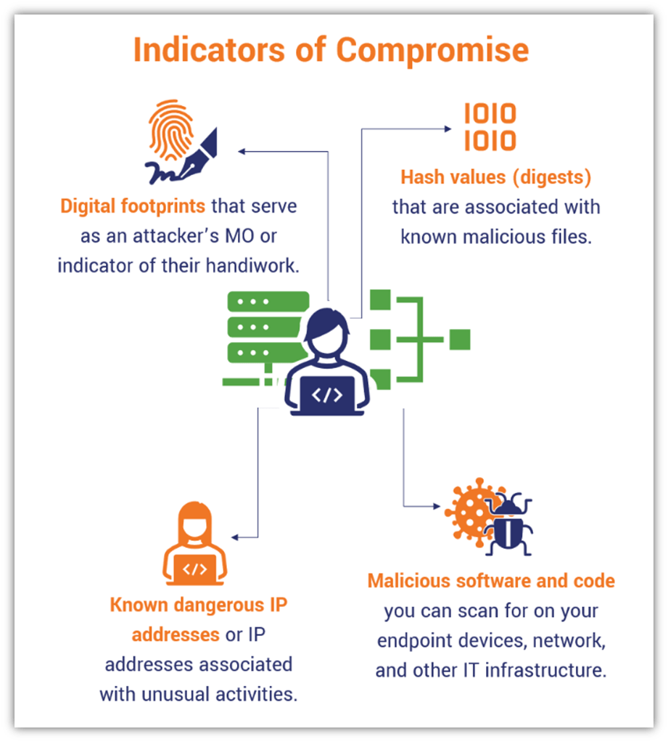
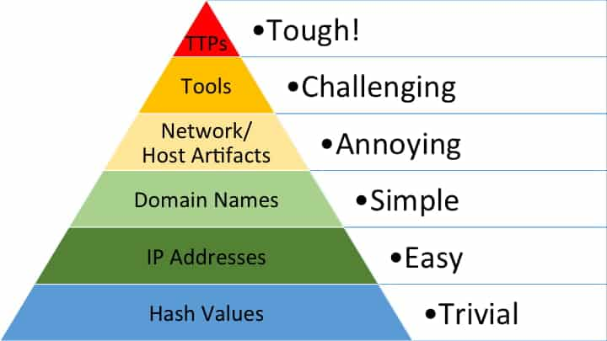
The Cyber Kill Chain describes the typical steps a malicious actor carries out to conduct a cyber attack

Slide 4
Malware File Types to Check for
.exe files - Windows executable files
.dll files - Dynamic Linked Libraries
.msi files – Windows installers
.bat files – Windows command line script
.vbs scripts – Visual Basic Scripts
.js scripts – Javascript file
.docx files – Microsoft Word Document (can contain macros)
.xlsx files – Microsoft Excel Spreadsheet (can contain macros)
.zip files – Compressed Archive Files (may have scripts when unzipped)
.pdf files – Can contain suspicious links, or a PDF reader vulnerability

Slide 5
There are many tools we can use for digital forensics, but we are covering some of the more well-known ones

Slide 6
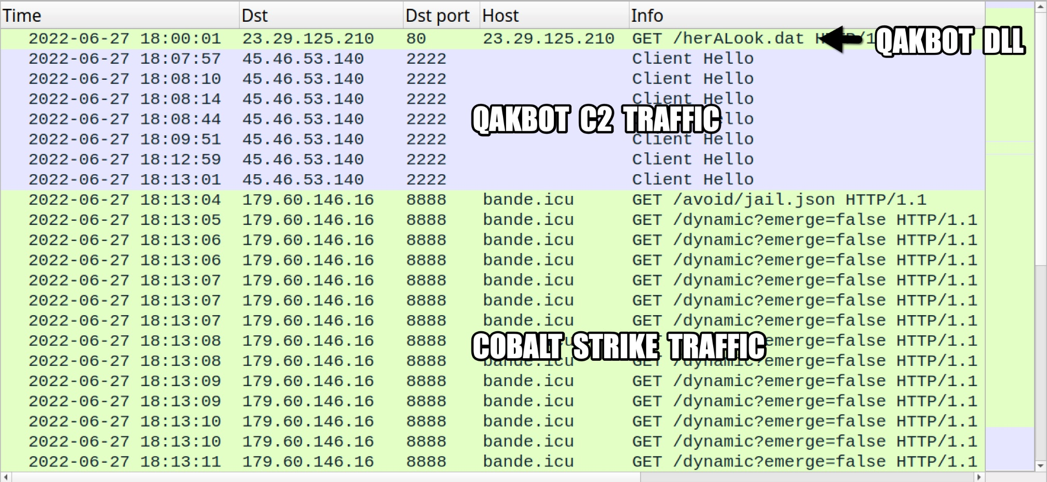
Wireshark
We can use Wireshark to identify specific malicious packets, and find the exact moment where the infection started
C2 server information, Victim information, other relevant evidence

Slide 7
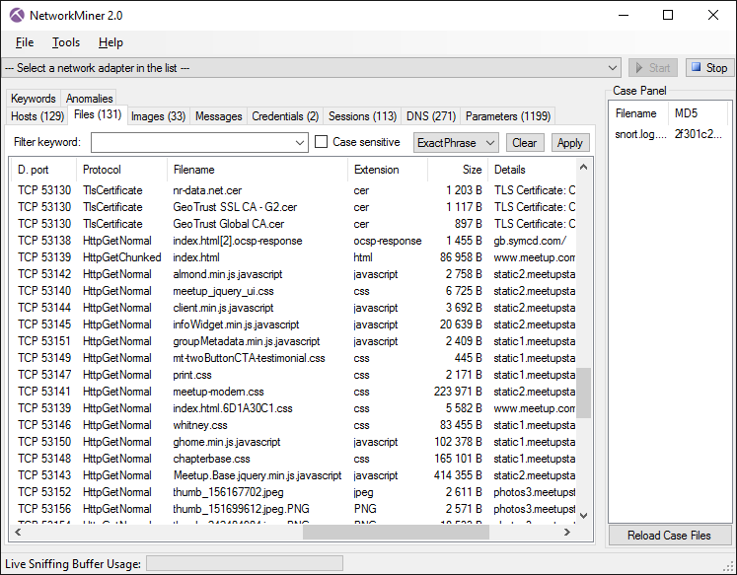

NetworkMiner
NetworkMiner is an automated flow analysis tool that will identify all hosts, downloaded files, emails, logins from a pcap file and attempt to reassemble them for analysis
Very powerful tool that can provide many helpful insights during an investigation
NetworkMiner should always be run in a sandbox environment (VM) that is disconnected from the network

Slide 8
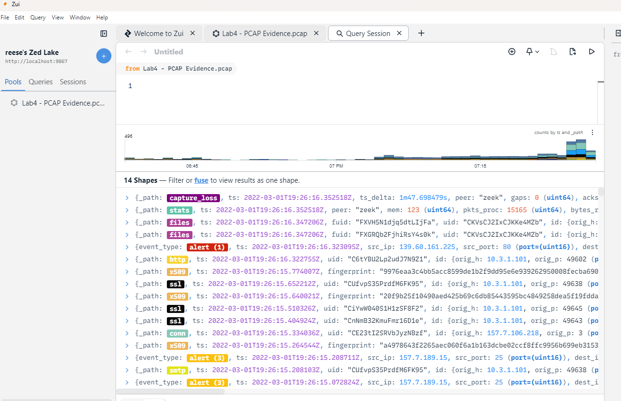
Zui
Zui (formerly known as brim) is a automated flow analysis tool that will identify any suspicious packets, emails, certificates, files from a pcap file and create a timeline
Won’t assemble the files, so it will be safer to use
Can help identify potential IOCs

Slide 9
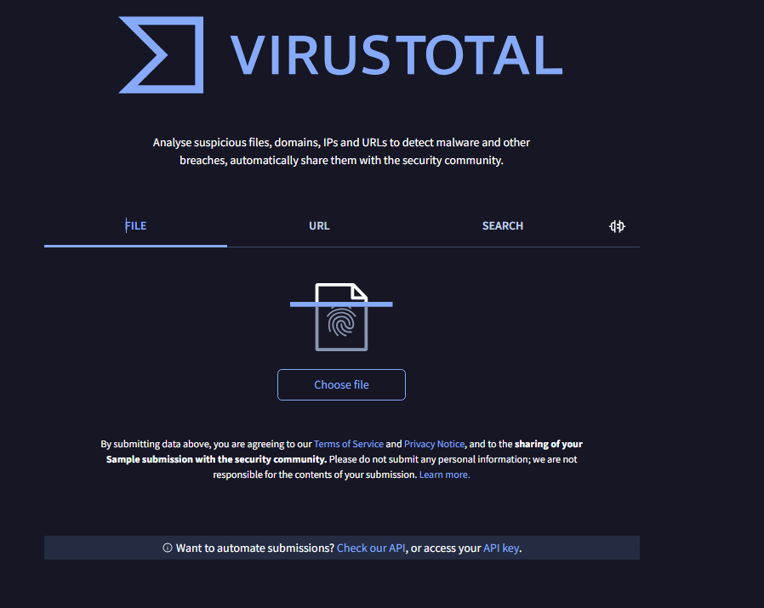
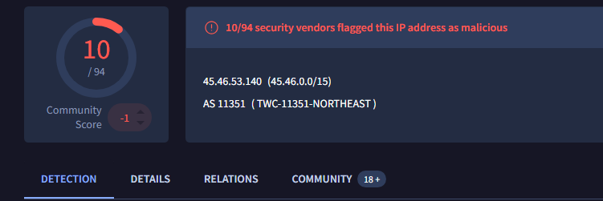

VirusTotal
VirusTotal is a massive database of known malware signatures and malicious fingerprints
We can provide signatures from our investigation to see if they have been flagged as malicious in the past
File Hashes
IP Addresses
Domain Names
The community tab will provide more context around the malicious signatures

Slide 10




Email Received from trustme@hacker.com
Example Timeline
Malicious link from email clicked on
Event
Malware Dropper Installed x1ksmv.js
Event
8:15 AM
Victim Machine contacts C2 server (45.132.22.7) and installs malware
What was contents of message?
8:27 AM
Event
What IP/Mail server did this come from?
Data Exfiltration to C2 server
What is the IP and MAC address of victim machine?
8:27 AM
Event
File Hash of this file?
How was the file downloaded?
What protocols were used?
8:28 AM
Event
File hash of files installed?
What data was stolen?
What ports were used?
8:33 AM
Any evidence of persistence?

Slide 11
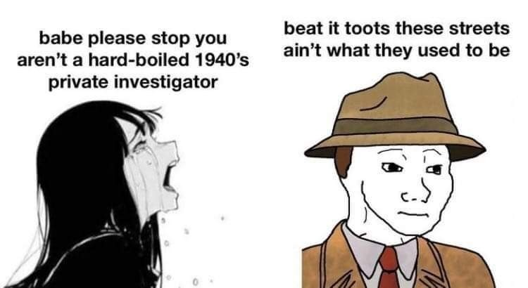

Let’s do an example investigation with real captured malicious traffic
We will want to keep a notepad to put relevant information as we are analyzing the PCAP file
We will want to be constructing a timeline as we are doing the investigation
network forensics investigator

Slide 12
Let’s do an example investigation with real captured malicious traffic

Slide 13
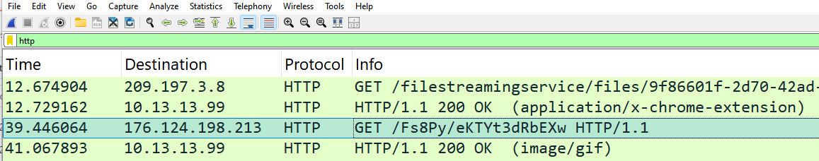
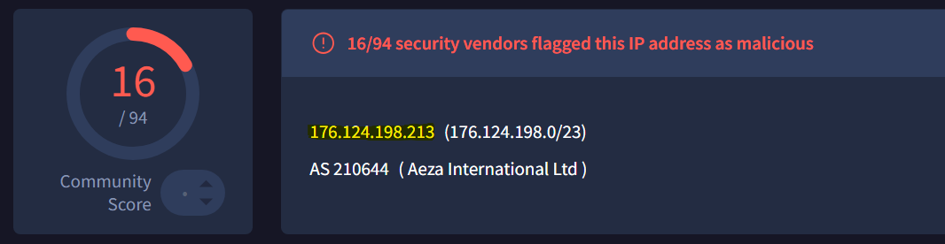
First, let’s try to find the piece of malware that was installed
This HTTP Get request seems suspicious
Strange URL in the header
VirusTotal confirms that this IP address is malicious

Slide 14
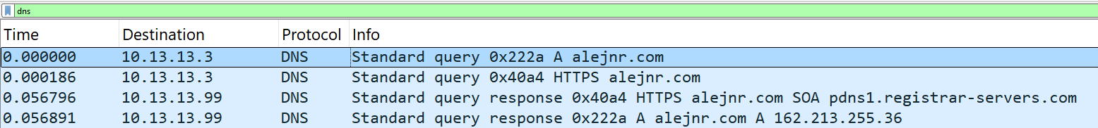
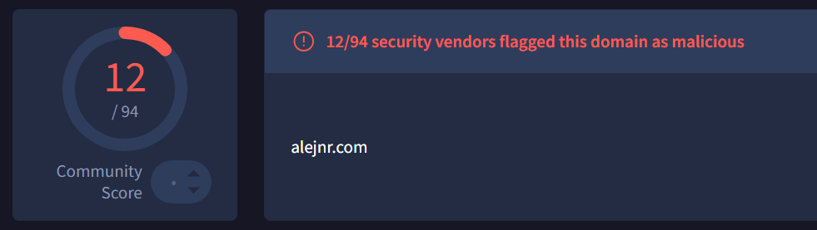
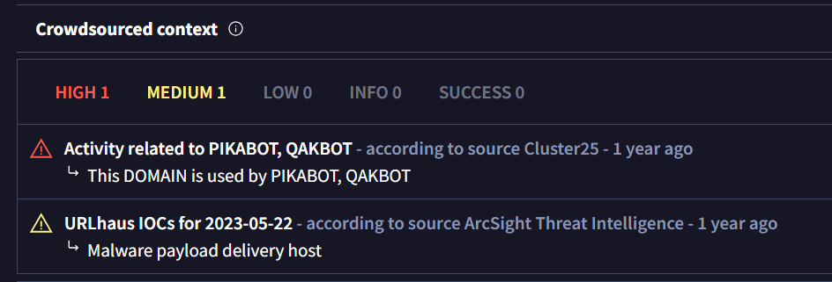
Investigating DNS
Many of the DNS requests were made to “normal” website. However, this domain seemed a bit strange and this request was made shortly before the malicious HTTP request
This domain had been flagged as malicious in the past
VirusTotal also provides context as to why it was flagged as malicious

Slide 15
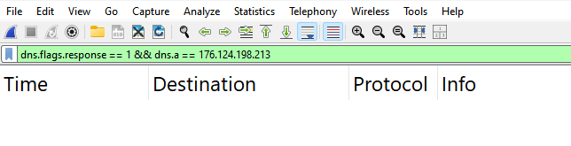
Where did this IP address come from?
This malicious IP did not come from a DNS response.
This could be an indicator that another piece of malware contacted that IP addressed and issued the HTTP request (malware dropper)
Many of the DNS requests were made to “normal” website. However, this domain seemed a bit strange and this request was made shortly before the malicious HTTP request

Slide 16
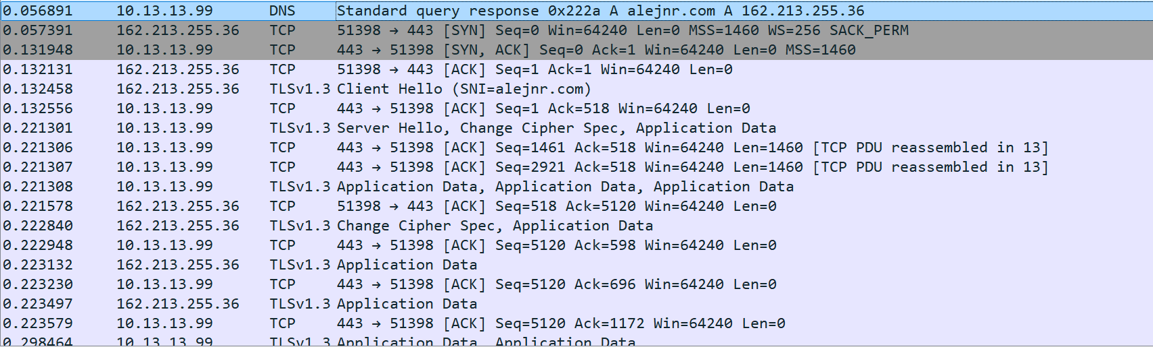
Immediately after we resolve the host name of alejnr.com, we start a TCP/TLS connection with that

Slide 17

Theory:
We reached out to this malicious domain alejnr.com and downloaded a malicious file which issued this HTTP request
We stop talking to that malicious domain, and then shortly after the malicious HTTP GET request is done

Slide 18
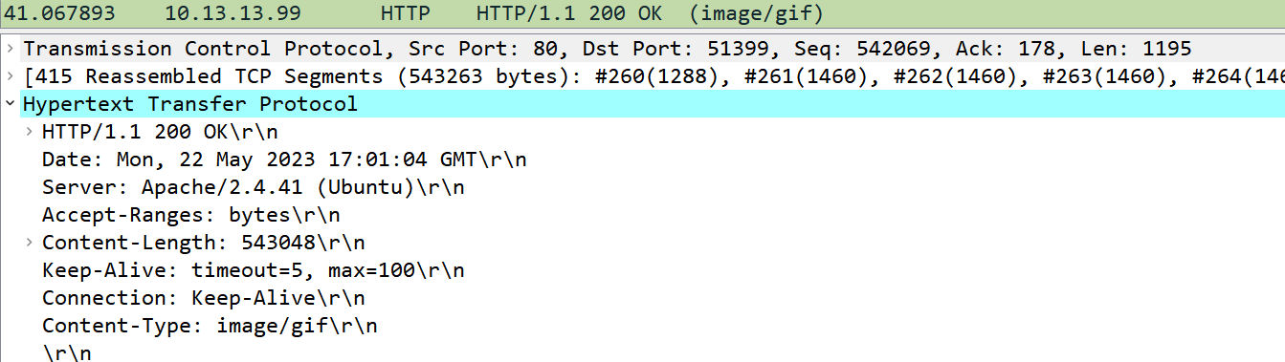
What is in this malicious HTTP request?
Request
Response
Wireshark thinks this file is GIF
Wireshark notices that there is something weird going on…

Slide 19
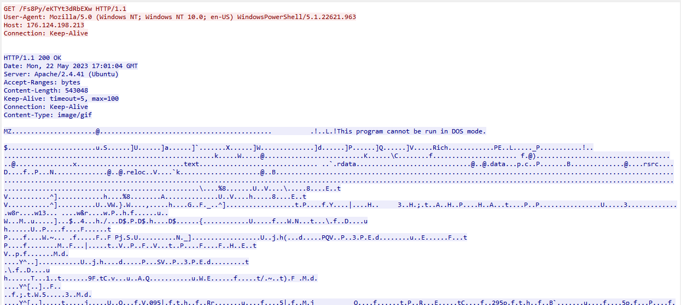
What is in this malicious HTTP request?
Right click → Follow TCP Stream
This is the “raw” contents of the GIF file
There is something very wrong here…

Slide 20

What is in this malicious HTTP request?
Right click → Follow TCP Stream
“This program cannot be run in DOS mode” is a very special string that appears in almost every Windows executable (.exe) or DLL file
It doesn’t make sense that this is part of a GIF file

Slide 21

What is in this malicious HTTP request?
Right click → Follow TCP Stream
Answer: this is actually a DLL file pretending to be a GIF file

Slide 22
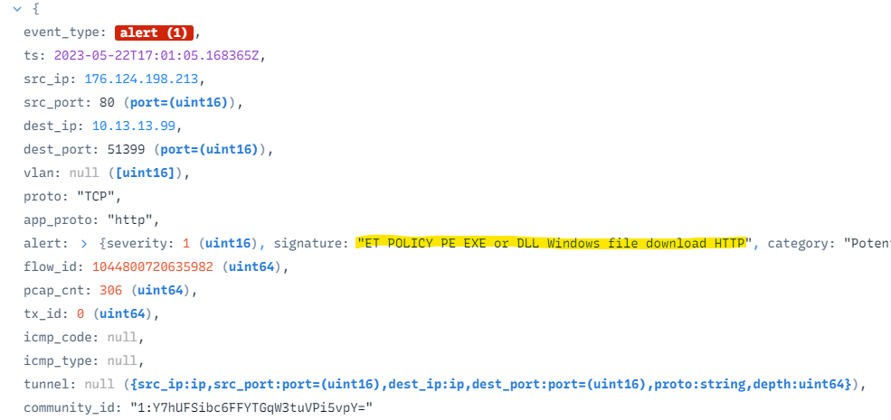
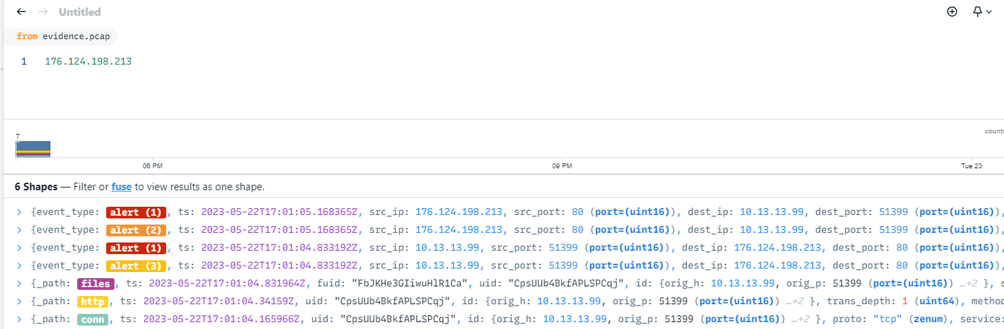

What is this malicious DLL file?
ZUI actually determined something malicious was possibly going on from our PCAP file
We can plug our malicious IP from the GET request into ZUI
We can expand the “files” info to see information about this file that was downloaded

Slide 23
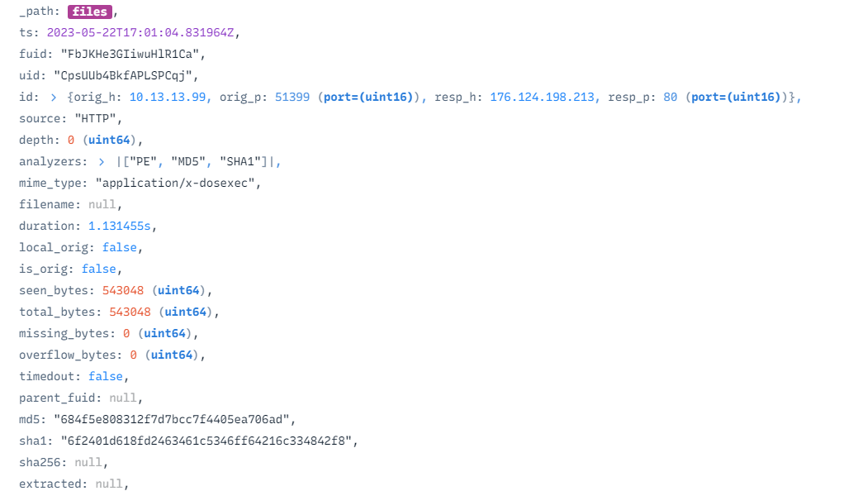
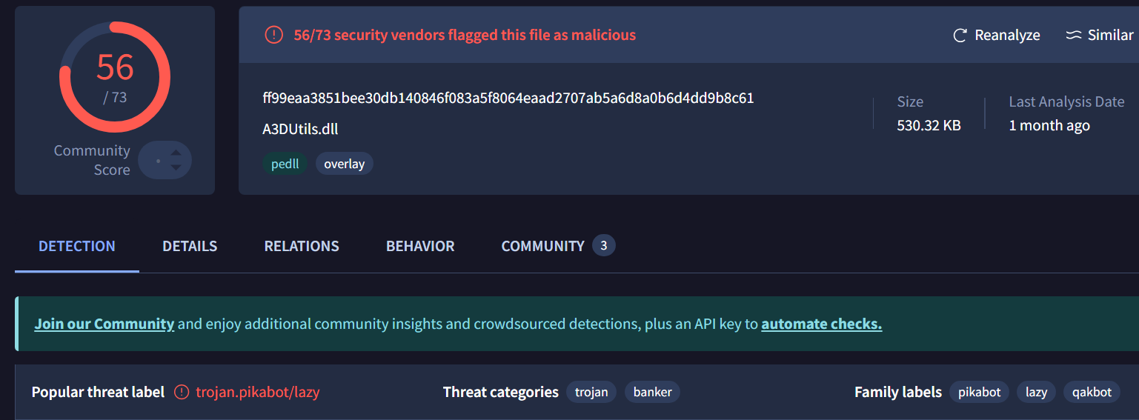



What is this malicious DLL file?
By plugging it into VirusTotal, we can see that this DLL file-pretending-to-be-a-gif is a known malicious file!
ZUI will compute the file hash for us !
The name of this malware is “PIKABOT”
VT seemed to redirect to the SHA256 hash value

Slide 24


What is this malicious DLL file?
This domain had been flagged as malicious in the past
VirusTotal also provides context as to why it was flagged as malicious
We saw “PIKABOT” earlier when we were investigating alejnr.com
The name of this malware is “PIKABOT”
VT seemed to redirect to the SHA256 hash value

Slide 25
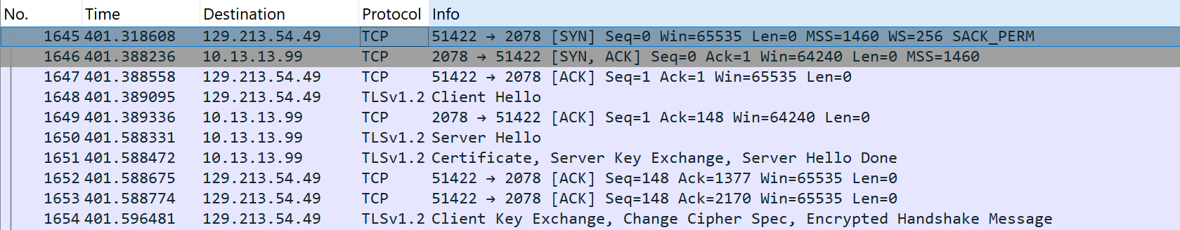
What happens after the malware was downloaded?
Let’s see if we can find evidence of command and control from this cyber attack
We can start plugging in IP addresses into VirusTotal to see if we get a hit

Slide 26
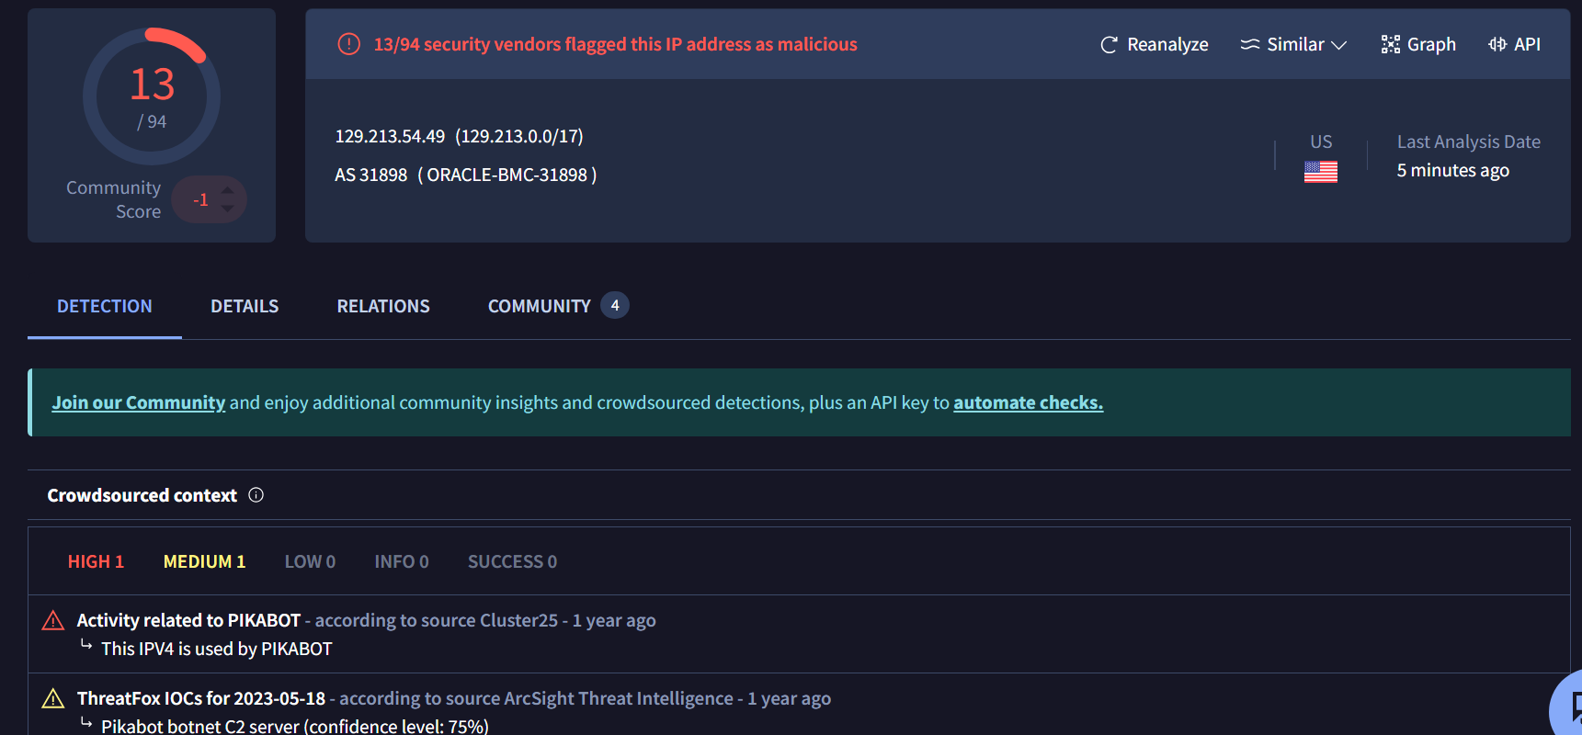

What happens after the malware was downloaded?
Let’s see if we can find evidence of command and control from this cyber attack
We discover that 129.213.54.49 is the IP address for the PIKABOT C2 server

Slide 27
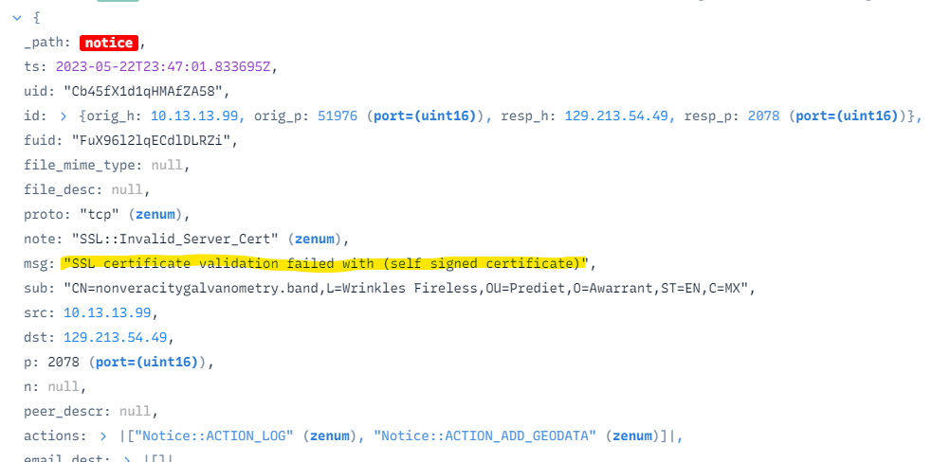

What happens after the malware was downloaded?
Let’s see if we can find evidence of command and control from this cyber attack
ZUI also generated a notice that this could possibly be a C2 server

Slide 28
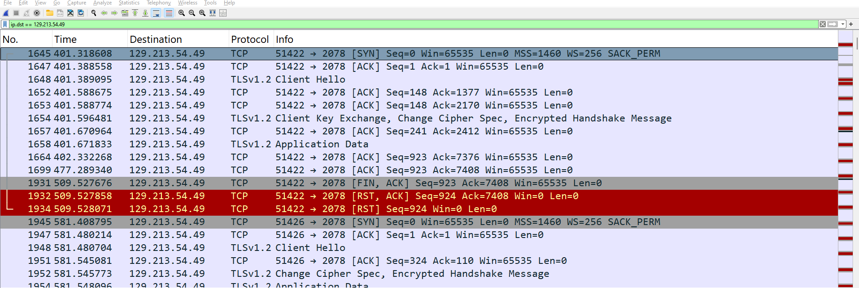
What damage was done?
A good amount of Data was exchanged with the C2 server
Since this all HTTPS encrypted traffic, we cannot see the content of these messages
However, this is evidence that it is possible that data may have been exfiltrated

Slide 29

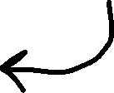


Timeline
162.213.255.36
alejnr.com was contacted
Connection with alejnr.com was made and malware dropper was installed
2023-05-22T17:00:24
2023-05-22T17:00:25
176.124.198.213
PikaBot DLL downloaded
2023-05-22T17:01:04
129.213.54.49
Possible Data Exfiltration ?
PikaBot C2 server contacted
2023-05-22T17:07:06

Slide 30

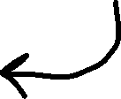





Timeline
162.213.255.36
alejnr.com was contacted
Connection with alejnr.com was made and malware dropper was installed
2023-05-22T17:00:24
2023-05-22T17:00:25
176.124.198.213
How did this attack begin?
PikaBot DLL downloaded
2023-05-22T17:01:04
129.213.54.49
Possible Data Exfiltration ?
PikaBot C2 server contacted
2023-05-22T17:07:06

Slide 31
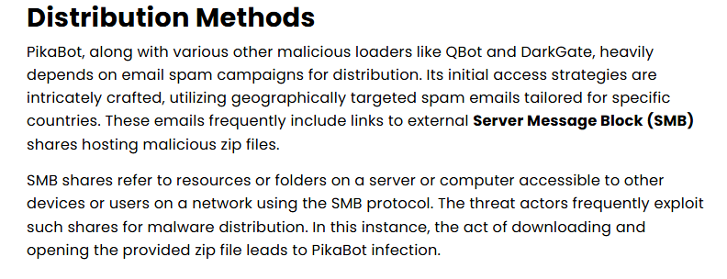
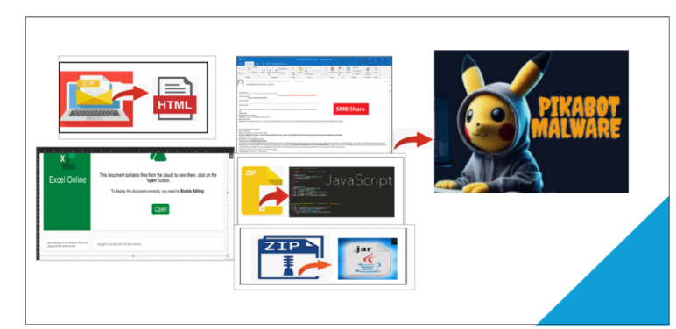
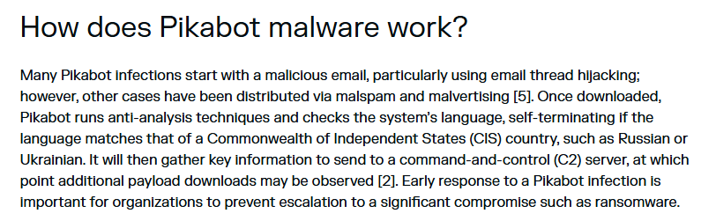

Finding Root cause
PIKABOT is a well-documented malware. We can do a little bit of investigation ourselves to figure out what happened
Full IOC: https://github.com/pan-unit42/tweets/blob/master/2023-05-22-IOCs-for-Pikabot-infection-with-Cobalt-Strike.txt

Slide 32

Timeline
162.213.255.36
alejnr.com was contacted
Connection with alejnr.com was made and malware dropper was installed
2023-05-22T17:00:24
2023-05-22T17:00:25
176.124.198.213
Phishing/Scam Email link
ff99eaa3851bee30db140846f083a5f8064eaad2707ab5a6d8a0b6d4dd9b8c61
PikaBot DLL downloaded
Our PCAP file does not have evidence of this step occuring
2023-05-22T17:01:04
129.213.54.49
Possible Data Exfiltration ?
PikaBot C2 server contacted
2023-05-22T17:07:06

