Slide 1

CSCI 466: Networks
Cloud Computing, Building a basic API
Reese Pearsall Fall 2024
https://www.cs.montana.edu/pearsall/classes/fall2024/466/main.html
*All images are stolen from the internet
1

Slide 2

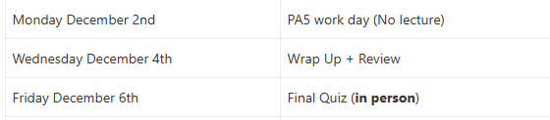


Announcements
Wireshark Lab 4 due Wednesday at 11:59 PM
PA4 due Sunday 11/24 @ 11:59 PM
Wednesday will also be lecture recording (no in-person lecture)
Friday will be a work day for PA4 (no lecture)
Final week of CSCI 466

Slide 3
Wireshark Lab 4

Slide 4

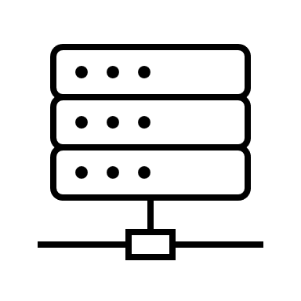


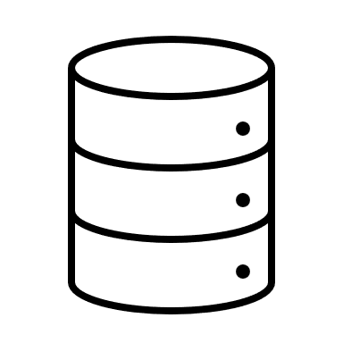
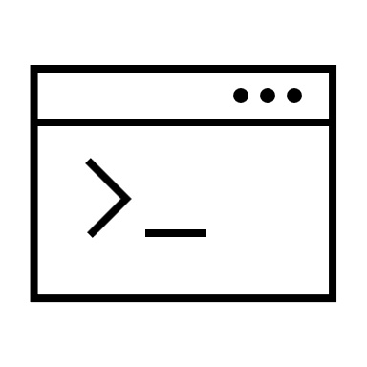









Cloud computing is the on-demand service of computing resources over the internet instead of on-premise
CSCI-466 Inc.
The Internet
On-Premise
Cloud Computing

Slide 5
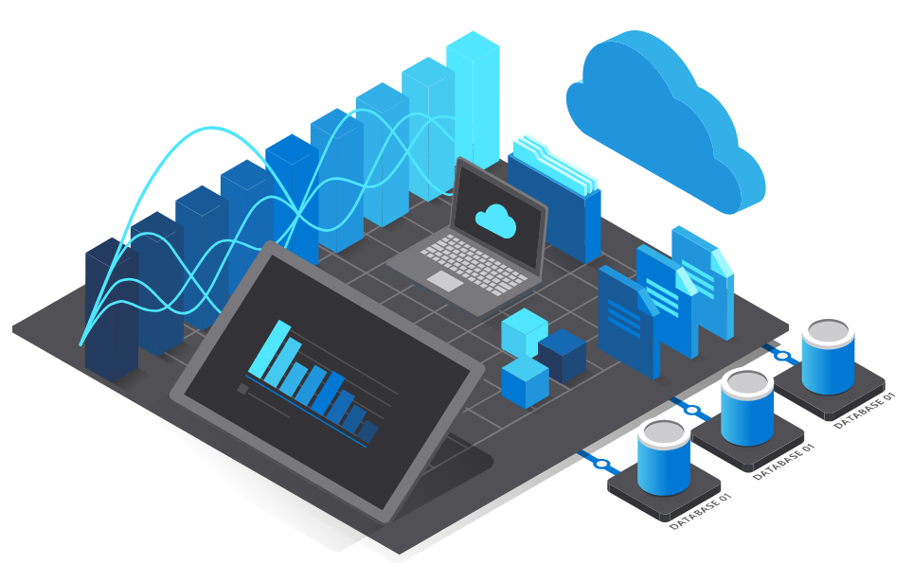
Benefits of Cloud Computing
Cons of Cloud Computing
Cost Efficiency – Hosting your services on a cloud system will generally be less expensive than purchasing and maintaining your own servers
→ Pay-as-you-go model
Scalability- Resources can quickly be scaled up or down based on demand
Accessibility – Cloud providers offer high uptime guarantees across multiple data centers
Backups – Cloud services provide regular backups in case of hardware failures or accidents
Security + Compliance – Trusted cloud providers generally provide solid security + guarantees on compliance
Control– less control over infrastructure and configuration
Security- Cloud systems are a common target in cyber attacks
Unexpected Costs

Slide 6



Deployment Types
Public Cloud- shared environment where resources are owned and operated by third-party cloud provider and accessible through the public internet
Private Cloud- computing resources are exclusively dedicated to one organization. Not accessible through the public internet
Hybrid Cloud- Combination of public and private. Information and Data flows between public and private cloud servers

Slide 7
Cloud Computing Services
These are all the computing resources in a normal tech stack
Applications (Software)
Data
Runtime
In an on-premise model, the organization is responsible for managing all of these
Middleware
OS
Virtualization
Servers
Storage
Networking

Slide 8
Cloud Computing Services
These are all the computing resources in a normal tech stack
Applications (Software)
Data
Runtime
Infrastructure as a Service (IaaS) provides virtualized computing resources and foundational IT building blocks over the internet
Middleware
OS
Virtualization
Servers
will manage these
Storage
Networking

Slide 9
Cloud Computing Services
These are all the computing resources in a normal tech stack
Applications (Software)
Platform as a Service (PaaS) provides hardware and software tools needed for application development
Data
Runtime
Write code without having to worry about underlying infrastructure
Middleware
OS
Virtualization
will manage these
Servers
Storage
Networking

Slide 10
Cloud Computing Services
These are all the computing resources in a normal tech stack
Applications (Software)
Software as a Service (SaaS) delivers fully-functional applications over the internet
Data
Runtime
Most commonly used for web applications (Google Drive)
Middleware
OS
Virtualization
will manage these
Servers
Storage
Networking

Slide 11
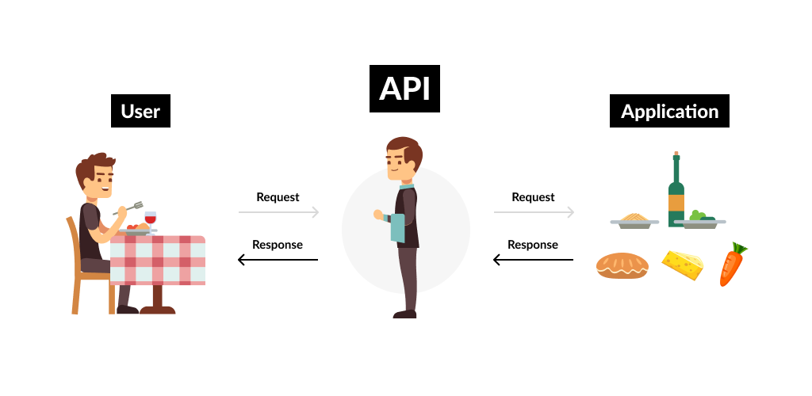
API
An Application Programming Interface (API) is a very common application to deploy on the cloud
An API accepts requests, and communicates with a backend service to retrieve/update/delete data
APIs typically listen for HTTP requests, perform some actions, and then send data back in an HTTP response

Slide 12
API
An Application Programming Interface (API) is a very common application to deploy on the cloud
An API accepts requests, and communicates with a backend service to retrieve/update/delete data
APIs typically listen for HTTP requests, perform some actions, and then send data back in an HTTP response
If our API is on the cloud, it will be accessible 24/7 and it doesn’t have to use our computational resources

Slide 13

API
Today and Wednesday (and on Programming Assignment 5), our goal will be to build a basic API, and then deploy it to the cloud
We will first build it locally, and then deploy to Amazon Web Service (AWS)
3.127.45.8
API

Slide 14
API
Today and Wednesday (and on Programming Assignment 5), our goal will be to build a basic API, and then deploy it to the cloud
We will first build it locally, and then deploy to Amazon Web Service (AWS)
3.127.45.8
HTTP Request
Name: “Reese”
192.168.1.4
API

Slide 15

API
Today and Wednesday (and on Programming Assignment 5), our goal will be to build a basic API, and then deploy it to the cloud
We will first build it locally, and then deploy to Amazon Web Service (AWS)
3.127.45.8
HTTP Request
Name: “Reese”
192.168.1.4
raven.txt
HTTP Response
“Hello Reese!
Once upon a midnight dreary, while I pondered, weak and weary, … ”
API

Slide 16

Flask
Flask is a popular python framework for creating basic web applications and API
Easy to learn (maybe too easy?)
Powerful routing system for different endpoints
Built-in handling and templating of HTTP requests/responses
RESTful API support
Can be combined with many other web frameworks

Slide 17
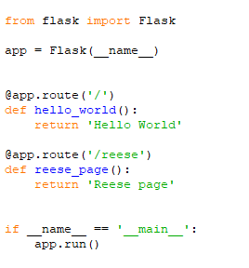
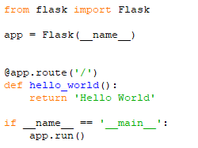
Anatomy of Flask Program
If I visit this IP in my web browser, or send an HTTP request to it, I will get “Hello World” returned
This app now has two endpoints you can send requests
http://127.0.0.1:5000/reese will return “Reese page”

Slide 18


Anatomy of Flask Program
Creates a new endpoint
value that gets returned when HTTP request is sent to that endpoint
If I visit this IP in my web browser, or send an HTTP request to it, I will get “Hello World” returned
This app now has two endpoints you can send requests
http://127.0.0.1:5000/reese will return “Reese page”

Slide 19
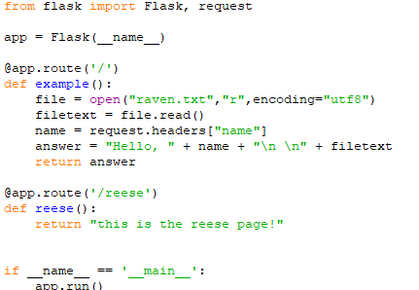
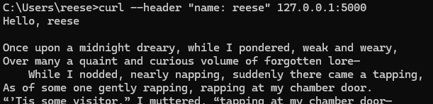
Nevermore API
Sending HTTP requests to API

