Slide 1

CSCI 466: Networks
Cloud Computing, Deploying using AWS
Reese Pearsall Fall 2024
https://www.cs.montana.edu/pearsall/classes/fall2024/466/main.html
*All images are stolen from the internet
1

Slide 2
Announcements
Workday on 11/22 and 12/2 (no class)
PA4 due 11/24

Slide 3
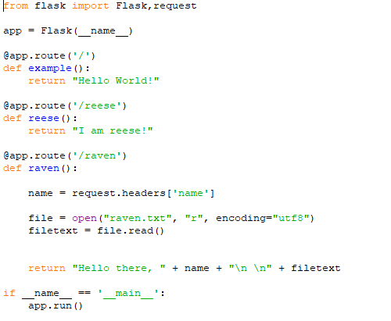
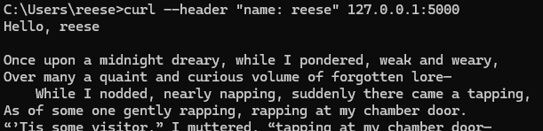
Flask App
Sending HTTP requests to API
We have built our API, and we have tested it locally. We are ready to deploy it to the cloud!

Slide 4
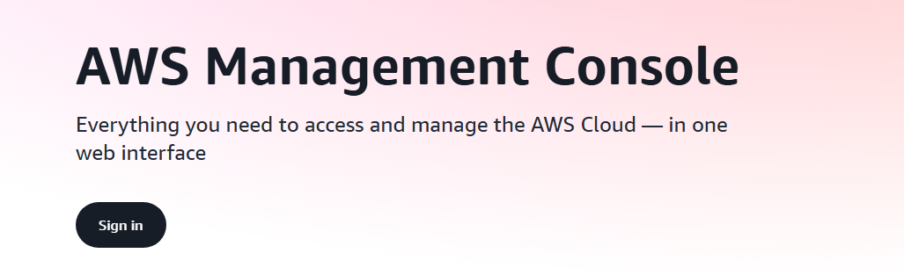
Amazon AWS
https://aws.amazon.com/console/
First, we will need to make an account, and then log into the AWS console

Slide 5
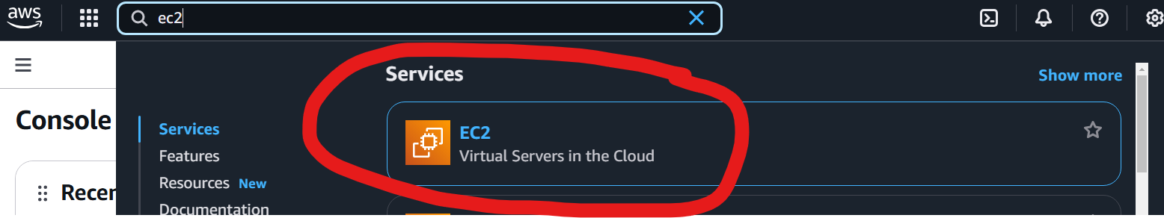
Amazon AWS
We will put our application on an EC2 instance (a virtual server in the cloud)

Slide 6
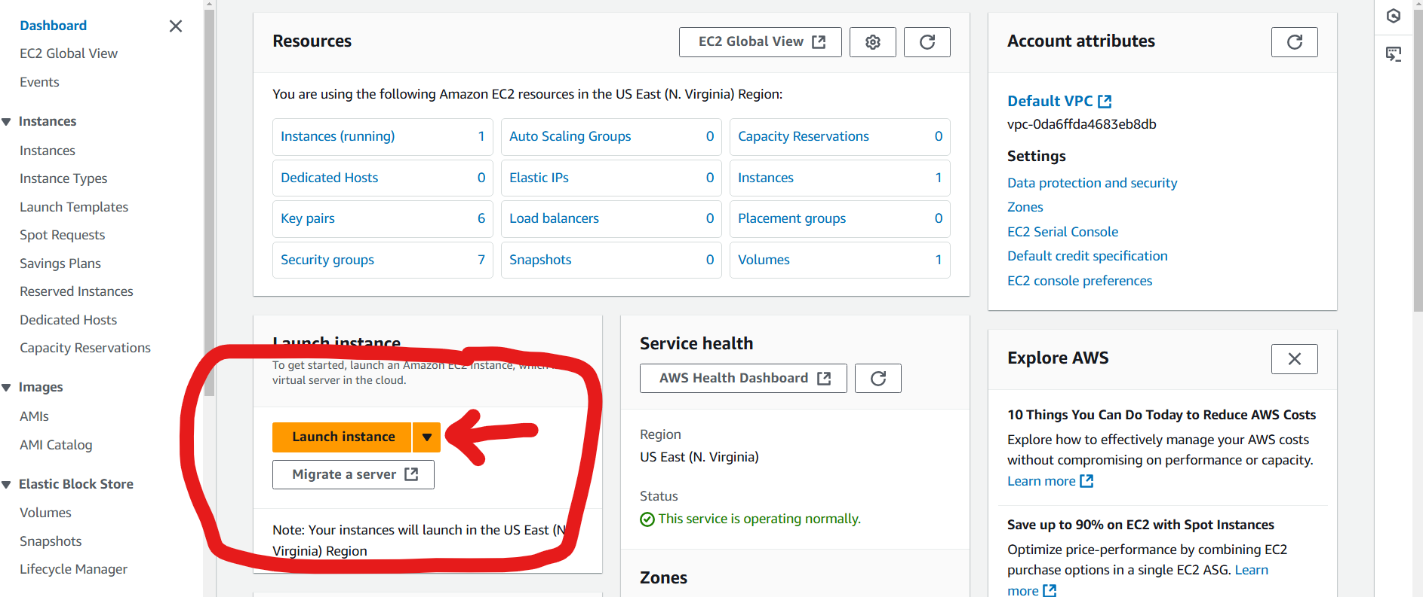
Deploying with AWS

Slide 7
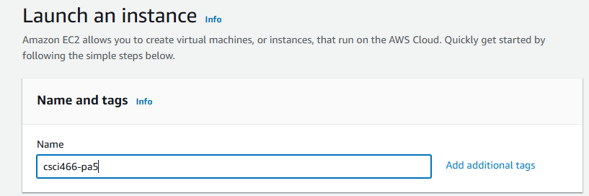
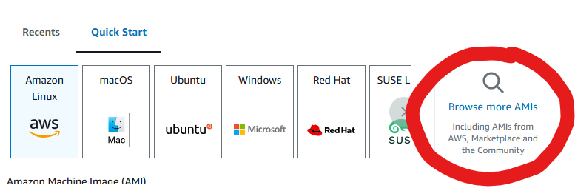
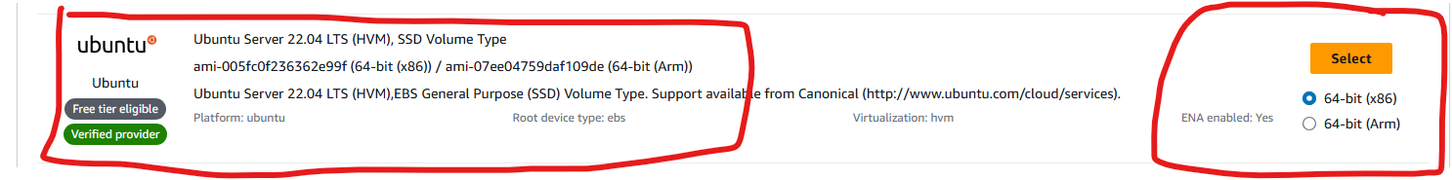
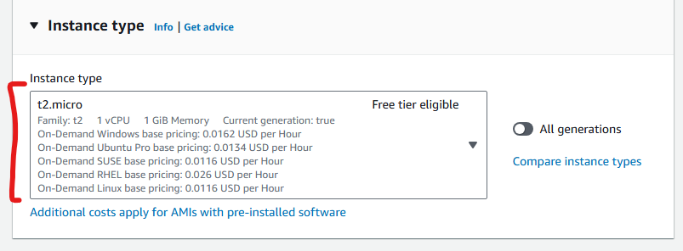
Deploying with AWS
Give your EC2 a name
Our cloud machine will be an Ubuntu 22.04 web server
Use the t2.micro instance type

Slide 8
Deploying with AWS
Give your EC2 a name
Our cloud machine will be an Ubuntu 22.04 web server
Use the t2.micro instance type

Slide 9
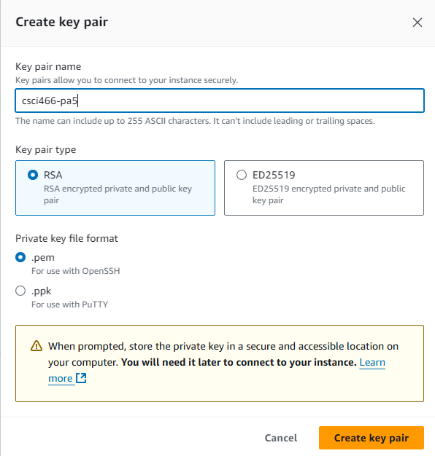
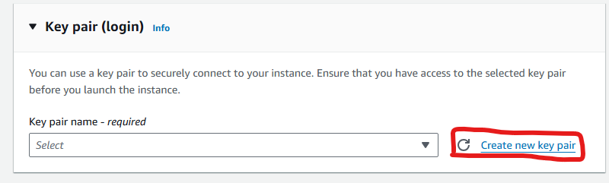
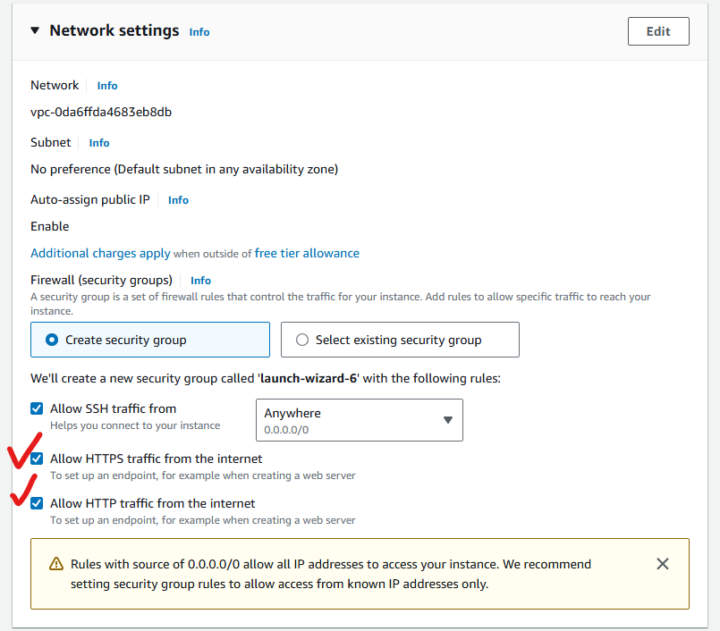


Deploying with AWS
You will need to generate a key pair (this gives you a way to log into your cloud machine remotely)
Enable port 80 and 443 to allow for HTTP requests

Slide 10

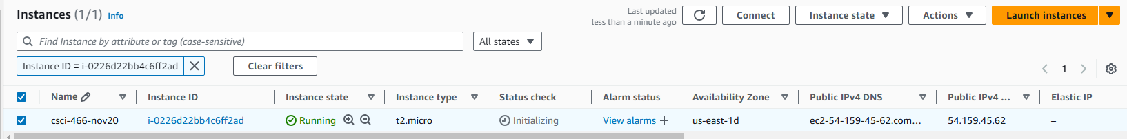
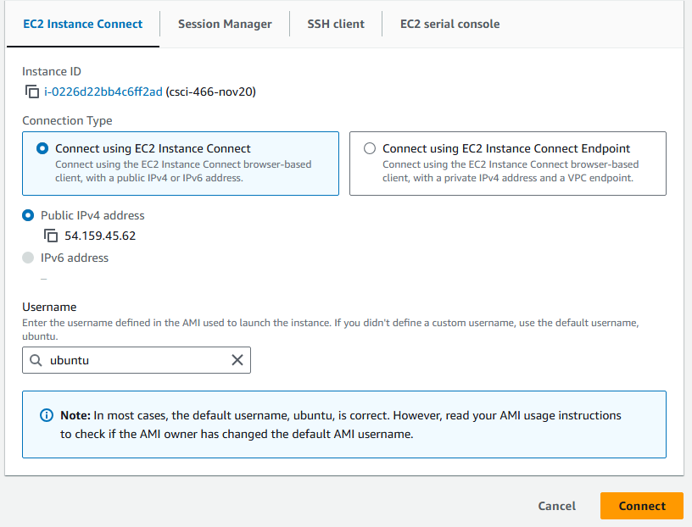



Deploying with AWS
If you want to connect to your machine with SSH, you can follow the instructions there

Slide 11
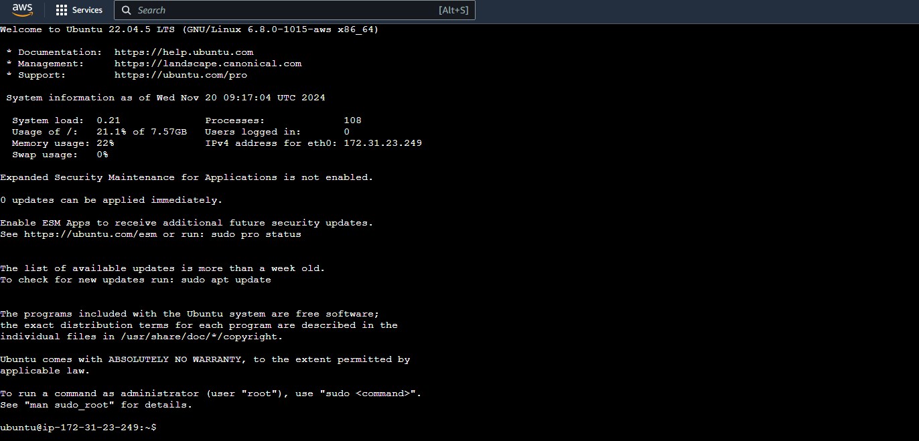
Setting up our server
We are now connected to our cloud server !

Slide 12
Setting up our server
We need to run some commands to configure our machine:
// get python set up
sudo apt-get update sudo apt-get install python3-venv
//create folder for our files and activate python
mkdir pa5 cd pa5 python3 -m venv venv source venv/bin/activate
//install flask pip install Flask

Slide 13

Setting up our server
Now, lets copy and paste over out app.py and our raven.txt

Slide 14
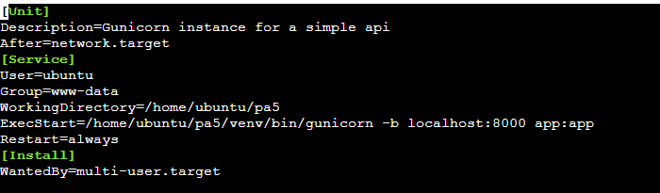


Gunicorn
We will use gunicorn to manage our Flask application and forward requests to it
pip install gunicorn
We want to make sure gunicorn is always running, so we will make a background process for it
sudo nano /etc/systemd/system/pa5.service
This file will make sure that on startup, it run the command
gunicorn localhost:8000 app:app
sudo systemctl daemon-reload sudo systemctl start pa5 sudo systemctl enable pa5
Our Flask API is running on port 8000 !
Start the process

Slide 15



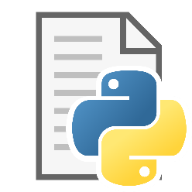


Nginx
Our app is listening on port 8000.
We want to take requests on port 80 (port for HTTP requests) and redirect them to gunicorn, which will redirect them to our Flask app!
We will use nginx as a proxy !
HTTP Request
Port 80
Port 8000

Slide 16
Nginx
Our app is listening on port 8000.
We want to take requests on port 80 (port for HTTP requests) and redirect them to gunicorn, which will redirect them to our Flask app!
We will use nginx as a proxy !
sudo apt-get install nginx
sudo systemctl enable nginx
Then we need to configure nginx to reroute traffic
sudo nano /etc/nginx/sites-available/default

Slide 17
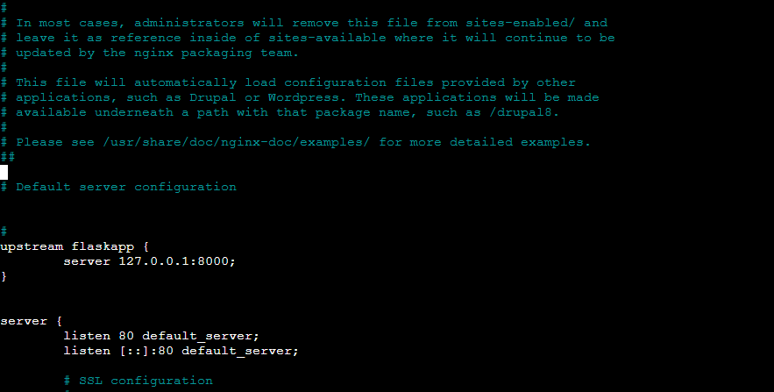
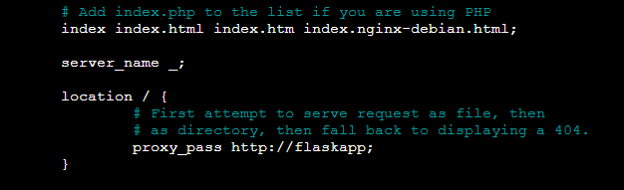





Nginx
sudo nano /etc/nginx/sites-available/default
Listen on port 80
Route requests to this function
Forward to port 8000
sudo systemctl restart nginx

Slide 18

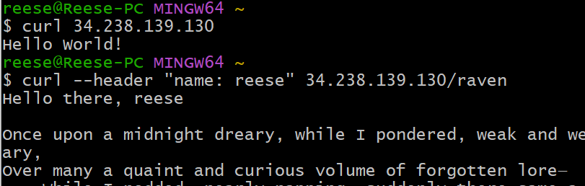
Testing
We can now send curl requests to the public API of our cloud machine!
Our cloud application is now online 24/7, and can accept requests!

Slide 19
PA5

