Slide 1

CSCI 476: Computer Security
SQL Injection Attack
Reese Pearsall
Fall 2024
*all images are stolen from the internet
https://www.cs.montana.edu/pearsall/classes/fall2024/476/main.html

Slide 2
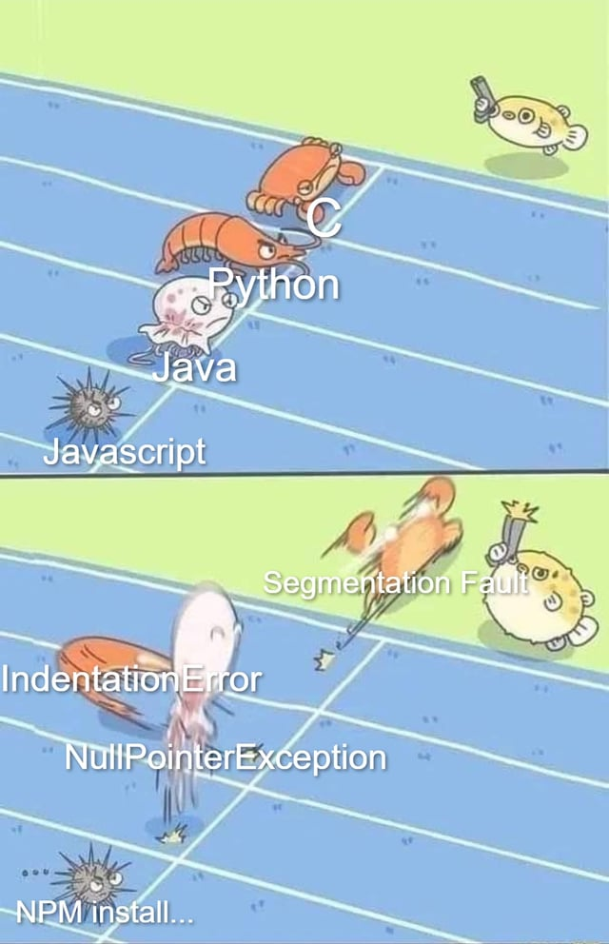
Announcements
Lab 3 (Buffer Overflow) Due Tuesday @ 11:59 PM
No class on Thursday
Project Instructions Posted

Slide 3
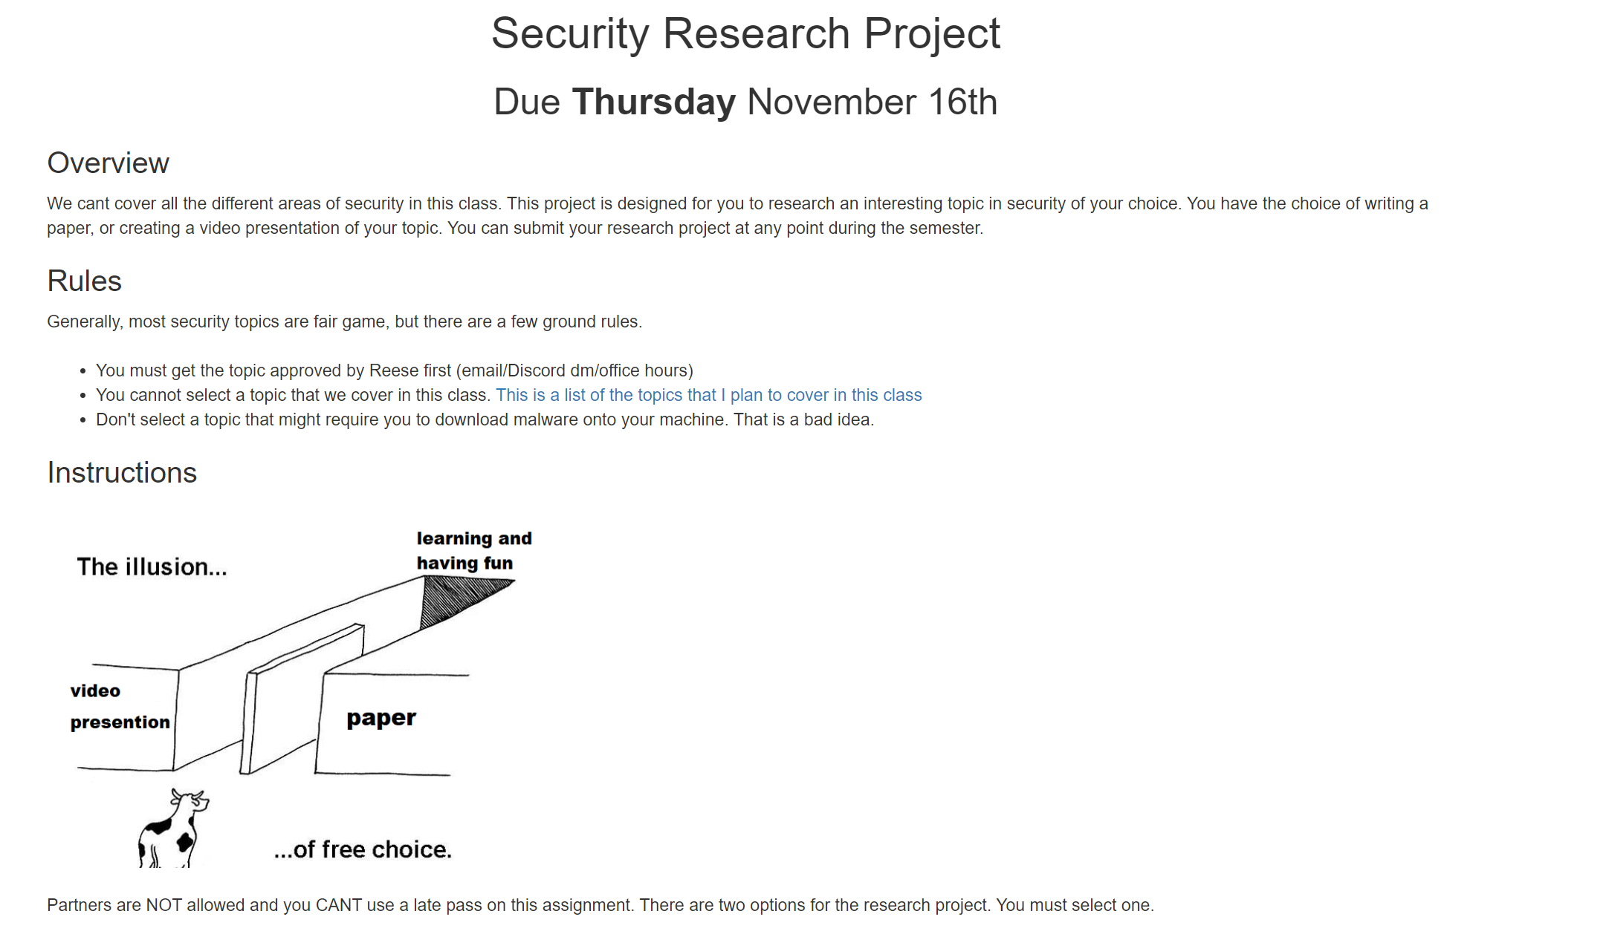
Research Project

Slide 4




HTTP Request
GET http://cs.montana.edu/pearsll/rainer.jpeg
Brief Review of
client
server
Communication of the web:
URL
protocol://hostname[:port]/[path/]file
ex. http://cs.montana.edu/pearsall/rainer.jpeg
HTTP Request:
Format: Method, Headers, Body
Methods: GET, POST, HAD, UPDATE
Headers: Host, referrer, User-agent, Cookie…
database

Slide 5

HTTP Request
GET http://cs.montana.edu/pearsll/rainer.jpeg
Brief Review of
client
server
Communication of the web:
URL
protocol://hostname[:port]/[path/]file
ex. http://cs.montana.edu/pearsall/rainer.jpeg
HTTP Request:
Format: Method, Headers, Body
Methods: GET, POST, HAD, UPDATE
Headers: Host, referrer, User-agent, Cookie…
HTTP Response
200 OK
database
HTTP Response:
Format: Status, Response Headers, Body
Status Codes: 2xx (successful), 3xx (redirect), 4xx (bad request), 5xx (server error)

Slide 6

Brief Review of
client
server
Communication of the web:
URL
HTTP Request:
Format: Method, Headers, Body
Methods: GET, POST, HAD, UPDATE
Headers: Host, referrer, User-agent, Cookie…
HTTP Response:
Format: Status, Response Headers, Body
Status Codes: 2xx (successful), 3xx (redirect), 4xx (bad request), 5xx (server error)
Server-side functionality
database
•
•
•
Serve static resources (HTML, CSS, Images)
Serve dynamic Resources (PHP, Ruby, Java, Javascript…)
Query Databases
➢ Relational (MySql)
➢ Non-Relational (MongoDB)

Slide 7
Brief Review of
client
server
Often times, we will want to query only certain data from the database
“Give me all the red, SUV cars”
“Give me all the cars that cost less than $40,000”
If we are working with an SQL-like database, then we can issue an SQL query
database
Query parameters can be passed via URL or in an HTTP request
protocol://hostname[:port]/[path/]file[?color=red&type=suv]

Slide 8


Brief Review of
client
server
In SQL, our database consists of tables
Each row is an entry in the database
Each column represents an attribute of the entries
FRIENDS
ID | FirstName | LastName | Age | Job
1 | Reese | Pearsall | 15 | Instructor
2 | John | Paxton | 51 | Director
3 | Sean | Yaw | 34 | Professor
4 | Susan | McCartney | 28 | Student
5 | Tom | Brady | 46 | Quarterback
6 | Parker | Pearsall | 27 | Chemist
database

Slide 9


Brief Review of
client
server
In SQL, our database consists of tables
Each row is an entry in the database
Each column represents an attribute of the entries
“I want to see the names of all my friends who are older than 34!”
FRIENDS
ID | FirstName | LastName | Age | Job
1 | Reese | Pearsall | 15 | Instructor
2 | John | Paxton | 51 | Director
3 | Sean | Yaw | 34 | Professor
4 | Susan | McCartney | 28 | Student
5 | Tom | Brady | 46 | Quarterback
6 | Parker | Pearsall | 27 | Chemist
database

Slide 10
Brief Review of
“I want to see the names of all my friends who are older than 34!”
client
server
SQL Query Format
SELECT FROM WHERE
In SQL, our database consists of tables
Each row is an entry in the database
Each column represents an attribute of the entries
FRIENDS
ID | FirstName | LastName | Age | Job
1 | Reese | Pearsall | 15 | Instructor
2 | John | Paxton | 51 | Director
3 | Sean | Yaw | 34 | Professor
4 | Susan | McCartney | 28 | Student
5 | Tom | Brady | 46 | Quarterback
6 | Parker | Pearsall | 27 | Chemist
database

Slide 11
Brief Review of
“I want to see the names of all my friends who are older than 34!”
client
server
SQL Query Format
SELECT FirstName FROM FRIENDS WHERE AGE > 34
In SQL, our database consists of tables
Each row is an entry in the database
Each column represents an attribute of the entries
FRIENDS
ID | FirstName | LastName | Age | Job
1 | Reese | Pearsall | 15 | Instructor
2 | John | Paxton | 51 | Director
3 | Sean | Yaw | 34 | Professor
4 | Susan | McCartney | 28 | Student
5 | Tom | Brady | 46 | Quarterback
6 | Parker | Pearsall | 27 | Chemist
database

Slide 12
Brief Review of
“I want to see the names of all my friends who are older than 34!”
client
server
SQL Query Format
SELECT FirstName FROM FRIENDS WHERE AGE > 34
In SQL, our database consists of tables
Each row is an entry in the database
Each column represents an attribute of the entries
FRIENDS
ID | FirstName | LastName | Age | Job
1 | Reese | Pearsall | 15 | Instructor
2 | John | Paxton | 51 | Director
3 | Sean | Yaw | 34 | Professor
4 | Susan | McCartney | 28 | Student
5 | Tom | Brady | 46 | Quarterback
6 | Parker | Pearsall | 27 | Chemist
database

Slide 13
Brief Review of
“I want to see the names of all my friends who are older than 34!”
client
server
SQL Query Format
SELECT FirstName FROM FRIENDS WHERE AGE > 34
In SQL, our database consists of tables
Each row is an entry in the database
Each column represents an attribute of the entries
FRIENDS
ID | FirstName | LastName | Age | Job
1 | Reese | Pearsall | 15 | Instructor
2 | John | Paxton | 51 | Director
3 | Sean | Yaw | 34 | Professor
4 | Susan | McCartney | 28 | Student
5 | Tom | Brady | 46 | Quarterback
6 | Parker | Pearsall | 27 | Chemist
database

Slide 14


Brief Review of
“I want to see the names of all my friends who are older than 34!”
client
server
SQL Query Format
SELECT FirstName FROM FRIENDS WHERE AGE > 34
In SQL, our database consists of tables
Each row is an entry in the database
Each column represents an attribute of the entries
FRIENDS
ID | FirstName | LastName | Age | Job
1 | Reese | Pearsall | 15 | Instructor
2 | John | Paxton | 51 | Director
3 | Sean | Yaw | 34 | Professor
4 | Susan | McCartney | 28 | Student
5 | Tom | Brady | 46 | Quarterback
6 | Parker | Pearsall | 27 | Chemist
database
Response: John, Sean, Tom

Slide 15
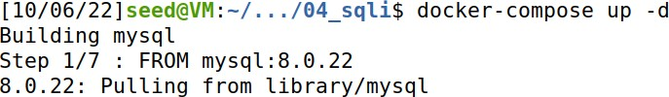
Setup
(Make sure the docker containers from Shellshock are turned off)
We will use docker again to create a web server running an SQL server!
cd into the 04_sqli folder
docker-compose up –d
Log into the mysql server

Slide 16
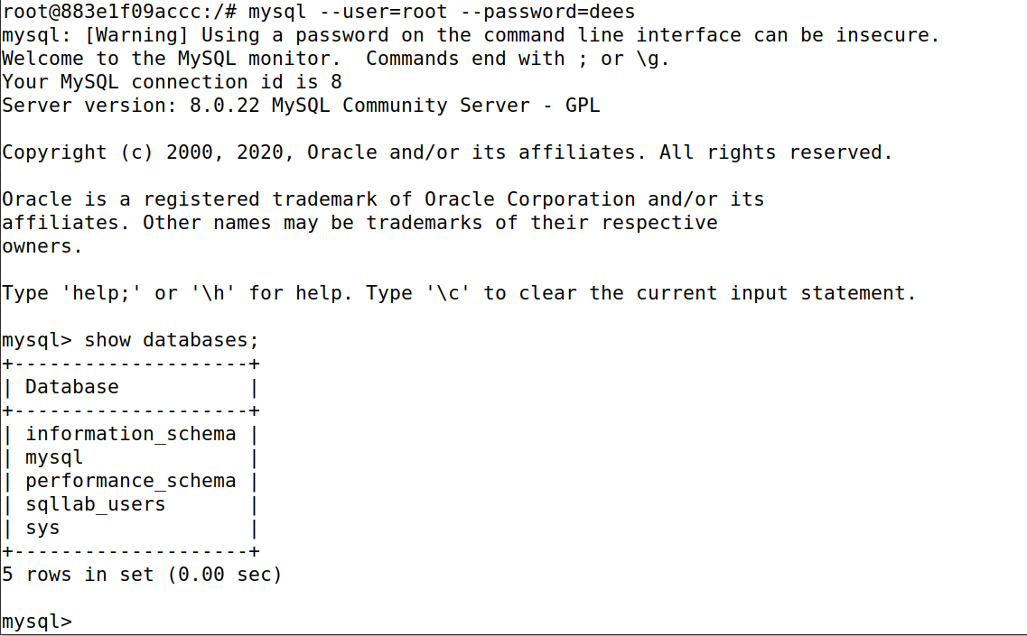
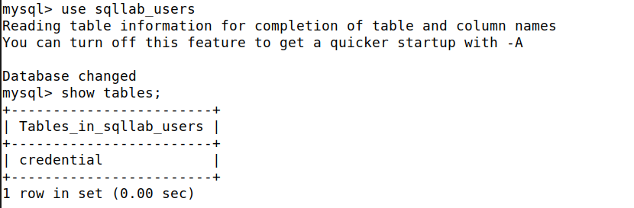
Setup
Log into the mysql server
We will be using the sqllab_users database
Log in with credentials and show databases

Slide 17
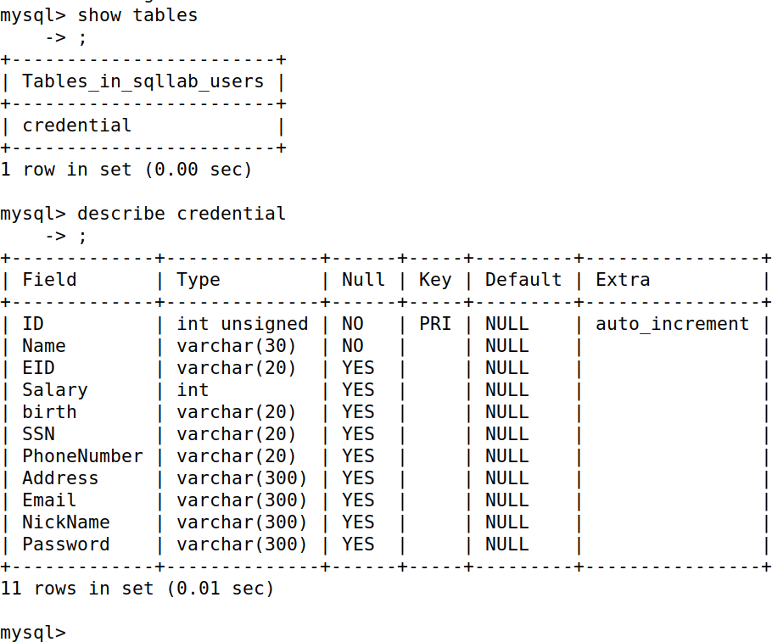
Basic SQL Queries
The database that we are using in this lab only has one table (credential)

Slide 18
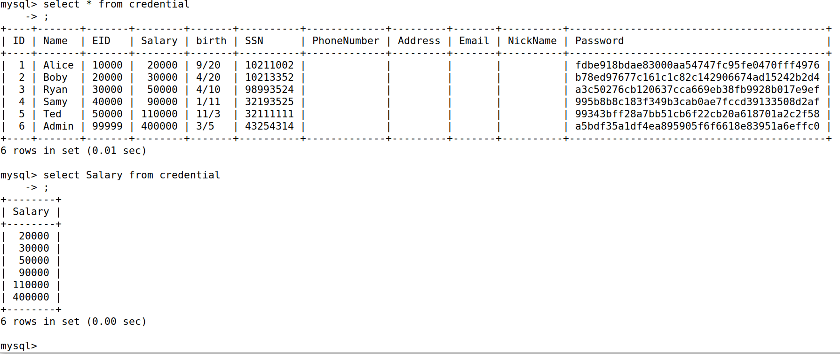
Basic SQL Queries

Slide 19
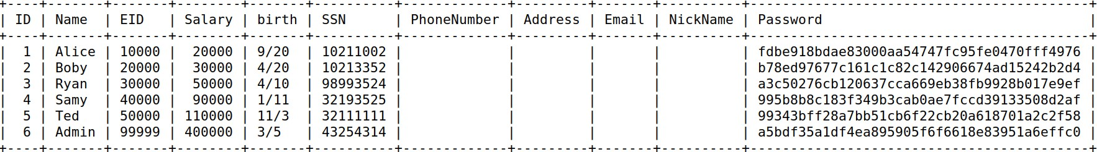
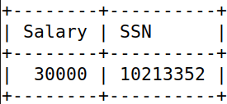
Basic SQL Queries
SELECT FROM WHERE ;
Select everything
SELECT * FROM credential;
SELECT Salary, SSN FROM crediential WHERE Name=“Boby”;

Slide 20
SELECT * FROM credential; #this is a comment
Basic SQL Queries
SELECT * FROM credential; -- this is a comment
SELECT * /*this is a comment*/ FROM credential;

Slide 21
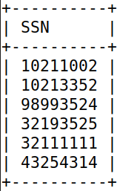
Basic SQL Queries
SELECT SSN FROM credential WHERE 1=1;
Always True, so select all the rows!

Slide 22
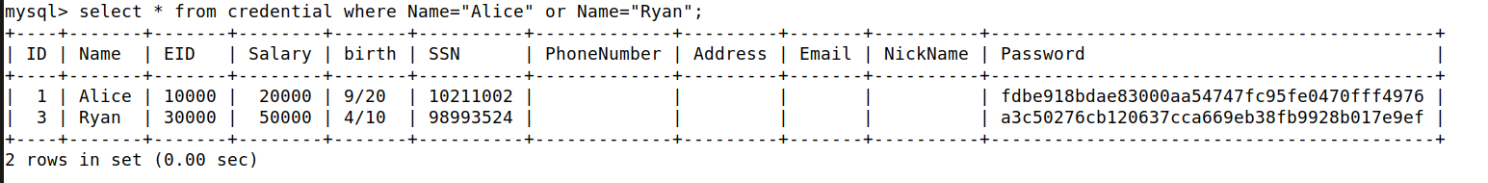
Basic SQL Queries
We have and and or operators
(both conditions need to be true)
(only one, or both, conditions need to be true)

Slide 23
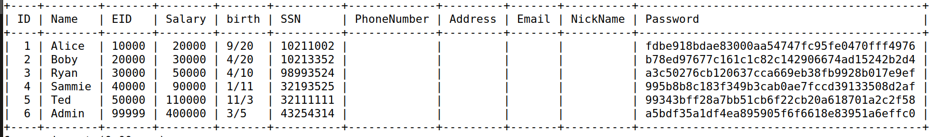
Basic SQL Queries
We can update information in SQL tables with the UPDATE keyword
UPDATE credential SET Name=“Sammie” WHERE Name=“Samy”;
select * from credential;
Select * FROM credential WHERE Name=“Samy”
(no results)

Slide 24
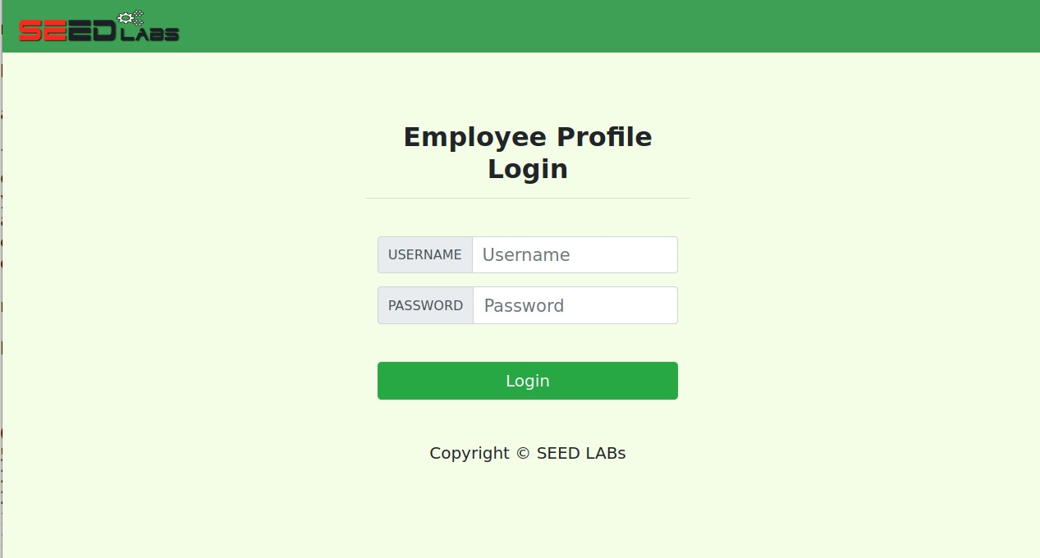

SQL Injections
http://www.seedlabsqlinjection.com/

Slide 25
Flow of stuff
HTTP Request Username=alice Password=seedalice
Client
Server
Query results as HTTP reponse
SELECT * from credential where username=alice and password=seedalice

Slide 26
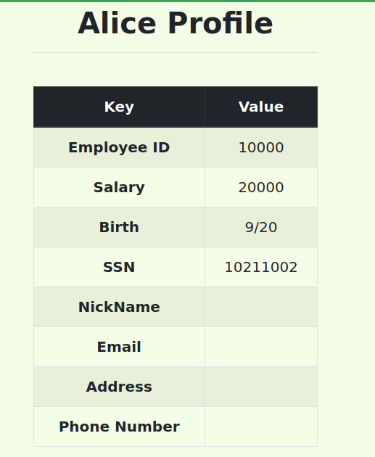
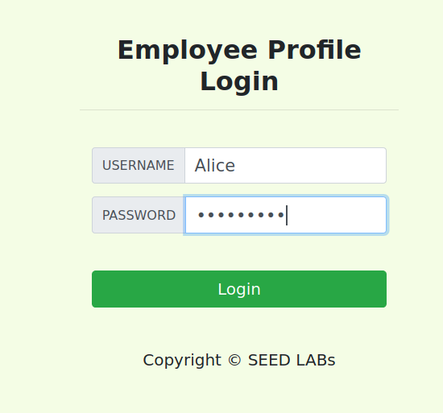
The server issues an SQL query to pull all of Alice’s information, and then sends an HTTP response back
seedalice

Slide 27
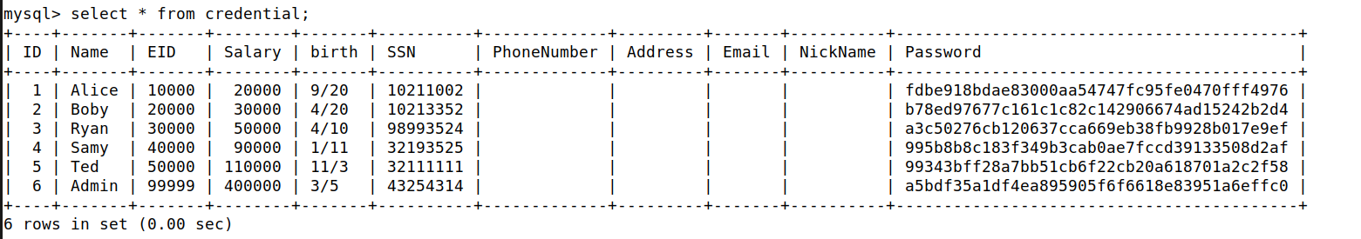
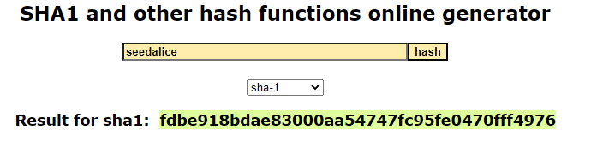

Storing Passwords
In our table, the plaintext password is not stored in the database (good!!). Instead, the hash of the password is stored
A hash function is used to generate a fixed-length, deterministic, unique output* for a given input

Slide 28
Backend Handling of SQL Query
Code for webpage can be found in 04_sqli/image_www/code/unsafe_home.php
$sql =
FROM credential
WHERE name= '$input_uname' and password='$hashed_pwd'";
"SELECT id, name, eid, salary, birth, ssn,
phoneNumber, address, email, nickname, password

Slide 29
Backend Handling of SQL Query
Code for webpage can be found in 04_sqli/image_www/code/unsafe_home.php
$sql =
FROM credential
WHERE name= '$input_uname' and password='$hashed_pwd'";
"SELECT id, name, eid, salary, birth, ssn,
phoneNumber, address, email, nickname, password
One long PHP string that is eventually executed as an SQL query

Slide 30
Backend Handling of SQL Query
Code for webpage can be found in 04_sqli/image_www/code/unsafe_home.php
$sql =
FROM credential
WHERE name= '$input_uname' and password='$hashed_pwd'";
"SELECT id, name, eid, salary, birth, ssn,
phoneNumber, address, email, nickname, password
One long PHP string that is eventually executed as an SQL query

Slide 31
Backend Handling of SQL Query
Code for webpage can be found in 04_sqli/image_www/code/unsafe_home.php
$sql =
FROM credential
WHERE name= '$input_uname' and password='$hashed_pwd'";
"SELECT id, name, eid, salary, birth, ssn,
phoneNumber, address, email, nickname, password
Username input from webpage
Password input from webpage
One long PHP string that is eventually executed as an SQL query

Slide 32
$sql = “SELECT * FROM credential WHERE name= ‘Alice' and password=‘seedalice'";
Backend Handling of SQL Query
PHP Code
SELECT * FROM credential WHERE
name= ‘Alice' and password=‘seedalice’;
SQL Command that is executed
The values that we supply on the webpage eventually get turned into code!

Slide 33
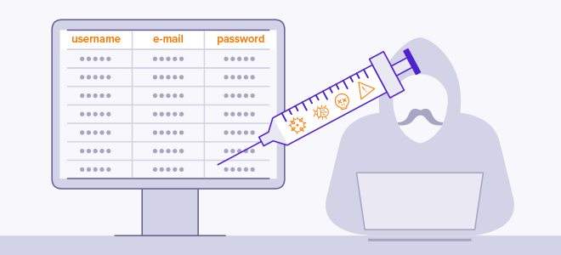
An SQL Injection is a code injection attack where an attacker is able to manipulate and interfere with SQL queries to access information that is not supposed to be accessed
Ie. We can trick a server into running our SQL queries

Slide 34
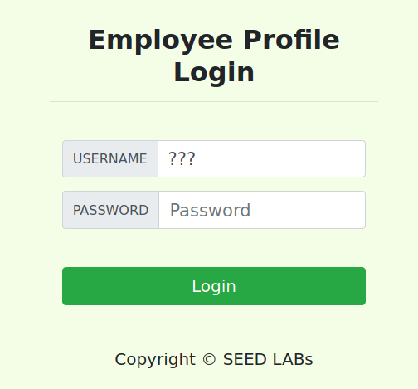
SQL Injections
SELECT * FROM credential WHERE
name= ‘ ' and password=‘ ’;
Suppose we don’t know Alice’s password. How could we still get her information?
???

Slide 35
SQL Injections
SELECT * FROM credential WHERE
name= ‘ ' and password=‘ ’;
Suppose we don’t know Alice’s password. How could we still get her information?
USERNAME = Alice’#
???
Password =
???

Slide 36
SQL Injections
SELECT * FROM credential WHERE
name= ‘ ' and password=‘ ’;
Suppose we don’t know Alice’s password. How could we still get her information?
Alice’#
USERNAME = Alice’#
Closes the string
Comment out rest of query
???
Password =
asdasdasdasdas

Slide 37
SQL Injections
SELECT * FROM credential WHERE
name= ‘ ' and password=‘ ’;
Suppose we don’t know Alice’s password. How could we still get her information?
Alice’#
USERNAME = Alice’#
Closes the string
Comment out rest of query
???
Password =
asdasdasdasdas
It doesn’t matter what the password is, because we comment out the entire 2nd part of the and clause

Slide 38
SQL Injections
seedlabsqlinjection.com/unsafe_home.php? username=Alice%27%20%23&password=password
We can conduct the same attack using just the URL!
Certain characters cannot go in a URL, so we have to use special codes
Character | URL Escape Code
SPACE | %20
# | %23
; | %3B
‘ | %27

Slide 39
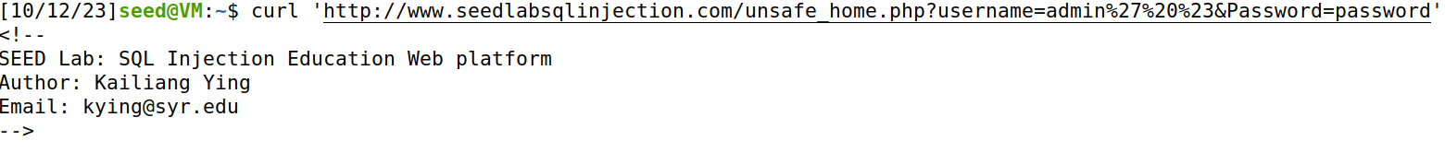
SQL Injections
seedlabsqlinjection.com/unsafe_home.php? username=Alice%27%20%23&password=password
(HTML page contents)

Slide 40
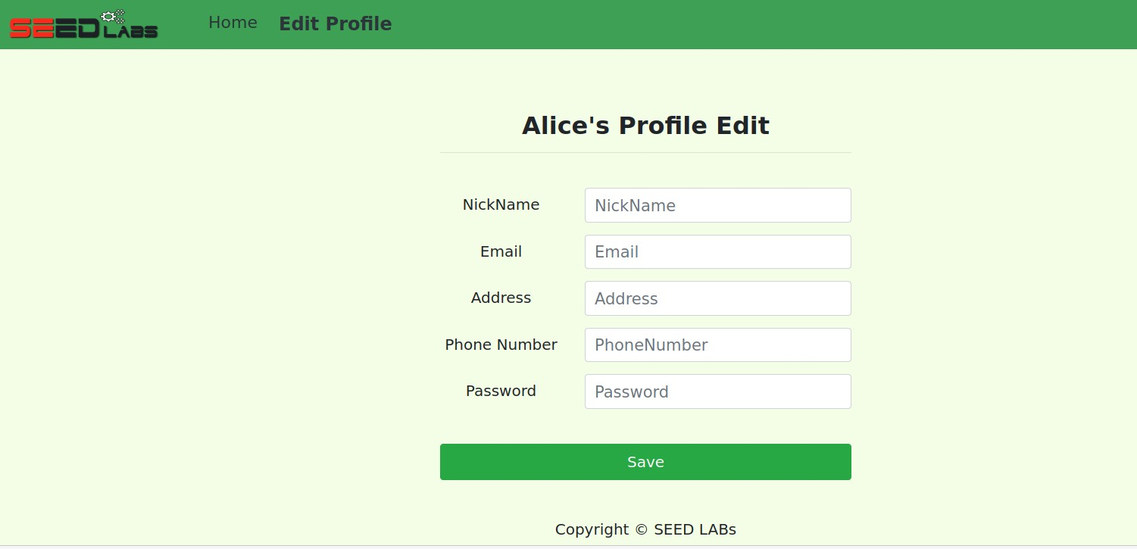
SQL Injections
When a user logs in, they can also edit some of their personal information!

Slide 41
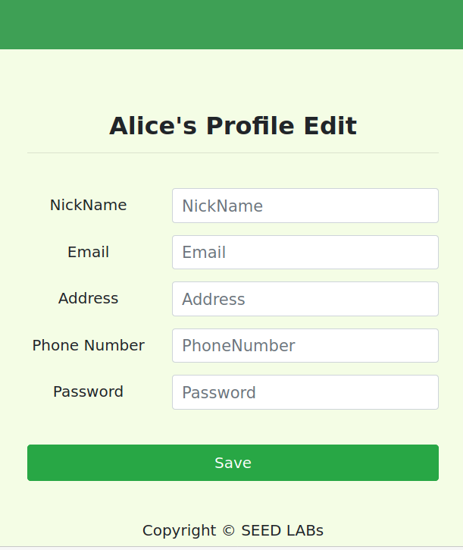
SQL Injections
UPDATE credential SET nickname='$input_nickname’, email='$input_email’, address='$input_address’, PhoneNumber='$input_phonenumber’ where ID=$id;
We know our Salary is also stored in this same SQL table.
How could we change our salary?

Slide 42
SQL Injections
UPDATE credential SET nickname='$input_nickname’, email='$input_email’, address='$input_address’, PhoneNumber='$input_phonenumber’ where ID=$id;
We know our Salary is also stored in this same SQL table.
How could we change our salary?
NickName: ’,salary=‘100000000

Slide 43
UPDATE credential SET
SQL Injections
nickname='’,salary=‘100000000’,
email='$input_email’, address='$input_address’, PhoneNumber='$input_phonenumber’ where ID=$id;
’,salary=‘100000000
We know our Salary is also stored in this same SQL table.
How could we change our salary?
NickName: ’,salary=‘100000000

Slide 44
UPDATE credential SET
nickname=‘ ’,
SQL Injections
email='$input_email’, address='$input_address’, PhoneNumber='$input_phonenumber’ where ID=$id;
Change someone else’s salary??

Slide 45
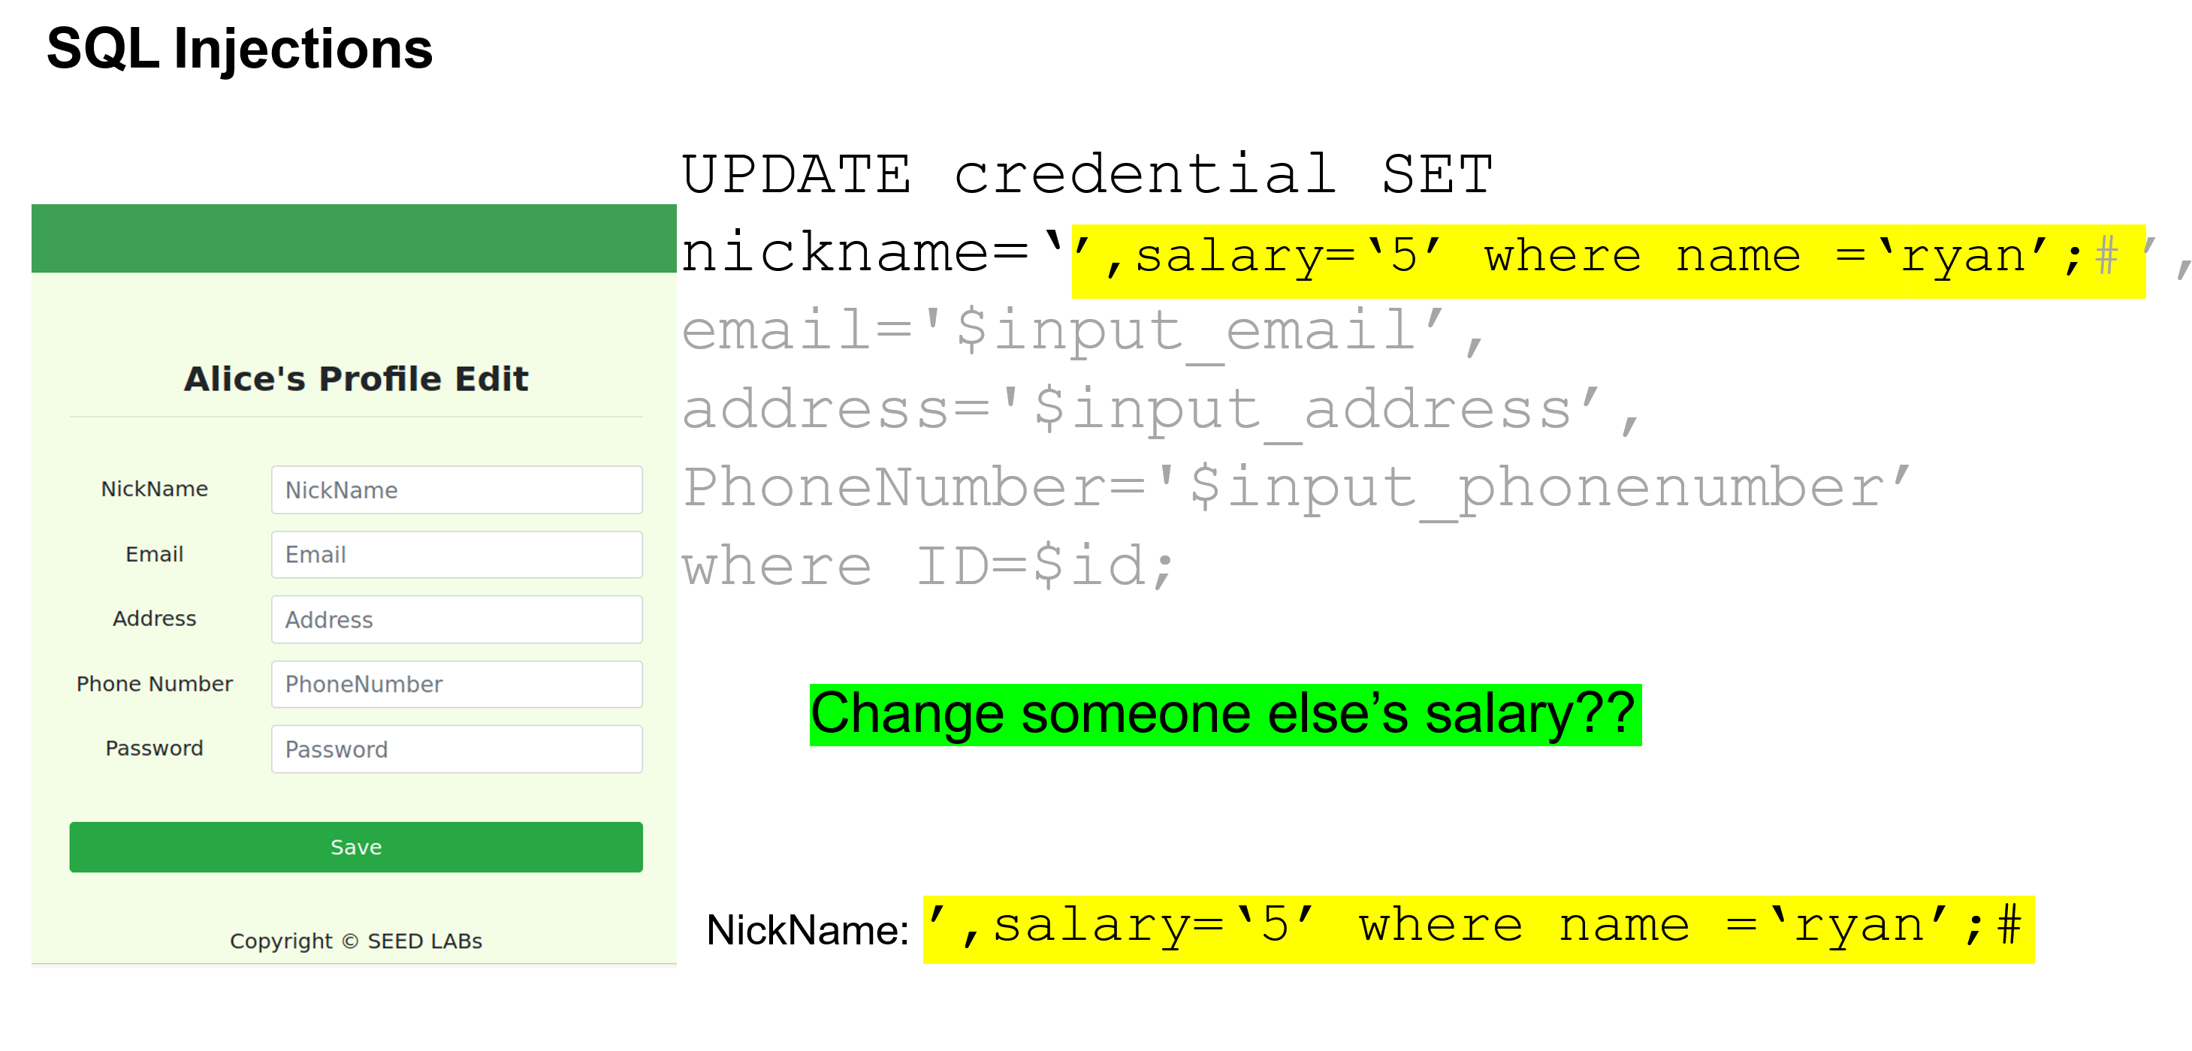

Slide 46
SQL Injections
UPDATE credential SET nickname=‘ ’, email='$input_email’, address='$input_address’, PhoneNumber='$input_phonenumber’ where ID=$id;
Change someone else’s password??

Slide 47
UPDATE credential SET
SQL Injections
nickname=‘’,password=‘reese’ where name =‘ryan’;# ’, email='$input_email’, address='$input_address’, PhoneNumber='$input_phonenumber’
where ID=$id;
Change someone else’s password??
NickName =‘’,password=‘reese’ where name =‘ryan’;#

Slide 48
UPDATE credential SET
SQL Injections
nickname=‘’,password=‘reese’ where name =‘ryan’;# ’, email='$input_email’, address='$input_address’, PhoneNumber='$input_phonenumber’
where ID=$id;
Change someone else’s password??
NickName =‘’,password=‘reese’ where name =‘ryan’;#
This does not work!!

Slide 49
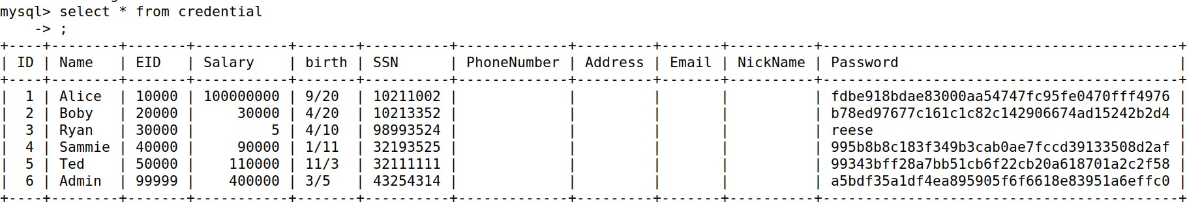
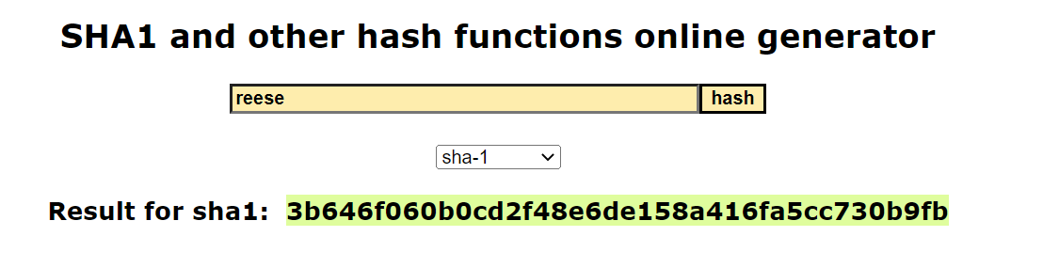


UPDATE credential SET
SQL Injections
nickname=‘’,password=‘3b646f060b0cd2f48e6de158a416fa5cc730b9fb’ where name =‘ryan’;# ’,
email='$input_email’, address='$input_address’,
PhoneNumber='$input_phonenumber’
where ID=$id;
We need to insert the SHA1 hash of ‘reese’ instead!

Slide 50
SQL Injections
SELECT * FROM credential WHERE name= ‘ ' and password=‘
How could we delete an entry, or drop the entire table??
’;
USERNAME =
???

Slide 51
SELECT * FROM credential WHERE
name= ‘';DROP TABLE credential;# ' and password=‘
SQL Injections
’;
How could we delete an entry, or drop the entire table??
USERNAME =
';DROP TABLE credential;#
???

Slide 52
SELECT * FROM credential WHERE
name= ‘';DROP TABLE credential;# ' and password=‘
SQL Injections
’;
How could we delete an entry, or drop the entire table??
USERNAME =
';DROP TABLE credential;#
This wont work! Fortunately, this webpage only allows for one SQL query to be executed!
???

Slide 53
SQL Injections Countermeasures
Why is this webpage unsafe?

Slide 54
SQL Injections Countermeasures
Why is this webpage unsafe?
Mixing of executable code and user input data!

Slide 55
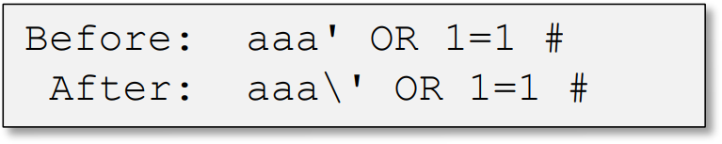
SQL Injections Countermeasures
Filtering and Sanitizing input data
Before mixing user-provided data with code, inspect the data and filter/sanitize any character that may be interpreted as code
Most languages have built-in methods or 3rd party extensions to encode/escape characters that have special meaning in the target language
Real_escape_string
htmLawed
htmlspecialchars

Slide 56
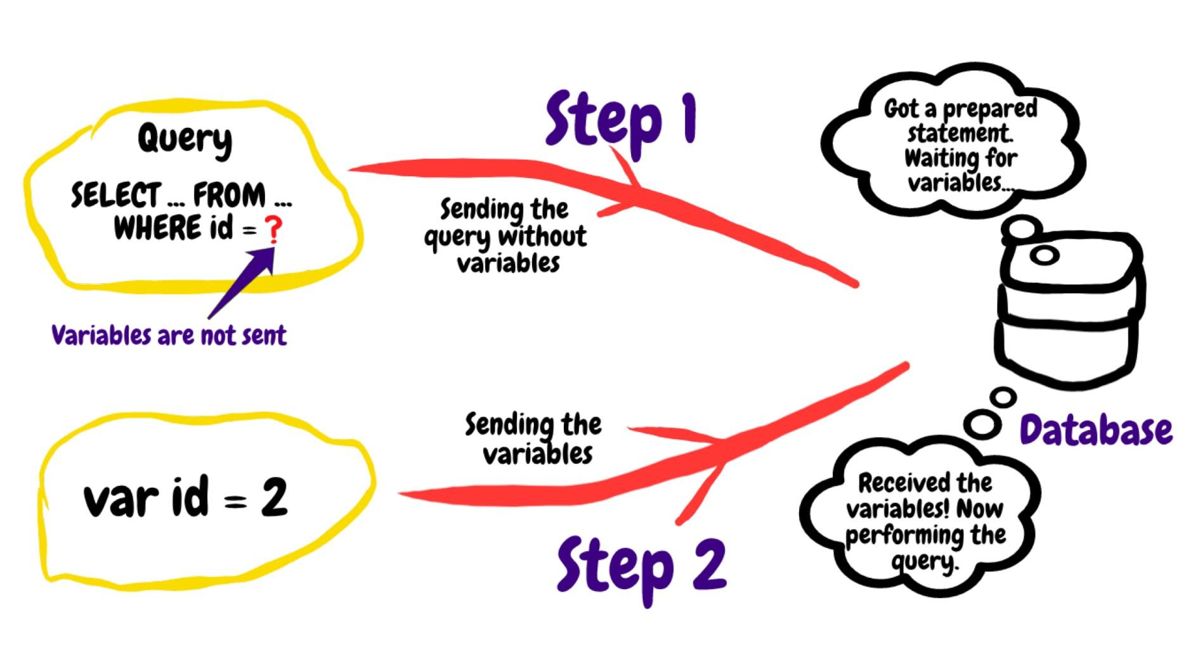
SQL Injections Countermeasures
Prepare Statements
Send code and data in separate channels to the database server

Slide 57
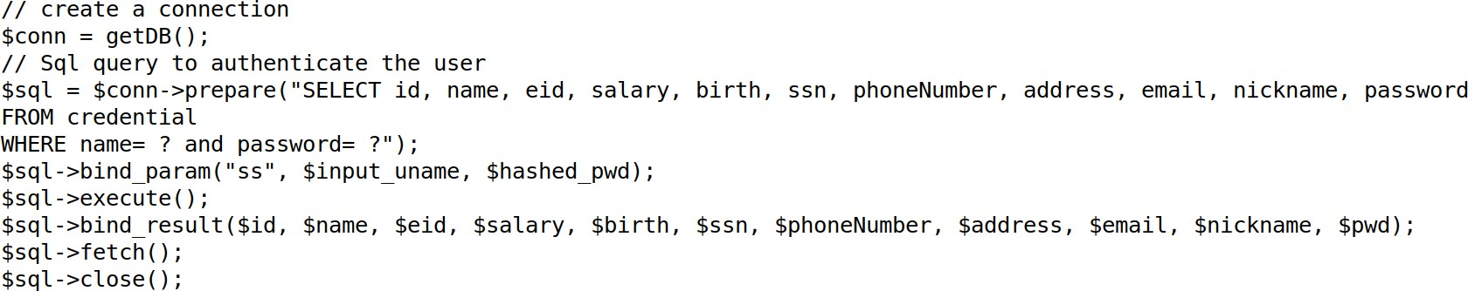
SQL Injections Countermeasures
User input is not attached to the SQL query
$conn → prepare
Send SQL query string to server
$sql → bind_param
Send input data to server
$sql → execute()
Execute query
$sql → fetch()
Get results of query

Slide 58
SQL Injection Limitations
If we wanted to conduct an SQL injection on a server, what things would we need to know?

Slide 59
SQL Injection Limitations
If we wanted to conduct an SQL injection on a server, what things would we need to know?
It’s very likely we don’t know this information
Table names
Table column
Backend Code
Type of database
Ways we might be able to get server to leak this
information?

Slide 60
SQL Injection Limitations
Error-based SQLi is an in-band SQL Injection technique that relies on error messages thrown by the database server to obtain information about the structure of the database. In some cases, error-based SQL injection alone is enough for an attacker to enumerate an entire database.
Ex.
Conversion failed when converting the varchar value ‘salary’ to data type int.
Cannot find column “lkafhasflkash” in table employee.
https://github.com/payloadbox/sql-injection-payload-list

